Slide 1
AVR Memory Architecture

Slide 2
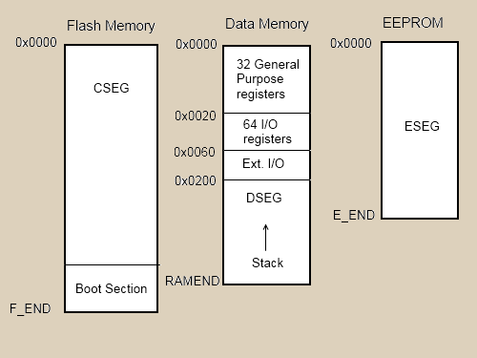
Overview
Harvard architecture
Notes:
AVR is a modified Harvard architecture with 16-bit instructions and 8-bit data. It saves program and data in separate memories locations.
AVR CPU has two busses: one instruction bus where the CPU reads executable instructions; and one data bus to read or write the corresponding data.

Slide 3
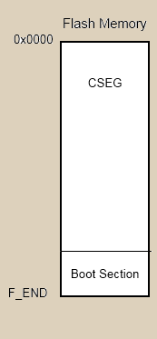
Overview
Flash
Bootloader
CSEG
Notes:
a bootloader is just a normal AVR application that is positioned in a special region of flash memory.

Slide 4
Overview
EEPROM(Electrically Erasable Programmable Read-Only Memory)
ESEG
Notes:
a bootloader is just a normal AVR application that is positioned in a special region of flash memory.

Slide 5
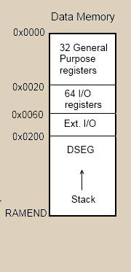
Overview
SRAM
General-purpose Registers
I/O Registers
DSEG
Notes:
a bootloader is just a normal AVR application that is positioned in a special region of flash memory.

Slide 6
AVR Register
The first 32 bytes of RAM are general-purpose registers
8 bits capacity, the least significant bit starts with 0
Can be used directly in assembly commands
e.g. MOV R20,R18
Only load and store instructions access RAM
7 | 6 | 5 | 4 | 3 | 2 | 1 | 0

Slide 7
AVR Register
32 general-purpose Registers:
R0 | Temporary register - use in interrupts not recommended.
R1 | Zero register - can be used for temporary data but must be set to zero after use.
R18-R27, R30-R31 | These are general purpose registers and don't need to be saved when using in conjunction with 'C' code.
R2-R17, R28-R29 | These are general purpose registers but do need to be saved when using in conjunction with 'C' code.

Slide 8
AVR Register
Special registers :
R25:R24 : return value of a function call
R29:R28 : Stack Frame Pointer (Y pointer)
Notes:
these pairs have extra names in assembler: X, Y and Z. These pairs are 16-bit pointer registerspoint to adresses with max. 16-bit into SRAM locations (X, Y or Z) or into locations in program memory (Z).

Slide 9
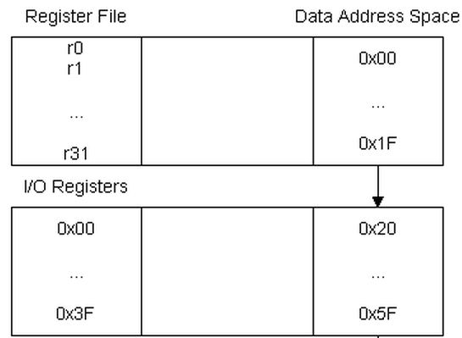
AVR Register
The next 64 bytes of RAM are I/O registers
written as "0x00 (0x20)" through "0x3F (0x5F)"

Slide 10
AVR Register
Special I/O registers :
0x3E:0x3D (0x5E:0x5D): Stack Pointer (SP, which indicates the current top of the stack)

Slide 11
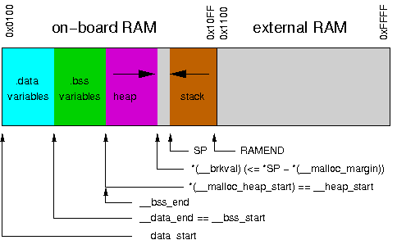
AVR Memory Model
Notes:
Basically the compiler takes all the global variables in your program and allocates them to RAM in the Global Data section
section .bss, contains all uninitialized global or static local variables.
.data section contains all initialized global or static local variables
Heap: Used for dynamic memory applications such as malloc()
Stack: Used to store return address, actual parameters, conflict registers and local variables and other information.

Slide 12
AVR Stack Structure
A stack consists of stack frames
A Stack frame is a region in the stack used by a function
Created whenever a function is called
Freed whenever the function returns.
What’s inside a stack frame?

Slide 13
AVR Stack Structure
RAMEND
int main(void)
{ …
foo(arg1, arg2, …, argM);
}
void foo(arg1, arg2, …, argM)
{ int var1, var2, …, varN;
…
}
Stack Frame for main()
Return Address
Conflict Registers
Local Variable N
…
Local variable 1
Parameter M
…
Parameter 1
Empty
Stack frame pointer Y for main()
Stack frame for foo()
Stack frame pointer Y for foo()

Slide 14
Why Stack Frame?

