Slide 1
Current Results

Slide 2
Clustering Privacy Profiles
First Part

Slide 3
In the first part, we…
Cluster relevant Profiles
Choose the appropriate cluster numbers
Define the Privacy Profiles
Create definition from the cluster centroid
Find the features that drives the recommendation
Evaluate using J48 tree algorithm
Use cross fold validation

Slide 4
Evaluating the number of clusters
F
S
A
G

Slide 5
“I chose 2 clusters for each set using the elbow method, it fits well especially for the F set which is highly binary. For the A set, it is debatable between 2 and 3 though, but I still chose 2 for simplicity and uniformity, also to reduce overfitting.” - Odnan Ref

Slide 6
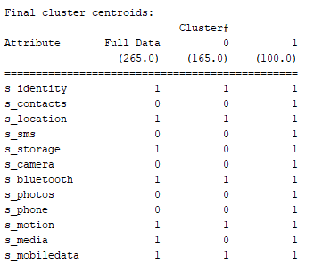
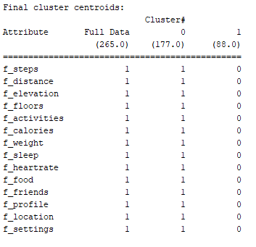
Defining the Profiles
S
(Cluster 0) Minimal – Allows only the minimum permissions needed to run the app (unsure)
(Cluster 1) Unconcerned – Allows every app smartphone permission request
F
(Cluster 0) Unconcerned – Allows third party apps to access her fitness data
(Cluster 1) Strict – Does not allow any third party to access her fitness data
NOTE: F data is much more affected by the WHO context

Slide 7
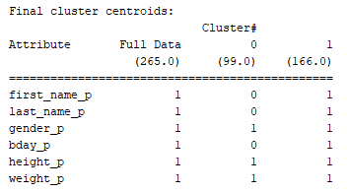
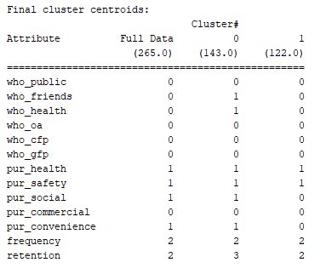
Defining the Profiles
A
(Cluster 0) Anonymous – Does not allow names and birthday
(Cluster 1) Unconcerned – Allows every app permission request
(Cluster 0) Socially Active – allows social media (friends only) and health apps to access her fitness data and allows for social, safety, and health purposes only.
(Cluster 1) Health-focused – Does not allow any other third party (aside from the main third party) and allows her data to be accessed only for the health and safety purposes
G
LEGEND: 1- allow
0- deny
For Frequency
1- separate
2- when using
3- continuous
Retention
1- indefinite
2- uninstalled
3- when no longer used

Slide 8
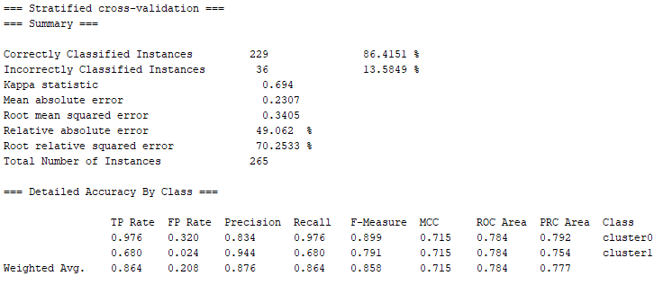
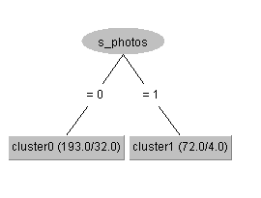
Features that drives the recommendation - S

Slide 9
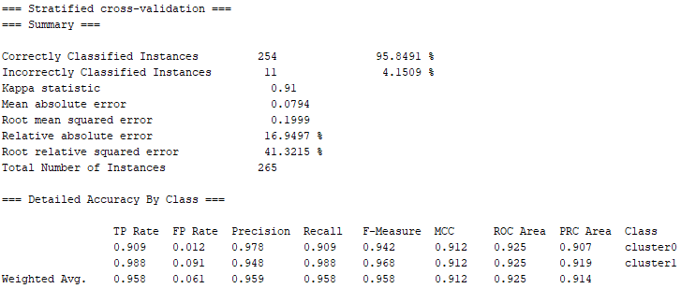
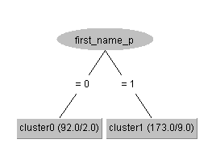
Features that drives the recommendation - A

Slide 10
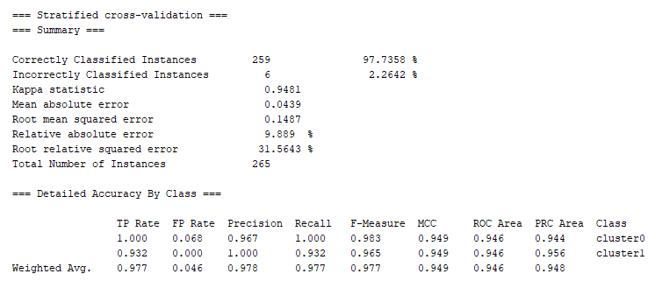
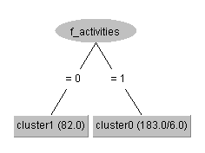
Features that drives the recommendation - F

Slide 11
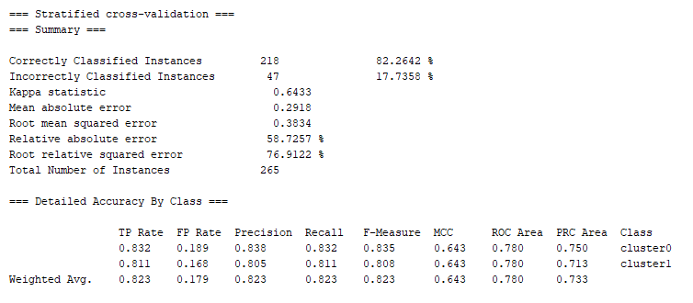
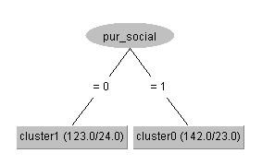
Features that drives the recommendation - G

Slide 12
Attitude-based Recommendation
Second Part

Slide 13
In the second part, we…
Search for different identifiers using the
Trust, expertise, privacy concern, surveillance, intrusion, secondary use of information
Social Influence and Homophily effect
Negotiability
Exercise data and Demographics (Spoiler: no accurate results for these data)
Build USER INTERFACE USING THESE RESULTS

Slide 14
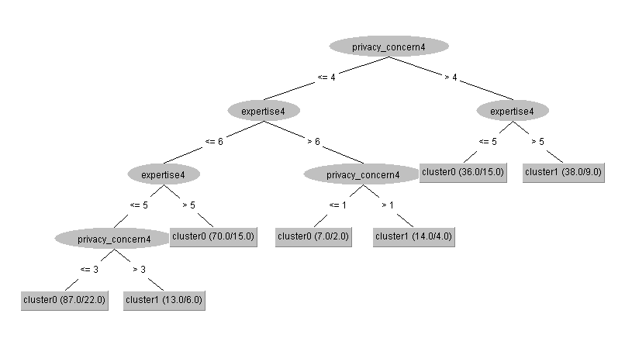
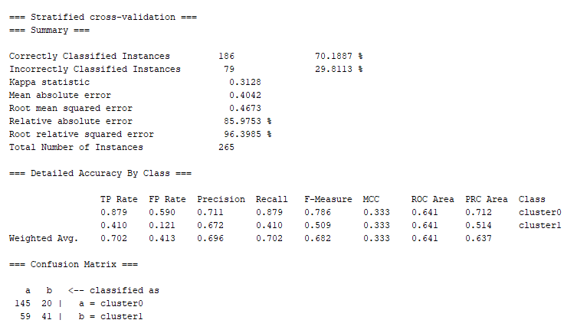
Features that drives the recommendation - S

Slide 15
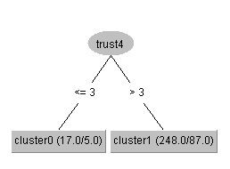
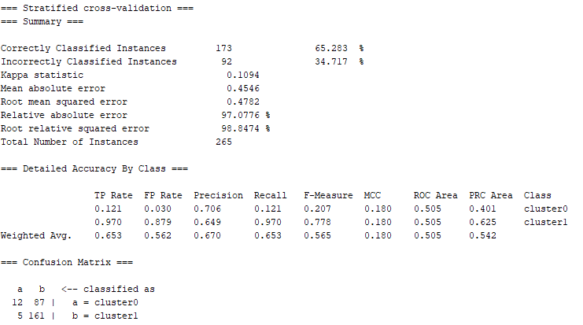
Features that drives the recommendation - A

Slide 16
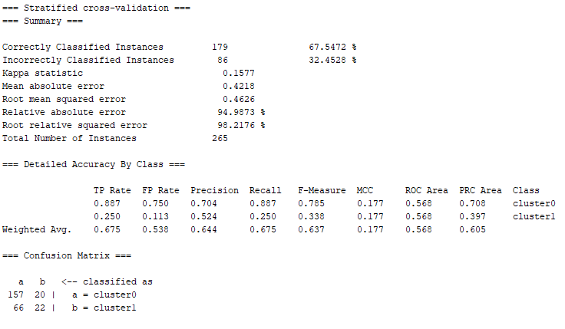
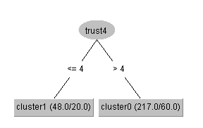
Features that drives the recommendation - F

Slide 17
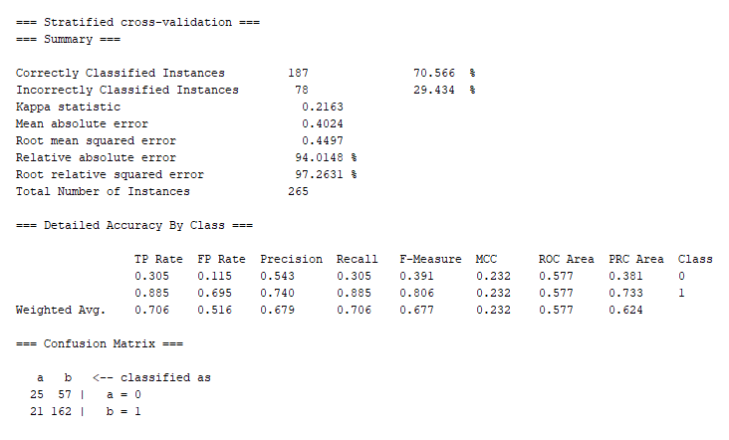
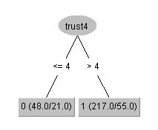
Features that drives the recommendation – F 2nd with TRICK!
Instead, of using cluster labels to build the tree, use the f_activities as the output!
Plus Knowing that the f_activities is a determiner from part 1
(98% accuracy)
Same tree from previous slide with 3% more accuracy!

Slide 18
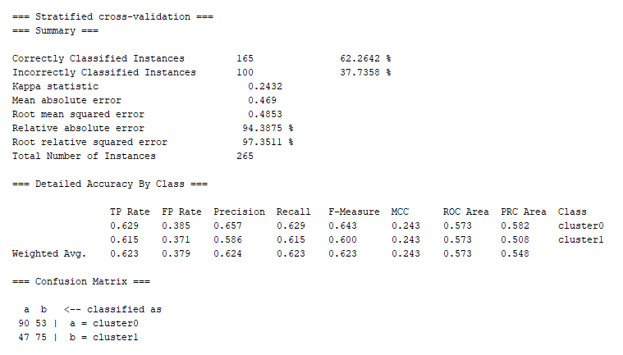
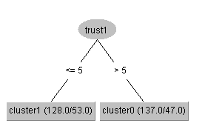
Features that drives the recommendation - G

Slide 19
Trust, Expertise, Privacy Concern Conclusion
After reviewing the questionnaire, TRUST1 question is appropriate for the G Dataset as it is a question on HANDLING the data.
I believe the company providing this fitness tracker is trustworthy in handling my information.
Those who agree (6) and extremely agree (7) are recommended with the socially active (more permissions)
Those who completely disagree to somewhat agree (1-5) (doesn’t trust) are health-focused (less permissions given)
Trust4 for are also perfect for A and F since they are information provided to the third party.
I believe this company is honest when it comes to using the information I provide.
Those who strongly disagree to neutral (to somewhat disagree for A) are more likely to deny permission and are recommended with the strict (minimum for A)
For the S permissions, we need expertise and privacy concern
Those who agree that other people are too concerned with online privacy issues and believe they are able to choose the right healthy-living measures are people who are unconcerned (cluster 1), etc….

Slide 20
Social Influence/ Homophily Effect
Second Part

Slide 21
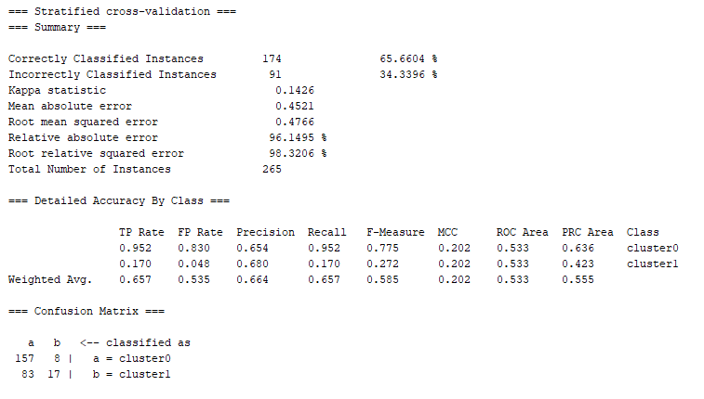
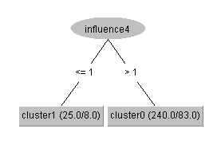
Features that drives the recommendation - S

Slide 22
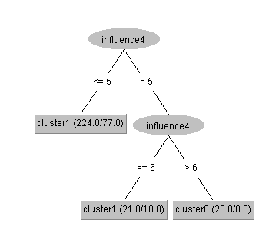
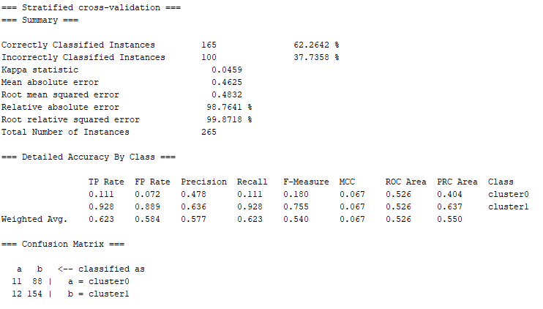
Features that drives the recommendation - A

Slide 23
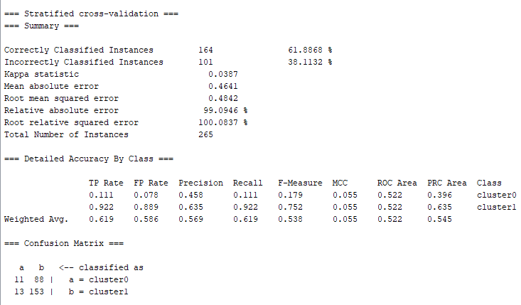
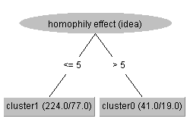
Features that drives the recommendation – A NEW
NEW

Slide 24
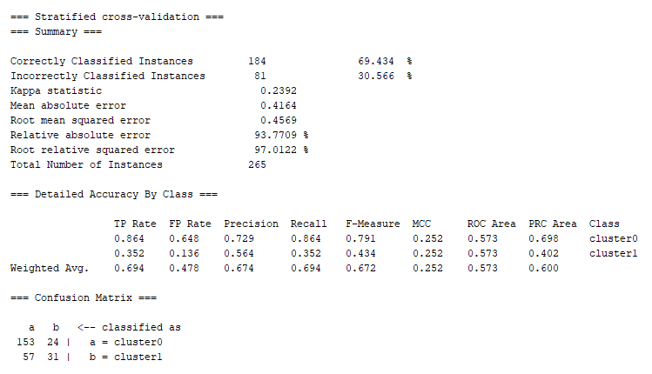
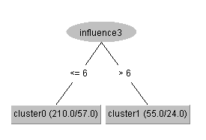
Features that drives the recommendation - F

Slide 25
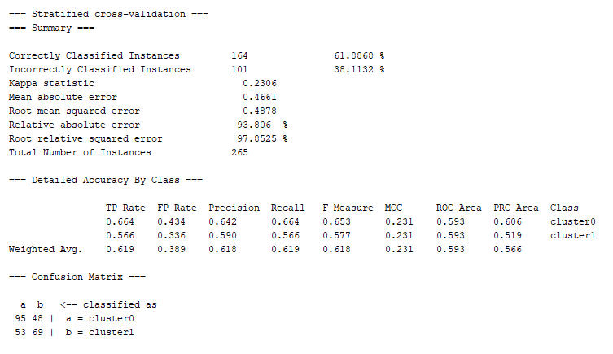
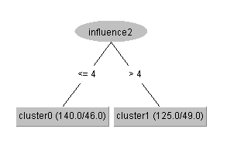
Features that drives the recommendation - G

Slide 26
Social Influence and Homophily Effect Conclusion
Are you open to the idea of meeting new friends while you exercise? (INFLUENCE4 – Homophily effect)
Those who answered Definitely Yes (1) are unconcerned (cluster 1 S) and
Those who answered Definitely No (7) are anonymous (cluster 0 A)
How often do you meet new friends while you exercise? (Influence3- Homophily Effect)
Those who answered Never Occurred (7) are STRICT (cluster 1 F)
If your <b>social media friends</b> exercise, does this influence you to exercise? (INFLUENCE2- Social Influence)
Those who answered Definitely Yes to Neutral (1-4) are socially active (cluster 0 G)

Slide 27
Negotiability
Second Part

Slide 28
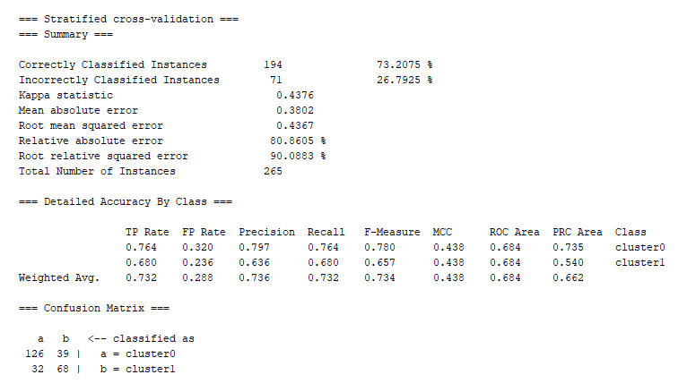
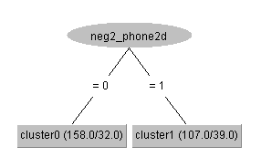
Features that drives the recommendation - S

Slide 29
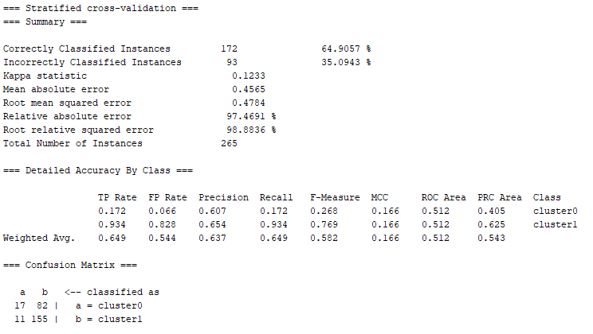
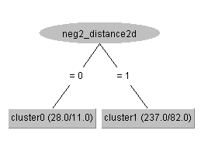
Features that drives the recommendation - A
Distance and Steps are the highest in accuracy, but does not have good recall (imbalance) so I chose the next, which is identity, having 2% lesser in accuracy

Slide 30
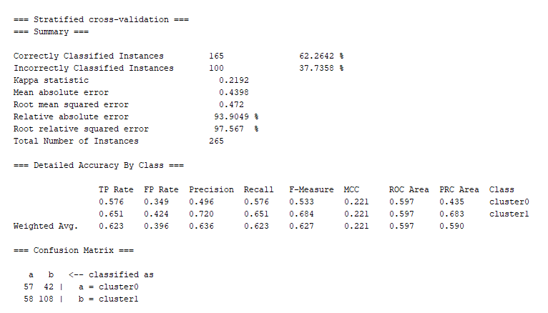
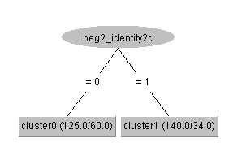
Features that drives the recommendation - A

Slide 31
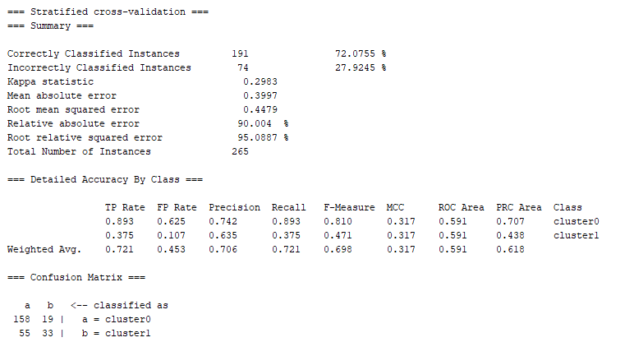
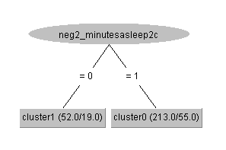
Features that drives the recommendation - F

Slide 32
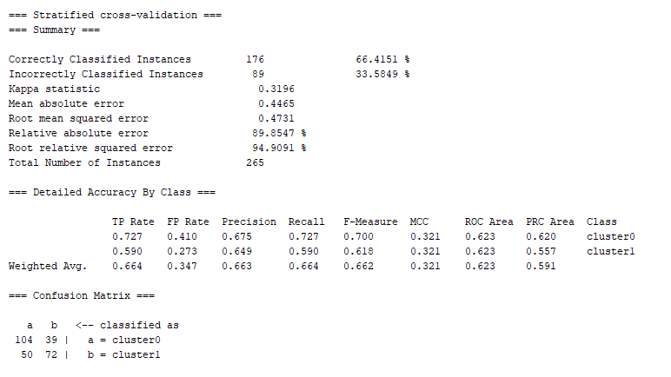
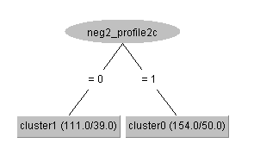
Features that drives the recommendation - G

Slide 33
Negotiability Conclusion
Would you share the phone permission if the benefits significantly increased? (phone2d S)
If yes (1), unconcerned (cluster1), If no, minimal (cluster 0) → coincides with Smartphone Set!
Would you share the sleep fitness data if the risk significantly decreased? (minutesasleep2c F)
If yes (1), unconcerned (cluster1), If no, strict (cluster 0) → coincides with Fitness Set (sleep is a fitness p)!
Would you share the profile if the benefits significantly increased? (profile2c G)
If yes (1), socially active (cluster1), If no, health focus (cluster 0) → coincides with G set about social!
BONUS: both profile and friends are good identifiers for G set
Would you share your identity if the risks significantly decreased? (identity2c A)
If yes (1), unconcerned (cluster1), If no, Anonymous (cluster 0) → coincides with Application permission!

Slide 34
User Evaluation (accuracy table on the 30 user validation set)
 | Smart Baseline | Direct Identifiers (from FIRST PART) | Attitude Trust, gpc, exp | Social influence/ Homophily Effect | Negotiability | User Demographics/ Health Questions
S(ave) | 70.28 | 78.06 | 71.11 | 68.33 | 74.44 | X No GOOD
A(ave) | 66.67 | 83.89 | 66.67 | 70.00 | 64.44 | X No GOOD
F(ave) | 66.19 | 94.29 | 70.00 | 70.47 | 76.19 | X No GOOD
G(ave) | 71.02 | 76.41 | 72.3 | 69.74 | 72.56 | X No GOOD
Ave | 68.74 | 83.41 | 70.52 | 69.62 | 73.11 | X No GOOD

Slide 35
User Interface Design

Slide 36
No question for Smart Profile

Slide 37
Direct questions (4 q) MOST ACCURATE

Slide 38
Attitude (4 questions 7pt likert scale)
I believe the company providing this fitness tracker is trustworthy in handling my information.
I believe this company is honest when it comes to using the information I provide.
I am able to choose the right healthy-living measures.
I believe other people are too concerned with online privacy issues.

Slide 39
Negotiability (4 questions allow/deny)
Would you share the phone permission if the benefits significantly increased?
Would you share the sleep fitness data if the risk significantly decreased?
Would you share the profile if the benefits significantly increased?
Would you share your identity if the risks significantly decreased?

Slide 40
Social influence & Homophily Effect
(3 questions 7pt likert scale)
Are you open to the idea of meeting new friends while you exercise?
How often do you meet new friends while you exercise?
If your <b>social media friends</b> exercise, does this influence you to exercise?

Slide 41
Furthermore, we can…
Create Profiles from Negotiability so dynamically if the risks/benefits increases/decreases, we already have the Profiles for recommendation.
TO DO: Semi-automation (i.e., If Cluster1 selected for S set, provide recommendation for other sets.

Slide 42
Thank You

