Slide 1

Vehicle Classification: Using Machine Learning PAPER ID: 461
School of Computer Science and Engineering
Guided By: Himanshu
Presented By: Priyanshu Ranjan, Tirtha Sanyal

Slide 2
ABSTRACT
Vehicle image classification model using a convolutional neural network.
Multiple category of vehicle data set has been considered for the classification training.
Bus, Bicycle, Car and Motorcycle.
The image data in the real world are mostly in the form of unlabelled unstructured format. These unstructured images are need to be classified.
There are number of parameters that need to be learn for vehicle classification. Thus, CNN is the best model to use.

Slide 3
INTRODUCTION
Image classification plays an important role in computer vision.
Vehicle detection and classification are crucial in various applications, such as traffic management, surveillance, parking management and autonomous driving.
It consists of process including image pre-processing, image segmentation, key feature extraction and matching identification.
High-quality data is essential to overcome the limitations and errors in the classification process

Slide 4
EXISTING SYSTEM
Image classification can me done using several methods including Support Vector Machine, Decision Tree and Transfer learning.
Transfer learning is a technique that involves using a pre-trained model for a different task and fine-tuning it for image classification. A pre-trained model such as VGG or ResNet, and then fine-tune it for your specific classification task.
SVMs may not perform as well as CNNs for image classification tasks that involve a large number of classes or complex image features.
Decision trees are a type of model that can be used for image classification. These models work by making a series of decisions based on the input features.

Slide 5
PROPOSED SYSTEM
An image classifier using convolutional neural network, which use vigorous amount of data from all the 4 types of classes of the road transportation for training.
Classifies the images with more accuracy.

Slide 6
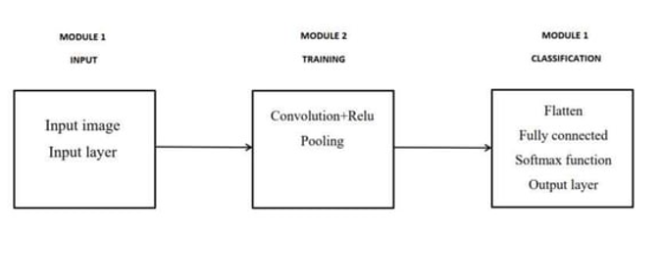
SYSTEM ARCHITECTURE
Module Description

Slide 7
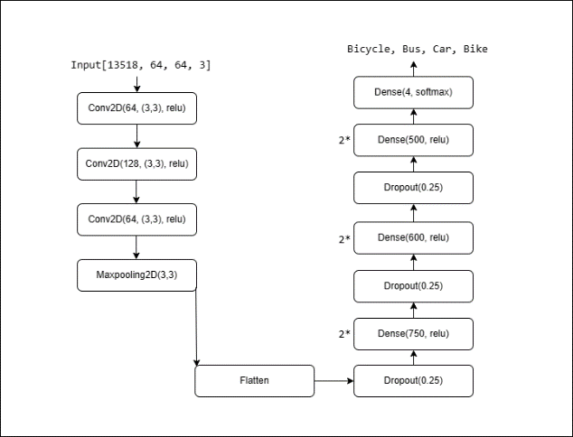
SYSTEM ARCHITECTURE
Layers of CNN

Slide 8
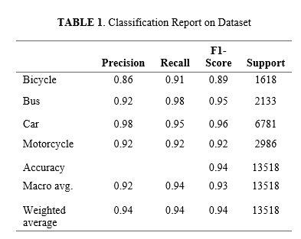
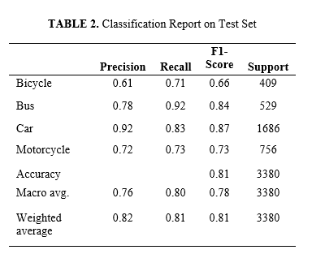
RESULTS

Slide 9
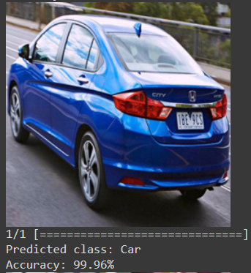
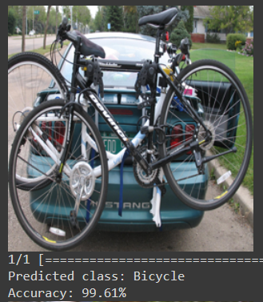
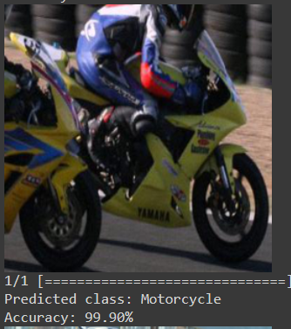
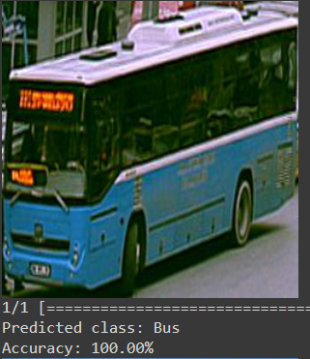
TESTING

Slide 10
FUTURE SCOPE
Increase the classes of prediction including 3 major mode of transports.
Images can be classified and stored in their respective class folder.
Implementation on video footage.

Slide 11
CONCLUSION
Implemented an image classifier using CNN which is more efficient for image classification when compared to the other methods.
This model is able to classify 4 types of road transport vehicle: Bus, Bicycle, Car and Motorcycle.
This model on further upgrade can be used in the multi-story parking system to enhance the classification of vehicle in the parking.
Toll-plaza can use this model to classify vehicles.

Slide 12
Thank You

