Slide 1

News Article NLP Analyzer
Ryan Bae
Crystal Ding
Charles Duze
Mohammed Helal
Paul Wright
Team: WeReadTheNews

Slide 2
Project Background
News Article Recommendation System based on topic relevance
Takes user input query article or topic search from UI
Output:
Visualizes sentiment, topic analysis results from user input
Recommends relevant articles from database based on topic analysis
Data sources:
Kaggle dataset include news articles by 15 publishers from 2015 to 2017
Article information from NYtimes with category labels for guided LDA model
Intended users:
News readers who are interested in analysis of their current article and get other news articles with similar topics

Slide 3
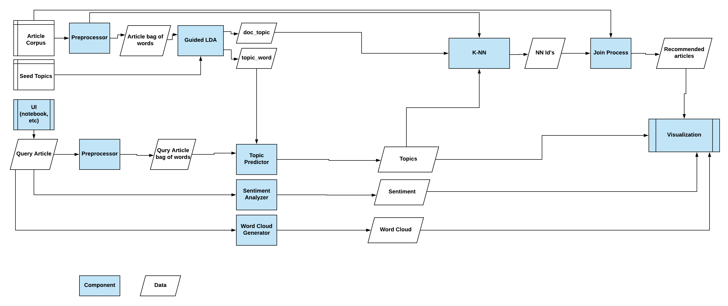
Components Overview

Slide 4
LDA Background
LDA (Latent Dirichlet Allocation)
Popular unsupervised statistical model for topic modeling
Model takes corpus of articles and returns:
Doc to topic relation
Words to topic relation
Interpretability Problem
Topics generated using LDA may not be so interpretable!
Certain desired topics get merged
Solution = Guided LDA
“seed” interpretable topics to “guide” the LDA algorithm
Semi-supervised model

Slide 5
Guided LDA Library
Guided LDA
https://medium.freecodecamp.org/how-we-changed-unsupervised-lda-to-semi-supervised-guidedlda-e36a95f3a164
Pros
Allows for interpretable, desired topics
Can run both guided and regular LDA
Necessary for our use case since we use both models
Easy to install and use (only require numpy and pbr)
Cons
Not as powerful or flexible as other topic modeling libraries (genism, scikit-learn, etc)
Not good for very large corpus, no multi-processor support

