Slide 1

News Article NLP Analyzer
Ryan Bae
Crystal Ding
Charles Duze
Mohammed Helal
Paul Wright
Team: WeReadTheNews

Slide 2
Project Background
News Article Recommendation System based on topic relevance
Takes user input query article or topic search from UI
Output:
Visualizes sentiment, topic analysis results from user input
Recommends relevant articles from database based on topic analysis
Data sources:
Kaggle dataset include news articles by 15 publishers from 2015 to 2017
Article information from NYtimes with category labels for guided LDA model
Intended users:
News readers who are interested in analysis of their current article and get other news articles with similar topics

Slide 3
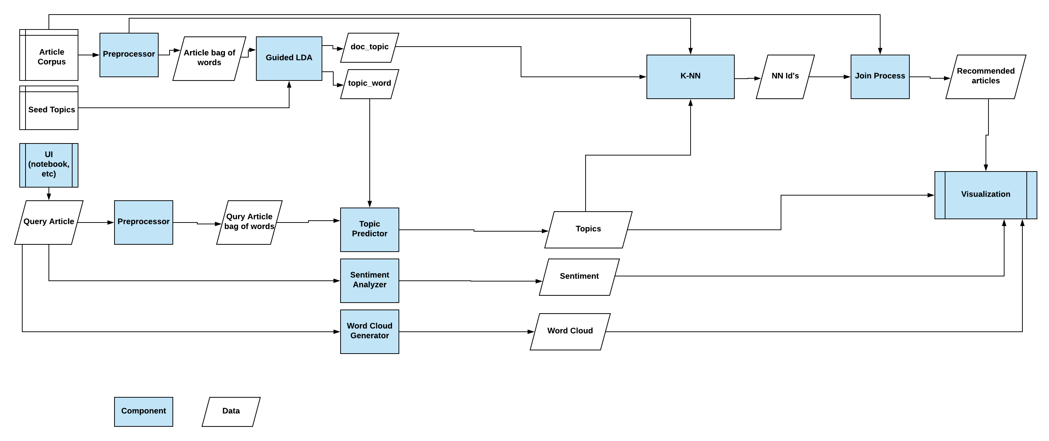
Components Overview

Slide 4
LDA Background
LDA (Latent Dirichlet Allocation)
Popular unsupervised statistical model for topic modeling
Model takes corpus of articles and returns:
Doc to topic relation
Words to topic relation
Multi-layered Topic Modeling
We want to model high level topics such as politics, science, entertainment, etc
We also want to model more specific sub-topics: Russia investigation, healthcare reform, etc
Interpretability Problem
Topics generated using LDA may not be so interpretable!
Certain desired topics get merged

Slide 5
Guided LDA Library
Guided LDA
https://medium.freecodecamp.org/how-we-changed-unsupervised-lda-to-semi-supervised-guidedlda-e36a95f3a164
Pros
Allows for interpretable, desired topics
Can run both guided and regular LDA
Necessary for our use case since we use both models
Easy to install and use (only require numpy and pbr)
Cons
Not as powerful or flexible as other topic modeling libraries (genism, scikit-learn, etc)
Not good for very large corpus, no multi-processor support

Slide 6
Gensim Library
Gensim
Pros
Powerful topic modeling and NLP library
LDA variants using different sampling methods
Word2vec Deep learning
Word embedding
Gensim would make adding other capabilities easier
Cons
Doesn’t natively support seeding of topics
This is very important for our use case!!
Complex to use with high learning curve

Slide 7
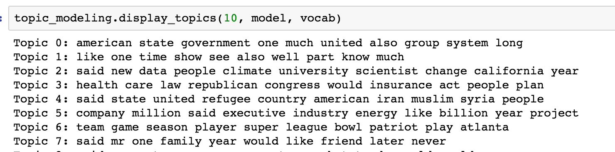
Our Pick
Solution = Guided LDA
Allows interpretable high level topics while doing more granular sub-topic modeling
Simple and easy to use, runs quick enough for our application
Application
Model 1: Guided LDA for high-level topic modeling
Model 2: Regular LDA for lower-level topic modeling
Both are used in our recommender system and visualization output

