Slide 1

News Articles Recommender
Ryan Bae
Crystal Ding
Charles Duze
Mohammed Helal
Paul Wright
Team: WeReadTheNews

Slide 2


Problem Statement
Current search engines only take keywords, but we want to find similar articles based on a reference article!
OUR LOGO HERE

Slide 3
Background
News article recommendation system based on topic relevance
Takes user input query article or topic search from UI
Analyzes user input through topic modeling and sentiment analyzer
Recommends relevant articles from corpus based on user input
Visualizes user input through word cloud to summarize article
Lists topic modeling result for user input article
Presents sentiment analysis based on number of positive/negative/neutral sentences in input

Slide 4
Target Users
Researchers
Academics looking for specific news articles for their research
General Public
News enthusiasts looking for similar articles
Users who want sentiment and topic information on an article

Slide 5
Data Sources
Kaggle news articles dataset (all-the-news dataset)
Our news articles corpus
140,000 articles including article title, author, publisher, content and date
Articles from 2015 to 2017 from 15 major US publishers
NY Times topic category labels and seed words
News article topics from NY Times
Passed through guided LDA model to produce interpretable topics

Slide 6
User Interface (Paul)
UI picture and info here

Slide 7
Component Structure (Ryan)
Simplified project diagram and info here

Slide 8
Git Repo Structure
Repo structure tree here

Slide 9
Component 1: Preprocessor (Mo)

Slide 10
Component 2: Topic Modeler (Ryan)

Slide 11
Component 3: Recommender (Crystal)

Slide 12
Component 4: Sentiment Analyzer (Charles)

Slide 13
Demo
Website here for the demo

Slide 14
Problems Encountered
Dataset and model storage
Had to create build scripts to build models locally
Model tuning
Included extra stop words and deleted bad articles
NY Times seed words were time period sensitive, so had to get topic words over longer time scale
Number of topics for the LDA models had to be tuned manually
Interpretability
Not all LDA topics were interpretable
Divided topic modeling into guided topics and unguided topics

Slide 15
Future Work
Improve recommender system
Add additional non-topic related features in the recommendation system
Further optimize hyperparamters to the LDA models
Corpus-wide visualizations for data exploration
Prettify UI

Slide 16
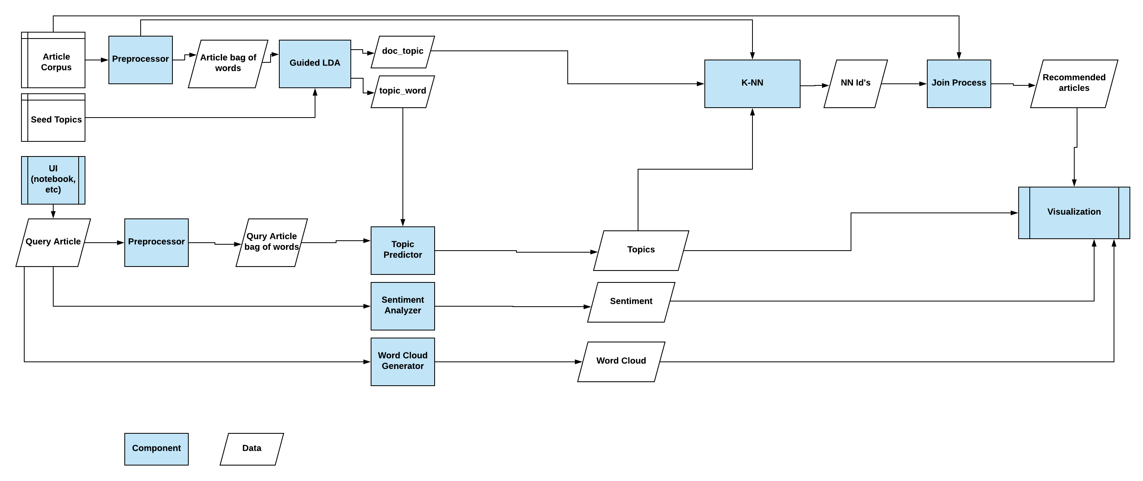
Detailed Design (Appendix)

