Slide 1

News Article NLP Analyzer
Ryan Bae
Crystal Ding
Charles Duze
Mohammed Helal
Paul Wright
Team: WeReadTheNews

Slide 2
Background
News article recommendation system based on topic relevance
Takes user input query article or topic search from UI
Analyzes user input through topic modeling and sentiment analyzer
Recommends relevant articles from corpus based on user input
Visualizes user input through word cloud to summarize article
Lists topic modeling result for user input article
Presents sentiment analysis based on number of positive/negative/neutral sentences in input

Slide 3
Data Sources
Kaggle news articles dataset
140,000 articles including article title, author, publisher, content and date
Articles from 2015 to 2017 from 15 major US publishers
NYtimes topic category labels
News article topics from NYtimes
Passed through guided LDA model to produce interpretable topics

Slide 4
Target Users

Slide 5
Demo

Slide 6
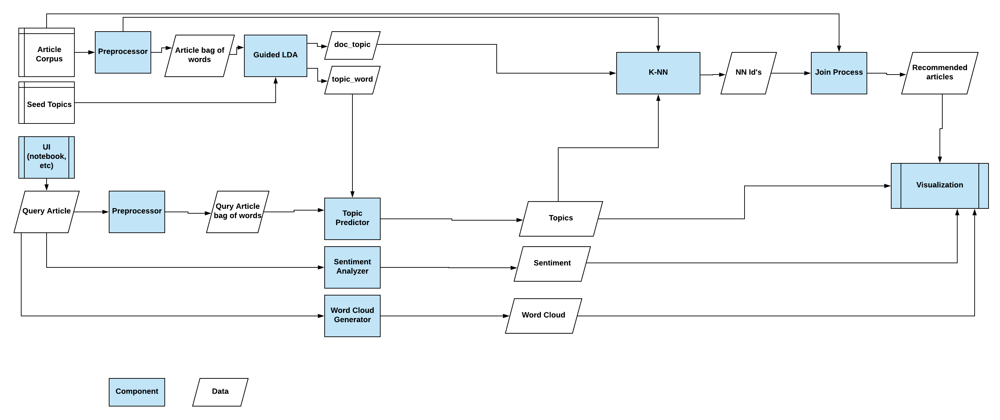
Design Overview

Slide 7
Project Structure

Slide 8
Future Work

