Slide 1



CAREER CONNECT
AASHUTOSH GUPTA

Slide 2

Problem Statement
CONTENTS
Outcomes
CONTENTS
Requirement Specifications
OUTPUT

Slide 3

PROBLEM STATMENT
The problem is to design a job portal that connects job seekers and employers. Job seekers should
be able to create profiles, search for job openings, apply to job postings, receive job
recommendations, and save job postings. Employers should be able to create company profiles,
post job openings, search for job seekers, view profiles and applications, and message job seekers.
The portal must be user-friendly, secure, and scalable to handle large volumes of job seekers and
employers.

Slide 4
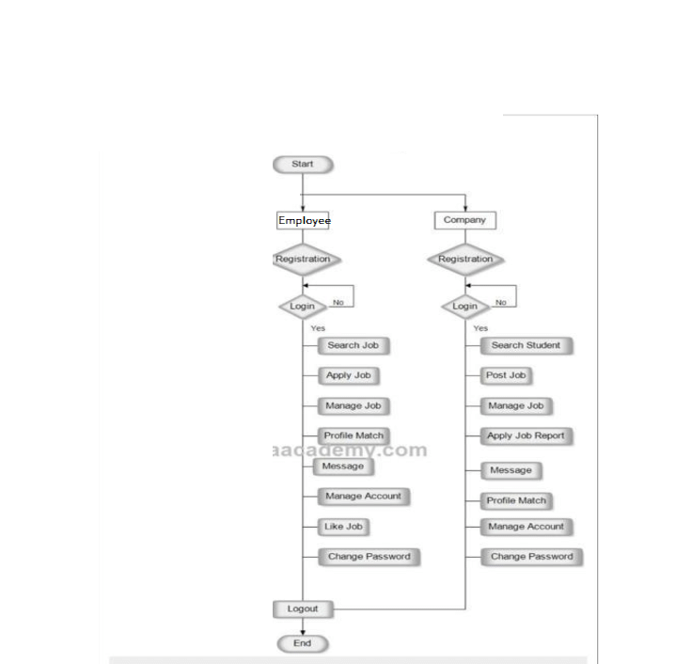
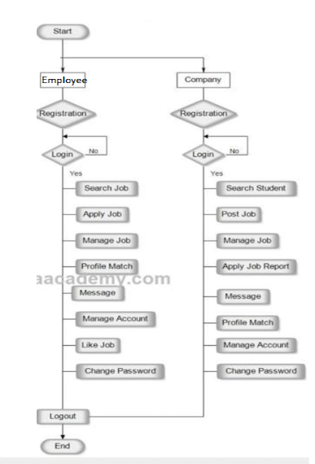
FLOW-CHART

Slide 5

Outcomes
Efficient job search
Increased job opportunities
Streamlined recruitment process
Enhanced user experience

Slide 6
Requirement Specifications
HARDWARE REQUIREMENT:
SOFTWARE REQUIREMENTS:
Processor: Intel I5 core.
RAM: 2GB and more.
Hard Disk: 5GB and more.
HTML
CSS
PHP
DATABASE-MYSQL

Slide 7
Thank you

Slide 8
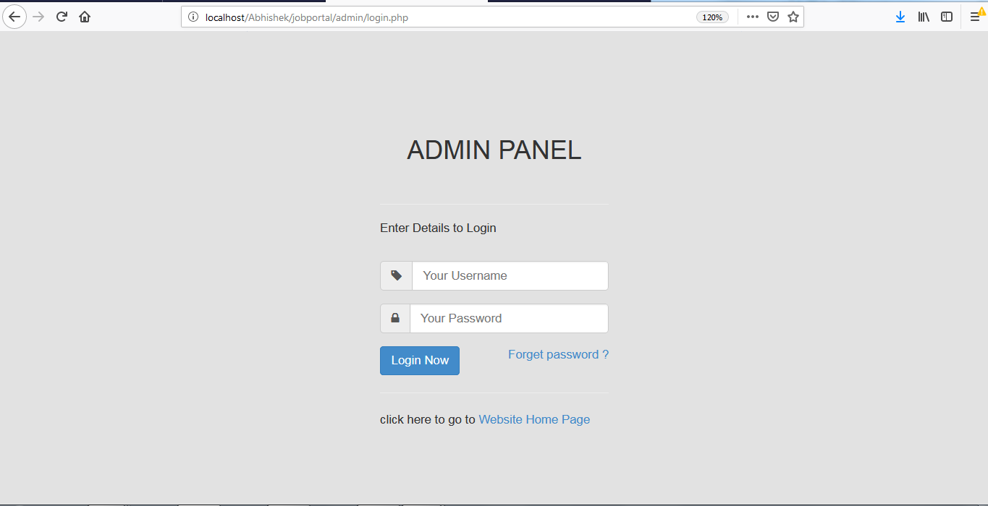

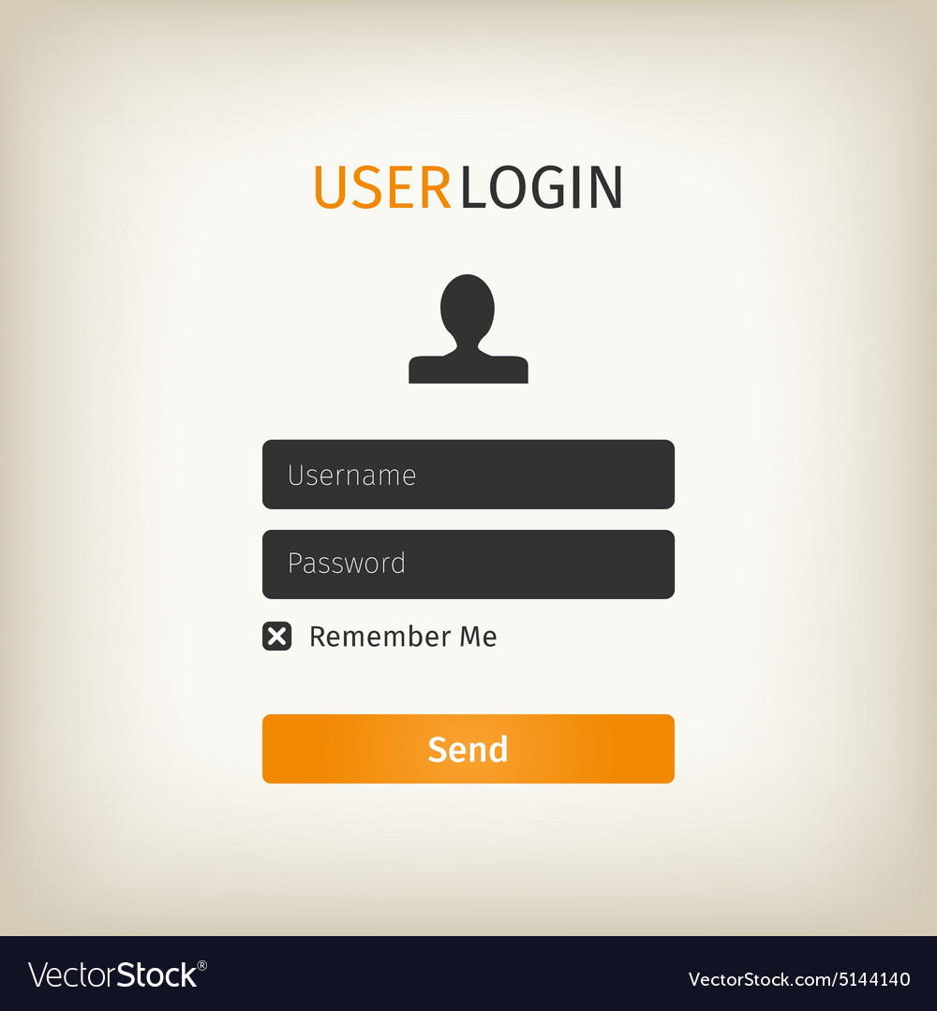
OUTPUT

