Slide 1
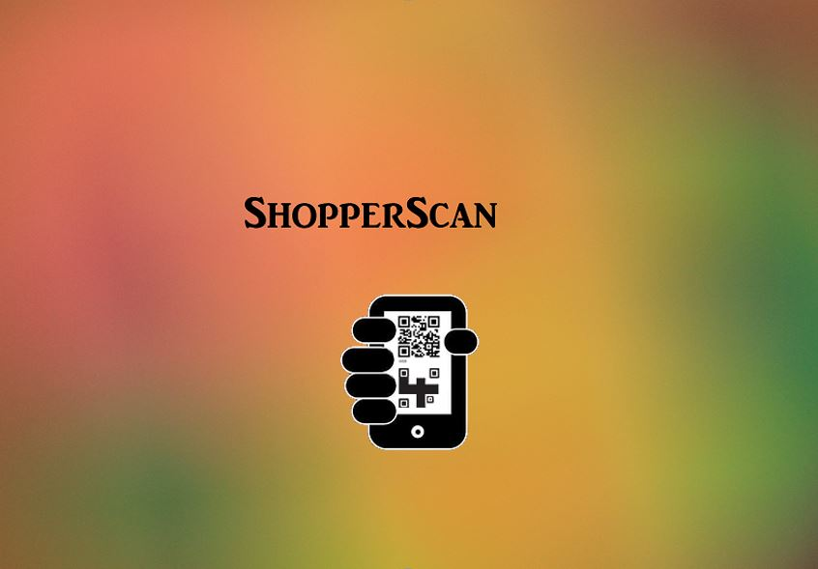
Shopperscan

Slide 2
Introduction
Our aim is to reduce the never ending queue at check out in a shopping store.
This idea came up when we were waiting for checkout in the Walmart store
Scan the barcode of your item and check out.

Slide 3
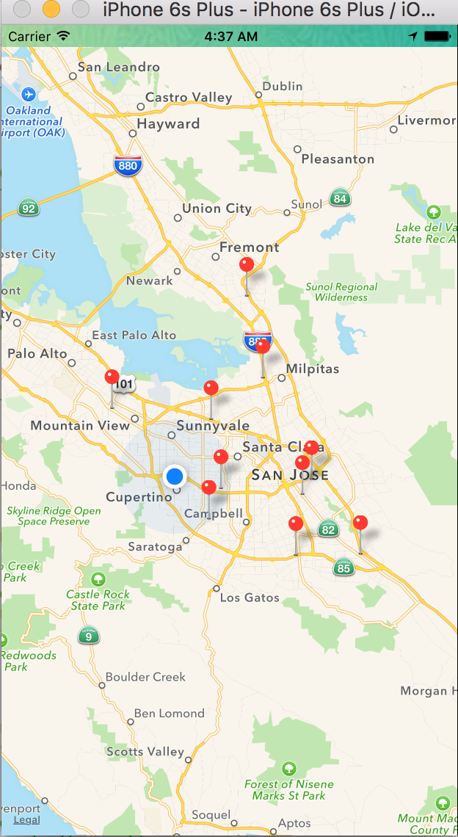
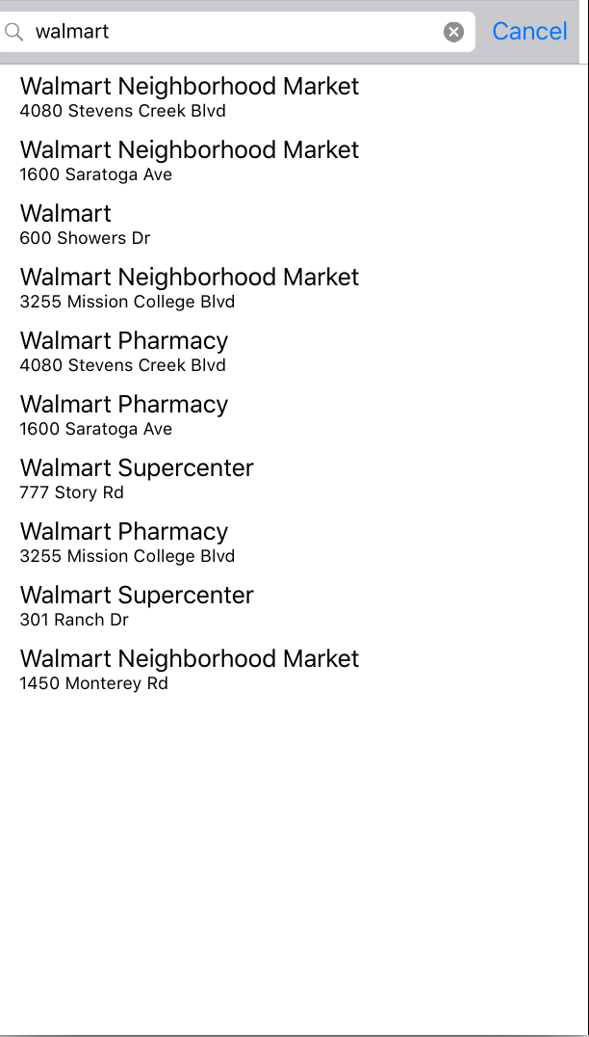
features
Find stores automatically nearby your location. You can also look up for a specific store.

Slide 4
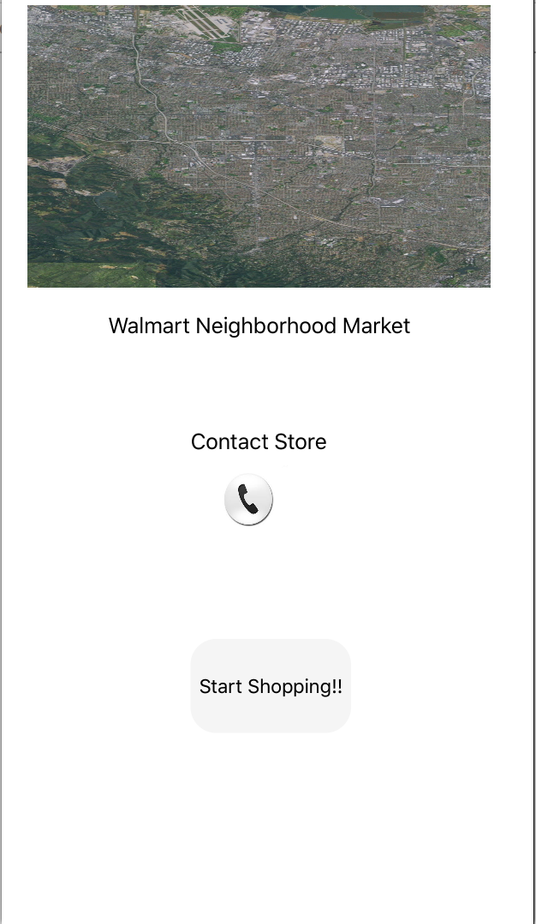
Get details of the store.

Slide 5
Scan the barcode of the item.
Check out

Slide 6
Functionalities
Touch Id
Login
Map
GPS
Camera
Phone
Database/Server

Slide 7
Future Work
Payment gateway
Email
Expand the app to include for many stores

