Slide 1


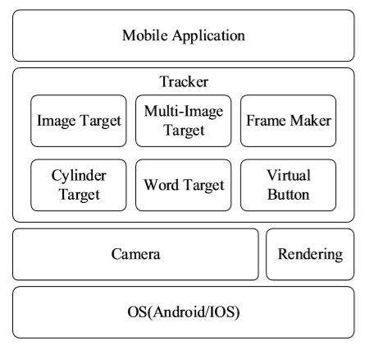
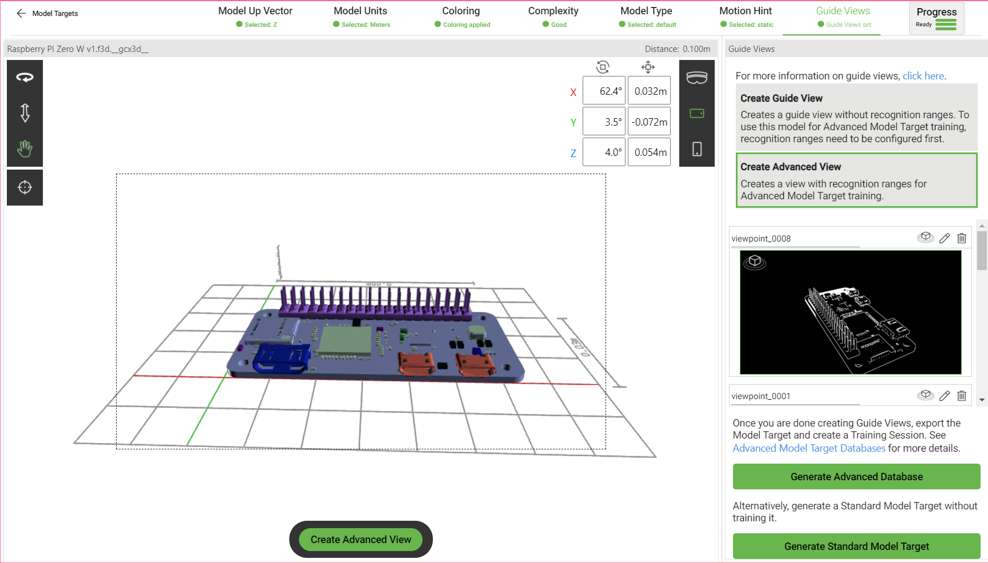
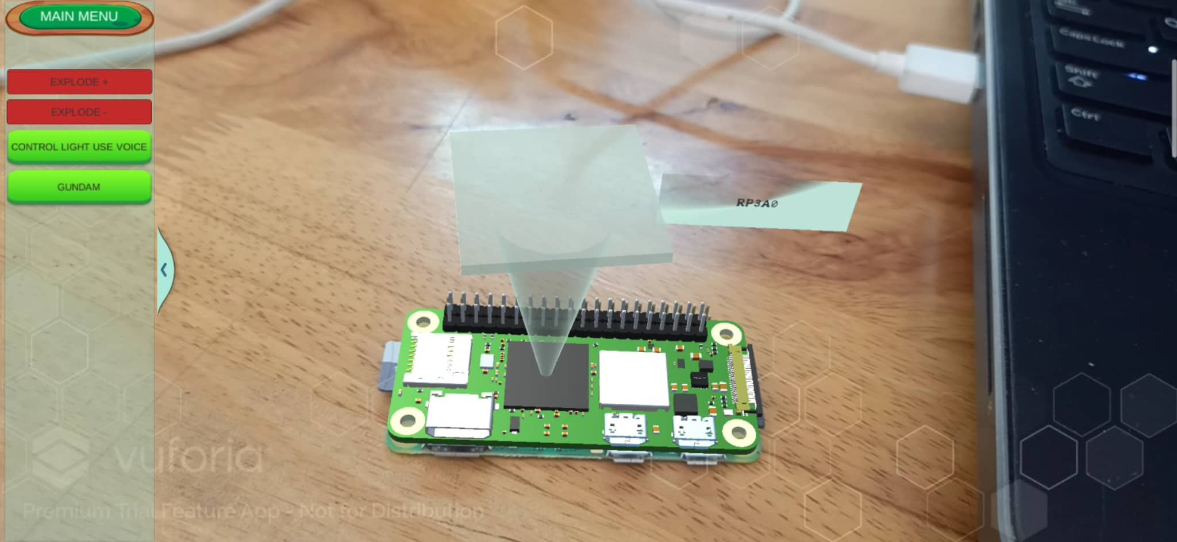
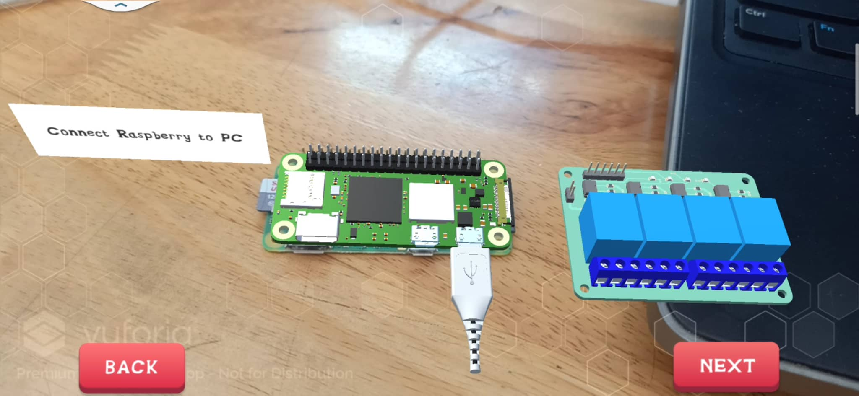
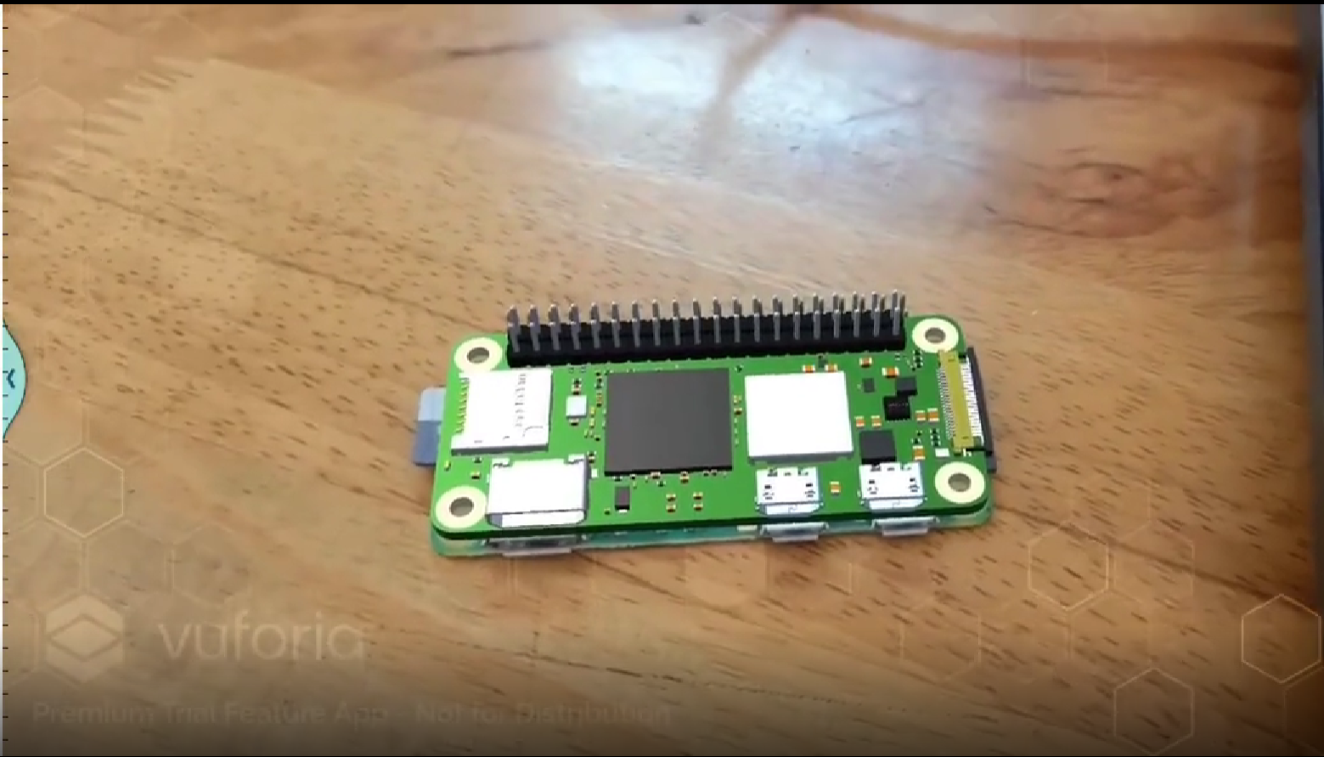
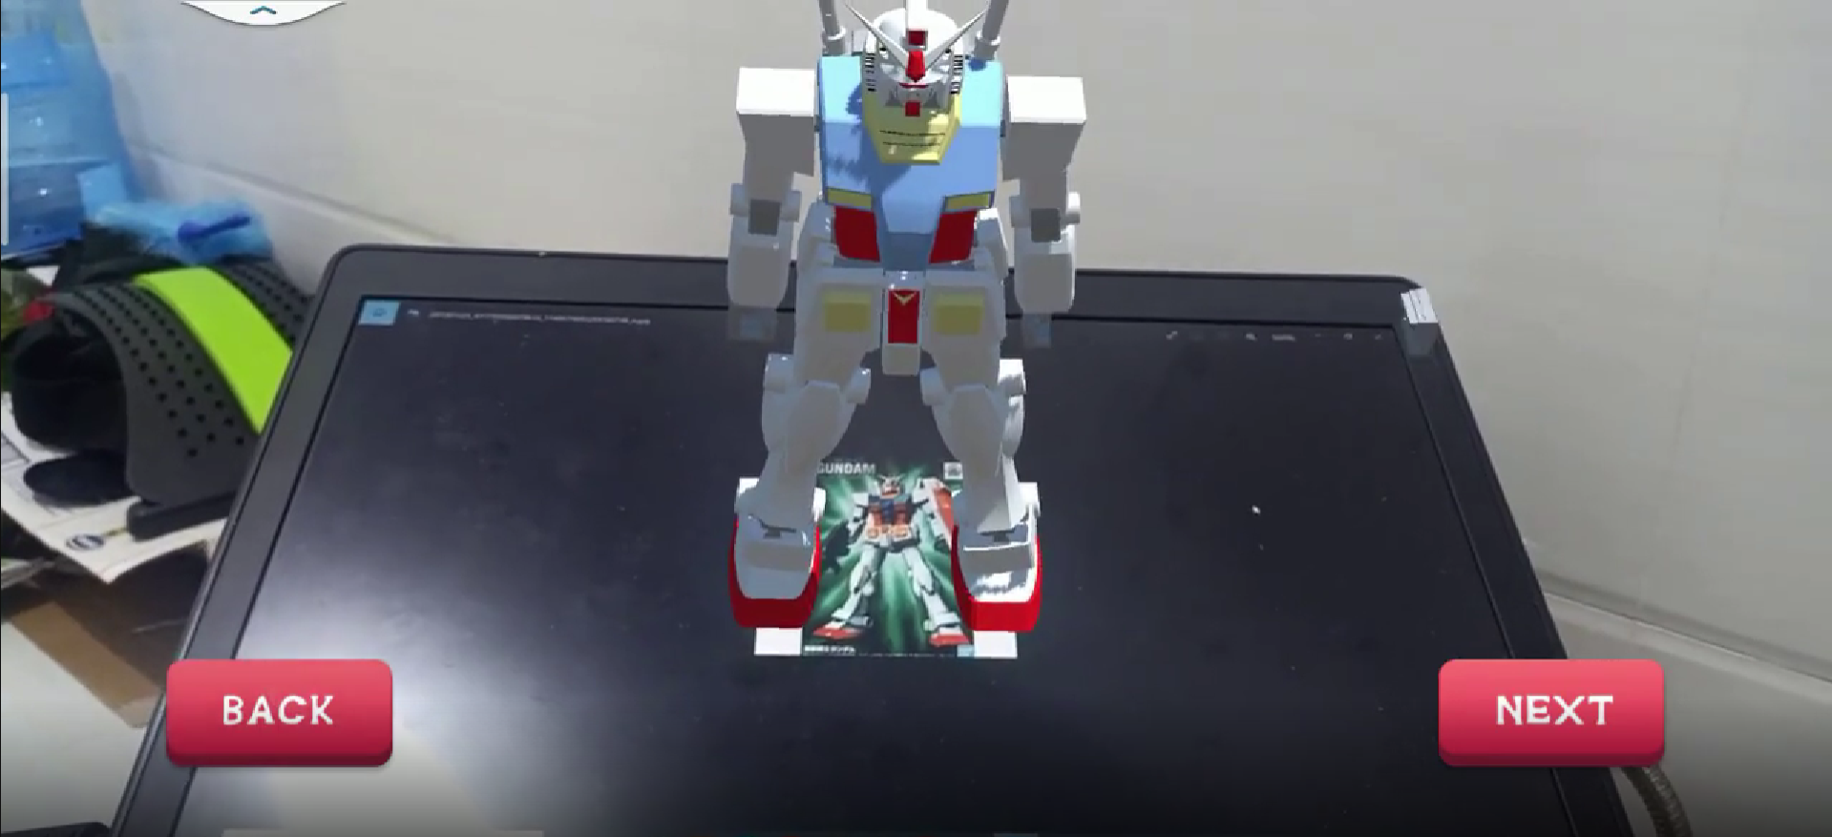
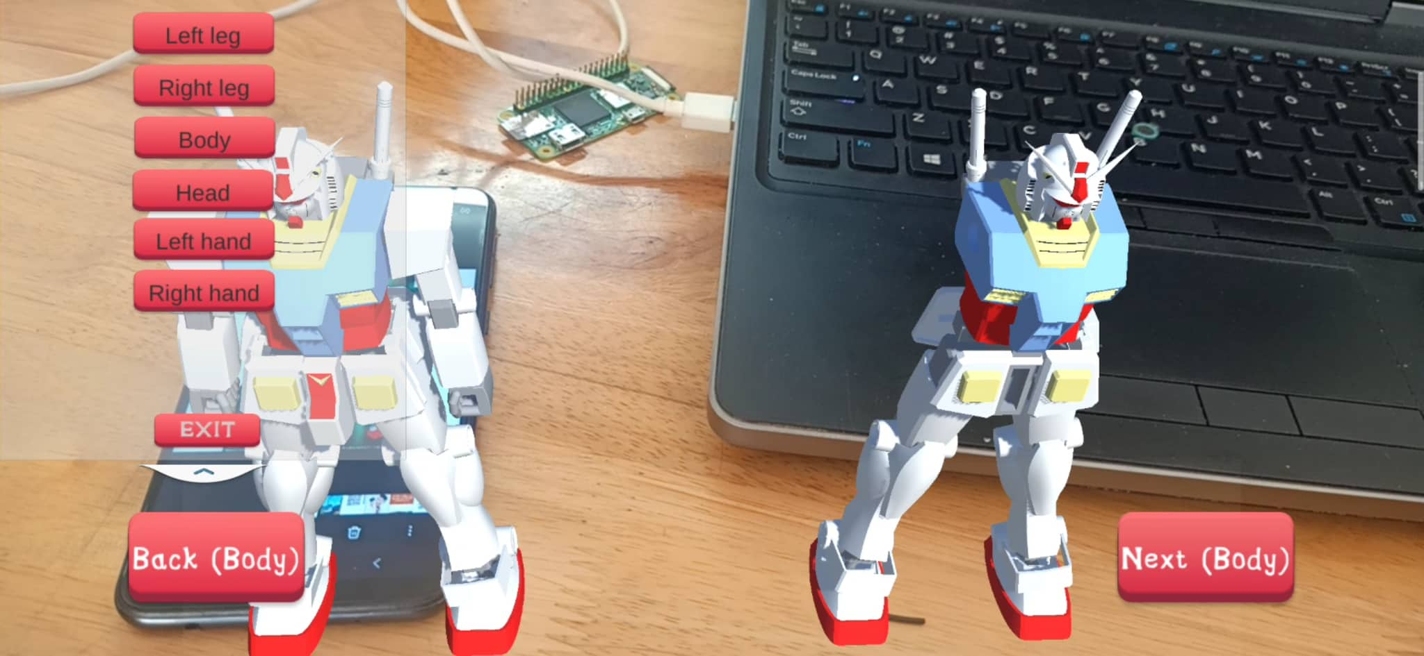
HO CHI MINH CITY UNIVERSITY OF TECHNOLOGY AND EDUCATION
FACULTY OF MECHANICAL ENGINEERING
FINAL PROJECT:
Lecturer: Phan Gia Luan
Student: ID:
Nguyen Ngoc Han 20134014 Ha Gia Kinh 20134016
Nguyen Quoc Viet 20134027
Nguyen Huynh Lam Vu 20134028
3D INSPECTION AND TRAINING INSTRUCTION WITH AUGMENTED REALITY FOR RASPHBERRY AND GUNDAM ASSEMBLY
I. Introduction
III- Augmented reality method
Video tutorials can be more effective because they use the power of animated visual instruction, but the user must repeatedly switch between the video and the real-world environment. Instead of reading a paper manual, a person could look at an engine while an AR application uses virtual cues to shows the parts that need to be adjusted and the sequence of steps required. This paper presents the 3D inspection, training instructions for Rasphberry and the assembly of Gundam. Inspection and training instruction for manual assembly and maintenance is one type of learning that can benefit significantly from the use of AR because these “hands-on” tasks are usually executed in a large work space and take much time to instruct directly
In this paper, image recognition is used. Two methods of storing image database are provided: device database and cloud database. The main difference between them is that the former does not require network connection, time response is faster, is limited to 100 targets per downloaded device target database and has no metadata support whereas the later requires network connection and cloud recognition, time response is depends on network conditions, supports more target database(>1 million targets )and metadata
Additionally, with training instruction and assembly applications, this system integrates capturing and rendering technologies : • Capturing: The camera is used to capture activities within a large-scale environment. Considering the different modalities registered the captured activities can be rendered using different output devices. AR module is used to link contextual information to specific machine parts. By combining forces, torques requirements with multi-media illustrations and audio, video files, the system can document complex assemblies and maintenance workflows. • Rendering: Information captured from each training scenario can be presented in two different modes: a 3D-animation illustrating the current assembly step that is directly superimposed onto the captured video image ,or a tracked icon that indicates what contextual information is available displaying the machine part if the icon is selected by the user.
II. Overview system
This system builds Model Targets by using Vuforia Engine to recognize and track particular objects in the real world based on the shape of the object. It requires the access to 3D model data for a particular object to make a Model Target for this object. The object must be geometrically rigid and present stable surface features. Using the Model Target Generator (MTG) application to generate a Model Target
Model Targets are supported at runtime on the majority of Vuforia Engine platforms. The Model Target Generator takes as input a 3D model representing the object which is configured suitably for optimal tracking with Guide Views and Advanced Views. The MTG generates a Vuforia Database which can be used with Vuforia Engine's Unity integration in order to track the object
IV- Result
User turns on an app and points the camera at the object that user wants to work with. Then the app captures target and recognizes it in the video area. If the recognized object matches with the model target database, specified 3D models will be uploaded and displayed on the screen
Additionally, with training instruction and assembly applications, this system integrates capturing and rendering technologies : • Capturing: The camera is used to capture activities within a large-scale environment. Considering the different modalities registered the captured activities can be rendered using different output devices. AR module is used to link contextual information to specific machine parts • Rendering: Information captured from each training scenario can be presented in two different modes: a 3D-animation illustrating the current assembly step that is directly superimposed onto the captured video image ,or a tracked icon that indicates what contextual information is available displaying the machine part if the icon is selected by the user.
Fig. 1 Inspection
Fig. 2 Training instruction
Fig. 3 Gundam Assembly

