Slide 1
STATEMENT OF ANALYSIS · 2007–2011
BANK LOAN ANALYSIS
An End-to-End Data Analytics Project
Excel
MySQL
Power BI
Tableau
Prepared by
Dheeraj Gupta

Slide 2
PROJECT OVERVIEW
One dataset, five questions, four tools
Analyze bank loan data to understand loan performance, borrower characteristics, payment behavior, and loan status.
Transform raw loan records into structured analysis, KPI calculations, SQL results, and interactive dashboards.
Solve the same five project questions across Excel, MySQL, Power BI, and Tableau.
Present the work as one end-to-end analytics case study, prepared by Dheeraj Gupta, while keeping each tool's working file separate.
02

Slide 3
THE BRIEF
The five project KPIs
Exact KPI questions supplied for this project
Year-wise loan amount statistics
1
Grade- and sub-grade-wise revolving balance (revol_bal)
2
Total payment for Verified Status vs. Total Payment for Non-Verified Status
3
State-wise and month-wise loan status
4
Home ownership vs. last payment date statistics
5
03

Slide 4
METHODOLOGY
Tools & workflow
1
2
3
4
Excel
MySQL
Power BI
Tableau
Cleaning · calculations · charts
Queries · joins · aggregations
Modeling · DAX · interactive dashboard
Visualization · trend analysis
Dataset
>
Preparation
>
KPI Analysis
>
Validation
>
Dashboard
>
Insights
The analytical outputs remain aligned to the same five project questions across every tool.
04

Slide 5
DATASET & PROJECT METRICS
Key figures reported across the project
39,717
$445.6M
$434.81M
Total loan
applications
Total loan
amount
Total funded
amount
$482.7M
12.02%
13.32%
Total amount
received
Average
interest rate
Average
DTI
Loan analysis covers loan amount, interest rate, DTI and loan status. Customer analysis includes home ownership, state, grade and sub-grade.
05

Slide 6
KPI 01
Year-wise loan amount
The dashboards report strong growth in lending volume from 2007 to 2011
Growth
117×
from $2.22M (2007) to $260.51M (2011)
2007 $2.22M
2011 $260.51M
The displayed series shows a substantial, accelerating increase in lending volume across the period.
06

Slide 7
KPI 02
Grade & sub-grade-wise revolving balance
Grade B reports the largest grade-level revolving balance
Top three grades
B
$161.31M
A
$114.77M
C
$110.12M
Balance tapers sharply from Grade B through Grade G, which holds the smallest revolving balance at $6.46M.
07

Slide 8
KPI 03
Verified vs. non-verified
Verification distribution reported across the dashboards
68.19%
Verified
31.81%
Non-verified
The KPI compares total payment between these two verification groups. Exact payment totals are reported in the corresponding Excel, SQL and BI project outputs.
08

Slide 9
KPI 04
State-wise & month-wise loan status
Two analytical views are used to answer one KPI question
STATE-WISE
State on axis
Count of loan records
Loan Status as legend
Compare status across states
MONTH-WISE
Month on axis
Count of loan records
Loan Status as legend
Track status across time
09

Slide 10
KPI 05
Home ownership vs. last payment date
The dashboards compare monthly last-payment amounts across home-ownership groups
Mortgage
Highest
Rent
Second
Other
Lowest
Mortgage customers show the highest last-payment amounts in most displayed months. Rent is the next prominent group, while other home-ownership categories sit consistently lower. This KPI connects home-ownership type with payment behavior over time.
10

Slide 11
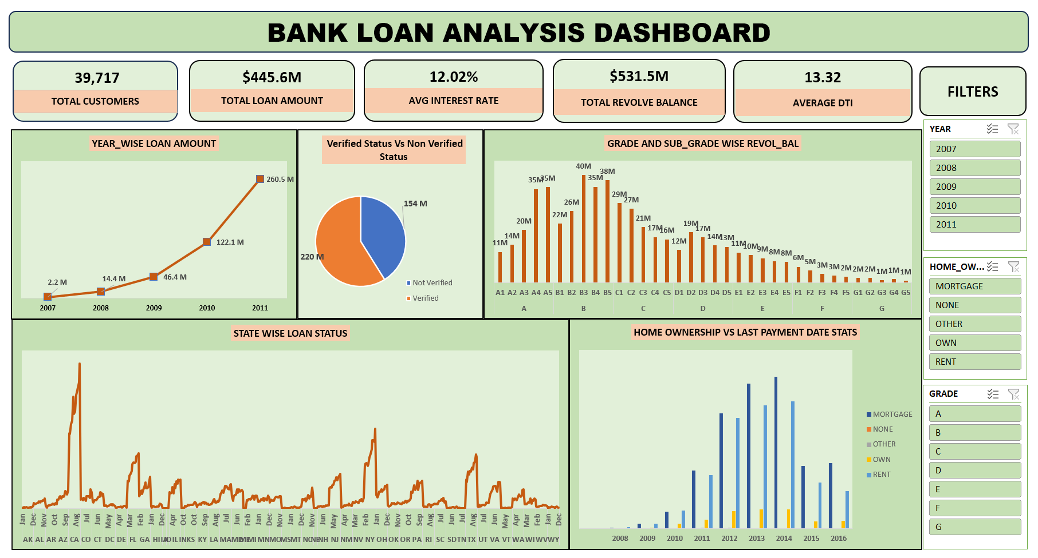
Excel dashboard
11

Slide 12
MySQL analysis
Querying, joins, aggregations and data validation
bank_loan_analysis.sql
MySQL was used for KPI queries, joins, aggregations and validation.
The five project questions were solved separately in the SQL module.
SQL outputs can be cross-checked with Excel, Power BI and Tableau results.
SELECT issue_year,
SUM(loan_amnt) AS total_loan_amount
FROM loan_data
GROUP BY issue_year
ORDER BY issue_year;
SQL to KPI
Cross-check
Grouped results and validation
Compare outputs across Excel, Power BI and Tableau
12

Slide 13
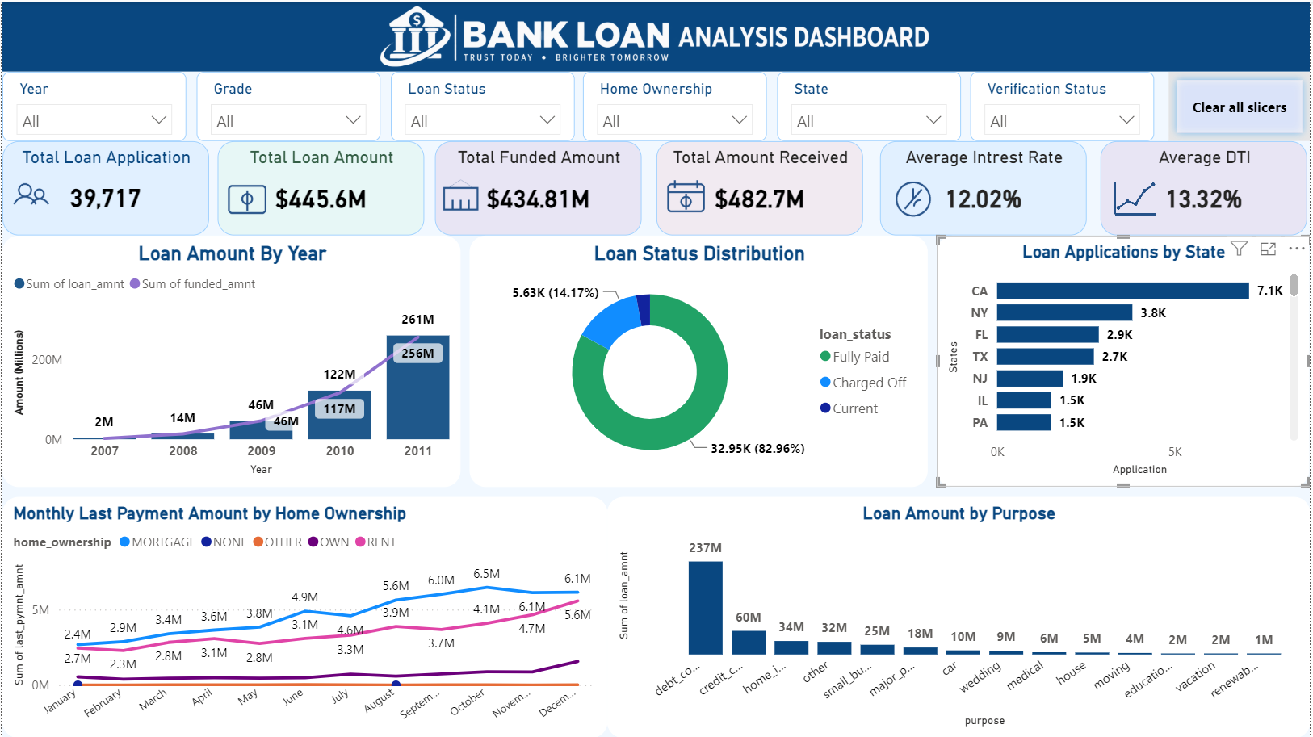
Power BI dashboard
13

Slide 14
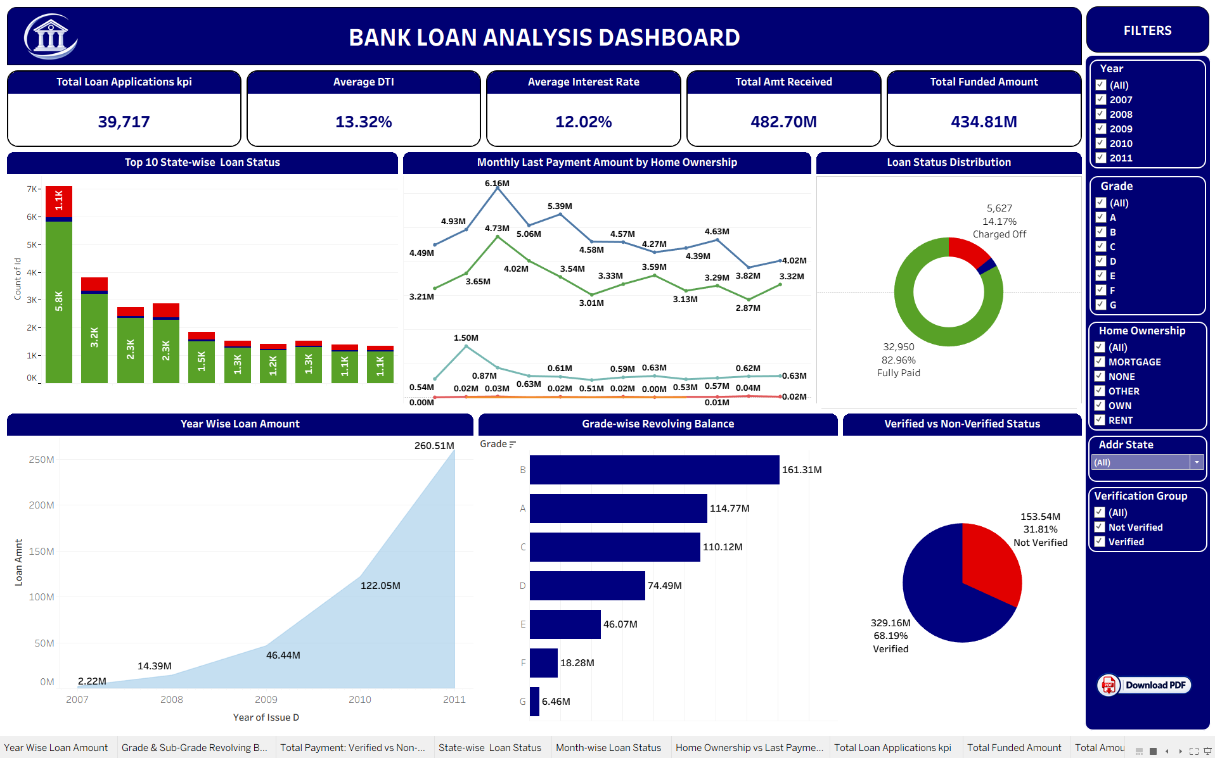
Tableau dashboard
14

Slide 15
RESULTS
Key findings
Figures and patterns directly supported by the analysis
39,717
82.96%
$2.22M > $260.51M
Total loan applications analyzed end to end
Fully Paid vs. 14.17% Charged Off, and a small Current share
Loan volume growth from 2007 to 2011
7,099
$161.31M
68.19% / 31.81%
California applications — the highest of any state
Grade B revolving balance — the largest of any grade
Verified vs. non-verified payment split
Bonus insight from the Power BI model: debt consolidation is the single largest loan purpose, accounting for roughly $236.6M of funded loans.
15

Slide 16
APPROACH
Challenges & solutions
How the analytical workflow handled practical project issues
CHALLENGE
SOLUTION
Multiple related datasets
Used lookups, relationships and joins to connect analysis.
CHALLENGE
SOLUTION
Inconsistent raw data
Standardized formats and validated fields before analysis.
CHALLENGE
SOLUTION
Complex KPI calculations
Cross-verified results across all four analytical tools.
CHALLENGE
SOLUTION
Cluttered dashboard design
Used slicers, filters and consistent visual structures.
CHALLENGE
SOLUTION
Four separate tool files
Maintained one shared KPI framework across Excel, SQL, Power BI and Tableau.
16

Slide 17
CONCLUSION
Project conclusion
Transforms bank loan data into structured KPI analysis and interactive dashboards.
All five official project questions were addressed across Excel, MySQL, Power BI and Tableau.
Demonstrates data preparation, SQL querying, KPI calculations, data modeling, visualization and dashboard development.
Provides clear views of loan growth, loan status, revolving balance, verification status, state distribution and payment behavior.
Organized as one end-to-end analytics case study with separate tool files and a common KPI framework.

Slide 18
THANK YOU
Bank Loan Analysis · Excel · MySQL · Power BI · Tableau
Dheeraj Gupta

