Slide 1
Filling gaps in weather radar
What each input contributed in the KLGX holdout tests
Nearest observed radar pixel is the common baseline
15 November 2021 held-out storm
Notes:
Sources: README.md and the figures in outputs. The presentation separates pre-satellite and satellite-era experiments.

Slide 2
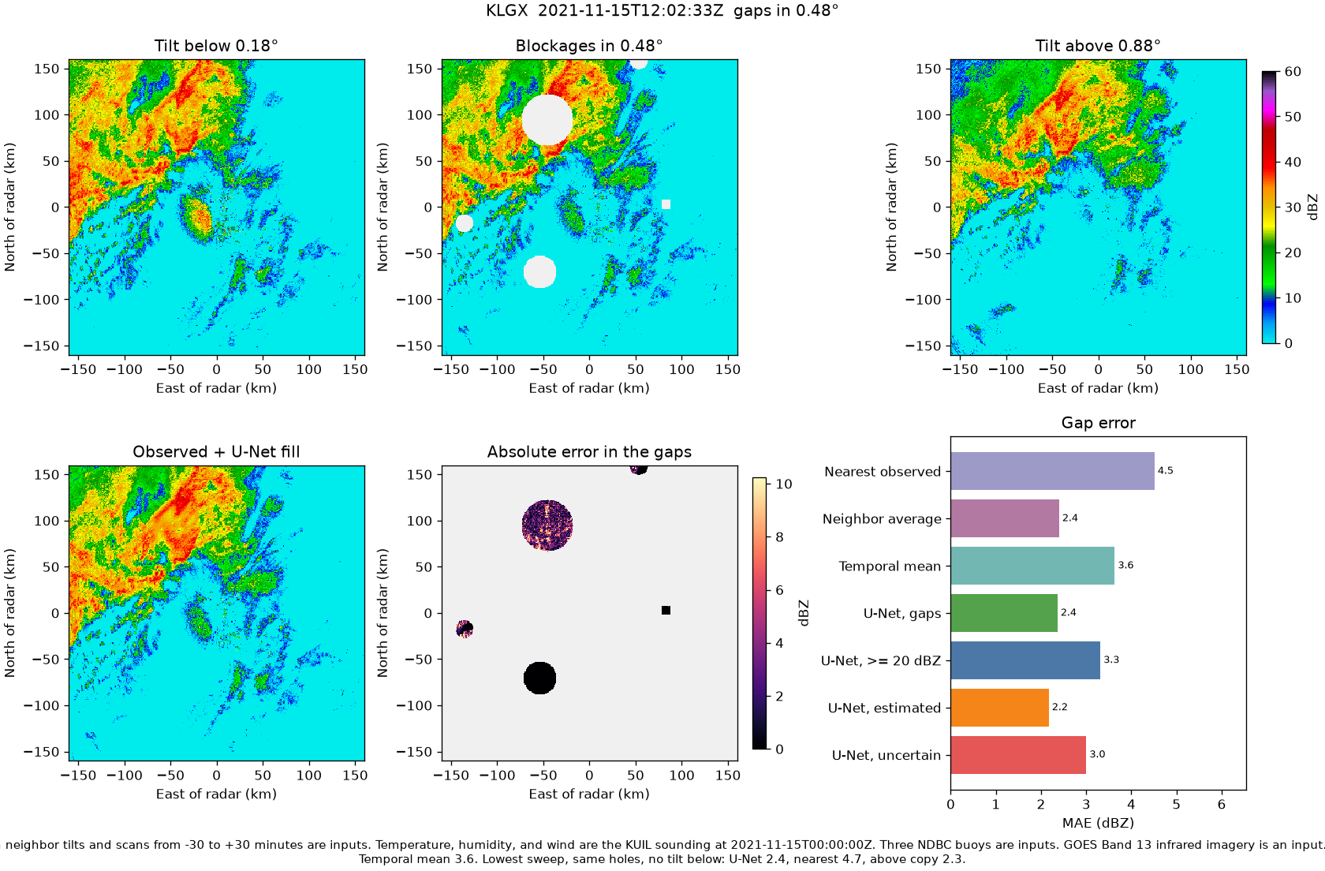
The test hides known radar pixels
The model sees surrounding data. We score only the hidden pixels against the radar values we kept as truth.
Notes:
Source: outputs/gapfill_holdout_gaps.png; src/radar/holdout_gaps.py.

Slide 3
Nearest observed is the baseline
Lower mean absolute error (MAE) is better. A 1 dBZ error means the prediction misses the true radar value by 1 dBZ on average.
Middle tilt, 0.48° | MAE in dBZ | All methods use the same holdout mask
Notes:
Source: outputs/gapfill_holdout_gaps.png and README.md. Scores are for the middle tilt on the same artificial holes.

Slide 4
What the model can see
Visible target sweep
Radar pixels outside the artificial hole
Vertical neighbors
Radar tilt immediately below and above
Temporal scans
Up to 12 scans from −30 to +30 minutes
Atmosphere
Temperature, humidity, and wind from a nearby weather balloon
Marine buoys
Wind, pressure, sea and air temperature, dew point
Satellite
GOES Band 13 infrared image before the radar scan
Missing values get a separate validity flag. The 73 channel version adds two satellite channels.
Notes:
Sources: src/radar/model.py, src/radar/holdout_gaps.py, README.md. The Quillayute weather balloon measures a vertical profile. The model maps temperature, humidity, and wind to each radar beam height.

Slide 5
Settings held constant in the tests
Training
Rain emphasis
5 KLGX days; 20 epochs; 40 steps per epoch
Hidden pixels ≥20 dBZ have 4× loss weight
Image grid
Categories
1 km cells over a 320 × 320 km area
Estimated ≤12 km from a visible pixel; farther is uncertain
Training crop
Holdout
128 × 128 cells
15 Nov 2021, separate day and fixed mask
Wide holes
Satellite timing
28 km radius in half of sampled crops
Most recent completed scene, at most 20 min old
The figures test input combinations. They do not measure the effect of changing these fixed settings.
Notes:
Sources: src/radar/holdout_gaps.py, src/radar/train.py, src/radar/masks.py. These settings were fixed, not individually tuned in the output figures.

Slide 6
All tested input combinations
Middle tilt MAE (dBZ). New: 73 channels. Earlier: 71 channels before satellite. Nearest observed: 4.51.
Notes:
Sources: outputs/gapfill_holdout_gaps.png, gapfill_holdout_no_satellite.png, gapfill_holdout_no_buoy.png, gapfill_holdout_no_temporal.png, gapfill_holdout_no_neighbors.png, gapfill_holdout_no_neighbors_no_buoy.png, gapfill_holdout_temporal_buoy.png, gapfill_holdout_temporal_only.png; README.md. New refers to the 73 channel model. Earlier refers to the 71 channel model built before satellite input. The one-epoch smoke run is excluded because it did not use the full training schedule.

Slide 7
What changed when inputs were removed
Vertical neighbors
With: 2.27 dBZ. Without: 3.8 dBZ.
The adjacent radar tilts carry strong information about the hidden area.
Temporal scans
With: 2.27 dBZ. Without: about 2.1 dBZ.
In this holdout, the extra time scans did not improve the full pre-satellite run.
Buoys
With: 2.27 dBZ. Without: 2.21 dBZ. Their effect depends on the other inputs.
Comparison is on one held-out day. Lower is better. The weather balloon input has not been isolated.
Notes:
Sources: README.md and the pre-satellite PNG files in outputs. The weather balloon input has no isolated on/off comparison in these saved figures.

Slide 8
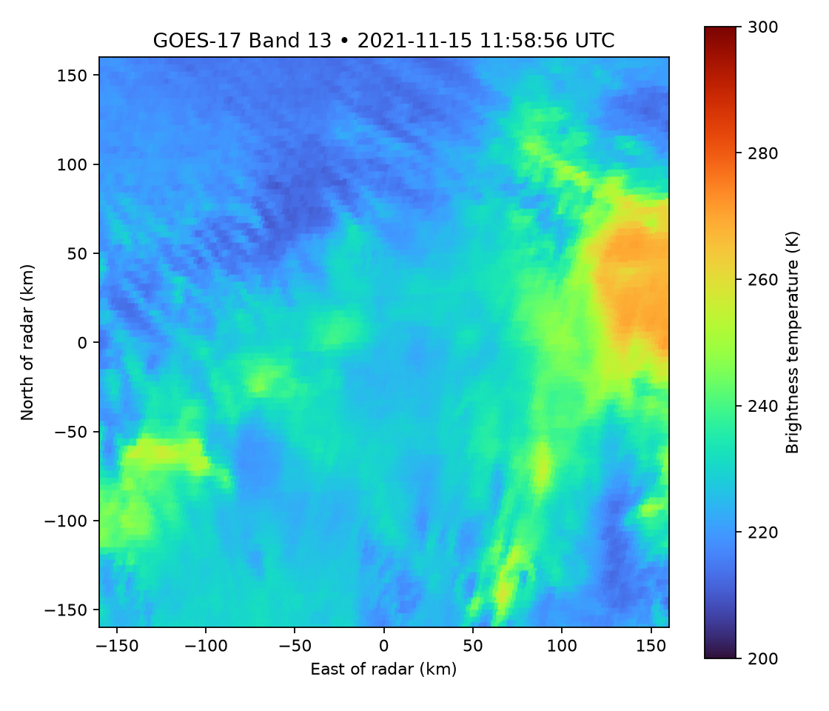
Satellite imagery improved this holdout
Middle tilt
Off: 2.80. On: 2.36 dBZ.
Lowest tilt
Off: 3.52. On: 2.44 dBZ.
Same training setup and hole mask. Only the satellite channels changed.
MAE in dBZ. The image ended at 11:58:56 UTC, before the 12:02:33 radar scan.
Notes:
Sources: outputs/gapfill_holdout_gaps.png, outputs/gapfill_holdout_no_satellite.png, outputs/holdout_goes_band13.png; README.md. Both runs use the same seed and 73 channel architecture.

Slide 9
Where the satellite model still errs
Middle tilt MAE (dBZ). Larger holes and stronger rain remain harder to reconstruct.
Notes:
Source: outputs/gapfill_holdout_gaps.png. Estimated and uncertain refer to distance from a visible radar pixel; precipitation is a separate subset of hidden cells.

Slide 10
What these results support
Measured here
Nearest observed is a clear baseline at 4.51 dBZ on the middle tilt. Adjacent tilts provide the largest gain in the earlier tests. Satellite imagery improves the matched 73 channel run.
Limits
One storm was held out. Holes are artificial.
The positive time offsets make this an offline reconstruction test.
  The model uses radar scans taken after the scan it is filling, up to 30 minutes later. That makes this a retrospective test. It could not produce the same prediction immediately in real time.
There is no isolated sounding ablation or sweep of training hyperparameters.
  Did not run a matched test with only the weather balloon data switched off, so we cannot say how much that input helped.
  Did not systematically try different training settings, such as crop size, hole size, or rain weighting, to find the best values.
Next evidence: repeat the same ablations across more storm days and real blockage patterns.
Notes:
Sources: README.md, outputs and src/radar/holdout_gaps.py.

