Slide 1
CSE 311 Operating System

Slide 2
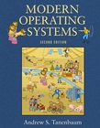
Textbooks
Modern Operating Systems
Andrew S. Tanenbaum
3rd Edition or Newer

Slide 3
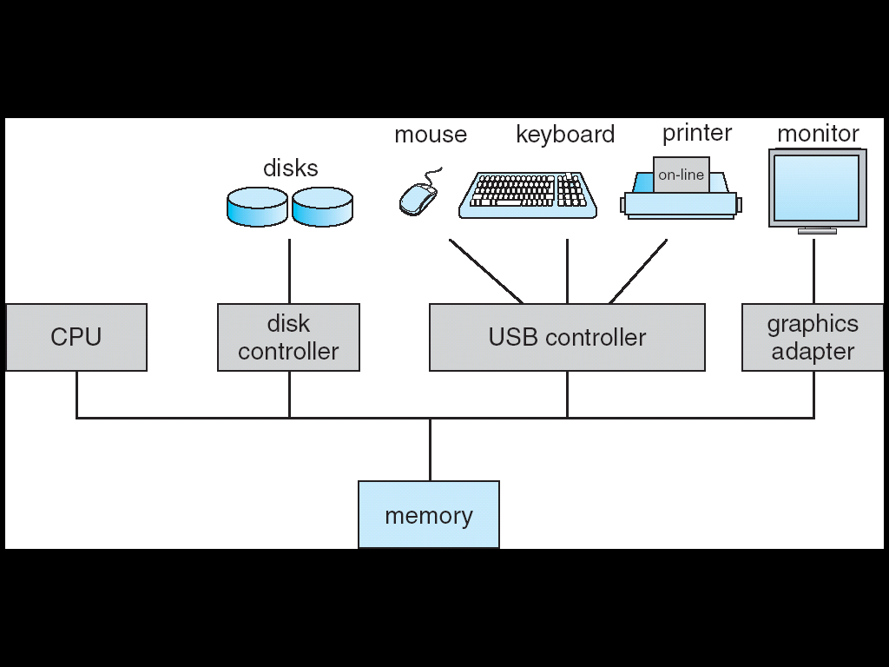
Modern Computer System
Complex system
Many H/W components
Many programs running simultaneously
Each running program
Executed in the CPU
Resides in the Memory
May Interact with several devices

Slide 4
Modern Computer System
To ensure the correct operation someone needs to
Understand how all these components work
Manage them wisely
Allocate them efficiently
A very challenging task!!!
If application programmer had to consider everything
No code would ever get written
So, computers are equipped with a special software
THE OPERATING SYSTEM

Slide 5
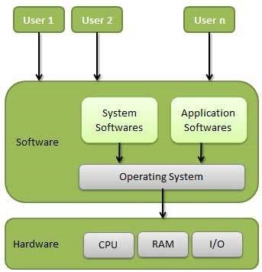
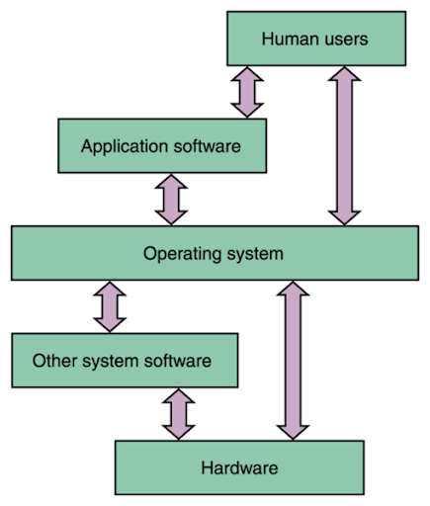
What is an OS?
Operating System is nothing but a software
Placement of OS
Scope of Interaction

Slide 6
Role of OS
An Extended machine
Provides application programmers a clean abstract set of resources instead of the messy hardware ones.
Works as an intermediary between applications/users and hardware
Resource manager
Manages the hardware resources
Multiple program running concurrently can be chaotic. It’s the responsibility of the OS to bring order.
“DESPISE CHAOS, CREATE ORDER”

Slide 7
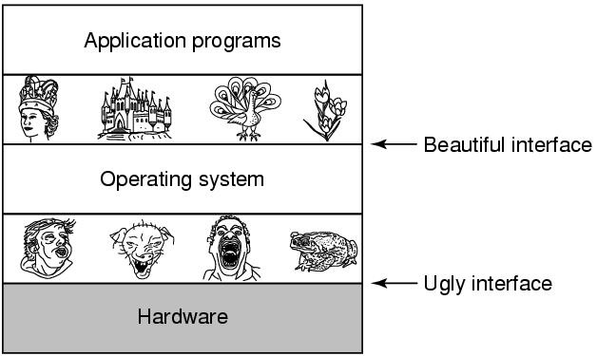
ABSTRACTION

Slide 8
An Extended Machine
Dealing with hardware can be very difficult.
Need to understand the operation
Need low level programming
Consider direct read write to hard disk
Programmers want a simple, high-level abstraction to deal with hardware.
The job of the OS is to create good abstractions
Example:
OS abstracts hard disk by the file-system

Slide 9
A Resource Manager
Allows multiple programs to run at the same time
Provide an orderly and controlled allocation of
Processors
Memories
I/0 devices
Among the competing programs
Example:
3 programs running on some computer
All tried to print their output simultaneously on the same printer
The OS can bring order to the potential chaos by buffering all the output on the disk

Slide 10
A Resource Manager
Resources can be shared in two different ways:
Time multiplexing:
In a single CPU system, several running programs take turns.
Space multiplexing:
main memory is divided up among several running programs

Slide 11
Computer Hardware Review

Slide 12
Processors
Fetches instructions from memory and executes them.
Basic cycle:
Fetch Decode Execute
The cycle is repeated until the program finishes.

Slide 13
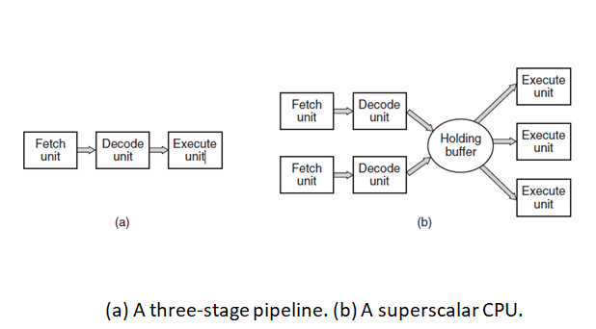
Pipelining vs Superscalar Architecture

Slide 14
Multithreaded vs Multicore Chips
Multithreaded Chips
Replicate some of the control logic.
Allow the CPU to hold the states of two different threads and then switch back and forth on a nanosecond time scale.
Does not offer true parallelism though!
Multicore Chips
CPU chips with two or four or more complete processors or cores on them.
Requires a multiprocessor operating system.

Slide 15
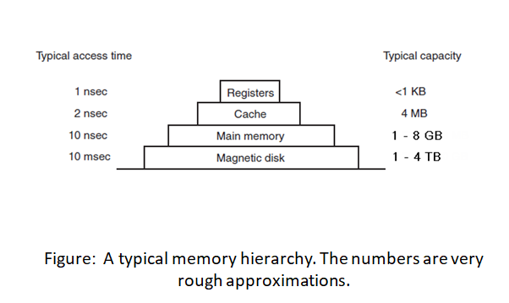
Memory
Ideally, a memory should be extremely fast, abundantly large, and dirt cheap.

Slide 16
Booting the Computer
OS loads every other program into RAM for running
So OS has to load into RAM before any other programs
But how to load the OS into RAM after power-on?
The procedure of starting a computer by loading the OS into RAM is known as booting the system

Slide 17
Booting the Computer
Motherboard includes a non-volatile ROM chip
The ROM chip is shipped with a start up program referred to as the BIOS (Basic Input/Output System)

Slide 18
Booting the Computer
When the computer is booted, BIOS Program is started
BIOS first runs diagnostics to determine the state of the machine
checks how much RAM is installed and
checks whether the keyboard and other basic devices are installed and responding correctly
…

Slide 19
Booting the Computer
BIOS then determines the boot device by trying a list of devices stored in the CMOS memory
Hard drive
CD-ROM
Flash drive
The first sector from the boot device is read into memory and executed
This sector contains a program that examines the partition table at the end of the boot sector to determine the active partition
Then a secondary boot loader is read in from that partition.
This loader reads in the OS from the active partition and starts it.
OS performs the initialization tasks, creates whatever background processes are needed, and starts up a login program or GUI.

Slide 20
Fundamental Concepts

Slide 21
Kernel
The most fundamental part of an operating system
Heart of an OS
The first thing that is loaded into memory when OS starts loading
Runs at all times on the computer
Major role includes memory management, process management, disk management etc.
Often used as another name of OS

Slide 22
Kernel
Key Roles of the Kernel:
Process management – Starts, stops, and schedules processes (programs in execution).
Memory management – Keeps track of every byte in your RAM: what's being used and by whom.
Device management – Controls communication between software and hardware (via device drivers).
File system management – Organizes data storage and access.
System calls & security – Offers a safe interface for applications to request system resources.

Slide 23
Dual-Mode Operation
CPU executes in 2 Modes
Kernel mode
CPU can execute all machine instructions
CPU can use every hardware feature
User mode
permits only a subset of the instructions and a subset of the hardware features.
Allows OS to protect itself and other system components

Slide 24
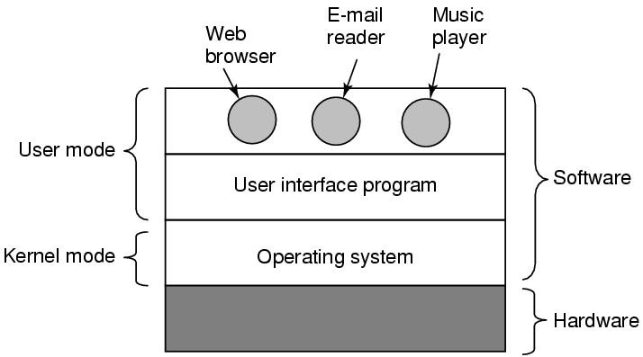
Dual-Mode Operation
OS runs in kernel mode, user programs in user mode
OS is Boss, the applications are laborers
Mode bit provided by hardware
Provides ability to distinguish when system is running user code or kernel code
Some instructions designated as privileged, only executable in kernel mode

Slide 25
Kernel Mode vs User Mode
To protect the system and keep it stable, CPUs support two main operating modes:
Why this distinction?
Safety: If user-mode programs crash, the rest of the system stays safe.
Control: The kernel has ultimate authority over the machine.
Feature | Kernel Mode | User Mode
Who operates here? | The kernel and low-level system tasks | Regular applications (Word, Chrome, etc.)
Hardware access | Full access | No direct hardware access
Memory access | Access to all memory | Restricted memory access
Security risk | High—bugs can crash the system | Low—bugs are contained
Switching | Happens during system calls or interrupts | Runs until it needs kernel services

Slide 26
Kernel Mode Execution
When does CPU start executing in kernel mode?
System Boot - starting a computer
Hardware Interrupt - generated by hardware devices to signal that they need some attention from the OS.
Trap
A software-generated interrupt caused either by an error (i.e. division by 0 or invalid memory access) or
By a specific request from a user program that an operating-system service needs to be performed.

Slide 27
Switching Modes
To obtain services from the operating system,
an user program must make a system call, which traps into the kernel and invokes the operating system.
The TRAP instruction switches from user mode to kernel mode and starts the operating system.
When the work has been completed, control is returned to the user program at the instruction following the system call.

Slide 28
System Calls
A system call is the programming interface to the services provided by the kernel of the OS. It allows user-mode programs to request services from the operating system in a safe, controlled manner.
Typically used from a high-level language (C or C++) program.
Typically a number is associated with each system call, and the OS maintains a table indexed according to these numbers.

Slide 29
High-Level Language Use
Most system calls are accessed through functions in C or C++, provided by standard libraries like glibc on Linux.
Example in C: int fd = open("file.txt", O_RDONLY);
This looks like a normal function call, but it ultimately invokes a system call to the OS to open the file.
System Call Numbers
Under the hood, each system call is associated with a unique number (ID).
Example (Linux x86_64):
When a system call is made, the number is placed in a CPU register (e.g., rax on x86_64), and a special instruction (like syscall or int 0x80) transfers control to the kernel.
System Call | Number
read | 0
write | 1
open | 2
close | 3

Slide 30
Flow of a System Call
User Program (in C)
↓
Standard Library (like glibc)
↓
System Call Interface
↓
System Call Number + Arguments
↓
CPU Switches to Kernel Mode
↓
Kernel Executes the Service
↓
Result Returned to User Mode

Slide 31
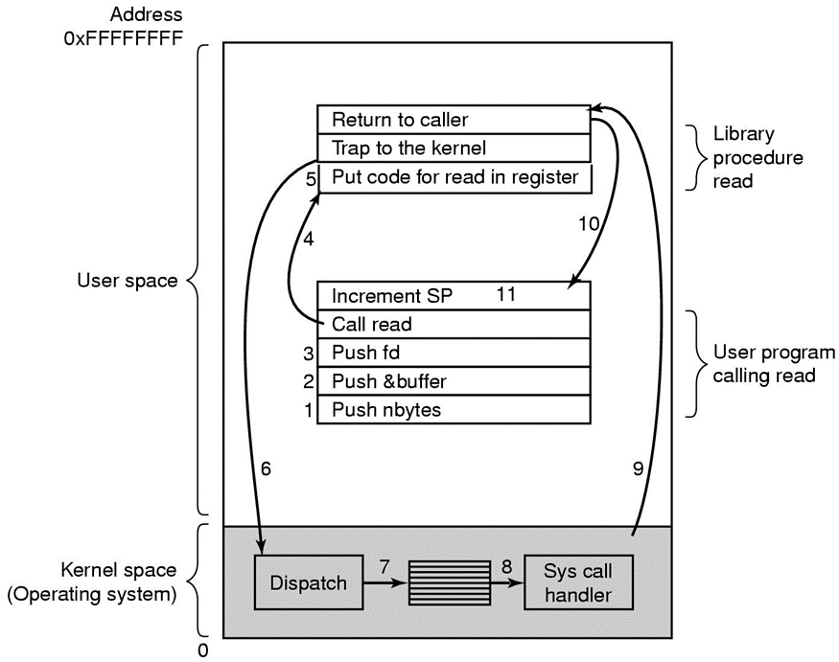
Steps in making a System Call
UNIX has a read system call for reading files
invoked from C programs by calling a library procedure with the same name read like this:
count = read(fd, buffer, nbytes);
TRAP instruction is executed for mode switching
See the steps in more details in Section 1.6

Slide 32
Trapping into kernel is costly
Save minimal CPU state (PC, sp, …) – done by hardware
Switches to KERNEL mode
KERNEL determines what system call has occurred
KERNEL verifies that the parameters passed are correct and legal
Restore state before returning to user program
User Mode
Mode bit = 1
User process
System Call
Resume process
Trap
Mode bit = 0
Kernel Mode
Mode bit = 0
Return
Mode bit = 1
Save Caller’s state
Execute system call
Restore state

Slide 33
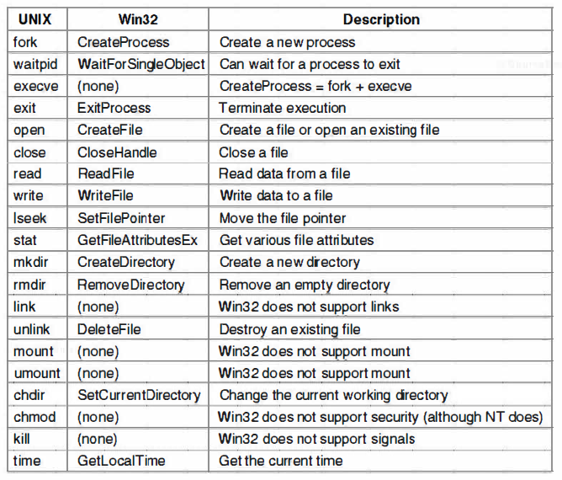
Examples of Windows & Unix System Calls

Slide 34
Some OS Components/Services/functions
Process Management
Memory Management
I/O Management
Deadlock Management
File System

Slide 35
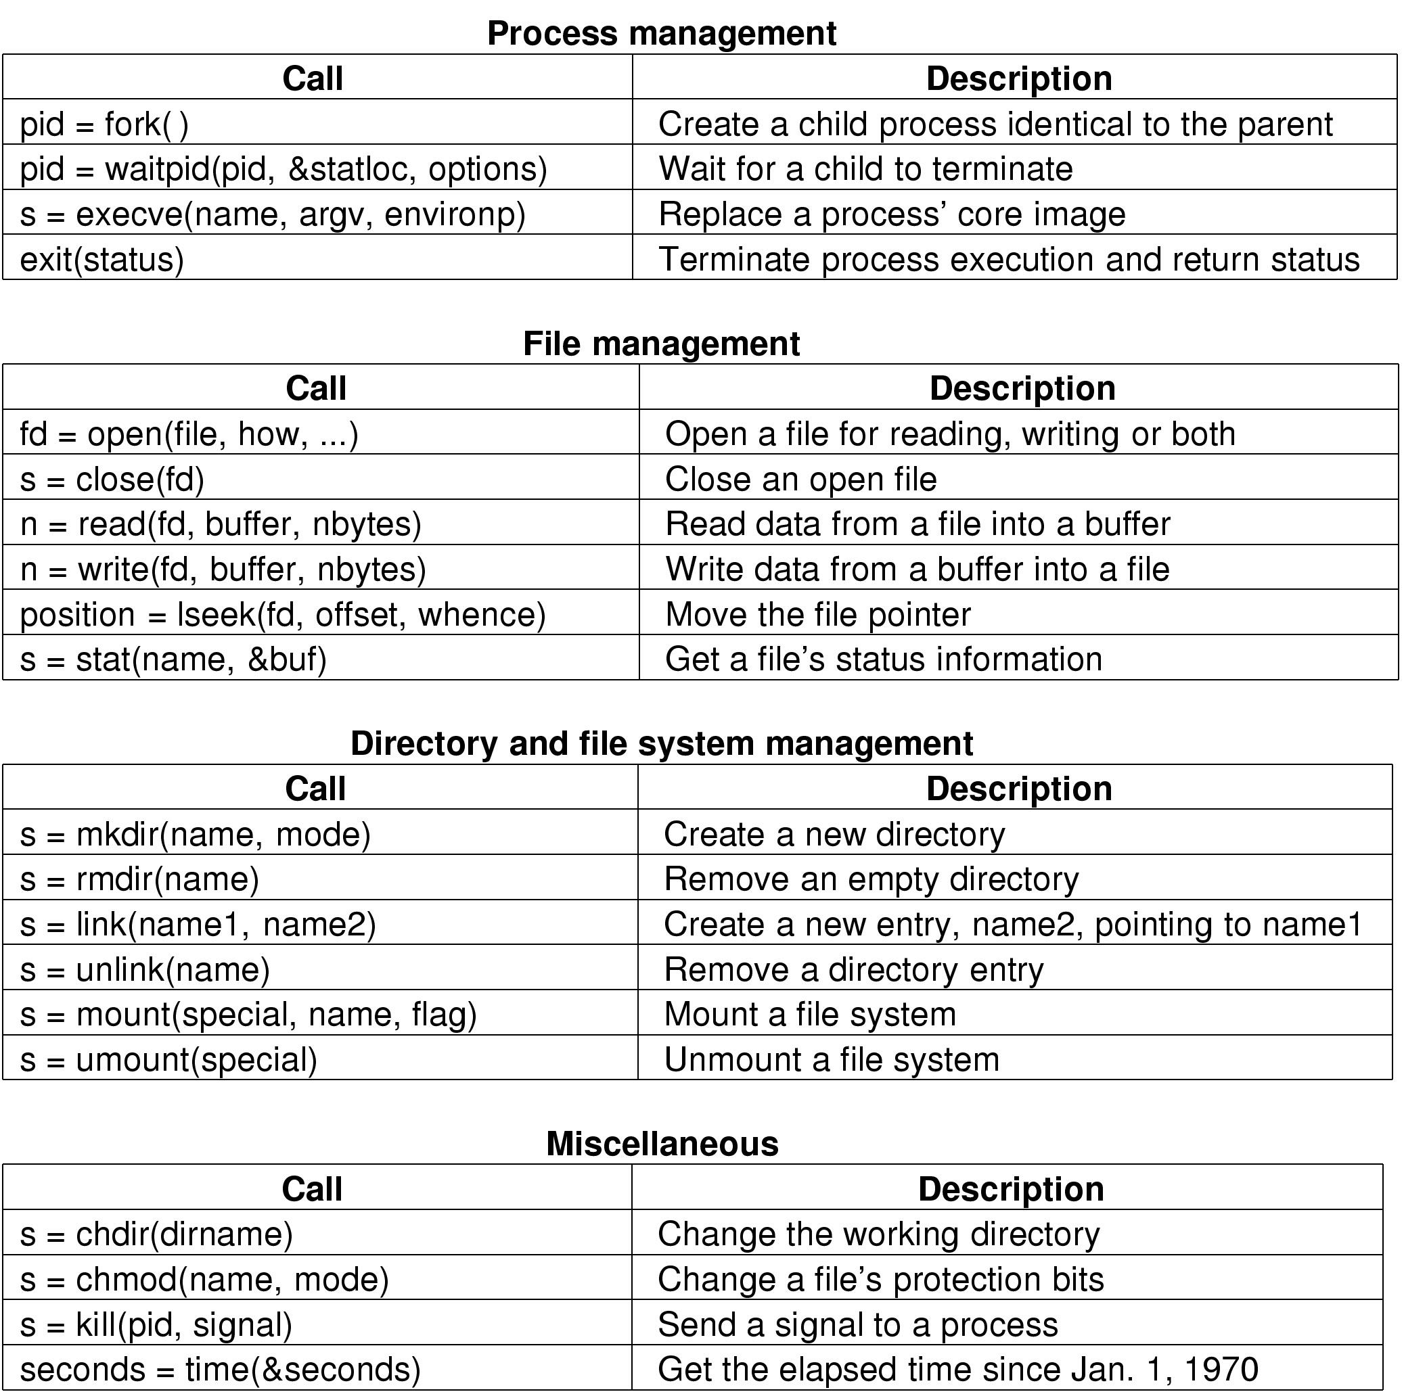
Some UNIX System Calls For Process Management

Slide 36
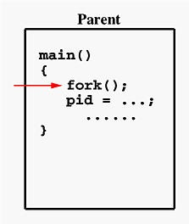
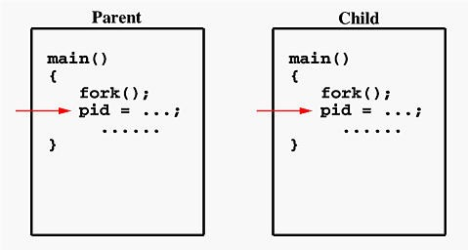
The fork()System Call
When fork()is called in process A
Control is switched to kernel
Kernel creates new process B which is exact duplicate of process A
OS now has two identical processes to run. Both resume from after fork().
return value of fork() will 0 in the child process and will be equal to the child's process identifier (PID) in the parent process

Slide 37
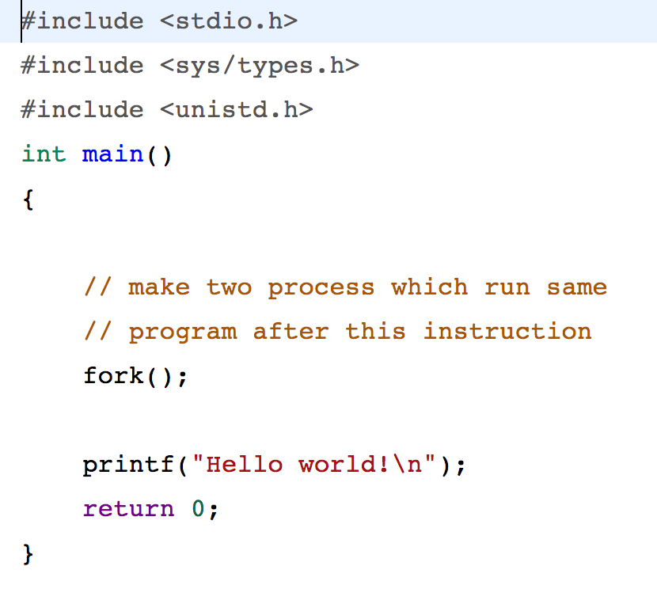
fork()Example 1

Slide 38
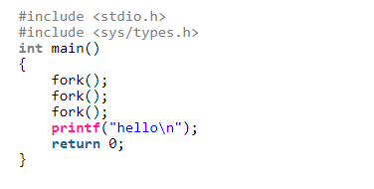
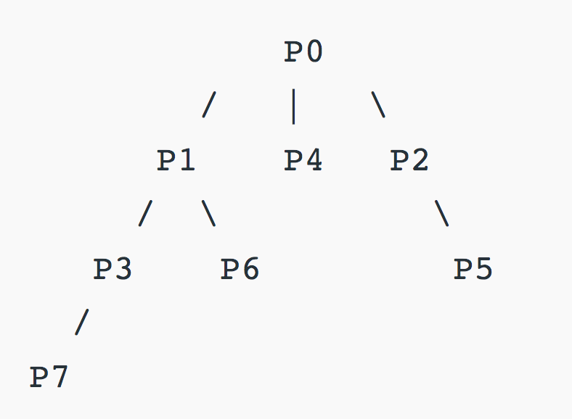
fork()Example 2
What is the output of this code?
Can you draw the fork() tree?
For further practice:
https://www.geeksforgeeks.org/fork-system-call/
https://www.youtube.com/watch?v=IFEFVXvjiHY

Slide 39
OS architecture/structure
2 main architectures:
monolithic kernel
microkernel

Slide 40
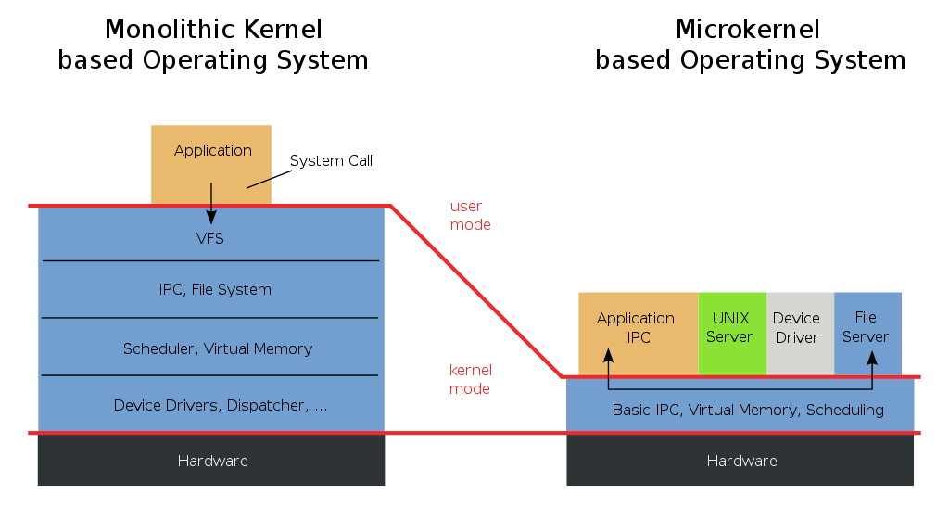
Os Architecture

Slide 41
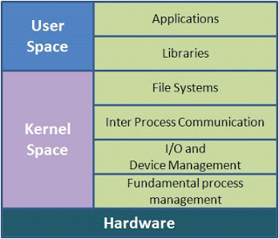
Monolithic kernel
Entire operating system runs as a single program in kernel mode.
Set of system calls implement all operating system services such as process management, memory management etc.

Slide 42
Monolithic kernel
Drawbacks:
increased kernel size
difficult to understand
bad maintainability
Advantage
Good performance

Slide 43
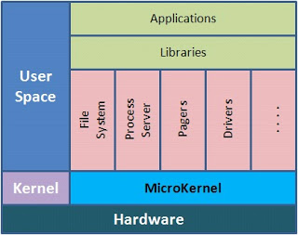
Microkernel
reduce the kernel to basic process communication and I/O control
let the other system services reside in user space in form of normal processes
user space services are called as servers
Do most of the work of the operating system.
One server for managing memory issues
one server does process management
another one manages drivers, and so on.

Slide 44
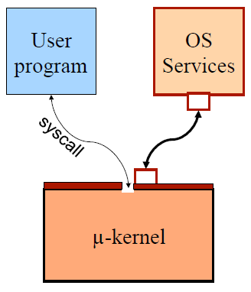
Microkernel
The main function of the microkernel is to provide a communication facility between the user program and the various servers
if the user program wishes to access a file, it must interact with the file server.
The user program and service communicate indirectly by exchanging messages with the microkernel.

Slide 45
Microkernel
Drawbacks:
Performance overhead of user space to kernel space communication
Advantage
Easier to extend the OS
All new services are added to user space and consequently do not require modification of the kernel
More secure & reliable
most services are running as user processes. If a service fails, the rest of the operating system remains untouched.

Slide 46
Example
Bugs in the kernel can bring down the system instantly.
What will be the impact of a bug (severe one) in audio driver
In a Monolithic Kernel based operating system?
In a Microkernel based operating system?

