Slide 1
Processes and Threads

Slide 2
Processes
Operating system provided abstraction to represent what is needed to run a single program.
The unit of execution.
Processes turn a single CPU into multiple virtual CPUs.
Each process has its own virtual CPU.
A single CPU can only execute one instruction at a time.
However, the OS rapidly switches between processes, giving the illusion that multiple programs are running at the same time.
This switching is done so fast (thousands of times per second) that users don’t notice the pauses.
So, each process feels like it has its own CPU, but in reality, they’re all sharing the same physical CPU.
This concept is called virtualization — creating the appearance of many CPUs from one.

Slide 3
Processes
Multiple Parts
The Program Code, Also Called Text Section
Current Activity Including the current values of PC, Registers
Stack Containing Temporary Data
Function Parameters, Return Addresses, Local Variables
Data Section Containing Global Variables
Heap Containing Memory Dynamically Allocated During Run Time

Slide 4
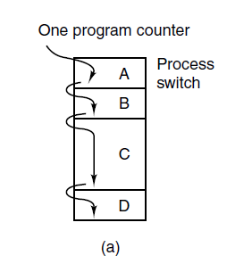
The Process Model
Figure 2-1. (a) Multiprogramming of four programs in memory. Only one physical program counter.
Tanenbaum & Bo,Modern Operating Systems:4th ed., (c) 2013 Prentice-Hall, Inc. All rights reserved.

Slide 5
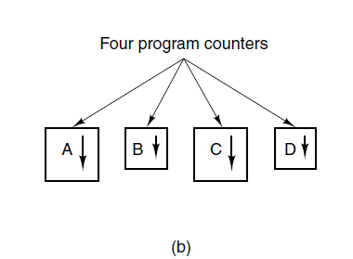
The Process Model
Figure 2-1. (b) Conceptual model of
four independent, sequential processes. There exist only one physical program counter, but four different logical counters. When a program runs, its logical counter is loaded into the physical program counter
Tanenbaum & Bo,Modern Operating Systems:4th ed., (c) 2013 Prentice-Hall, Inc. All rights reserved.

Slide 6
Physical Program Counter and Logical Program Counter
1. Physical Program Counter (PC)
This is a real hardware register inside the CPU.
It always points to the next instruction of the currently running process.
There is only one physical program counter, because the CPU can only execute one process at a time.
2. Logical Program Counter
This is a saved copy of the program counter for each individual process.
When a process is not running, its logical PC value is stored in its Process Control Block (PCB).
During a context switch, the OS:
Saves the physical PC into the logical PC of the outgoing process.
Loads the logical PC of the next process into the physical PC.
So, each process has its own logical PC value, even though there’s only one physical PC.

Slide 7
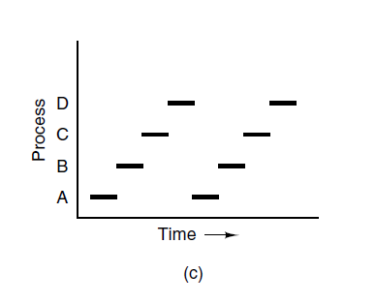
The Process Model
Figure 2-1. (c) Only one program is active at once. All processes have made progress, but at any given instant only one process is actually running.
Tanenbaum & Bo,Modern Operating Systems:4th ed., (c) 2013 Prentice-Hall, Inc. All rights reserved.

Slide 8
Multiprogramming
Rapidly switching back and forth from process to process is called multiprogramming.
When each process runs, its logical program counter is loaded into the real program counter.
When it is finished (for the time being), the physical program counter is saved in the process’ stored logical program counter in memory.
From now on, we assume that there is only one CPU.

Slide 9
What is a program?
A Program is an executable file that contains:
Code: Machine Instructions
Data: Variables Stored And Manipulated In Memory
initialized variables (globals)
dynamically allocated variables (malloc, new)
stack variables (C automatic variables, function arguments)
Process != Program
Example:
We can run 2 instances of Mozilla Firefox:
Same program
Separate processes

Slide 10
An analogy Baking a Cake
Need a cake recipe and a kitchen well stocked with all the input: flour, eggs, sugar ….
the recipe is the program (i.e., an algorithm expressed in some suitable notation),
the baker is the processor (CPU),
and the cake ingredients are the input data.
The process is the activity consisting of the baker reading the recipe, fetching the ingredients, and baking the cake.

Slide 11
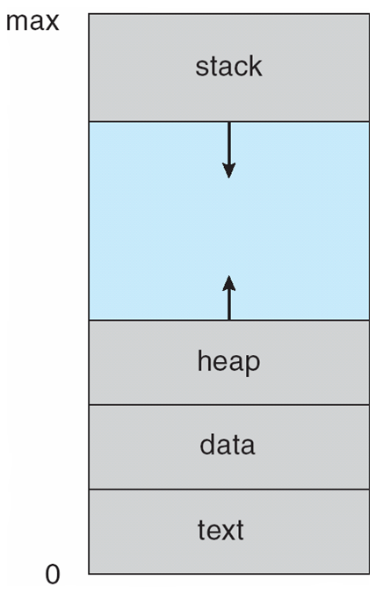
Process in Memory
Program becomes process when executable file loaded into memory
Process address space
set of all memory addresses accessible by a process

Slide 12
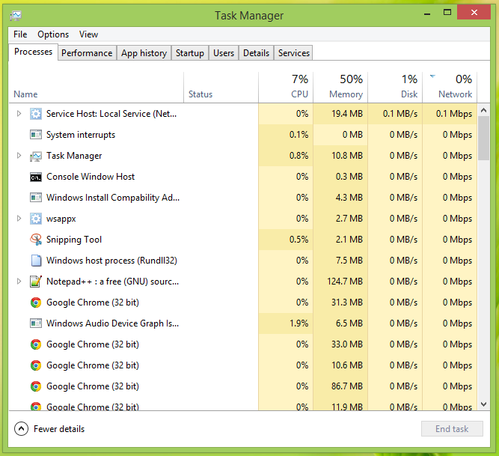

Slide 13
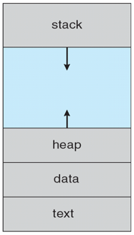
How Program Becomes Process
When a program is launched
OS loads program into memory
Creates kernel data structure for the process
Initializes data (global/static variables)
Starts from an entry point (e.g., main())
Executable
101010101010101010101010101010101010101010101010
OS
a.out
Loader

Slide 14
Process Creation
Four principal events for process creation:
System initialization.
Execution of process creation system call by a running process.
A user can request to create a new process (typing a command or double clicking an icon).

Slide 15
Process Termination
Nothing lasts forever, not even processes ☺
A process terminates usually due to
Normal exit (voluntary)
Error exit (voluntary)
Fatal error (involuntary)
Killed by another process (involuntary)

Slide 16
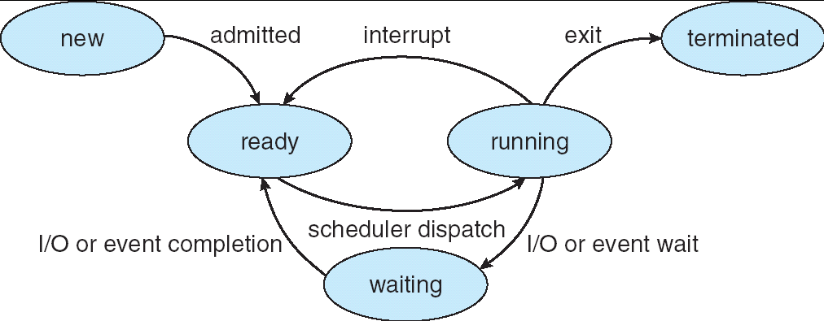
Lifecycle of a Process
As a process executes, it changes state
new: The process is being created
ready: The process is waiting to run
running: Instructions are being executed
waiting (or, blocked): Process waiting for some event to occur
terminated: The process has finished execution

Slide 17
Process Data Structures
OS represents a process using a Process Control Block (PCB)
Has all the details of a process
Context of the process
Also called process table entry

Slide 18
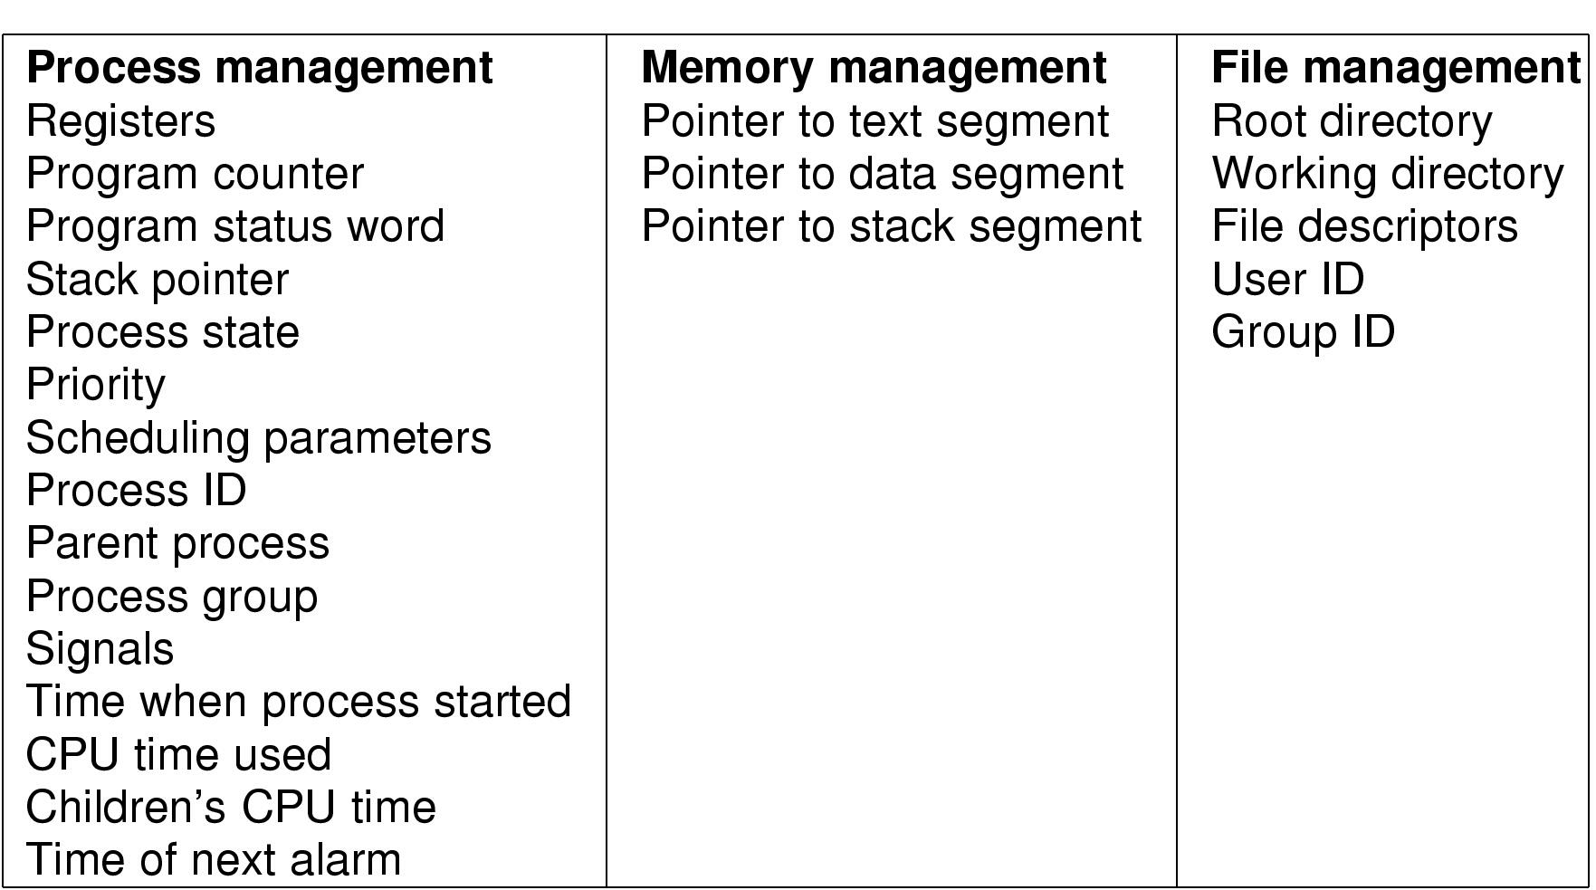
Process Control Block (PCB)
Figure: Fields of a PCB

Slide 19
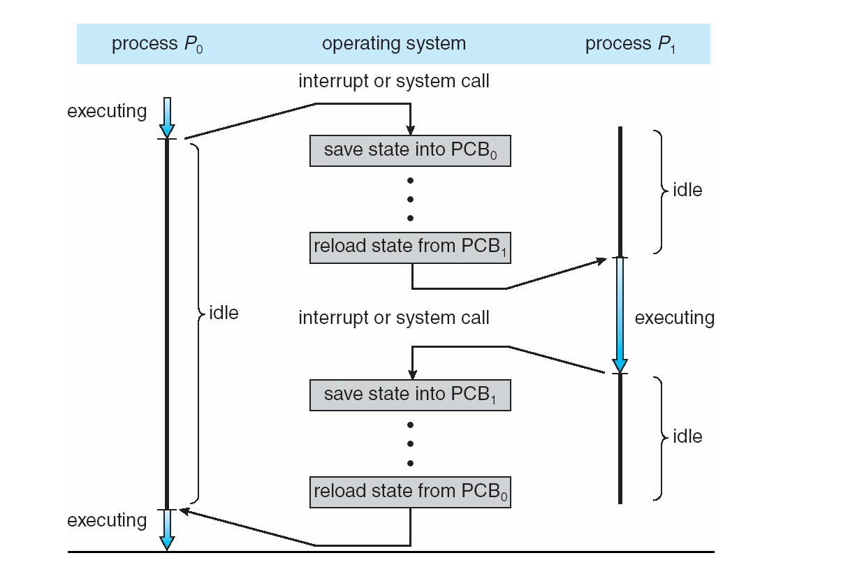
CPU Switch From Process to Process

Slide 20
Context Switch
For a running process
All registers are loaded in CPU and modified
E.g. Program Counter, Stack Pointer, General Purpose Registers
When process relinquishes the CPU, the OS
Saves register values to the PCB of that process
To execute another process, the OS
Loads register values from PCB of that process
Context Switch
Process of switching CPU from one process to another
Very machine dependent for types of registers

Slide 21
What does it take to create a process?
Must construct new PCB
Inexpensive
Must set up new address space
More expensive
Creating a new process is costly
Context switching is costly
Need something more lightweight!

Slide 22
Threads and Processes
Most operating systems therefore support two entities:
the process,
which defines the address space and general process attributes
the thread,
which defines a sequential execution stream within a process
Like a miniprocess within a process
A thread is bound to a single process.
For each process, however, there may be many threads.
Threads are the unit of scheduling
Processes are containers in which threads execute

Slide 23
Threads and Processes
Thread within the same process needs a new ability:
Share an address space and all of it’s data among themselves.
Remember, processes does not share their address spaces.

Slide 24
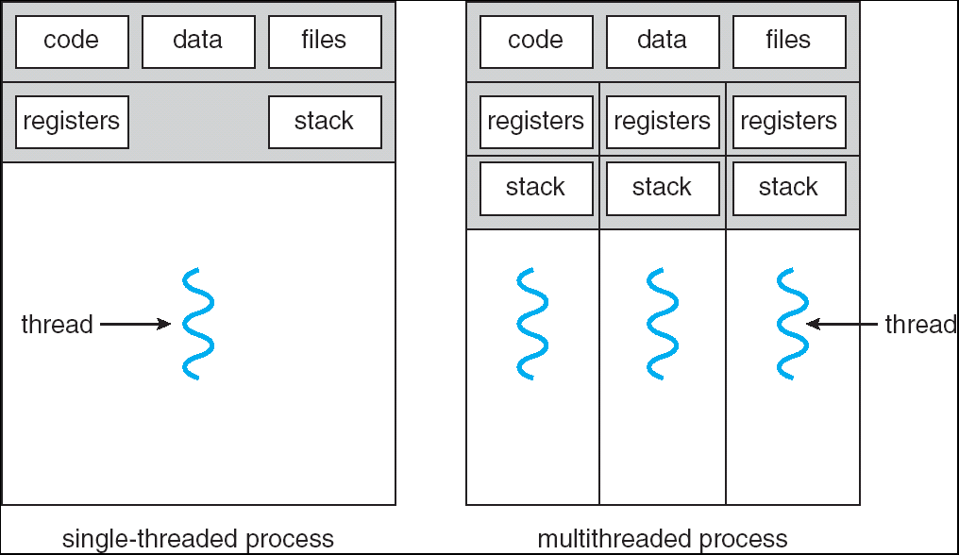
Multithreaded Processes
11/9/2018
Dept. of CSE, BUET

Slide 25
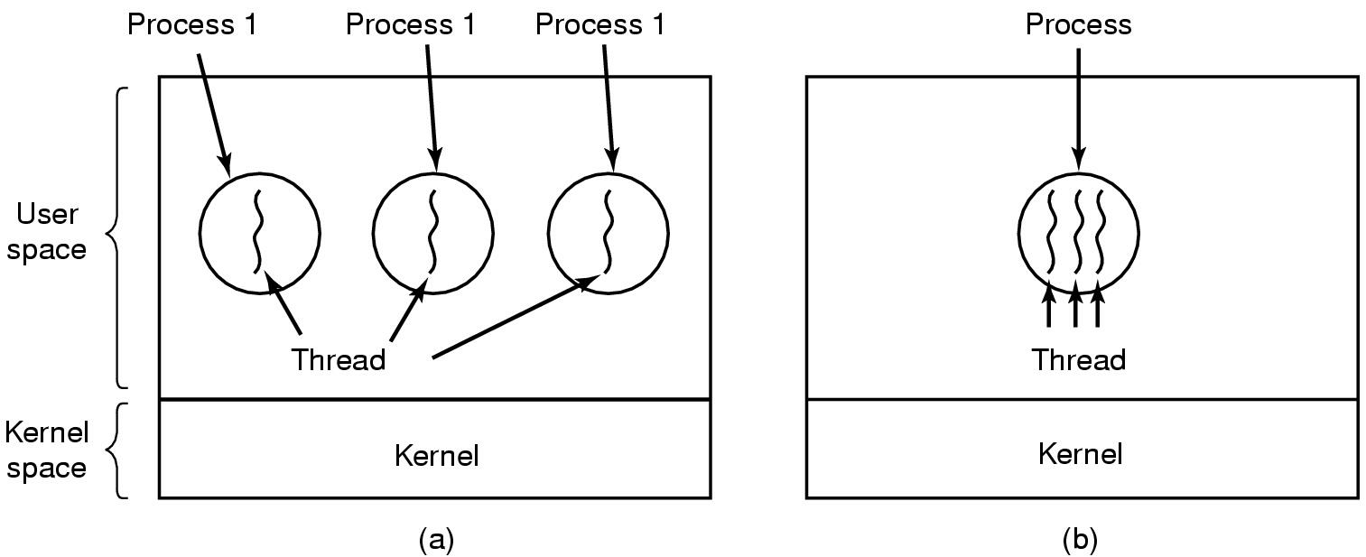
The Classical Thread Model
(a) Three processes each with one thread
(b) One process with three threads

Slide 26
The Classical Thread Model
Shared information
Address space: text, data structures, etc.
I/O and file: comm. ports, directories and file descriptors, etc.
Global variables and child processes.
Accounting info: stats
Private state
State (ready, running and blocked)
Registers
Program counter
Execution stack
Each thread execute separately
11/9/2018
Dept. of CSE, BUET

Slide 27
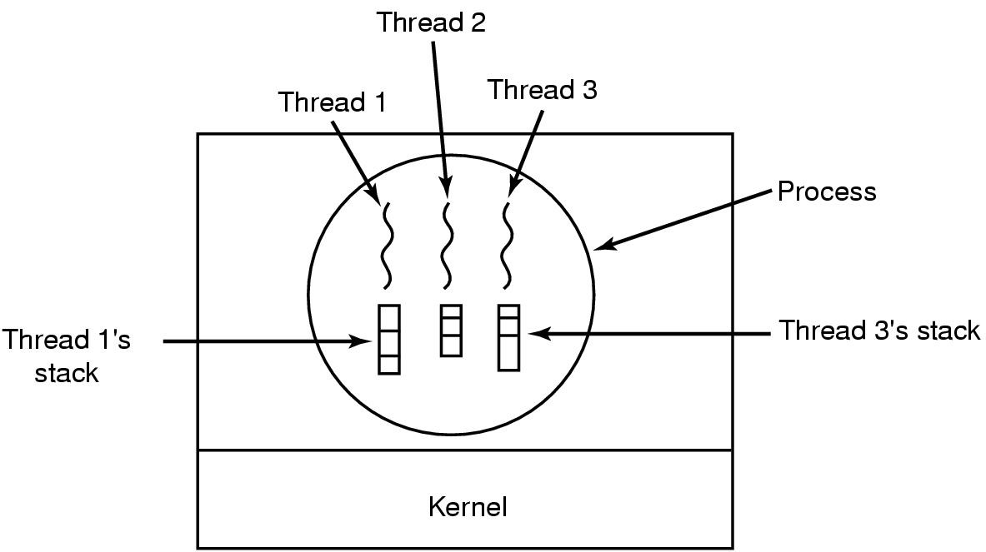
Why each thread has its own stack?
What will happen if they share one stack?
Each thread call different procedures and each has a different execution history.
11/9/2018
Dept. of CSE, BUET

Slide 28
Thread Context Switch
Multiplex multiple threads on single CPU
Similar to process context switch, but less expensive
Still needs to switch register set
But no memory management related work!!!
11/9/2018
Dept. of CSE, BUET

Slide 29
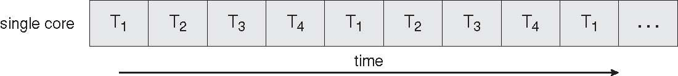
Concurrent Execution on a Single-core System

Slide 30
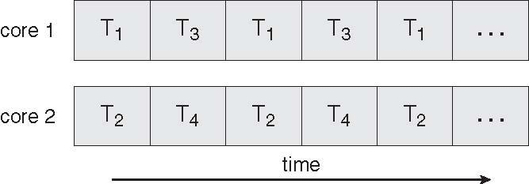
Parallel Execution on a Multicore System

Slide 31
Thread Dynamics
Threads are dynamically created/terminated
Thread is the unit of scheduling. Multiple threads need to be scheduled
Ready
Blocked
Running
Terminated
Threads share CPU and on single processor machine only one thread can run at a time
11/9/2018
Dept. of CSE, BUET

Slide 32
Thread Usage
Why need threads?
Simplify coding
Concurrent activities within a process
Better CPU utilization
Better responsiveness
Less costly to create & switch
Utilizing parallelism of multi-processor systems
11/9/2018
Dept. of CSE, BUET

Slide 33
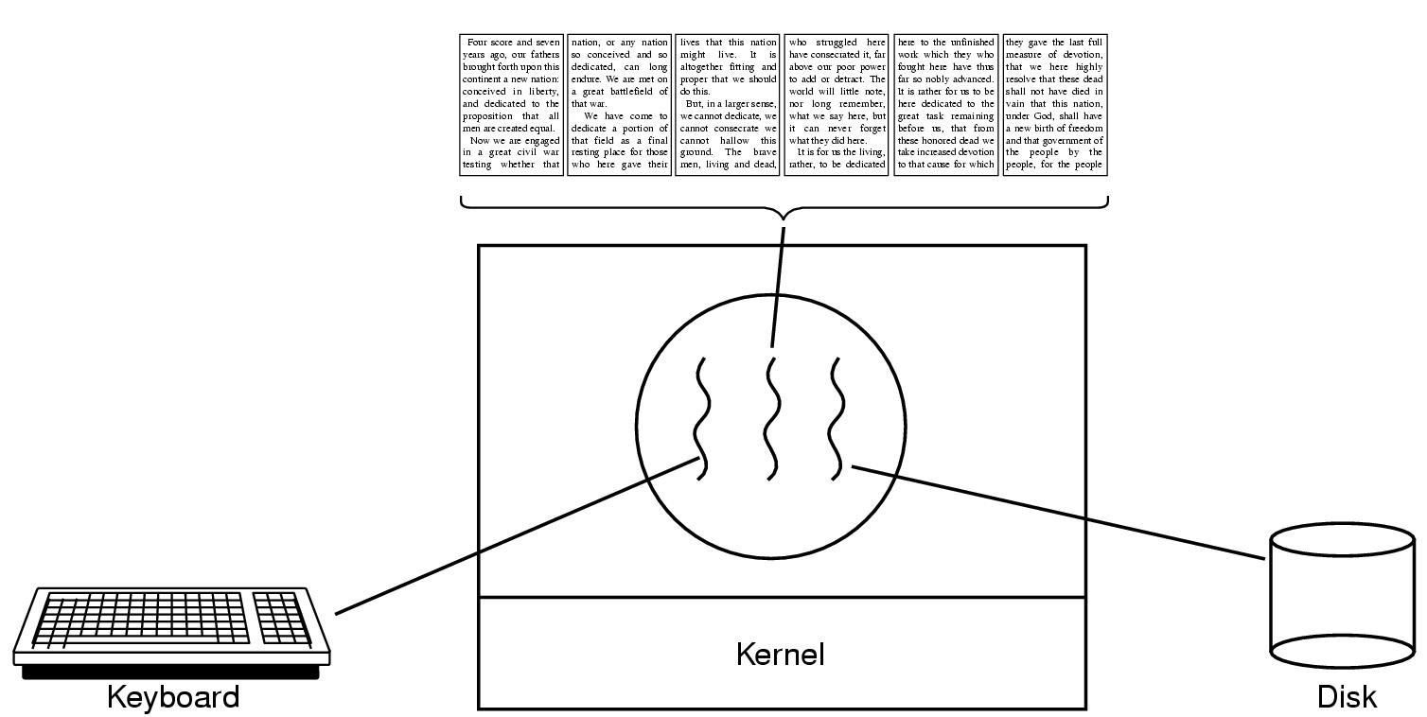
Thread Usage: word processor
A thread can wait for I/O, while the others can still be running.
What if it is single-threaded?
11/9/2018
Dept. of CSE, BUET

Slide 34
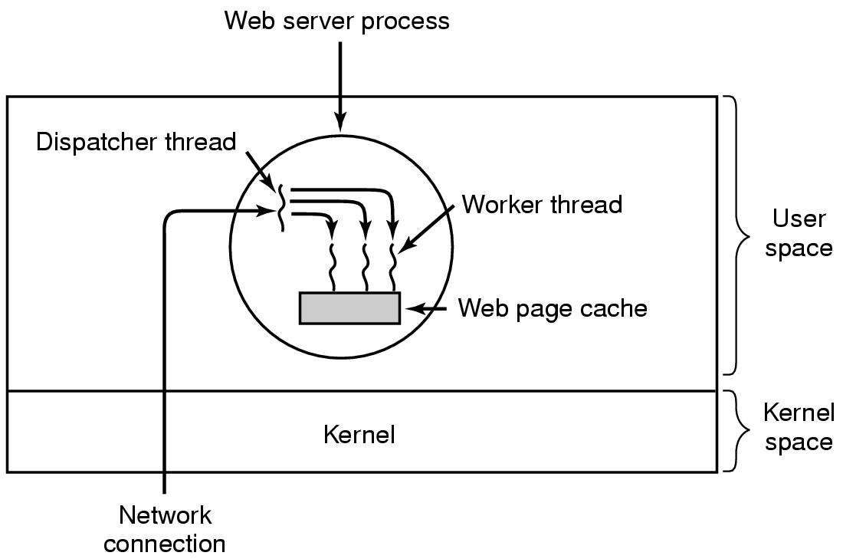
Thread Usage: Web Server
11/9/2018
Dept. of CSE, BUET

Slide 35
Blocking System Calls
Usually I/O related: read(), fread(), getc(), write()
Doesn’t return until the call completes
The process/thread is switched to blocked state
When the I/O completes, the process/thread becomes ready
Simple to implement
11/9/2018
Dept. of CSE, BUET

Slide 36
Thread Implementation
In user space
Kernel unaware of multiple threads
User level runtime system does scheduling
In kernel space
Kernel supports threads (lightweight process)
11/9/2018
Dept. of CSE, BUET

Slide 37
User-Level Threads
The thread scheduler is part of a user-level library
Each thread is represented simply by:
PC
Registers
Stack
Small control block
All thread operations are at the user-level:
Creating a new thread
switching between threads
synchronizing between threads
11/9/2018
Dept. of CSE, BUET

Slide 38
User-Level vs. Kernel Threads
User-Level
Managed by application
Kernel not aware of thread
Context switching cheap
Create as many as needed
Must be used with care
Kernel-Level
Managed by kernel
Consumes kernel resources
Context switching expensive
Number limited by kernel resources
Simpler to use
11/9/2018
Dept. of CSE, BUET

Slide 39
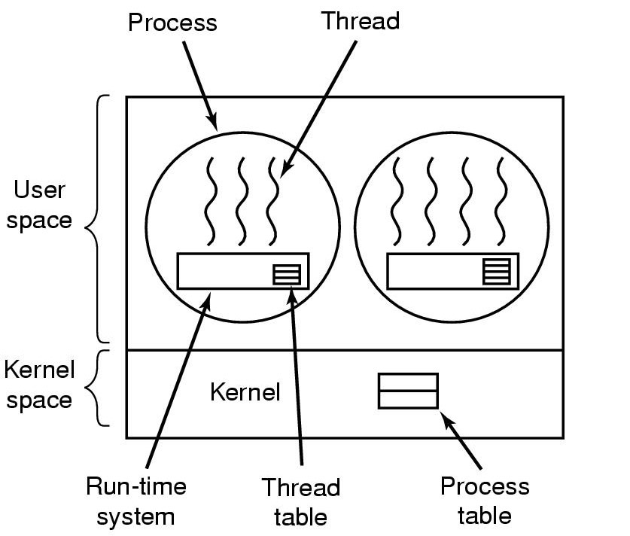
Implementing Threads in User Space
A user-level threads package

Slide 40
User-level Threads
Advantages
Fast Context Switching:
Switching entirely in user mode – local procedures.
No need to trap to kernel, no memory flush;
Customized Scheduling
Disadvantages
Blocking
Any user-level thread can block the entire task executing a single system call (page fault is similar case).
No protection, threads are expected to be polite to share CPU.
Uncooperative/buggy threads may monopolize CPU.
11/9/2018
Dept. of CSE, BUET

Slide 41
Kernel Threads
Kernel threads may not be as heavy weight as processes, but they still suffer from performance problems:
Any thread operation still requires a system call.
The kernel doesn’t trust the user
there must be lots of checking on kernel calls
Dept. of CSE, BUET
11/9/2018

Slide 42
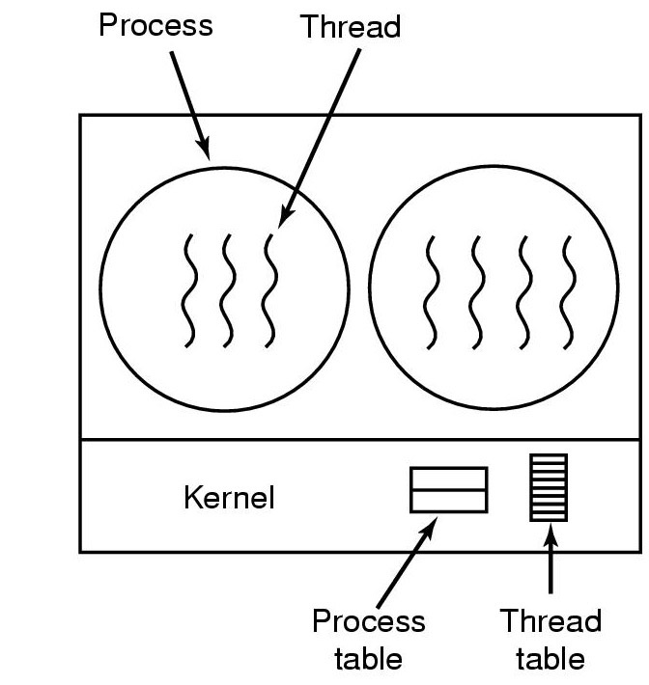
Implementing Threads in the Kernel
A thread package managed by the kernel
11/9/2018
Dept. of CSE, BUET

Slide 43
Kernel-Level Threads
Advantages:
Kernel aware of threads, if one thread blocks, can schedule another thread in the process.
Disadvantages:
Context switch is more expensive.
11/9/2018
Dept. of CSE, BUET

Slide 44
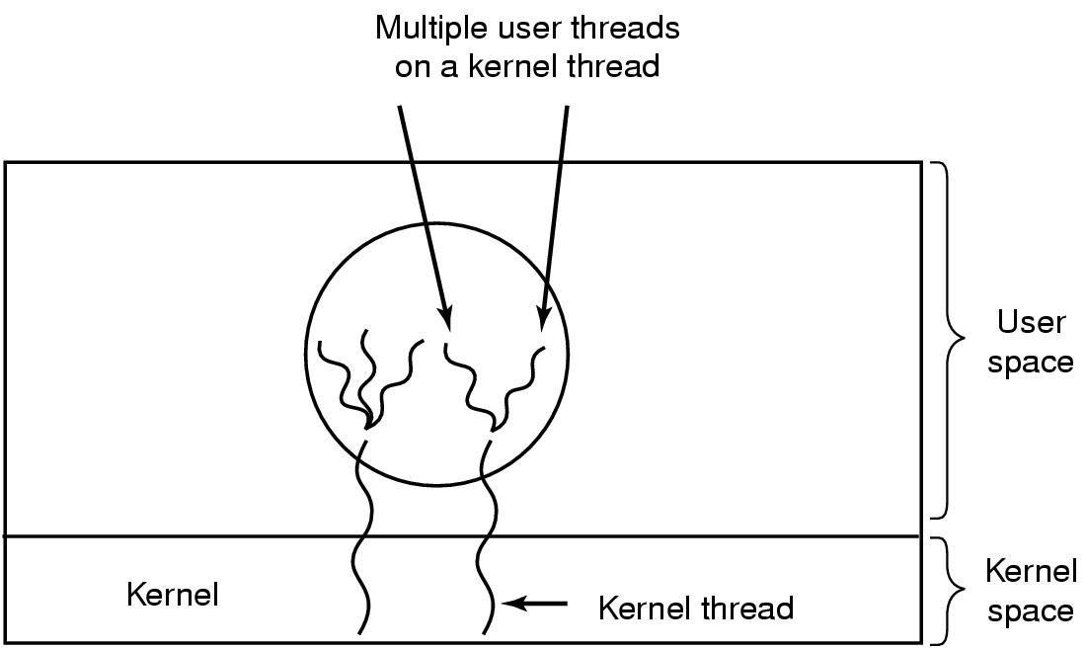
Hybrid Implementations
Multiplexing user-level threads onto kernel- level threads

Slide 45
Hybrid Implementations
Combining the advantages of the 2 methods
the kernel is aware of only the kernel-level threads and schedules those.
,each kernel-level thread has some set of user-level threads that take turns using it.
These user-level threads are created, destroyed, and scheduled just like user-level threads in a process

Slide 46
Thanks ☺

