Slide 1
CSE321
Microprocessor-Based System Design
Lecture 1

Slide 2
Marks Distribution
Quiz: 10%
Attendance: 10%
Assignment : 10%
Mid Term Examination: 30%
Final Examination: 40%
Total: 100%

Slide 3
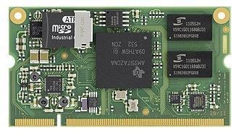
Embedded Systems
What is an Embedded System?
An embedded system is a specialized computer system—a combination of a computer processor, computer memory, and input/output peripheral devices—that has a dedicated function within a larger mechanical or electronic system. - wikipedia
The brain of these systems are either microprocessors or microcontrollers

Slide 4
Microprocessor
Microprocessor is a digital device on a chip that can fetch instructions from memory, decode and execute them, and give results.
RAM, ROM and I/O are separated and can be configured accordingly
Larger in Size
More power-hungry

Slide 5
Microcontroller
A microcontroller (MCU) is a small computer on a single integrated circuit that is designed to control specific tasks within electronic systems
Contains RAM, ROM and I/O on a single board. Hence, less configurable.
Smaller in Size
Less power-hungry
Microcontroller is a more compact version of microprocessor.

Slide 6
I/O Systems
Computers need to interact with I/O units to read input and produce the appropriate outputs.
I/O units need to keep track of the data for a short amount of time, hence they need to have memory space of their own.
Not all embedded systems handle I/O memory in the same way.
Two types of mapping exist for I/O memory
Memory mapped I/O
Isolated I/O

Slide 7
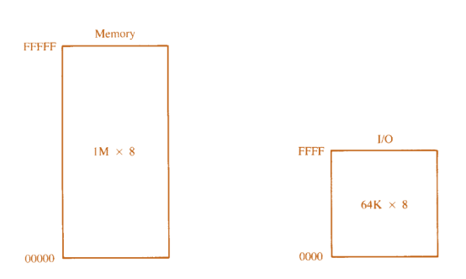
Isolated I/O
The memory for the computer and I/O are in different compartments
More space allocation for both memory and I/O
Communication time delay is increased because of distance

Slide 8
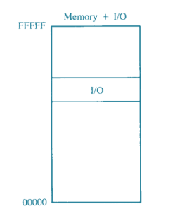
Memory Mapped I/O
The memory for the computer and I/O are in the same compartment
Less space allocation for both memory and I/O
Communication time delay is small because of distance

Slide 9
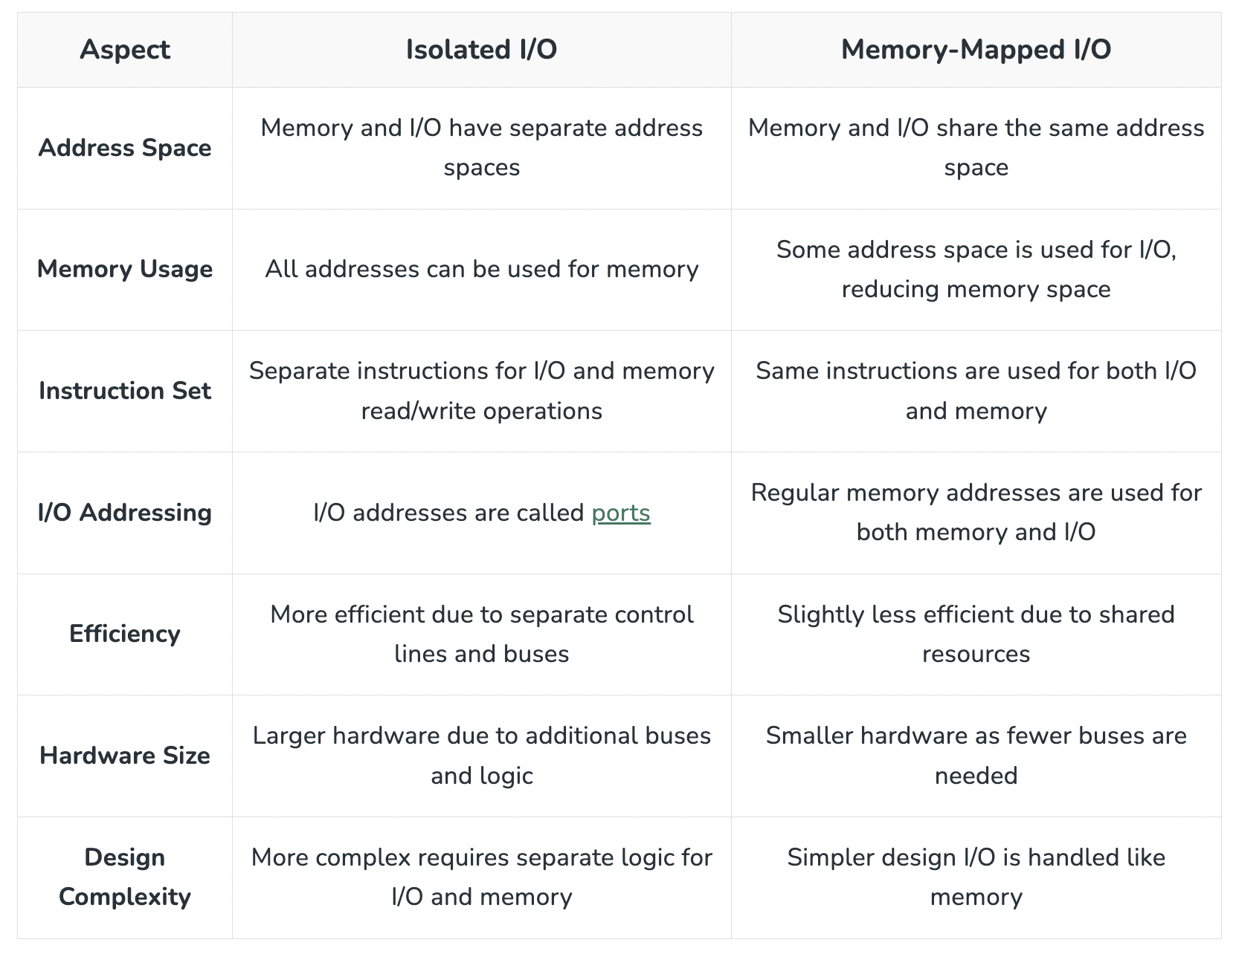
Comparison on I/O types

Slide 10
Thank You

