Slide 1

SDK Overview
Rob DeCarlo
Bechtel

Slide 2

What does it do?
Delivers standardized RESTful Data APIs with metadata.
Search Reference Data
Store & Manage Reference Data
Abstract Data in terms of Reference Data (Mapping)
Extensible Framework
Multiple Data APIs

Slide 3
Packages
iRINGTools Apps
iRINGTools Services
Sandbox Query
Sandbox Service
Reference Data Editor
Reference Data Service
Application Editor
Hibernate Service
Adapter Service
Mapping Editor
Data Transfer Service
Façade Query
Façade Service

Slide 4
Dependencies
iRINGTools Apps
iRINGTools Services
dotNetRDF
NHibernate
Windows Server
2003
.NET 4.0
IIS 6.0
WCF REST
ASP.NET MVC
SQL Server
2005 Express
Internet

Slide 5
Ref Data Federation
Sandbox
Sandbox
Sandbox
RDS/WIP
Reference Data Service
QMXF
Reference Data Editor

Slide 6
Hibernate Configuration
Legacy Database
Adapter Service
Dictionary
Code Generation & Configuration
Hibernate Service
Database Dictionary
App Editor

Slide 7
Raw Data
Legacy Database
Adapter Service
Data

Slide 8
Mapping
Legacy Database
Adapter Service
Mapping
Mapping Editor
Ref Data Service

Slide 9
Projection
Legacy Database
Adapter Service
DTO
XML
RDF

Slide 10
Data Services
Widget
XML
Adapter
Service
MVC
Data
Reporting

Slide 11
Data Exchange
ESB
DTO
Data Transfer
Service
Consumers
Exchange Manager

Slide 12
Semantic Publishing
Legacy Database
Facade Service
Façade

Slide 13
SPARQL Protocol
SPARQL Protocol
SPARQL Query
SPARQL Client
SPARQL Endpoint
SPARQL Results

Slide 14
SPARQL Data Exchange
SPARQL Protocol
SPARQL Client
Façade
SPARQL Endpoint
Facade Service
SPARQL Endpoint
SPARQL Endpoints

Slide 15
Extensible Framework
Data Stores
& APIs
Projection
Engines
Database
NHibernate
RDF
Part 8
Custom SQL
Mapping
Part 7
DTO
Data Objects
File
Excel
Data
Layers
Projection
Engines
XML
Application
Library
Custom API
Data
[extensible]
…
[extensible]
…

Slide 16
Multiple Data APIs
DTO
(Generic)
JSON
(Generic)
DXFR Protocol
Part 7
Generic
Data Service
XML
(Dynamic)
RDF
(Part 8)
JSON
(Dynamic)
Projected Objects
DTO
(Generic)
Non-Part7
Data Service
Part7
Data Service
JSON
(Generic)
XML
(Dynamic)
Extensible
Triple Stores
(Part 7, 8 & 9)
Extensible
dotNetRDF API
Jena/ARQ
API
SPARQL Protocol

Slide 17
Framework Layers
Service
Provider
Semantic Layer
Projection Layer
Data Layer

Slide 18
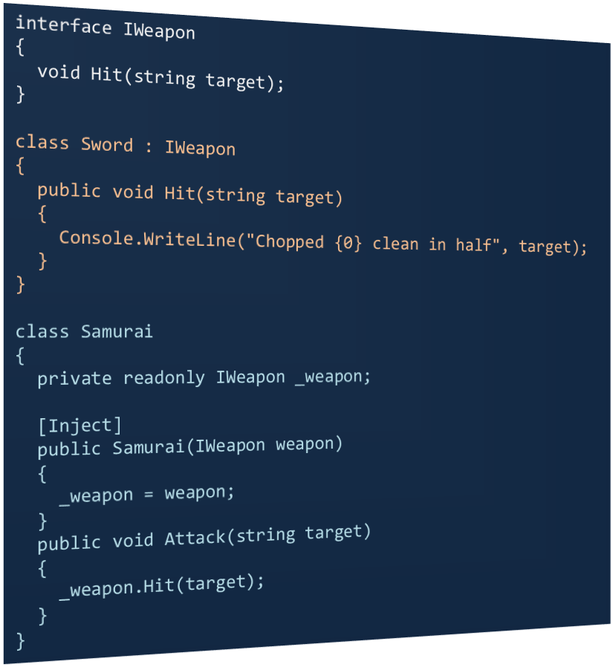

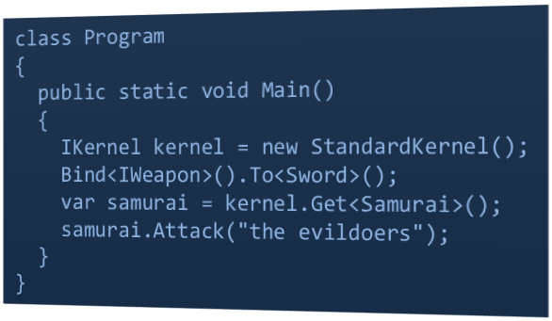
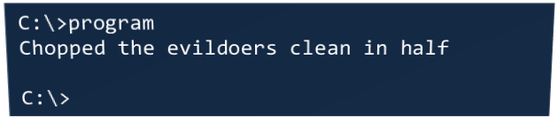
Dependency Injection

Slide 19
Data Layer Extensibility
Application API
IDataLayer
Application
Library
Custom Data Layer
Projection Engine
Create
Identifiers
API
Get
Calls
IDataObject
Post
Data
Filter
Delete
DataObject
Application
Class
GetDictionary
Response
GetProperty
SetProperty
Data
Dictionary

Slide 20
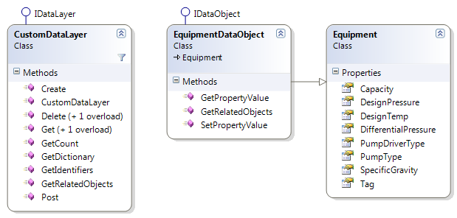
Data Layer Extensibility

