Slide 1

SDK Overview
Rob DeCarlo
Bechtel

Slide 2

Packages
iRINGTools Apps
iRINGTools Services
Reference Data Editor
Sandbox Service
Reference Data Service
Application Editor
Hibernate Service
Adapter Service
Mapping Editor
Data Transfer Service
Facade Service

Slide 3
Dependencies
iRINGTools Apps
iRINGTools Services
dotNetRDF
NHibernate
Windows Server
.NET 4.0
IIS
WCF REST
ASP.NET MVC
SQL Server
Internet

Slide 4
Packages
iRINGTools Adapter
iRINGTools Sandbox
Interface Service
Sandbox Service
Adapter Service
Reference Data Service
Mapping Editor
Reference Data Editor

Slide 5
Dependencies
iRINGTools Adapter
iRINGTools Sandbox
Mapping Editor
Reference Data Editor
Adapter Service
Reference Data Service
Interface Service
Sandbox Service
Windows Server
.NET 3.5 SP1
IIS
SQL Server
Internet

Slide 6
Federated Reference Data
Sandbox
Sandbox
Sandbox
RDS/WIP
Reference Data Service
QMXF
Reference Data Editor

Slide 7
Adapter Overview
Façade
RDF
Legacy Database
Adapter Service
DTO
DB Dictionary
Mapping Editor
iRING Tools Sandbox

Slide 8
SPARQL Protocol
SPARQL Protocol
SPARQL Query
SPARQL Client
SPARQL Endpoint
SPARQL Results

Slide 9
SPARQL Data Exchange
SPARQL Protocol
SPARQL Client
Interface Service
(SPARQL Endpoint)
SPARQL Query Only
SPARQL Endpoint
Adapter
Service
(SPARQL Client)
SPARQL Endpoint
SPARQL Endpoints
SPARQL Query Only

Slide 10
XML Data Exchange
Adapter
Service
DTO
Adapter
Service

Slide 11
Data Services
ESB
DTO
Adapter
Service
Ajax
Client
Reporting

Slide 12
Adapter Framework
Triple
Stores
SPARQL Query & Update
dotNetRDF API
[extensible]
…
Data Stores
& APIs
Semantic Repository
Part 9
Projection
Engines
NHibernate
RDF
Part 8
CSV
QTXF
Data Source
Projection
Data Objects
XMpDE
DTO
ECSchema
ESB
[extensible]
…
[extensible]
…
Mapping

Slide 13
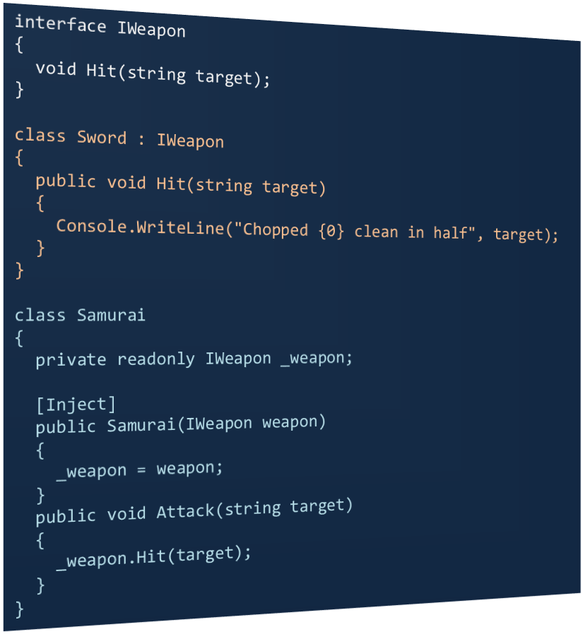

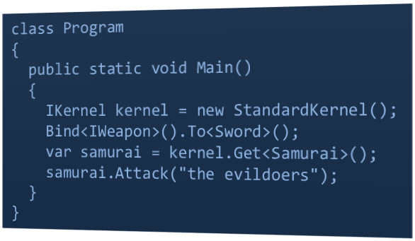
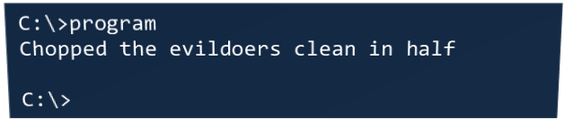
Dependency Injection

Slide 14
Adapter Layers
Adapter Service
Adapter Provider
Projection Layer
Semantic Layer
DTO Layer
Data Layer

Slide 15
Data Layer Extensibility
Adapter Service
Adapter Provider
DTO Layer
Custom Data Layer
Create
Identifiers (List<string>)
Application API
Data Object
Application
Entity
IDataObject
Get
Post
Data
Filter
Data
Dictionary
Delete
Response (List<string>)
GetDictionary
IDataLayer

Slide 16
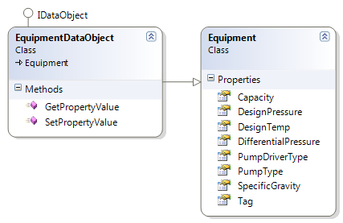
Data Layer Extensibility

Slide 17
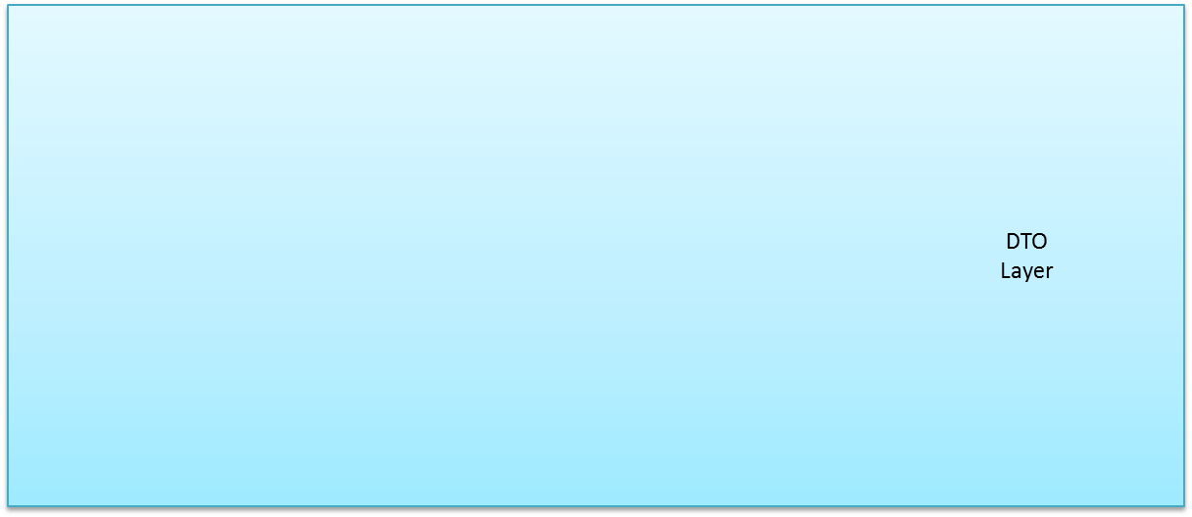
CSV Data Layer
Adapter Service
Adapter Provider
CSVDataLayer
CSV
Data
Objects
Post
Entity
Objects
Entity
Objects
Get
Linq To XML
CSV Line

