Slide 1

SDK Overview
Rob DeCarlo
Bechtel

Slide 2

Packages
iRINGTools Adapter
iRINGTools Sandbox
Interface Service
Sandbox Service
Adapter Service
Reference Data Service
Mapping Editor
Reference Data Editor

Slide 3
Dependencies
iRINGTools Adapter
iRINGTools Sandbox
Mapping Editor
Reference Data Editor
Adapter Service
Reference Data Service
Interface Service
Sandbox Service
Windows Server
.NET 3.5 SP1
IIS
SQL Server
Internet

Slide 4
Federated Reference Data
Sandbox
Sandbox
Sandbox
RDS/WIP
Reference Data Service
QMXF
Reference Data Editor

Slide 5
Adapter Overview
Façade
RDF
Legacy Database
Adapter Service
DTO
QXF
DB Dictionary
Mapping Editor
iRING Tools Sandbox

Slide 6
SPARQL Protocol
SPARQL Protocol
SPARQL Query
SPARQL Client
SPARQL Endpoint
SPARQL Results

Slide 7
SPARQL Data Exchange
SPARQL Protocol
SPARQL Client
Interface Service
(SPARQL Endpoint)
SPARQL Query Only
SPARQL Endpoint
Adapter
Service
(SPARQL Client)
SPARQL Endpoint
SPARQL Endpoints
SPARQL Query Only
SPARQL Protocol

Slide 8
XML Data Exchange
Adapter
Service
DTO
Adapter
Service

Slide 9
Data Services
BizTalk
DTO
Adapter
Service
Ajax
Client
SSRS

Slide 10
Adapter Framework
Triple
Stores
SPARQL Query & Update
SemWeb API
[extensible]
…
Data Stores
& APIs
Semantic Repository
Part 9
Serialization
NHibernate
RDF
Part 8
ECSchema
QXF
Data Source
Projection
DTO
Part 7
EFSchema
QTXF
Excel
MIMOSA
[extensible]
…
[extensible]
…
Mapping

Slide 11
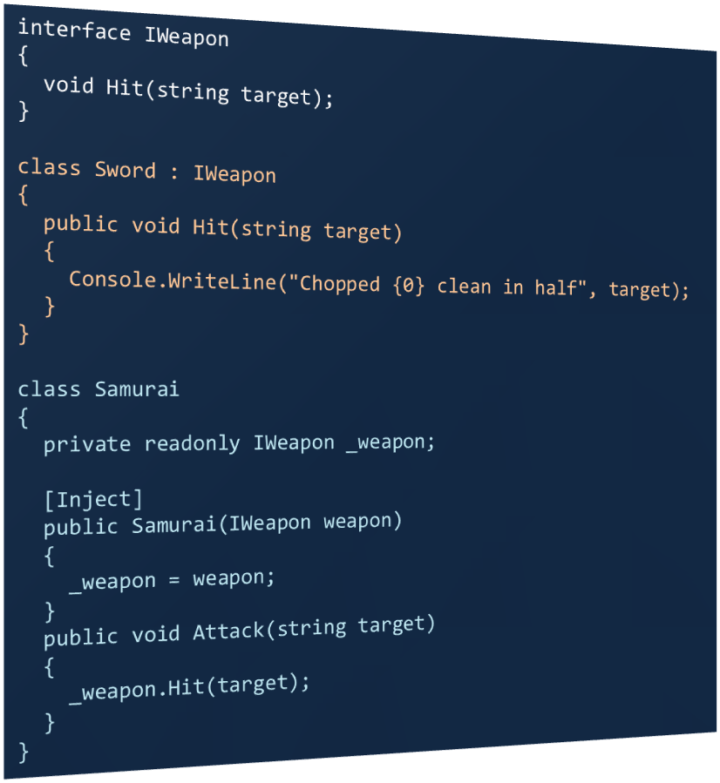

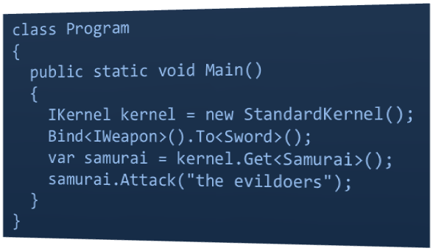

Dependency Injection

Slide 12
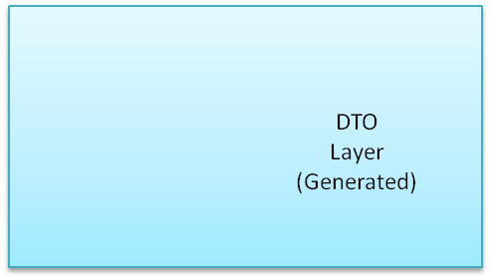
Adapter Interfaces
Adapter Service
Adapter Provider
Semantic Layer
ISemanticLayer
Projection Layer
Data
Layer
IProjectionLayer
IAdapterService
IDataLayer

Slide 13
Data Layer Extensibility
Implementers should provide generic access to classes representing legacy application data, and provide a dictionary describing them.
DTO Layer (Generated)
Response
(List<string>)
IDataLayer
Custom
Data Layer
object Get(string type, string filter);
IList<object> GetList(string type, string filter);
object Create(string type);
object GetProperty(object dataObject, string property);
void SetProperty(object dataObject, string property , object value);
Response Post(object dataObject);
Response PostList(List<object> dataObjects);
DataDictionary GetDictionary();
Data API
Your Types (T)
Data
Dictionary
Binding Configuration
IDataLayer
Binding Configuration tells NInject where to find your classes.

Slide 14
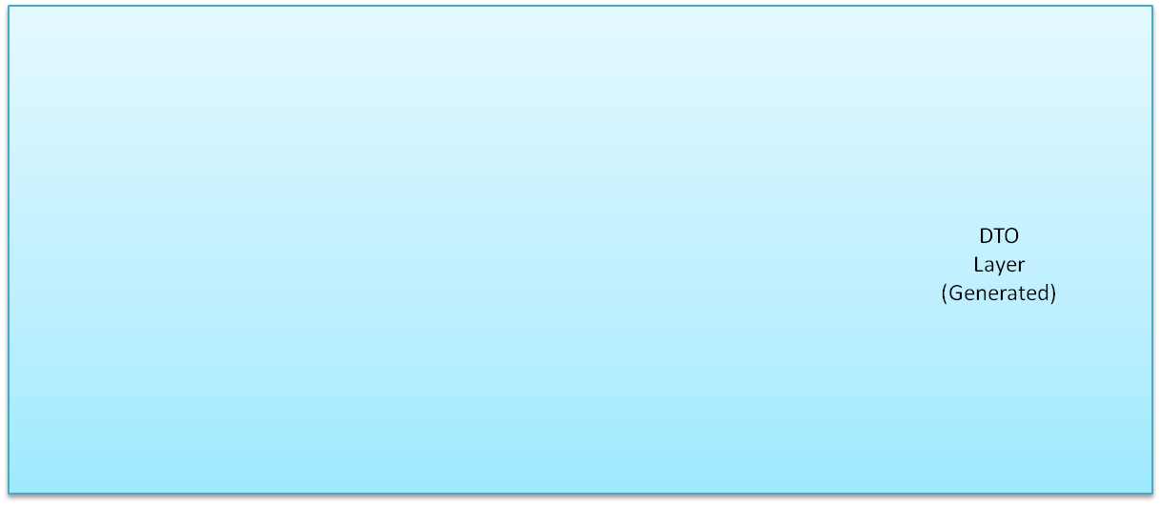
CSV Data Layer
Adapter Service
Adapter Provider
CSVDataLayer
CSV
Entity
Objects
Post
Entity
Objects
Entity
Objects
Get
Linq To XML
DOM
CSV Line

