Slide 1
Connect : Madison’s Distributed Message Board
Irtiza Ahmed Akhter
Zainab Ghadiyali
Fall 2012

Slide 2
We will present:
Motivation
Introduction/Background
Tools
Design
Evaluation
Conclusion
Q&A

Slide 3
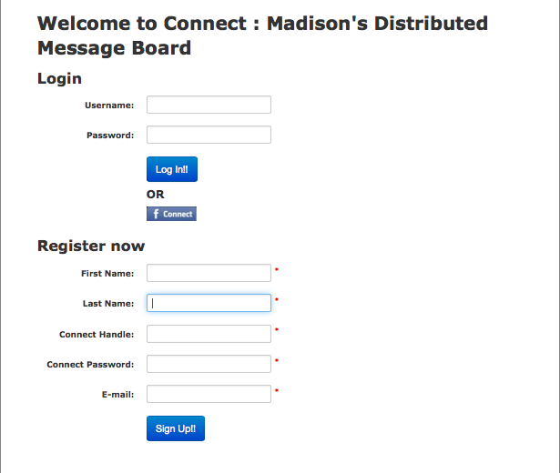
Connect is an distributed message board
Online message board system
Connect
Find if another user is connected
Leave messages
Easy access to old messages
Nothing is ever lost

Slide 4

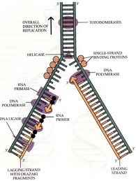

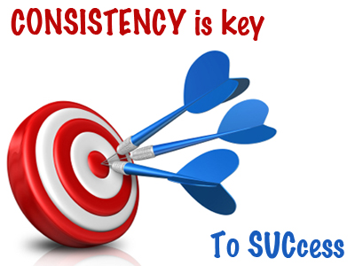

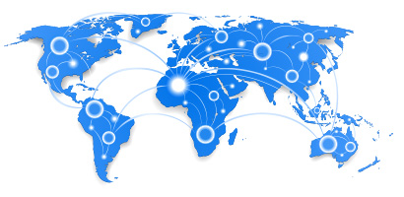
Playing with different aspects of DS

Slide 5
Client-Server model is better suited for our goal
Reliable v/s Unreliable
TCP <-> UDP
We choose TCP since it provides greater reliability
Peer-Peer chat v/s Client-Server architecture
We choose a client-server model because we are interested in studying the implementation and performance of distributed systems

Slide 6
Technical Paraphernalia
EC2
Apache web server
MYSQL database
PHP, Bash scripting, Jquery, Javascript, CSS
Jmeter

Slide 7
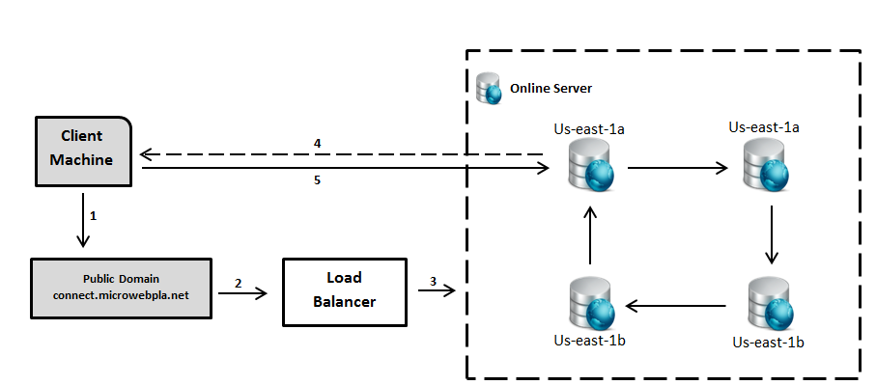
Work Flow

Slide 8
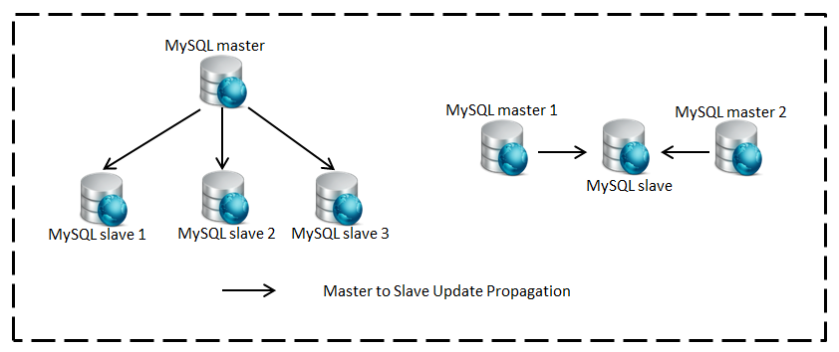
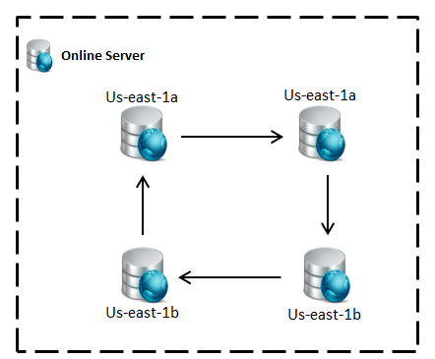
Data is replicated

Slide 9
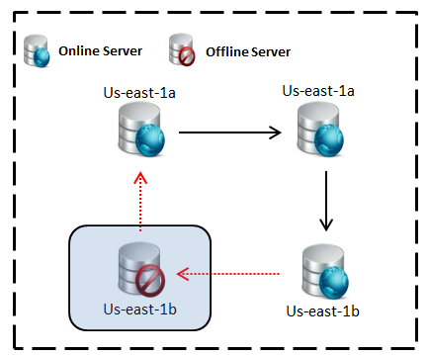
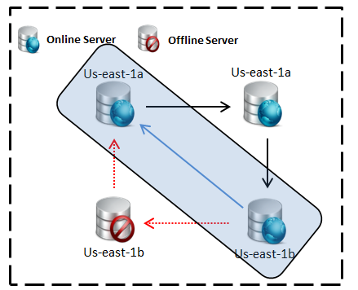
Self Healing

Slide 10
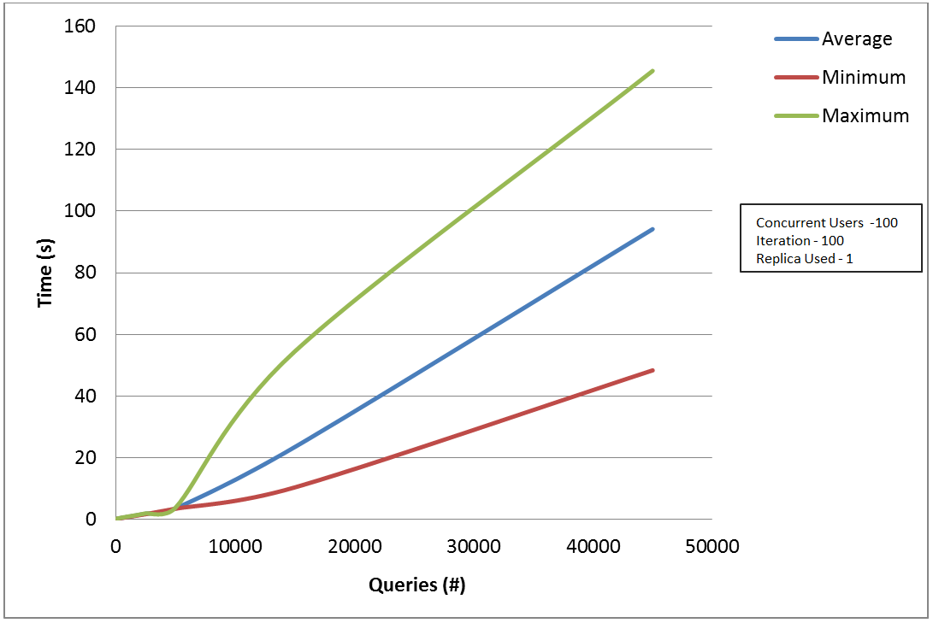
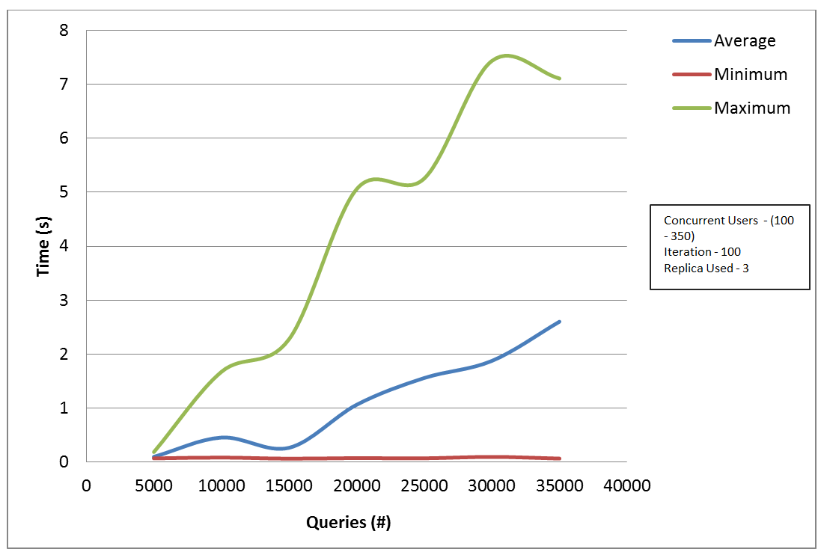
Replication improves performance

Slide 11
Load balancing and replication improve performance

Slide 12
Lessons Learnt
Replication and load balancing improve performance
Replication with MYSQL can be tedious
Web Stress Testing can be easily conducted
Debug distributed system is painful

Slide 13

Thanks for your attention. We look forward to questions.

Slide 14
Fun facts
Testing 75M I/O writes
System failure for > 1000 users
Jmeter failure for > 1M users
~$85 in surcharge

