Slide 1

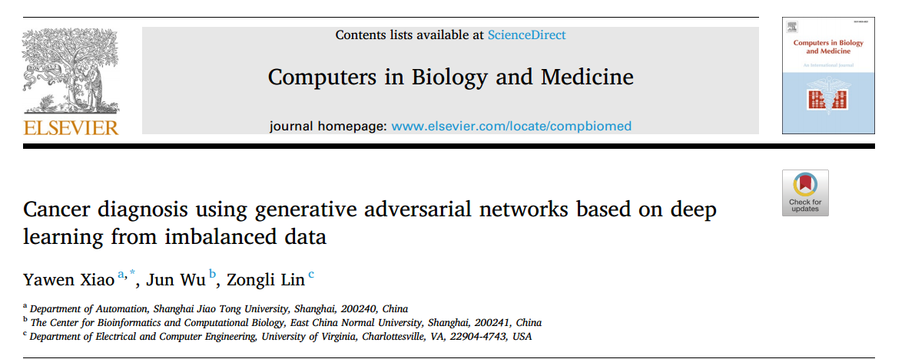
2021 Computers in Biology and Medicine
汇报人:蒋拓
2023/04/10

Slide 2
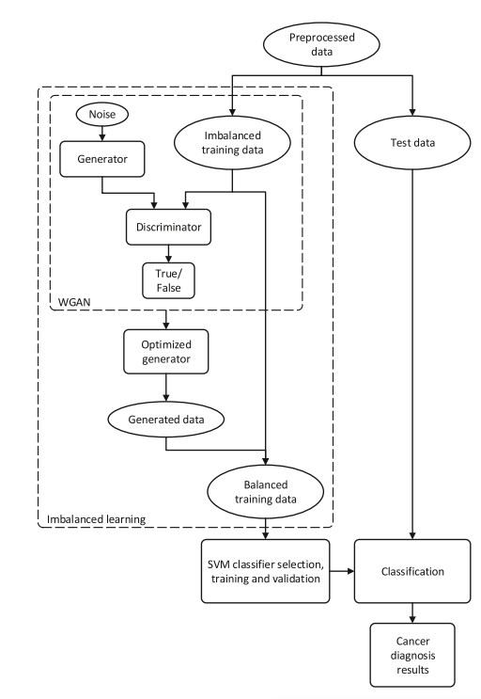
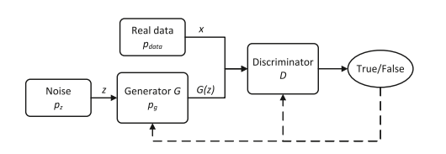
Achitecture

Slide 3
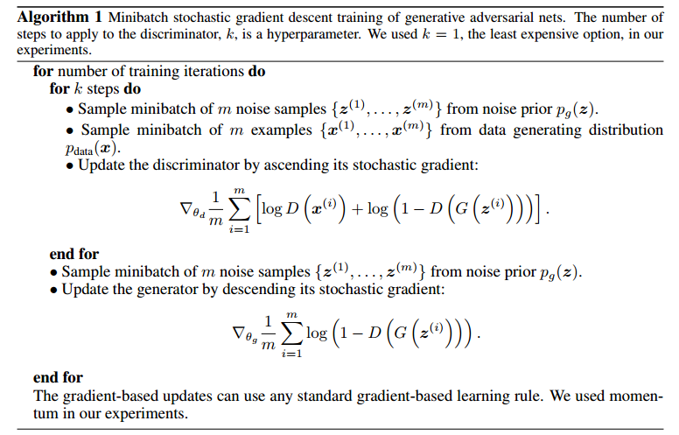
GAN

Slide 4
GAN

