Slide 1

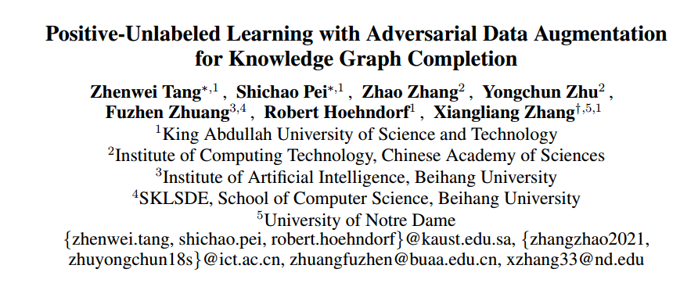
2022 IJCAI
汇报人:蒋拓
2023/06/27

Slide 2
Abstract
大多数现实世界的知识图谱不完整、不全面
现有的KGC方法的有两个问题。FN，数据稀疏(TP)
提出了用于完成KGC的方案，该方案结合无标签学习与生成对抗学习

Slide 3
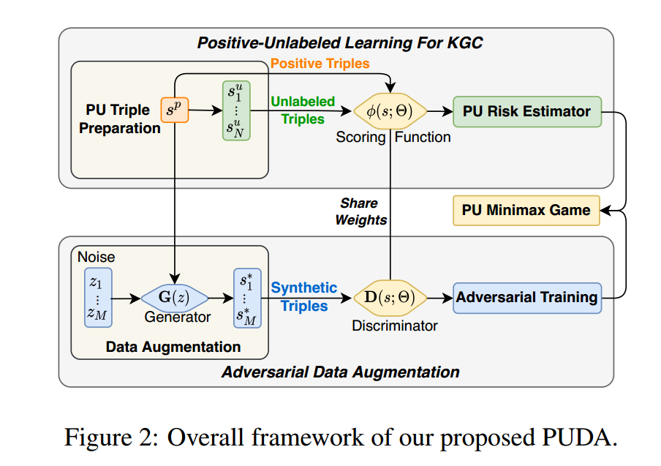
PUDA

Slide 4

PUDA

Slide 5


PU Classification Risk Estimator
这几个公式定义PU learning 的risk estimator

Slide 6




PU Classification Risk Estimator For KGC
大多数的PU Risk Estimator

Slide 7
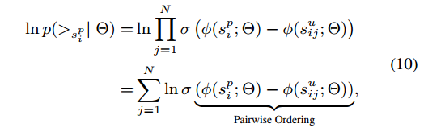
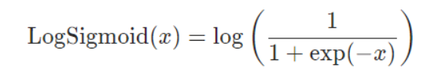
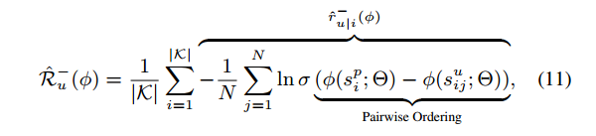
PU Classification Risk Estimator For KGC
However, it is unnecessarily hard to push σ(φ(s; Θ)) to be 1 (0) for all positive (unlabeled) triples in a KGC task. It is easier and more desirable to just push positive triples to be ranked higher than the unlabeled triples

Slide 8
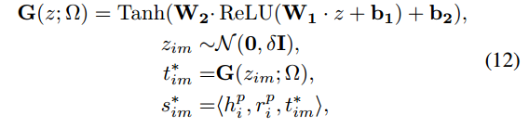
PU Classification Risk Estimator For KGC

Slide 9

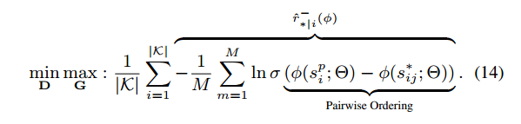
GAN Minmax Game

Slide 10


PU Minmax Game

Slide 11
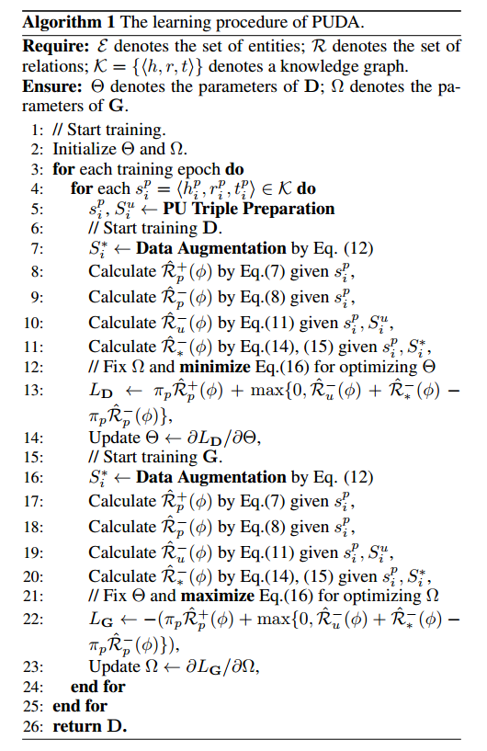
PUDA

Slide 12
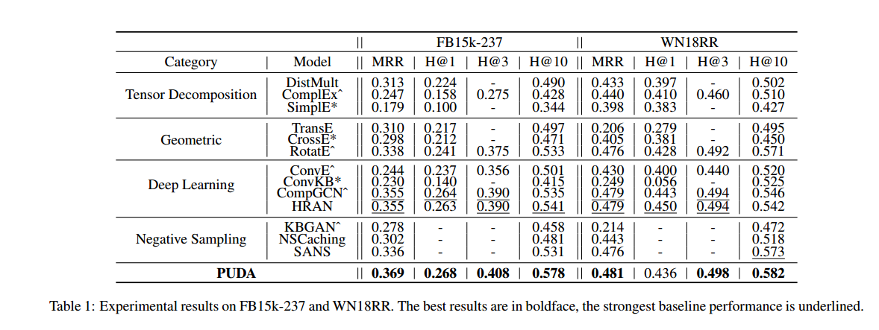
Result

Slide 13
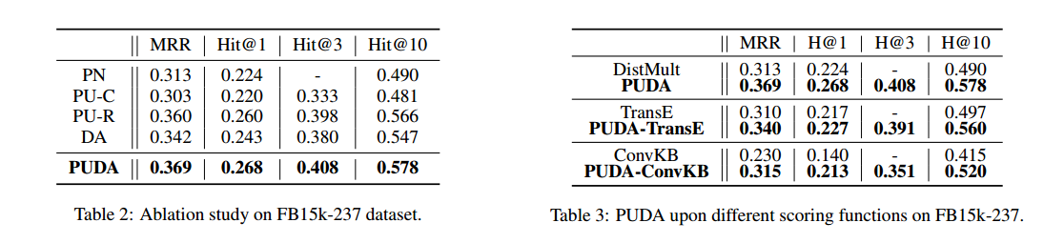
Result
PN-普通二元分类 ；PU-C 点排序的PU学习；PU-R成对排序的PU学习；DA对抗数据增强

Slide 14
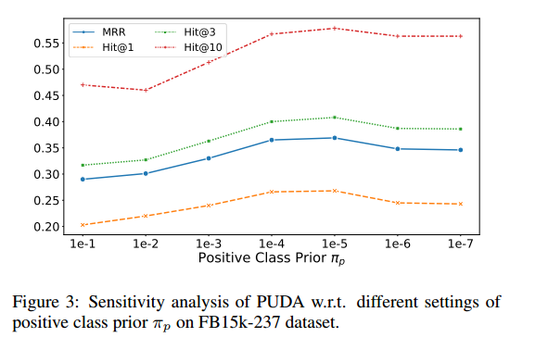
Result

Slide 15
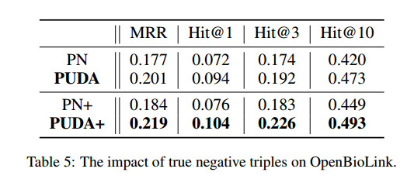
Result

