Slide 1
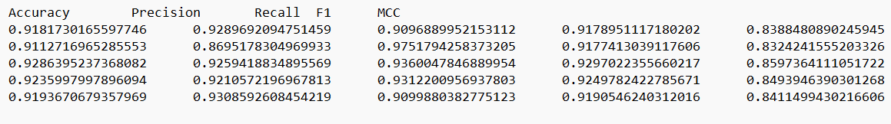
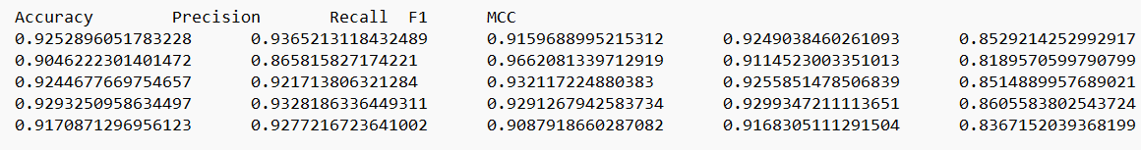
Borderline SMOTE and Random Oversample
Random Oversample
Borderline SMOTE

Slide 2
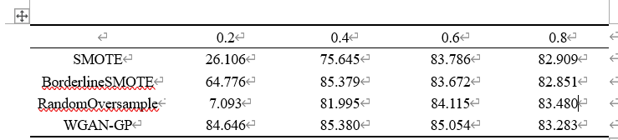
About oversample rate
MCC性能比较，基于SVM

Slide 3
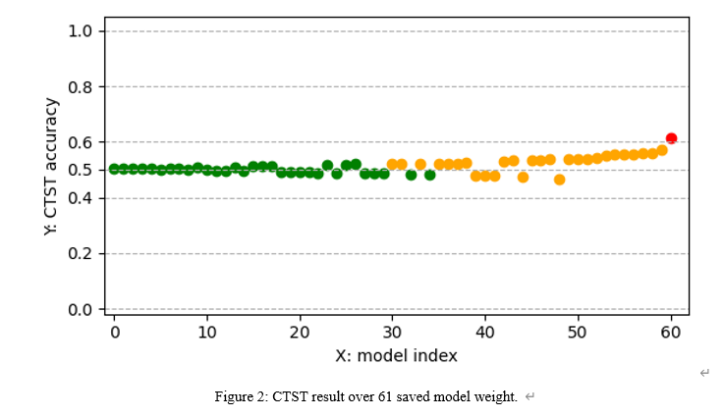
CTST plot
说明用CTST去筛选的必要性，参考的 Protein function prediction is improved by creating synthetic feature samples with generative adversarial networks 或者还可以用偏离0.5比较多的生成模型去做对比

Slide 4
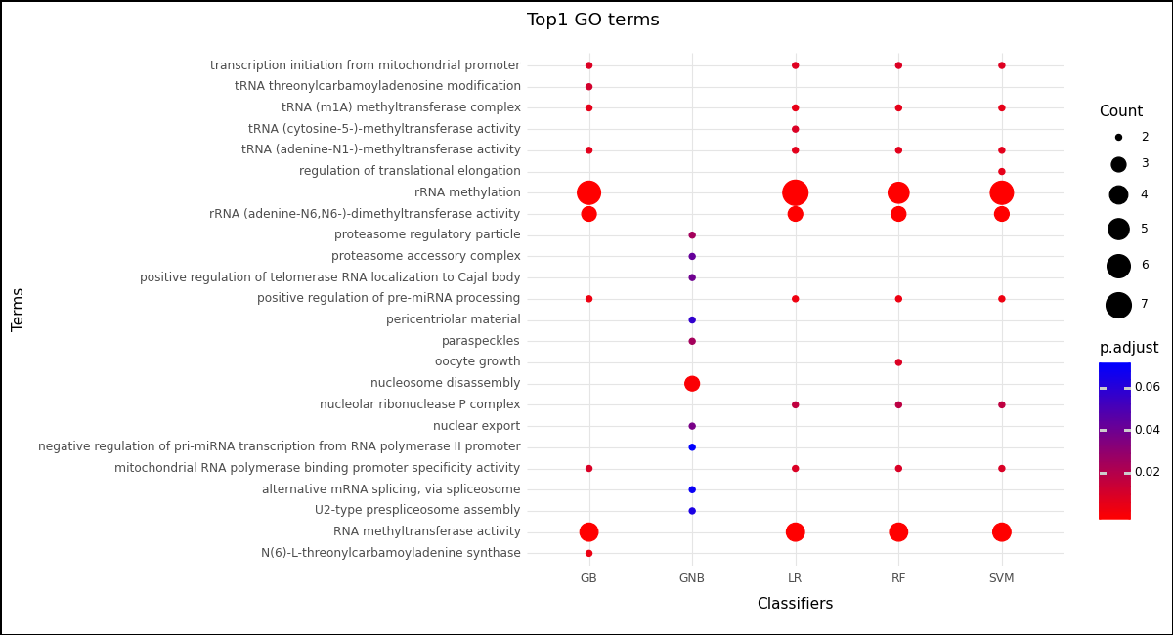
GO terms enrichment plot
取置信度前1%的gene做GO terms富集分析。 GNB的有点问题。

