Slide 2
Quantum Computing

Slide 3

Why?
It has the potential to revolutionize our world by contributing not only in computer science but in various other disciplines as well.

Slide 4
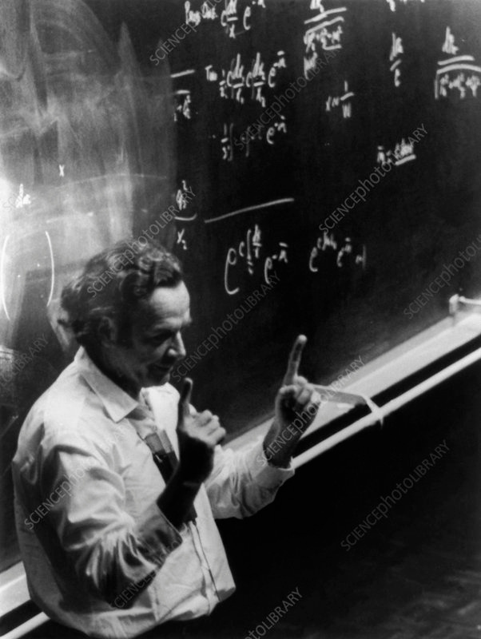
Introduction
Quantum computers were proposed in the 1980s by Richard Feynman when he faced a roadbloack simulating quantum particles.

Slide 5
BITS
Classical
0
1

Slide 6


QUBITS
1
0

Slide 7
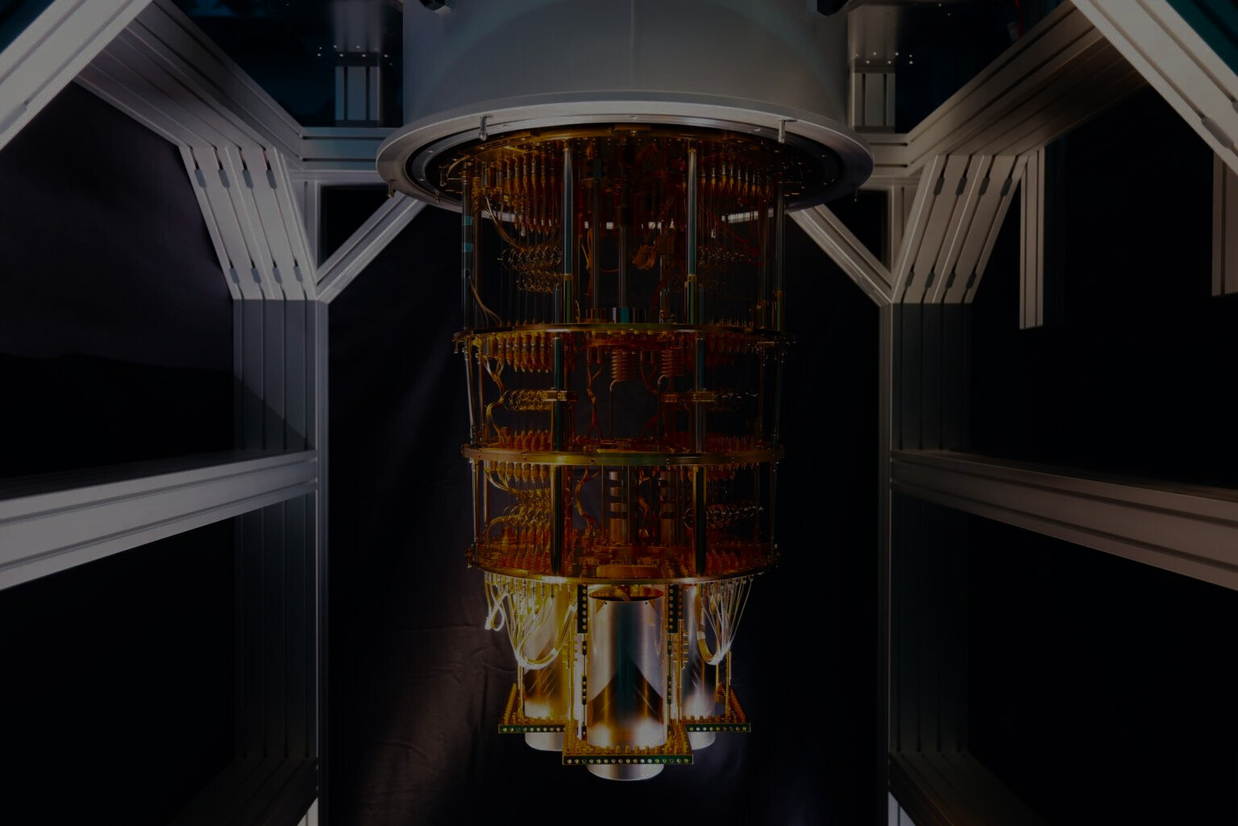
Merits:
Fast : They can compute large amount of data faster than even supercomputers.
Google claimed to carry out a calculation in about 200s that would take a classical supercomputer around 10,000 years.
Powerful : They have high computation power hence can render complex problems.
Efficient : They can solve equations involving high degree of complexity

Slide 8
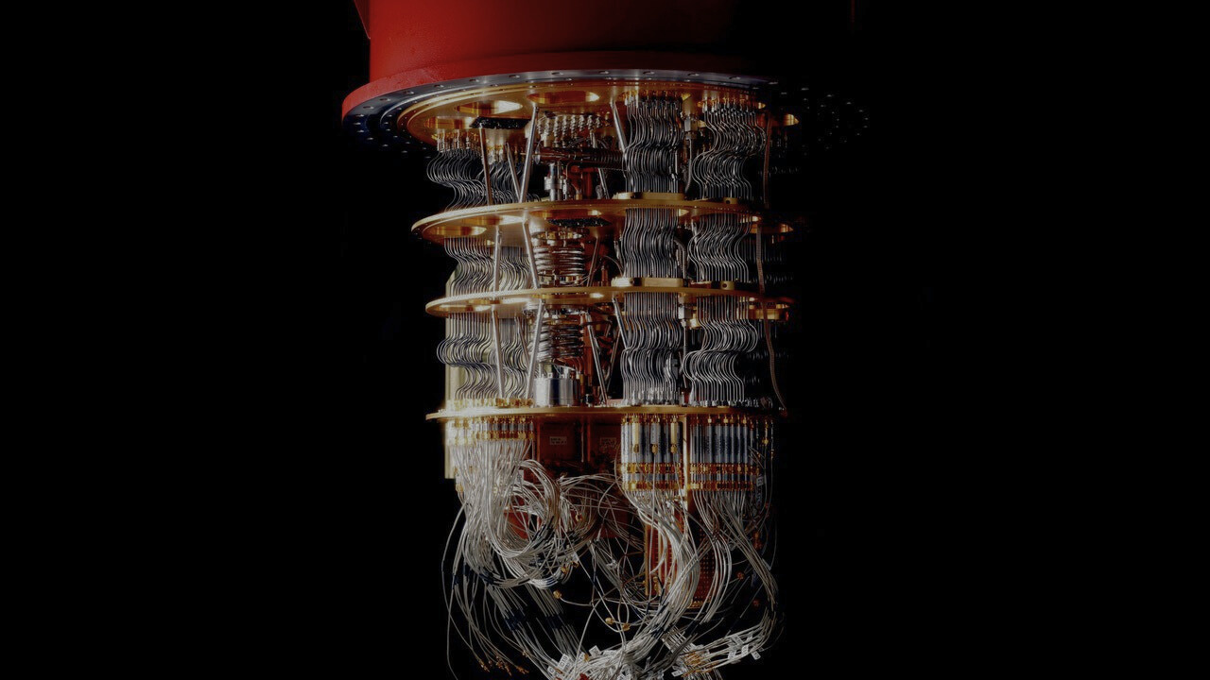
Demerits:
Sensitive : Can be operated only in certain conditions.
Unreliable : Still in early development hence they break current encryption systems, which could leave doors open for data theft.
Expensive : A Quantum Computer with 50 quibits can cost upto $15 million.
Notes:
Topic's name: Quantum Computing
Why did you choose this topic: It has the potential to revolutionize our world
Introduction:
Elaboration:
What is the scope:
Advantages:
Demerits:
Conclusion:
Your take on the topic:
References:
End.

Slide 9
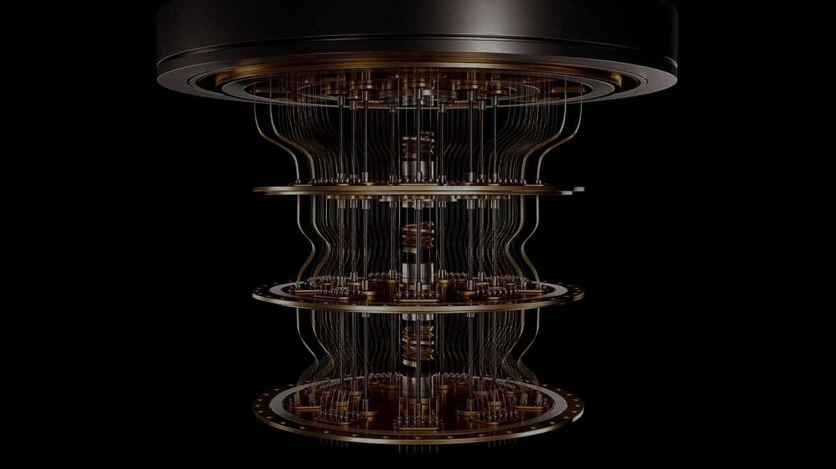
My Take
With Google NASA working together and IBM already having built their own Quantum Computer I am intrigued to witness the revolution.
Though it is still uncertain, Its exciting to see what the future holds for us.

Slide 10
References:
Articles:
YouTube:
Quanta Magazine
Quanta Magazine
IBM
IBM
Wired UK
Ted ED
Built In
Veritasium

Slide 11
THANK YOU

