Slide 1

Sensor-Based Gas Leakage System

Slide 2

INTRODUCTION:
LPG Gas Detection System: Enhancing Safety
- LPG's growing use for cooking and heating boosts energy efficiency.
- Yet, its flammability poses risks like fire hazards from leaks.
- Our solution: LPG Gas Detection System.
- Advanced sensors detect even minor leaks, triggering alarms.
- Focus on reliability, cost-effectiveness, and proactive monitoring.
- Scalable design for easy implementation in diverse settings.

Slide 3

Gas Leakage: A Looming Threat
Gas leakage, prevalent in residences, industries, and vehicles like CNG, poses a serious risk.
LPG, is highly flammable, leading to severe accidents. Its desirable properties, including high calorific value and environmental friendliness, make LPG widely used.
Accidents from gas leakage result in explosions, fires, and human injuries, causing material loss and fatalities.
Recent incidents highlight the growing threat to human life and property, exemplified by tragedies like the Bhopal gas disaster.

Slide 4
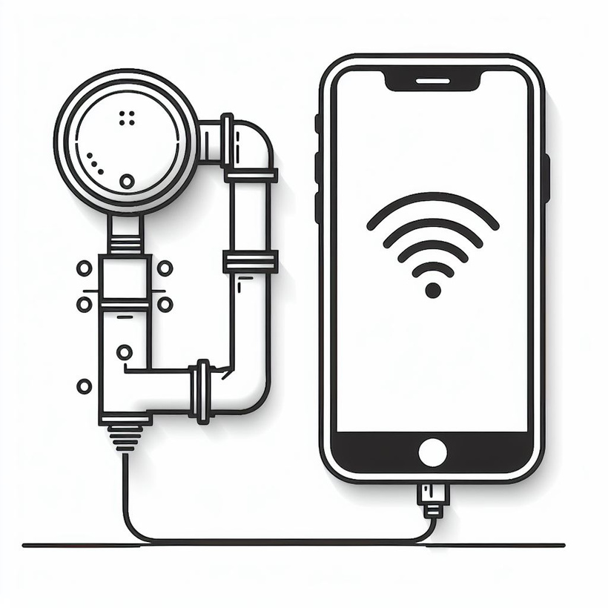
Solution
Gas explosions often result from substandard cylinders, worn-out valves, and lack of regular checks, necessitating reliable detection methods.
Odorants like ethane thiol are added to LPG for smell detection, but some with reduced sense of smell remain vulnerable.
Our proposed solution: A low-cost advanced sensor-based gas leakage detector, alert, and control system.
Efficient, user-friendly, portable, small-sized, and cost-effective.

Slide 5
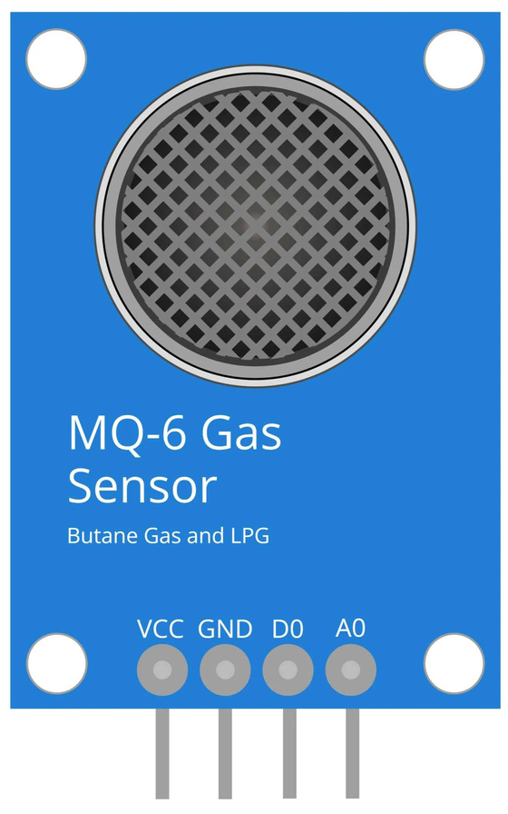


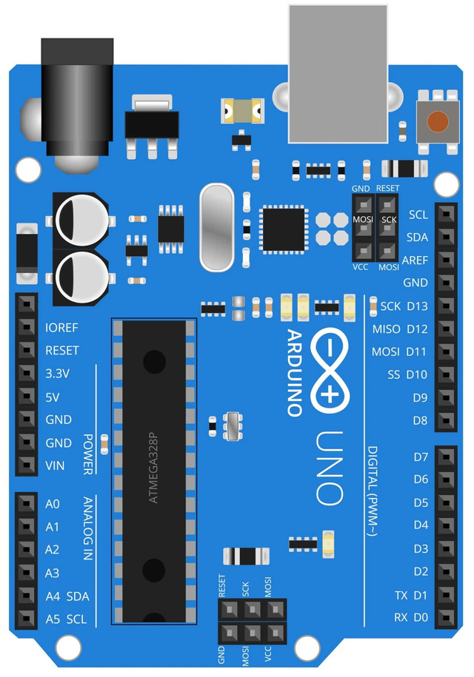

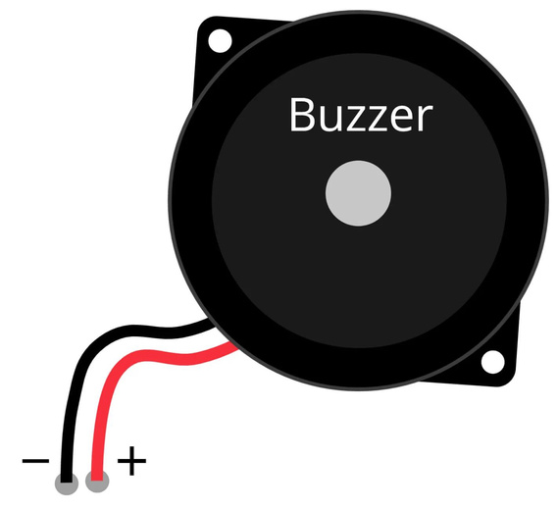


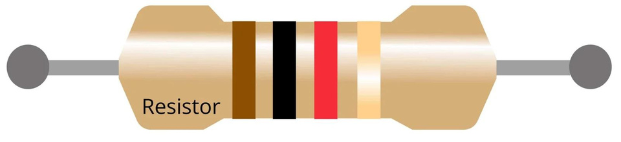
Components
Arduino
LED
Resistor
LPG gas sensor
Buzzer

Slide 6
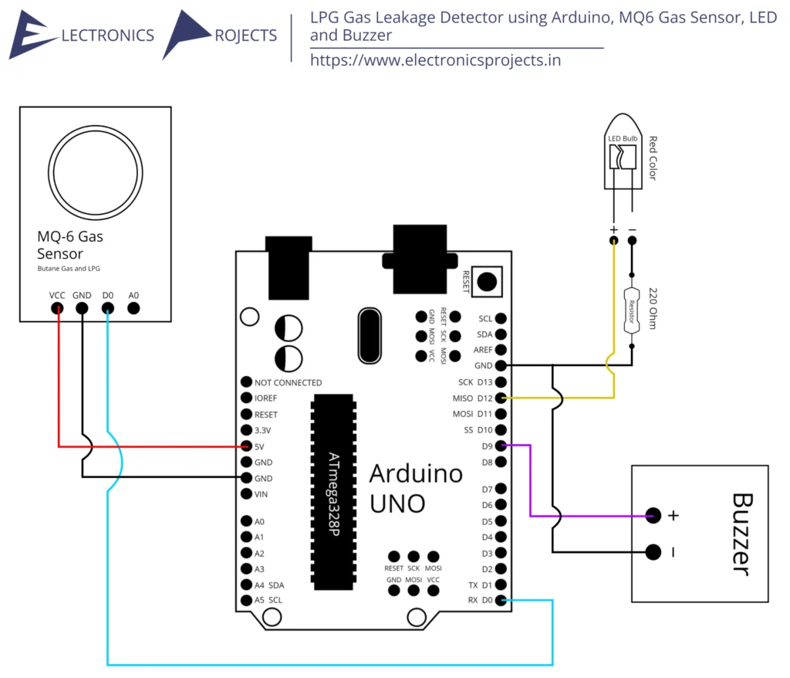
WORKING
-The system is based on Arduino UNO and R3+ MQ-6 gas sensor.
-Sensor detects gas in the environment, and gives digital output: 1 for gas, 0 for no gas. --Arduino receives sensor output. If high, buzzer and LCD display ‘Gas detected: Yes’. If low, no buzzer, LCD shows ‘Gas detected: No’.
-Buzzer includes switches/sensors to control unit, activates warning sound in the form of buzzing.

Slide 7
Advantages of Sensor-Based Gas Leakage System
1. Early Detection: Detects leaks at early stages, preventing hazards.
2. Enhanced Safety: Ensures a safer environment by continuous monitoring.
3. Accuracy: Provides precise measurements, reducing false alarms.
4. Reliability: Consistent performance for peace of mind.
5. Remote Monitoring: Allows remote access for real-time alerts and control.
6. Cost-Effectiveness: Prevents costly damages and liabilities and thereby saves money.

Slide 8
IMPROVEMENTS:
Gas Detection System Mobile App:
- Remote monitoring, alerts, and control.
- Bluetooth/Wi-Fi for Arduino-mobile connectivity.
User Interface:
- Intuitive controls and status indicators.
- Buttons/knobs/touchscreens for settings and status view.
Safety Features:
- Auto shutdown for high gas concentrations.
- Backup power (e.g., battery), tamper detection.

Slide 9
Alarm System:
- Visual, audible alerts with different levels.
- Email, SMS notifications.
Display Readings:
- LCD/OLED screen for real-time gas levels.

Slide 10
FUTURE SCOPE
Remote Monitoring & Control:
- Web/mobile app for remote gas monitoring.
- Real-time alerts & system control via internet.
Emergency Response Integration:
- Links with fire depts. & EMS for automatic alerts.
- Dispatch assistance during gas leak emergencies.
Smart Home Integration:
- Works with Google Home & Amazon Alexa.
-Voice-controlled operation & integration with other smart devices.

Slide 11
Machine Learning Algorithms:
- Analyzes gas concentration data.
- Predicts leaks & optimizes detection thresholds.
Data Analytics & Reporting:
- Analyzes historical gas data for trends.
- Generates insights for safety improvements.

Slide 12
References:
https://electronicsprojects.in/lpg-gas-leakage-detector-using-arduino-mq6-gas-sensor-led-and-buzzer/
Soundarya, T.; Anchitaalagammai, J.V.; Priya, G.D.; Karthickkumar, S.S. C-Leakage: Cylinder LPG Gas Leakage Detection for Home Safety. IOSR .J Electron. Commun. Eng. 2014, 9, 53-58.
Shrivastava, A.; Prabhaker, R.; Kumar, R.; Verma, R. GSM based gas leakage detection system. Int. .J
Emerg. Trends Electr. Electron. 2013, 3, 42-45.

Slide 13
Thank
you!

