Slide 1

Final Project of Fixed Income
Credit Risk Management
Yifu He, Kaiwen Peng, Jiahang Guo
Final Project

Slide 2



CONTENTS
SVM
Chapter1
Chapter2
Dataset
Description
Data
Preprocessing
Logistic
regression
Decision
tree
Chapter3
Chapter4
Visualization Result &
Evaluation
Classification
Random
Forests
Model
Selection
KNN
LDA
Final Project

Slide 3
Chapter 1
Description
Final Project

Slide 4
C
H
A
PT
E
R
2
1.Lending Club dataset
Response:
“Fully Paid” vs “charged off”
Predictors:
144 attributes * 40000 instances
Purpose: Classify Clients who have
potential default risk to
evaluate default probability.
Final Project

Slide 5
Chapter 2
Preprocessing
Final Project

Slide 6

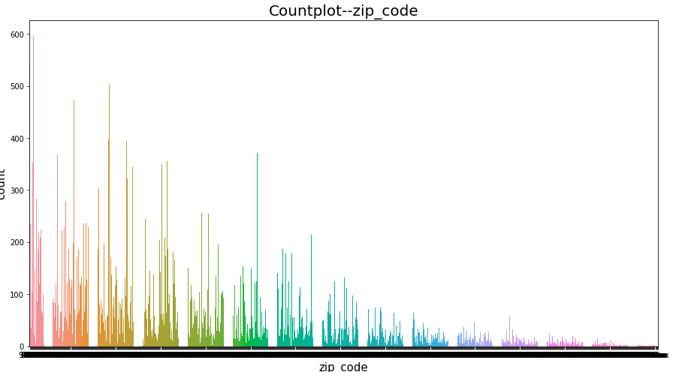
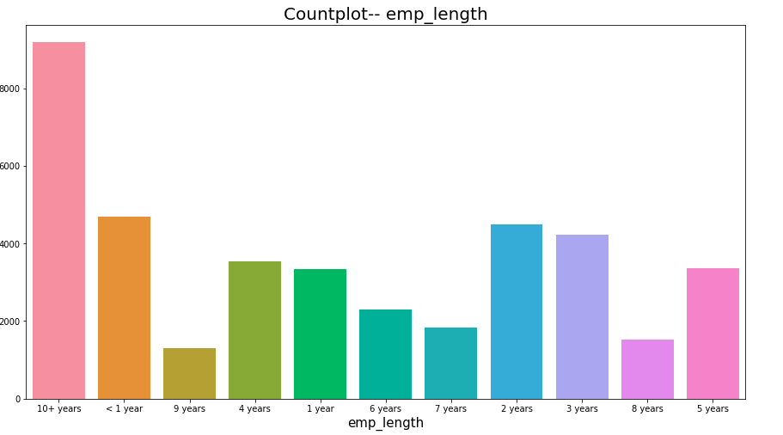
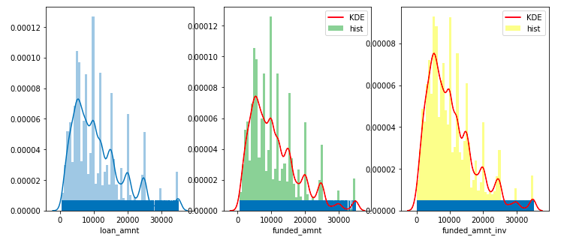
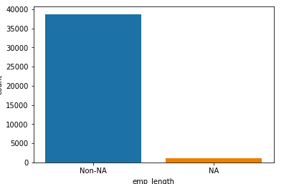



C
H
A
PT
E
R
2
1.Preprocessing
Never use future information
Eg: recoveries, last_pymnt_amnt, total_rec_prncp.
Missing Values
1.Important property: eliminate when missing part is greater than 5%.
Eg: verification_status_joint.
2.Miss part is less than 5%, manually fill the attribute by “forward fill”.
Eg: Emp_length.
Duplicated Values
1.Delete those attributes, 95% of which has the same values.
Eg: “pymnt_plan”
2.Delete attributes which have similar information.
Eg: “loan_amnt”,”funded_amnt”,”funded_amnt_inv”
Missing Values
Duplicated Values
Future Information
Final Project

Slide 7

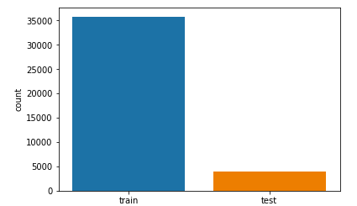
C
H
A
PT
E
R
2
2.Normalization
Never use future information
Eg: recoveries, last_pymnt_amnt, total_rec_prncp.
a. Categorial variables: converted to dummy variables
b. Numerical variables: Minmax Normalization
3.Set Validation Set
Training Set : Test Set = 9 : 1
Missing Values
Duplicated Values
Future Information
Final Project

Slide 8
Chapter 3
Model Performance
& Selection
Final Project

Slide 9
C
H
A
PT
E
R
3
Model Selection
Models:
Support Vector Machine
Decision Tree
Random Forests
KNN
Linear Discriminant Analysis
Logistic Regression
Principal:
Occam’s Razor
Thus, We choose Decision Tree model
SVM
Logistic
regression
Decision
tree
Classification
Random
Forests
KNN
LDA
Final Project

Slide 10
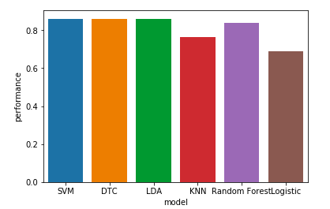
Optimization
内容1
内容1
DNN
内容1
内容1
C
H
A
PT
E
R
3
Model Performance
Final Project

Slide 11


Result
Analysis
Decision Tree
evaluation
Chapter4
Final Project

Slide 12
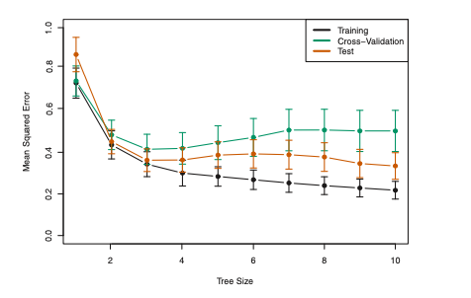
Cross-validation
Decision Tree

Slide 13
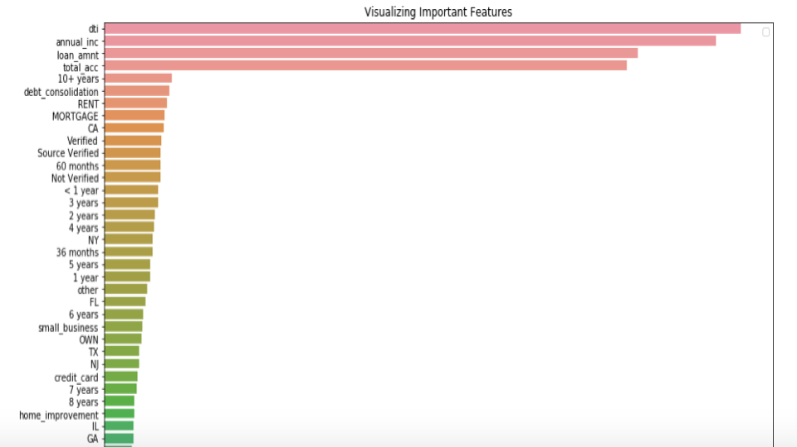

Slide 14
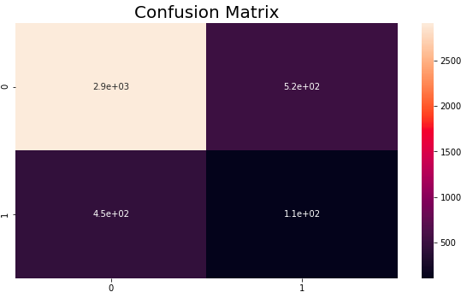
Confusion Matrix
evaluation
Final Project

Slide 15
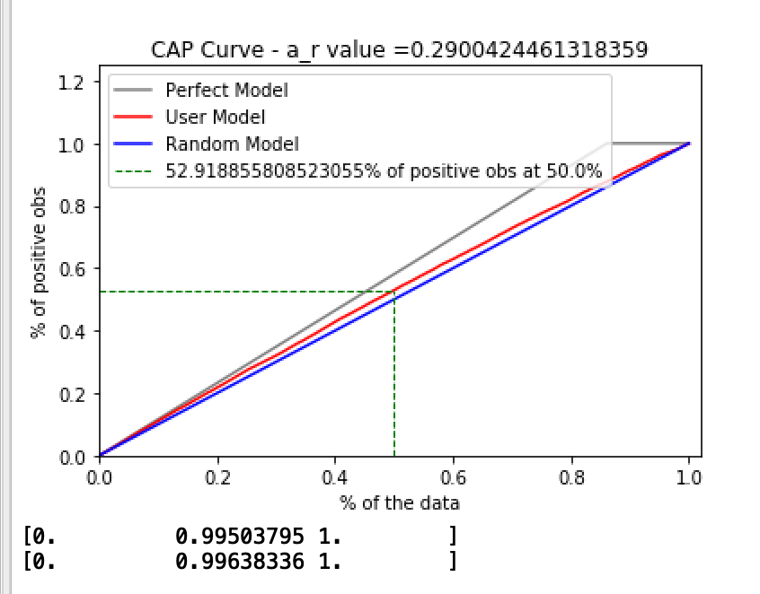
CAP Curve
evaluation
Final Project

Slide 16
Fur ther
Further Concideration
1.Why different attributes don’t matters very much?
Overfitting problem.
Dimension reduction
2.Unbalanced data problem
Categorize 100 picture of cats and dogs:
99 cats v.s. 1 dog
3. One more aggregated attribute: the number of Missing Value
Why value is missing?
Num_missing
Final Project

Slide 17
Q & A
Thank you
Final Project

