Slide 1
Introduction to C++ Programming, Input/Output and Operators
Chapter 2 of C++ How to Program, 10/e

Slide 2
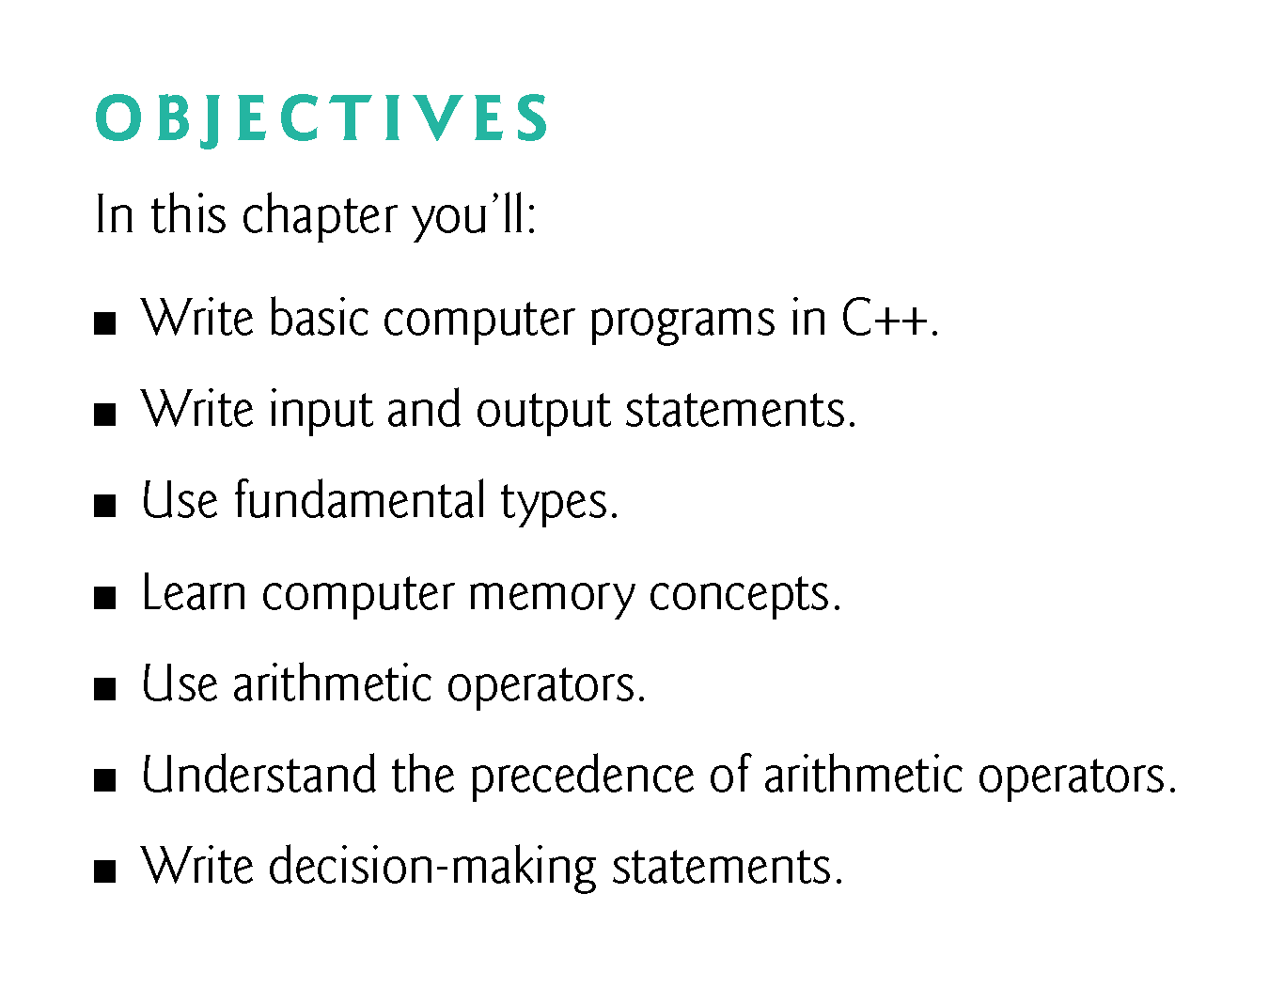

Slide 3
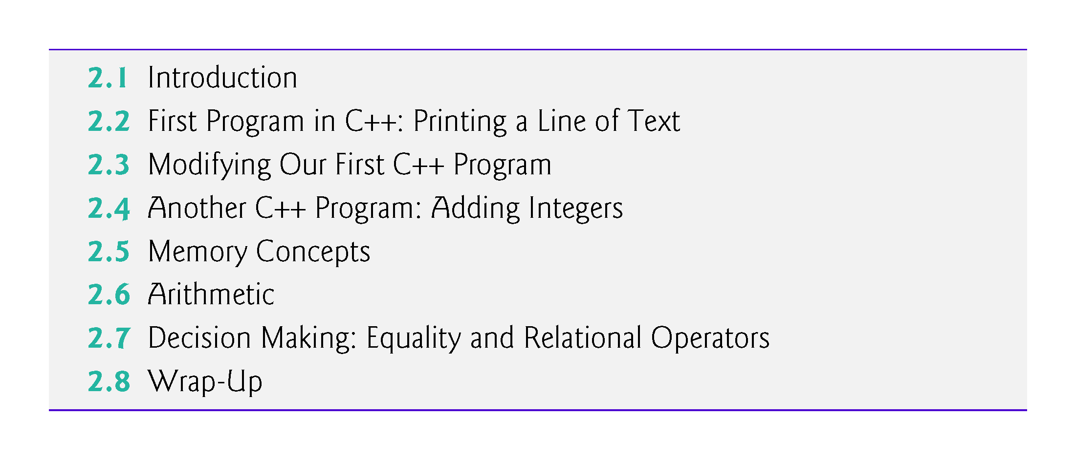

Slide 4
2.1 Introduction
We now introduce C++ programming, which facilitates a disciplined approach to program development.
Most of the C++ programs you’ll study in this book process data and display results.

Slide 5
2.2 First Program in C++: Printing a Line of Text
Simple program that prints a line of text (Fig. 2.1).

Slide 6
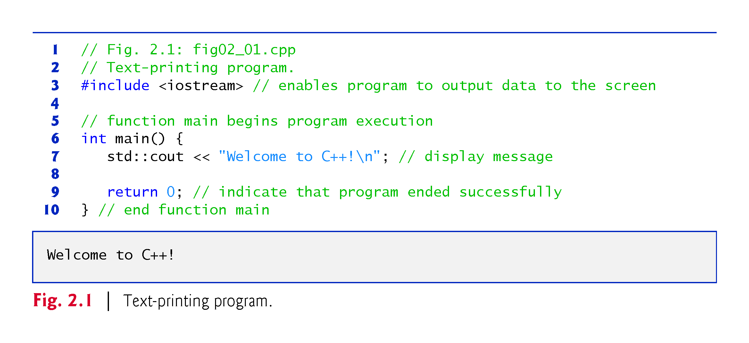

Slide 7
2.2 First Program in C++: Printing a Line of Text (cont.)
// indicates that the remainder of each line is a comment.
You insert comments to document your programs and to help other people read and understand them.
Comments are ignored by the C++ compiler and do not cause any machine-language object code to be generated.
A comment beginning with // is called a single-line comment because it terminates at the end of the current line.
You also may use comments containing one or more lines enclosed in /* and */.

Slide 8


Slide 9
2.2 First Program in C++: Printing a Line of Text (cont.)
A preprocessing directive is a message to the C++ preprocessor.
Lines that begin with # are processed by the preprocessor before the program is compiled.
#include <iostream> notifies the preprocessor to include in the program the contents of the input/output stream header file <iostream>.
This header is a file containing information used by the compiler when compiling any program that outputs data to the screen or inputs data from the keyboard using C++-style stream input/output.

Slide 10
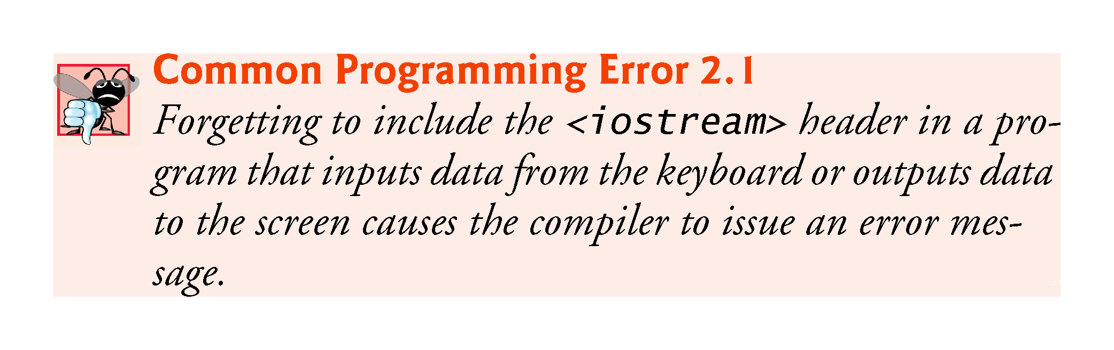

Slide 11
2.2 First Program in C++: Printing a Line of Text (cont.)
You use blank lines, space characters and tab characters (i.e., “tabs”) to make programs easier to read.
Together, these characters are known as white space.
White-space characters are normally ignored by the compiler.

Slide 12
2.2 First Program in C++: Printing a Line of Text (cont.)
main is a part of every C++ program.
The parentheses after main indicate that main is a program building block called a function.
C++ programs typically consist of one or more functions and classes.
Exactly one function in every program must be named main.
C++ programs begin executing at function main, even if main is not the first function defined in the program.
The keyword int to the left of main indicates that main “returns” an integer (whole number) value.
A keyword is a word in code that is reserved by C++ for a specific use.
For now, simply include the keyword int to the left of main in each of your programs.

Slide 13
2.2 First Program in C++: Printing a Line of Text (cont.)
A left brace, {, must begin the body of every function.
A corresponding right brace, }, must end each function’s body.
A statement instructs the computer to perform an action.
Together, the quotation marks and the characters between them are called a string, a character string or a string literal.
We refer to characters between double quotation marks simply as strings.
White-space characters in strings are not ignored by the compiler.
Most C++ statements end with a semicolon (;), also known as the statement terminator.
Preprocessing directives (like #include) do not end with a semicolon.

Slide 14
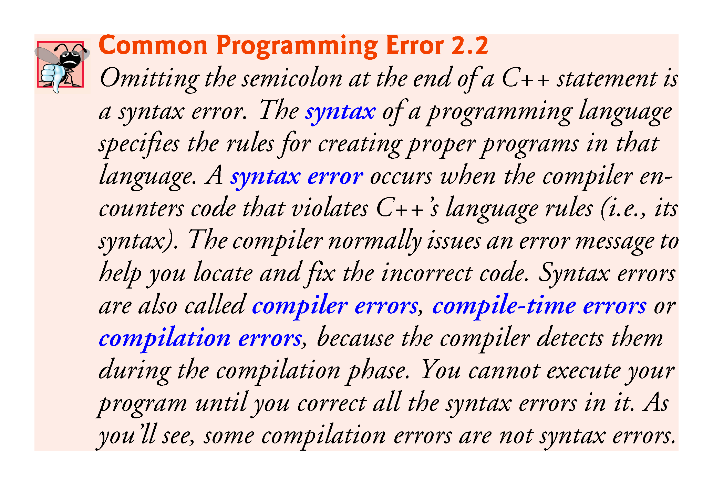

Slide 15
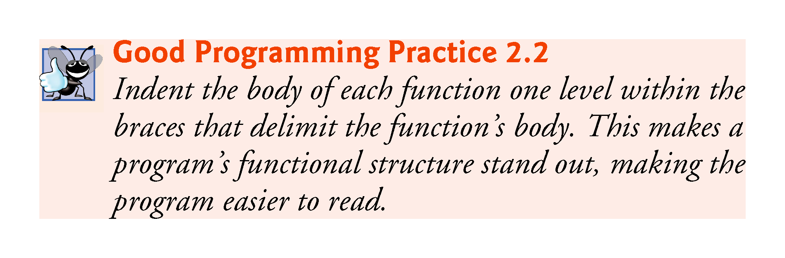

Slide 16
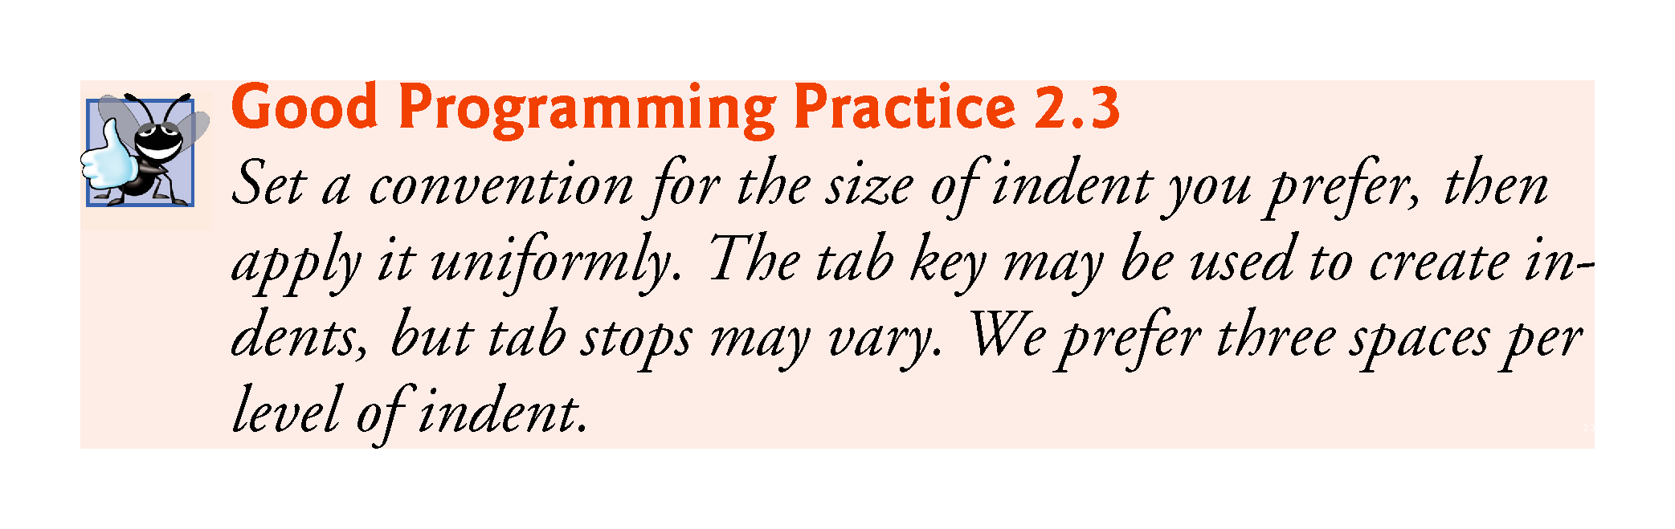

Slide 17
2.2 First Program in C++: Printing a Line of Text (cont.)
Typically, output and input in C++ are accomplished with streams of data.
When a cout statement executes, it sends a stream of characters to the standard output stream object—std::cout—which is normally “connected” to the screen.
The std:: before cout is required when we use names that we’ve brought into the program by the preprocessing directive #include <iostream>.
The notation std::cout specifies that we are using a name, in this case cout, that belongs to “namespace” std.
The names cin (the standard input stream) and cerr (the standard error stream) also belong to namespace std.

Slide 18
2.2 First Program in C++: Printing a Line of Text (cont.)
In the context of an output statement, the << operator is referred to as the stream insertion operator.
The value to the operator’s right, the right operand, is inserted in the output stream.
The characters \n are not printed on the screen.
The backslash (\) is called an escape character.
It indicates that a “special” character is to be output.
When a backslash is encountered in a string of characters, the next character is combined with the backslash to form an escape sequence.
The escape sequence \n means newline.
Causes the cursor to move to the beginning of the next line on the screen.

Slide 19
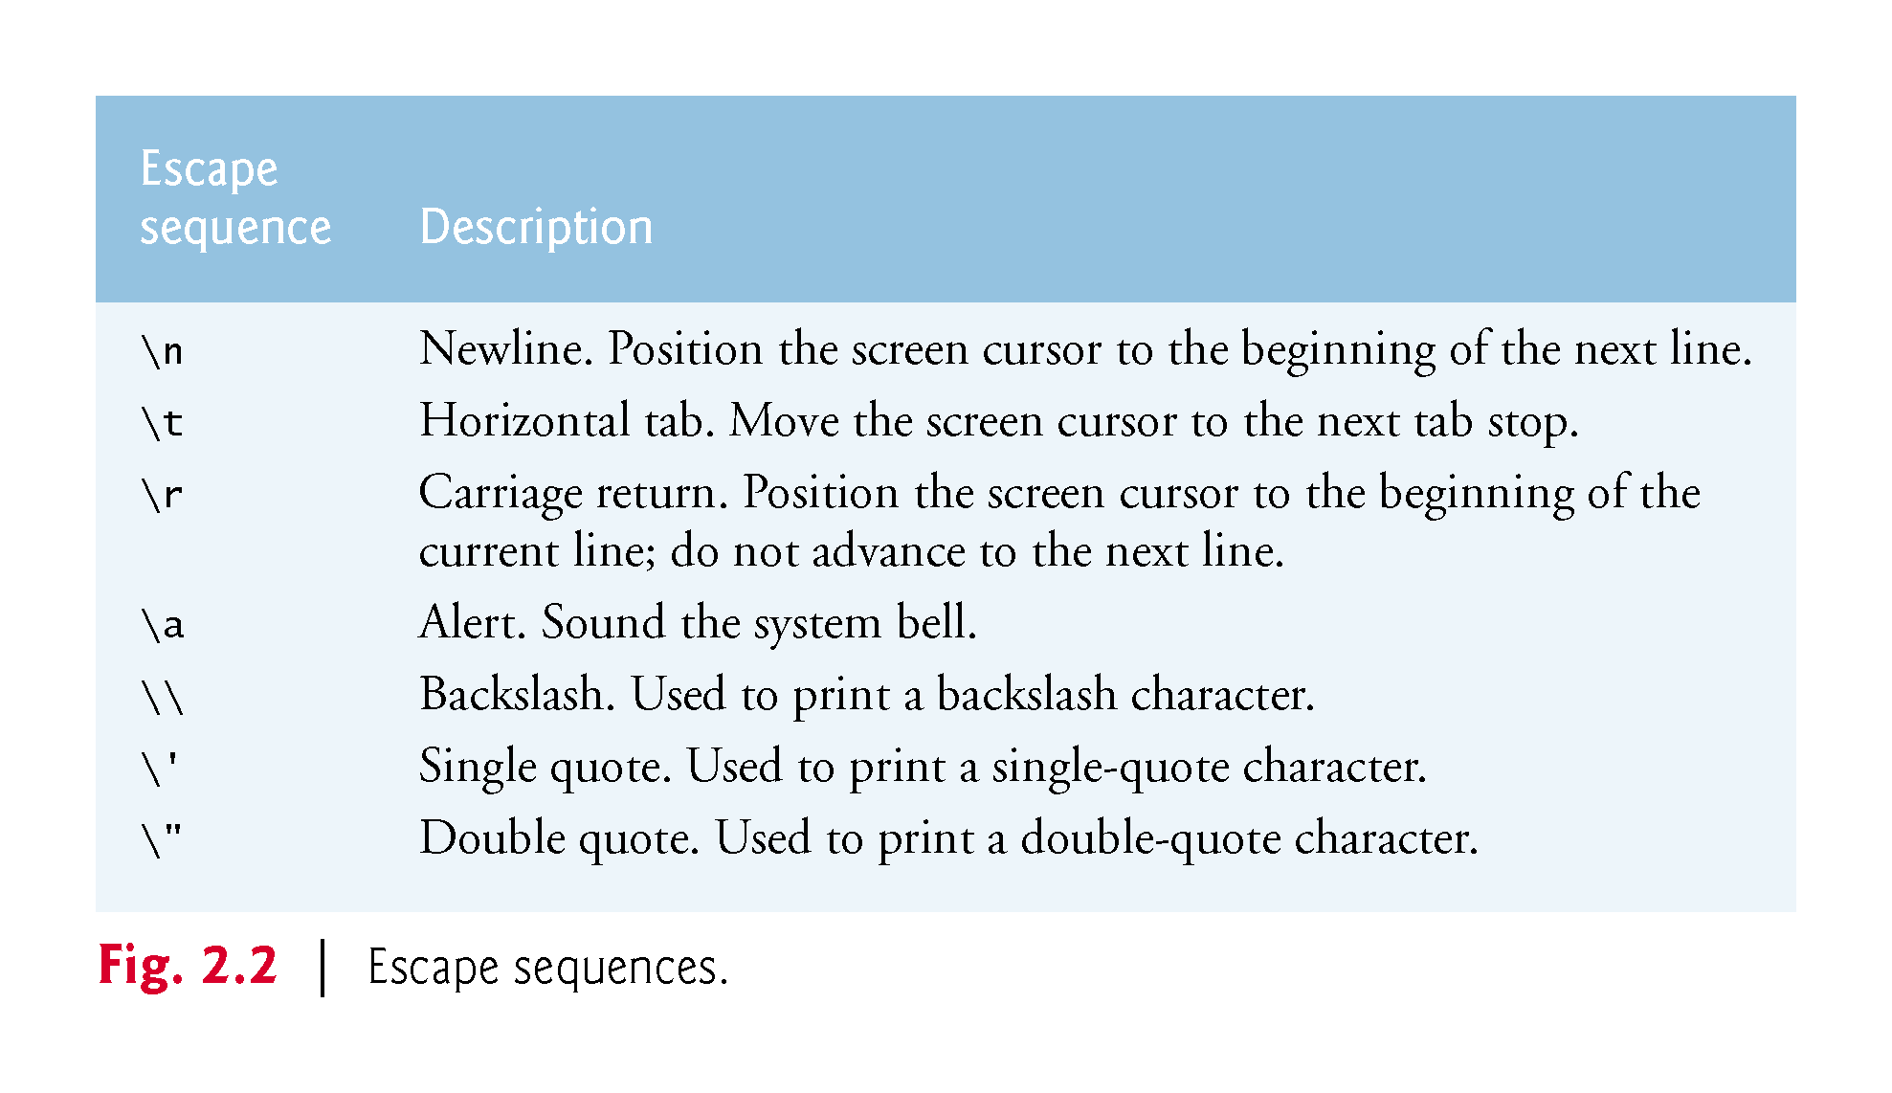

Slide 20
2.2 First Program in C++: Printing a Line of Text (cont.)
When the return statement is used at the end of main the value 0 indicates that the program has terminated successfully.
According to the C++ standard, if program execution reaches the end of main without encountering a return statement, it’s assumed that the program terminated successfully—exactly as when the last statement in main is a return statement with the value 0.

Slide 21
2.3 Modifying Our First C++ Program
Welcome to C++! can be printed several ways.

Slide 22
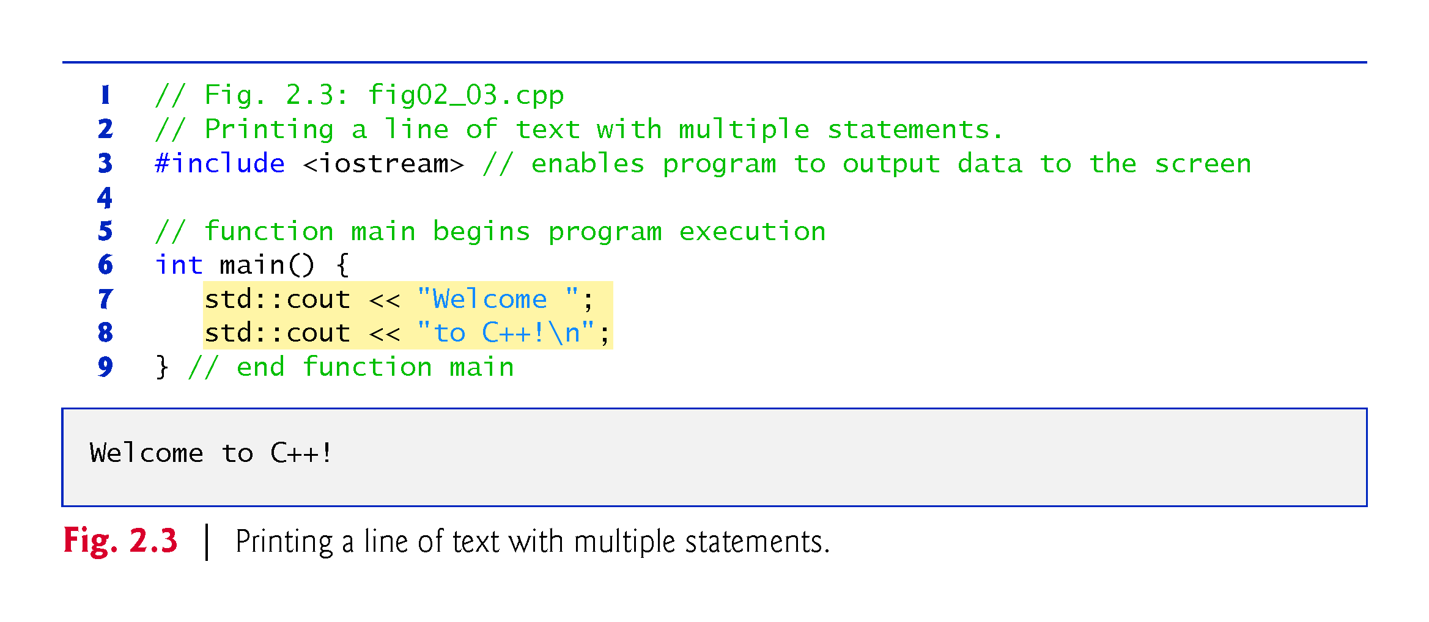

Slide 23
2.3 Modifying Our First C++ Program (cont.)
A single statement can print multiple lines by using newline characters.
Each time the \n (newline) escape sequence is encountered in the output stream, the screen cursor is positioned to the beginning of the next line.
To get a blank line in your output, place two newline characters back to back.

Slide 24
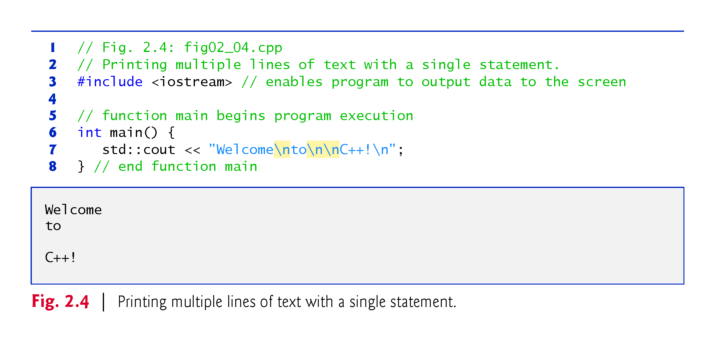

Slide 25
2.4 Another C++ Program: Adding Integers
The next program obtains two integers typed by a user at the keyboard, computes their sum and outputs the result using std::cout.
Figure 2.5 shows the program and sample inputs and outputs.

Slide 26
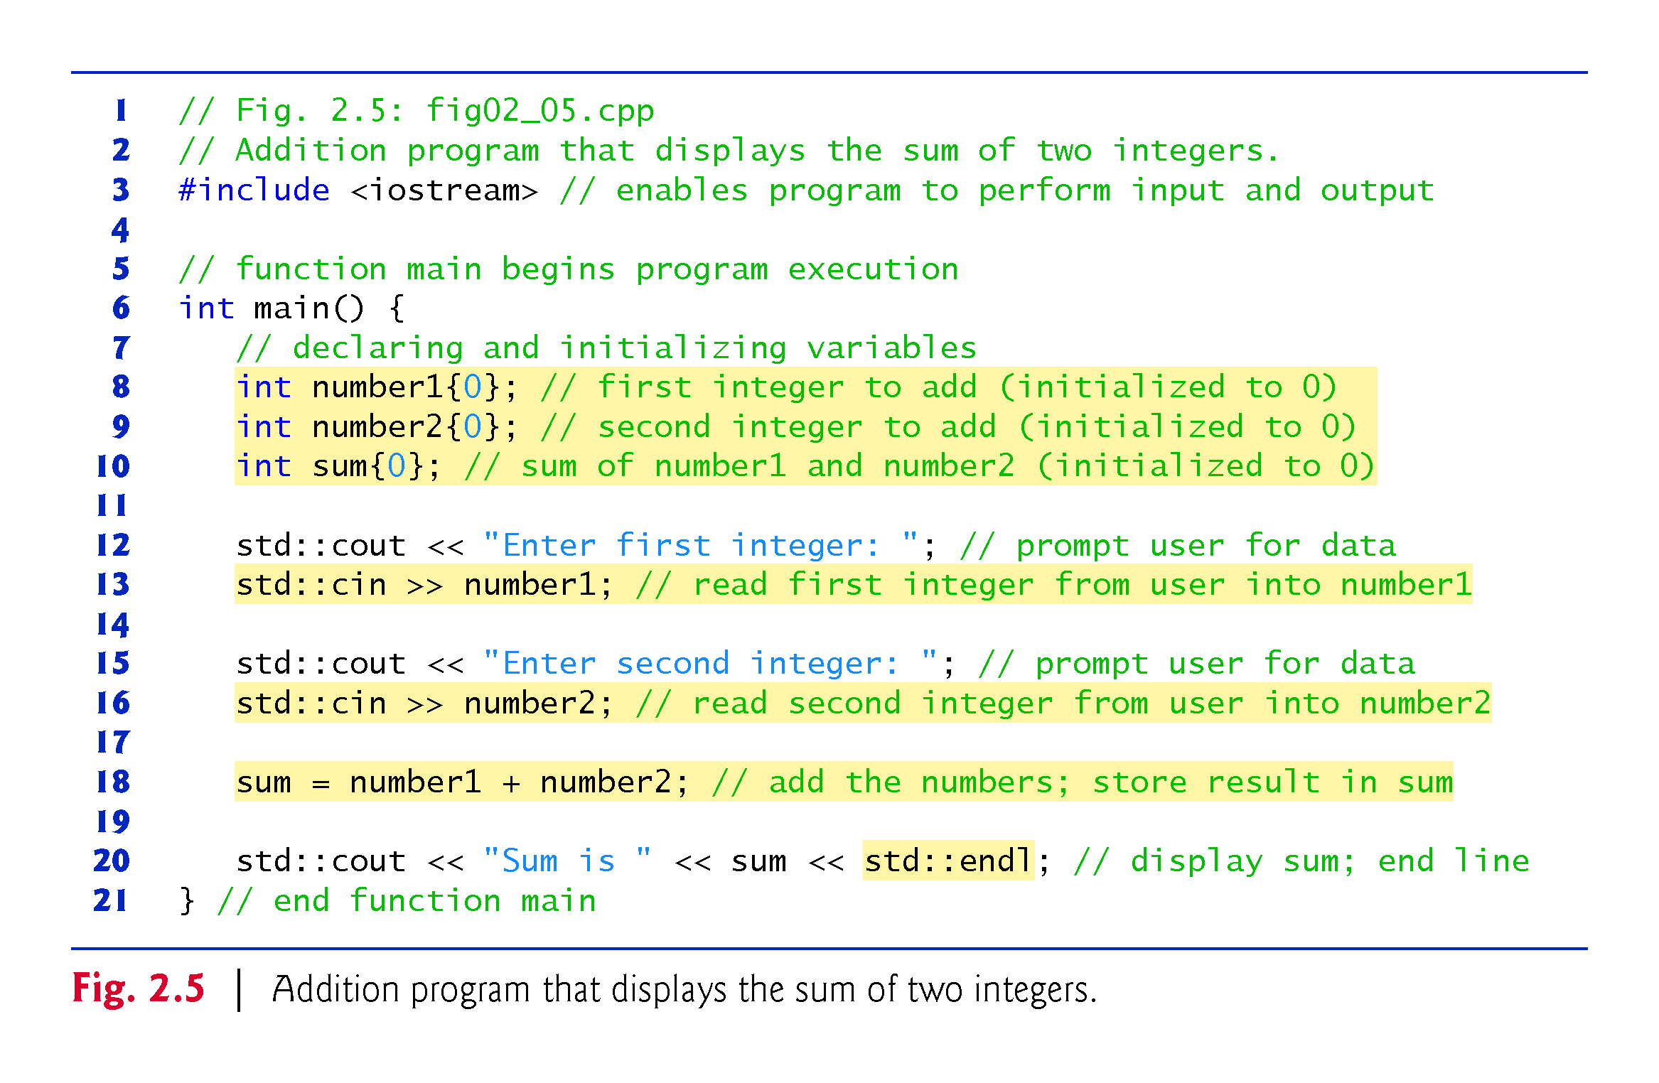

Slide 27
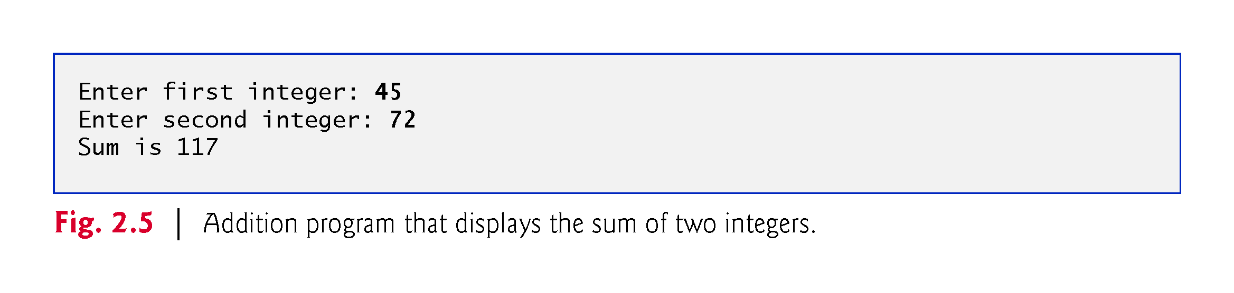

Slide 28
2.4 Another C++ Program: Adding Integers (cont.)
Declarations introduce identifiers into programs.
The identifiers number1, number2 and sum are the names of variables.
A variable is a location in the computer’s memory where a value can be stored for use by a program.
Variables number1, number2 and sum are data of type int, meaning that these variables will hold integers (whole numbers such as 7, –11, 0 and 31914).

Slide 29
2.4 Another C++ Program: Adding Integers (cont.)
Lines 8–10 initialize each variable to 0 by placing a value in braces ({ and }) immediately following the variable’s name
Known as list initialization
Introduced in C++11
Previously, these declarations would have been written as:
int number1 = 0;
int number2 = 0;
int sum = 0;

Slide 30
2.4 Another C++ Program: Adding Integers (cont.)
All variables must be declared with a name and a data type before they can be used in a program.
If more than one name is declared in a declaration (as shown here), the names are separated by commas (,); this is referred to as a comma-separated list.

Slide 31
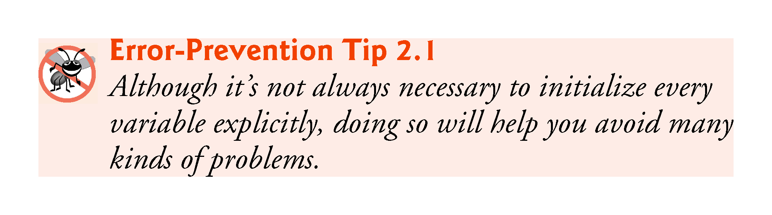

Slide 32
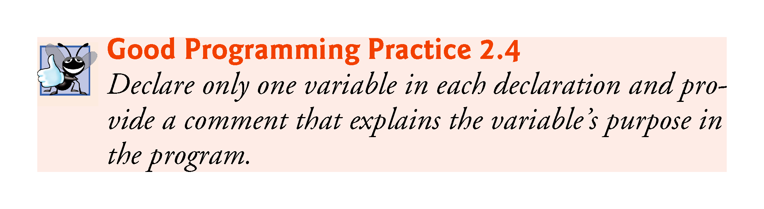

Slide 33
2.4 Another C++ Program: Adding Integers (cont.)
Data type double is for specifying real numbers, and data type char for specifying character data.
Real numbers are numbers with decimal points, such as 3.4, 0.0 and –11.19.
A char variable may hold only a single lowercase letter, a single uppercase letter, a single digit or a single special character (e.g., $ or *).
Types such as int, double and char are called fundamental types.
Fundamental-type names are keywords and therefore must appear in all lowercase letters.
Appendix C contains the complete list of fundamental types.

Slide 34
2.4 Another C++ Program: Adding Integers (cont.)
A variable name is any valid identifier that is not a keyword.
An identifier is a series of characters consisting of letters, digits and underscores ( _ ) that does not begin with a digit.
C++ is case sensitive—uppercase and lowercase letters are different, so a1 and A1 are different identifiers.

Slide 35
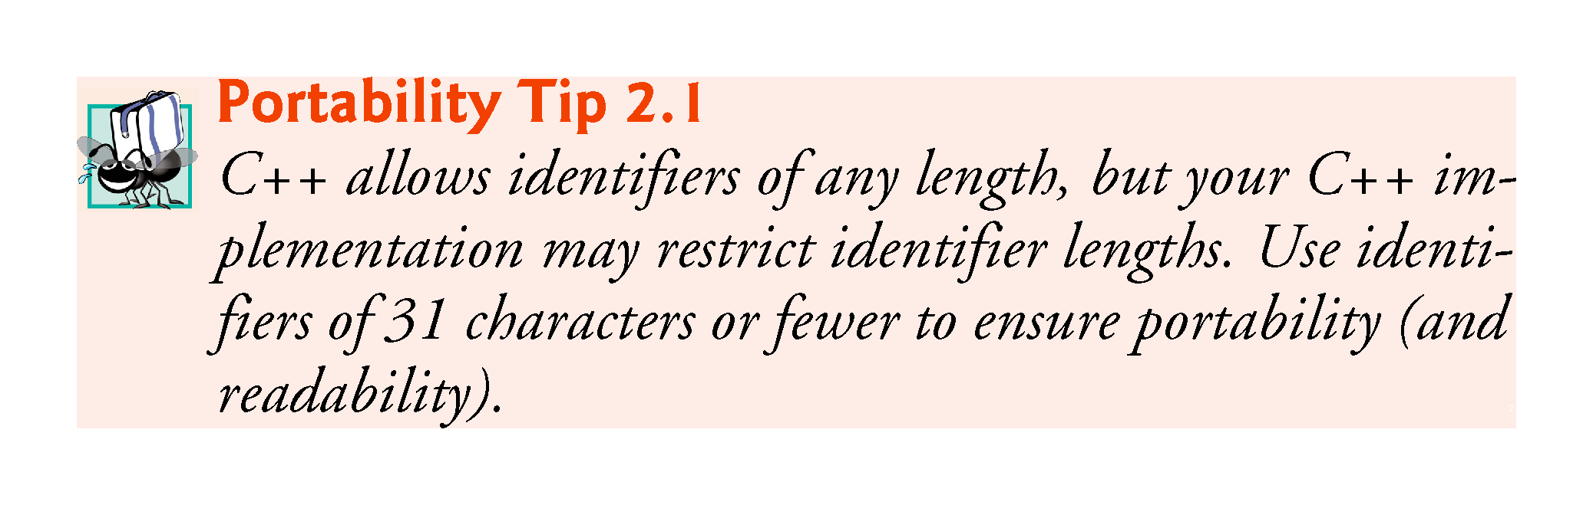

Slide 36
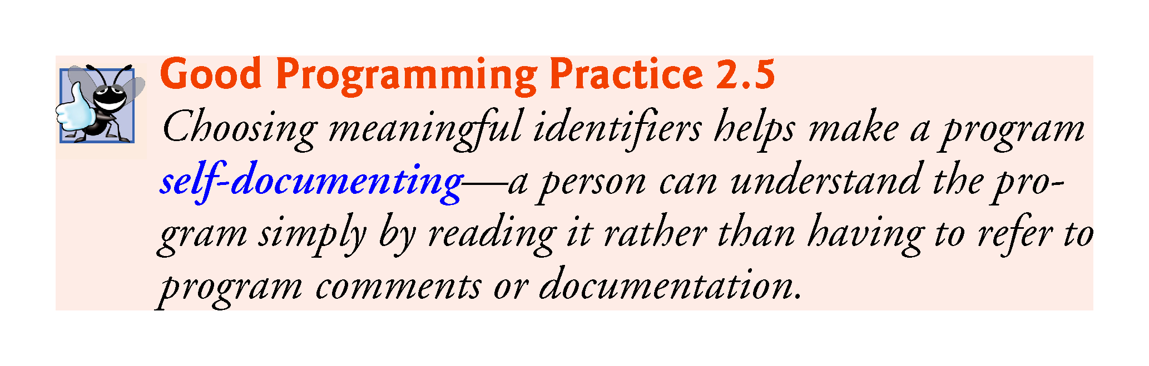

Slide 37
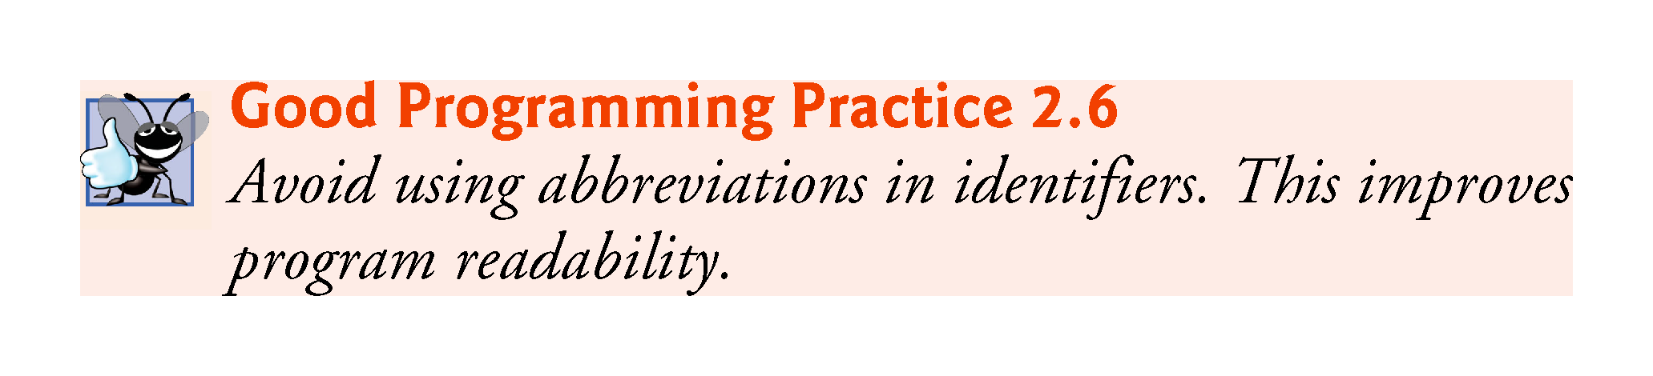

Slide 38
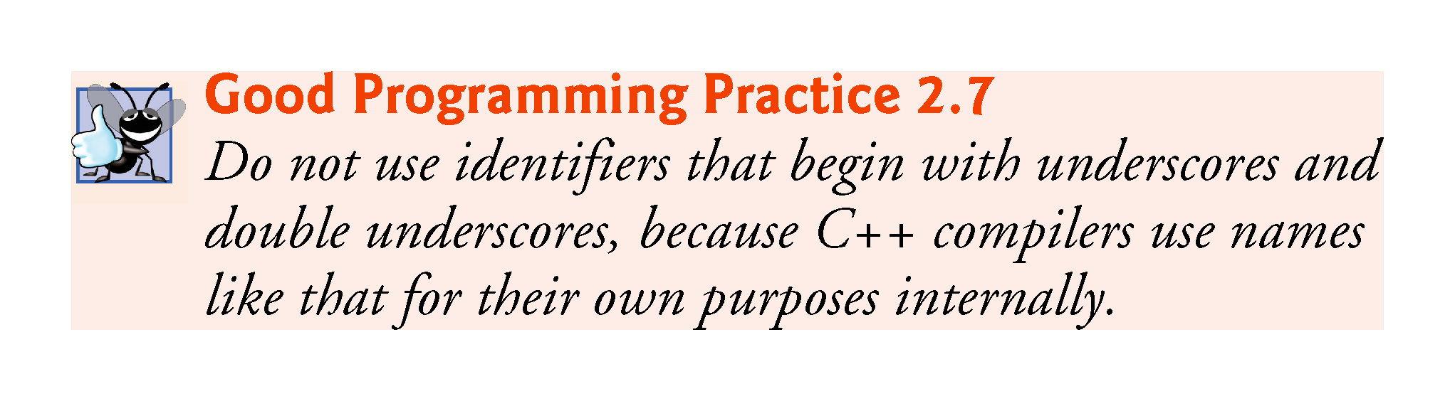

Slide 39
2.4 Another C++ Program: Adding Integers (cont.)
Declarations of variables can be placed almost anywhere in a program, but they must appear before their corresponding variables are used in the program.

Slide 40
2.4 Another C++ Program: Adding Integers (cont.)
A prompt it directs the user to take a specific action.
A cin statement uses the input stream object cin (of namespace std) and the stream extraction operator, >>, to obtain a value from the keyboard.
Using the stream extraction operator with std::cin takes character input from the standard input stream, which is usually the keyboard.

Slide 41
2.4 Another C++ Program: Adding Integers (cont.)
When the computer executes an input statement that places a value in an int variable, it waits for the user to enter a value for variable number1.
The user responds by typing the number (as characters) then pressing the Enter key (sometimes called the Return key) to send the characters to the computer.
The computer converts the character representation of the number to an integer and assigns (i.e., copies) this number (or value) to the variable number1.
Any subsequent references to number1 in this program will use this same value.
Pressing Enter also causes the cursor to move to the beginning of the next line on the screen.

Slide 42
2.4 Another C++ Program: Adding Integers (cont.)
In this program, an assignment statement adds the values of variables number1 and number2 and assigns the result to variable sum using the assignment operator =.
Most calculations are performed in assignment statements.
The = operator and the + operator are called binary operators because each has two operands.

Slide 43
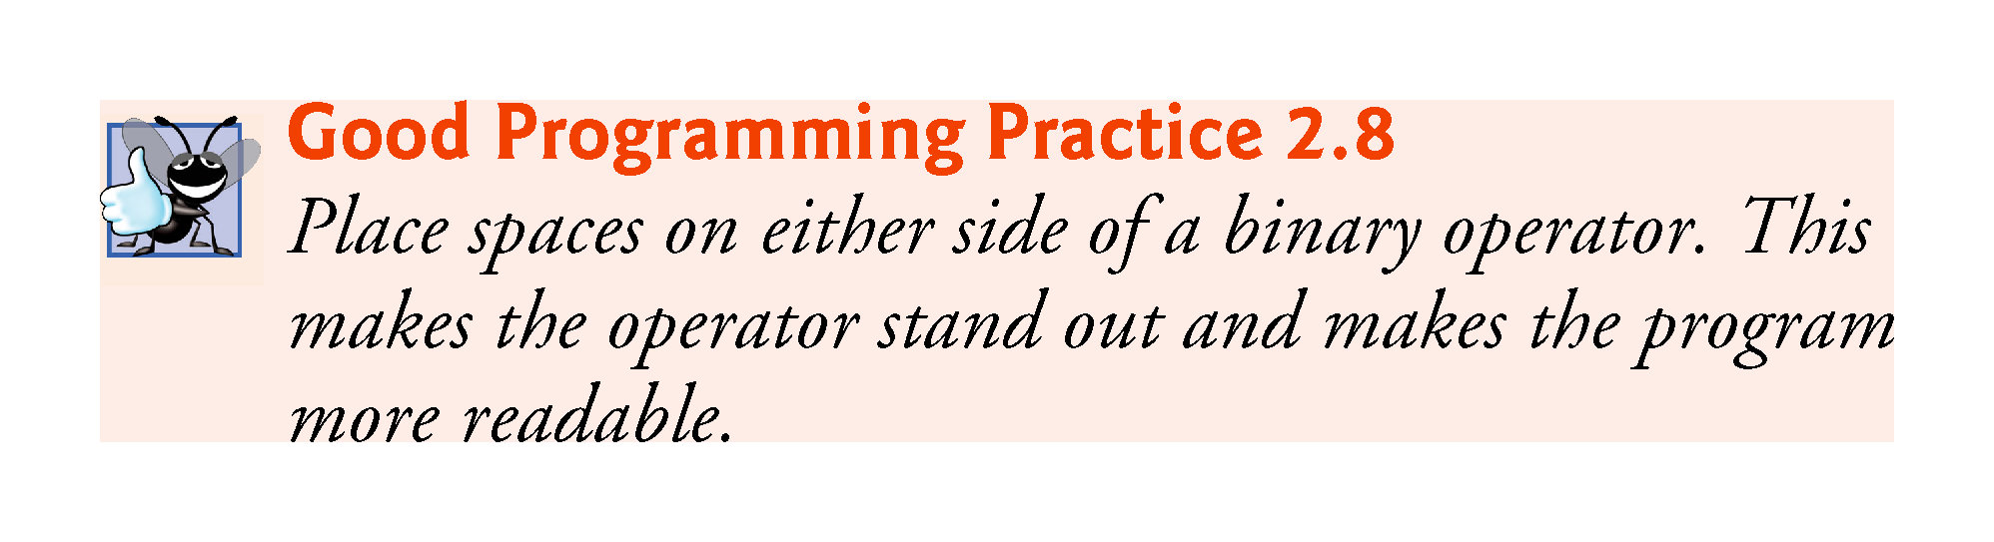

Slide 44
2.4 Another C++ Program: Adding Integers (cont.)
std::endl is a so-called stream manipulator.
The name endl is an abbreviation for “end line” and belongs to namespace std.
The std::endl stream manipulator outputs a newline, then “flushes the output buffer.”
This simply means that, on some systems where outputs accumulate in the machine until there are enough to “make it worthwhile” to display them on the screen, std::endl forces any accumulated outputs to be displayed at that moment.
This can be important when the outputs are prompting the user for an action, such as entering data.

Slide 45
2.4 Another C++ Program: Adding Integers (cont.)
Using multiple stream insertion operators (<<) in a single statement is referred to as concatenating, chaining or cascading stream insertion operations.
Calculations can also be performed in output statements.

Slide 46
2.5 Memory Concepts
Variable names such as number1, number2 and sum actually correspond to locations in the computer’s memory.
Every variable has a name, a type, a size and a value.
When a value is placed in a memory location, the value overwrites the previous value in that location; thus, placing a new value into a memory location is said to be destructive.
When a value is read out of a memory loca-tion, the process is nondestructive.

Slide 47
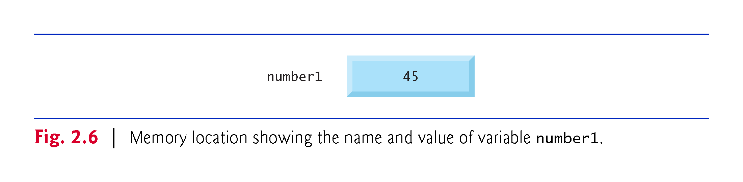

Slide 48
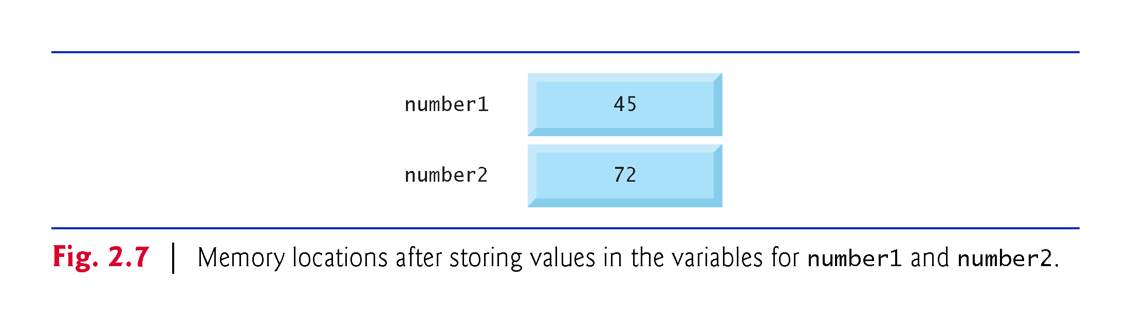

Slide 49
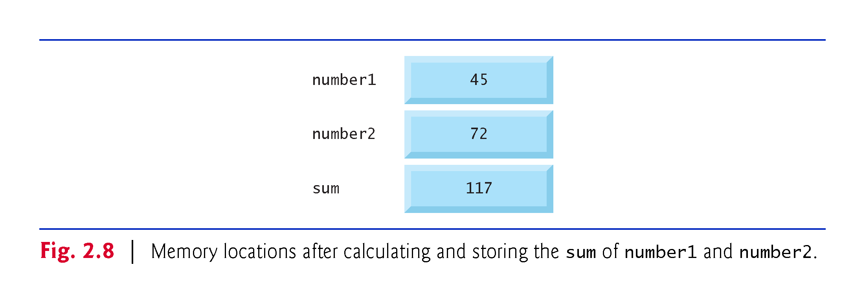

Slide 50
2.6 Arithmetic
Most programs perform arithmetic calculations.
Figure 2.9 summarizes the C++ arithmetic operators.
The asterisk (*) indicates multiplication.
The percent sign (%) is the remainder operator.
Yields the remainder after integer division.
Can be used only with integer operands.
The arithmetic operators are all binary operators.
Integer division (i.e., where both the numerator and the denominator are integers) yields an integer quotient.
Any fractional part in integer division is discarded (i.e., truncated)—no rounding occurs.

Slide 51
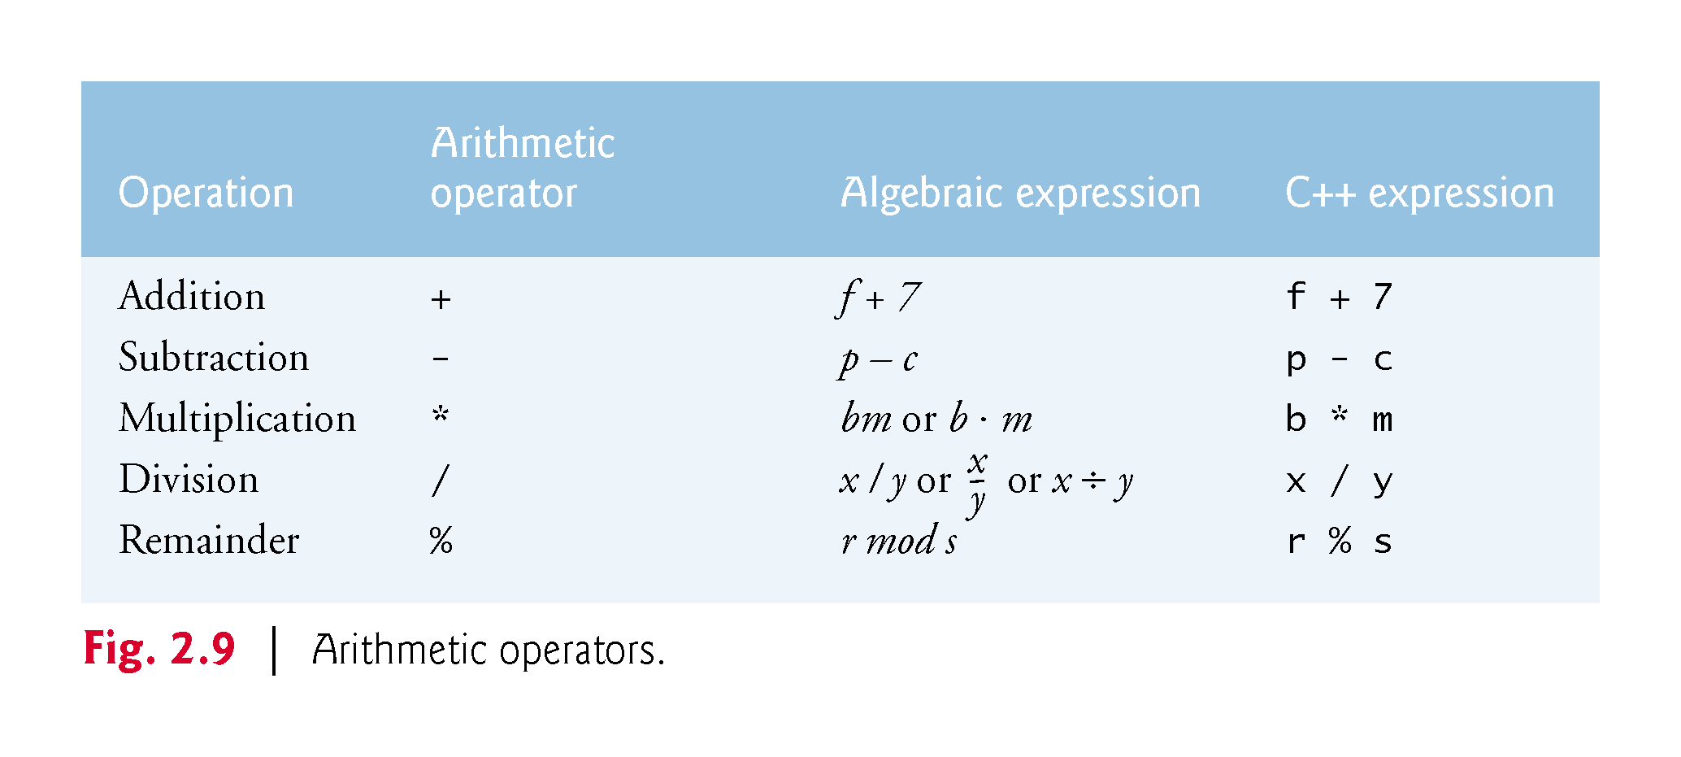

Slide 52
2.6 Arithmetic (cont.)
Arithmetic expressions in C++ must be entered into the computer in straight-line form.
Expressions such as “a divided by b” must be written as a / b, so that all constants, variables and operators appear in a straight line.
Parentheses are used in C++ expressions in the same manner as in algebraic expressions.
For example, to multiply a times the quantity b + c we write
a * ( b + c )

Slide 53
2.6 Arithmetic (cont.)
C++ applies the operators in arithmetic expressions in a precise sequence determined by the following rules of operator precedence, which are generally the same as those followed in algebra.

Slide 54
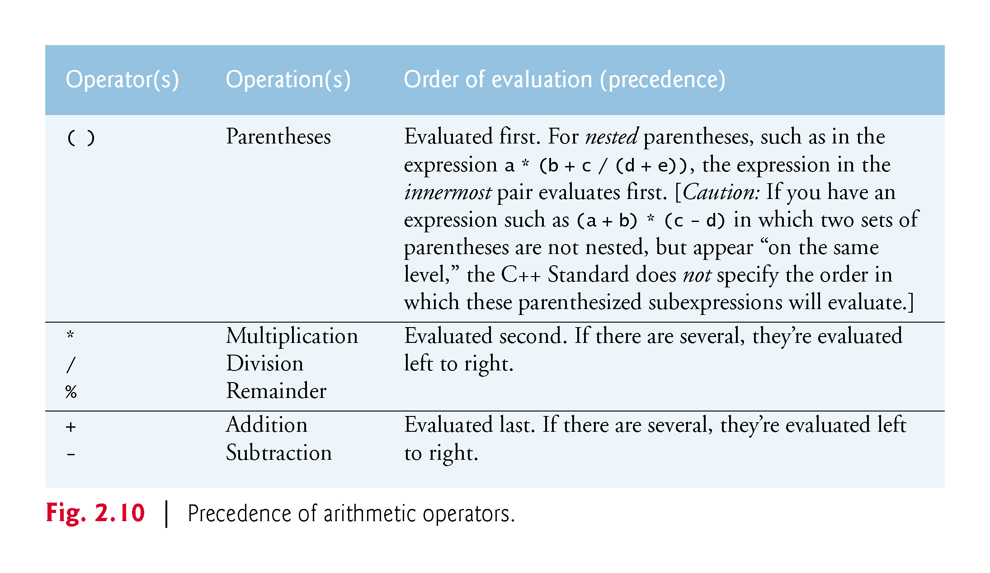

Slide 55
2.6 Arithmetic (cont.)
There is no arithmetic operator for exponentiation in C++, so x² is represented as x * x.
Figure 2.11 illustrates the order in which the operators in a second-degree polynomial are applied.
As in algebra, it’s acceptable to place redundant parentheses in an expression to make the expression clearer.

Slide 56
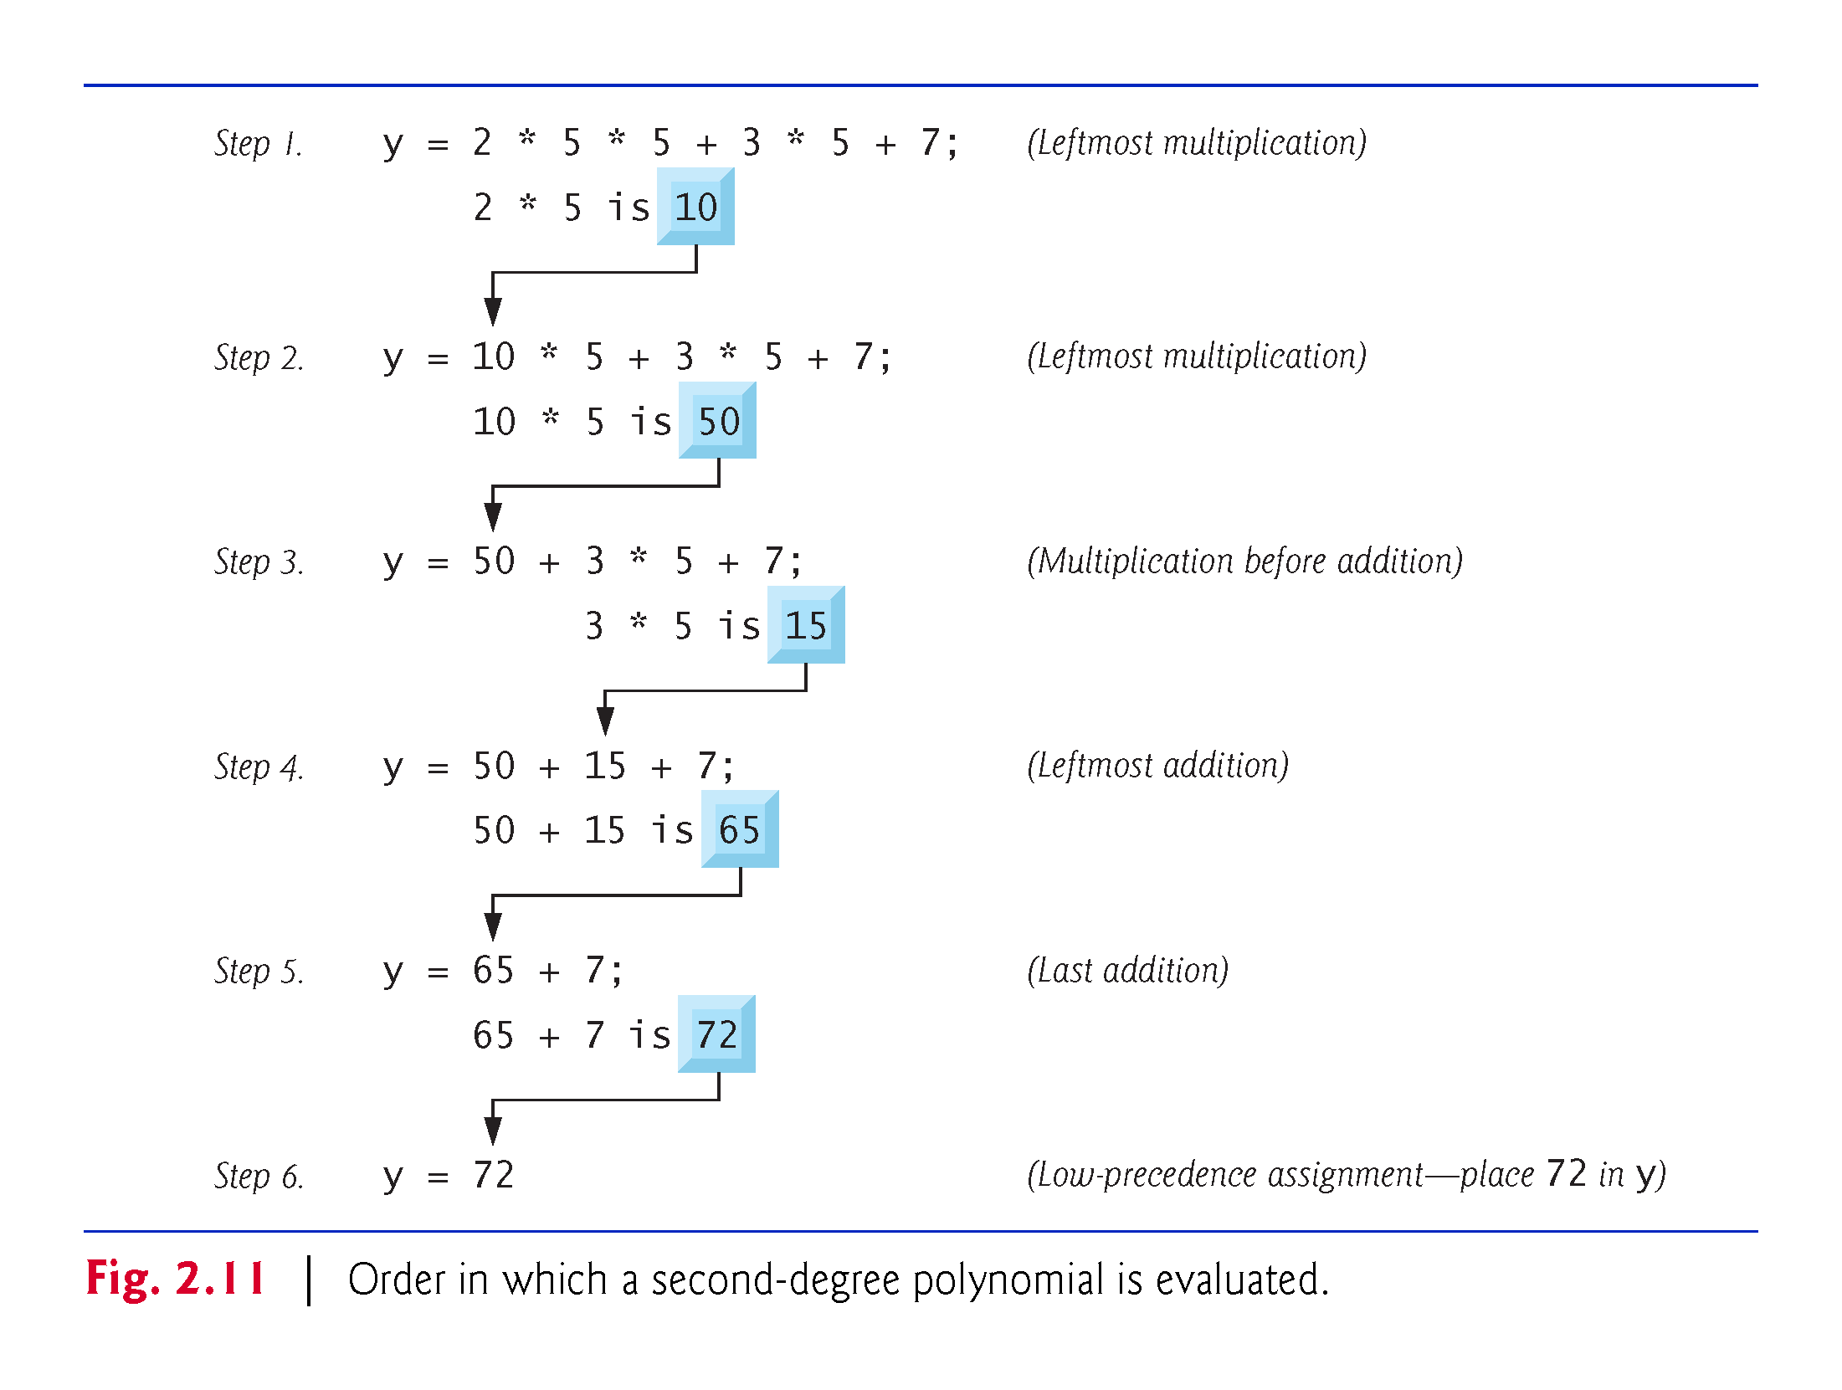

Slide 57
2.7 Decision Making: Equality and Relational Operators
The if statement allows a program to take alternative action based on whether a condition is true or false.
If the condition is true, the statement in the body of the if statement is executed.
If the condition is false, the body statement is not executed.
Conditions in if statements can be formed by using the equality operators and relational operators (Fig. 2.12).
The relational operators all have the same level of precedence and associate left to right.
The equality operators both have the same level of precedence, which is lower than that of the relational operators, and associate left to right.

Slide 58
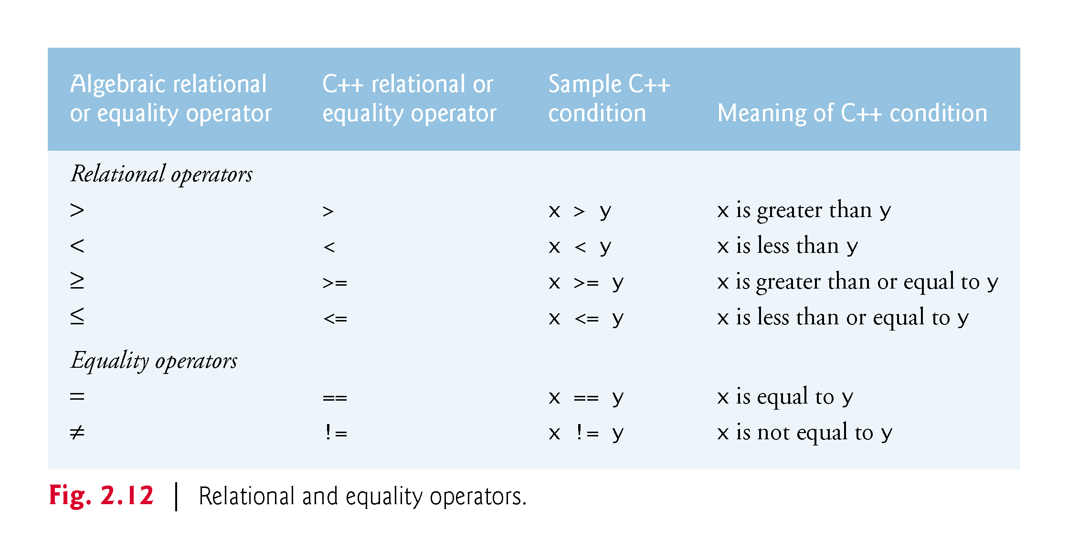

Slide 59
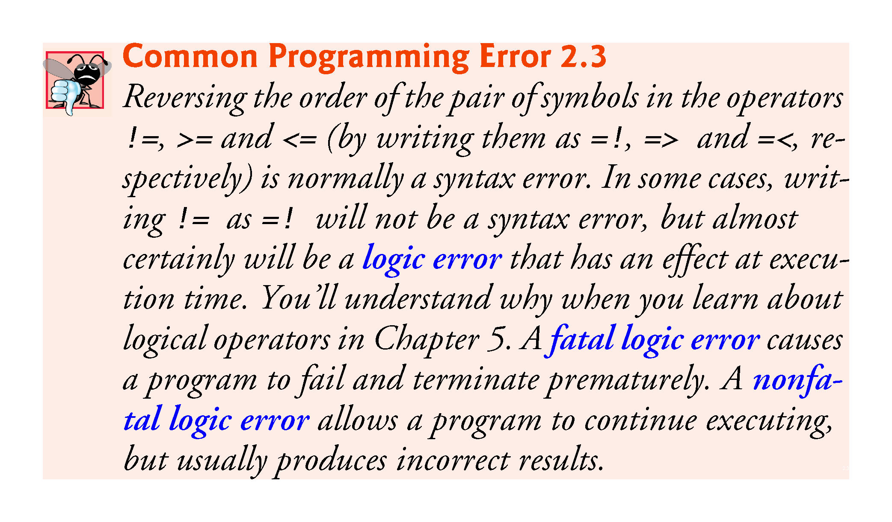

Slide 60
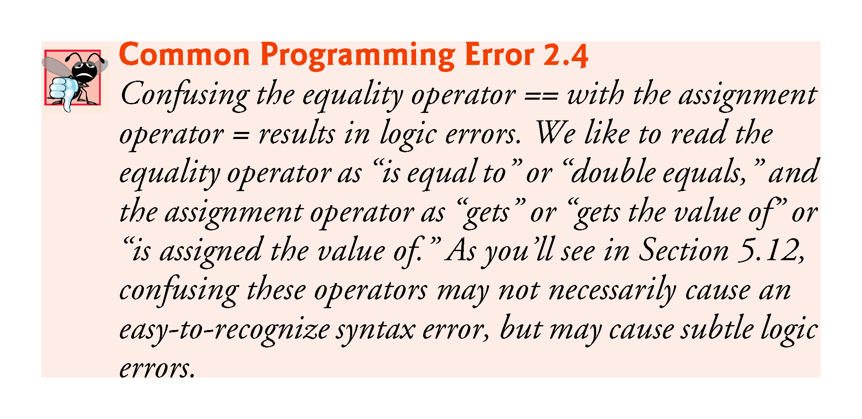

Slide 61
2.7 Decision Making: Equality and Relational Operators (cont.)
Fig. 2.12 uses six if statements to compare two numbers input by the user.
If the condition in any of these if statements is satisfied, the output statement associated with that if statement executes.
Figure 2.13 shows the program and the input/output dialogs of three sample executions.

Slide 62
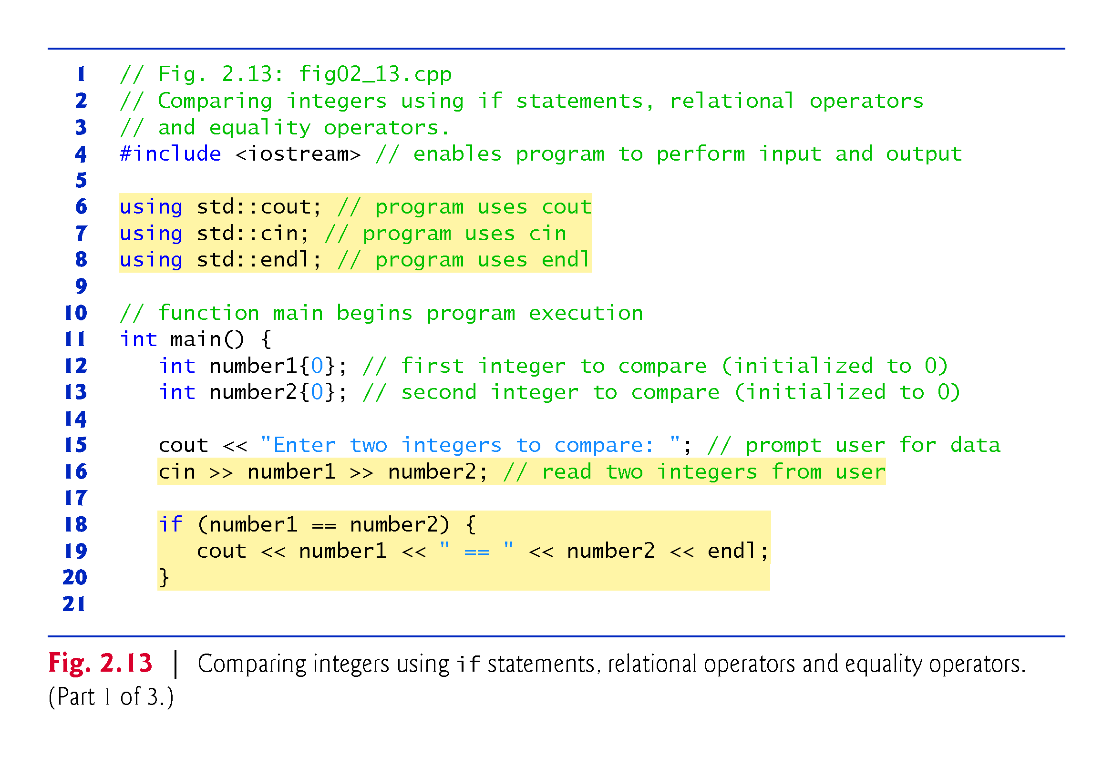

Slide 63
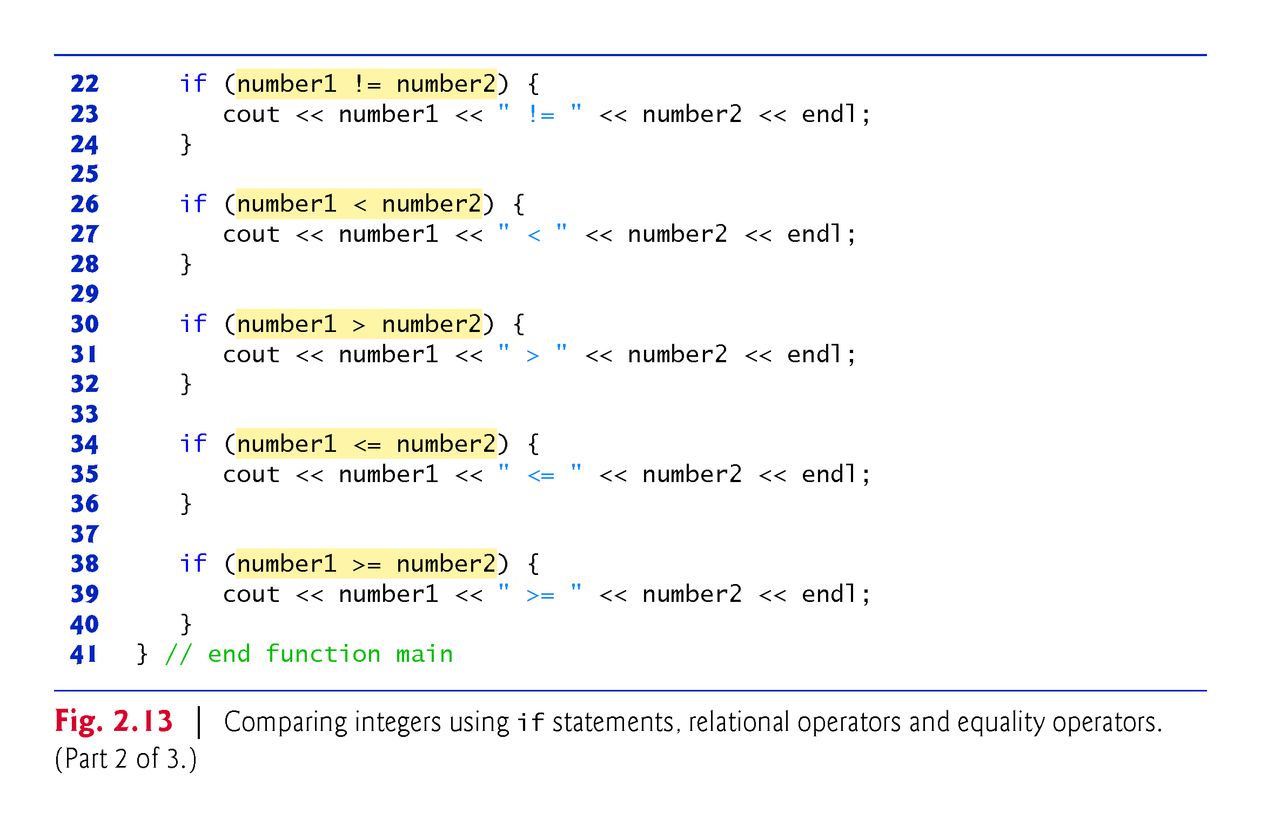

Slide 64
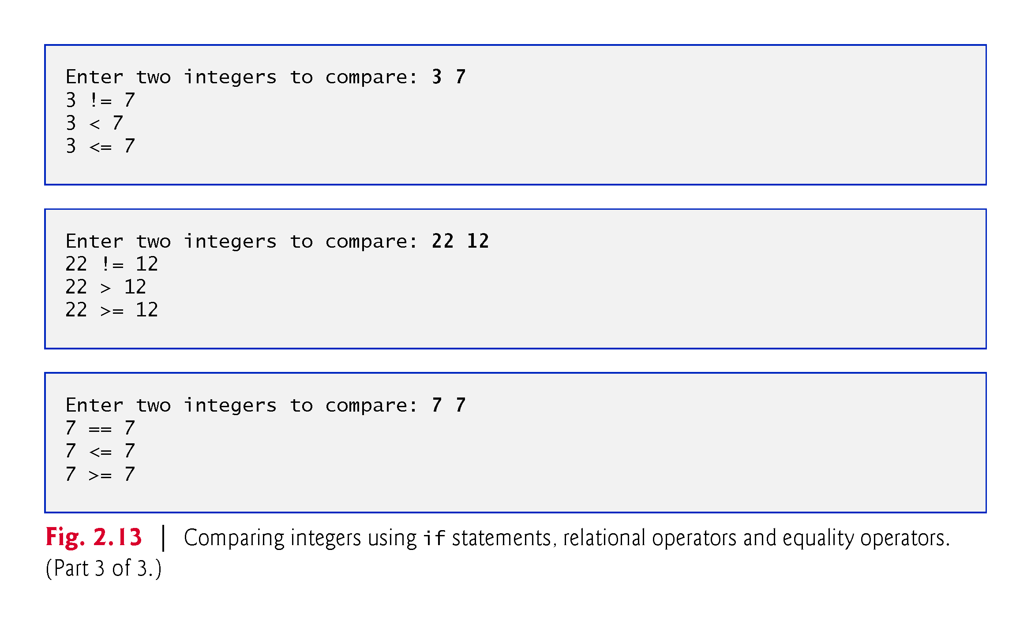

Slide 65
2.7 Decision Making: Equality and Relational Operators (cont.)
using declarations eliminate the need to repeat the std:: prefix.
Can write cout instead of std::cout, cin instead of std::cin and endl instead of std::endl, respectively, in the remainder of the program.
Many programmers prefer to use the declaration
using namespace std;
which enables a program to use all the names in any standard C++ header file (such as <iostream>) that a program might include.
From this point forward in the book, we’ll use the preceding declaration in our programs.

Slide 66
2.7 Decision Making: Equality and Relational Operators (cont.)
Each if statement in Fig. 2.13 has a single statement in its body and each body statement is indented.
Each if statement’s body is enclosed in a pair of braces, { }, creating what’s called a compound statement or a block that may contain multiple statements.

Slide 67


Slide 68
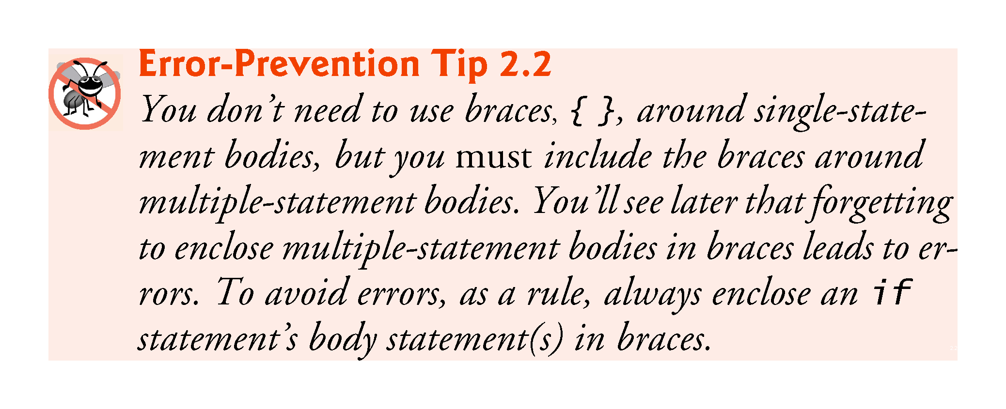

Slide 69
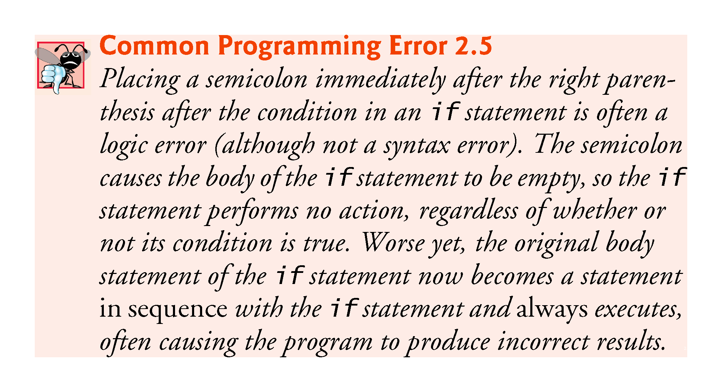

Slide 70
2.7 Decision Making: Equality and Relational Operators (cont.)
Statements may be split over several lines and may be spaced according to your preferences.
It’s a syntax error to split identifiers, strings (such as "hello") and constants (such as the number 1000) over several lines.

Slide 71
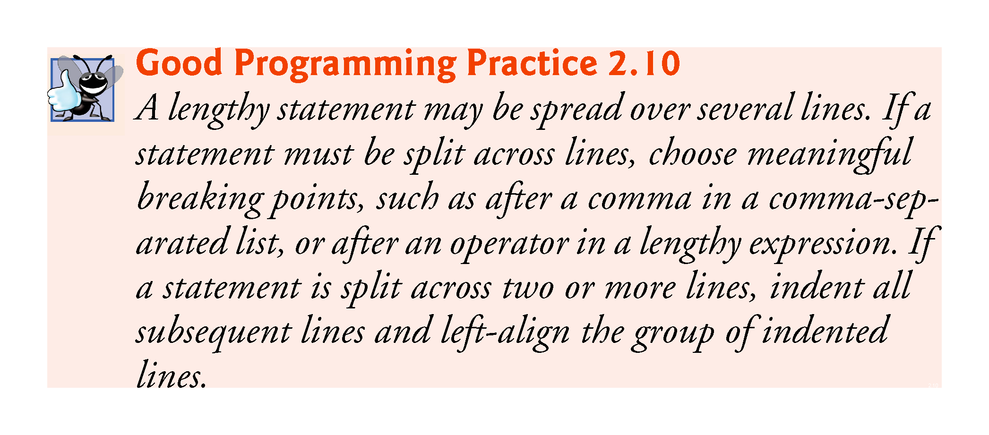

Slide 72
2.7 Decision Making: Equality and Relational Operators (cont.)
Figure 2.14 shows the precedence and associativity of the operators introduced in this chapter.
The operators are shown top to bottom in decreasing order of precedence.
All these operators, with the exception of the assignment operator =, associate from left to right.

Slide 73
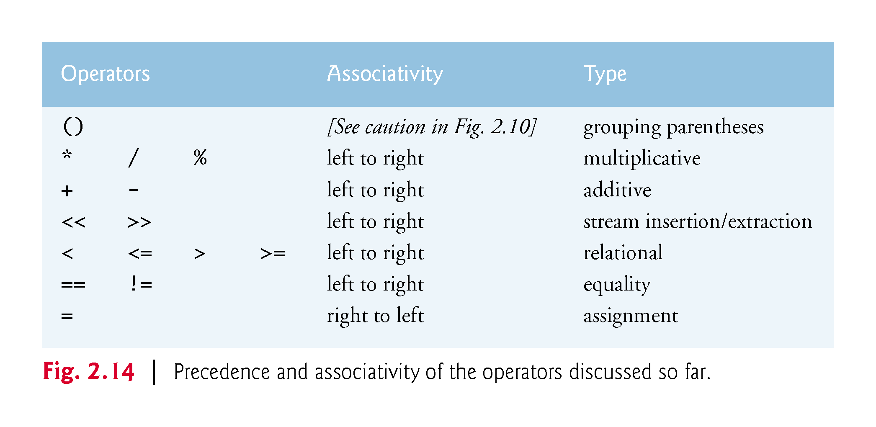

Slide 74
