Slide 1
Class Templates array and vector; Catching Exceptions
Chapter 7 of C++ How to Program, 10/e

Slide 2
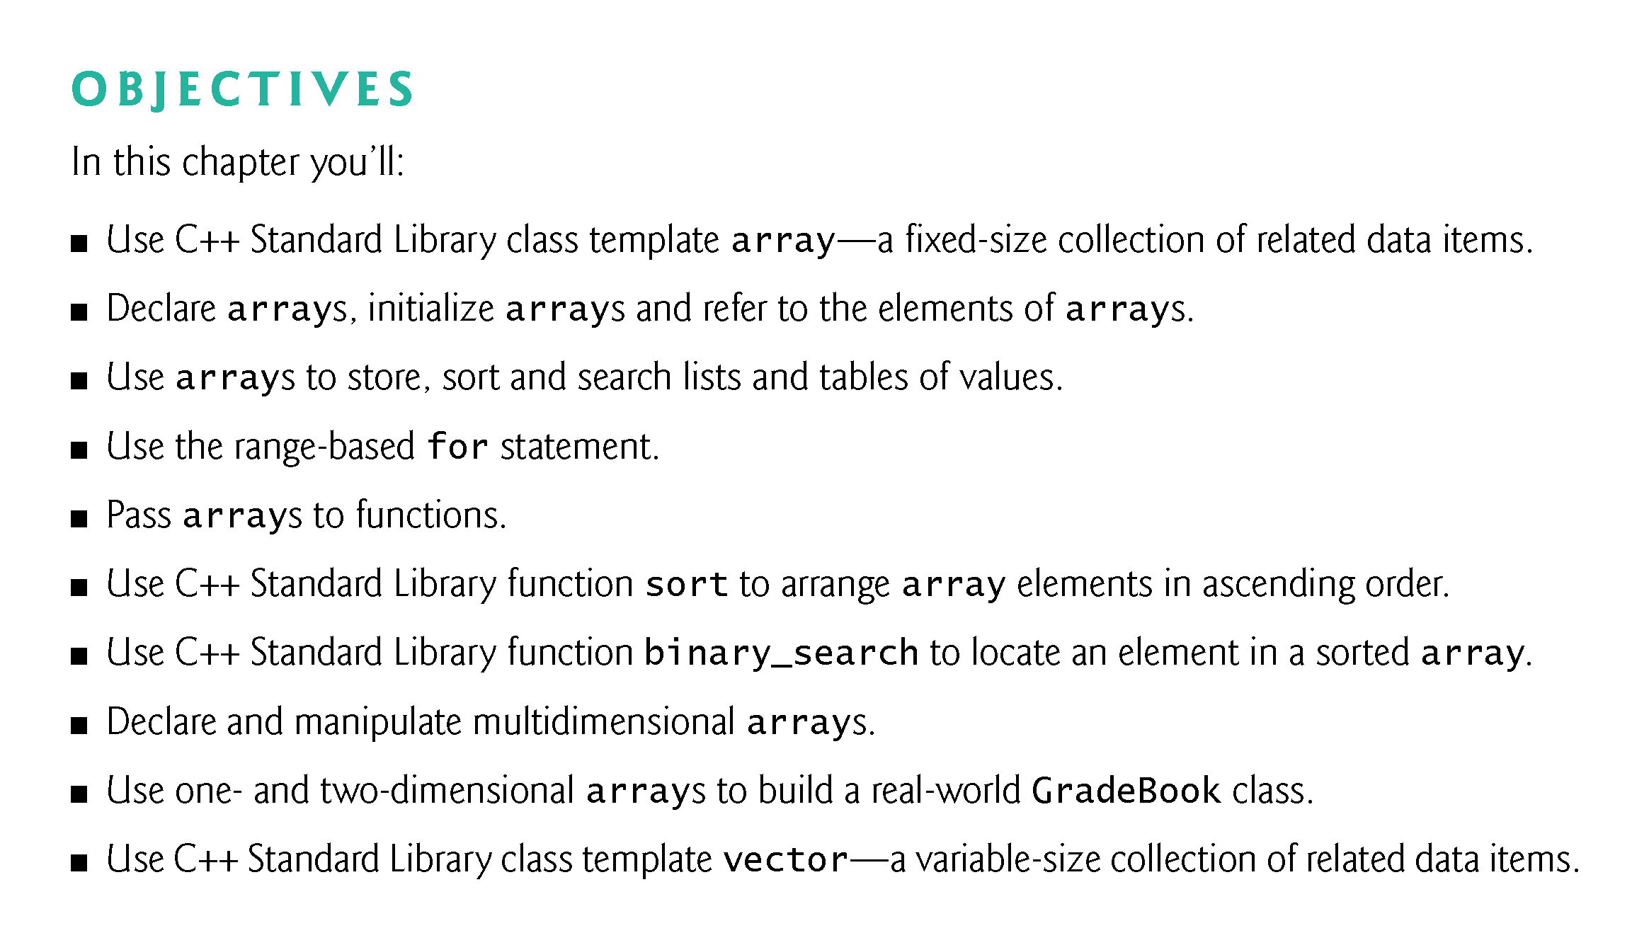

Slide 3
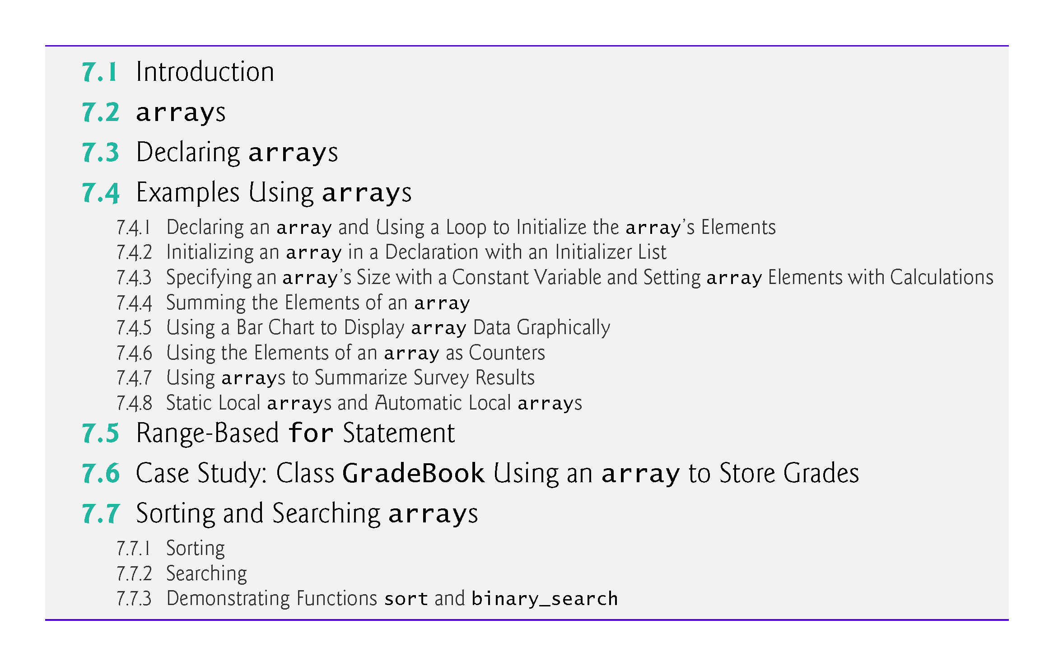

Slide 4
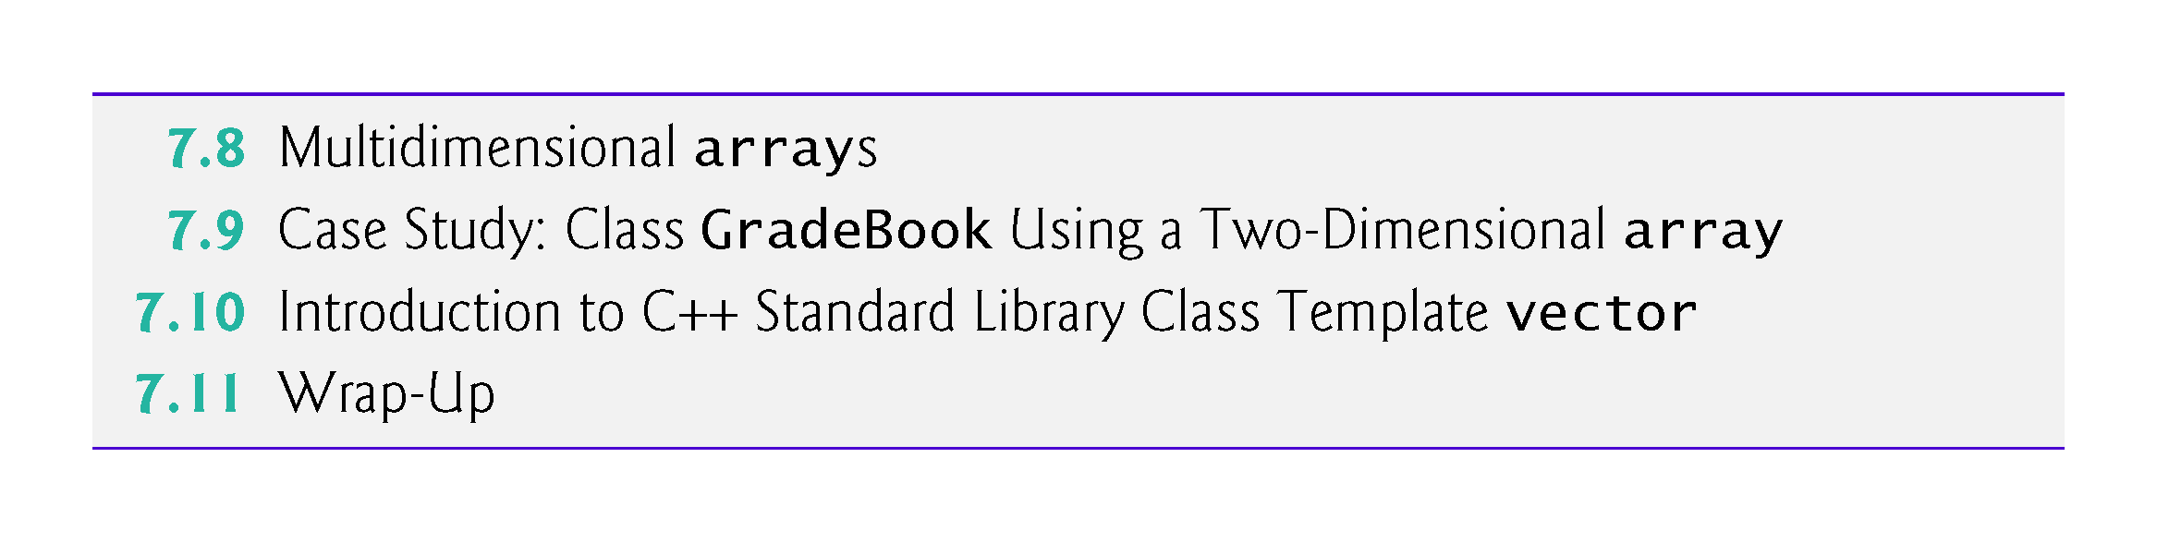

Slide 5
7.1 Introduction
This chapter introduces the topic of data structures—collections of related data items.
We discuss arrays which are fixed-size collections consisting of data items of the same type, and vectors which are collections (also of data items of the same type) that can grow and shrink dynamically at execution time.
Both array and vector are C++ standard library class templates.
We present examples that demonstrate several common array manipulations and introduce exception handling.

Slide 6
7.2 arrays
An array is a contiguous group of memory locations that all have the same type.
To refer to a particular location or element in the array, specify the name of the array and the position number of the particular element.
Figure 7.1 shows an integer array called c.
12 elements.
The position number is more formally called a subscript or index (this number specifies the number of elements from the beginning of the array).
The first element in every array has subscript 0 (zero) and is sometimes called the zeroth element.
The highest subscript in array c is 11, which is 1 less than the number of elements in the array (12).
A subscript must be an integer or integer expression (using any integral type).

Slide 7
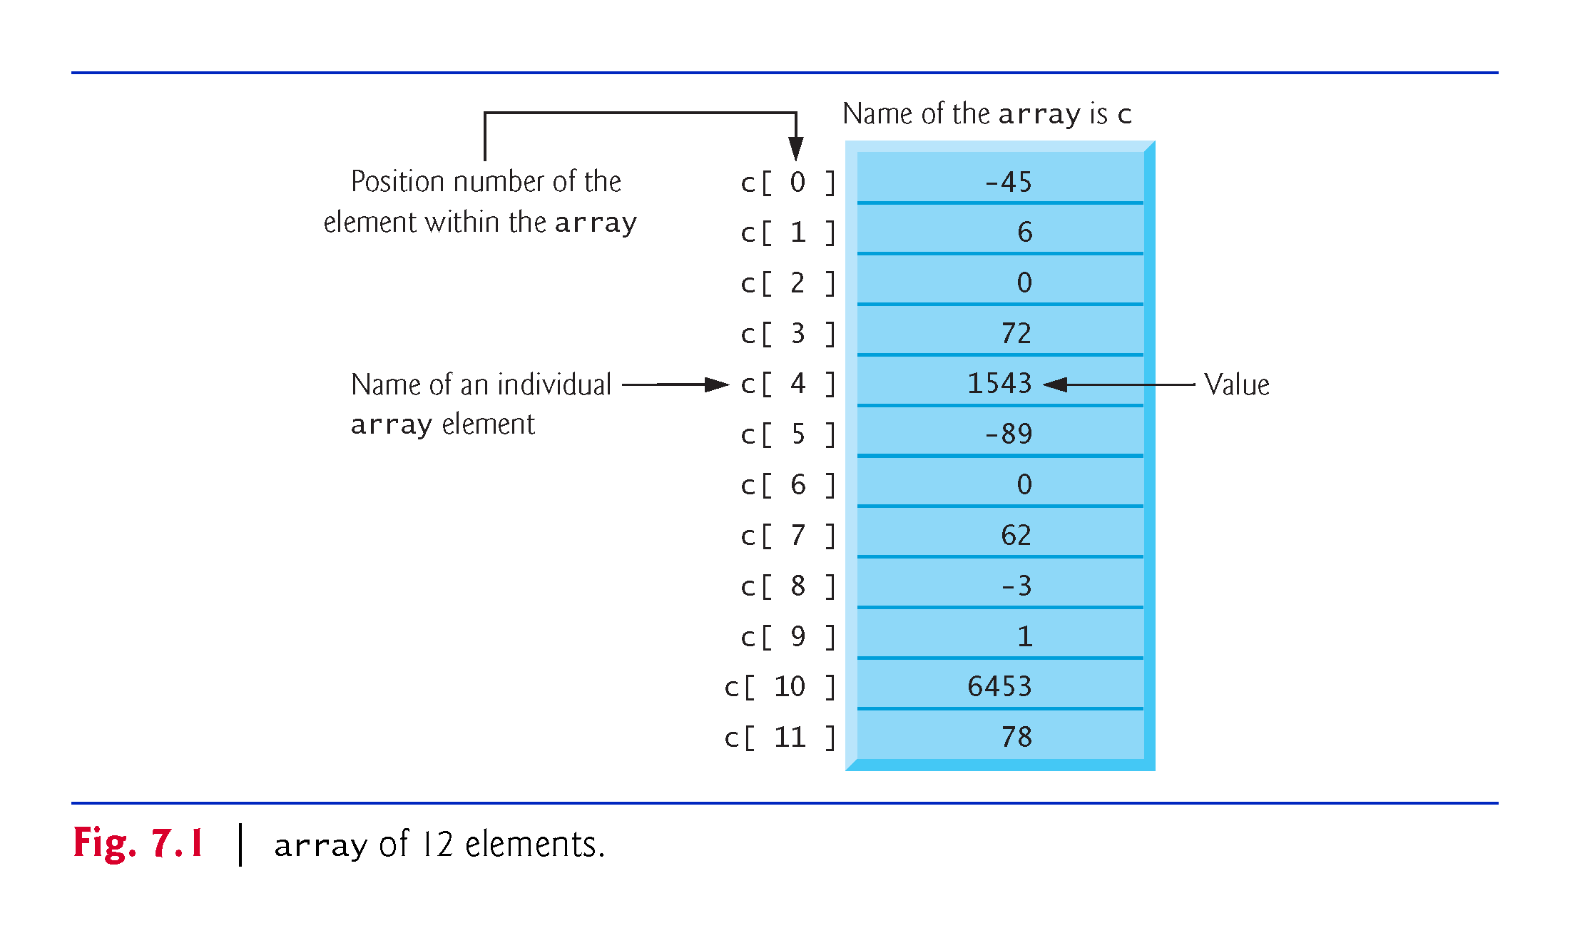

Slide 8
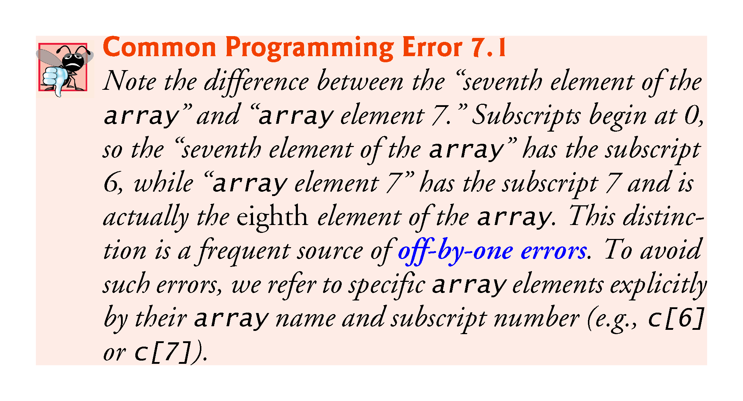

Slide 9
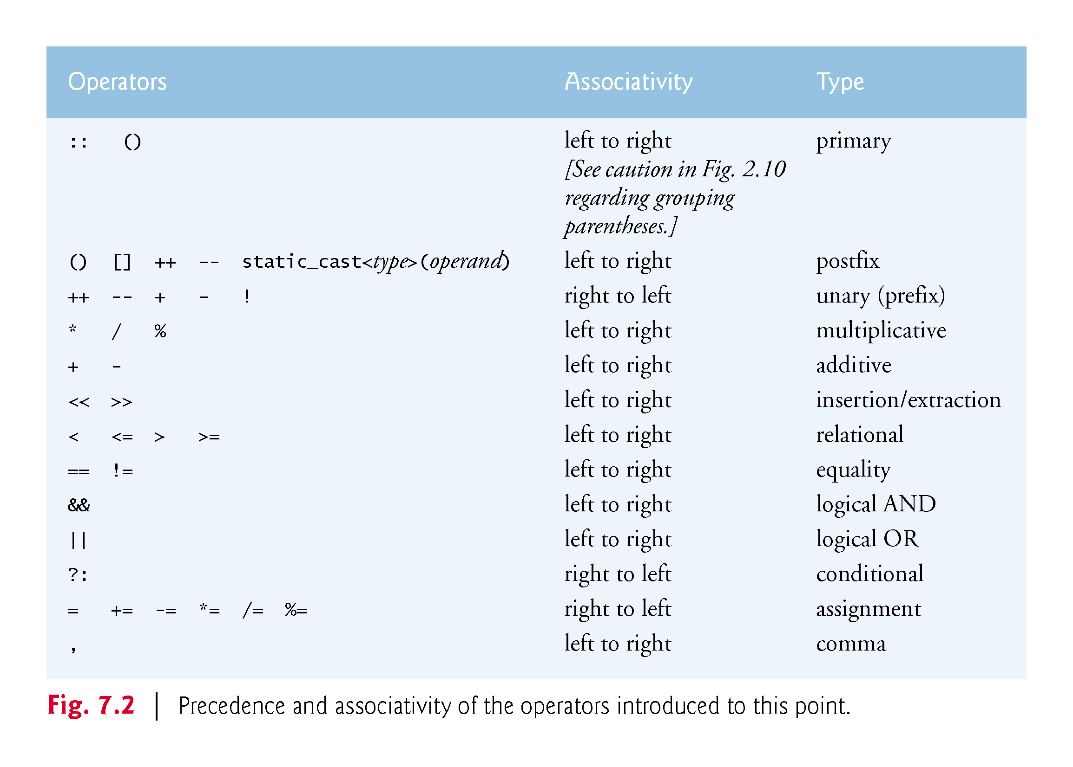

Slide 10
7.3 Declaring arrays
arrays occupy space in memory.
To specify the type of the elements and the number of elements required by an array use a declaration of the form:
array< type, arraySize > arrayName;
The notation <type, arraySize> indicates that array is a class template.
The compiler reserves the appropriate amount of memory based on the type of the elements and the arraySize.
arrays can be declared to contain values of most data types.

Slide 11
7.4 Examples Using arrays
The following examples demonstrate how to declare arrays, how to initialize arrays and how to perform common array manipulations.

Slide 12
7.4.1 Declaring an array and Using a Loop to Initialize the array’s Elements
The program in Fig. 7.3 declares five-element integer array n (line 10).
size_t represents an unsigned integral type.
This type is recommended for any variable that represents an array’s size or an array’s subscripts. Type size_t is defined in the std namespace and is in header <cstddef>, which is included by various other headers.
If you attempt to compile a program that uses type size_t and receive errors indicating that it’s not defined, simply include <cstddef> in your program.

Slide 13
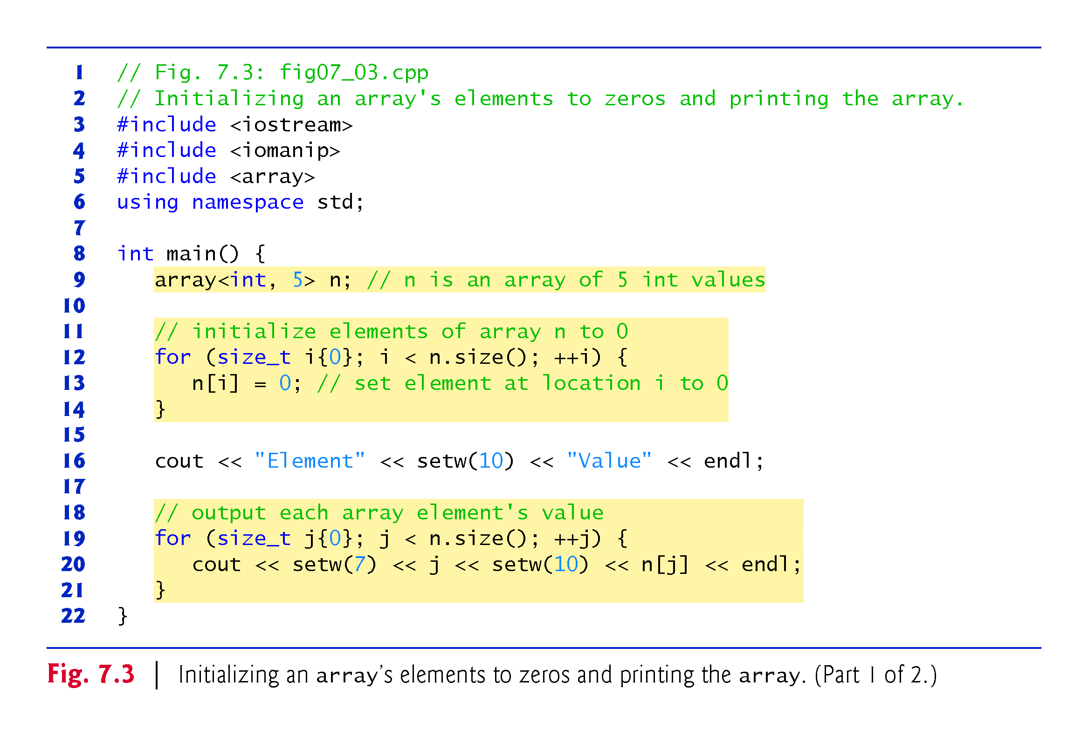

Slide 14
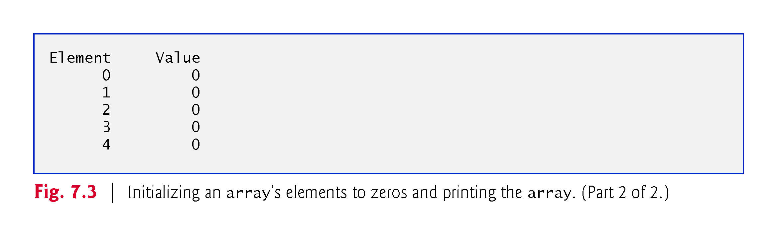

Slide 15
7.4.2 Initializing an array in a Declaration with an Initializer List
The elements of an array also can be initialized in the array declaration by following the array name with an equals sign and a brace-delimited comma-separated list of initializers.
The program in Fig. 7.4 uses an initializer list to initialize an integer array with five values (line 11) and prints the array in tabular format (lines 13–17).
If there are fewer initializers than elements in the array, the remaining array elements are initialized to zero.
If there are more, a compilation error occurs.

Slide 16
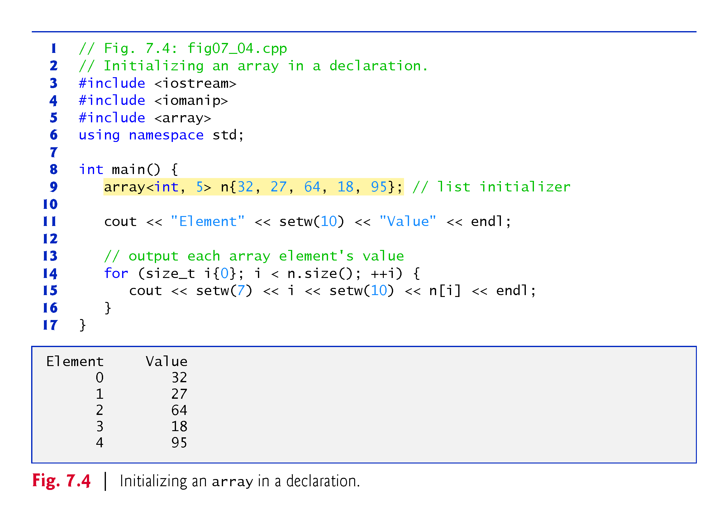

Slide 17
7.4.3 Specifying an array’s Size with a Constant Variable and Setting array Elements with Calculations
Figure 7.5 sets the elements of a 5-element array values to the even integers 2, 4, 6, 8 and 10 and prints the array in tabular format.
Line 10 uses the const qualifier to declare a constant variable arraySize with the value 5.
A constant variable that’s used to specify array’s size must be initialized with a constant expression when it’s declared and cannot be modified thereafter.
Constant variables are also called named constants or read-only variables.

Slide 18
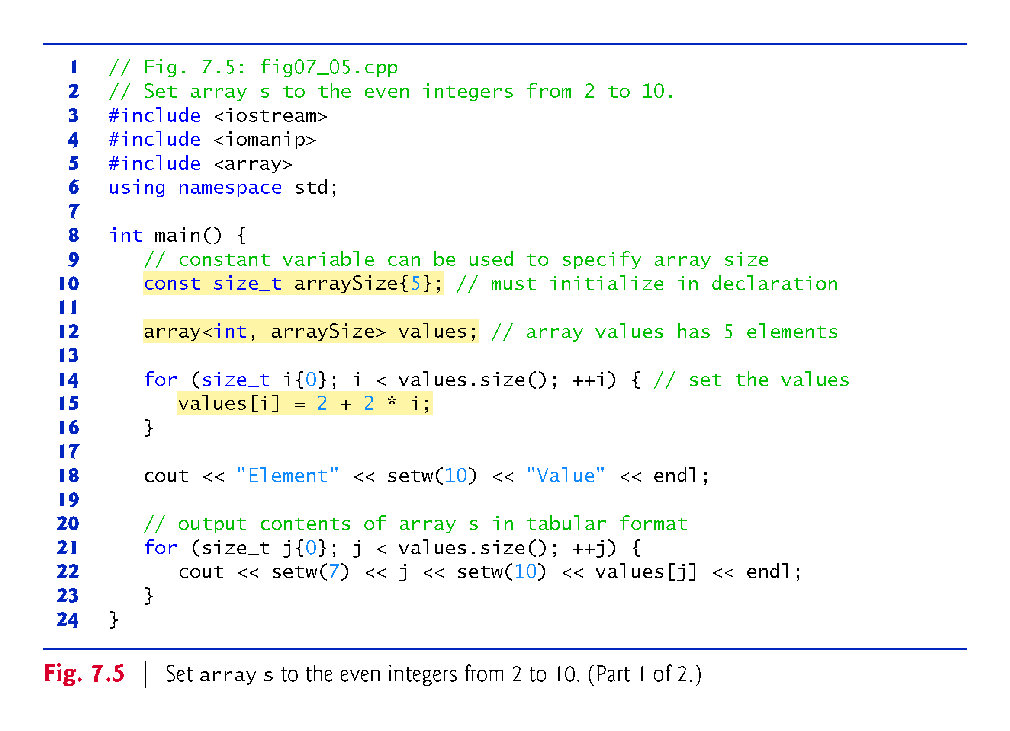

Slide 19
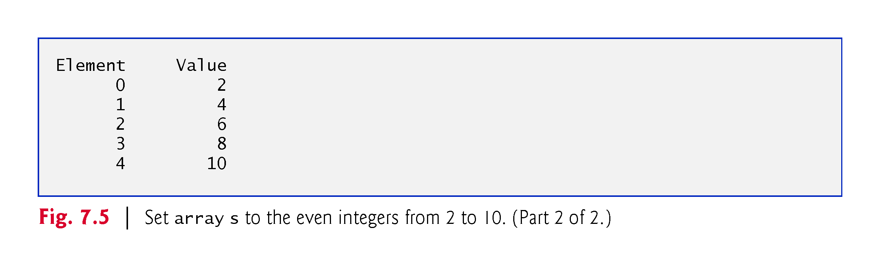

Slide 20


Slide 21
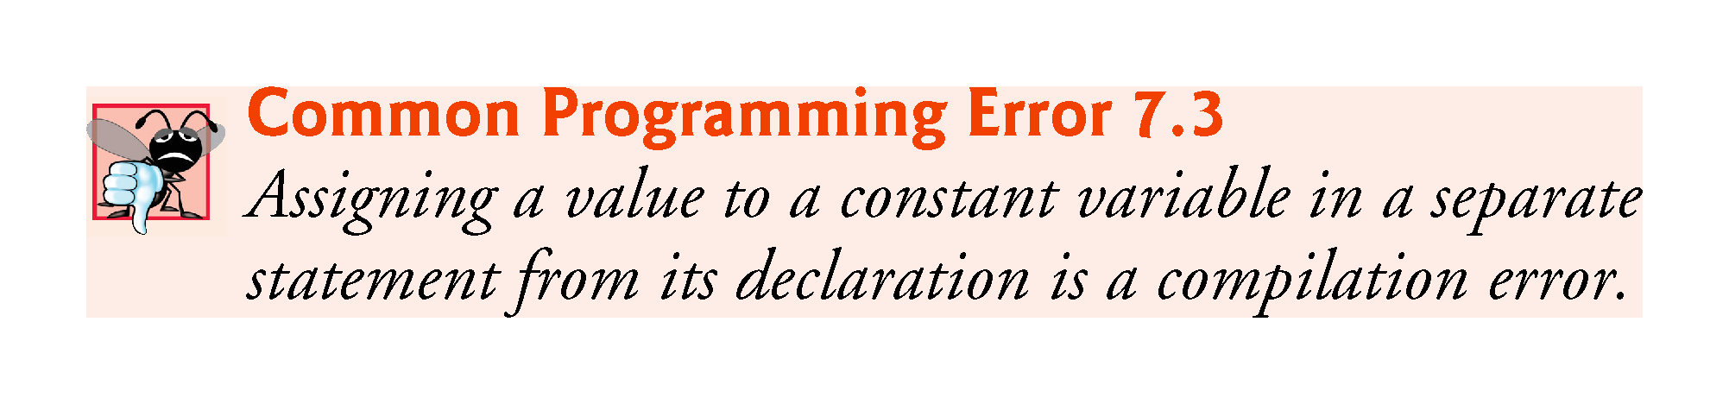

Slide 22
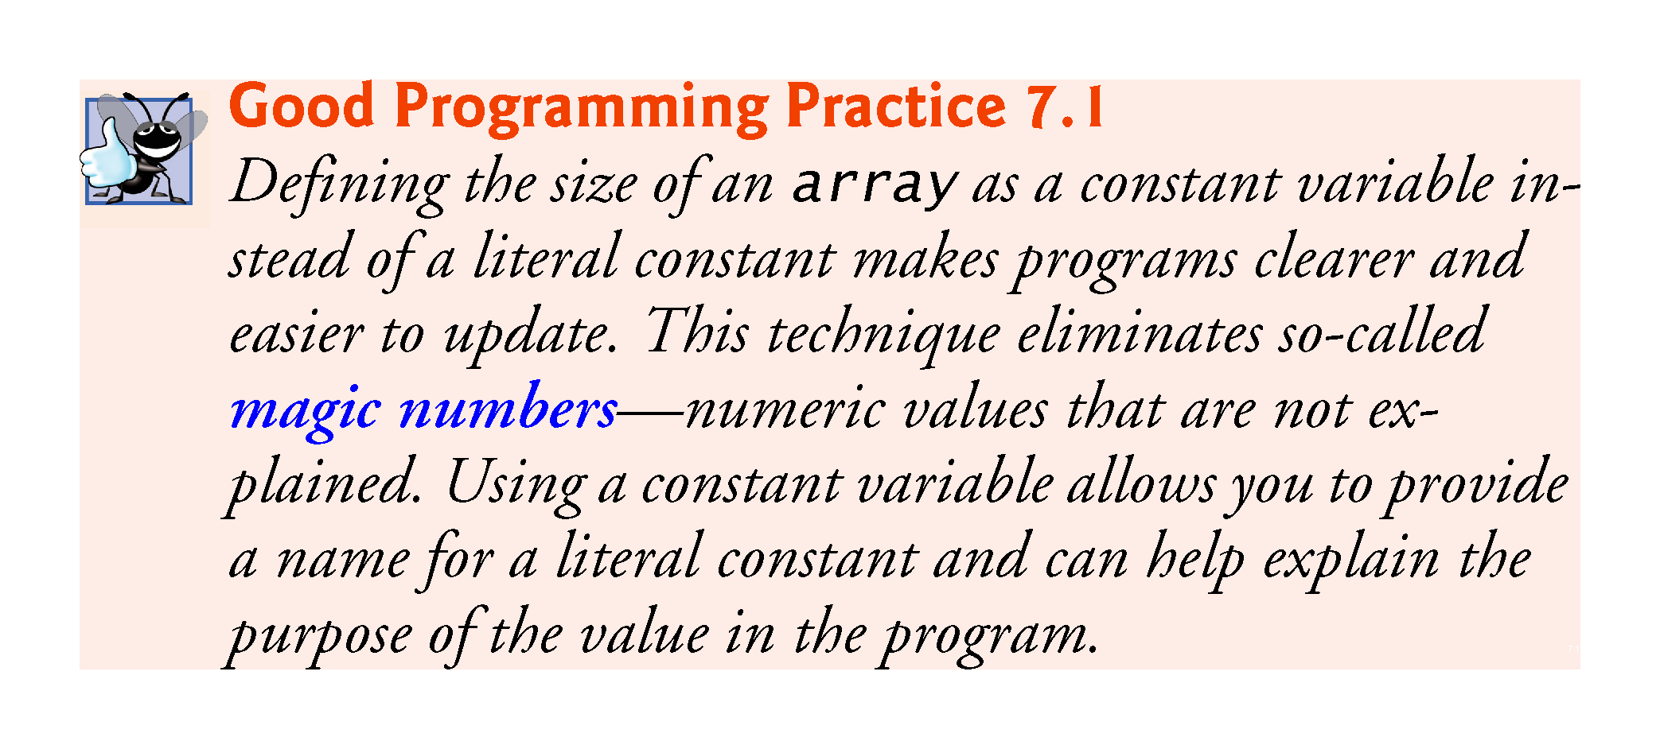

Slide 23
7.4.4 Summing the Elements of an array
Often, the elements of an array represent a series of values to be used in a calculation.
Fig. 7.6 sums the values contained in the four-element integer array a.

Slide 24
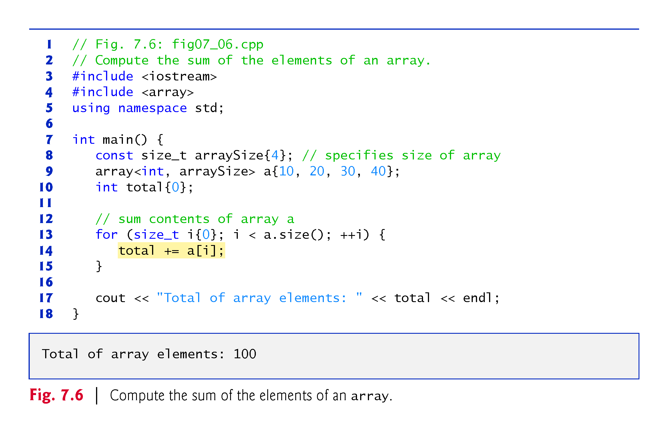

Slide 25
7.4.5 Using Bar Charts to Display array Data Graphically
Many programs present data to users graphically.
One simple way to display numeric data graphically is with a bar chart that shows each numeric value as a bar of asterisks (*).
Fig. 7.7 stores data in an array of 11 elements, each corresponding to a grade category.

Slide 26
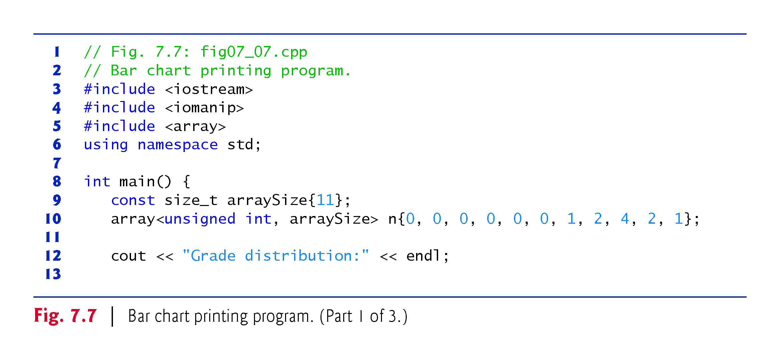

Slide 27
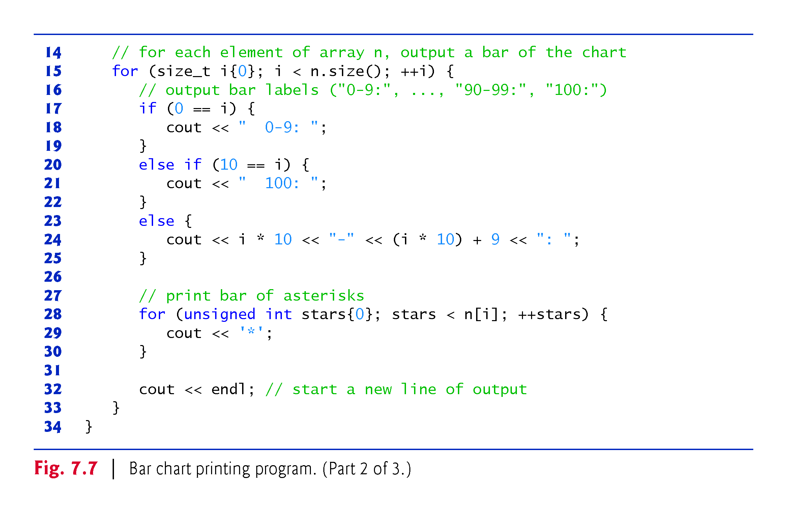

Slide 28
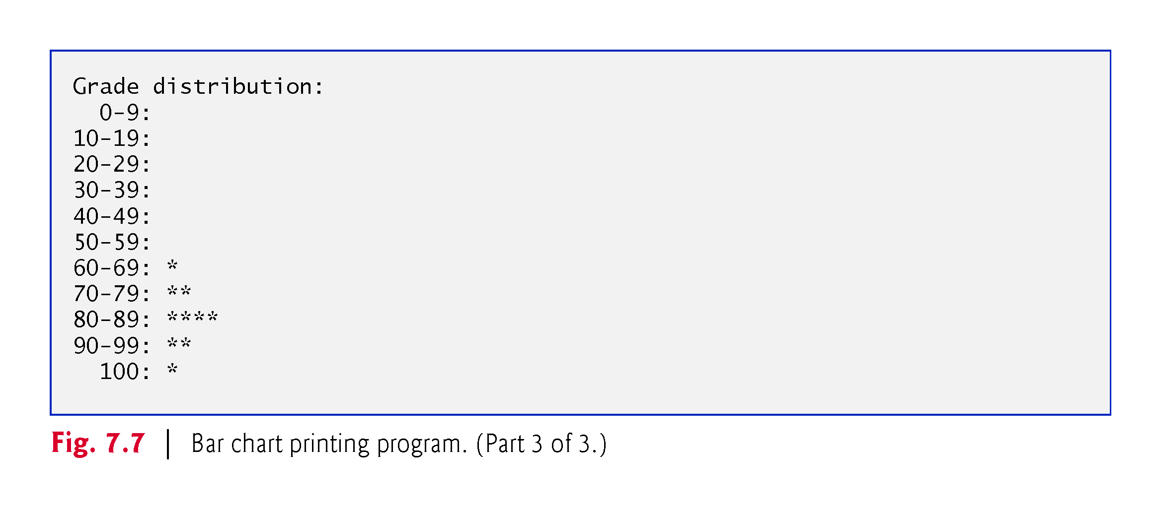

Slide 29
7.4.6 Using the Elements of an array as Counters
Sometimes, programs use counter variables to summarize data, such as the results of a survey.
In Fig. 6.9, we used separate counters in our die-rolling program to track the number of occurrences of each side of a die as the program rolled the die 60,000,000 times.
An array version of this program is shown in Fig. 7.8.
This version also uses the new C++11 random-number generation capabilities that were introduced in Section 6.9.
The single statement in line 21 of this program replaces the switch statement in Fig. 6.9.

Slide 30
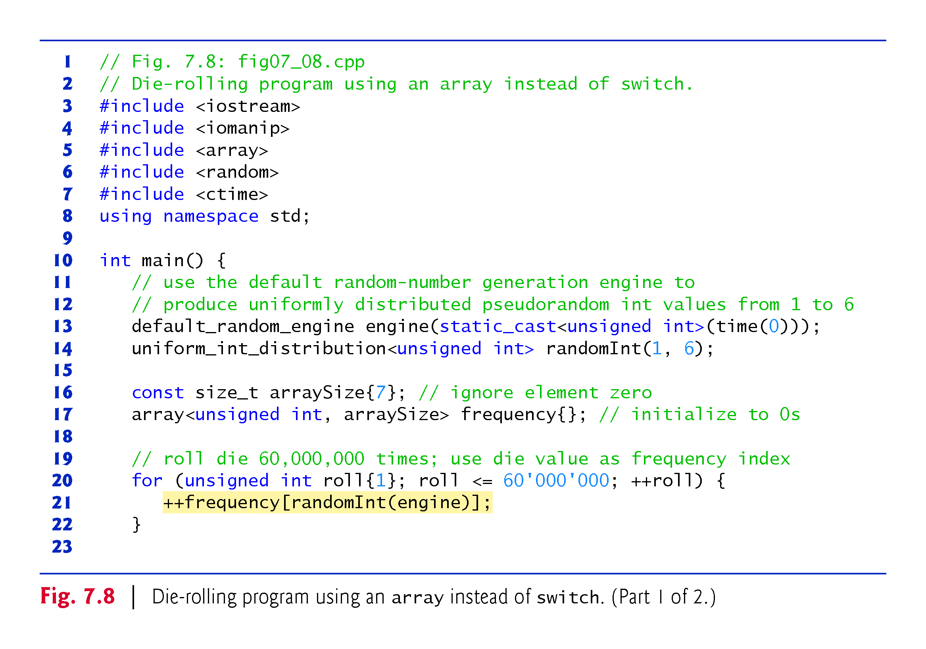

Slide 31
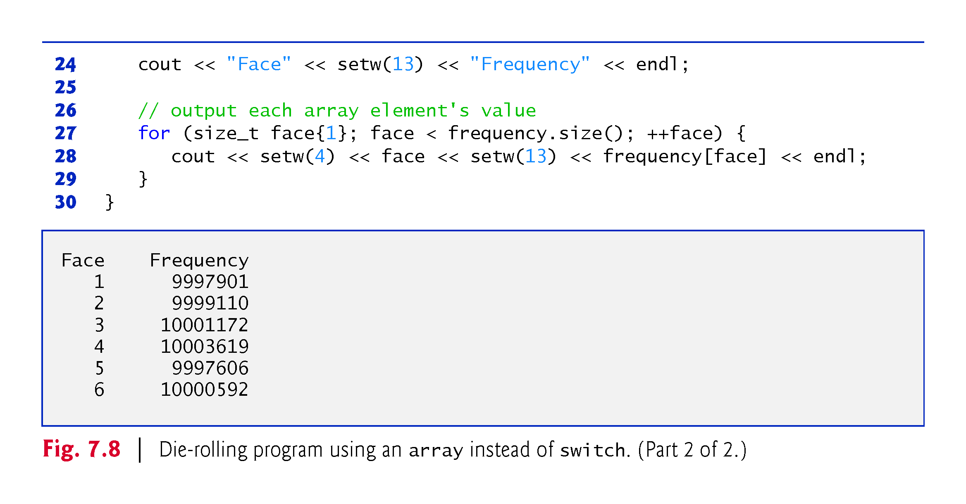

Slide 32
7.4.7 Using arrays to Summarize Survey Results
Fig. 7.9 uses arrays to summarize the results of data collected in a survey.
Consider the following problem statement:
Twenty students were asked to rate on a scale of 1 to 5 the quality of the food in the student cafeteria, with 1 being “awful” and 5 being “excellent.” Place the 20 responses in an integer array and determine the frequency of each rating.
C++ provides no automatic array bounds checking to prevent you from referring to an element that does not exist.
Thus, an executing program can “walk off” either end of an array without warning.
Class templates array and vector each have an at function that performs bounds checking for you.

Slide 33
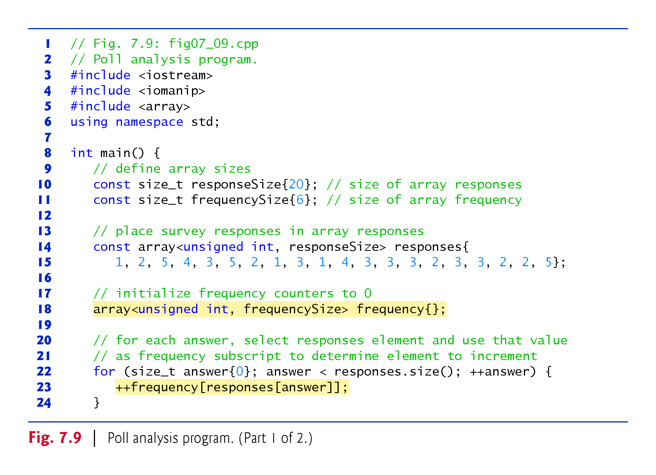

Slide 34
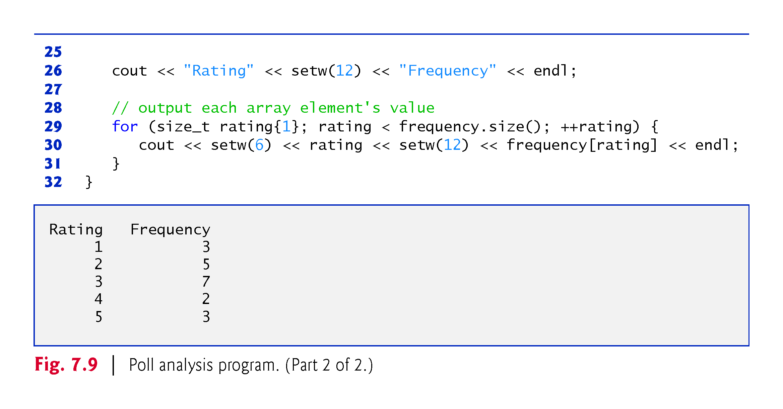

Slide 35
7.4.7 Using arrays to Summarize Survey Results
It’s important to ensure that every subscript you use to access an array element is within the array’s bounds—that is, greater than or equal to 0 and less than the number of array elements.
Allowing programs to read from or write to array elements outside the bounds of arrays are common security flaws.
Reading from out-of-bounds array elements can cause a program to crash or even appear to execute correctly while using bad data.
Writing to an out-of-bounds element (known as a buffer overflow) can corrupt a program’s data in memory, crash a program and allow attackers to exploit the system and execute their own code.

Slide 36
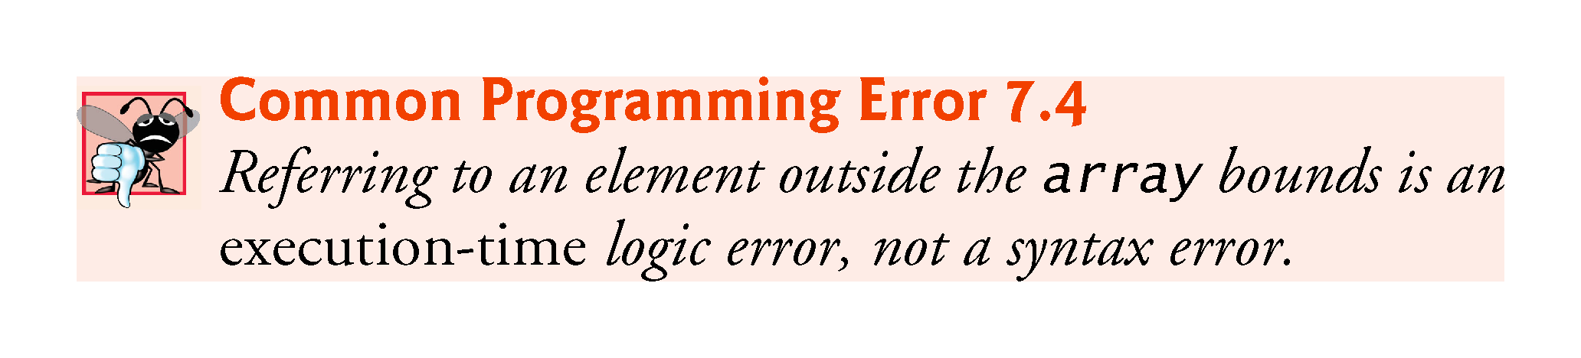

Slide 37
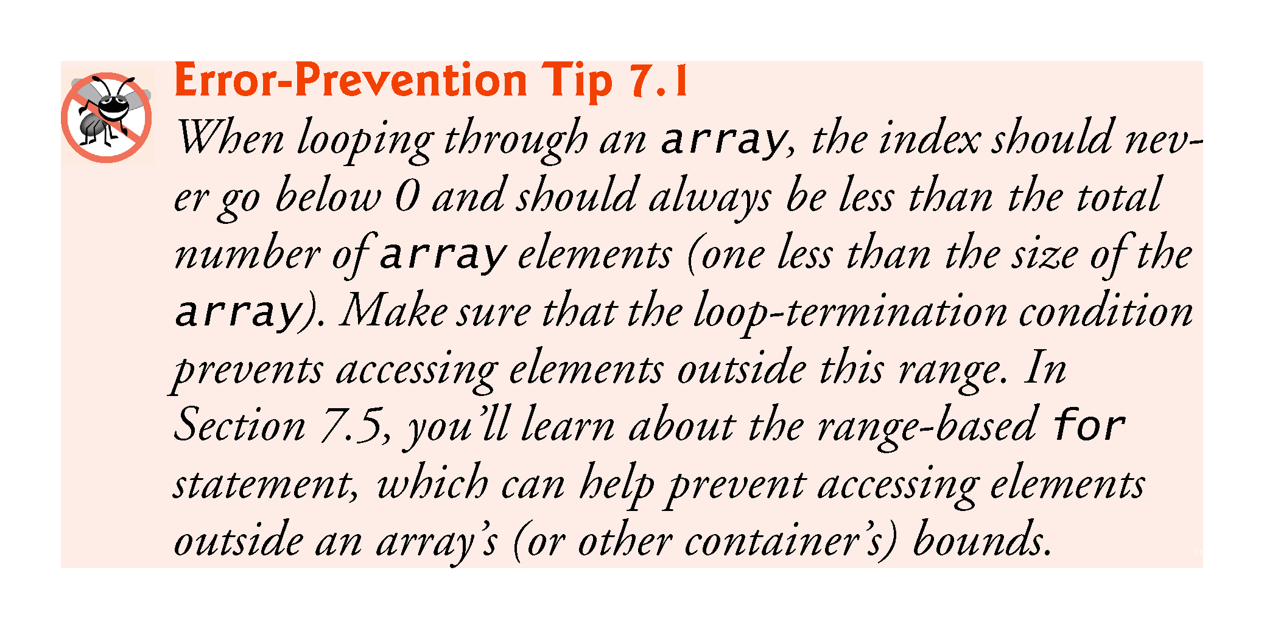

Slide 38
7.4.8 Static Local arrays and Automatic Local arrays
A program initializes static local arrays when their declarations are first encountered.
If a static array is not initialized explicitly by you, each element of that array is initialized to zero by the compiler when the array is created.
Local variables are sometimes called automatic variables because they’re automatically destroyed when the function finishes executing

Slide 39
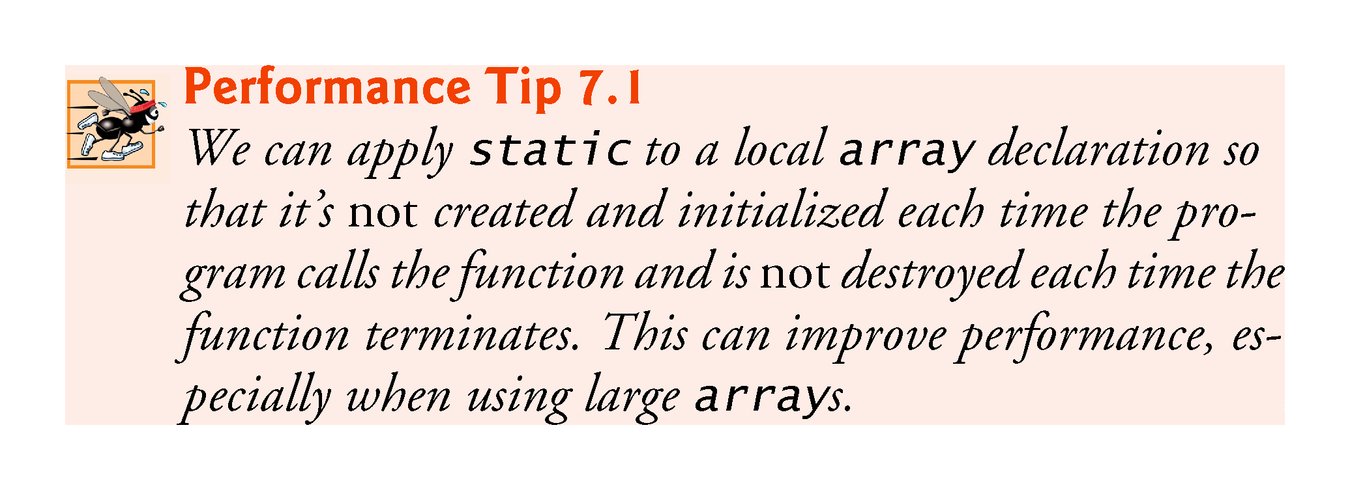

Slide 40
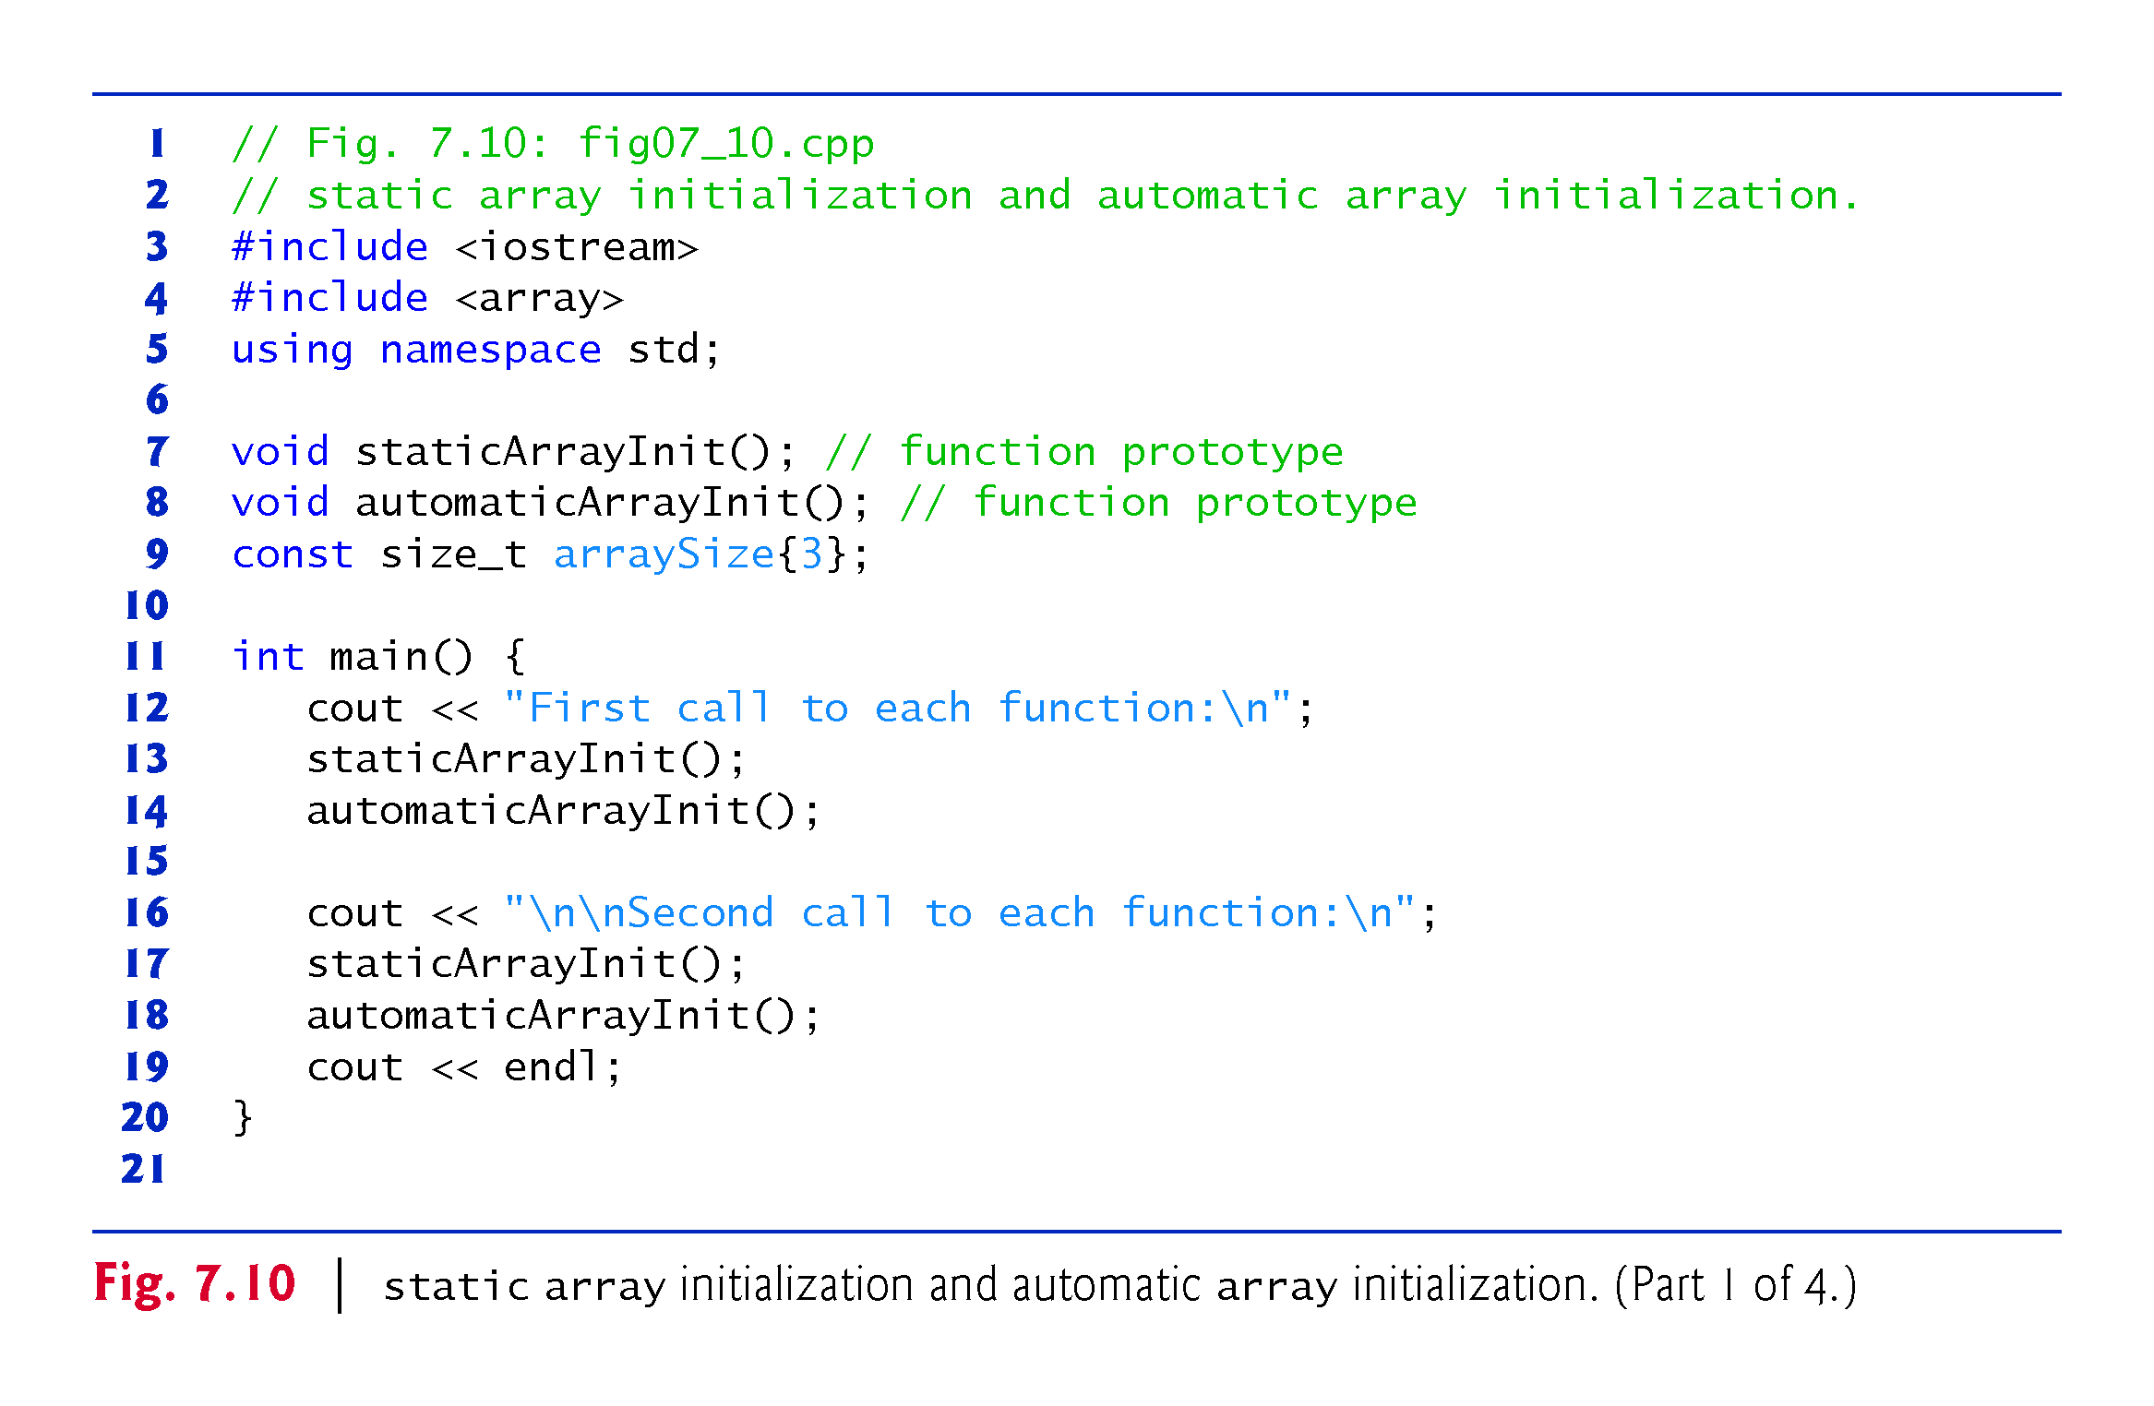

Slide 41
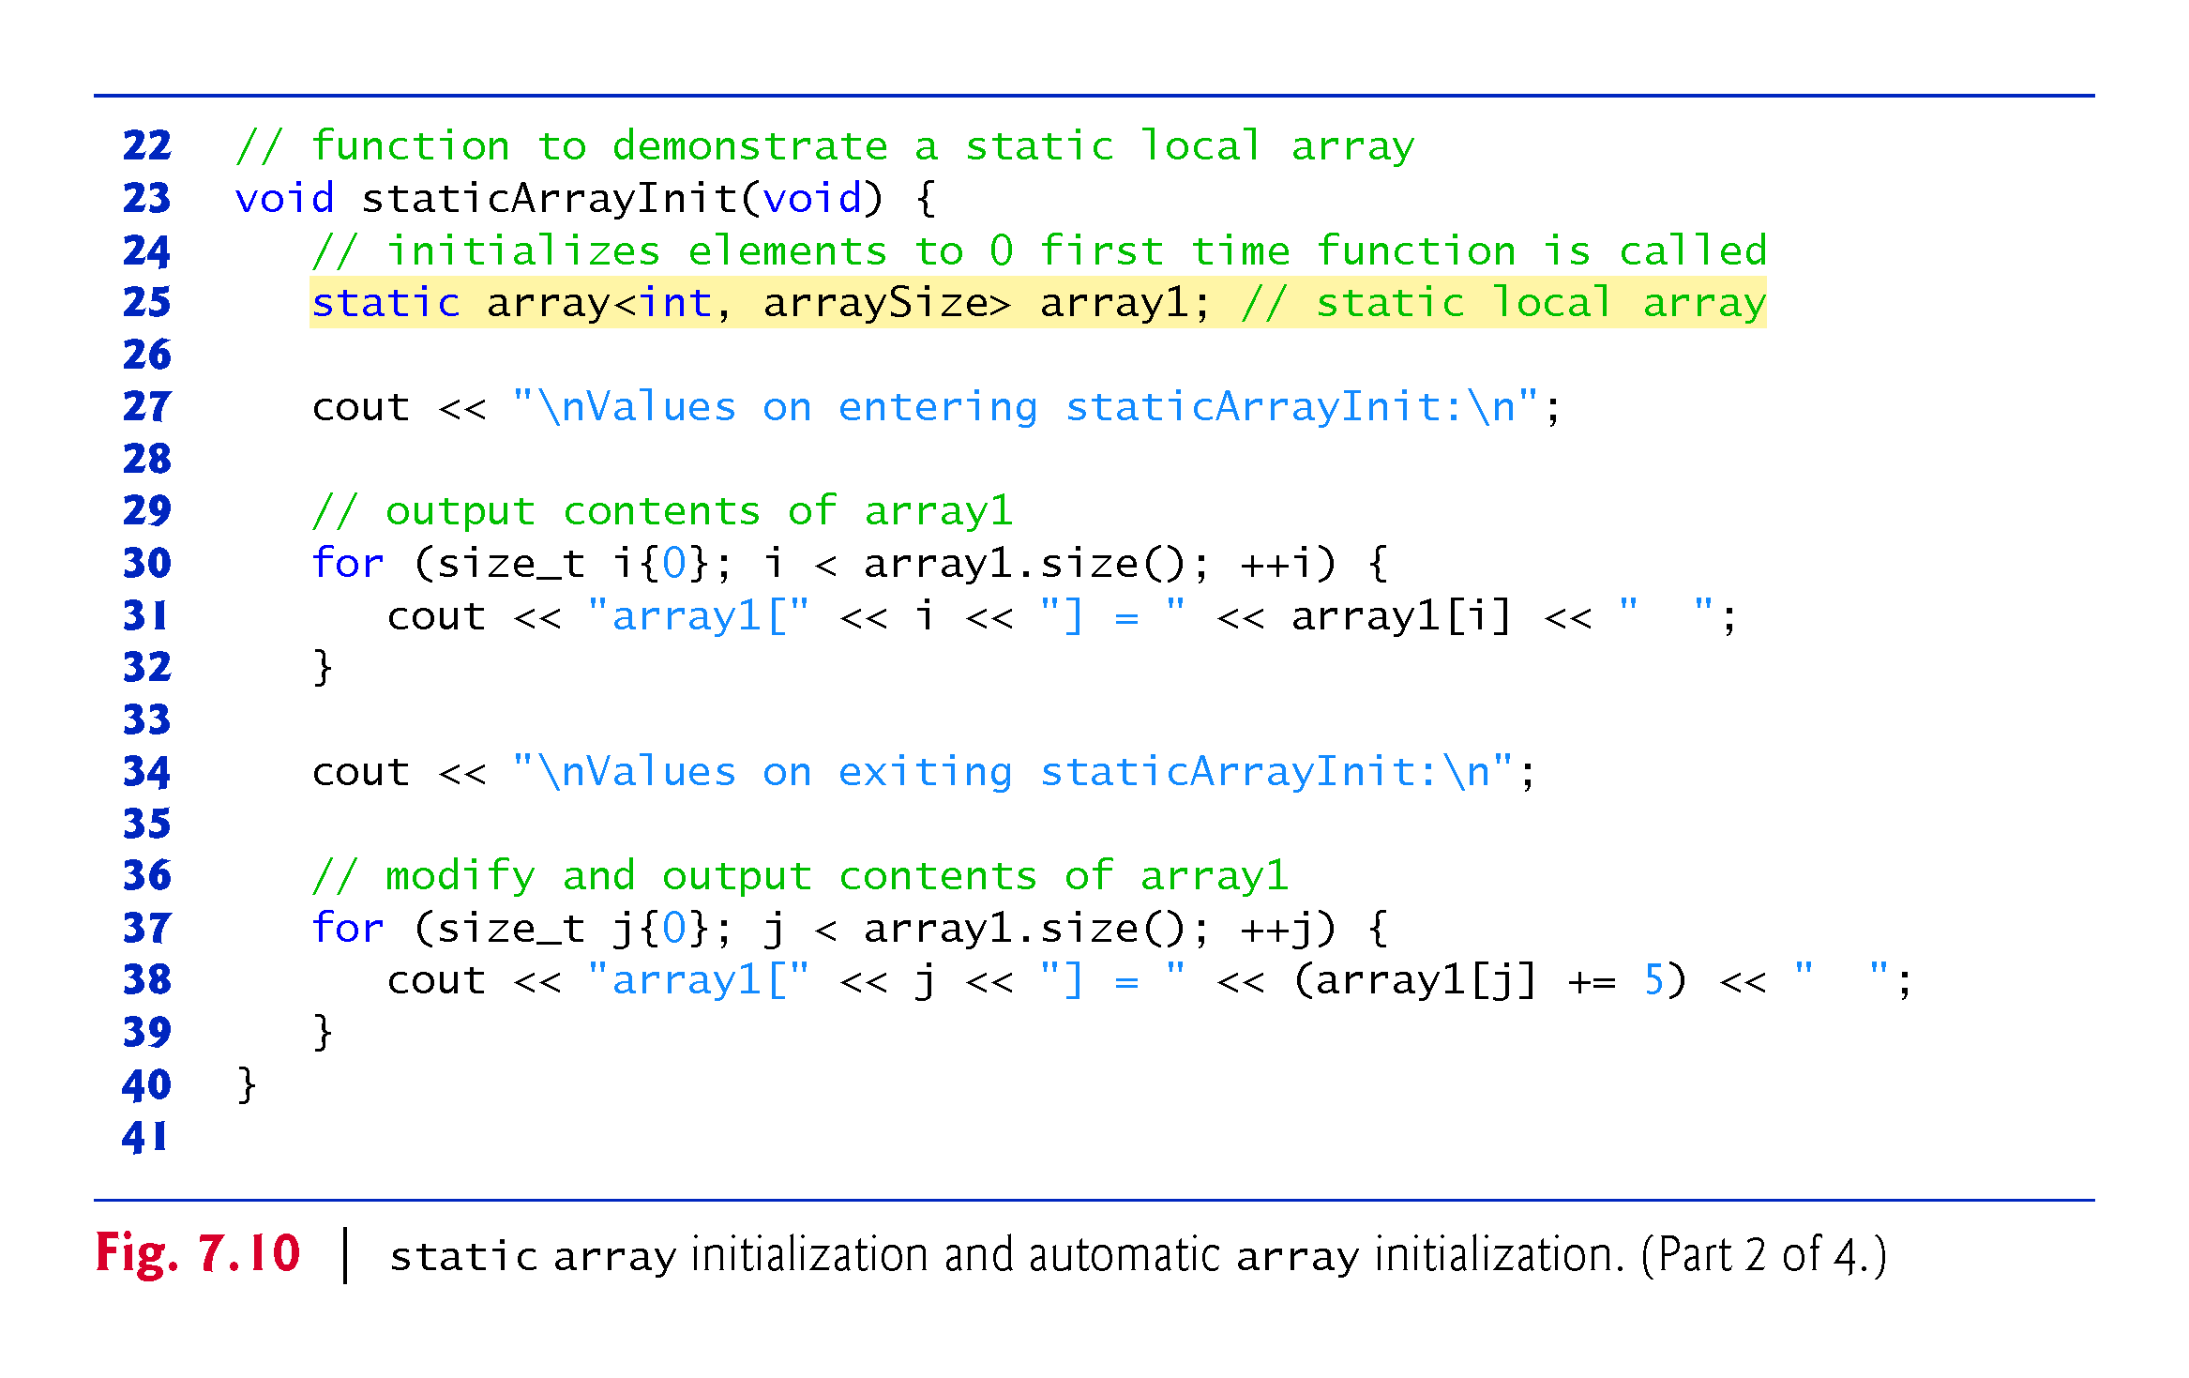

Slide 42
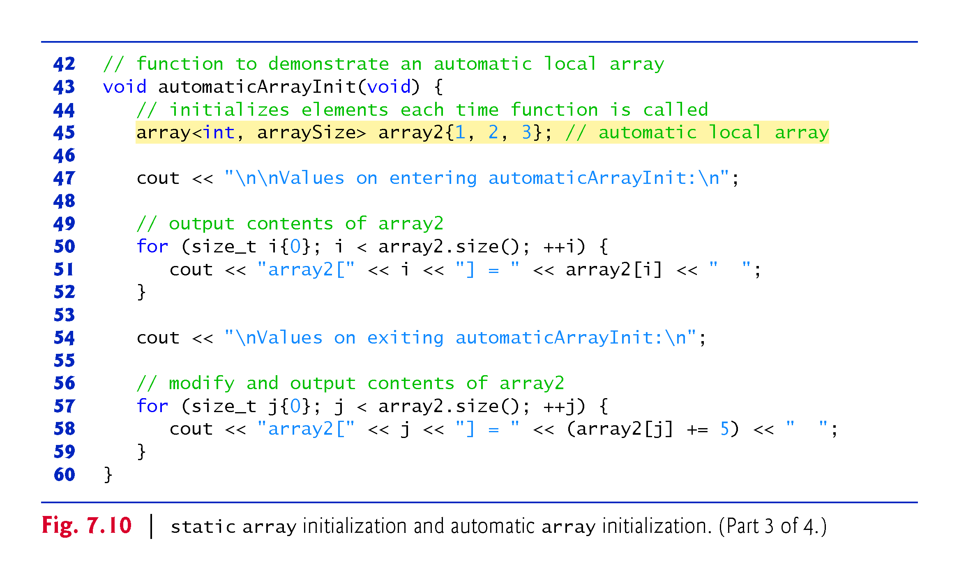

Slide 43
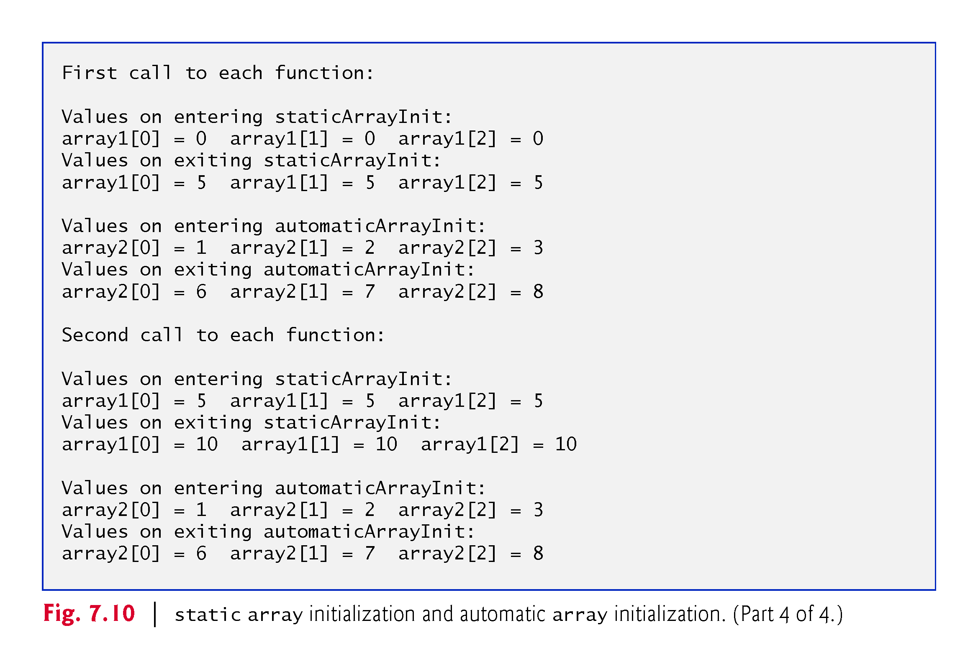

Slide 44
7.5 Range-Based for Statement
It’s common to process all the elements of an array.
The C++11 range-based for statement allows you to do this without using a counter, thus avoiding the possibility of “stepping outside” the array and eliminating the need for you to implement your own bounds checking.
Figure 7.11 uses the range-based for to display an array’s contents and to multiply each of the array’s element values by 2.

Slide 45
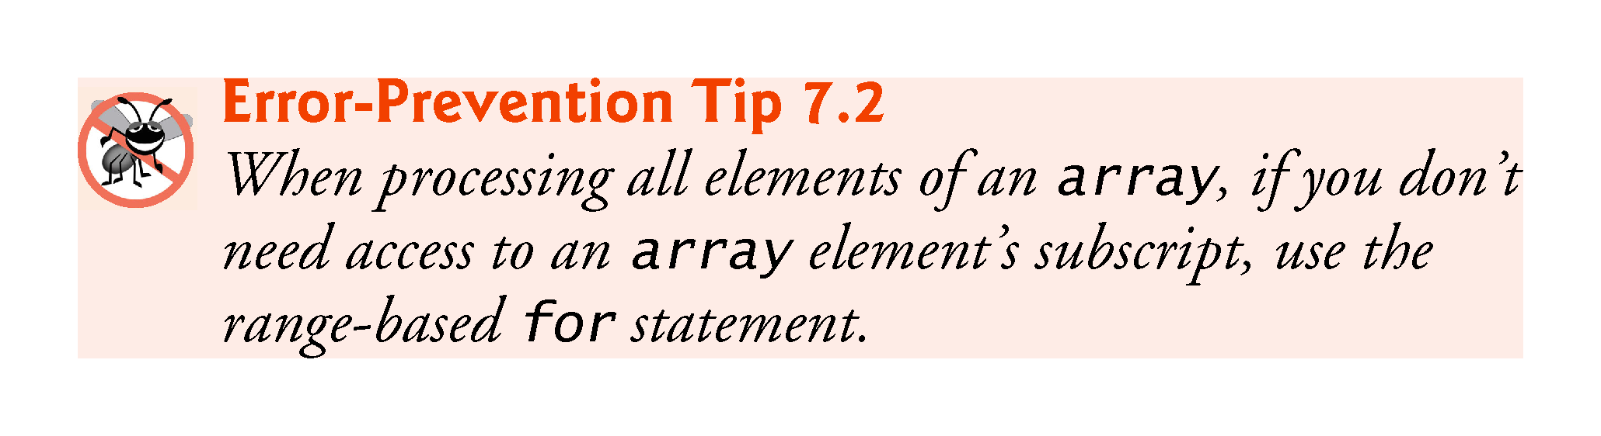

Slide 46
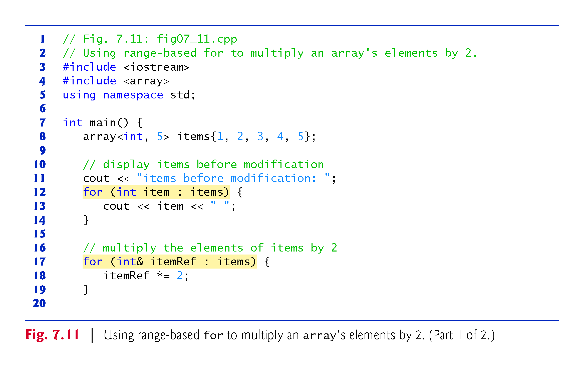

Slide 47
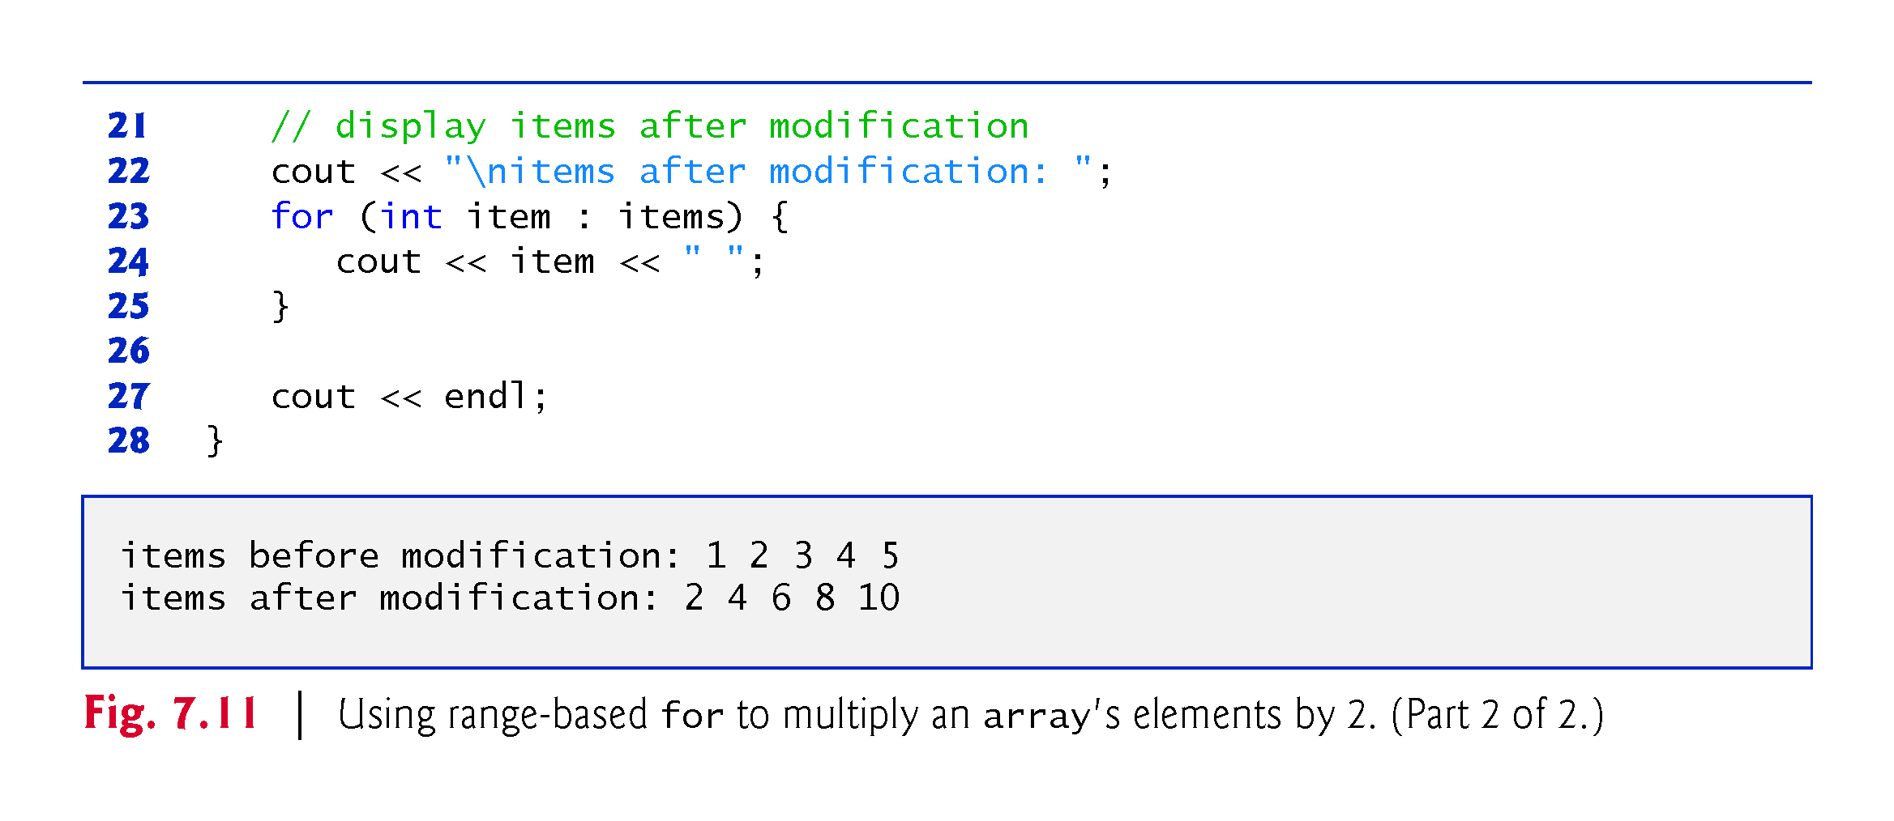

Slide 48
7.5 Range-Based for Statement (cont.)
Using the Range-Based for to Display an array’s Contents
The range-based for statement simplifies the code for iterating through an array.
Line 12 can be read as “for each iteration, assign the next element of items to int variable item, then execute the following statement.”
Lines 12–14 are equivalent to the following counter-controlled iteration:
for (int counter = 0; counter < items.size(); ++counter) {
cout << items[counter] << " "; }

Slide 49
7.5 Range-Based for Statement (cont.)
Using the Range-Based for to Modify an array’s Contents
Lines 17–19 use a range-based for statement to multiply each element of items by 2.
In line 17, the range variable declaration indicates that itemRef is an int reference (&).
We use an int reference because items contains int values and we want to modify each element’s value—because itemRef is declared as a reference, any change you make to itemRef changes the corresponding element value in the array.

Slide 50
7.5 Range-Based for Statement (cont.)
Using an Element’s Subscript
The range-based for statement can be used in place of the counter-controlled for statement whenever code looping through an array does not require access to the element’s subscript.
However, if a program must use subscripts for some reason other than simply to loop through an array (e.g., to print a subscript number next to each array element value, as in the examples early in this chapter), you should use the counter-controlled for statement.

Slide 51
7.6 Case Study: Class GradeBook Using an array to Store Grades
Case study on developing a GradeBook class that instructors can use to maintain students’ grades on an exam and display a grade report that includes the grades, class average, lowest grade, highest grade and a grade distribution bar chart.
This version stores the grades for one exam in a one-dimensional array.
In Section 7.9, we present a version that uses a two-dimensional array to store students’ grades for several exams.

Slide 52
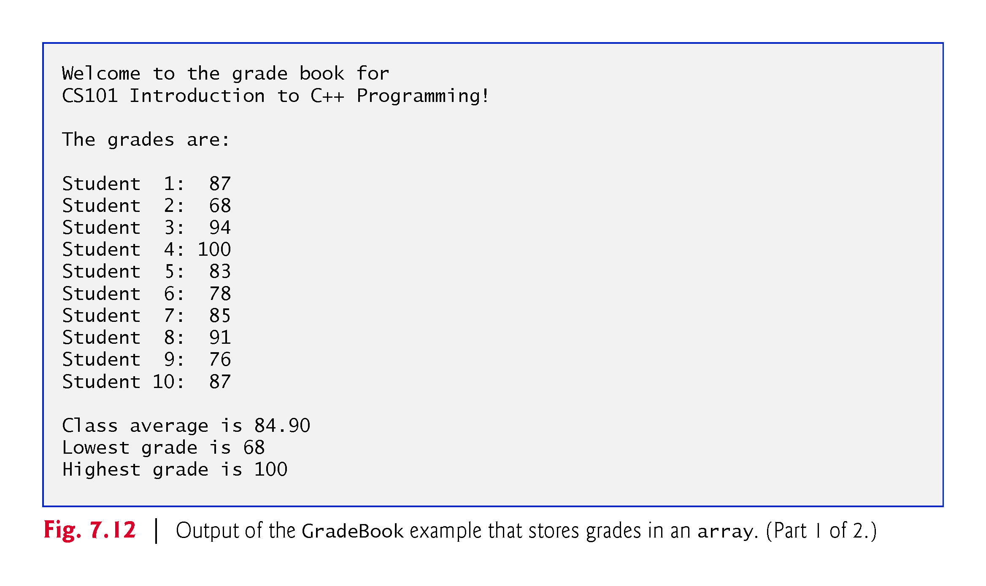

Slide 53
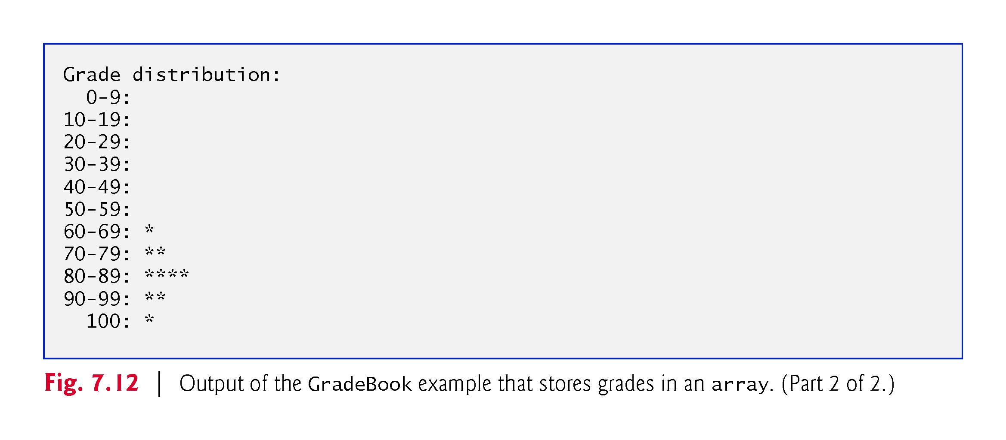

Slide 54
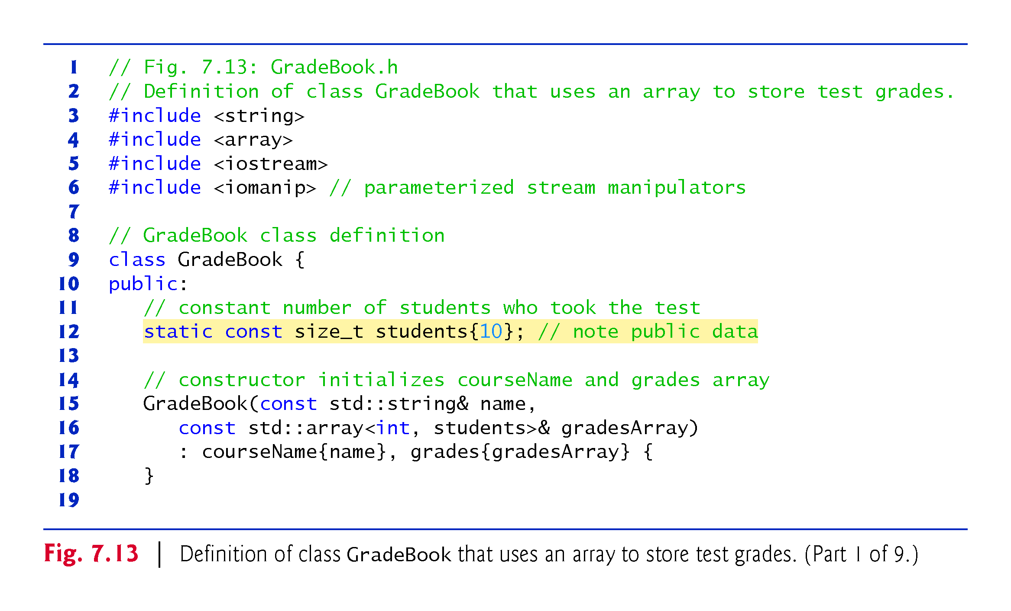

Slide 55
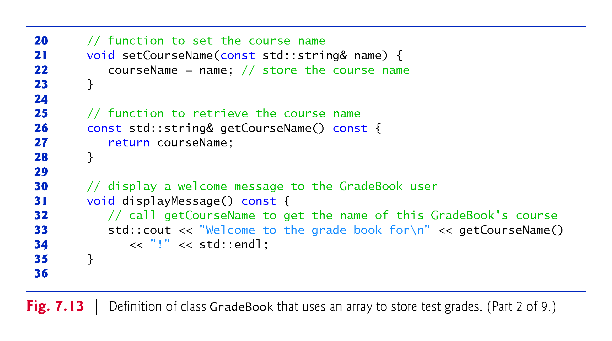

Slide 56
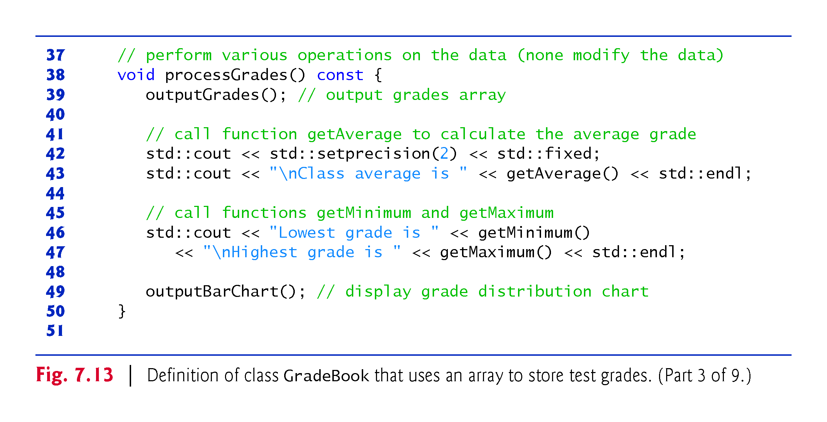

Slide 57
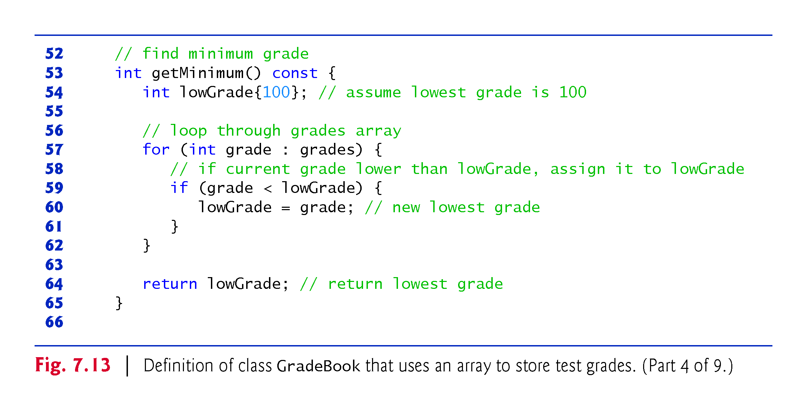

Slide 58
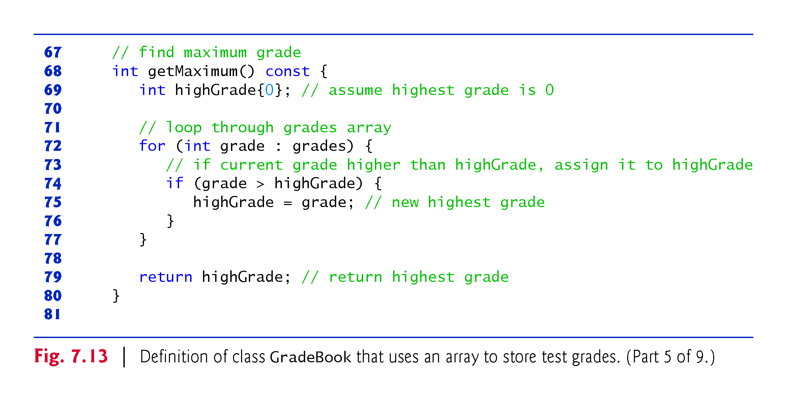

Slide 59
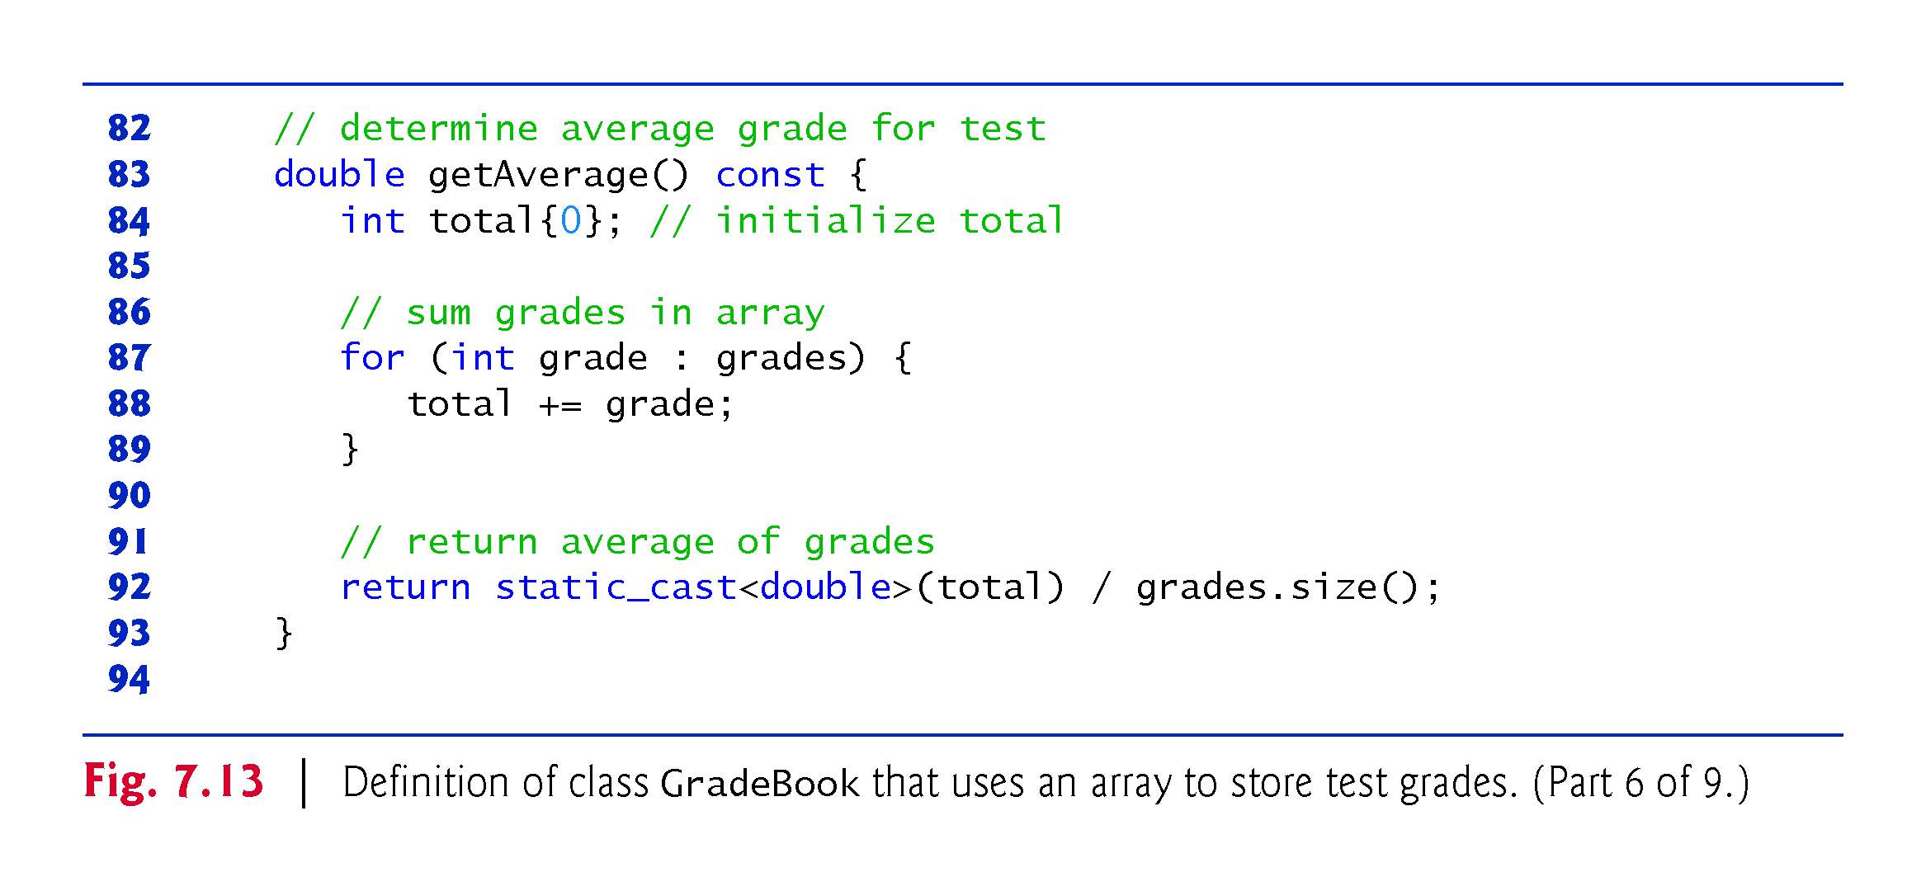

Slide 60
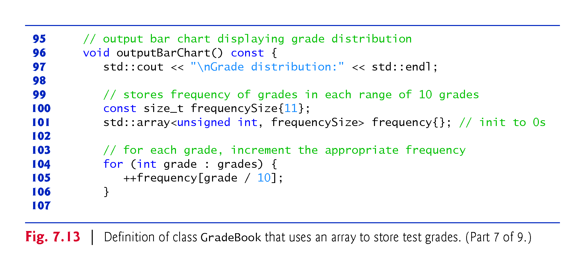

Slide 61
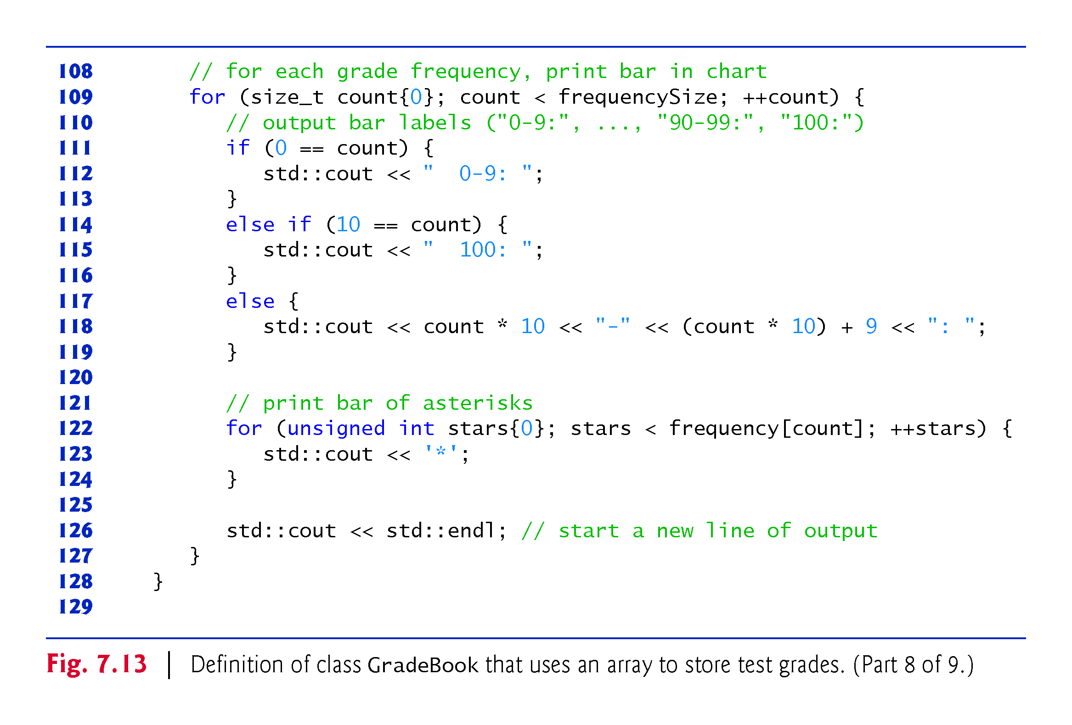

Slide 62
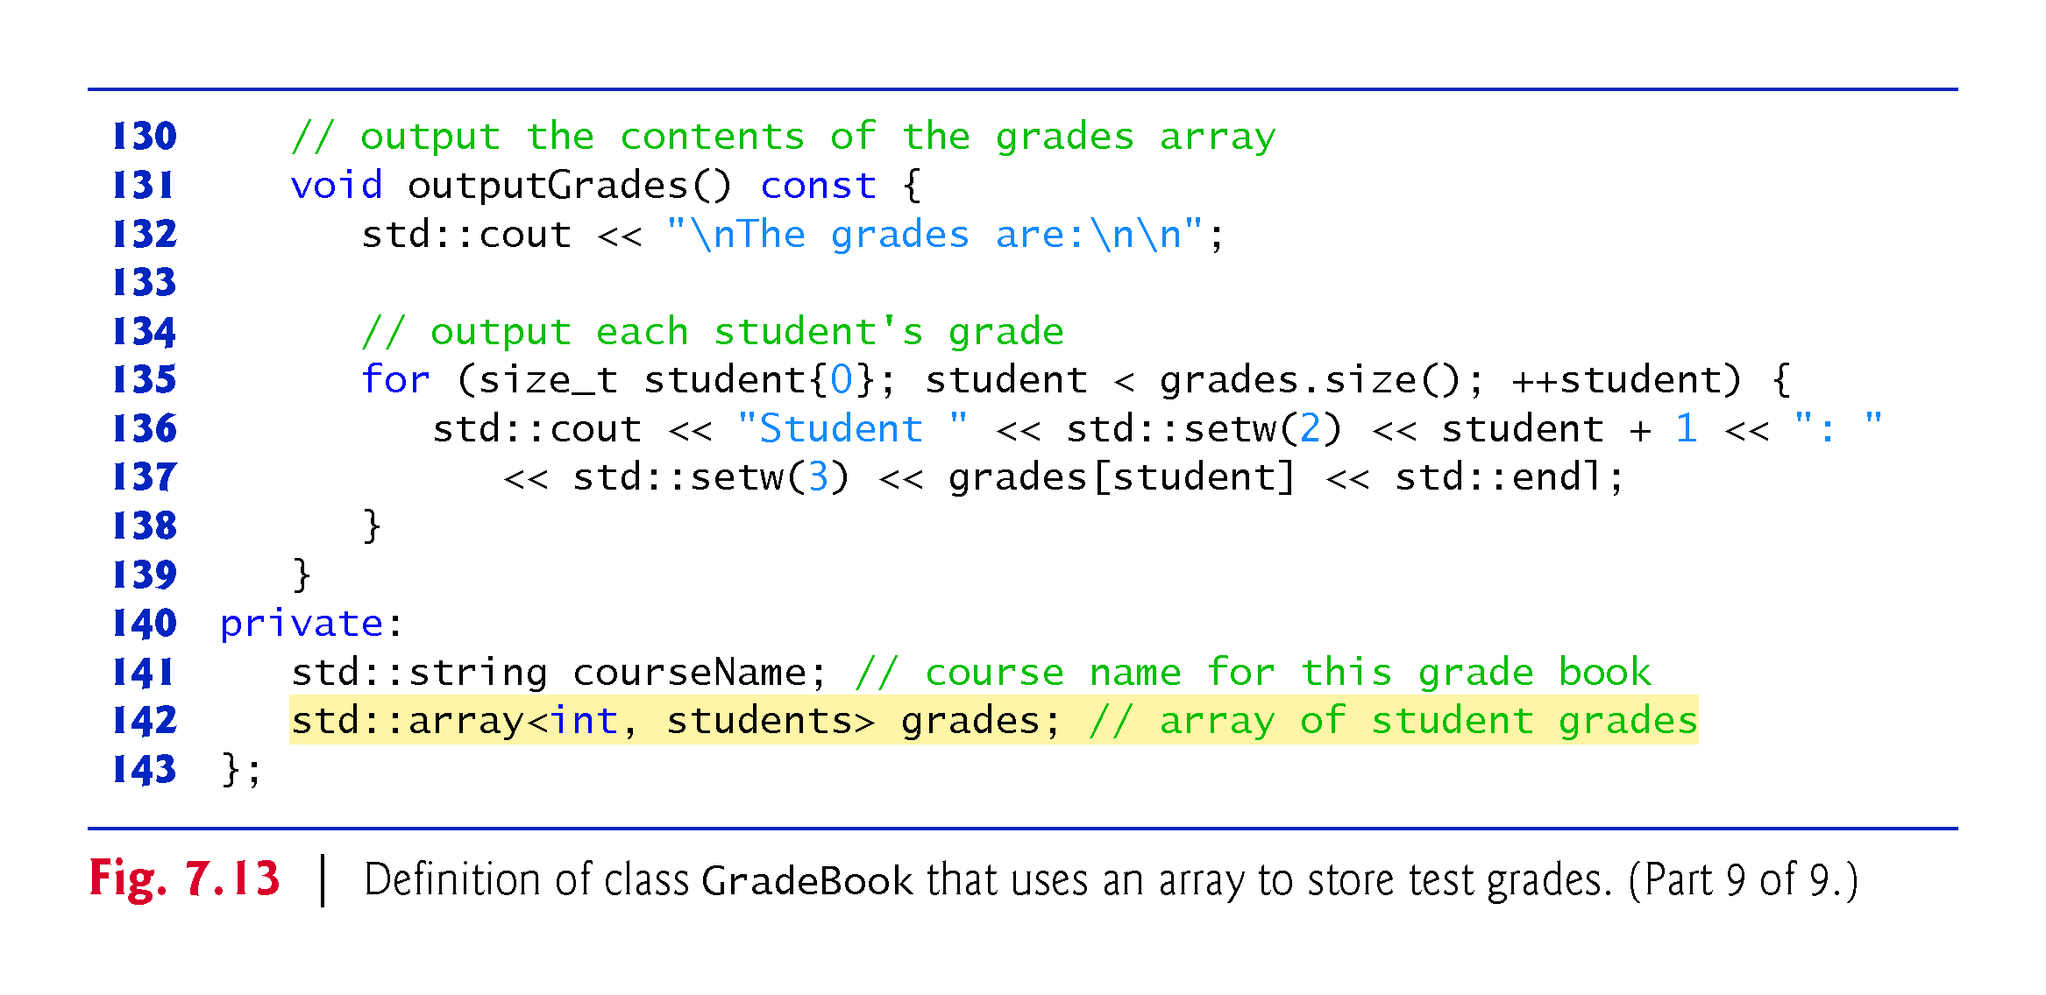

Slide 63
7.6 Case Study: Class GradeBook Using an Array to Store Grades (cont.)
The size of the array is specified as a public static const data member students.
public so that it’s accessible to the clients of the class.
const so that this data member is constant.
static so that the data member is shared by all objects of the class
There are variables for which each object of a class does not have a separate copy.
That’s the case with static data members, which are also known as class variables.
When objects of a class containing static data members are created, all the objects share one copy of the class’s static data members.

Slide 64
7.6 Case Study: Class GradeBook Using an Array to Store Grades (cont.)
A static data member can be accessed within the class definition and the member-function definitions like any other data member.
A public static data member can also be accessed outside of the class, even when no objects of the class exist, using the class name followed by the binary scope resolution operator (::) and the name of the data member.

Slide 65
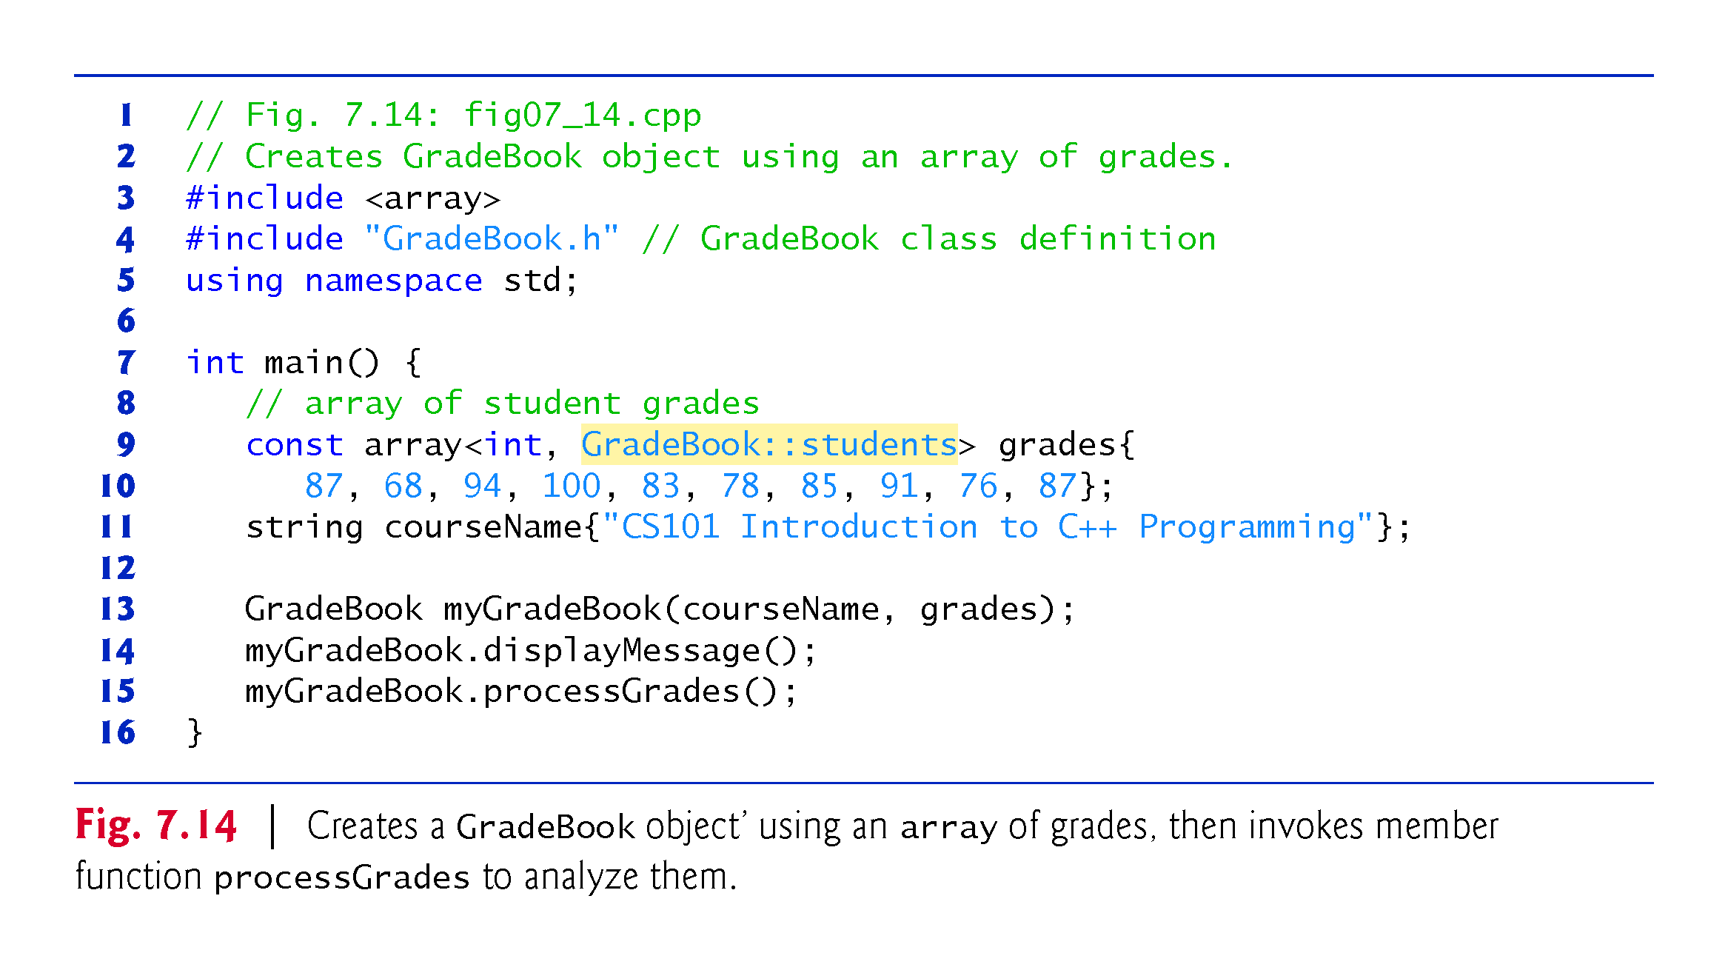

Slide 66
7.7 Sorting and Searching arrays
In this section, we use the built-in C++ Standard Library sort function to arrange the elements in an array into ascending order and the built-in binary_search function to determine whether a value is in the array.

Slide 67
7.7.1 Sorting
Sorting data—placing it into ascending or descending order—is one of the most important computing applications.

Slide 68
7.7.2 Searching
Often it may be necessary to determine whether an array contains a value that matches a certain key value.
This is called searching.

Slide 69
7.7.2 Searching
Figure 7.15 begins by creating an unsorted array of strings and displaying the contents of the array.
Line 21 uses C++ Standard Library function sort to sort the elements of the array colors into ascending order.
Lines 25–276 display the contents of the sorted array.

Slide 70
7.7 Sorting and Searching arrays (cont.)
Lines 30 and 354 demonstrate use binary_search to determine whether a value is in the array.
The sequence of values must be sorted in ascending order first—binary_search does not verify this for you.
The function’s first two arguments represent the range of elements to search and the third is the search key—the value to locate in the array.
The function returns a bool indicating whether the value was found.

Slide 71
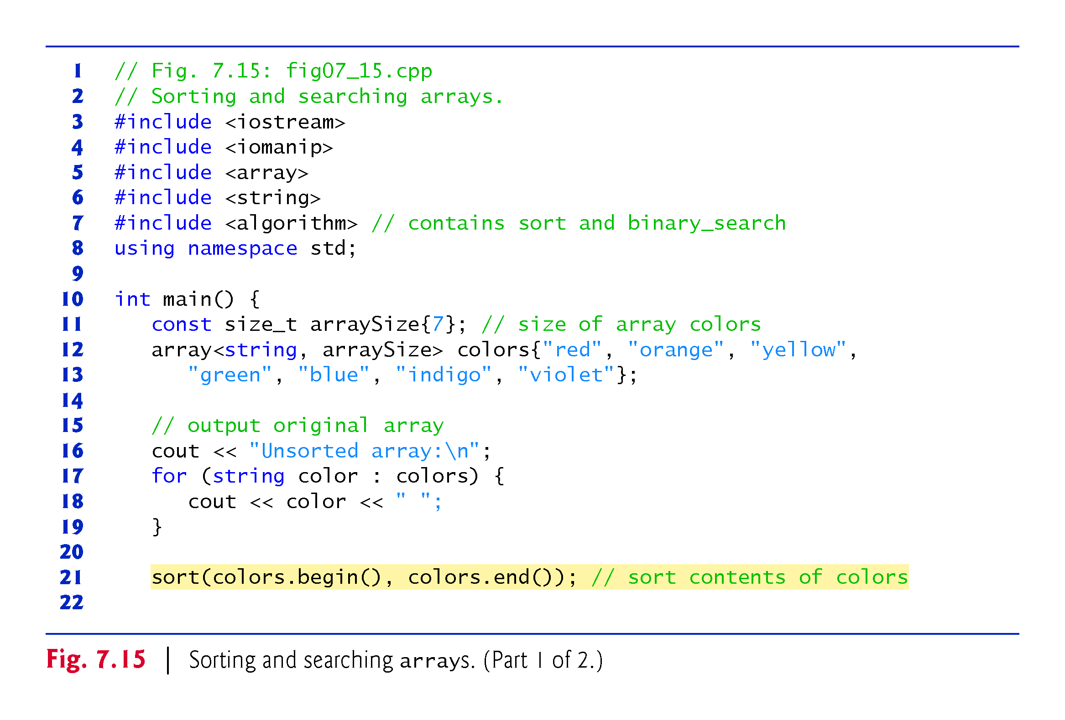

Slide 72
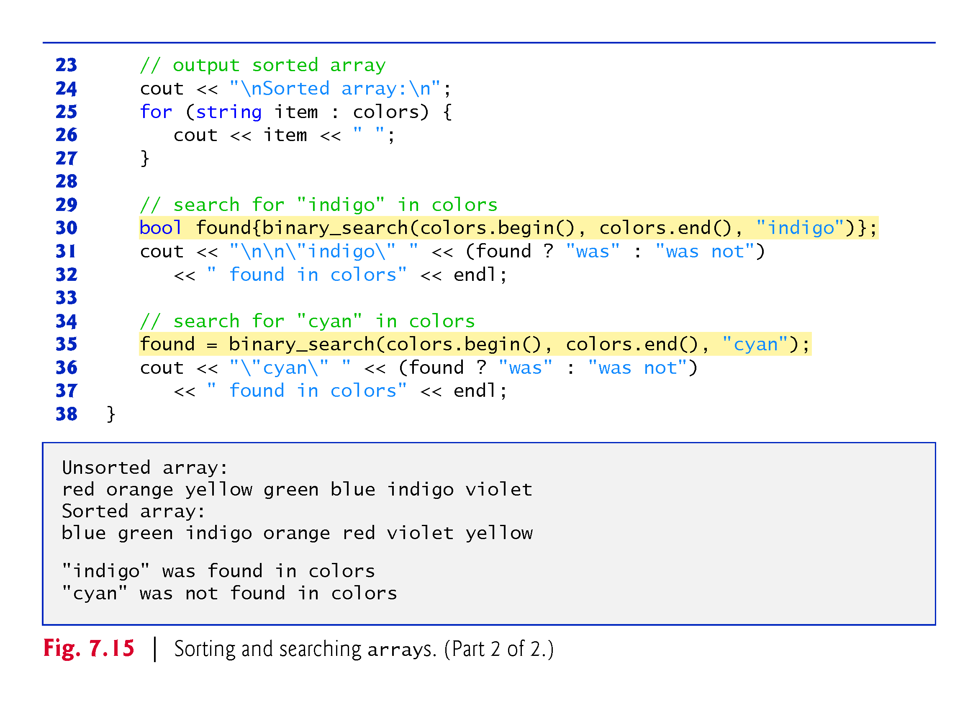

Slide 73
7.8 Multidimensional Arrays
You can use arrays with two dimensions (i.e., subscripts) to represent tables of values consisting of information arranged in rows and columns.
To identify a particular table element, we must specify two subscripts—by convention, the first identifies the element’s row and the second identifies the element’s column.
Often called two-dimensional arrays or 2-D arrays.
Arrays with two or more dimensions are known as multidimensional arrays.
Figure 7.16 illustrates a two-dimensional array, a.
The array contains three rows and four columns, so it’s said to be a 3-by-4 array.
In general, an array with m rows and n columns is called an m-by-n array.

Slide 74
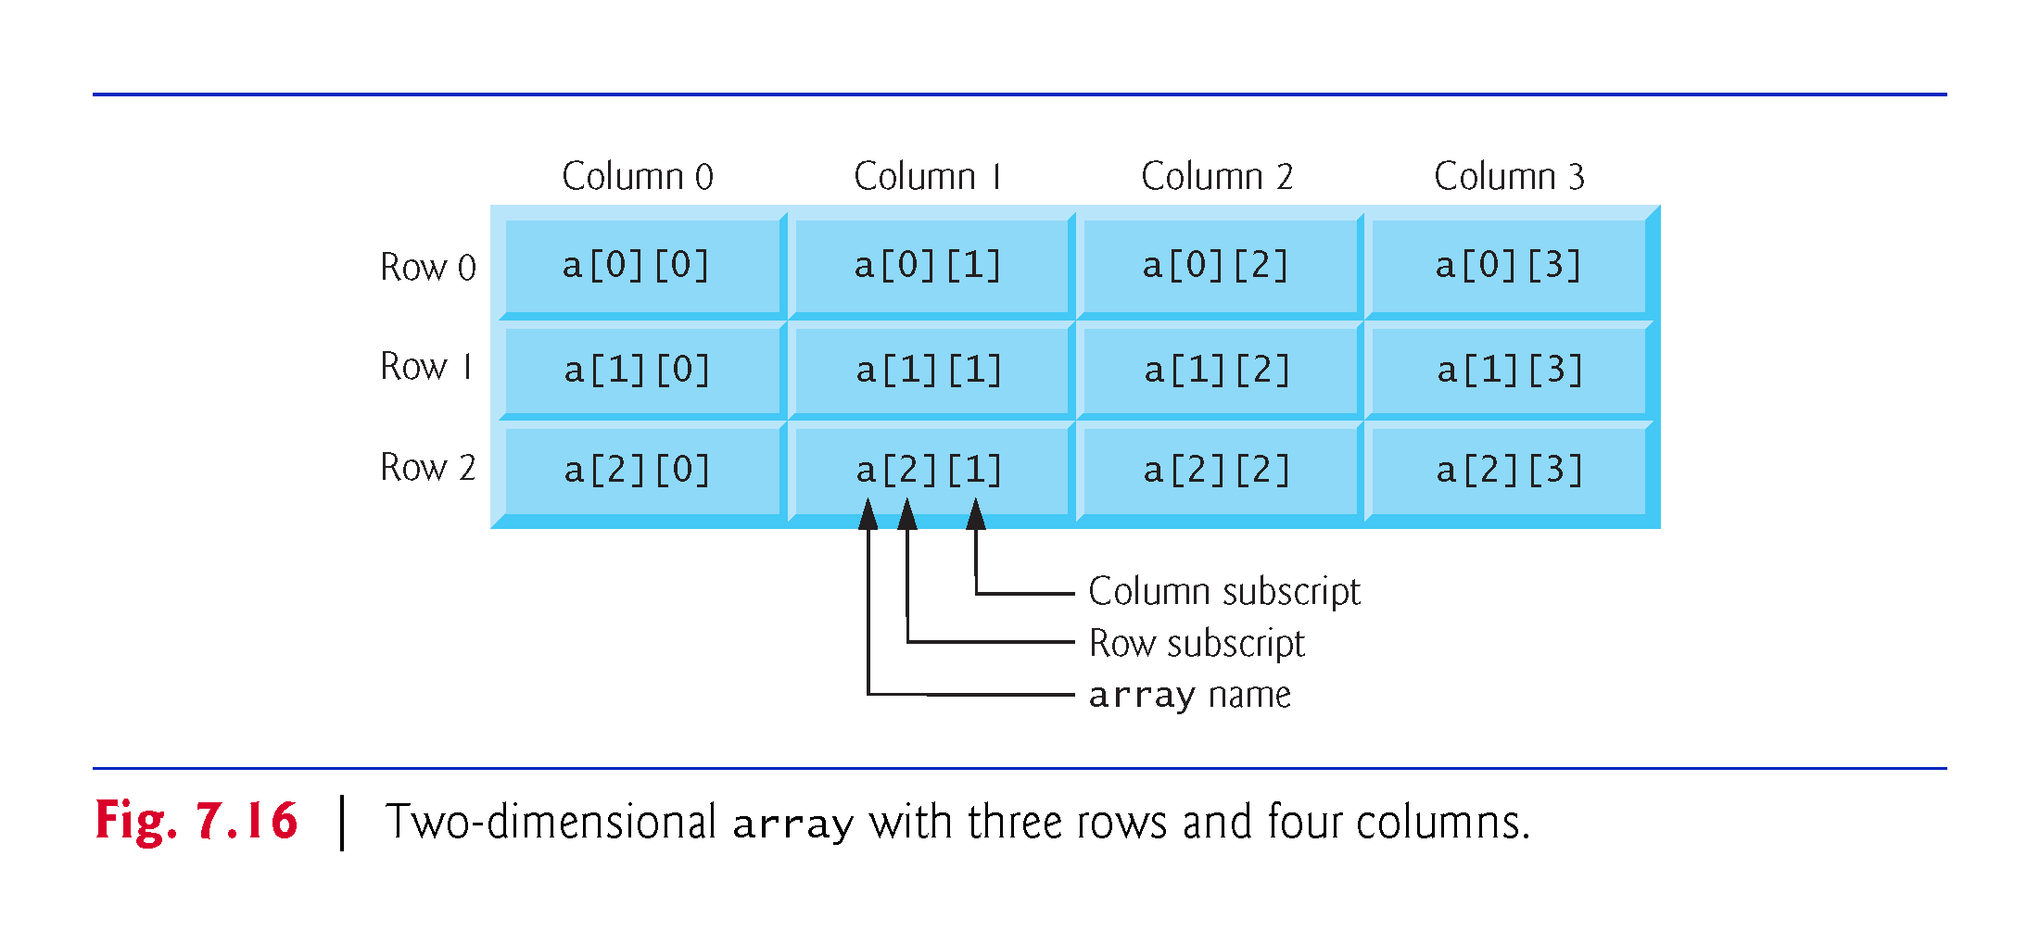

Slide 75
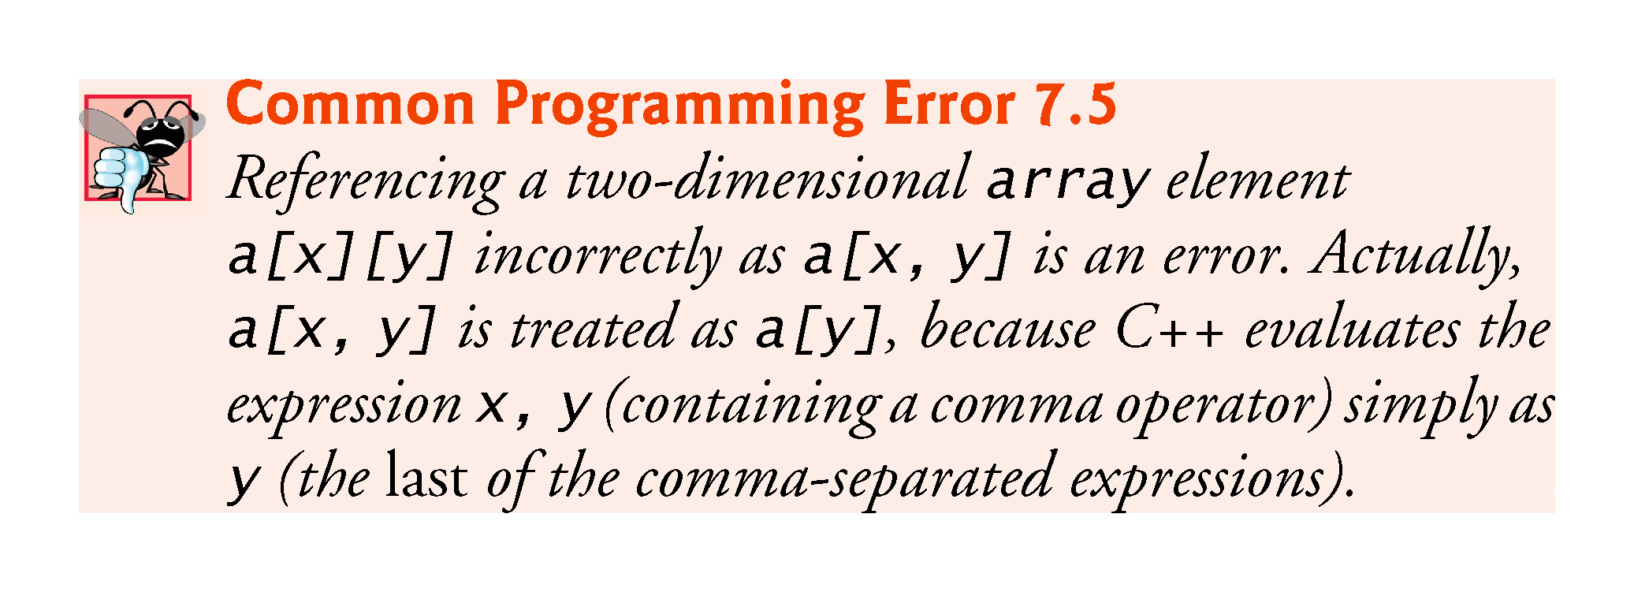

Slide 76
7.8 Multidimensional arrays (cont.)
Figure 7.17 demonstrates initializing two-dimensional arrays in declarations.
In each array, the type of its elements is specified as
array<int, columns>
Each array contains as its elements three-element arrays of int values—the constant columns has the value 3.

Slide 77
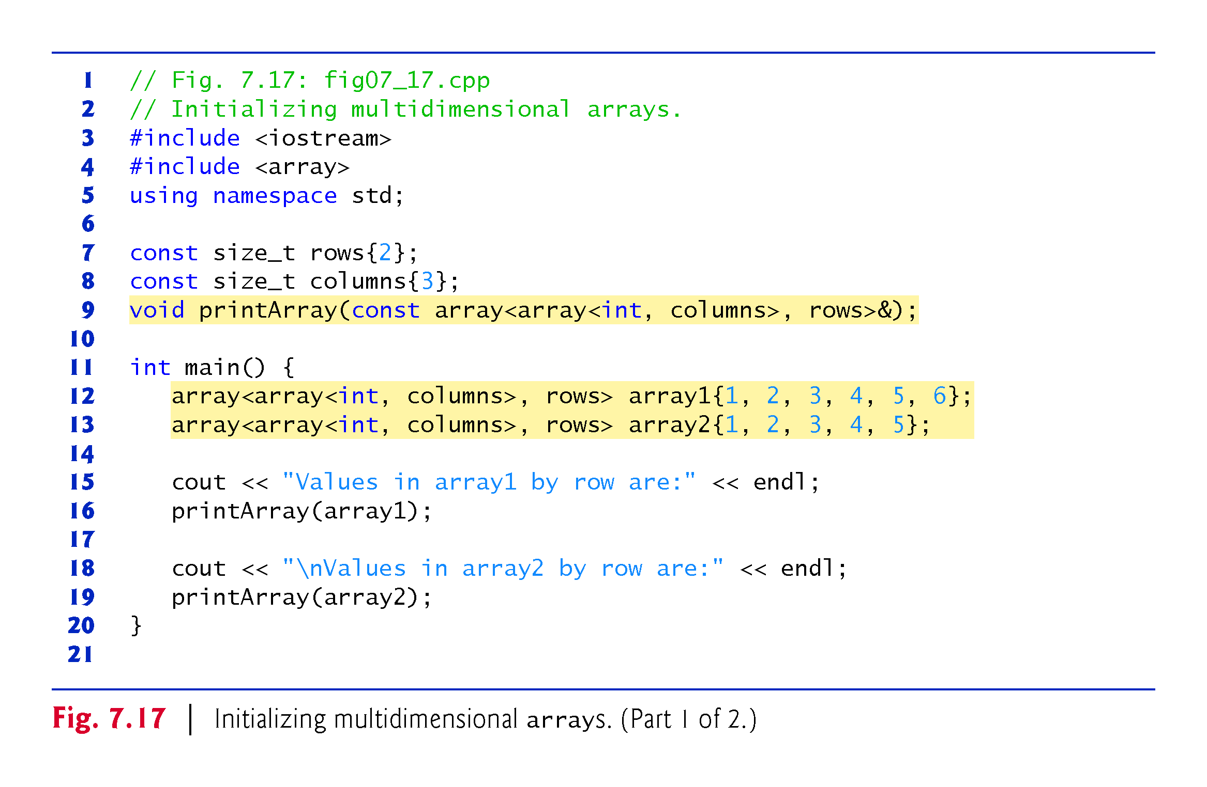

Slide 78
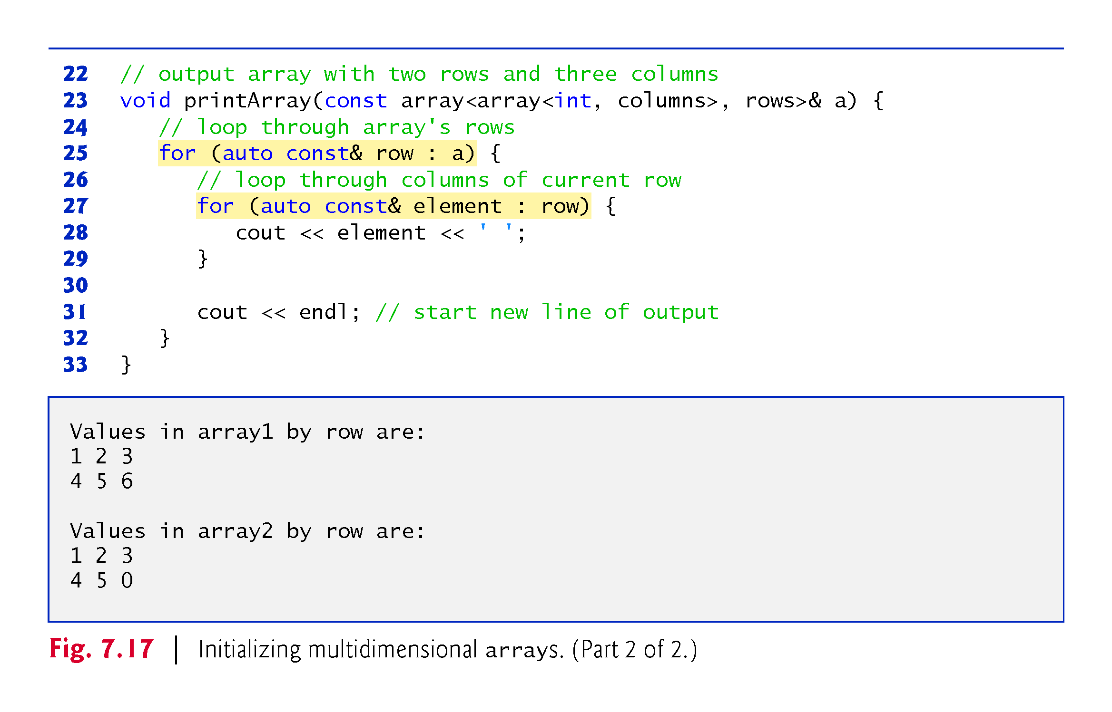

Slide 79
7.8 Multidimensional arrays (cont.)
Nested Range-Based for Statements
To process the elements of a two-dimensional array, we use a nested loop in which the outer loop iterates through the rows and the inner loop iterates through the columns of a given row.
The C++11 auto keyword tells the compiler to infer (determine) a variable’s data type based on the variable’s initializer value.

Slide 80
7.8 Multidimensional arrays (cont.)
Nested Counter-Controlled for Statements
We could have implemented the nested loop with counter-controlled iteration as follows:
for (size_t row = 0; row < a.size(); ++row) {
for (size_t column = 0; column < a[row].size(); ++column) {
cout << a[row][column] << ' '; }
cout << endl;
}

Slide 81
7.9 Case Study: Class GradeBook Using a Two-Dimensional array
In most semesters, students take several exams.
Professors are likely to want to analyze grades across the entire semester, both for a single student and for the class as a whole.
Figure 7.18 shows the output that summarizes 10 students grades on three exams.
We store the grades as a two-dimensional array in an object of the next version of class GradeBook Figures 7.19–7.20.
Each row of the array represents a single student’s grades for the entire course, and each column represents all the grades the students earned for one particular exam.

Slide 82
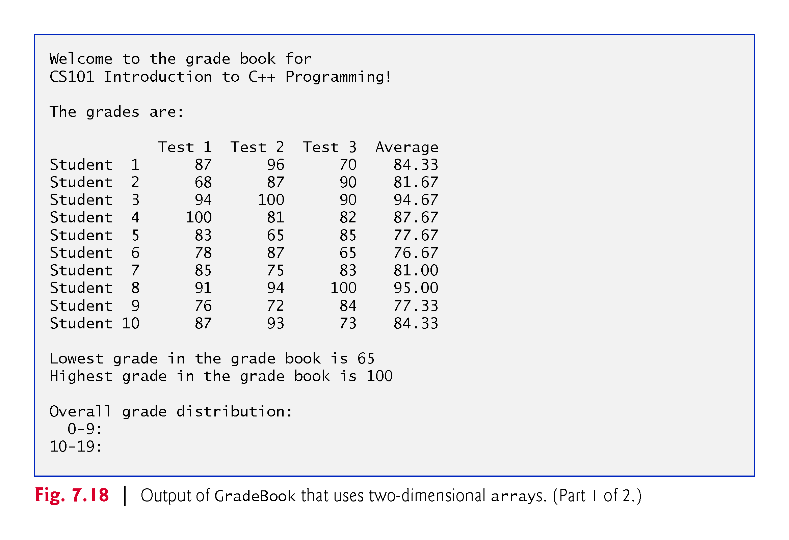

Slide 83


Slide 84


Slide 85


Slide 86


Slide 87


Slide 88


Slide 89


Slide 90


Slide 91


Slide 92


Slide 93


Slide 94


Slide 95


Slide 96
7.10 Introduction to C++ Standard Library Class Template vector
C++ Standard Library class template vector is similar to class template array, but also supports dynamic resizing.
Except for the features that modify a vector, the other features shown in Fig. 7.21 also work for arrays.
Standard class template vector is defined in header <vector> (line 5) and belongs to namespace std.

Slide 97


Slide 98


Slide 99


Slide 100


Slide 101


Slide 102


Slide 103


Slide 104
7.10 Introduction to C++ Standard Library Class Template vector (cont.)
By default, all the elements of a vector object are set to 0.
vectors can be defined to store most data types.
vector member function size obtain the number of elements in the vector.
As with class template array, you can also do this using a counter-controlled loop and the subscript ([]) operator.

Slide 105
7.10 Introduction to C++ Standard Library Class Template vector (cont.)
Notice that we used parentheses rather than braces to pass the size argument to each vector object’s constructor.
When creating a vector, if the braces contain one value of the vector’s element type, the braces are treated as a one-element initializer list, rather than a call to the constructor that sets the vector’s size.
The following declaration actually creates a one-element vector<int> containing the int value 7, not a 7-element vector
vector<int> integers1{7};

Slide 106
7.10 Introduction to C++ Standard Library Class Template vector (cont.)
You can use the assignment (=) operator with vector objects.
As is the case with arrays, C++ is not required to perform bounds checking when vector elements are accessed with square brackets.
Standard class template vector provides bounds checking in its member function at (as does class template array).

Slide 107
7.10 Introduction to C++ Standard Library Class Template vector (cont.)
An exception indicates a problem that occurs while a program executes.
The name “exception” suggests that the problem occurs infrequently.
Exception handling enables you to create fault-tolerant programs that can resolve (or handle) exceptions.
When a function detects a problem, such as an invalid array subscript or an invalid argument, it throws an exception—that is, an exception occurs.

Slide 108
7.10 Introduction to C++ Standard Library Class Template vector (cont.)
To handle an exception, place any code that might throw an exception in a try statement.
The try block contains the code that might throw an exception, and the catch block contains the code that handles the exception if one occurs.
You can have many catch blocks to handle different types of exceptions that might be thrown in the corresponding try block.
The vector member function at provides bounds checking and throws an exception if its argument is an invalid subscript.
By default, this causes a C++ program to terminate.

Slide 109


Slide 110
7.10 Introduction to C++ Standard Library Class Template vector (cont.)
Changing the Size of a vector
One of the key differences between a vector and an array is that a vector can dynamically grow and shrink as the number of elements it needs to accommodate varies.
To demonstrate this, line 88 shows the current size of integers3, line 89 calls the vector’s push_back member function to add a new element containing 1000 to the end of the vector and line 90 shows the new size of integers3.
Line 92 then displays integers3’s new contents.

Slide 111
7.10 Introduction to C++ Standard Library Class Template vector (cont.)
C++11: List Initializing a vector
Many of the array examples in this chapter used list initializers to specify the initial array element values.
C++11 also allows this for vectors (and other C++ Standard Library data structures).

