Slide 1
Object-Oriented Programming: Polymorphism
Based on Chapter 12 of C++ How to Program, 10/e

Slide 2
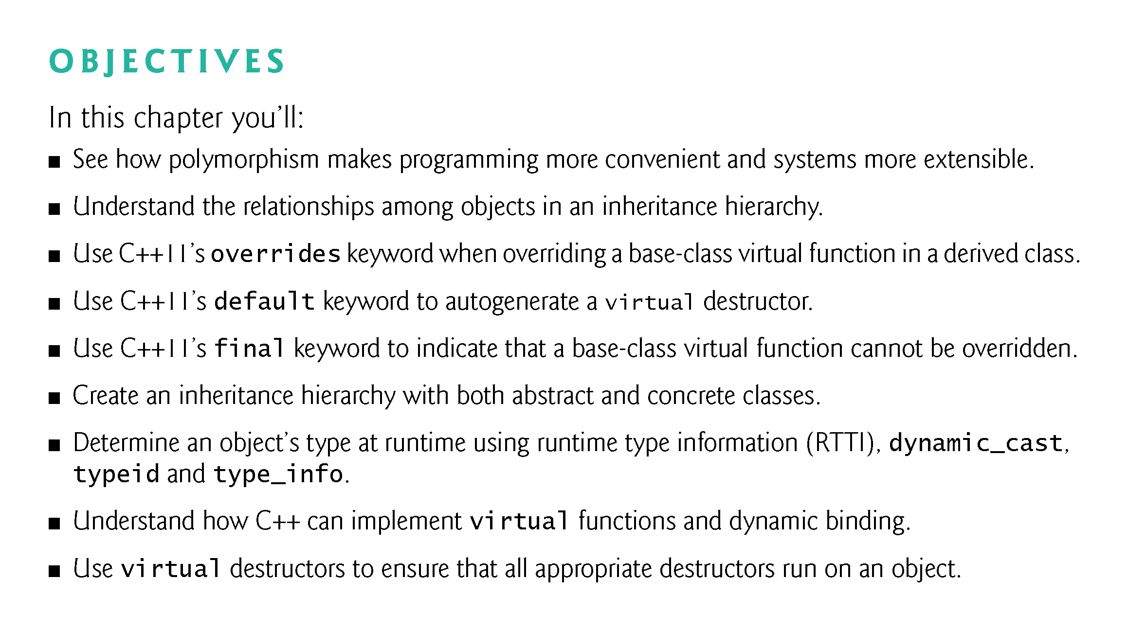

Slide 3
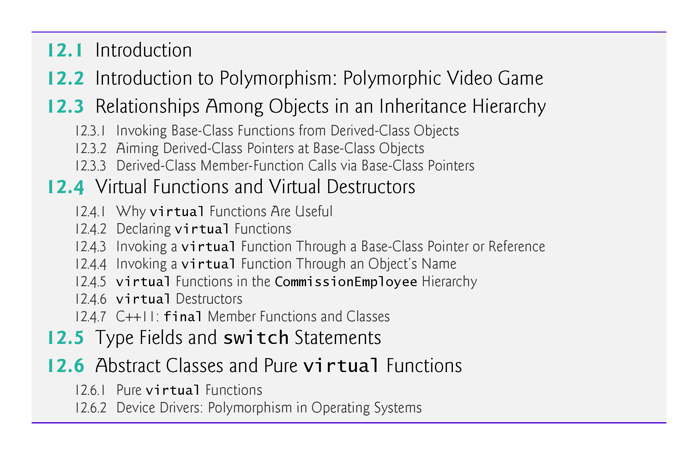

Slide 4
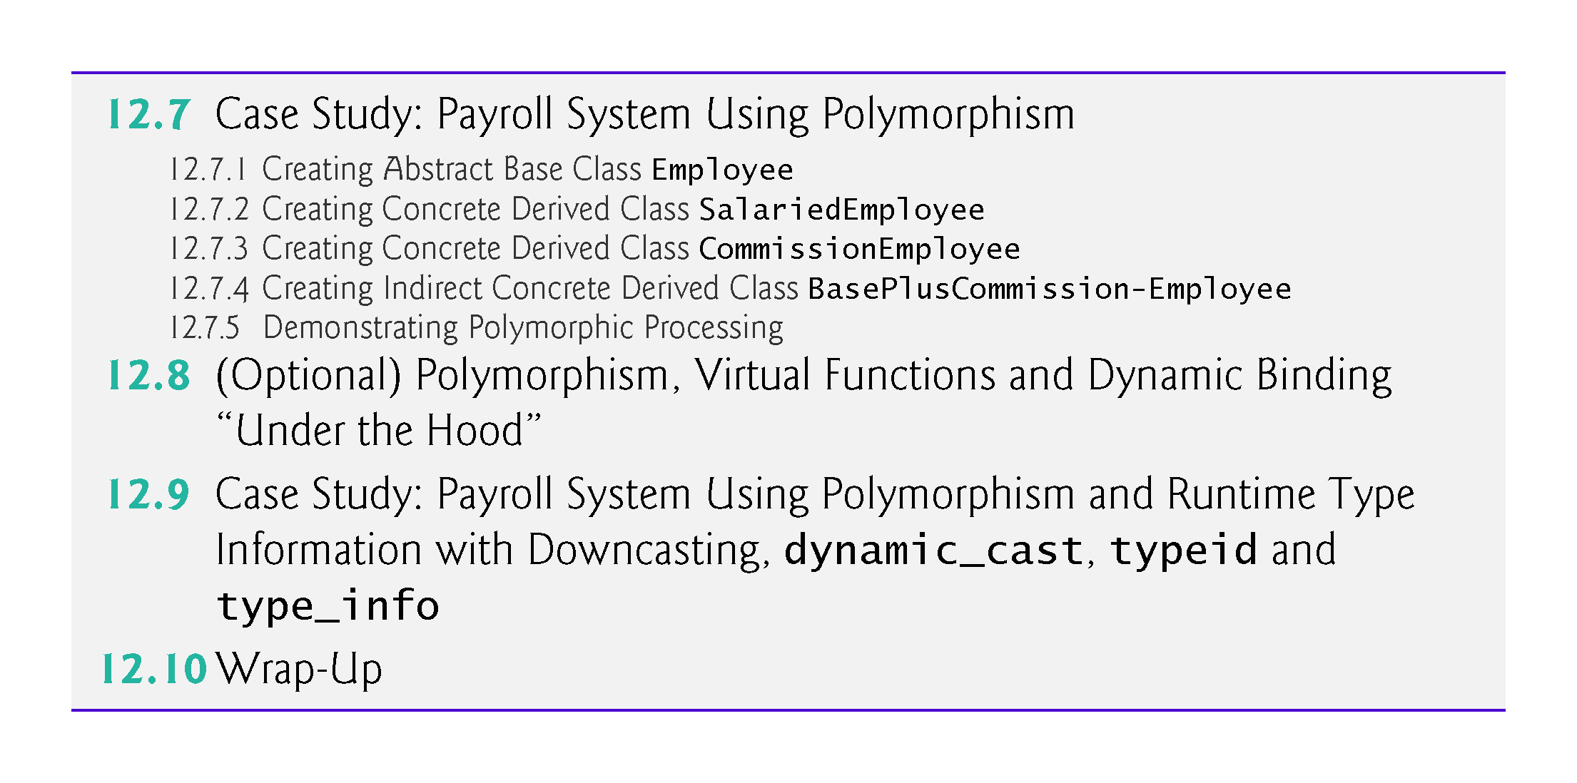

Slide 5
12.1 Introduction
We now continue our study of OOP by explaining and demonstrating polymorphism with inheritance hierarchies.
“program in the general” rather than “program in the specific.”
Write programs that process objects of classes that are part of the same class hierarchy as if they were all objects of the hierarchy’s base class.
Polymorphism works off base-class pointer handles and base-class reference handles, but not off name handles.
Relying on each object to know how to “do the right thing” in response to the same function call is the key concept of polymorphism.
The same message sent to a variety of objects has “many forms” of results—hence the term polymorphism.

Slide 6
12.1 Introduction (cont.)
Design and implement systems that are easily extensible.
New classes can be added with little or no modification to the general portions of the program, as long as the new classes are part of the inheritance hierarchy that the program processes generally.
The only parts of a program that must be altered to accommodate new classes are those that require direct knowledge of the new classes that you add to the hierarchy.

Slide 7
12.2 Introduction to Polymorphism: Polymorphic Video Game

Slide 8
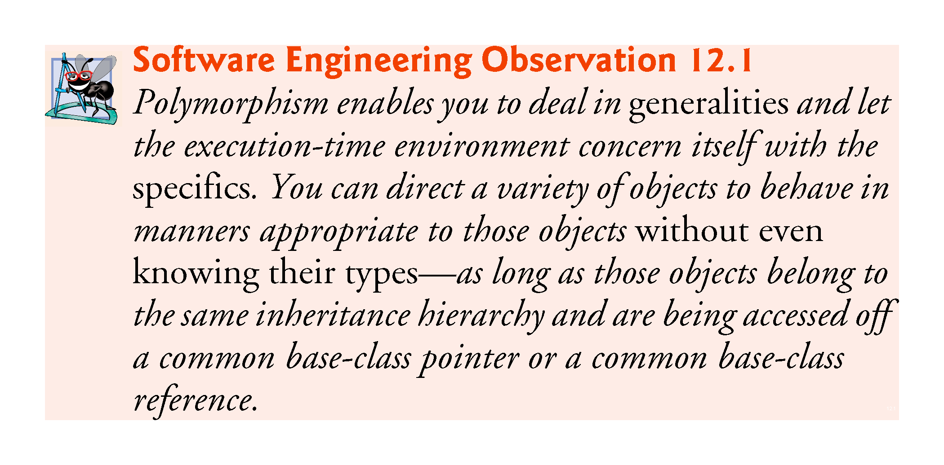

Slide 9
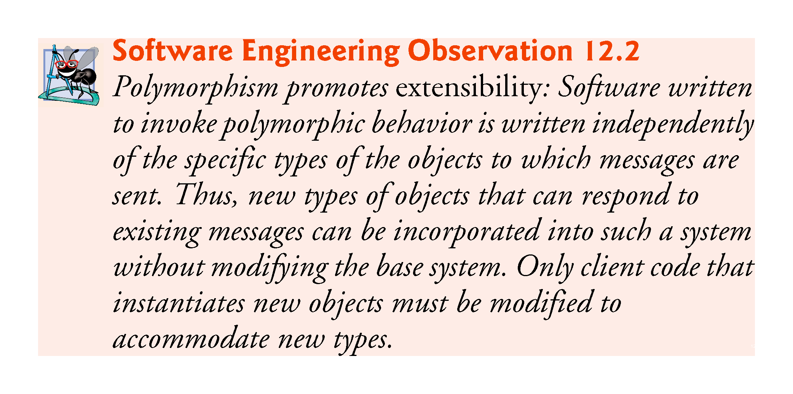

Slide 10
12.3 Relationships Among Objects in an Inheritance Hierarchy
How base-class and derived-class pointers can be aimed at base-class and derived-class objects, and how those pointers can be used to invoke member functions that manipulate those objects.
An object of a derived class can be treated as an object of its base class.
Despite the fact that the derived-class objects are of different types, the compiler allows this because each derived-class object is an object of its base class.
We cannot treat a base-class object as an any of its derived classes.
The is-a relationship applies only from a derived class to its direct and indirect base classes.

Slide 11
12.3.1 Invoking Base-Class Functions from Derived-Class Objects
Fig. 12.1 reuses the final versions of classes CommissionEmployee and BasePlusCommissionEmployee from Section 11.3.5.
The first two are natural and straightforward—we aim a base-class pointer at a base-class object and invoke base-class functionality, and we aim a derived-class pointer at a derived-class object and invoke derived-class functionality.
We demonstrate the relationship between derived classes and base classes (i.e., the is-a relationship of inheritance) by aiming a base-class pointer at a derived-class object and showing that the base-class functionality is indeed available in the derived-class object.

Slide 12
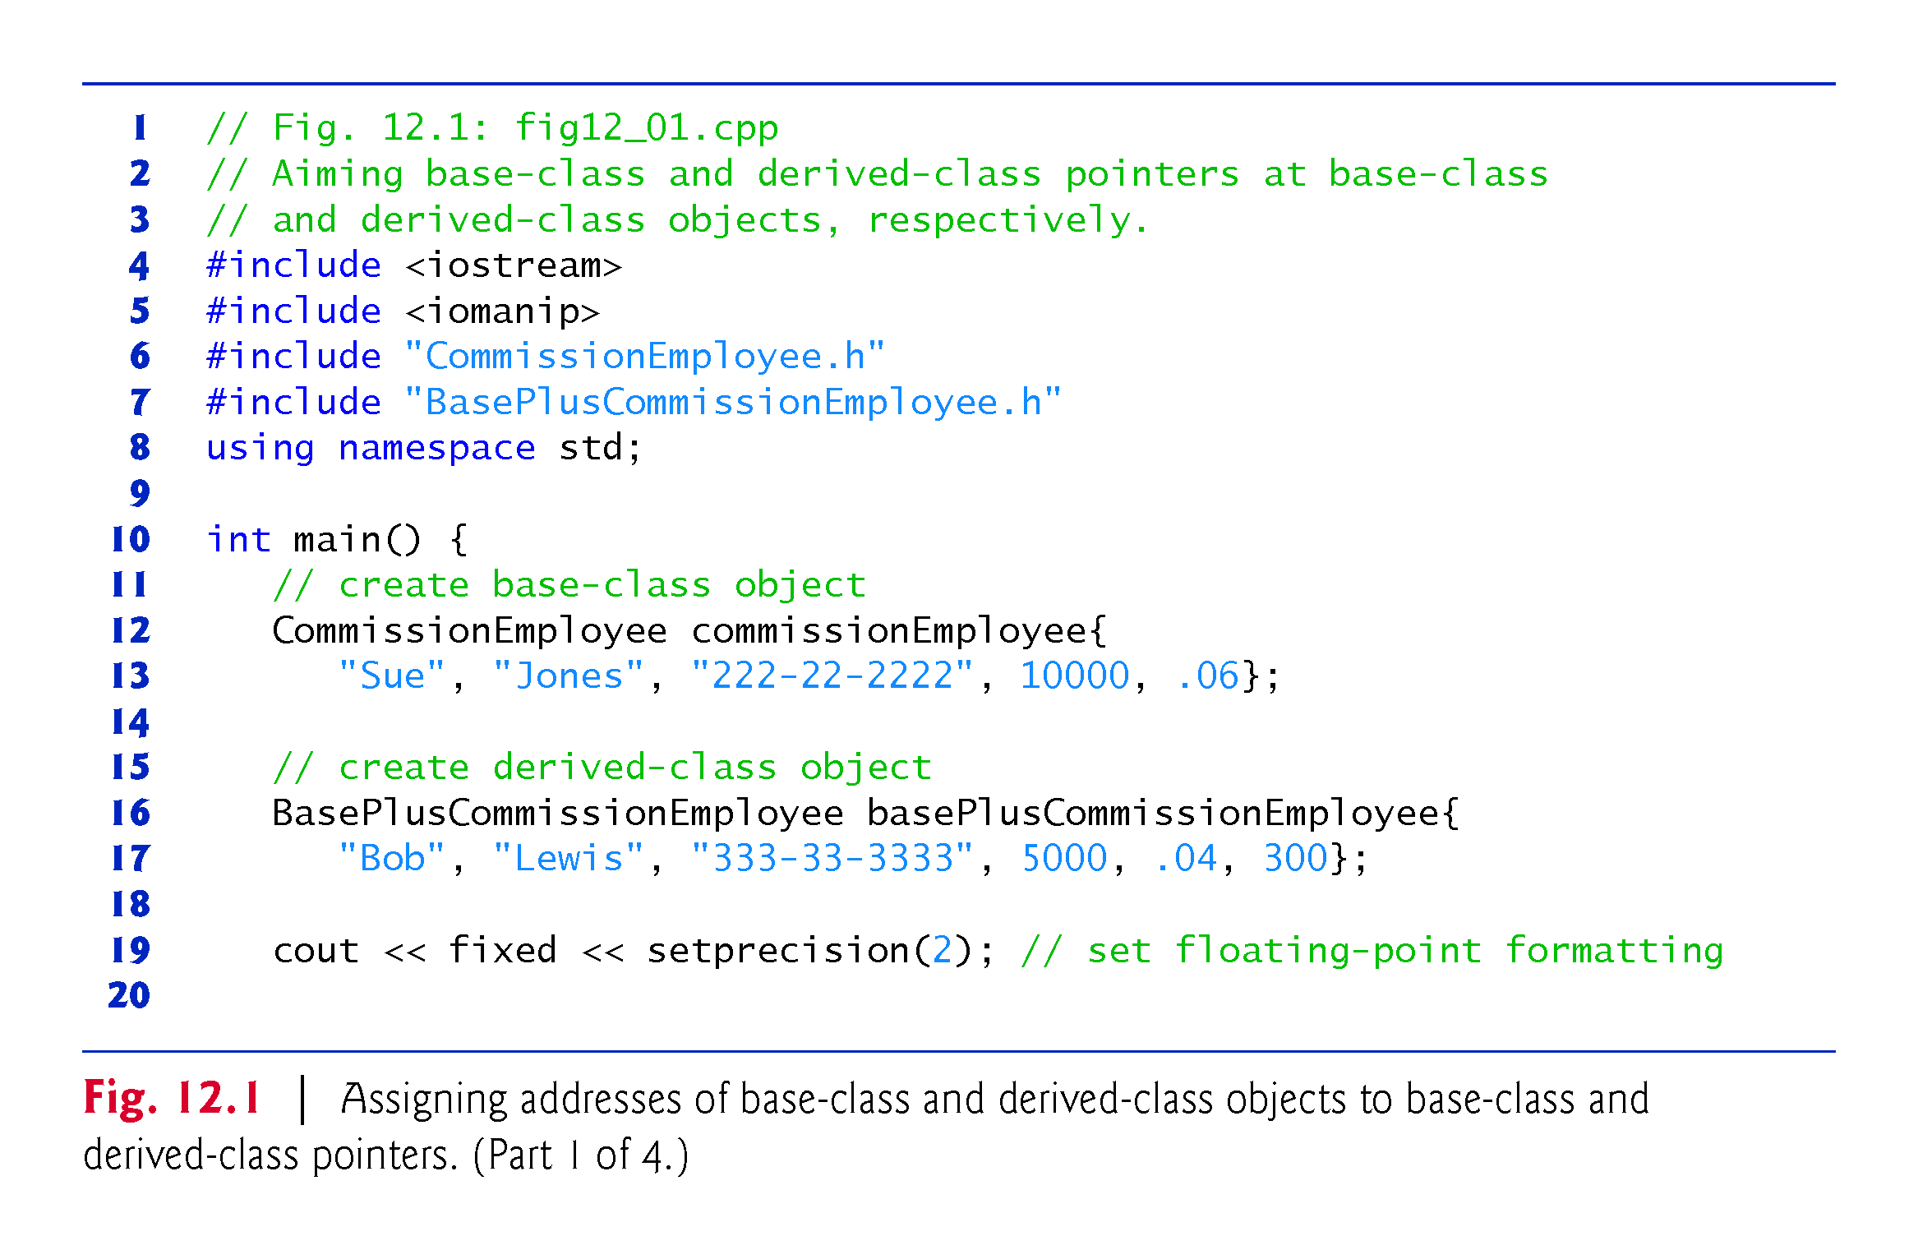

Slide 13
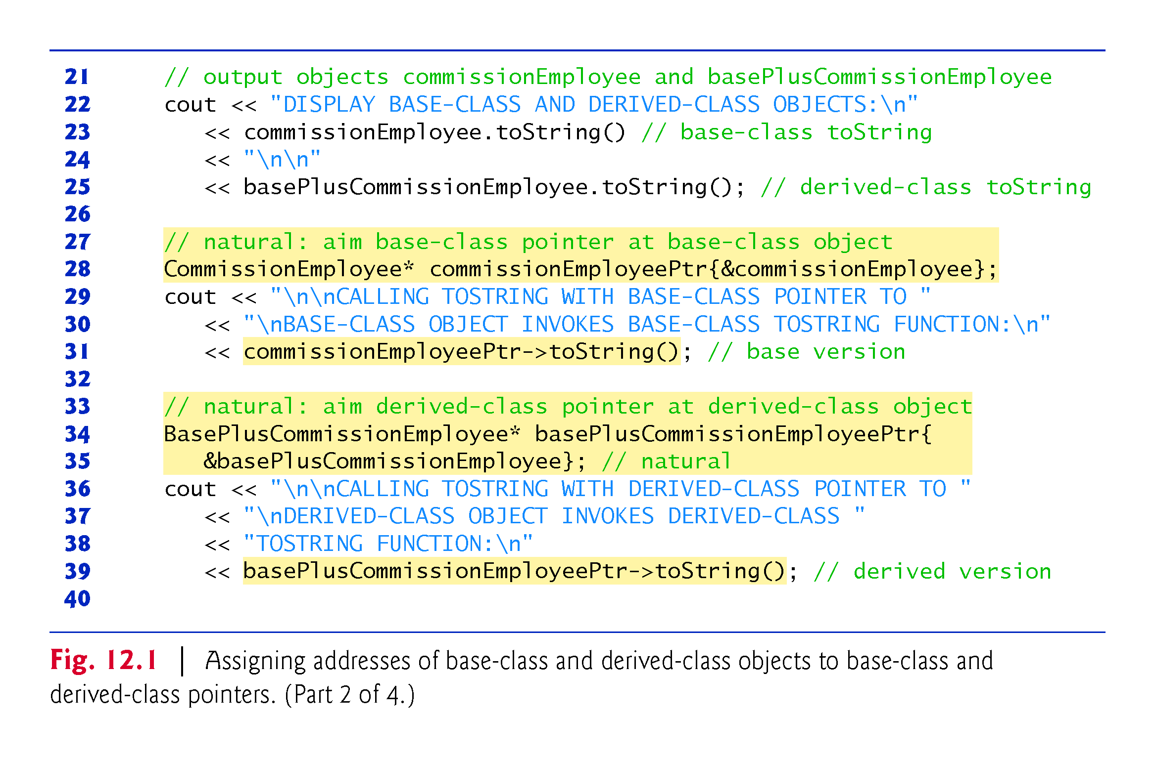

Slide 14
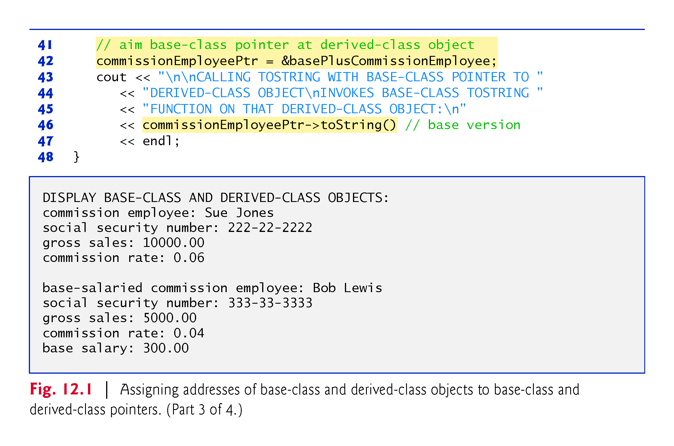

Slide 15
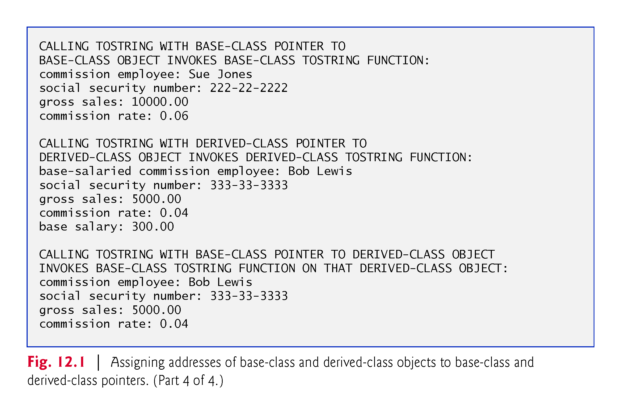

Slide 16
12.3.1 Invoking Base-Class Functions from Derived-Class Objects (cont.)
Aiming a Base-Class Pointer at a Base-Class Object
Line 28 creates base-class pointer commissionEmployeePtr and initializes it with the address of base-class object commissionEmployee
Line 31 uses this pointer to invoke member function toString on that CommissionEmployee object.
Invokes the version of toString defined in base class CommissionEmployee.

Slide 17
12.3.1 Invoking Base-Class Functions from Derived-Class Objects (cont.)
Aiming a Derived-Class Pointer at a Derived-Class Object
Lines 34-35 create basePlusCommissionEmployeePtr and initialize it with the address of derived-class object basePlusCommissionEmployee
Line 39 uses this pointer to invoke member function toString on that BasePlusCommissionEmployee.
This invokes the version of toString defined in derived class BasePlusCommissionEmployee.

Slide 18
12.3.1 Invoking Base-Class Functions from Derived-Class Objects (cont.)
Aiming a Base-Class Pointer at a Derived-Class Object
Line 42 assigns the address of derived-class object basePlusCommissionEmployee to base-class pointer commissionEmployeePtr, which line 46uses to invoke toString.
“crossover” allowed because of the is an relationship
base class CommissionEmployee’s toString member function is invoked (rather than BasePlusCommissionEmployee’s toString function).
The invoked functionality depends on the type of the pointer (or reference) used to invoke the function, not the type of the object for which the member function is called.

Slide 19
12.3.2 Aiming Derived-Class Pointers at Base-Class Objects
In Fig. 12.2, we attempt to aim a derived-class pointer at a base-class object.
C++ compiler generates an error.
The compiler prevents this assignment, because a CommissionEmployee is not a BasePlusCommissionEmployee.

Slide 20
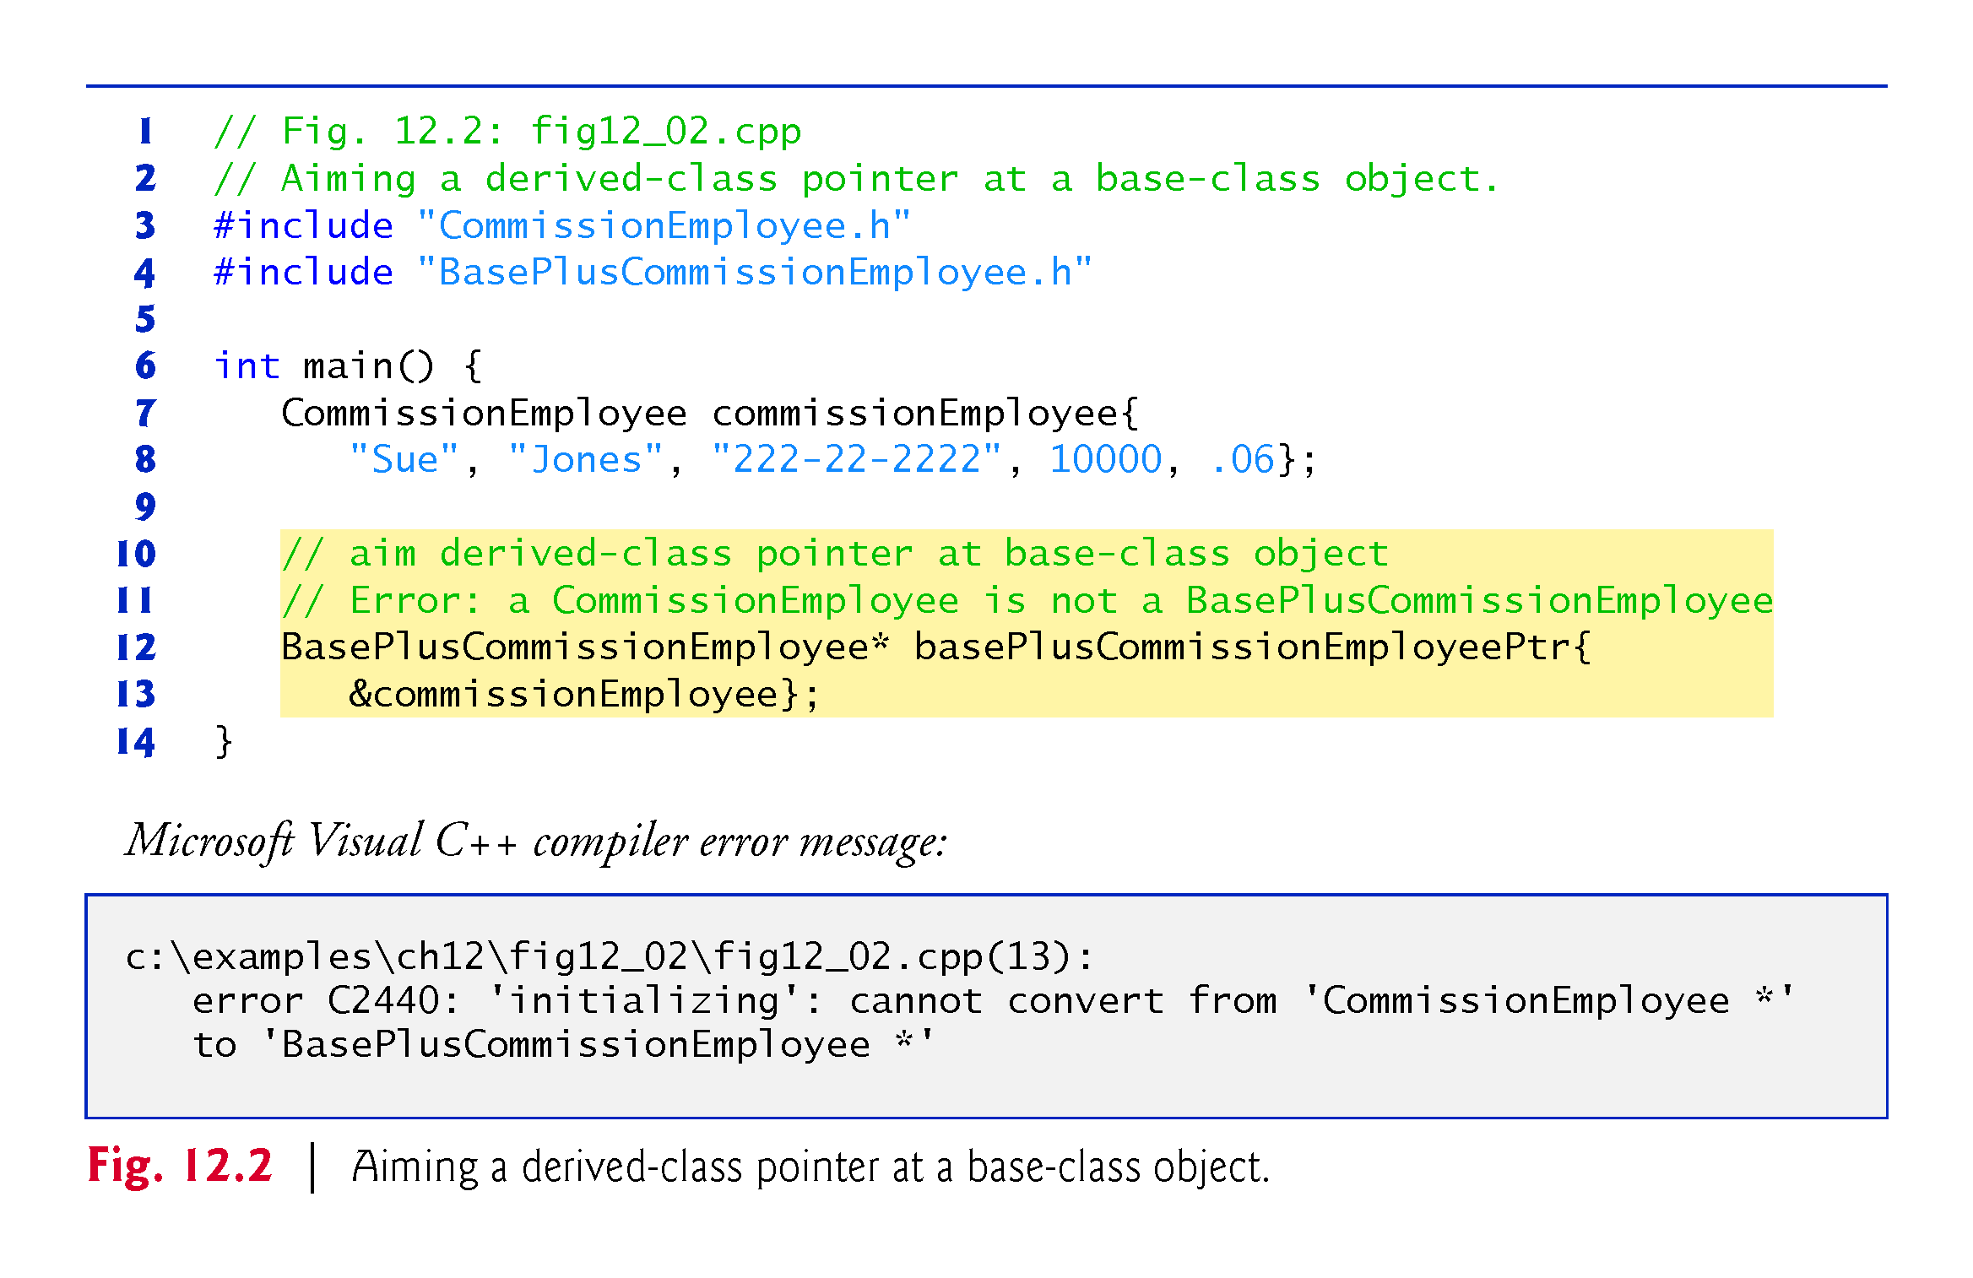

Slide 21
12.3.3 Derived-Class Member-Function Calls via Base-Class Pointers
Off a base-class pointer, the compiler allows us to invoke only base-class member functions.
If a base-class pointer is aimed at a derived-class object, and an attempt is made to access a derived-class-only member function, a compilation error will occur.
Figure 12.3 shows the consequences of attempting to invoke a derived-class-only member function off a base-class pointer.

Slide 22
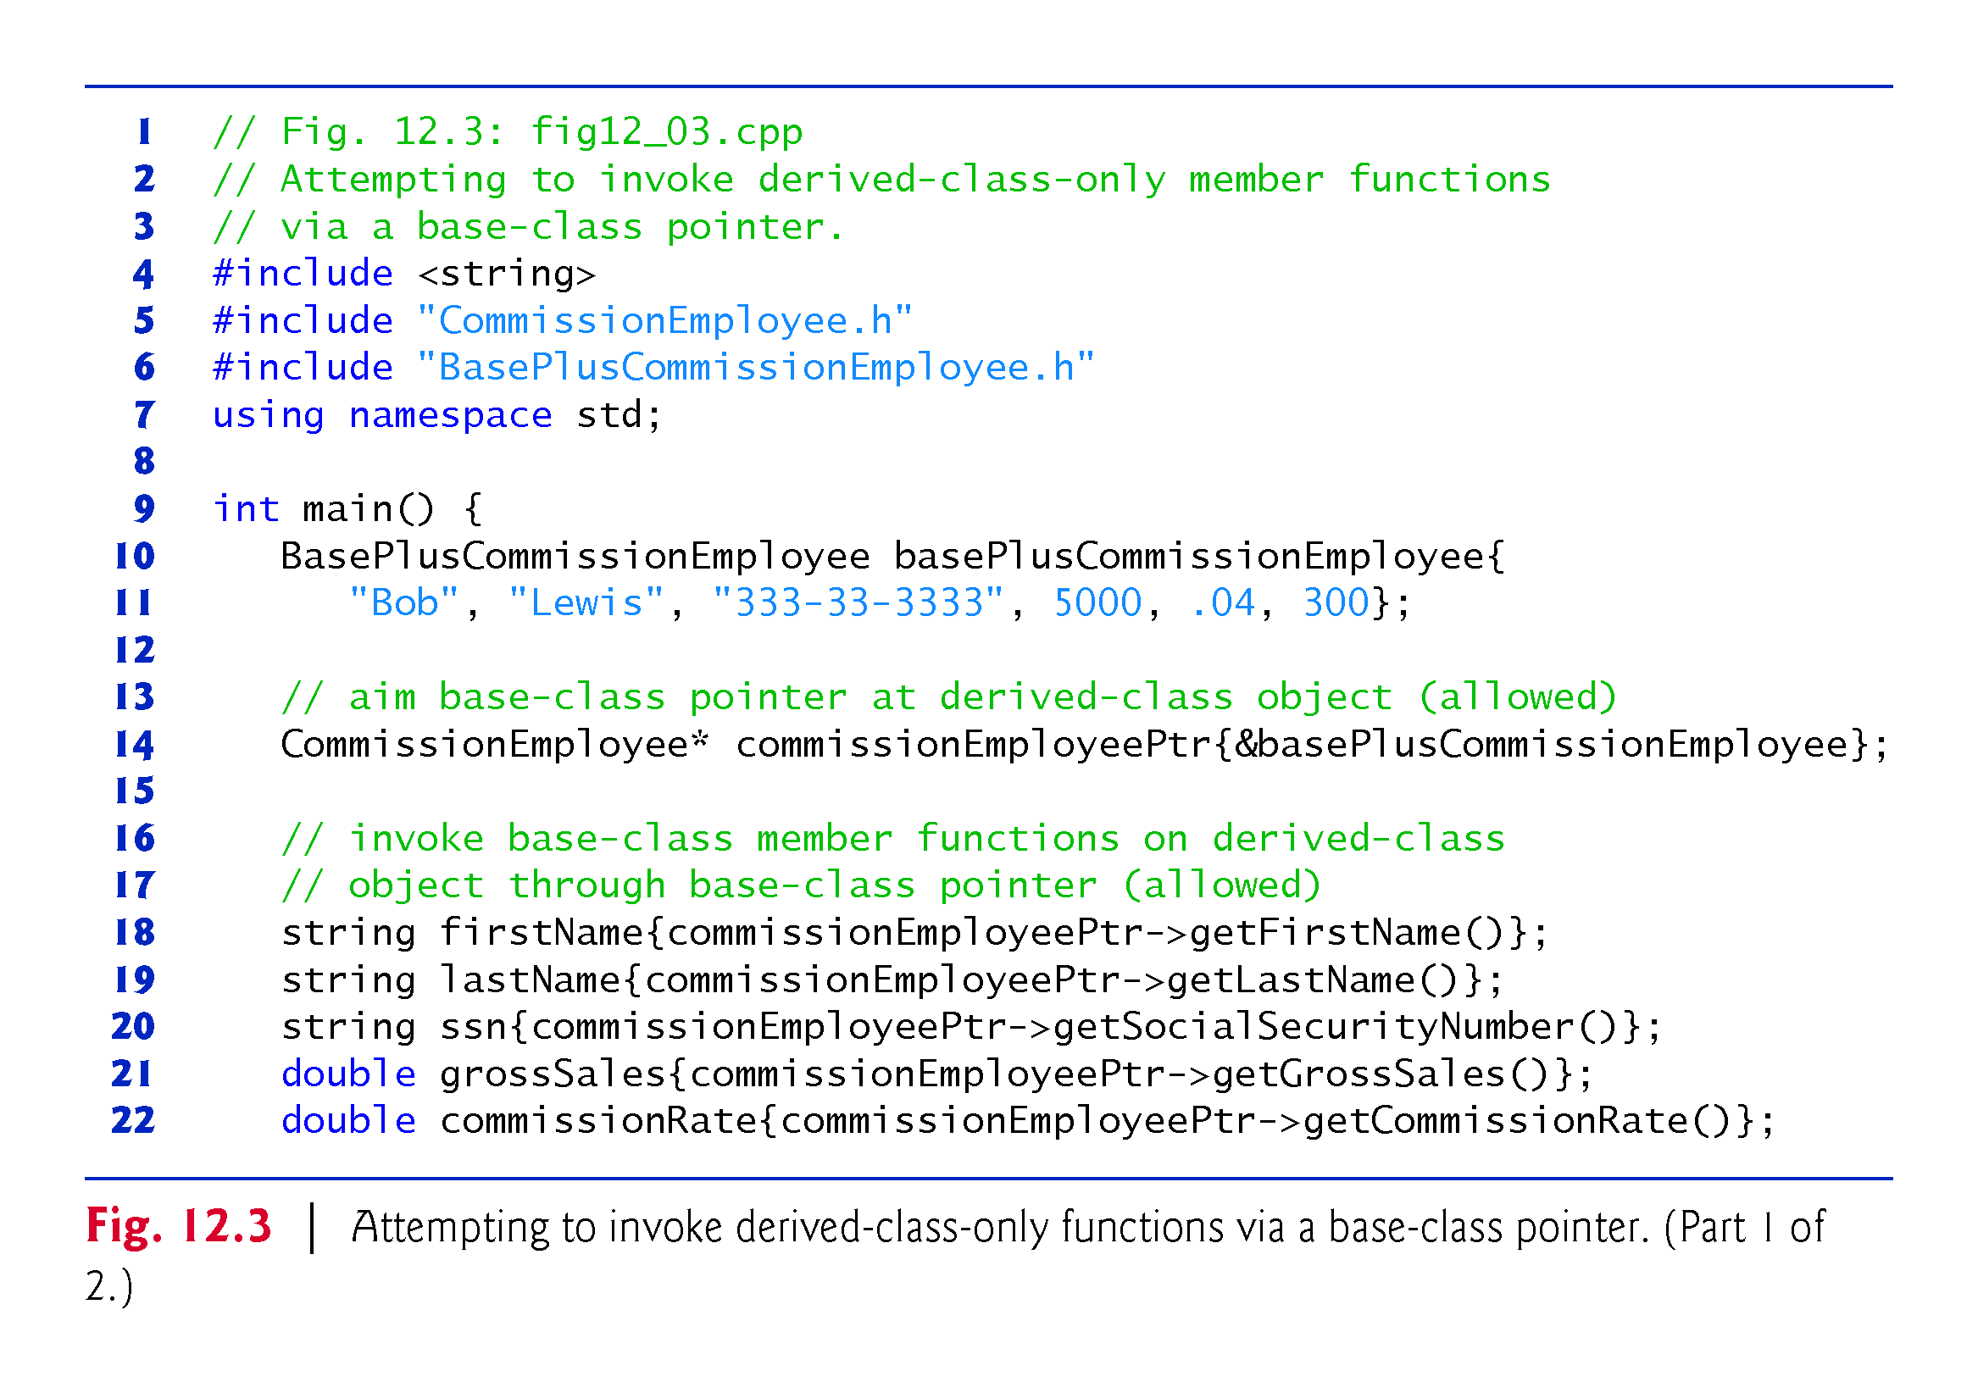

Slide 23
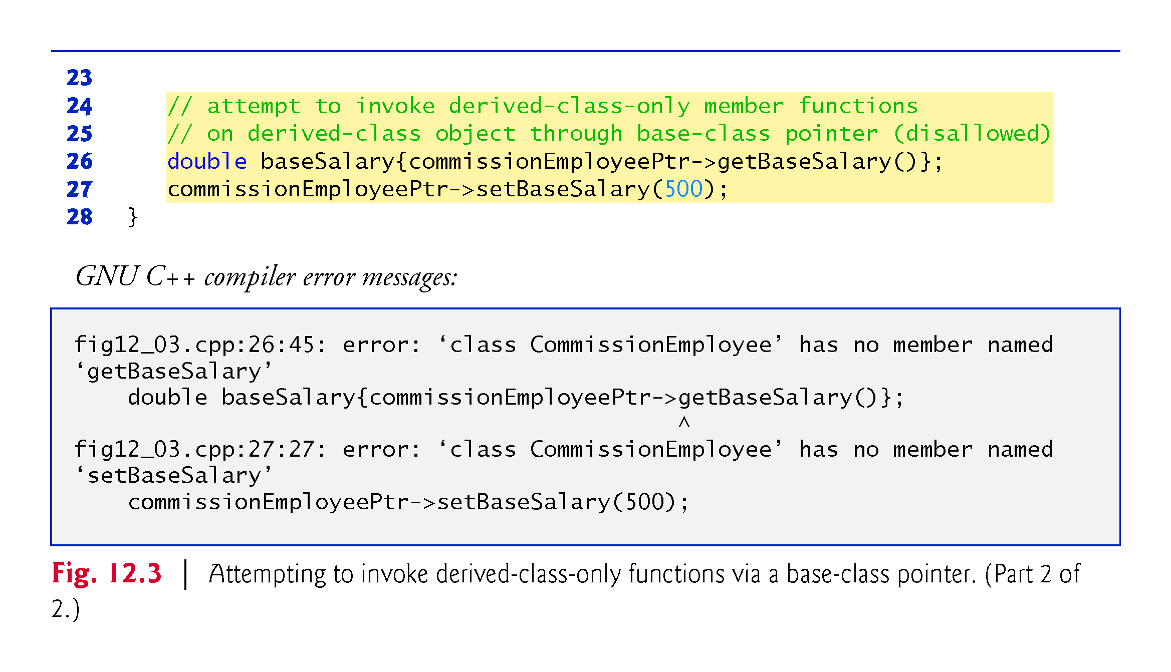

Slide 24
12.3.3 Derived-Class Member-Function Calls via Base-Class Pointers (cont.)
Downcasting
The compiler will allow access to derived-class-only members from a base-class pointer that is aimed at a derived-class object if we explicitly cast the base-class pointer to a derived-class pointer—known as downcasting.
Downcasting allows a derived-class-specific operation on a derived-class object pointed to by a base-class pointer.
After a downcast, the program can invoke derived-class functions that are not in the base class.
Section 12.8 demonstrates how to safely use downcasting.

Slide 25
12.4.1 Why virtual Functions Are Useful
Suppose that shape classes such as Circle, Triangle, Rectangle and Square are all derived from base class Shape.
Each of these classes might be endowed with the ability to draw itself via a member function draw, but the function for each shape is quite different.
In a program that draws a set of shapes, it would be useful to be able to treat all the shapes generally as objects of the base class Shape.
To draw any shape, we could simply use a base-class Shape pointer to invoke function draw and let the program determine dynamically (i.e., at runtime) which derived-class draw function to use, based on the type of the object to which the base-class Shape pointer points at any given time.
This is polymorphic behavior.

Slide 26
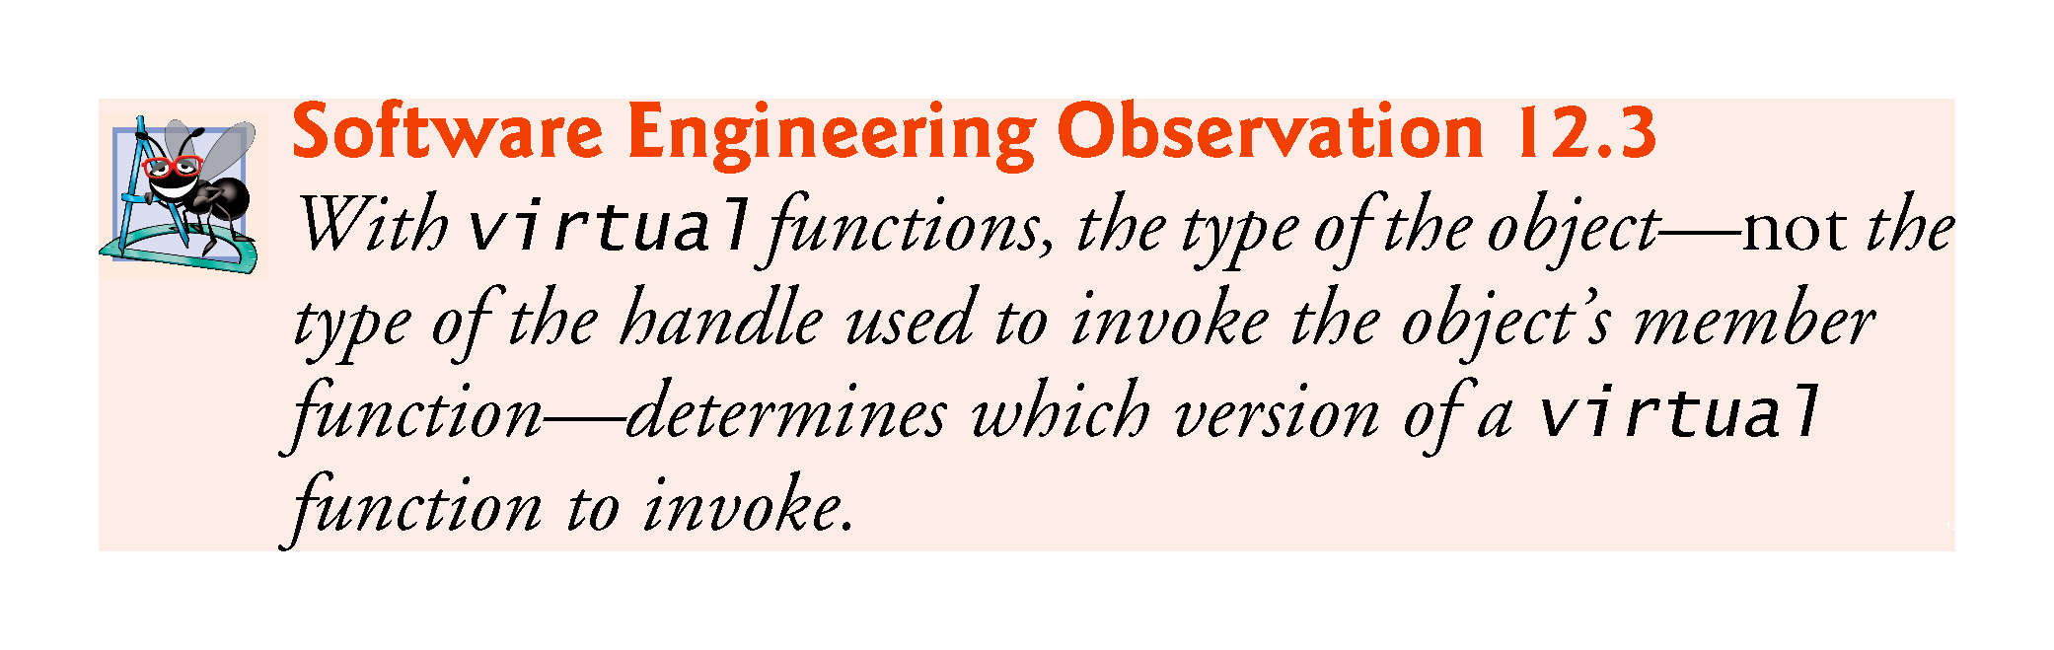

Slide 27
12.4.2 Declaring virtual Functions
To enable this behavior, we declare draw in the base class as a virtual function, and we override draw in each of the derived classes to draw the appropriate shape.
An overridden function in a derived class has the same signature and return type (i.e., prototype) as the function it overrides in its base class.
If we declare the base-class function as virtual, we can override that function to enable polymorphic behavior.
We declare a virtual function by preceding the function’s prototype with the key-word virtual in the base class.

Slide 28
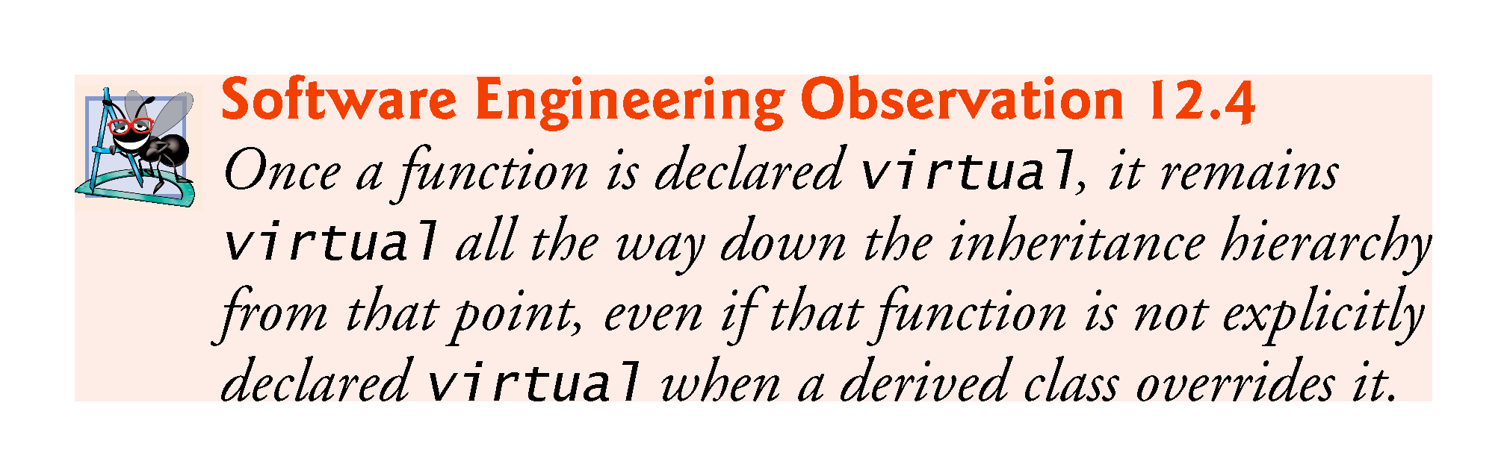

Slide 29
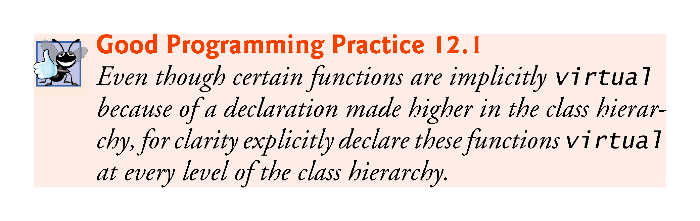

Slide 30
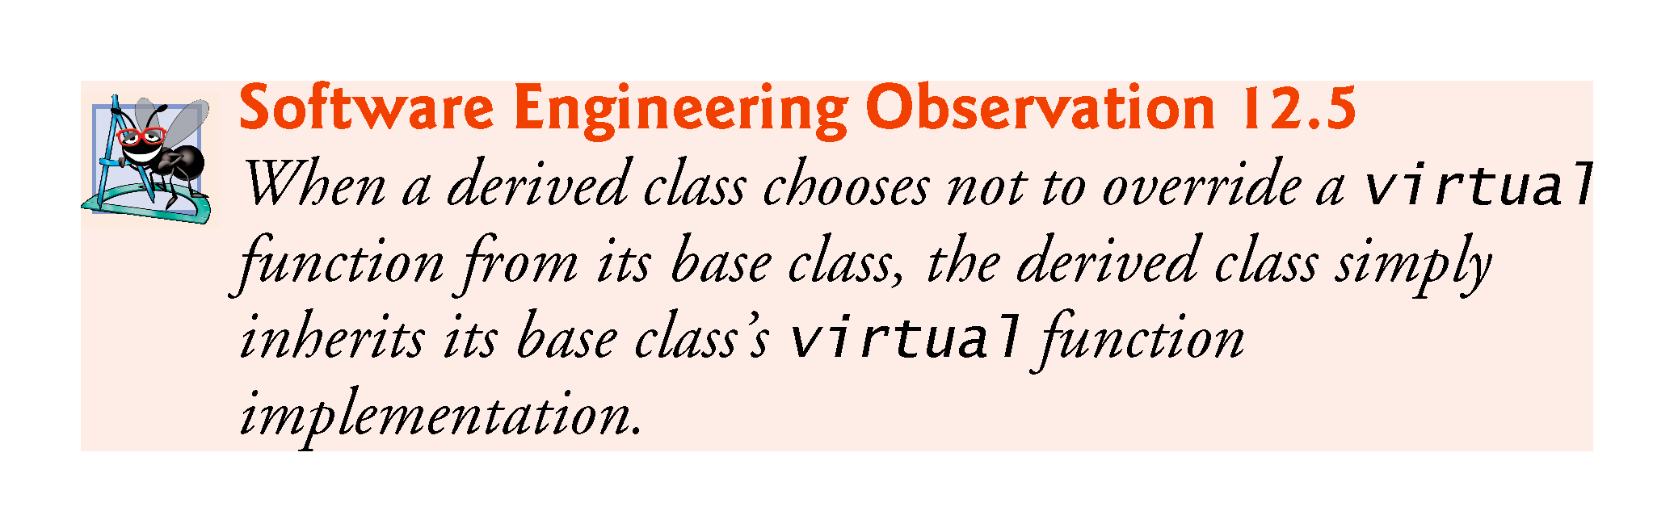

Slide 31
12.4.3 Invoking a virtual Function Through a Base-Class Pointer or Reference
If a program invokes a virtual function through a base-class pointer to a derived-class object or a base-class reference to a derived-class, the program will choose the correct derived-class function dynamically (i.e., at execution time) based on the object type—not the pointer or reference type.
Known as dynamic binding or late binding.

Slide 32
12.4.4 Invoking a virtual Function Through an Object’s Name
When a virtual function is called by referencing a specific object by name and using the dot member-selection operator, the function invocation is re-solved at compile time (this is called static binding) and the virtual function that is called is the one defined for (or inherited by) the class of that particular object—this is not polymorphic behavior.
Dynamic binding with virtual functions occurs only off pointers (and, as we’ll soon see, references).

Slide 33
12.4.4 virtual Functions in the CommissionEmployee Hierarchy
Figures 12.4–12.5 are the headers for classes CommissionEmployee and BasePlusCommissionEmployee, respectively.
We modified these to declare each class’s earnings and toString member functions as virtual.
Because functions earnings and toString are virtual in class CommissionEmployee, class BasePlusCommissionEmployee’s earnings and toString functions override class CommissionEmployee’s.
In addition, class BasePlusCommissionEmployee’s earnings and toString functions are declare override.

Slide 34
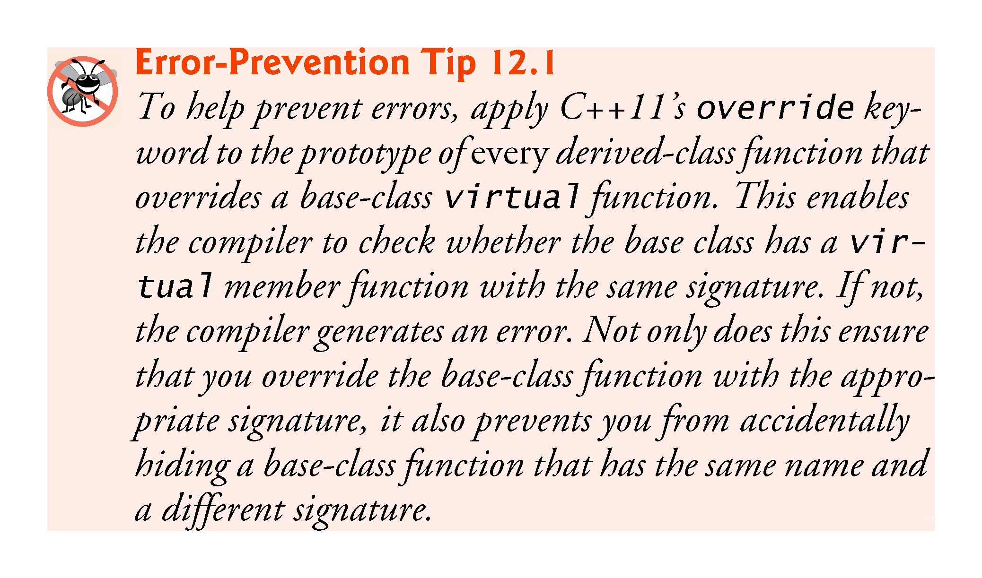

Slide 35
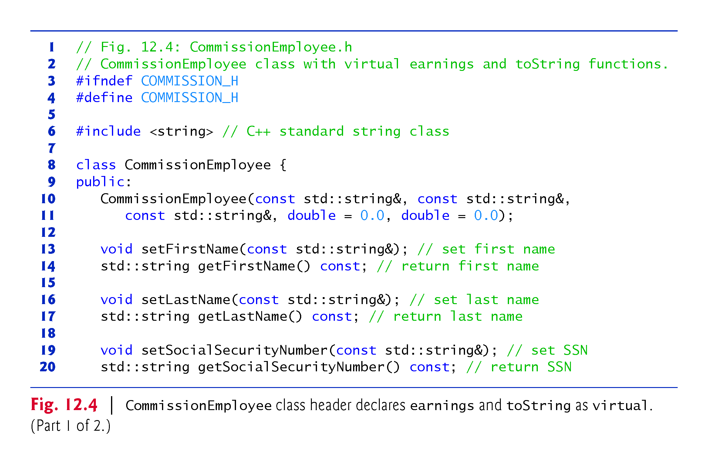

Slide 36
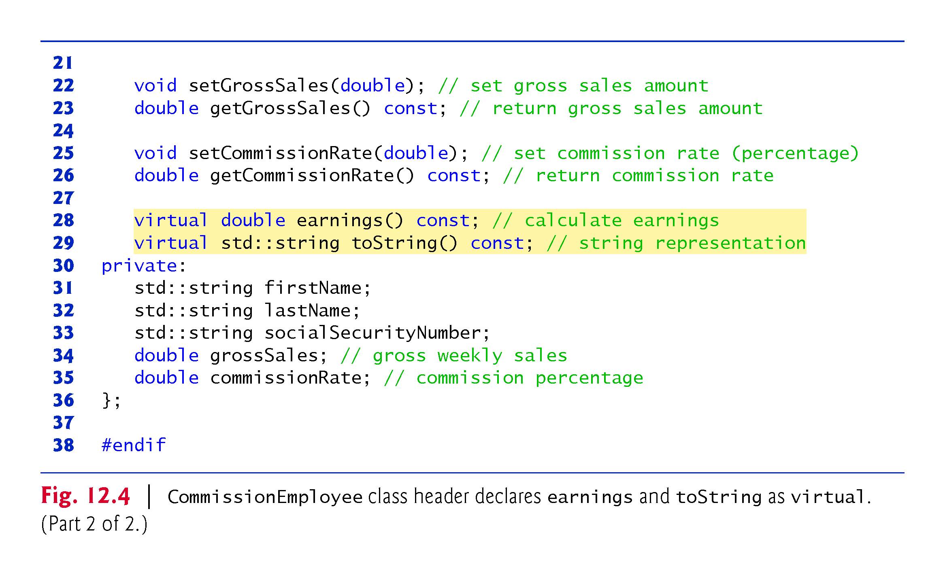

Slide 37
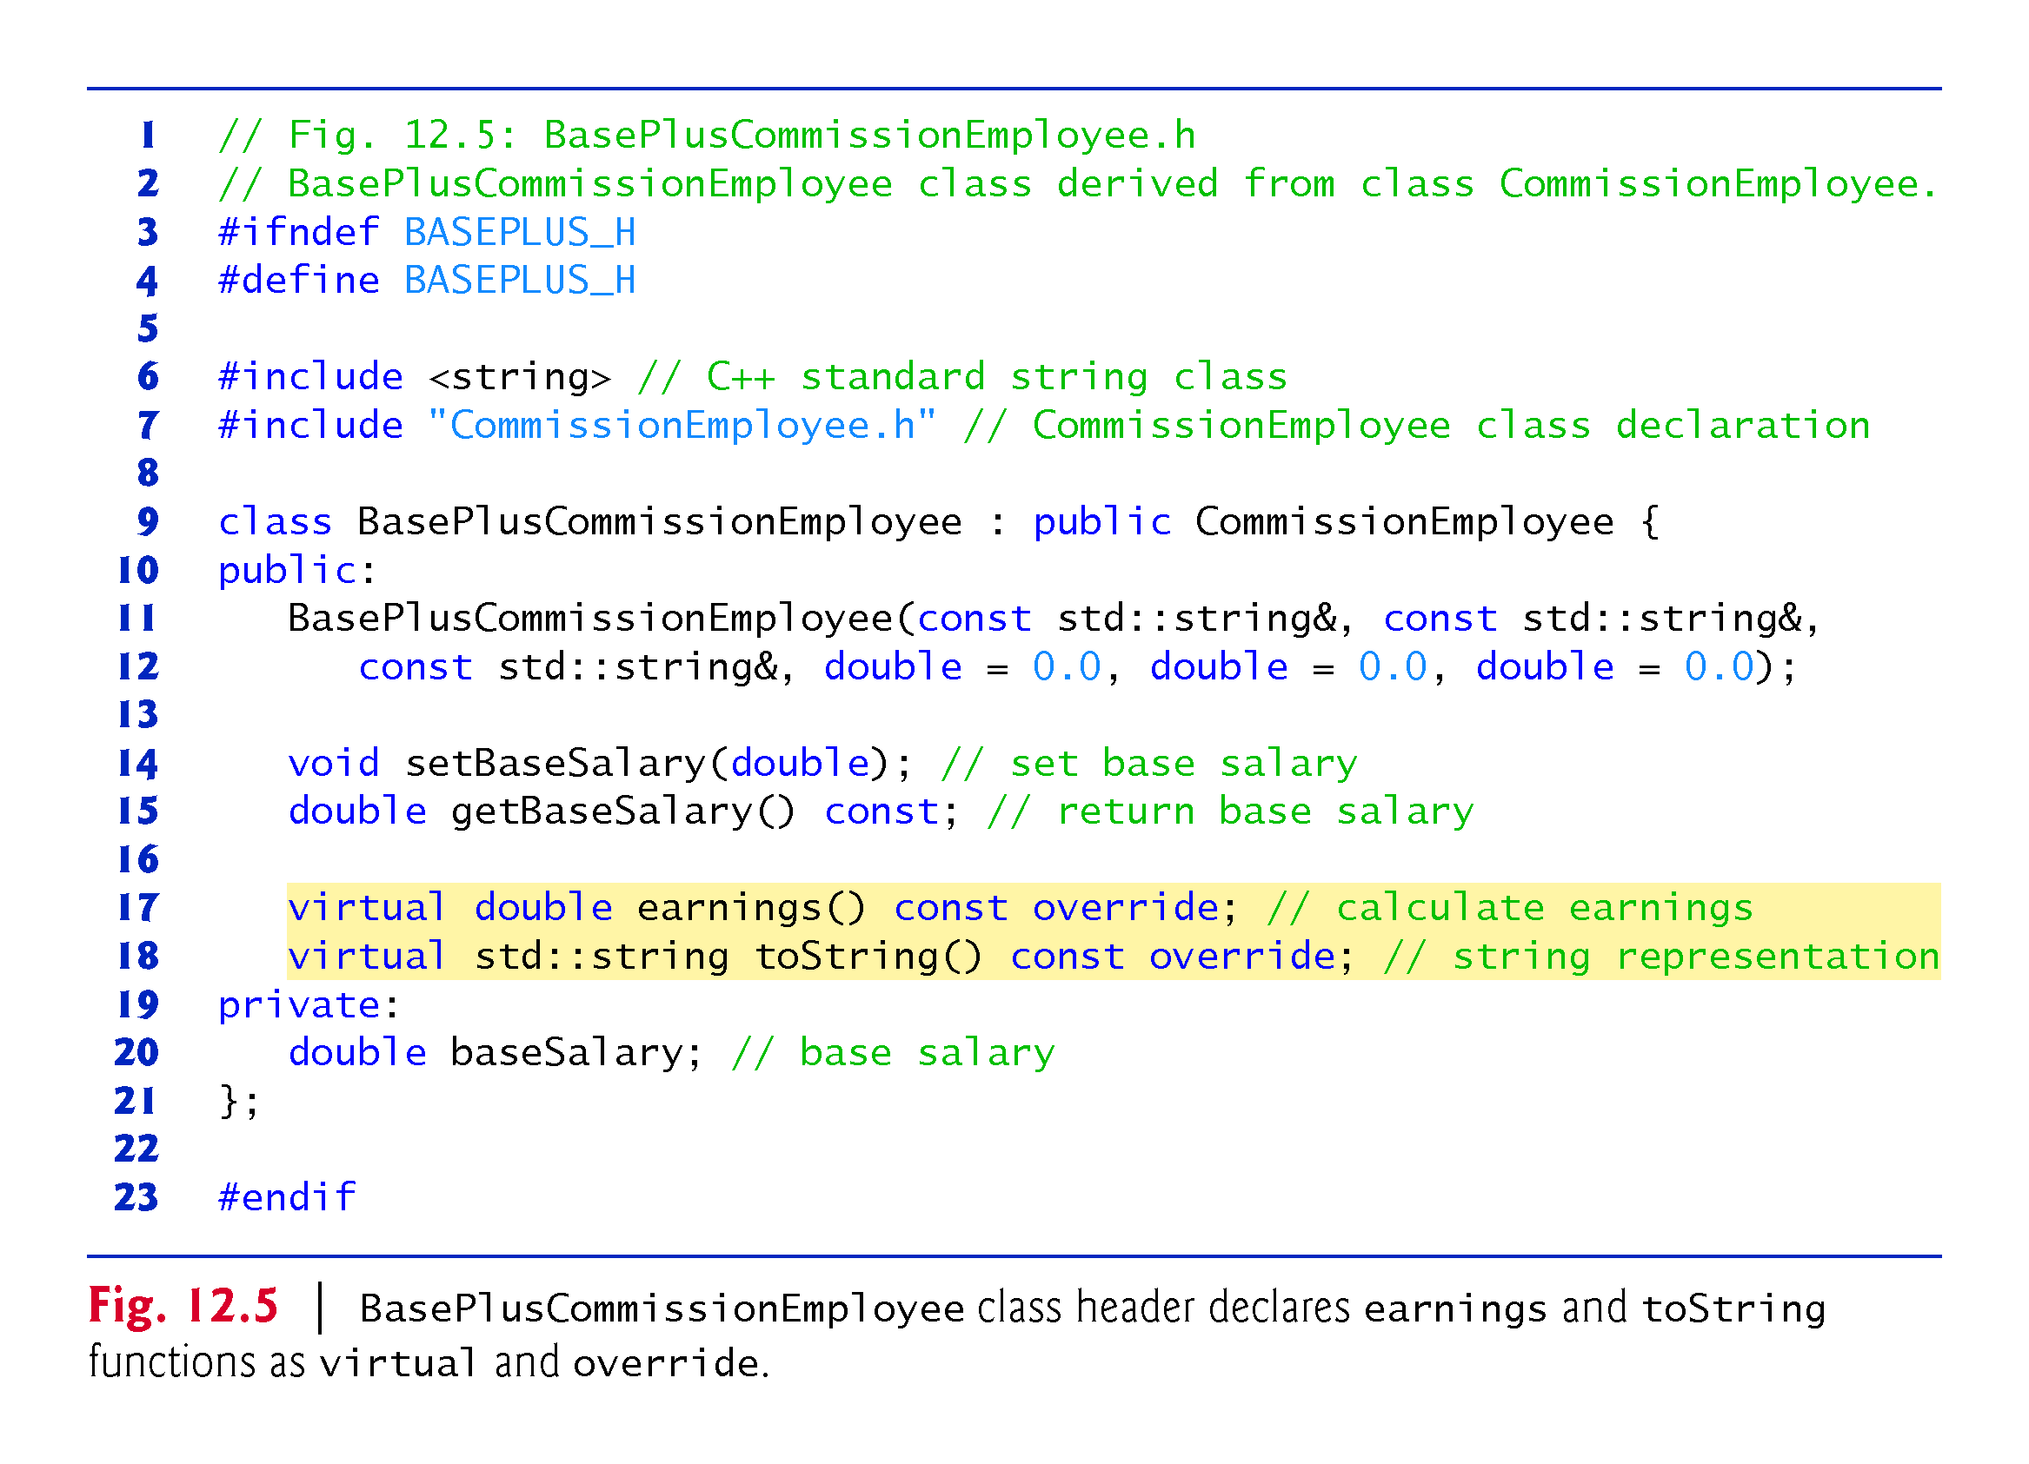

Slide 38
12.4.4 virtual Functions in the CommissionEmployee Hierarchy
We modified Fig. 12.1 to create the program of Fig. 12.6.
Line 47 aims base-class pointer commissionEmployeePtr at derived-class object basePlusCommissionEmployee.
When line 54 invokes member function toString off the base-class pointer, the derived-class BasePlusCommissionEmployee’s toString member function is invoked.
We see that declaring a member function virtual causes the program to dynamically determine which function to invoke based on the type of object to which the handle points, rather than on the type of the handle.

Slide 39
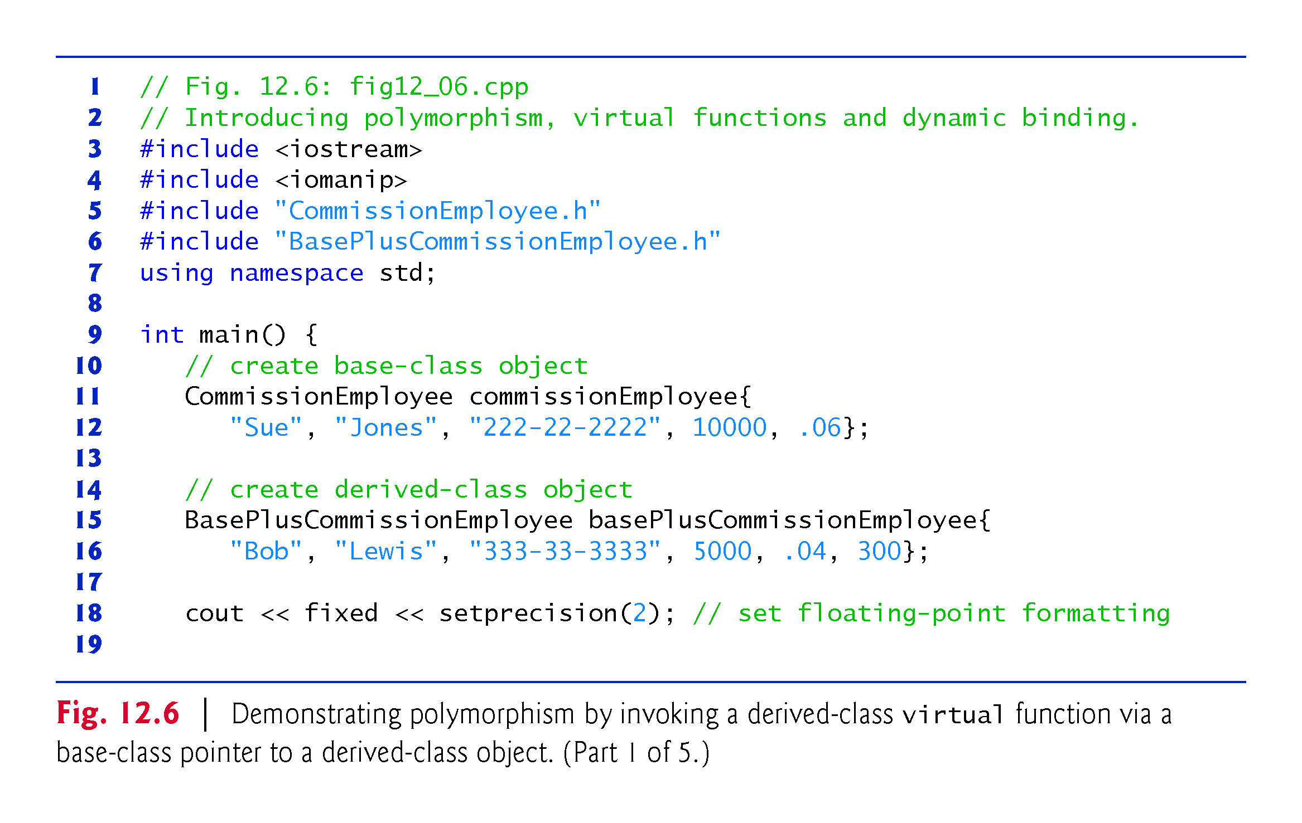

Slide 40
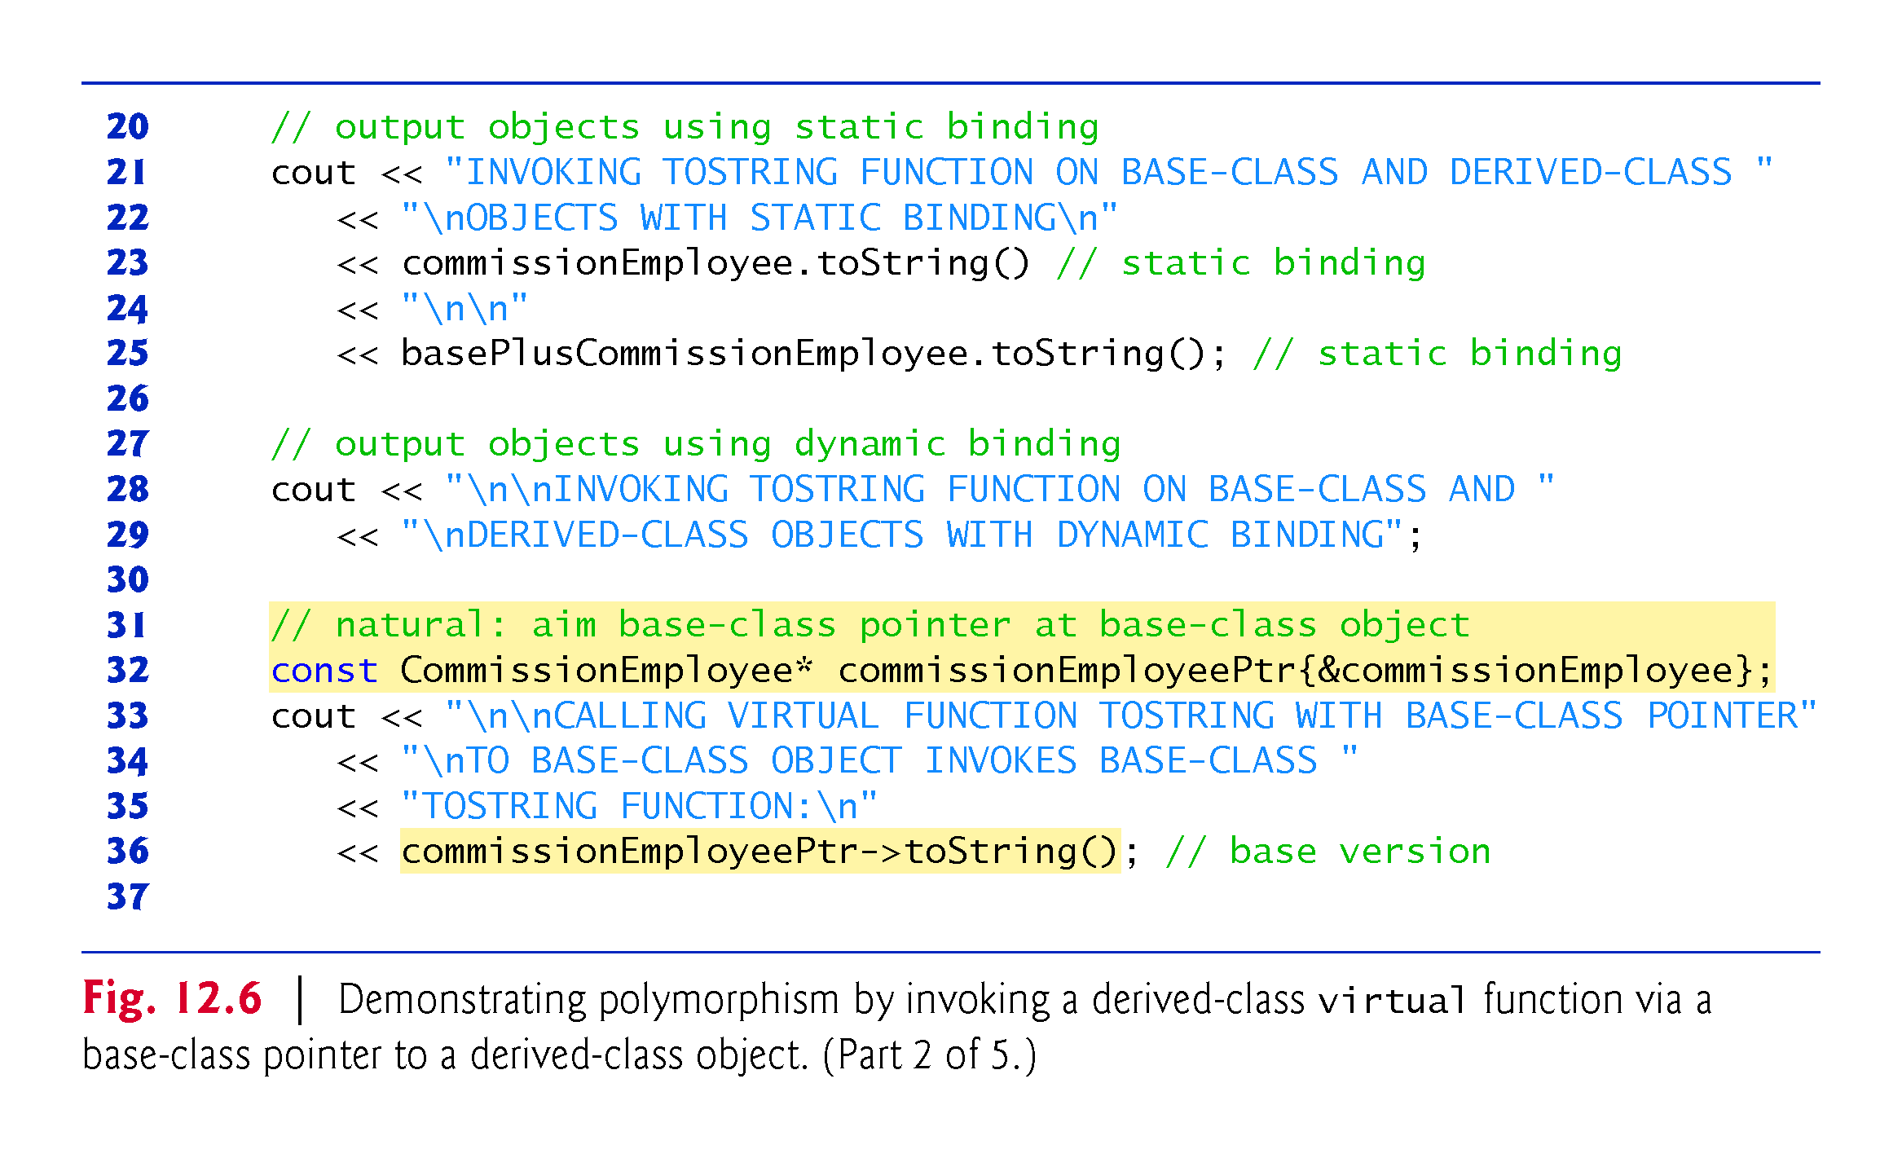

Slide 41
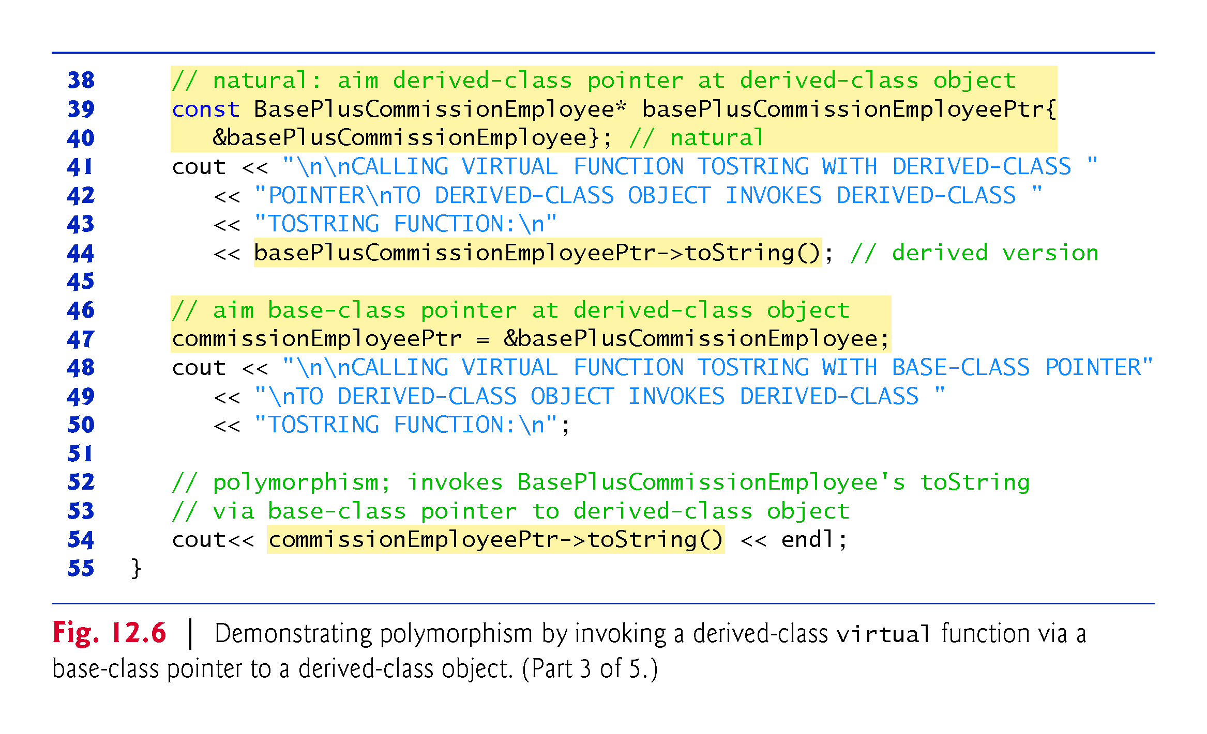

Slide 42
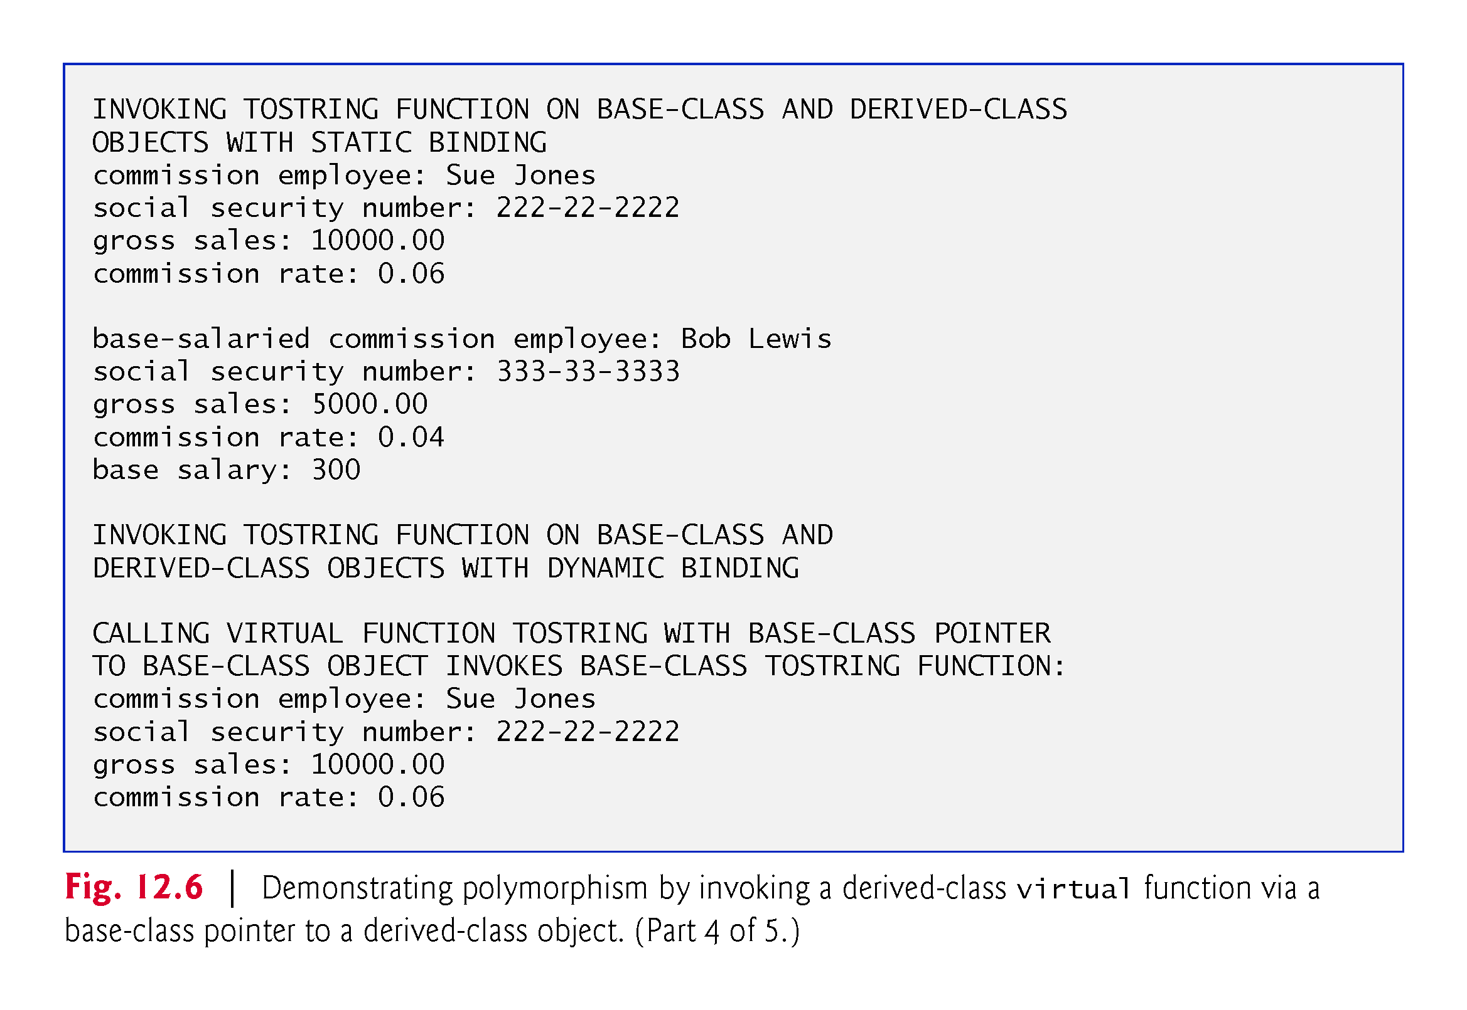

Slide 43
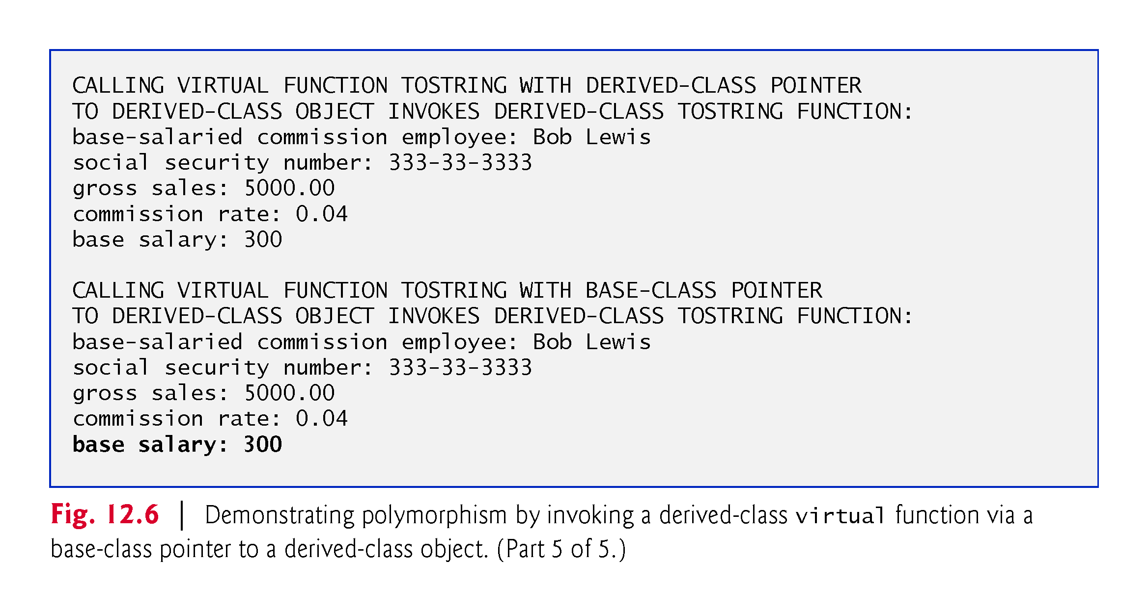

Slide 44
12.4.6 virtual Destructors
A problem can occur when using polymorphism to process dynamically allocated objects of a class hierarchy.
If a derived-class object with a non-virtual destructor is destroyed by applying the delete operator to a base-class pointer to the object, the C++ standard specifies that the behavior is undefined.
The simple solution to this problem is to create a public virtual destructor in the base class.
If a base class destructor is declared virtual, the destructors of any derived classes are also virtual.

Slide 45
12.4.6 virtual Destructors
In class CommissionEmployee’s definition, we can define the virtual destructor as follows:
virtual ~CommissionEmployee() { }
Now, if an object in the hierarchy is destroyed explicitly by applying the delete operator to a base-class pointer, the destructor for the appropriate class is called based on the object to which the base-class pointer points.
Remember, when a derived-class object is destroyed, the base-class part of the derived-class object is also destroyed, so it’s important for the destructors of both the derived and base classes to execute.
The base-class destructor automatically executes after the derived-class destructor.

Slide 46
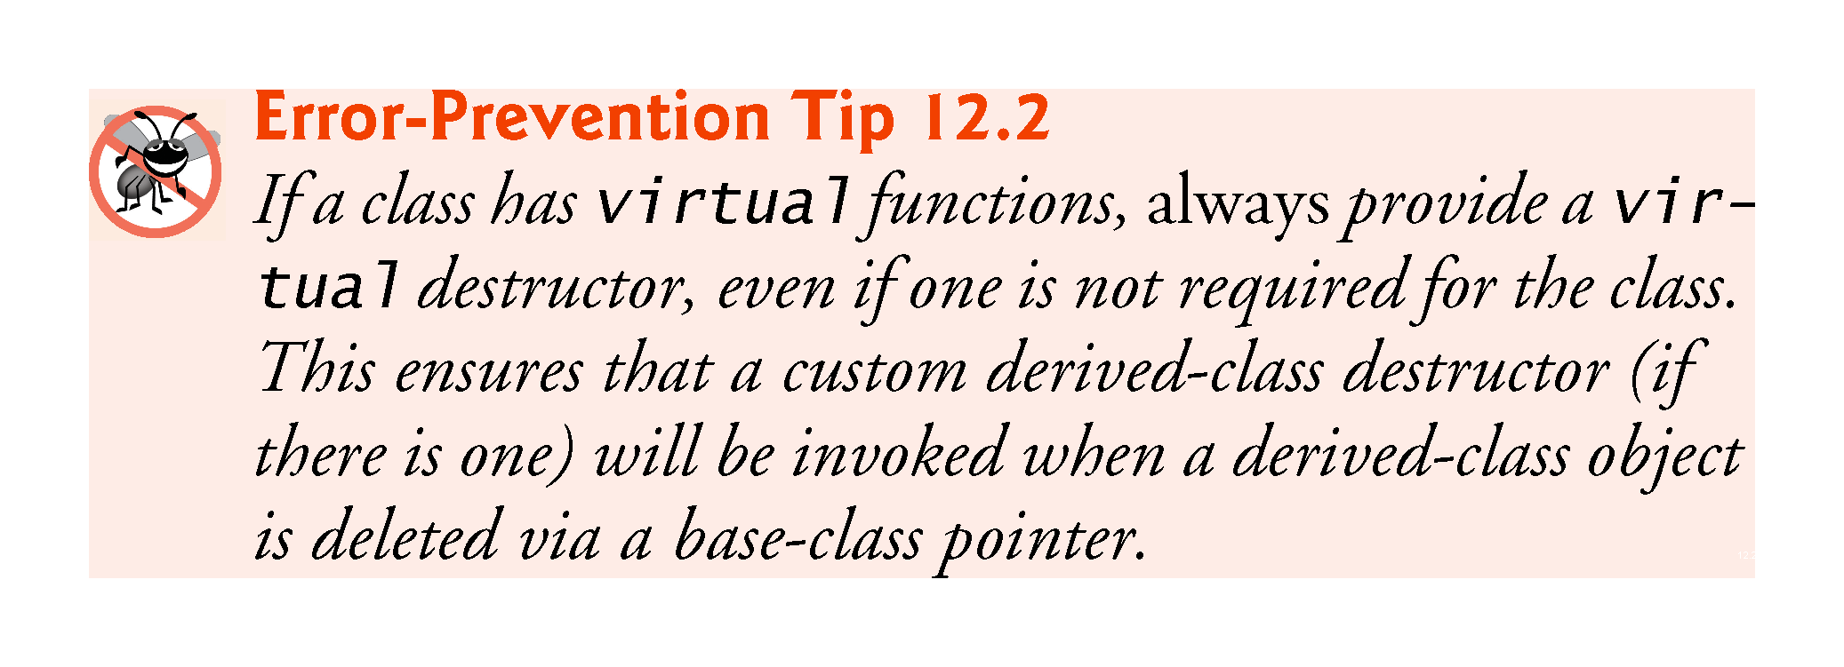

Slide 47
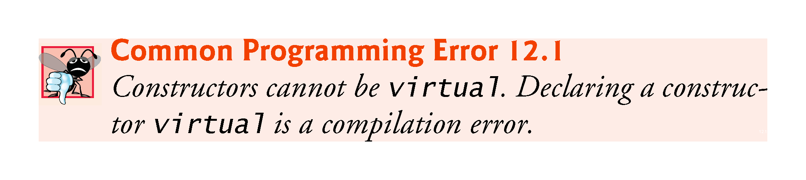

Slide 48
12.4.6 virtual Destructors
Destructor definition also may be written as follows:
virtual ~CommissionEmployee() = default;
You can tell the compiler to explicitly generate the default version of a default constructor, copy constructor, move constructor, copy assignment operator, move assignment operator or destructor by following the special member function’s prototype with = default.
Useful, for example, when you explicitly define a constructor for a class and still want the compiler to generate a default constructor as well—in that case, add the following declaration to your class definition:
ClassName() = default;

Slide 49
12.4.7 C++11: final Member Functions and Classes
In C++11, a base-class virtual function that’s declared final in its prototype, as in
virtual someFunction(parameters) final;
cannot be overridden in any derived class
Guarantees that the base class’s final member function definition will be used by all base-class objects and by all objects of the base class’s direct and indirect derived classes.

Slide 50
12.4.7 C++11: final Member Functions and Classes
You can declare a class as final to prevent it from being used as a base class, as in
class MyClass final // this class cannot be a base class
{
// class body
};
Attempting to override a final member function or inherit from a final base class results in a compilation error.

Slide 51
12.5 Type Fields and switch Statements
One way to determine the type of an object is to use a switch statement to check the value of a field in the object.
Can distinguish among object types, then invoke an appropriate action for a particular object, similar to polymorphism.
Using switch logic exposes programs to a variety of potential problems.
Might forget to include a type test when one is warranted, or might forget to test all possible cases in a switch statement.
When modifying a switch-based system by adding new types, you might forget to insert the new cases in all relevant switch statements.
Every addition or deletion of a class requires modification of every switch statement; tracking these down can be time consuming and error prone.

Slide 52
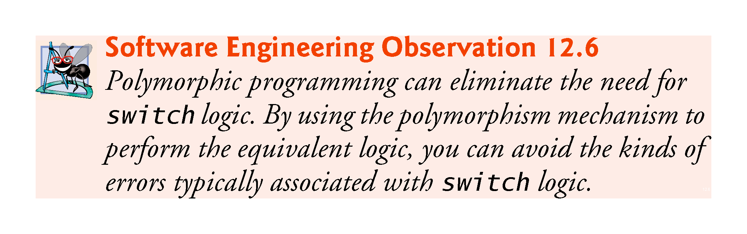

Slide 53
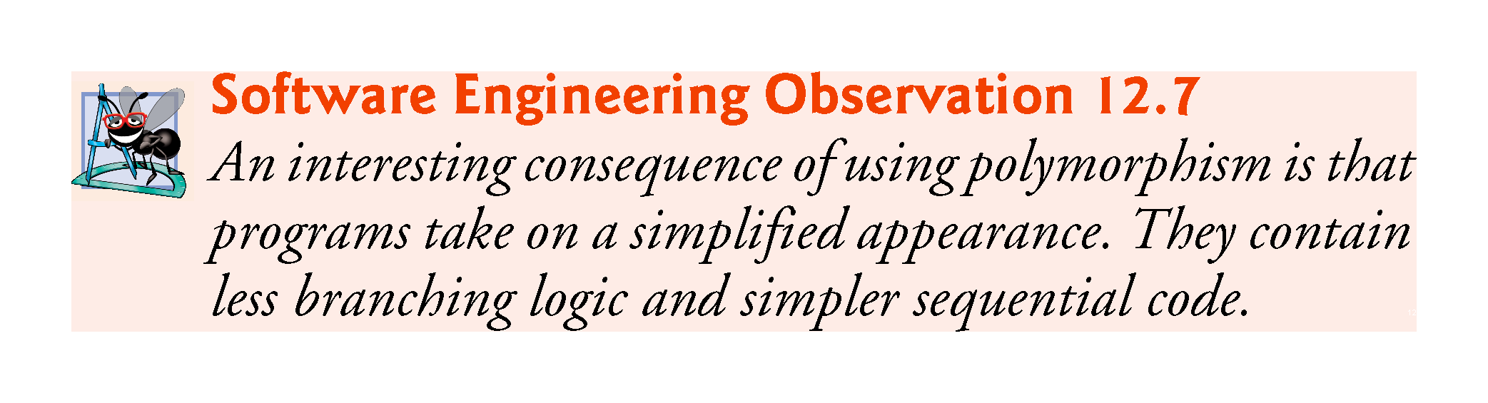

Slide 54
12.6 Abstract Classes and Pure virtual Functions
There are cases in which it’s useful to define classes from which you never intend to instantiate any objects.
Such classes are called abstract classes.
Because these classes normally are used as base classes in inheritance hierarchies, we refer to them as abstract base classes.
Cannot be used to instantiate objects, because they are incomplete—derived classes must define the “missing pieces.”
An abstract class is a base class from which other classes can inherit.
Classes that can be used to instantiate objects are concrete classes.
Such classes define every member function they declare.

Slide 55
12.6 Abstract Classes and Pure virtual Functions (cont.)
Abstract base classes are too generic to define real objects; we need to be more specific before we can think of instantiating objects.
For example, if someone tells you to “draw the two-dimensional shape,” what shape would you draw?
Concrete classes provide the specifics that make it possible to instantiate objects.

Slide 56
12.6.1 Pure virtual Functions
A class is made abstract by declaring one or more of its virtual functions to be “pure.” A pure virtual function is specified by placing “= 0” in its declaration, as in
virtual void draw() const = 0; // pure virtual function
The “= 0” is a pure specifier.
Pure virtual functions typically do not provide implementations, though they can.

Slide 57
12.6.1 Pure virtual Functions
Each concrete derived class must override all base-class pure virtual functions with concrete implementations of those functions; otherwise the derived class is also abstract.
The difference between a virtual function and a pure virtual function is that a virtual function has an implementation and gives the derived class the option of overriding the function.
By contrast, a pure virtual function does not have an implementation and requires the derived class to override the function for that derived class to be concrete; otherwise the derived class remains abstract.
Pure virtual functions are used when it does not make sense for the base class to have an implementation of a function, but you want all concrete derived classes to implement the function.

Slide 58
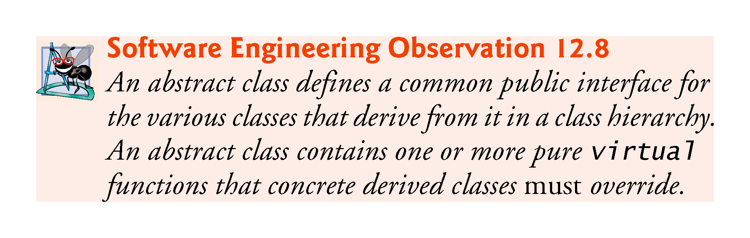

Slide 59
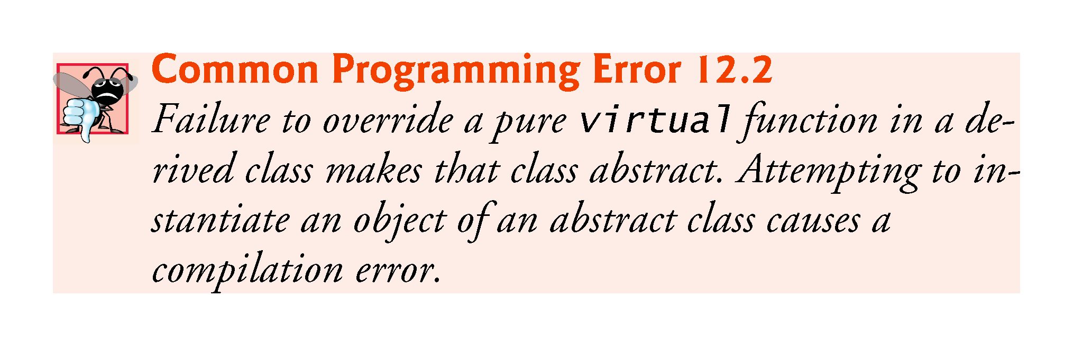

Slide 60
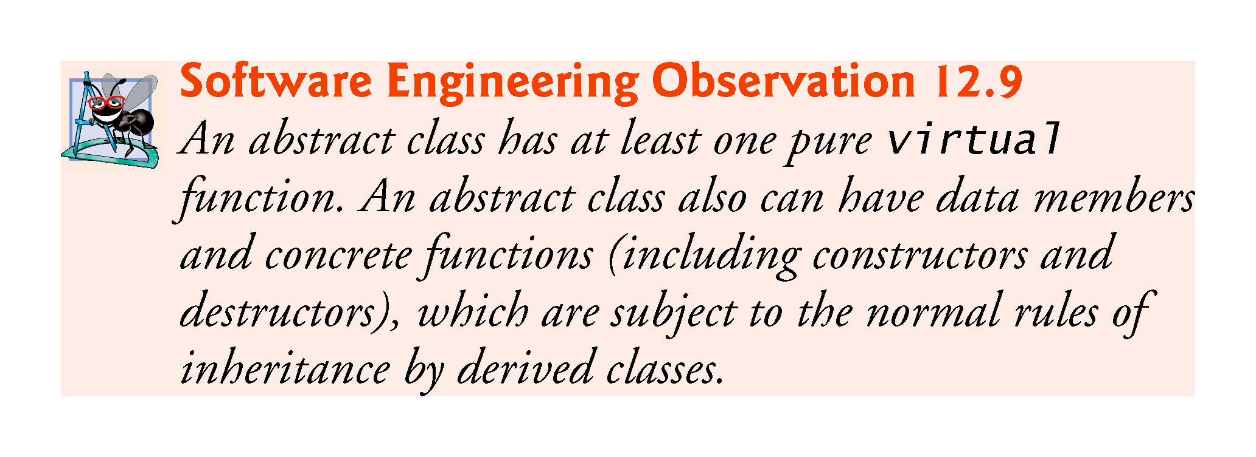

Slide 61
12.6.1 Pure virtual Functions
Although we cannot instantiate objects of an abstract base class, we can use the abstract base class to declare pointers and references that can refer to objects of any concrete classes derived from the abstract class.
Programs typically use such pointers and references to manipulate derived-class objects polymorphically.

Slide 62
12.7 Case Study: Payroll System Using Polymorphism
This section reexamines the CommissionEmployee-BasePlusCommissionEmployee hierarchy that we explored throughout Section 11.3. We use an abstract class and polymorphism to perform payroll calculations based on the type of employee.

Slide 63
12.7 Case Study: Payroll System Using Polymorphism (cont.)
Enhanced employee hierarchy to solve the following problem:
A company pays its employees weekly. The employees are of three types: Salaried employees are paid a fixed weekly salary regardless of the number of hours worked, commission employees are paid a percentage of their sales and base-salary-plus-commission employees receive a base salary plus a percentage of their sales. For the current pay period, the company has decided to reward base-salary-plus-commission employees by adding 10 percent to their base salaries. The company wants to implement a C++ program that performs its payroll calculations polymorphically-.
We use abstract class Employee to represent the general concept of an employee.

Slide 64
12.7 Case Study: Payroll System Using Polymorphism (cont.)
The UML class diagram in Fig. 12.7 shows the inheritance hierarchy for our polymorphic employee payroll application.
Abstract class name Employee is italicized, per UML convention.
Abstract base class Employee declares the “interface” to the hierarchy—set of member functions that a program can invoke on all Employee objects.
Each employee, regardless of the way his or her earnings are calculated, has a first name, a last name and a social security number, so private data members firstName, lastName and socialSecurityNumber appear in abstract base class Employee.

Slide 65
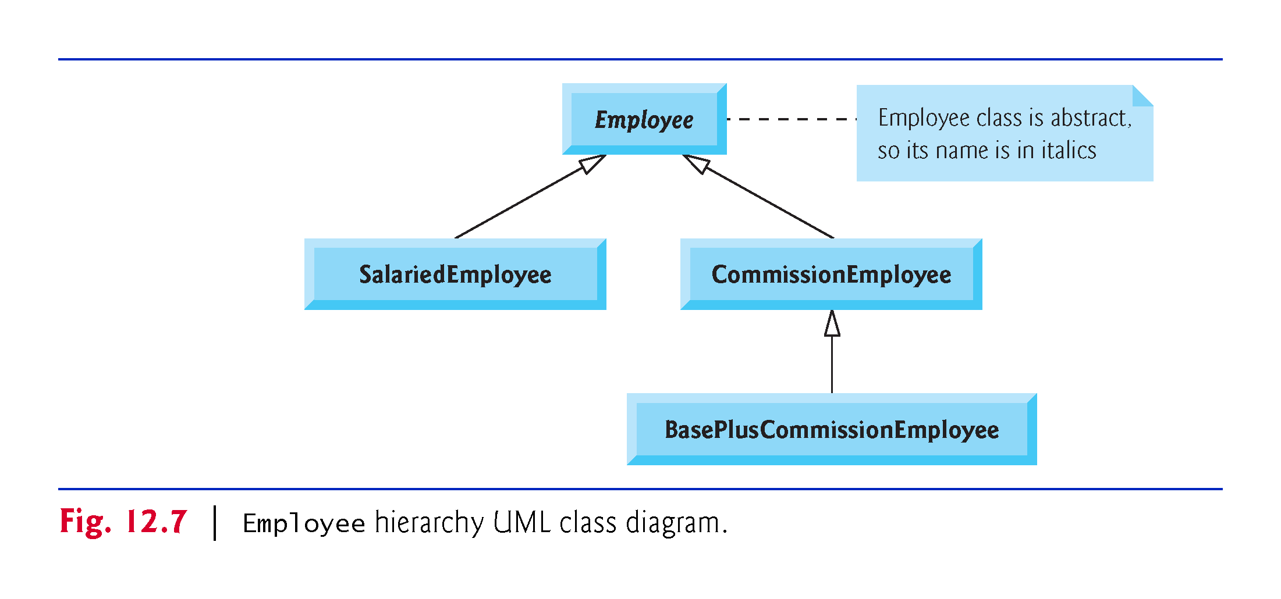

Slide 66
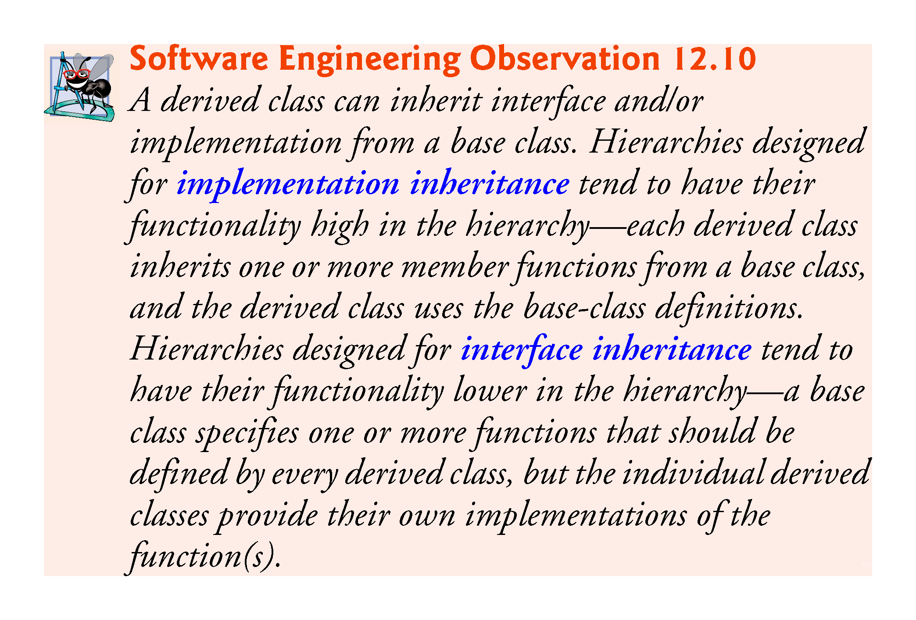

Slide 67
12.7.1 Creating Abstract Base Class Employee
Class Employee (Figs. 12.9–12.10, discussed in further detail shortly) provides functions earnings and toString, in addition to various get and set functions that manipulate Employee’s data members.
An earnings function certainly applies generally to all employees, but each earnings calculation depends on the employee’s class.
So we declare earnings as pure virtual in base class Employee because a default implementation does not make sense for that function—there is not enough information to determine what amount earnings should return.
Each derived class overrides earnings with an appropriate implementation.

Slide 68
12.7.1 Creating Abstract Base Class Employee (cont.)
To calculate an employee’s earnings, the program assigns the address of an employee’s object to a base class Employee pointer, then invokes the earnings function on that object.
We maintain a vector of Employee pointers, each of which points to object that is an Employee.
Iterate through the vector and call earnings for each Employee object.
C++ processes these function calls polymorphically.
Including earnings as a pure virtual function in Employee forces every direct concrete derived class of Employee to override earnings.
Enables the hierarchy designer to demand that each derived class provide an appropriate pay calculation, if indeed that derived class is to be concrete.

Slide 69
12.7.1 Creating Abstract Base Class Employee (cont.)
Function toString in class Employee returns the first name, last name and social security number of the employee.
Function toString could also call earnings, even though toString is a pure-virtual function in class Employee, because each concrete class is guaranteed to have an implementation of earnings.
The diagram in Fig. 12.8 shows each of the five classes in the hierarchy down the left side and functions earnings and toString across the top.

Slide 70
12.7.1 Creating Abstract Base Class Employee (cont.)
For each class, the diagram shows the desired results of each function.
Italic text represents where the values from a particular object are used in the earnings and toString functions.
Class Employee specifies “= 0” for function earnings to indicate that this is a pure virtual function.
Each derived class overrides this function to provide an appropriate implementation.

Slide 71
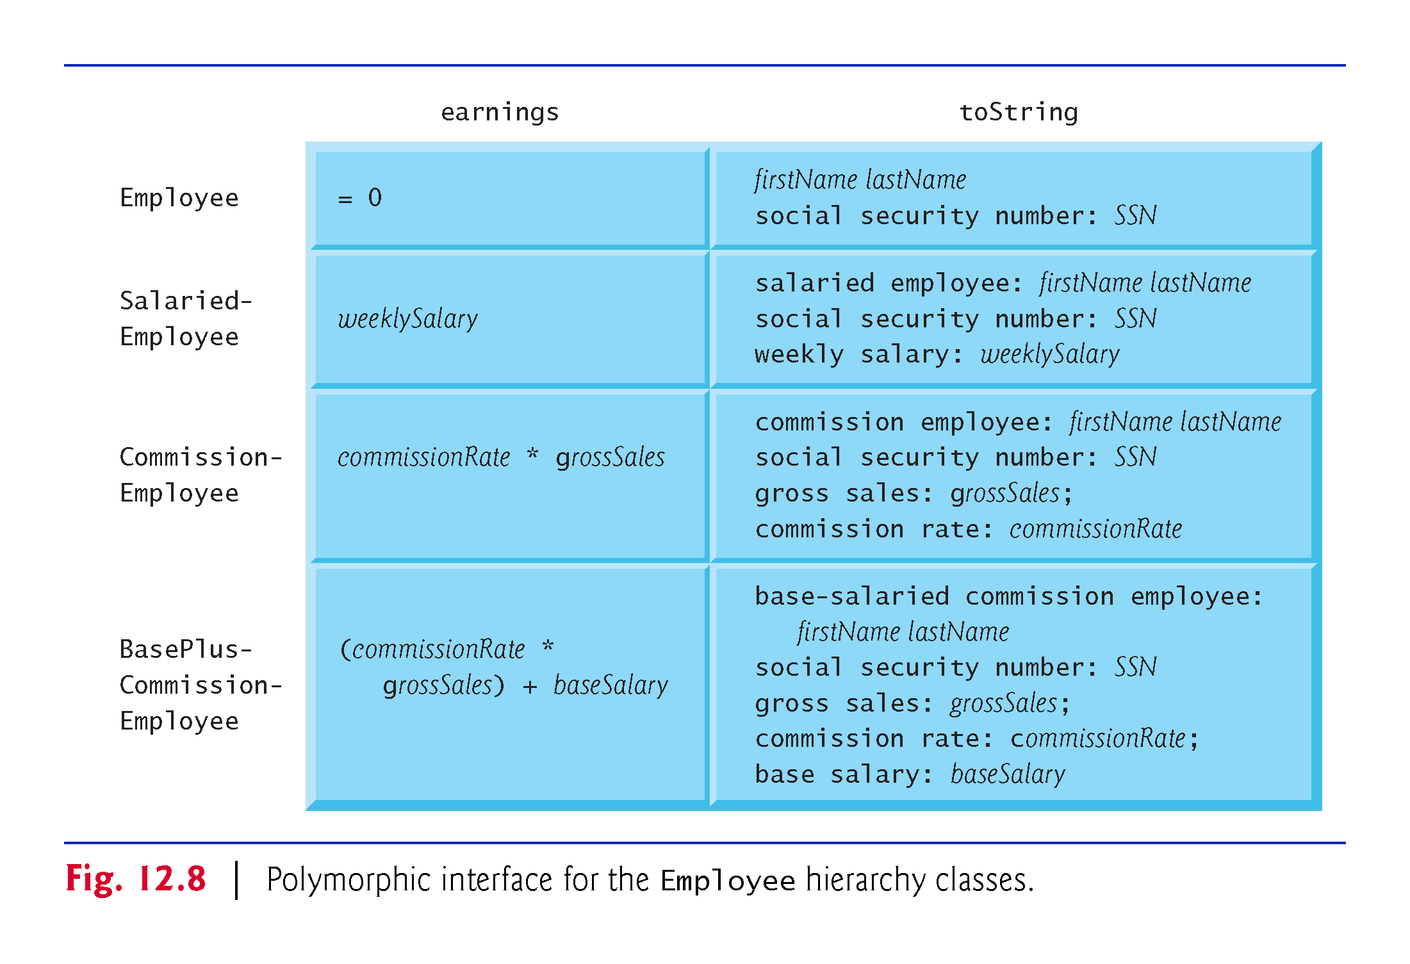

Slide 72
12.7.1 Creating Abstract Base Class Employee (cont.)
Class Employee’s header (Fig. 12.9).
The public member functions include
a constructor that takes the first name, last name and social security number as arguments
a default virtual destructor
set functions for first name, last name and social security number
get functions for first name, last name and social security number
pure virtual function earnings
virtual function toString

Slide 73
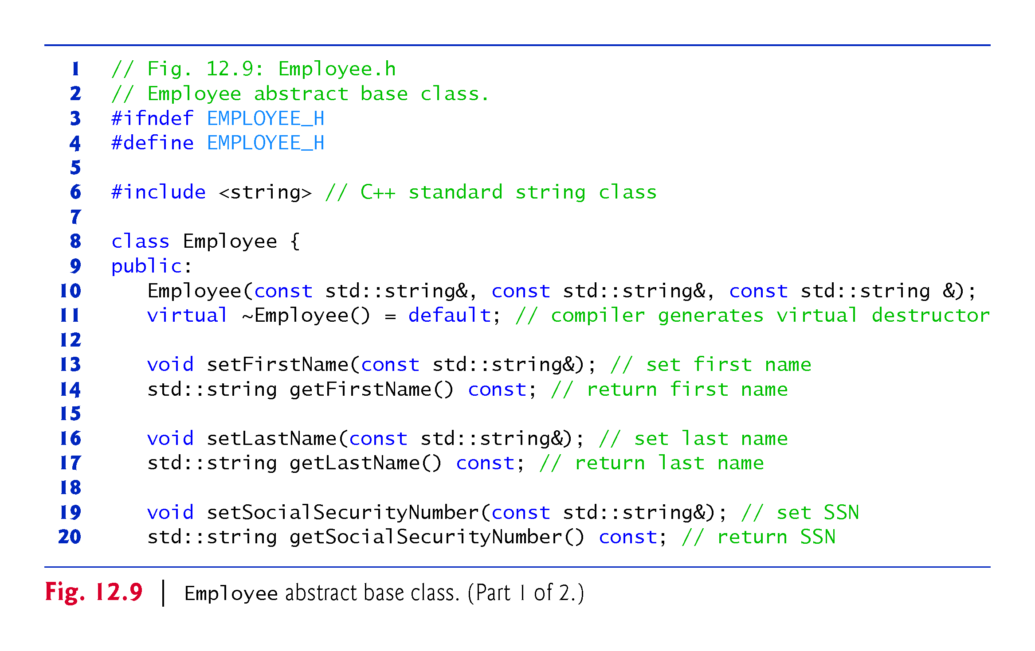

Slide 74
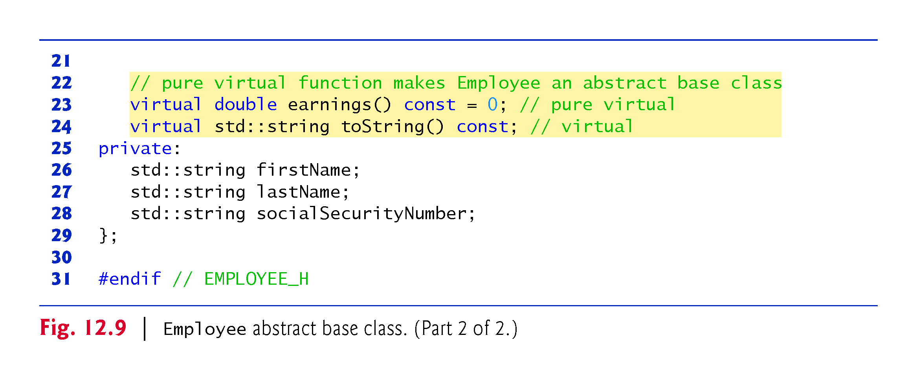

Slide 75
12.7.1 Creating Abstract Base Class Employee (cont.)
Figure 12.10 contains the member-function definitions for class Employee.
No implementation is provided for virtual function earnings.

Slide 76
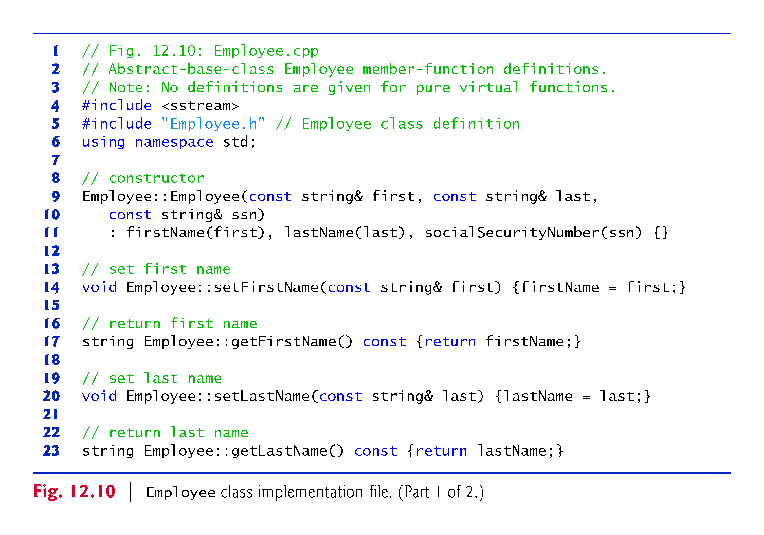

Slide 77
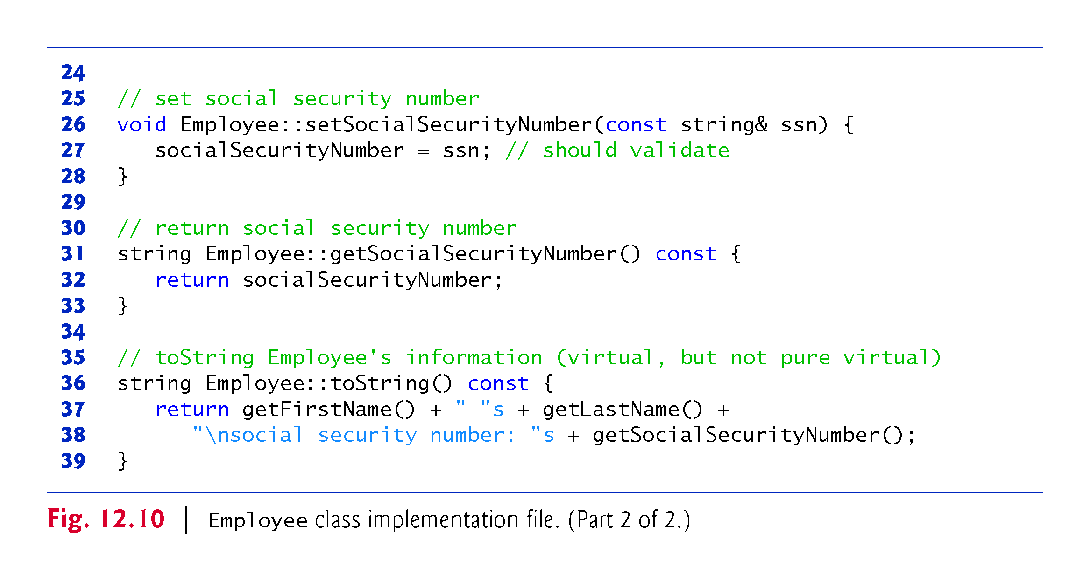

Slide 78
12.7.2 Creating Concrete Derived Class SalariedEmployee
Class SalariedEmployee (Figs. 12.11–12.12) derives from class Employee

Slide 79
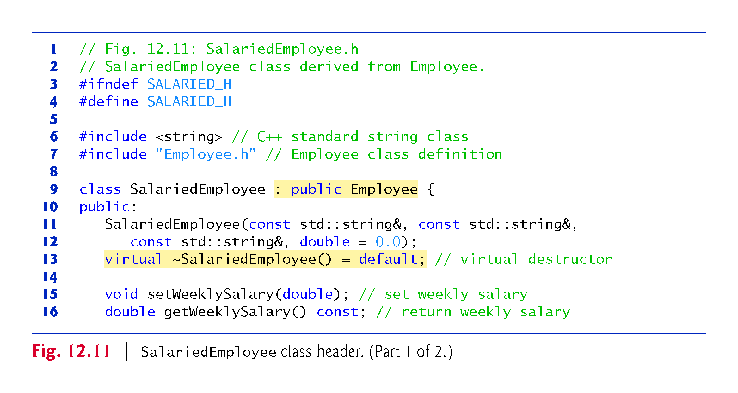

Slide 80
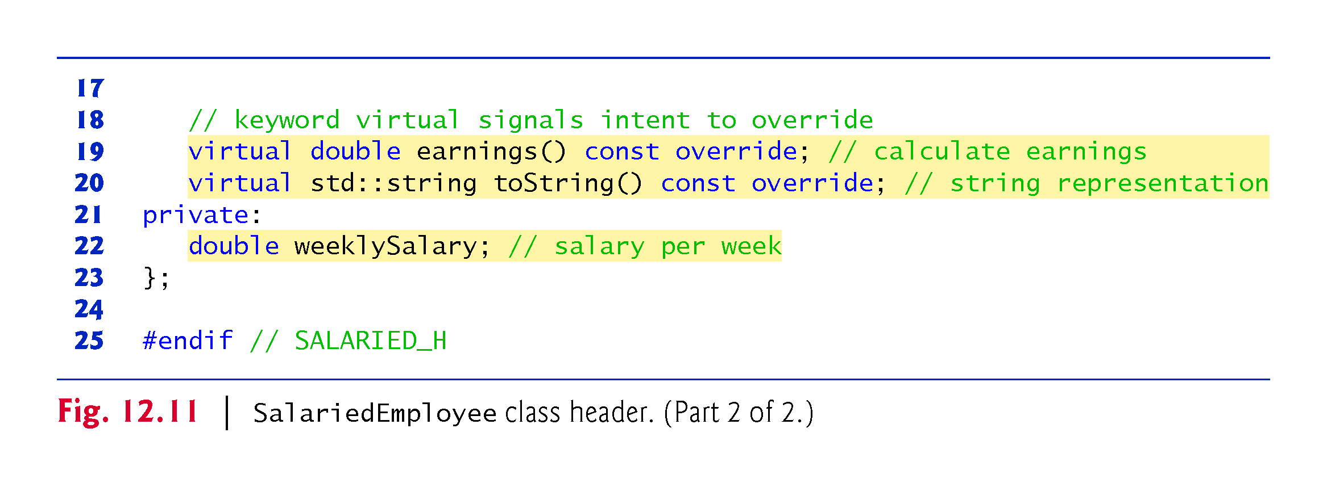

Slide 81
12.7.2 Creating Concrete Derived Class SalariedEmployee (cont.)
Figure 12.12 contains the member-function definitions for SalariedEmployee.
The constructor passes the first name, last name and social security number to the Employee constructor to initialize the private data members that are inherited from the base class, but not accessible in the derived class.
earnings overrides pure virtual function earnings in Employee to provide a concrete implementation that returns the SalariedEmployee’s weekly salary.

Slide 82
12.7.2 Creating Concrete Derived Class SalariedEmployee (cont.)
If we did not define earnings, class SalariedEmployee would be an abstract class.
In class SalariedEmployee’s header, we declared member functions earnings and toString as virtual
This is redundant.
We defined them as virtual in Employee, so they remain virtual functions throughout the class hierarchy.

Slide 83
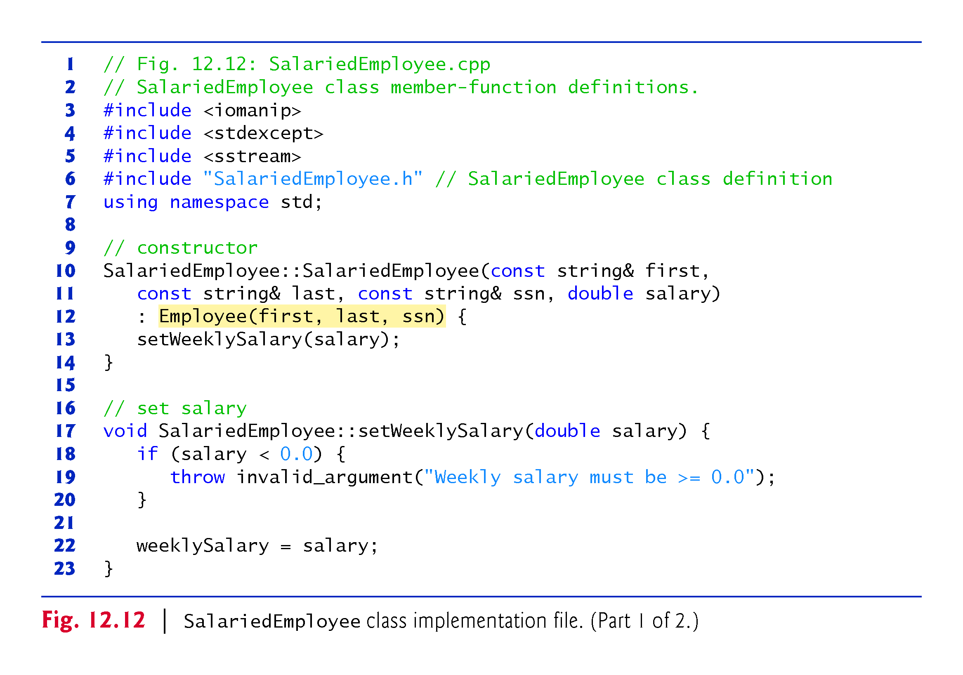

Slide 84
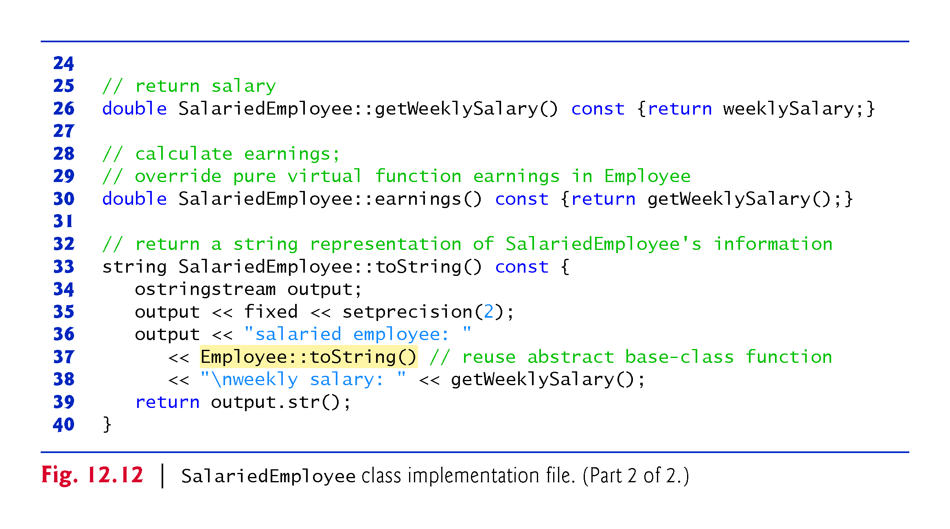

Slide 85
12.7.2 Creating Concrete Derived Class SalariedEmployee (cont.)
Function toString of class SalariedEmployee overrides Employee function toString.
If class SalariedEmployee did not override toString, SalariedEmployee would inherit the Employee version of toString.

Slide 86
12.7.3 Creating Concrete Derived Class CommissionEmployee
Class CommissionEmployee (Figs. 12.13–12.14) derives from Employee
The constructor passes the first name, last name and social security number to the Employee constructor to initialize Employee’s private data members.
Function toString calls base-class function toString to display the Employee-specific information.

Slide 87
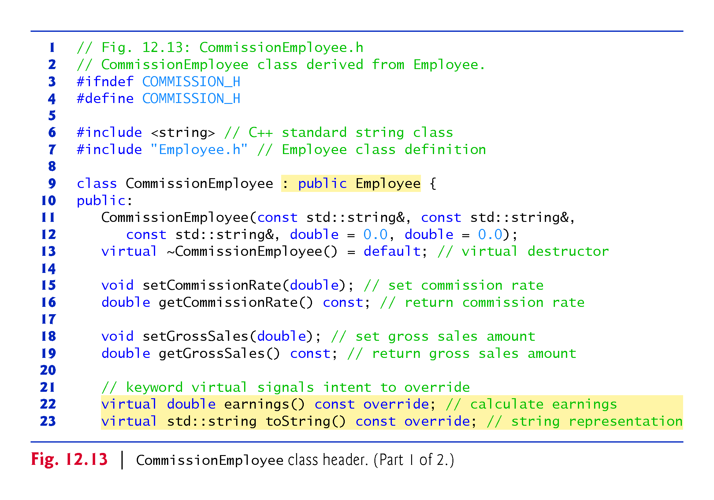

Slide 88
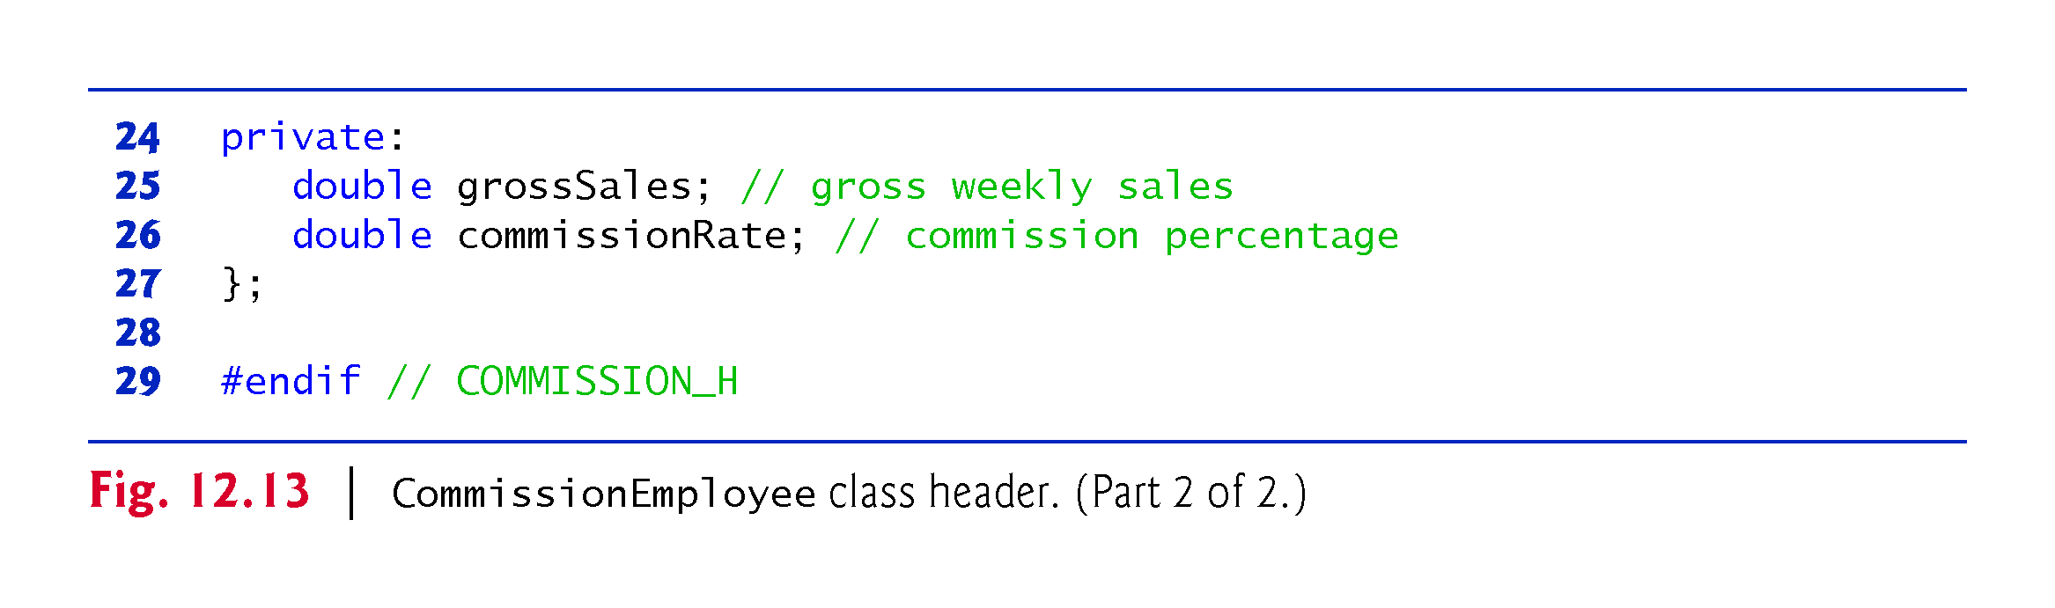

Slide 89
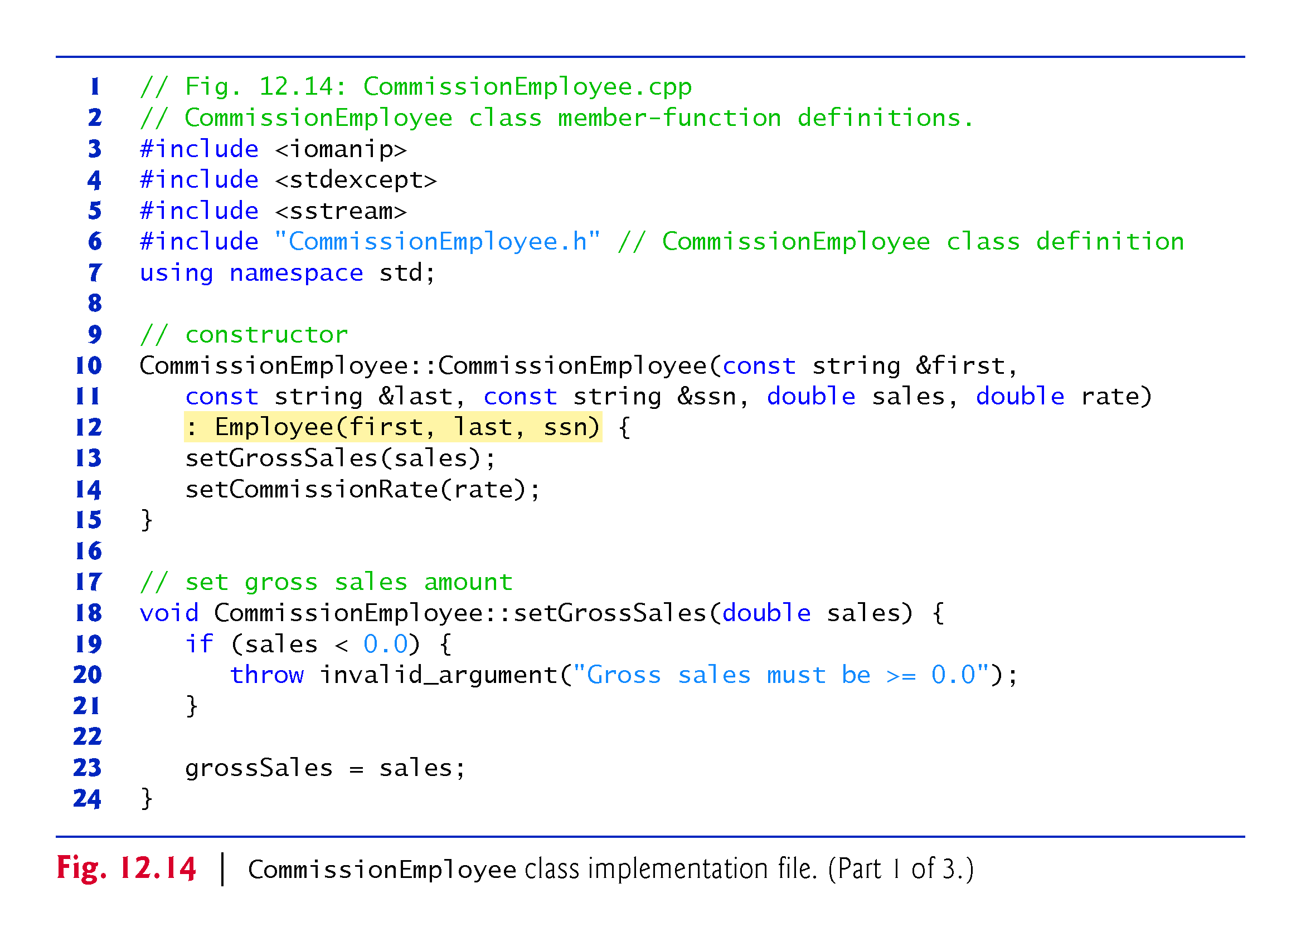

Slide 90
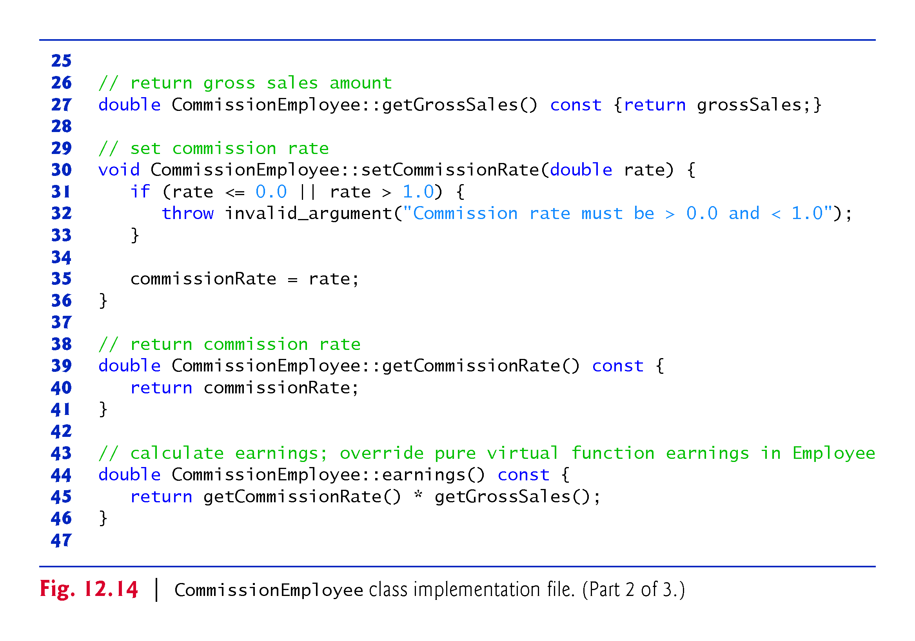

Slide 91
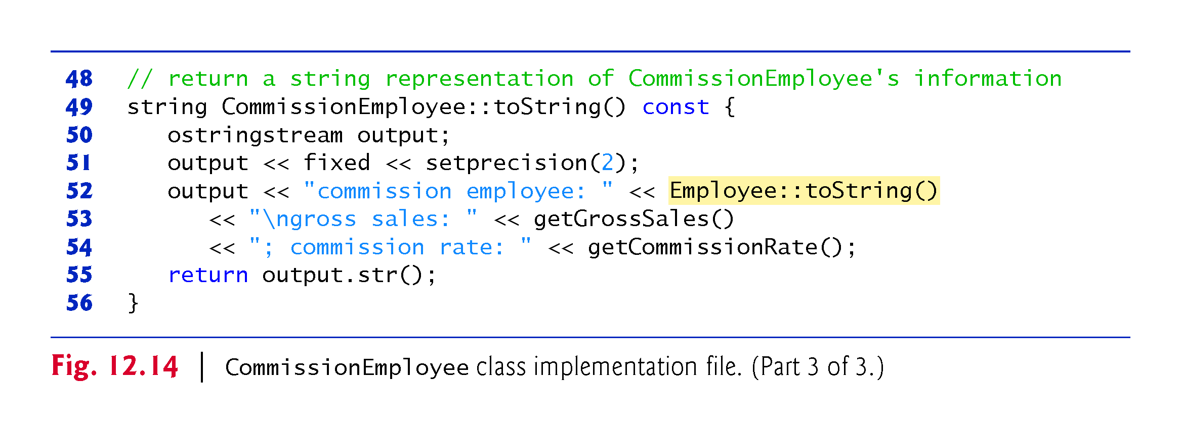

Slide 92
12.7.4 Creating Indirect Concrete Derived Class BasePlusCommissionEmployee
Class BasePlusCommissionEmployee (Figs. 12.15–12.16) directly inherits from class CommissionEmployee and therefore is an indirect derived class of class Employee.
BasePlusCommissionEmployee’s toString function outputs "base-salaried", followed by the output of base-class CommissionEmployee’s toString function (another example of code reuse), then the base salary.

Slide 93
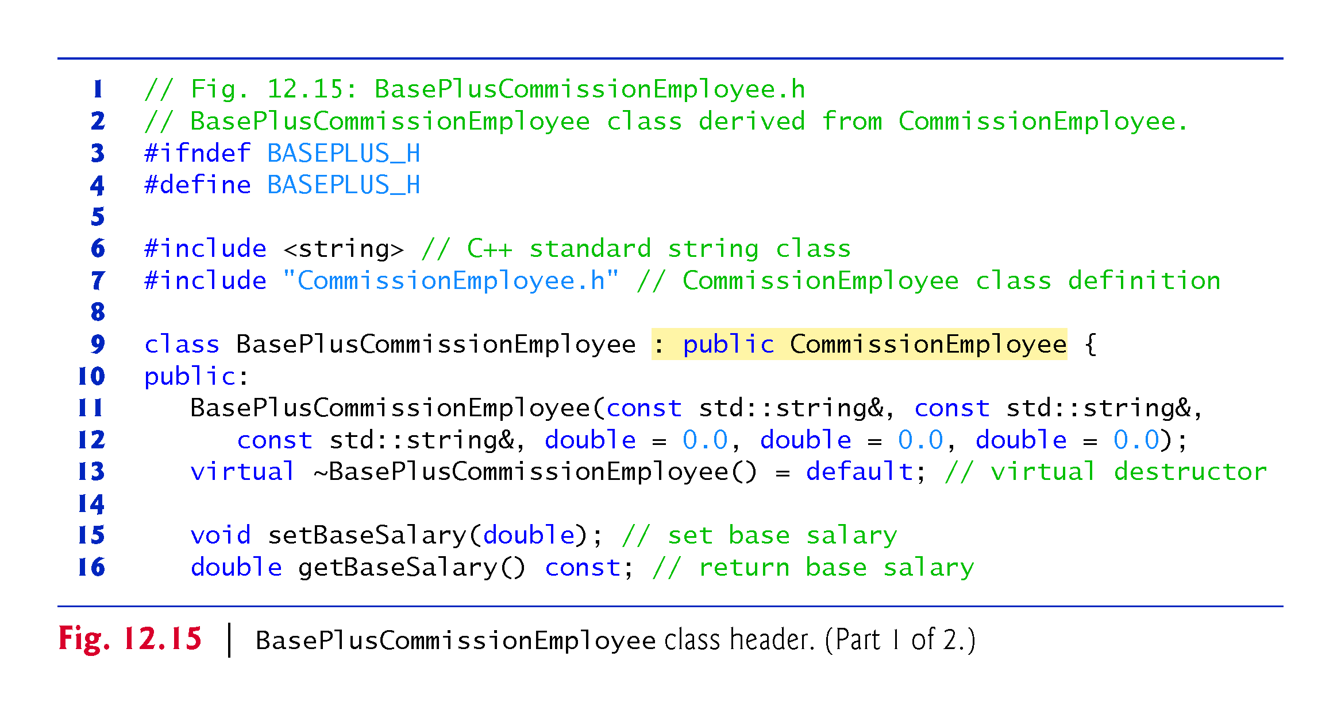

Slide 94
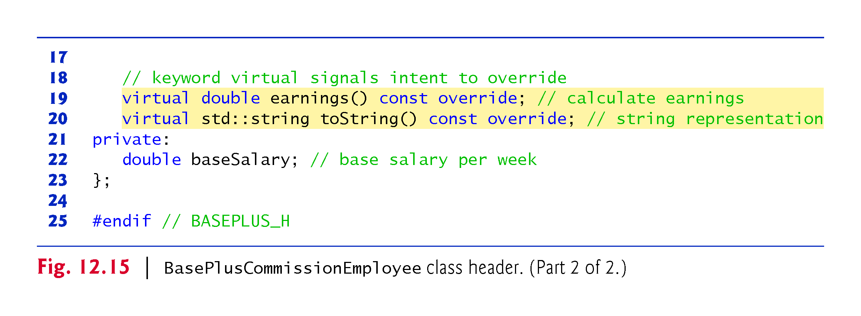

Slide 95


Slide 96


Slide 97
12.7.5 Demonstrating Polymorphic Processing
Fig. 12.17 creates an object of each of the four concrete classes SalariedEmployee, CommissionEmployee and BasePlusCommissionEmployee.
Manipulates these objects, first with static binding, then polymorphically, using a vector of Employee pointers.
Lines 20–25 create objects of each of the four concrete Employee derived classes.
Lines 28–34 output each Employee’s information and earnings.
Each member-function invocation is an example of static binding—at compile time, because we are using name, the compiler can identify each object’s type to determine which toString and earnings functions are called.

Slide 98


Slide 99


Slide 100


Slide 101


Slide 102


Slide 103


Slide 104


Slide 105
12.7.5 Demonstrating Polymorphic Processing (cont.)
Lines 37-38 create and initialize the vector employees, which contains three Employee pointers.
The compiler allows these assignments, because a SalariedEmployee is an Employee, a CommissionEmployee is an Employee and a BasePlusCommissionEmployee is an Employee.

Slide 106
12.7.5 Demonstrating Polymorphic Processing (cont.)
Lines 46–48 traverse vector employees and invoke function virtualViaPointer for each element in employees.
Function virtualViaPointer receives in parameter baseClassPtr (of type const Employee * const) the address stored in an employees element.
Each call to virtualViaPointer uses baseClassPtr to invoke virtual functions toString and earnings
Function virtualViaPointer does not contain any SalariedEmployee, CommissionEmployee or BasePlusCommissionEmployee type information.
The function knows only about base-class type Employee.
The output illustrates that the appropriate functions for each class are indeed invoked and that each object’s proper information is displayed.

Slide 107
12.7.5 Demonstrating Polymorphic Processing (cont.)
Lines 54–59 traverse employees and invoke function virtualViaReference for each vector element.
Function virtualViaReference receives in its parameter baseClassRef (of type const Employee &) a reference to the object obtained by dereferencing an employees element pointer
Each call to virtualViaReference invokes virtual functions toString and earnings via baseClassRef to demonstrate that polymorphic processing occurs with base-class references as well.
Each virtual-function invocation calls the function on the object to which baseClassRef refers at runtime.

Slide 108
12.8 (Optional) Polymorphism, Virtual Functions and Dynamic Binding “Under the Hood”
How C++ can implement polymorphism, virtual functions and dynamic binding.
Polymorphism is accomplished through three levels of pointers (i.e., “triple indirection”).
We’ll show how an executing program uses these data structures to execute virtual functions and achieve the dynamic binding associated with polymorphism.
Our discussion explains one possible implementation.

Slide 109
12.8 (Optional) Polymorphism, Virtual Functions and Dynamic Binding “Under the Hood” (cont.)
When C++ compiles a class that has one or more virtual functions, it builds a virtual function table (vtable) for that class.
The vtable contains pointers to the class’s virtual functions.
Just as the name of a built-in array contains the address in memory of the array’s first element, a pointer to a function contains the starting address of the code that performs the function’s task.
An executing program uses the vtable to select the proper function implementation each time a virtual function of that class is called.
The leftmost column of Fig. 12.18 illustrates the vtables for the Employee hierarchy.

Slide 110


Slide 111
12.8 (Optional) Polymorphism, Virtual Functions and Dynamic Binding “Under the Hood” (cont.)
In the Employee class vtable, the first function pointer is set to 0 (nullptr), because function earnings is a pure virtual function and therefore lacks an implementation.
The second function pointer points to function toString, which returns the employee’s full name and SSN.
A class with at least one null pointer in its vtable is abstract.
Classes without any null vtable pointers are concrete.

Slide 112
12.8 (Optional) Polymorphism, Virtual Functions and Dynamic Binding “Under the Hood” (cont.)
Class SalariedEmployee overrides function earnings to return the employee’s weekly salary, so the function pointer points to the earnings function of class SalariedEmployee.
SalariedEmployee also overrides toString, so the corresponding function pointer points to the SalariedEmployee version of toString.

Slide 113
12.8 (Optional) Polymorphism, Virtual Functions and Dynamic Binding “Under the Hood” (cont.)
The earnings function pointer in the vtable for class CommissionEmployee points to CommissionEmployee’s earnings function.
The toString function pointer points to the CommissionEmployee version of the function.
As in class SalariedEmployee, both functions override the functions in class Employee.

Slide 114
12.8 (Optional) Polymorphism, Virtual Functions and Dynamic Binding “Under the Hood” (cont.)
The earnings function pointer in the vtable for class BasePlusCommissionEmployee points to the BasePlusCommissionEmployee’s earnings function.
The toString function pointer points to the BasePlusCommissionEmployee version of the function.
Both functions override the functions in class CommissionEmployee.

Slide 115
12.8 (Optional) Polymorphism, Virtual Functions and Dynamic Binding “Under the Hood” (cont.)
Polymorphism is accomplished through an elegant data structure involving three levels of pointers.
We’ve discussed one level—the function pointers in the vtable.
These point to the actual functions that execute when a virtual function is invoked.
Now we consider the second level of pointers.
For each new object of a class with one or more virtual functions, the compiler attaches a pointer to the vtable for that class.
This pointer is normally at the front of the object, but it isn’t required to be implemented that way.

Slide 116
12.8 (Optional) Polymorphism, Virtual Functions and Dynamic Binding “Under the Hood” (cont.)
In Fig. 12.18, these pointers are associated with the objects created in Fig. 12.17.
Notice that the diagram displays each of the object’s data member values.
The third level of pointers simply contains the handles to the objects that receive the virtual function calls.
The handles in this level may also be references.
Fig. 12.18 depicts the vector employees that contains Employee pointers.

Slide 117
12.8 (Optional) Polymorphism, Virtual Functions and Dynamic Binding “Under the Hood” (cont.)
Consider the call baseClassPtr->toString() in function virtualViaPointer
Assume that baseClassPtr contains employees[1] (i.e., the address of object commissionEmployee in employees).
The compiler determines that the call is indeed being made via a base-class pointer and that toString is a virtual function and that toString is the second entry in each of the vtables.
To locate this entry, the compiler notes that it will need to skip the first entry.

Slide 118
12.8 (Optional) Polymorphism, Virtual Functions and Dynamic Binding “Under the Hood” (cont.)
Thus, the compiler compiles an offset or displacement of four bytes (four bytes for each pointer on today’s popular 32-bit machines, and only one pointer needs to be skipped) into the table of machine-language object-code pointers to find the code that will execute the virtual function call.

Slide 119
12.8 (Optional) Polymorphism, Virtual Functions and Dynamic Binding “Under the Hood” (cont.)
The compiler generates code that performs the following operations.
Select the i^{th} entry of employees, and pass it as an argument to function virtualViaPointer. This sets parameter baseClassPtr to point to commissionEmployee.
Dereference that pointer to get to the commissionEmployee object.
Dereference commissionEmployee’s vtable pointer to get to the CommissionEmployee vtable.
Skip the offset of four bytes to select the toString function pointer.
Dereference the toString function pointer to form the “name” of the actual function to execute, and use the function call operator () to execute the appropriate toString function.

Slide 120


Slide 121


Slide 122
12.9 Case Study: Payroll System Using Polymorphism and Runtime Type Information with Downcasting, dynamic_cast, typeid and type_info
For the current pay period, our fictitious company has decided to reward BasePlusCommissionEmployees by adding 10 percent to their base salaries.
When processing Employees polymorphically in Section 12.6.5, we did not worry about the “specifics.”
To adjust the base salaries of BasePlusCommissionEmployees, we have to determine the specific type of each Employee object at execution time, then act appropriately.

Slide 123
12.9 Case Study: Payroll System Using Polymorphism and Runtime Type Information with Downcasting, dynamic_cast, typeid and type_info (cont.)
This section demonstrates the powerful capabilities of runtime type information (RTTI) and dynamic casting, which enable a program to determine an object’s type at execution time and act on that object accordingly.
Figure 12.19 uses the Employee hierarchy developed in Section 12.6 and increases by 10 percent the base salary of each BasePlusCommissionEmployee.

Slide 124


Slide 125


Slide 126


Slide 127


Slide 128
12.9 Case Study: Payroll System Using Polymorphism and Runtime Type Information with Downcasting, dynamic_cast, typeid and type_info (cont.)
Since we process the Employees polymorphically, we cannot (with the techniques you’ve learned so far) be certain as to which type of Employee is being manipulated at any given time.
BasePlusCommissionEmployee employees must be identified so they can receive the 10 percent salary increase.
To accomplish this, we use operator dynamic_cast to determine whether the current Employee’s type is BasePlusCommissionEmployee.
This is the downcast operation we referred to in Section 12.3.3.
Lines 31–32 dynamically downcast employeePtr from type Employee * to type BasePlusCommissionEmployee *.

Slide 129
12.8 Case Study: Payroll System Using Polymorphism and Runtime Type Information with Downcasting, dynamic_cast, typeid and type_info (cont.)
If employeePtr element points to an object that is a BasePlusCommissionEmployee object, then that object’s address is assigned to derived-class pointer derivedPtr; otherwise, nullptr is assigned to derivedPtr.
Note that dynamic_cast rather than static_cast is required here to perform type checking on the underlying object—a static_cast would simply cast the Employee * to a BasePlusCommissionEmployee * regardless of the underlying object’s type.

Slide 130
12.8 Case Study: Payroll System Using Polymorphism and Runtime Type Information with Downcasting, dynamic_cast, typeid and type_info (cont.)
With a static_cast, the program would attempt to increase every Employee’s base salary, resulting in undefined behavior for each object that is not a BasePlusCommissionEmployee.
If the value returned by the dynamic_cast operator in lines 31–32 is not nullptr, the object is the correct type, and the if statement performs the special processing required for the BasePlusCommissionEmployee object.

Slide 131
12.8 Case Study: Payroll System Using Polymorphism and Runtime Type Information with Downcasting, dynamic_cast, typeid and type_info (cont.)
Operator typeid returns a reference to an object of class type_info that contains the information about the type of its operand, including the name of that type.
When invoked, type_info member function name returns a pointer-based string containing the typeid argument’s type name (e.g., "class BasePlusCommissionEmployee").
To use typeid, the program must include header <typeinfo>

Slide 132


