Slide 1
Standard Library Algorithms
Based on Chapter 16 of C++ How to Program, 10/e

Slide 2
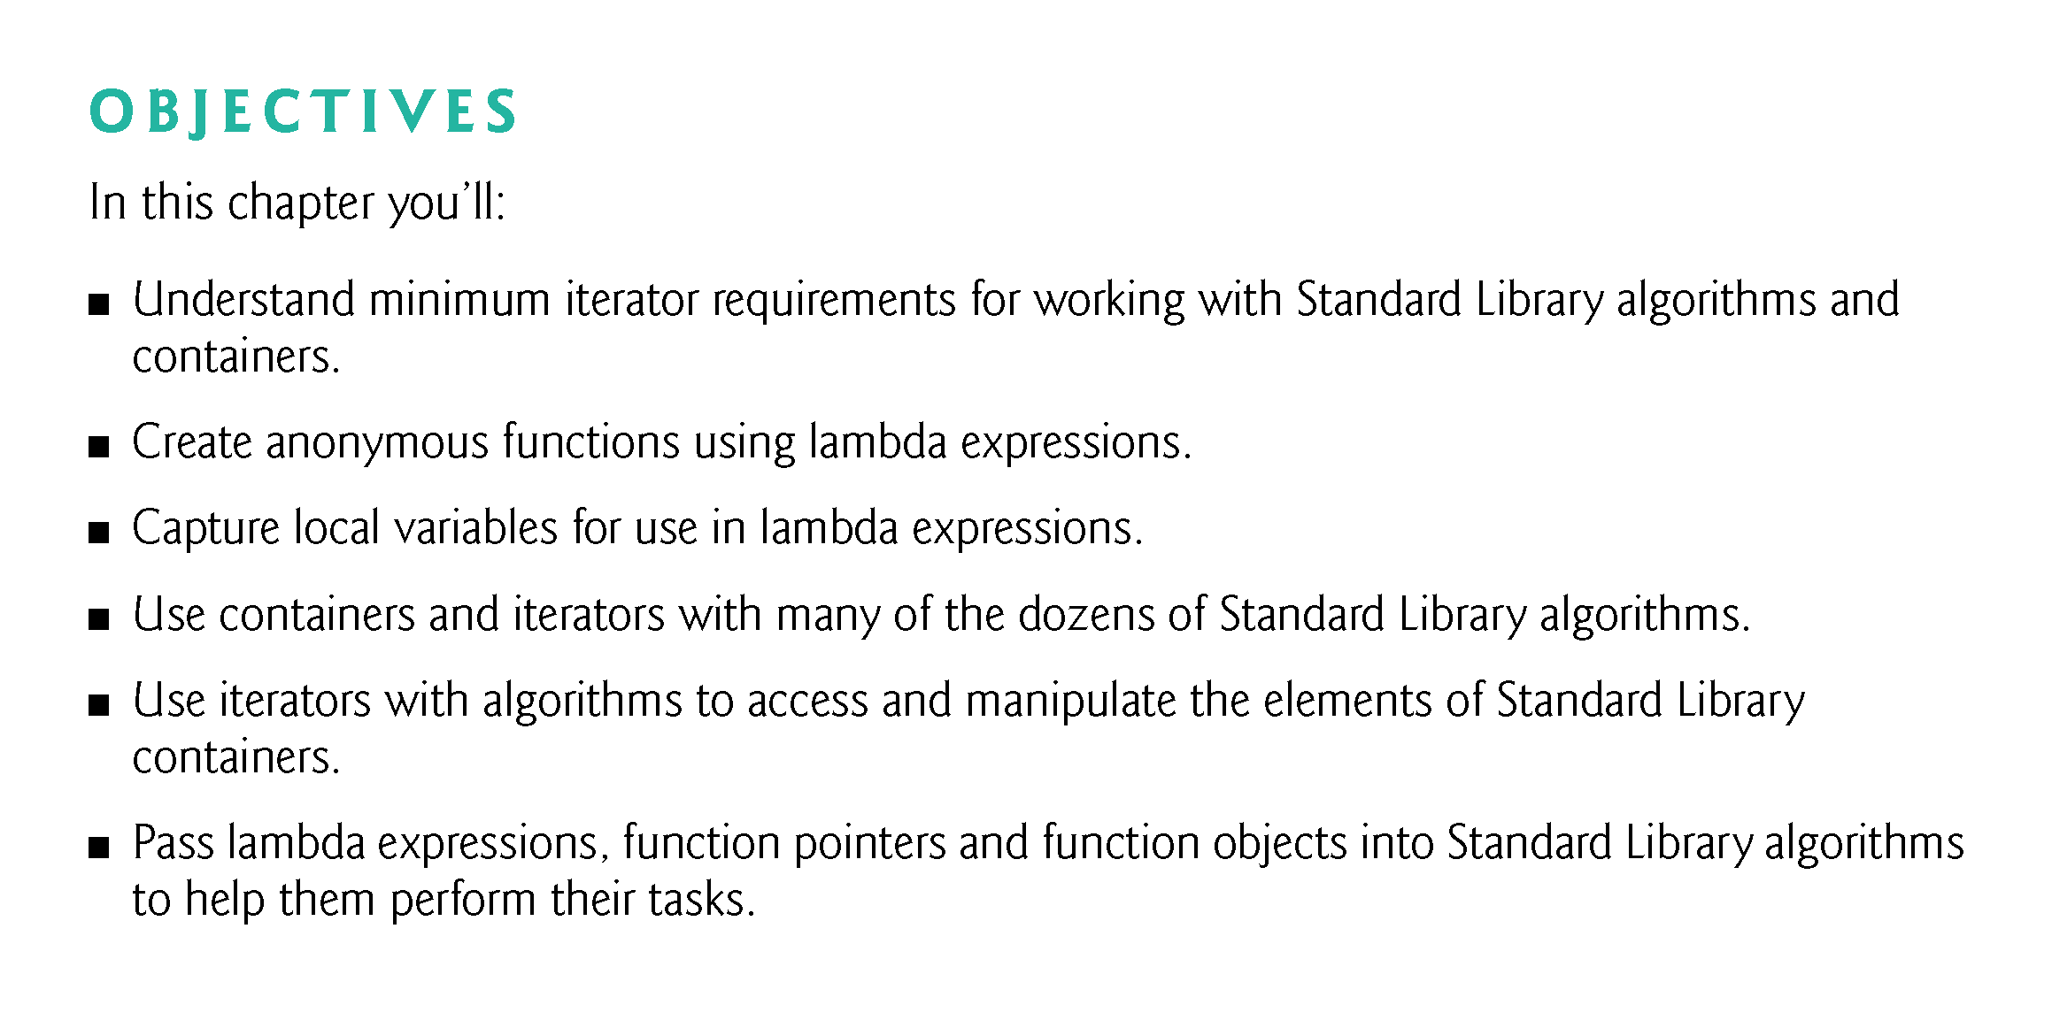

Slide 3
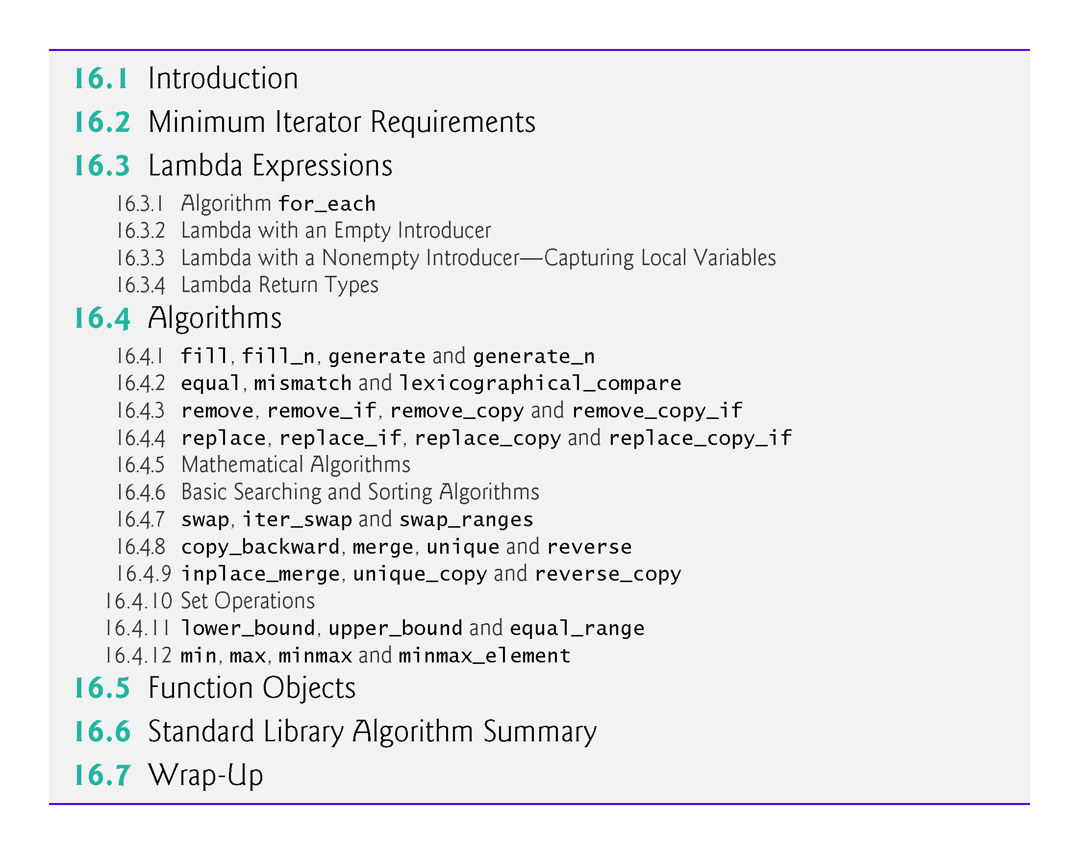

Slide 4
16.1 Introduction
This chapter discusses the Standard Library’s algorithms, focusing on common container manipulations.
Over 90 algorithms—many were added in C++11 and some are new in C++14. For the complete list, see
http://en.cppreference.com/w/cpp/algorithm
http://en.cppreference.com/w/cpp/numeric
As you’ll see, various algorithms can receive a function pointer as an argument. Such algorithms use the pointer to call the function, typically with one or two container elements as arguments.
Rather than function pointers we’ll typically use lambda expressions—C++11’s convenient shorthand notation for creating anonymous functions

Slide 5
16.2 Minimum Iterator Requirements
With few exceptions, the Standard Library separates algorithms from containers—makes it much easier to add new algorithms and to use them with multiple containers.
An important part of every container is the type of iterator it supports (Fig. 15.7).
This determines which algorithms can be applied to the container.
For example, both vectors and arrays support random-access iterators that provide all of the iterator operations shown in Fig. 15.9.
All Standard Library algorithms can operate on vectors and those that do not modify a container’s size can also operate on arrays.

Slide 6
16.2 Minimum Iterator Requirements (cont.)
Each Standard Library algorithm that takes iterator arguments requires those iterators to provide a minimum level of functionality.
If an algorithm requires a forward iterator, for example, that algorithm can operate on any container that supports forward iterators, bidirectional iterators or random-access iterators.

Slide 7
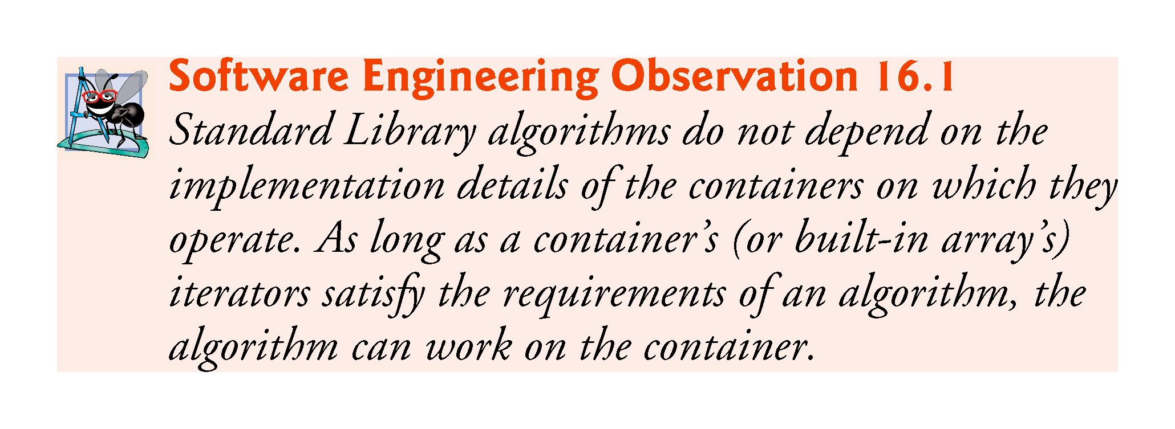

Slide 8
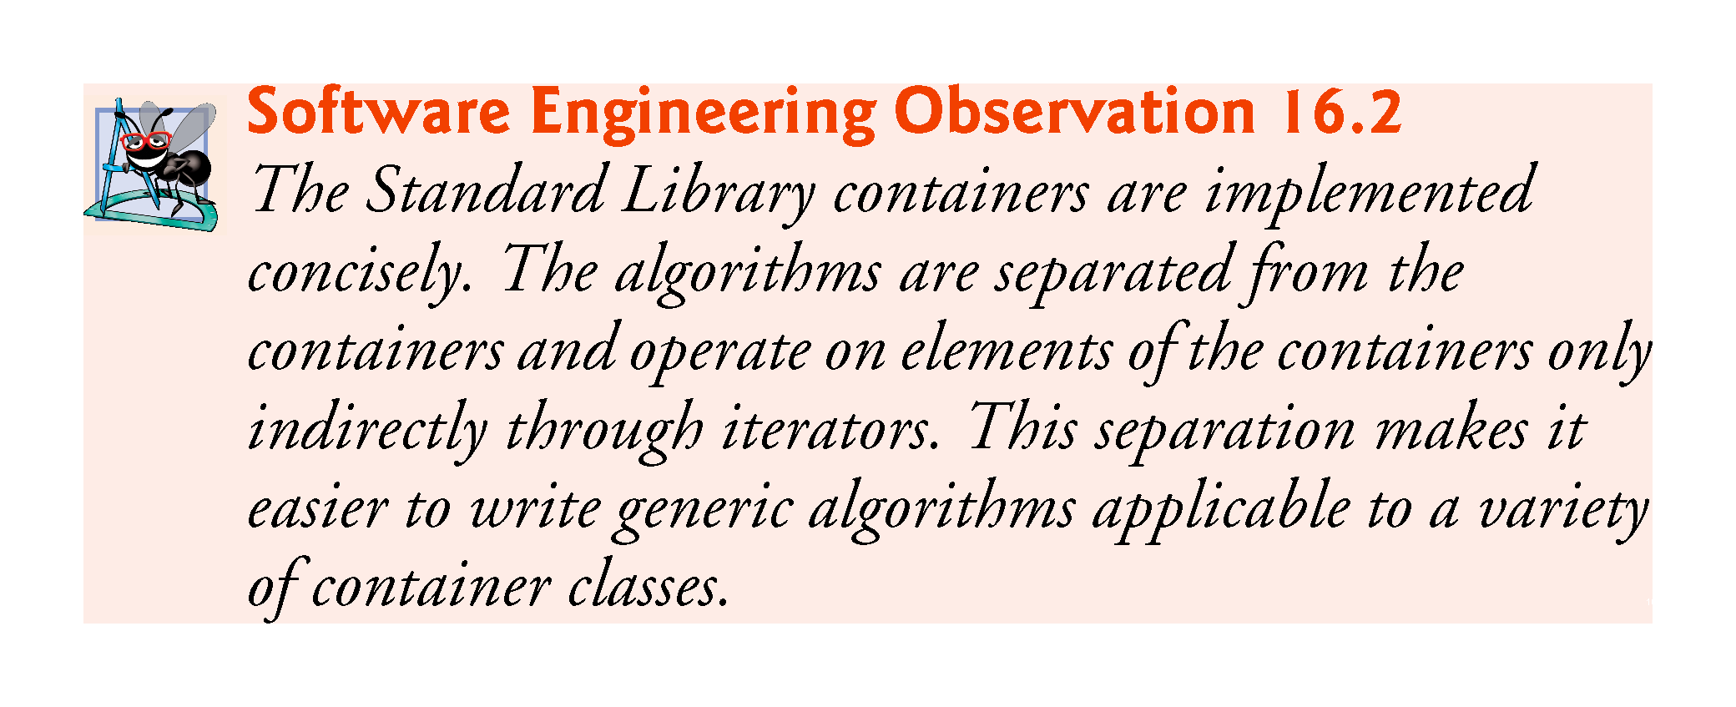

Slide 9
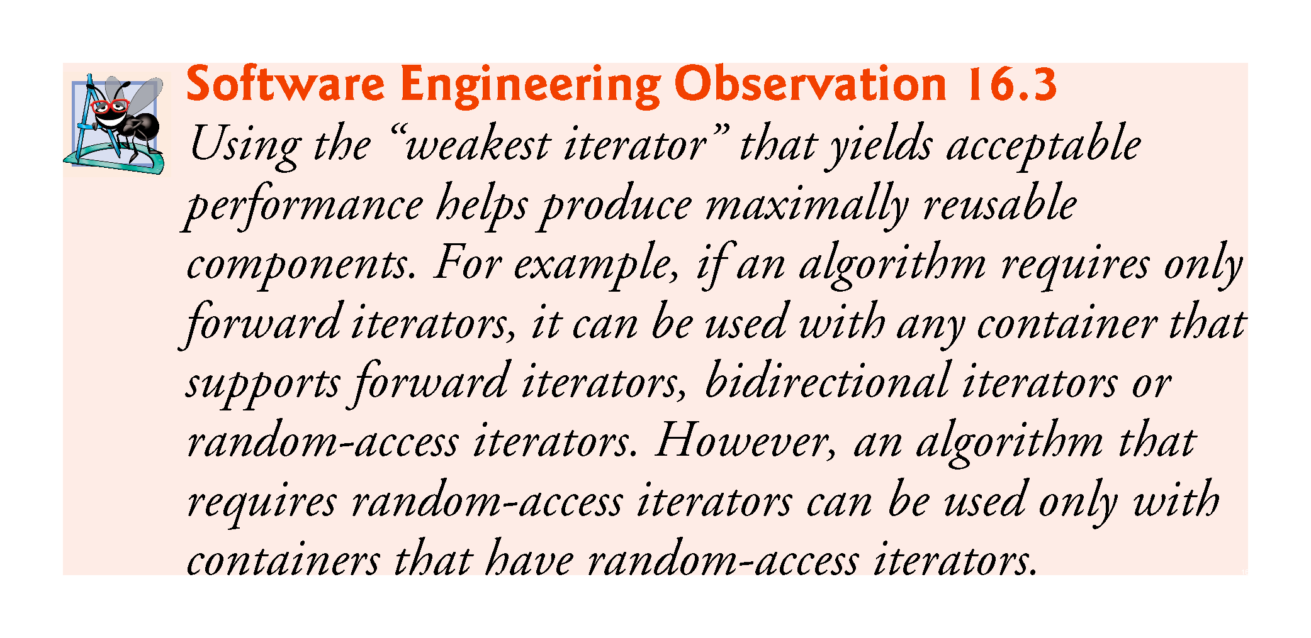

Slide 10
16.2 Minimum Iterator Requirements (cont.)
Iterator Invalidation
Iterators simply point to container elements, so it’s possible for iterators to become invalid when certain container modifications occur.
For example, if you invoke clear on a vector, all of its elements are destroyed.
Any iterators that pointed to that vector’s elements before clear was called would now be invalid.

Slide 11
16.2 Minimum Iterator Requirements (cont.)
Here we summarize when iterators are invalidated during insert and erase operations.
When inserting into:
a vector—If the vector is reallocated, all iterators pointing to that vector are invalidated. Otherwise, iterators from the insertion point to the end of the vector are invalidated.
a deque—All iterators are invalidated.
a list or forward_list—All iterators remain valid.
an ordered associative container—All iterators remain valid.
an unordered associative container—All iterators are invalidated if the container needs to be reallocated.

Slide 12
16.2 Minimum Iterator Requirements (cont.)
When erasing from a container, iterators to the erased elements are invalidated. In addition:
for a vector—Iterators from the erased element to the end of the vector are invalidated.
for a deque—If an element in the middle of the deque is erased, all iterators are invalidated.

Slide 13
16.3 Lambda Expressions
Many Standard Library algorithms can receive function pointers as parameters
Before you can pass a function pointer to an algorithm, the corresponding function must be declared.
C++11’s lambda expressions (or simply lambdas) enable you to define anonymous functions where they’re passed to a function.
They’re defined locally inside functions and can use and manipulate the local variables of the enclosing function.
Figure 16.1 demonstrates the Standard Library’s for_each algorithm, which invokes a function once for each element in a range. The example calls for_each twice, each with a simple lambda:
the first is used to display each element in an int array multiplied by 2.
the second is used to sum the elements of the int array.

Slide 14
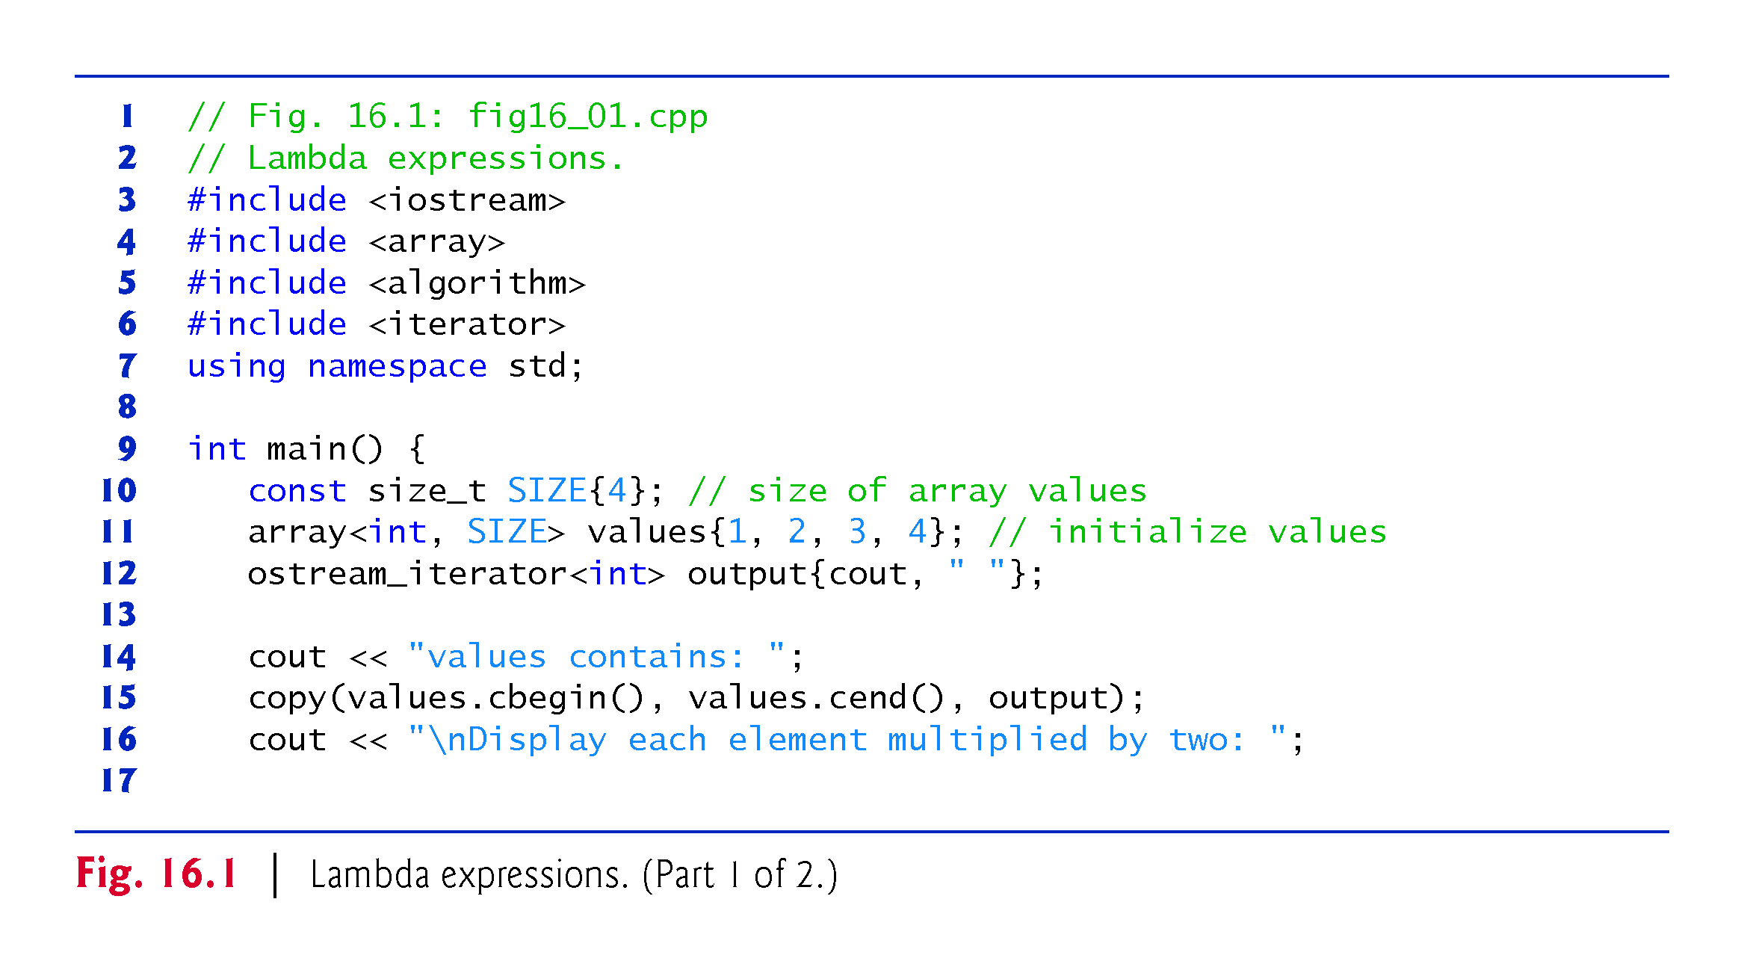

Slide 15
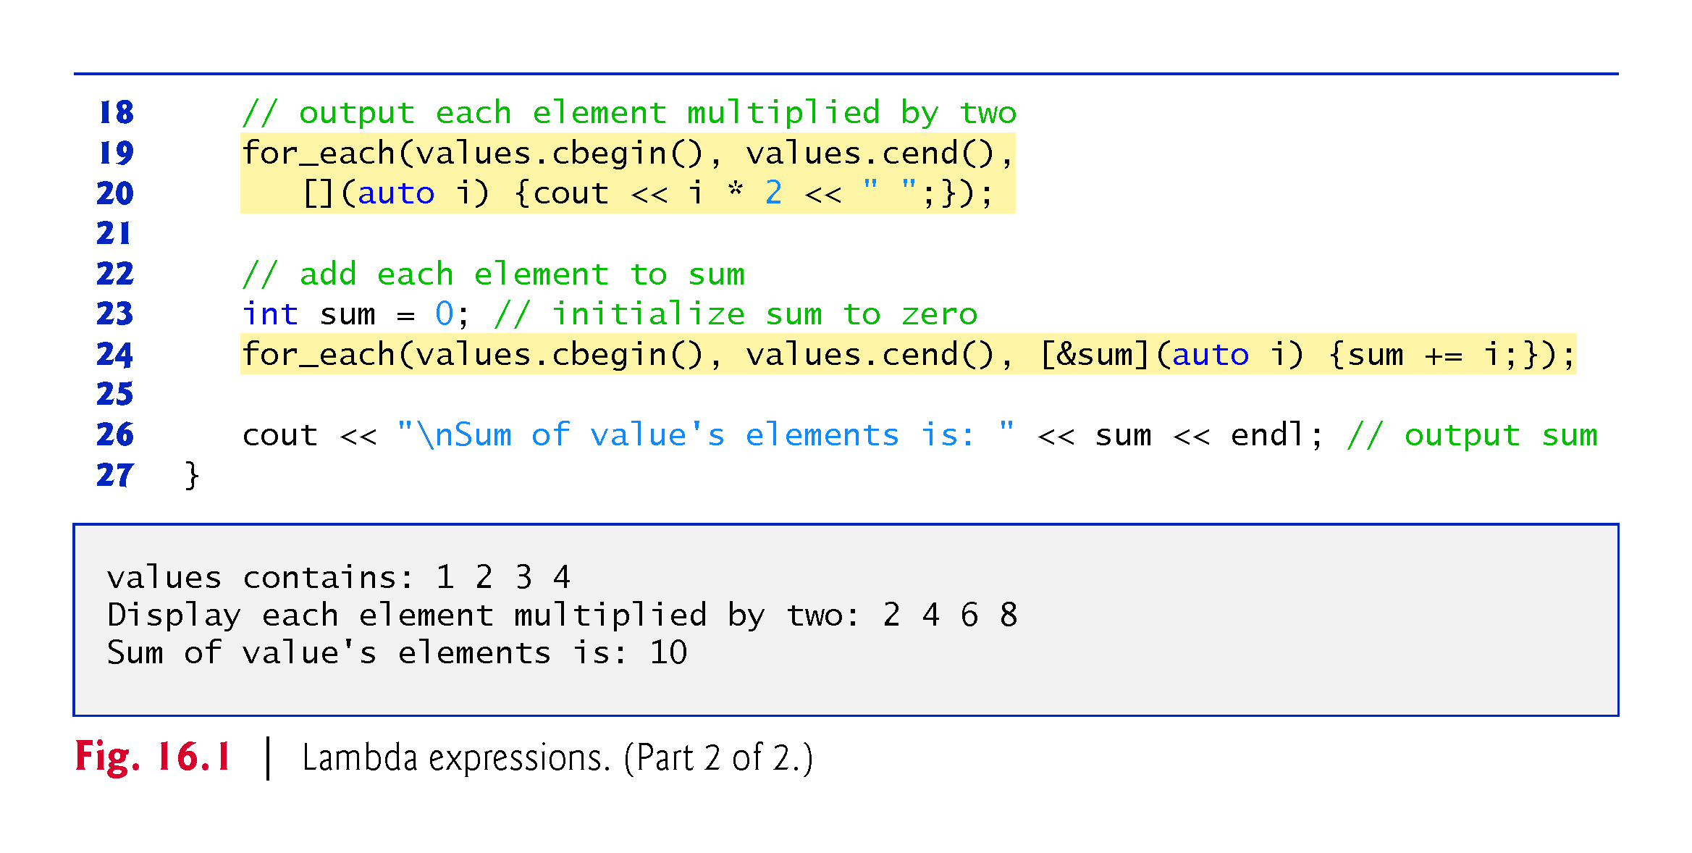

Slide 16
16.3.1 Algorithm for_each
Lines 19–20 and 24 use the for_each algorithm to call a function that performs a task once for each element of the array values.
Like copy (Section 15.3), for_each’s first two arguments represent the range of elements to process. This program processes all of the array’s elements.
The for_each algorithm’s two iterator arguments must be at least input iterators that point into the same container, so for_each can get values from that container.
The function specified by for_each’s third argument specifies the function to call with each element in the range.
The function must have one parameter of the container’s element type. for_each passes the current element’s value as the function’s argument, then the function performs a task using that value.
If the function’s parameter is a non-const reference and the iterators passed to for_each refer to non-const data, the function can modify the element.

Slide 17
16.3.2 Lambda with an Empty Introducer
Line 11 declares and initializes the array of ints named values and line 15 outputs its contents.
Lines 19–20 call for_each to multiply each element of values by 2 and display the result. The third argument (line 20) to for_each
[](auto i) {cout << i * 2 << " ";}
is a lambda expression that performs the multiplication and output.
A lambda can use local variables from the function in which the lambda is defined. The introducer enables you to specify which, if any, local variables the lambda uses—this is known as capturing the variables.
The empty lambda introducer ([]) indicates that the lambda does not use any of main’s local variables.

Slide 18
16.3.2 Lambda with an Empty Introducer
The lambda in line 20 receives one parameter named i.
Specifying the parameter’s type as auto enables the compiler to infer the parameter’s type, based on the context in which the lambda appears.
In this case, , since the array contains ints, the compiler infers parameter i’s type as int.
Using auto to infer the parameter type is a new C++14 feature of so-called generic lambdas.
The lambda in line 20 is similar to the standalone function
void timesTwo(int i) { cout << i * 2 << " "; }
which, if defined, we could have used as follows
for_each(values.cbegin(), values.cend(), timesTwo);

Slide 19
16.3.3 Lambda with a Nonempty Introducer—Capturing Local Variables
The second call to the for_each algorithm (line 24) totals array’s elements.
The lambda introducer [&sum] in
[&sum](auto i) {sum += i;}
indicates that this lambda expression captures the local variable sum (line 23) by reference.
Without the ampersand, sum would be captured by value and the lambda would not modify the local variable outside the lambda expression.
The for_each algorithm passes each element of values to the lambda, which adds the value to the sum. Line 26 then displays the sum.

Slide 20
16.3.4 Lambda Return Types
The compiler can infer a lambda’s return type if the body contains a statement of the form
return expression;
Otherwise, the lambda’s return type is void, unless you explicitly specify a return type using C++11’s trailing return type syntax, as in
[](parameterList) -> type {lambdaBody}
The trailing return type is placed between the parameter list’s closing right parenthesis and the lambda’s body.

Slide 21
16.4 Algorithms
Sections 16.4.1–16.4.12 demonstrate many of the Standard Library algorithms.

Slide 22
16.4.1 fill, fill_n, generate and generate_n
Figure 16.2 demonstrates algorithms fill, fill_n, generate and generate_n.
Algorithms fill and fill_n set every element in a range of container elements to a specific value.
Algorithms generate and generate_n use a generator function to create values for every element in a range of container elements.
The generator function takes no arguments and returns a value that can be placed in an element of the container.
We’ll define a generator function as a standalone function and as a lambda for comparison. The rest of the chapter uses lambdas.

Slide 23
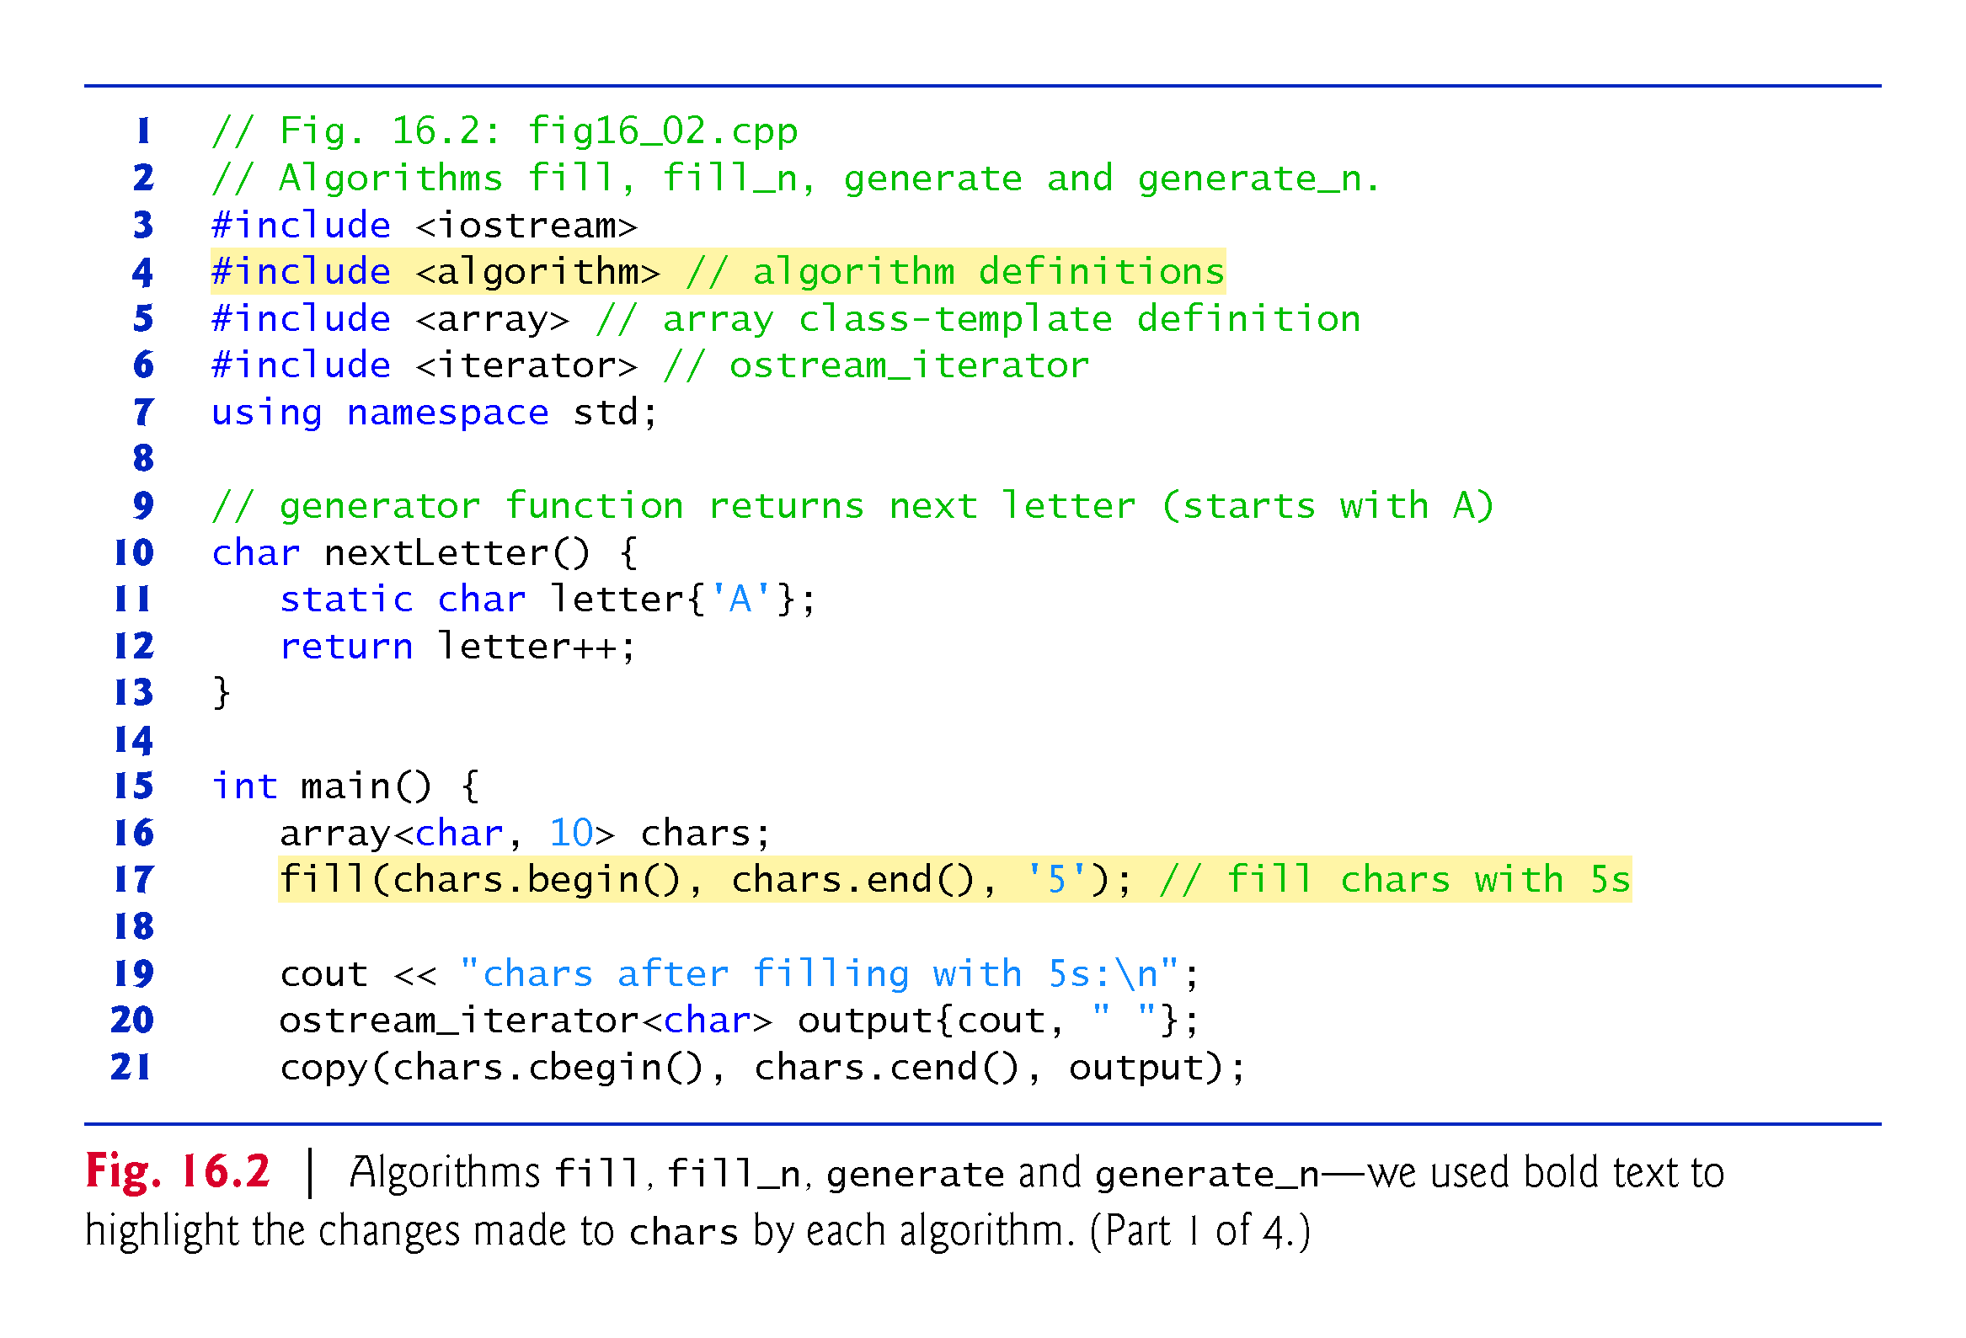

Slide 24
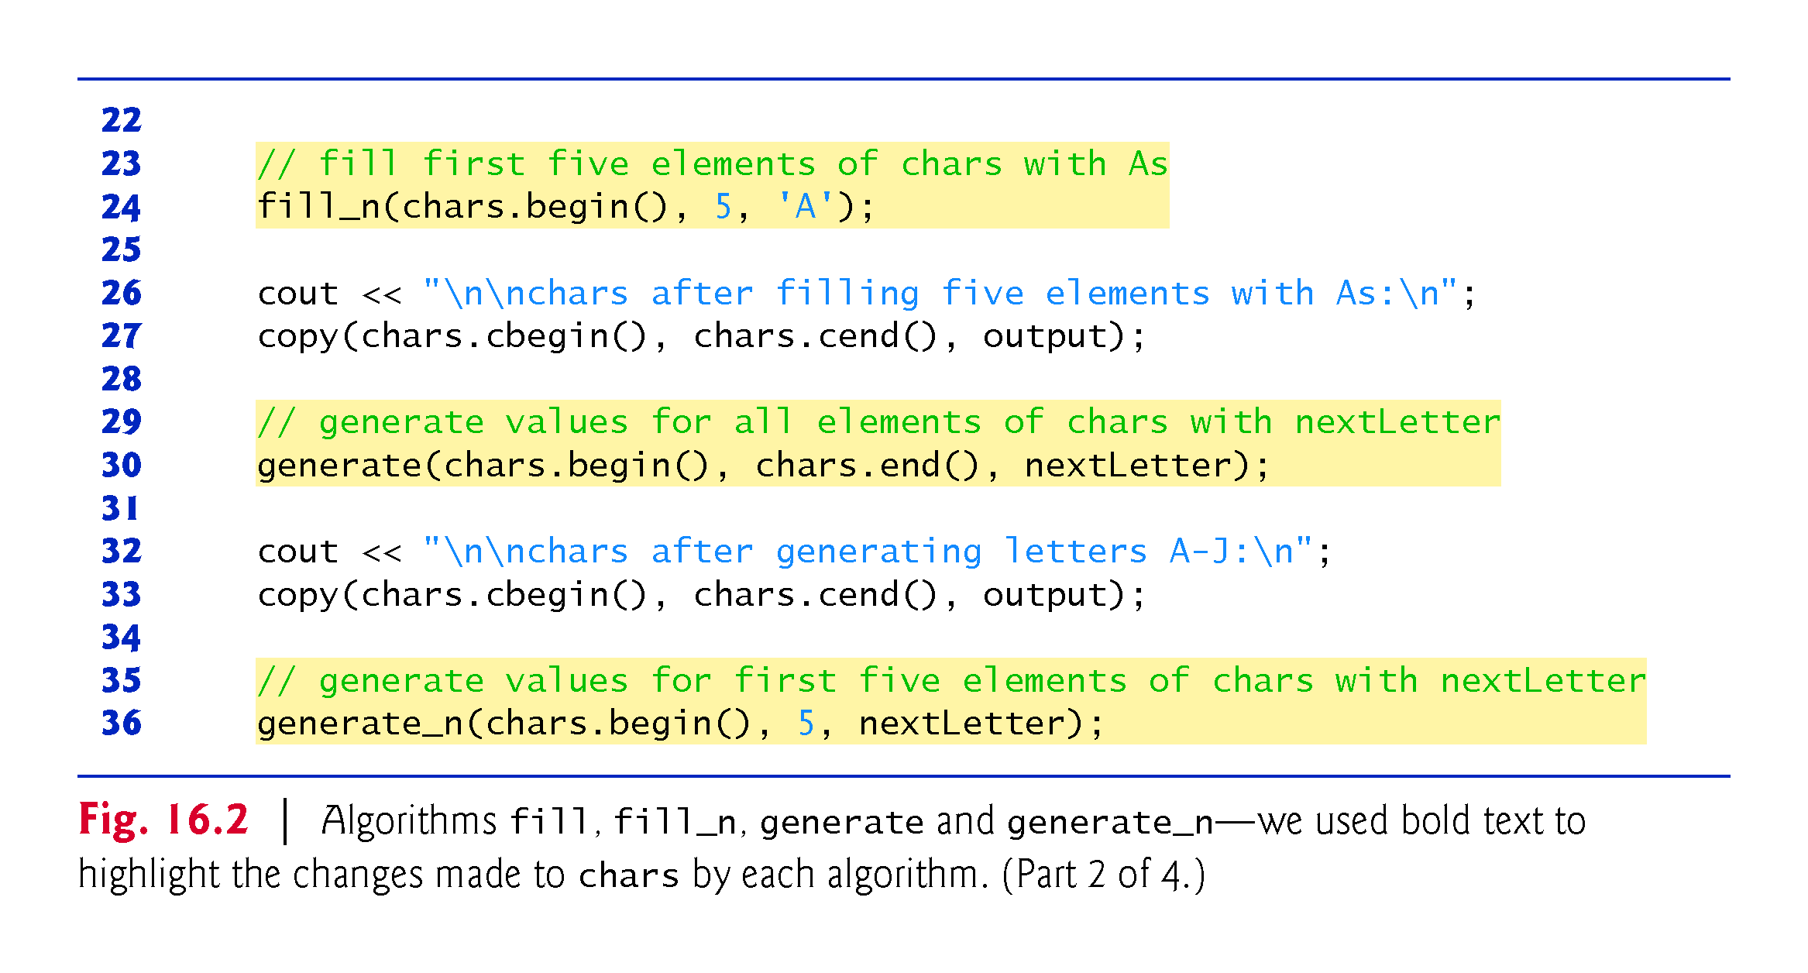

Slide 25
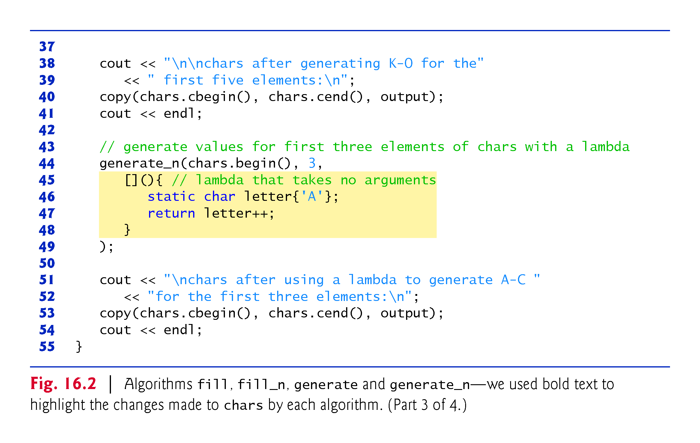

Slide 26
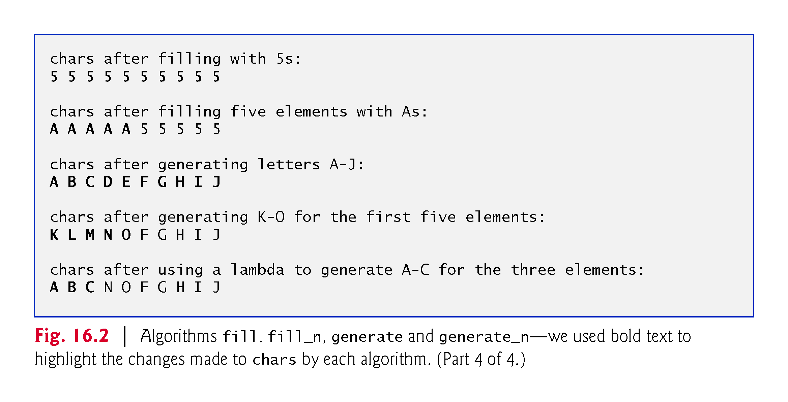

Slide 27
16.4.1 fill, fill_n, generate and generate_n (Cont.)
fill Algorithm
Line 16 defines a 10-element array of char values.
Line 17 uses the fill algorithm to place the character '5' in every element of chars from chars.begin() up to, but not including, chars.end().
The iterators supplied as the first and second argument must be at least forward iterators (i.e., they can be used for both input from a container and output to a container in the forward direction).
Forward iterators are required because they must be compared to determine when the end of the sequence has been reached.

Slide 28
16.4.1 fill, fill_n, generate and generate_n (Cont.)
fill_n Algorithm
Line 24 uses the fill_n algorithm to place the character 'A' in the first five elements of vector chars.
The iterator supplied as the first argument must be at least an output iterator (i.e., it can be used to write into a container in the forward direction).
The second argument specifies the number of elements to fill.
The third argument specifies the value to place in each element.

Slide 29
16.4.1 fill, fill_n, generate and generate_n (Cont.)
generate Algorithm
Line 30 uses the generate algorithm to place the result of a call to generator function nextLetter in every element of vector chars from chars.begin() up to, but not including, chars.end().
The iterators supplied as the first and second arguments must be at least forward iterators.
Function nextLetter (lines 10–13) begins with the character 'A' maintained in a static local variable.
The statement in line 12 returns the current value of letter then postincrements its value for use in the next call.

Slide 30
16.4.1 fill, fill_n, generate and generate_n (Cont.)
Generate_n Algorithm
Line 36 uses the generate_n algorithm to place the result of a call to generator function nextLetter in five elements of vector chars, starting from chars.begin().
The iterator supplied as the first argument must be at least an output iterator.
Lines 44–49 once again use the generate_n algorithm to place the result of a call to a generator function into elements of chars, starting from chars.begin().
The generator function is implemented as a lambda (lines 45–48) with no arguments that returns a generated letter.
For lambdas with no arguments, the parameter lists’ parentheses are not required.
The compiler infers that the lambda’s return type is char.

Slide 31
16.4.1 fill, fill_n, generate and generate_n (Cont.)
A Note About Reading Standard Library Algorithm Documentation
When you look at the Standard Library algorithms documentation for algorithms that can receive function pointers as arguments, you’ll notice in the documentation that the corresponding parameters do not show pointer declarations.
Such parameters can actually receive as arguments function pointers, function objects (Section 16.4) or lambda expressions (Section 16.5).
For this reason, the Standard Library declares such parameters using names that represent the parameters purpose.

Slide 32
16.4.1 fill, fill_n, generate and generate_n (Cont.)
For example, generate’s prototype is listed in the C++ standard document as:
template<class ForwardIterator, class Generator>
void generate(ForwardIterator first, ForwardIterator last,
Generator gen);
indicating that generate expects as arguments ForwardIterators representing the range of elements to process and a Generator function.
The standard explains that the algorithm calls the Generator function to obtain a value for each element in the range specified by the ForwardIterators.
The standard also specifies that the Generator must take no arguments and return a value that can be assigned to the element type.

Slide 33
16.4.2 equal, mismatch and lexicographical_compare
Figure 16.3 demonstrates comparing sequences of values for equality using algorithms equal, mismatch and lexicographical_compare.
When invoking an array’s copy constructor (line 12), you cannot use braces, as in
array<int, SIZE> a2{a1};
Compilation error, because the compiler treats the contents in braces as a list of values for the array’s elements.
In this case, the compiler attempts to initialize the first int element of a2 with the array object a1—there is no implicit conversion from an array object to a single int value.

Slide 34
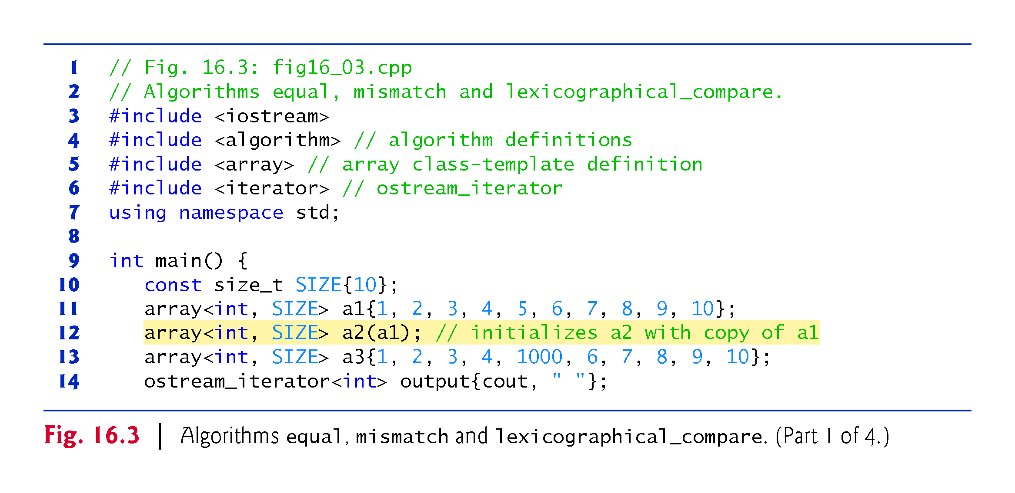

Slide 35
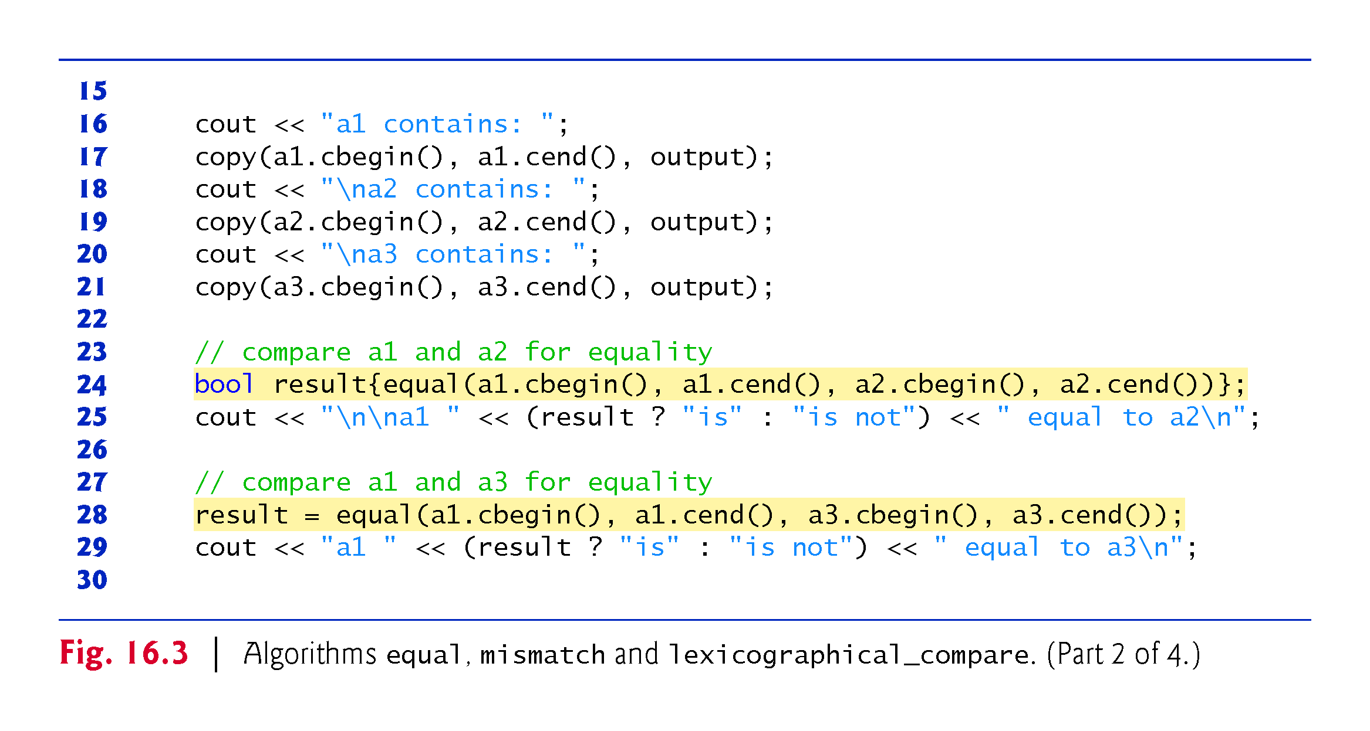

Slide 36
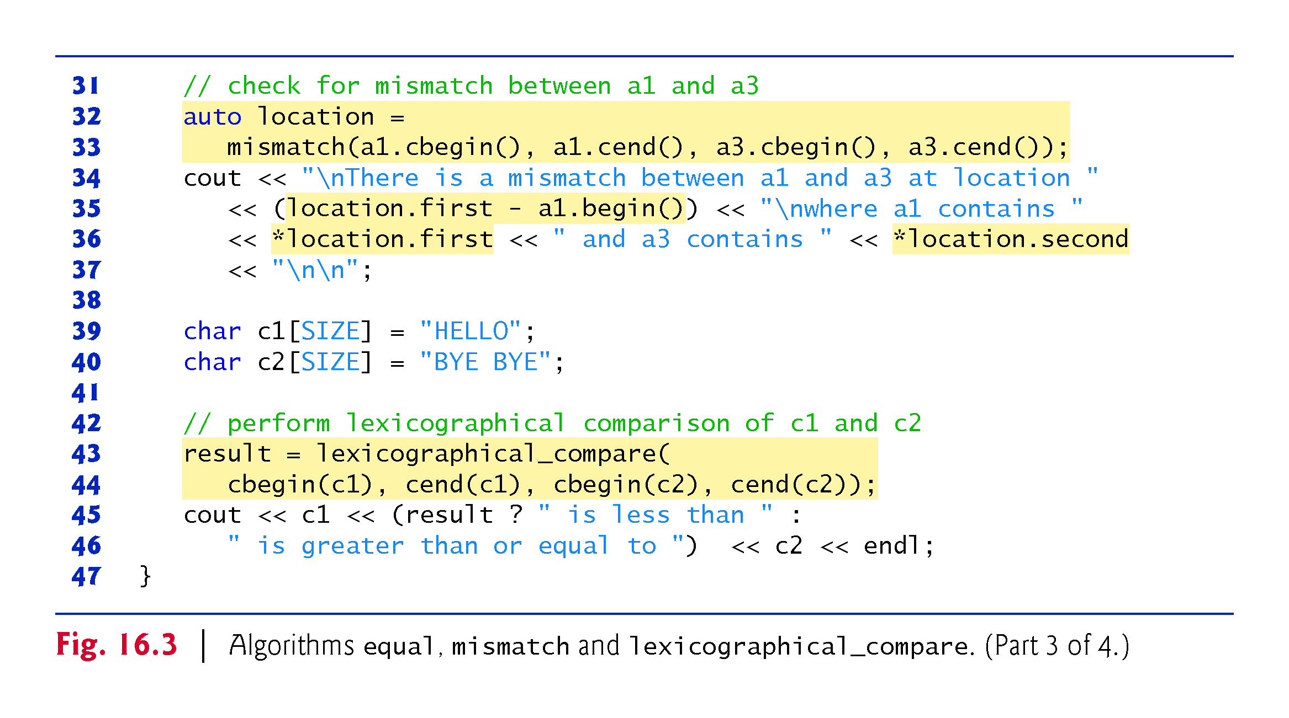

Slide 37
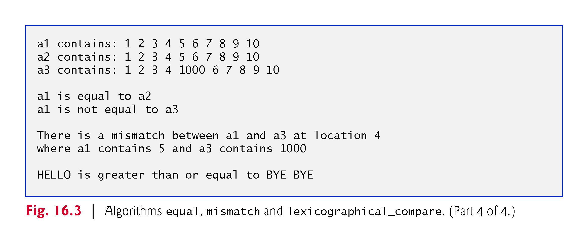

Slide 38
16.4.2 equal, mismatch and lexicographical_compare (Cont.)
equal Algorithm
Line 24 uses the C++14 version of the equal algorithm to compare two sequences of values for equality.
The second sequence must contain at least as many elements as the first—equal returns false if the sequences are not of the same length.
The == operator (whether built-in or overloaded) performs the element comparisons.
In this example, the elements in a1 from a1.cbegin() up to, but not including, a1.cend() are compared to the elements in a2 starting from a2.cbegin() up to, but not including, a2.cend().
In this example, they are equal.

Slide 39
16.4.2 equal, mismatch and lexicographical_compare (Cont.)
The four iterator arguments must be at least input iterators (i.e., they can be used for input from a sequence in the forward direction).
Line 28 uses function equal to compare a1 and a3, which are not equal.

Slide 40
16.4.2 equal, mismatch and lexicographical_compare (Cont.)
equal Algorithm with Binary Predicate Function
Each version of equal also has an overloaded version that takes a binary predicate function as the last parameter.
The binary predicate function receives the two elements being compared and returns a bool value indicating whether the elements are equal.
This can be useful in sequences that store objects or pointers to values rather than actual values, because you can define one or more comparisons.
For example, you can compare Employee objects for age, social security number, or location rather than comparing entire objects.
You can compare what pointers refer to rather than comparing the pointer values (i.e., the addresses stored in the pointers).

Slide 41
16.4.2 equal, mismatch and lexicographical_compare (Cont.)
mismatch Algorithm
Lines 32-33 call the C++14 version of the mismatch algorithm to compare two sequences of values.
The algorithm returns a pair of iterators indicating the location in each sequence of the first mismatched elements.
If all the elements match, the two iterators in the pair are equal to the end iterator for each sequence.
The four iterator arguments must be at least input iterators.
We infer the type of the pair object location with C++11’s auto keyword (line 32).

Slide 42
16.4.2 equal, mismatch and lexicographical_compare (Cont.)
Line 35 determines the actual location of the mismatch in the arrays with the expression location.first - a1.begin(), which evaluates to the number of elements between the iterators in the returned pair (this is analogous to pointer arithmetic; Chapter 8).
This corresponds to the element number in this example, because the comparison is performed from the beginning of each array.
As with equal, there are overloaded versions of mismatch that take a binary predicate function as the last parameter.

Slide 43
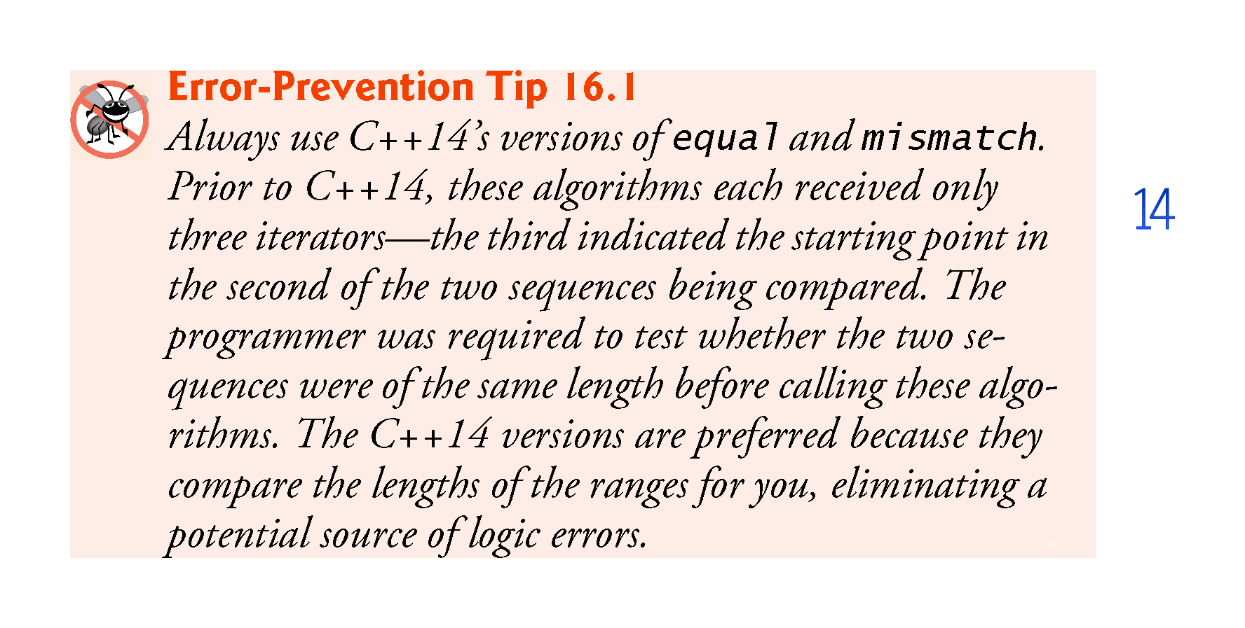

Slide 44
16.4.2 equal, mismatch and lexicographical_compare (Cont.)
Lines 32–33 use an equal sign (=) rather than braces to initialize the variable location.
This is due to a known limitation with variables that are declared auto and initialized with braced initializers.
There is a proposal to fix this limitation in C++17.

Slide 45
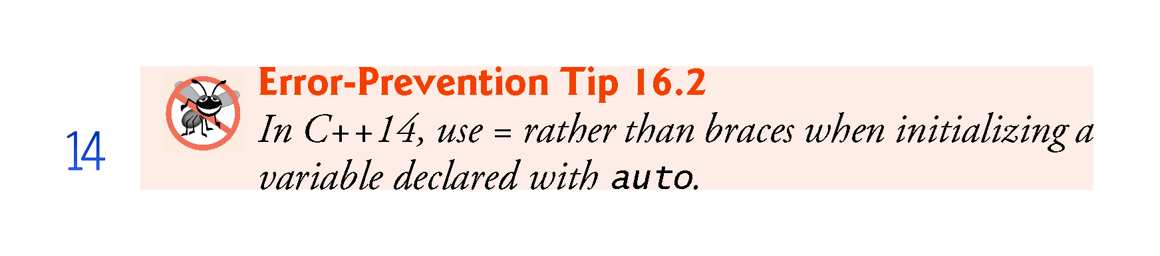

Slide 46
16.4.2 equal, mismatch and lexicographical_compare (Cont.)
lexicographical_compare Algorithm
Lines 43-44 use the lexicographical_compare algorithm to compare the contents of two char built-in arrays.
This algorithm’s four iterator arguments must be at least input iterators.
As you know, pointers into built-in arrays are random-access iterators.
The first two iterator arguments specify the range of locations in the first sequence.
The last two specify the range of locations in the second sequence.

Slide 47
16.4.2 equal, mismatch and lexicographical_compare (Cont.)
Once again, we use the C++11 begin and end functions to determine the range of elements for each built-in array.
While iterating through the sequences, if there is a mismatch between the corresponding elements in the sequences and the element in the first sequence is less than the corresponding element in the second sequence, the algorithm returns true.
If the element in the first sequence is greater than or equal to the element in the second sequence, the algorithm returns false.
This algorithm can be used to arrange sequences lexicographically.
Typically, such sequences contain strings.

Slide 48
16.4.3 remove, remove_if, remove_copy and remove_copy_if
Figure 16.4 demonstrates removing values from a sequence with algorithms remove, remove_if, remove_copy and remove_copy_if.

Slide 49
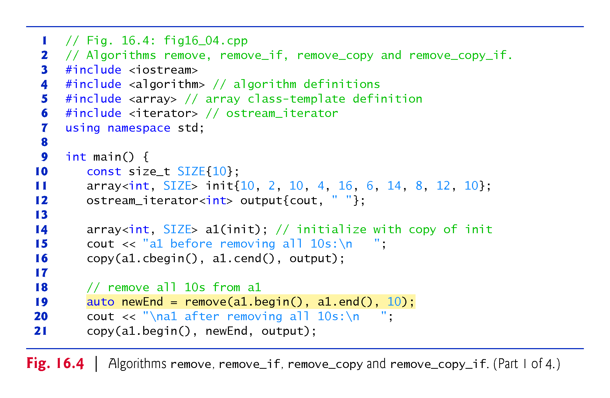

Slide 50
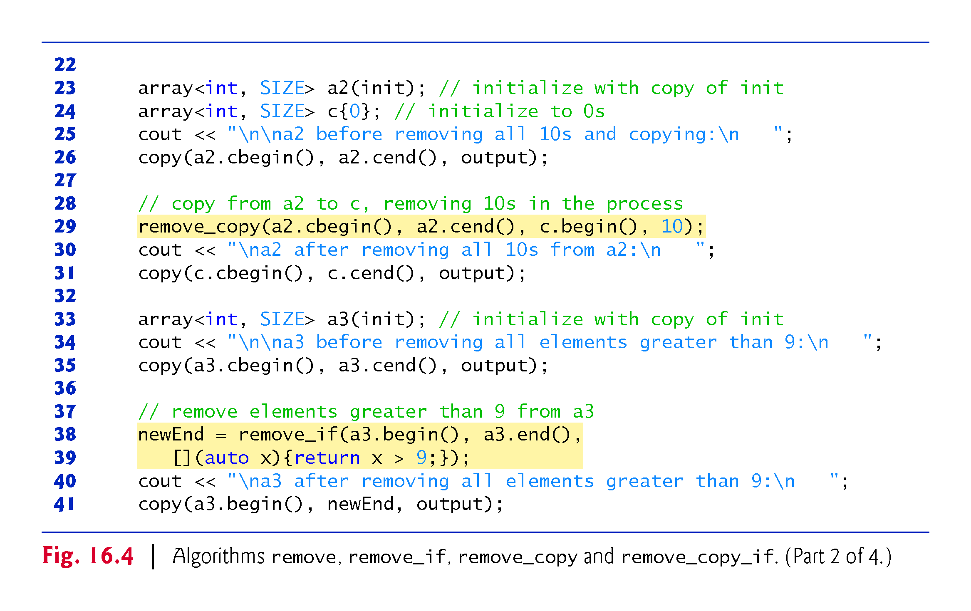

Slide 51
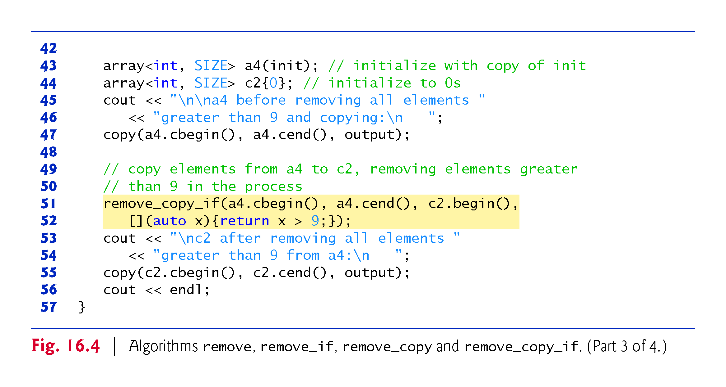

Slide 52
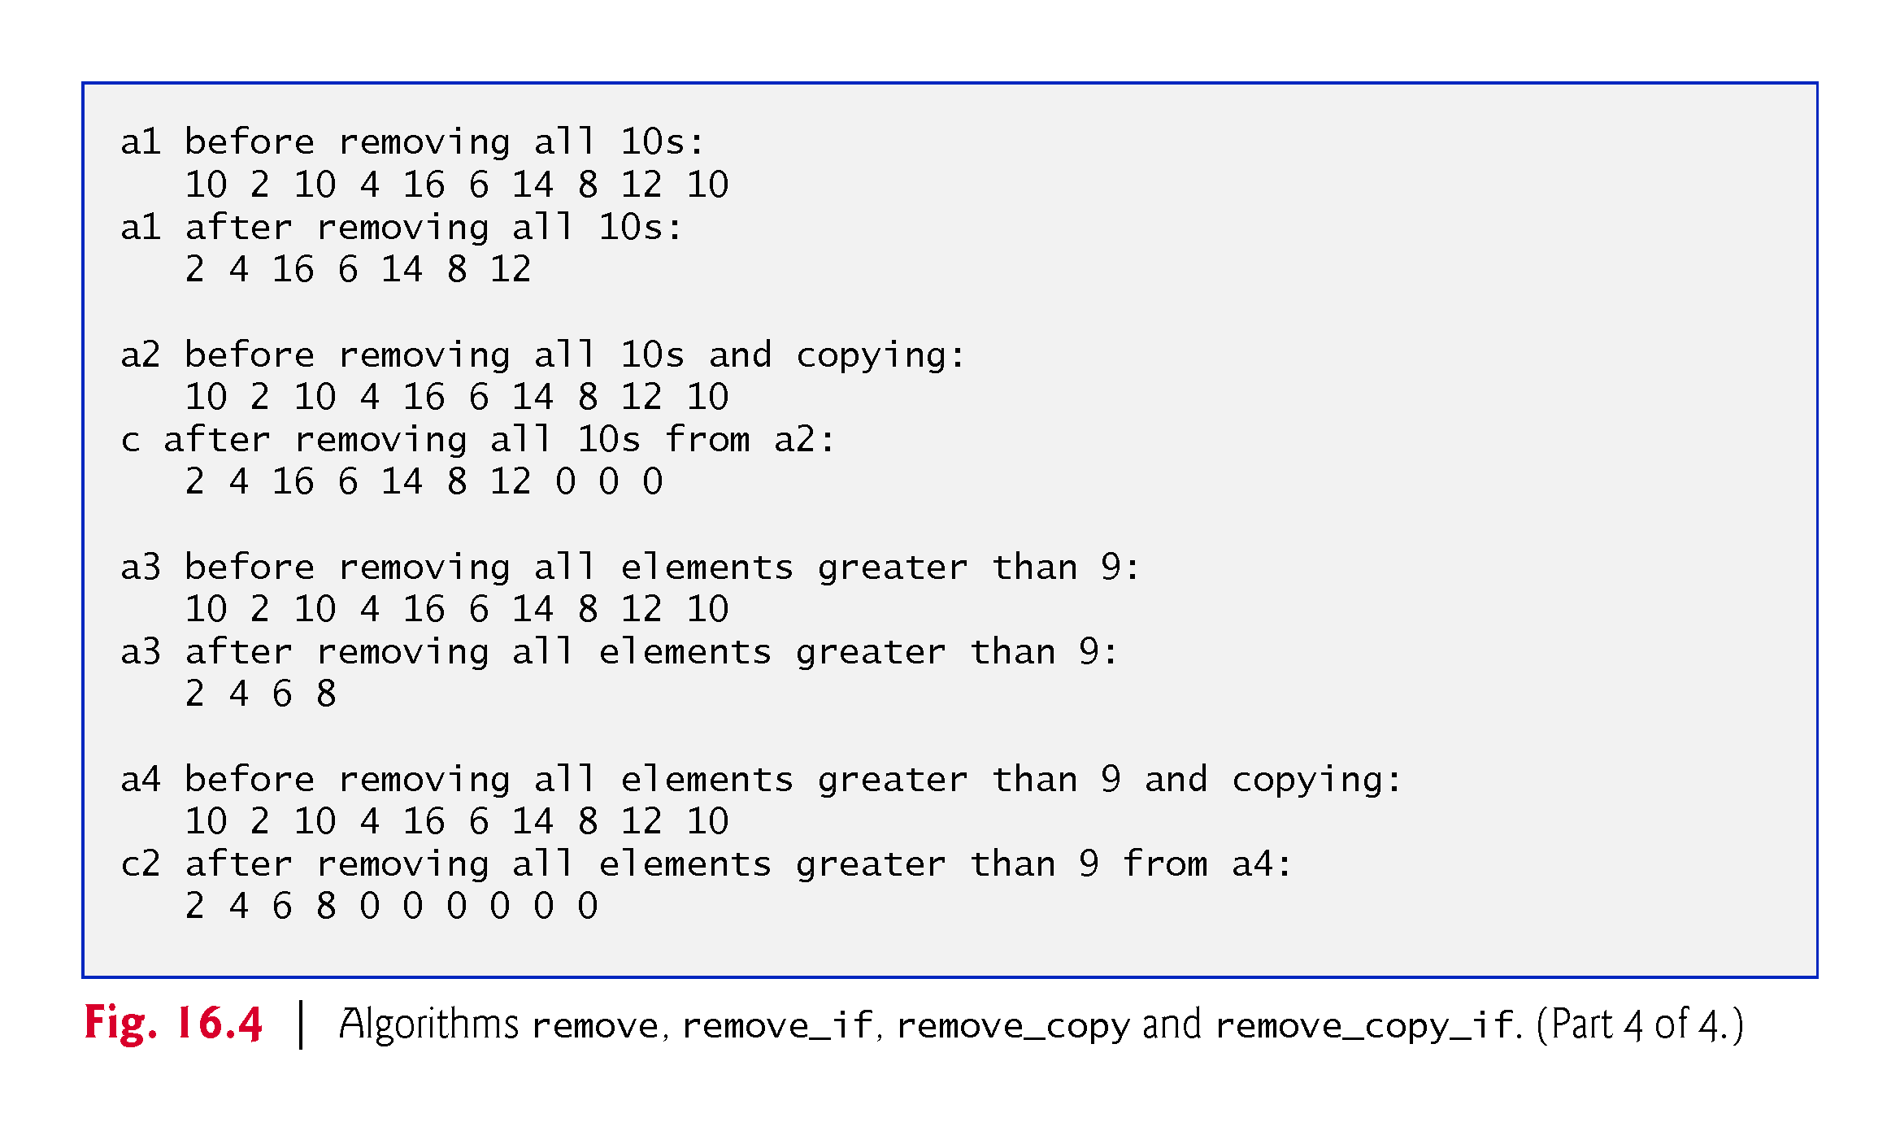

Slide 53
16.4.3 remove, remove_if, remove_copy and remove_copy_if (Cont.)
remove Algorithm
Line 19 uses the remove algorithm to eliminate from a1 all elements with the value 10 in the range from a1.begin() up to, but not including, a1.end().
The first two iterator arguments must be forward iterators.
This algorithm does not modify the number of elements in the container or destroy the eliminated elements, but it does move all elements that are not eliminated toward the beginning of the container.
The algorithm returns an iterator positioned after the last element that was not removed.
Elements from the iterator position to the end of the container have unspecified values and should not be used other than to assign them new values.
Line 21 outputs the elements of a1 from a1.begin() up to but not including newEnd.

Slide 54
16.4.3 remove, remove_if, remove_copy and remove_copy_if (Cont.)
remove_if Algorithm
Line 29 uses the remove_copy algorithm to copy all elements from a2 that do not have the value 10 in the range from a2.cbegin() up to, but not including, a2.cend().
The elements are placed in c, starting at position c.begin().
The iterators supplied as the first two arguments must be input iterators.
The iterator supplied as the third argument must be an output iterator so that the element being copied can be written into the destination container.
This algorithm returns an iterator positioned after the last element copied into c.

Slide 55
16.4.3 remove, remove_if, remove_copy and remove_copy_if (Cont.)
remove_if Algorithm
Lines 38-39 use remove_if to delete from a3 all those elements in the range from a3.begin() up to, but not including, a3.end() for which a unary predicate function returns true.
The unary predicate must receive one parameter and return bool.
[](auto x){return x > 9;}
returns true if the value passed to it is greater than 9; otherwise, the lambda returns false.
The compiler infers both the lambda’s parameter and return types:
Processing array of ints, so the lambda’s parameter type is int.
Returns a condition’s result, so the lambda’s return type is bool.

Slide 56
16.4.3 remove, remove_if, remove_copy and remove_copy_if (Cont.)
remove_if Algorithm
The iterators supplied as the first two arguments must be forward iterators.
This algorithm does not modify the number of elements in the container, but it does move to the beginning of the container all elements that are not removed.
This algorithm returns an iterator positioned after the last element that was not removed.
All elements from the iterator position to the end of the container have undefined values and should not be used.

Slide 57
16.4.3 remove, remove_if, remove_copy and remove_copy_if (Cont.)
remove_copy_if Algorithm
Lines 51-52 use remove_copy_if to copy the elements from a4 in the range from a4.cbegin() up to, but not including, a4.cend() for which a unary predicate function returns true.
The elements are placed in the array c2, starting at c2.begin().
The iterators supplied as the first two arguments must be input iterators.
The iterator supplied as the third argument must be an output iterator so that the element being copied can be written into the destination container.
This algorithm returns an iterator positioned after the last element copied into c2.

Slide 58
16.4.4 replace, replace_if, replace_copy and replace_copy_if
Figure 16.5 demonstrates replacing values from a sequence using algorithms replace, replace_if, replace_copy and replace_copy_if.

Slide 59
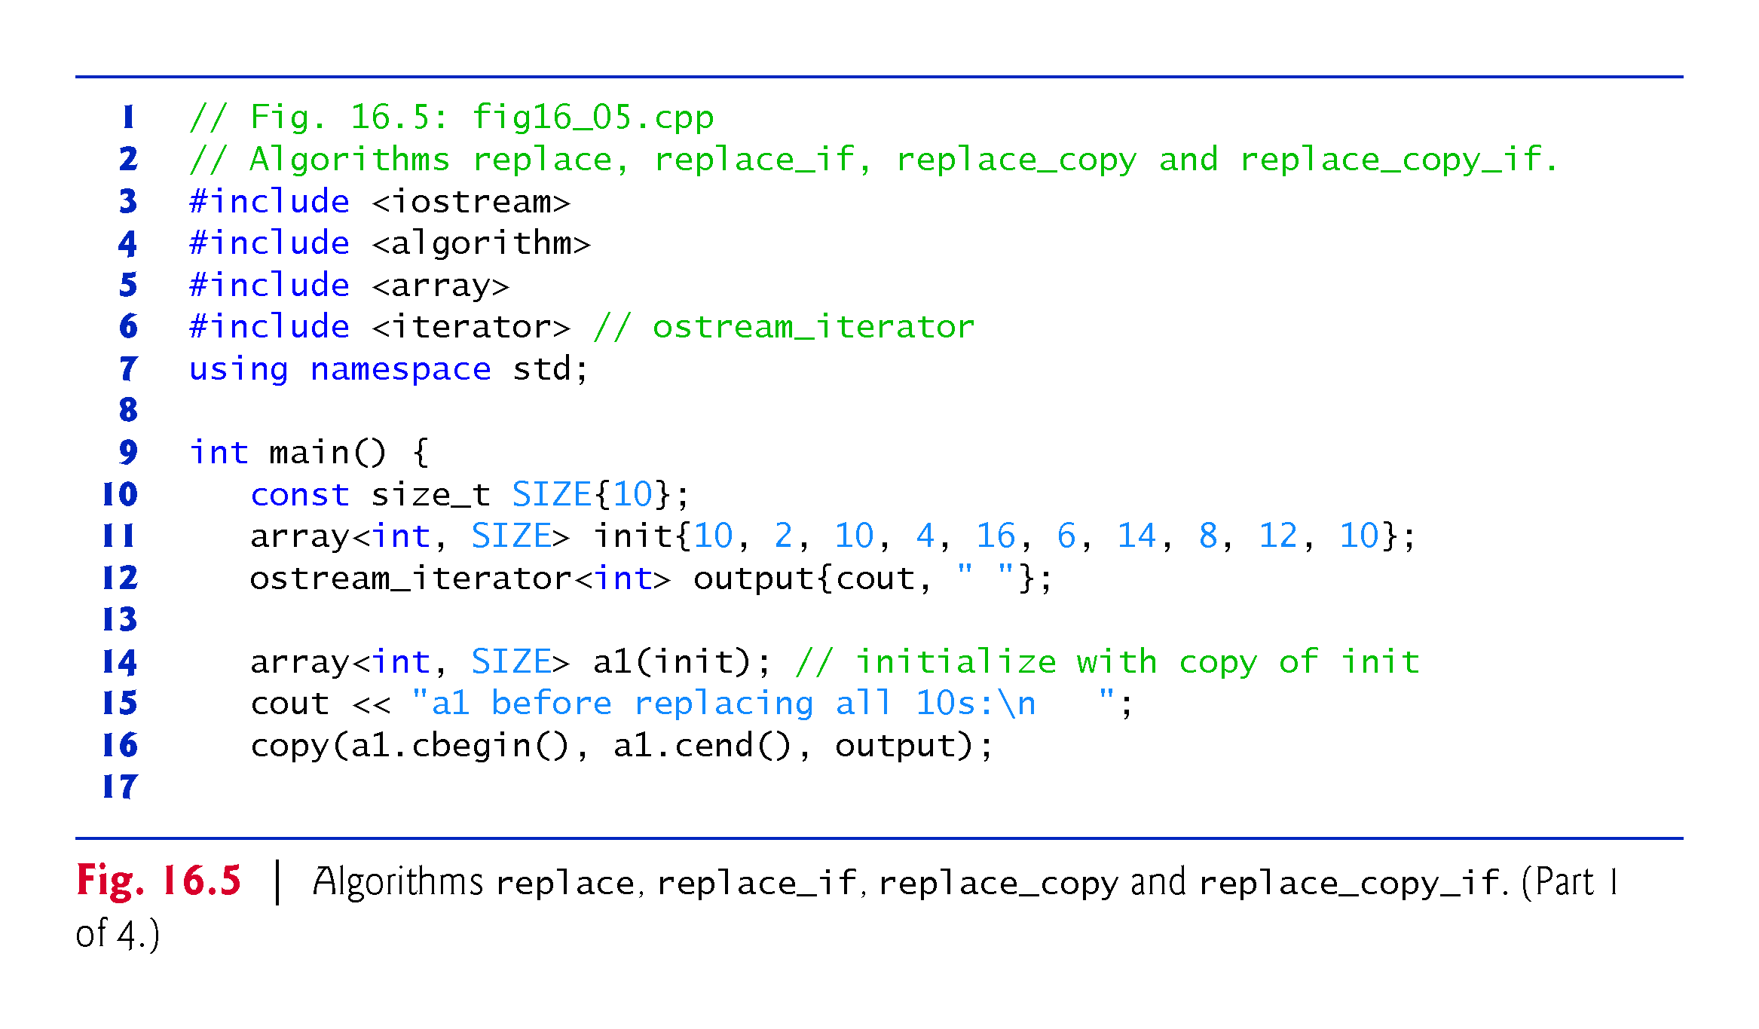

Slide 60
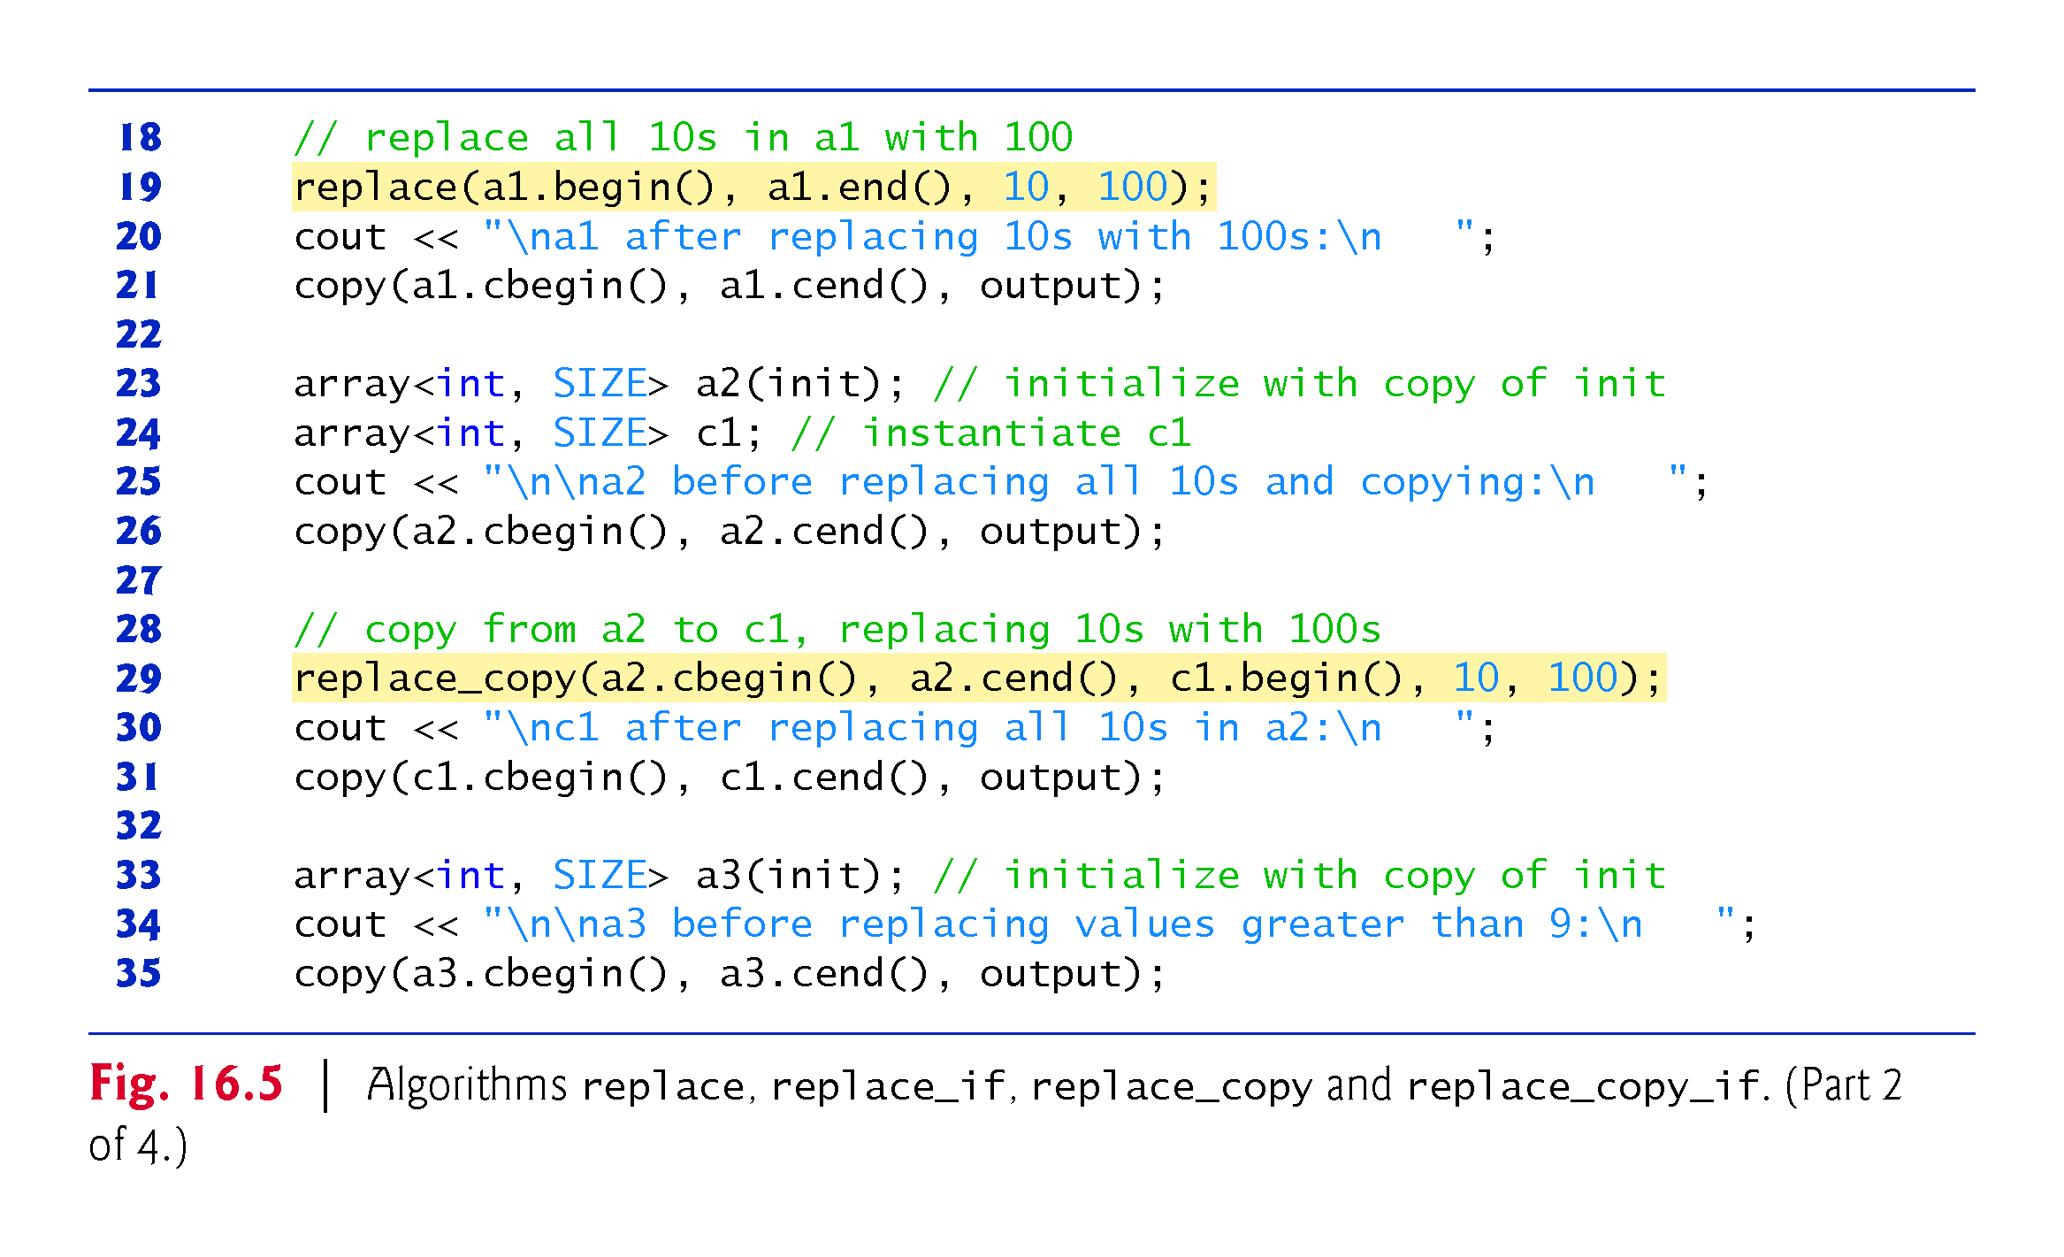

Slide 61
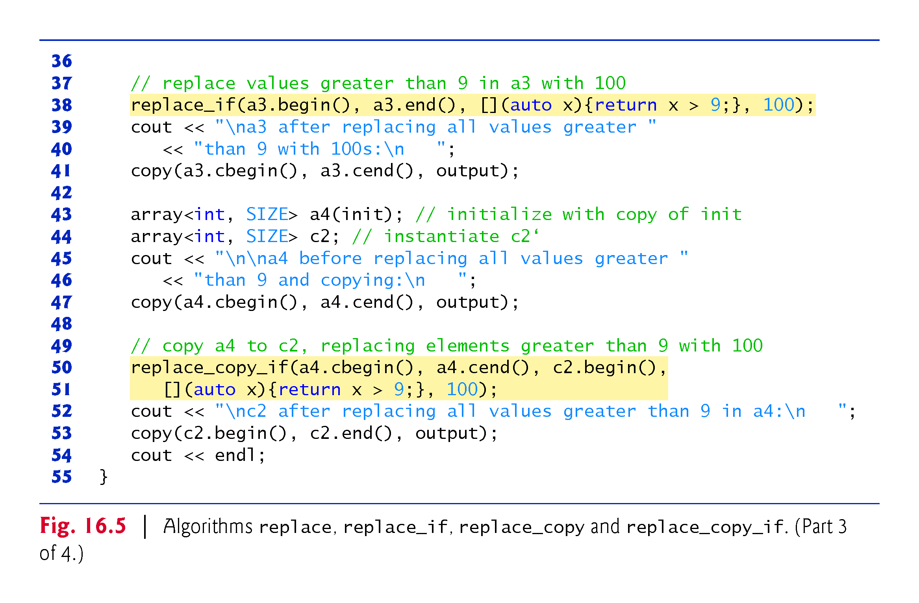

Slide 62
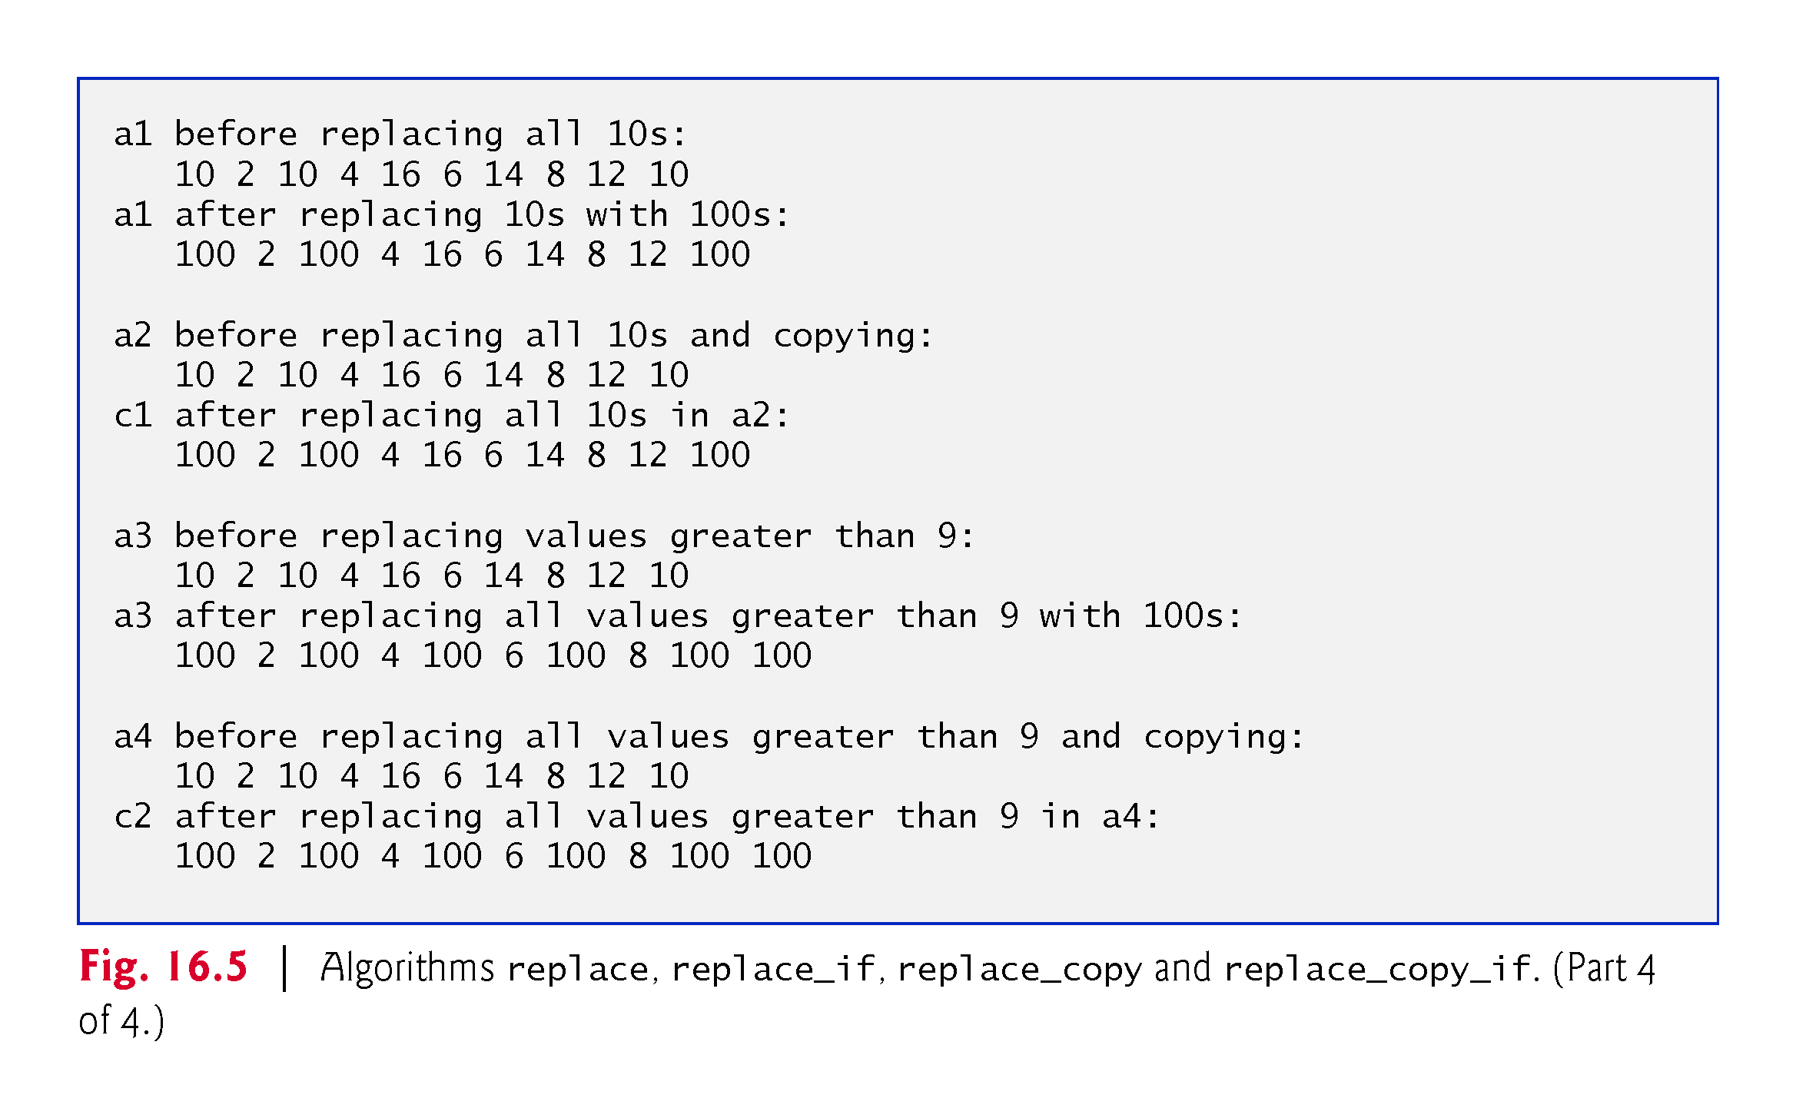

Slide 63
16.4.4 replace, replace_if, replace_copy and replace_copy_if (Cont.)
replace Algorithm
Line 19 uses the replace algorithm to replace all elements with the value 10 in the range a1.begin() up to, but not including, a1.end() with the new value 100.
The iterators supplied as the first two arguments must be forward iterators so that the algorithm can modify the elements in the sequence.

Slide 64
16.4.4 replace, replace_if, replace_copy and replace_copy_if (Cont.)
replace_copy Algorithm
Line 29 uses the replace_copy algorithm to copy all elements in the range a2.cbegin() up to, but not including, a2.cend(), replacing all elements with the value 10 with the new value 100.
The elements are copied into c1, starting at position c1.begin().
The iterators supplied as the first two arguments must be input iterators.
The iterator supplied as the third argument must be an output iterator so that the element being copied can be written into the destination container.
This function returns an iterator positioned after the last element copied into c1.

Slide 65
16.4.4 replace, replace_if, replace_copy and replace_copy_if (Cont.)
replace_if Algorithm
Line 38 uses the replace_if algorithm to replace all those elements from a3.begin() up to, but not including, a3.end() for which a unary predicate function returns true.
The lamda returns true if the value passed to it is greater than 9; otherwise, it returns false.
The value 100 replaces each value greater than 9.
The iterators supplied as the first two arguments must be forward iterators.

Slide 66
16.4.4 replace, replace_if, replace_copy and replace_copy_if (Cont.)
replace_copy_if Algorithm
Lines 50-51 use replace_copy_if to copy all elements from a4.cbegin() up to, but not including, a4.cend().
Elements for which a unary predicate function returns true are replaced with the value 100.
The elements are placed in c2, starting at position c2.begin().

Slide 67
16.4.4 replace, replace_if, replace_copy and replace_copy_if (Cont.)
The iterators supplied as the first two arguments must be input iterators.
The iterator supplied as the third argument must be an output iterator so that the element being copied can be written into to the destination container.
This algorithm returns an iterator positioned after the last element copied into c2.

Slide 68
16.4.5 Mathematical Algorithms
Figure 16.5 demonstrates several common mathematical algorithms, including shuffle, count, count_if, min_element, max_element, minmax_element, accumulate and transform.

Slide 69
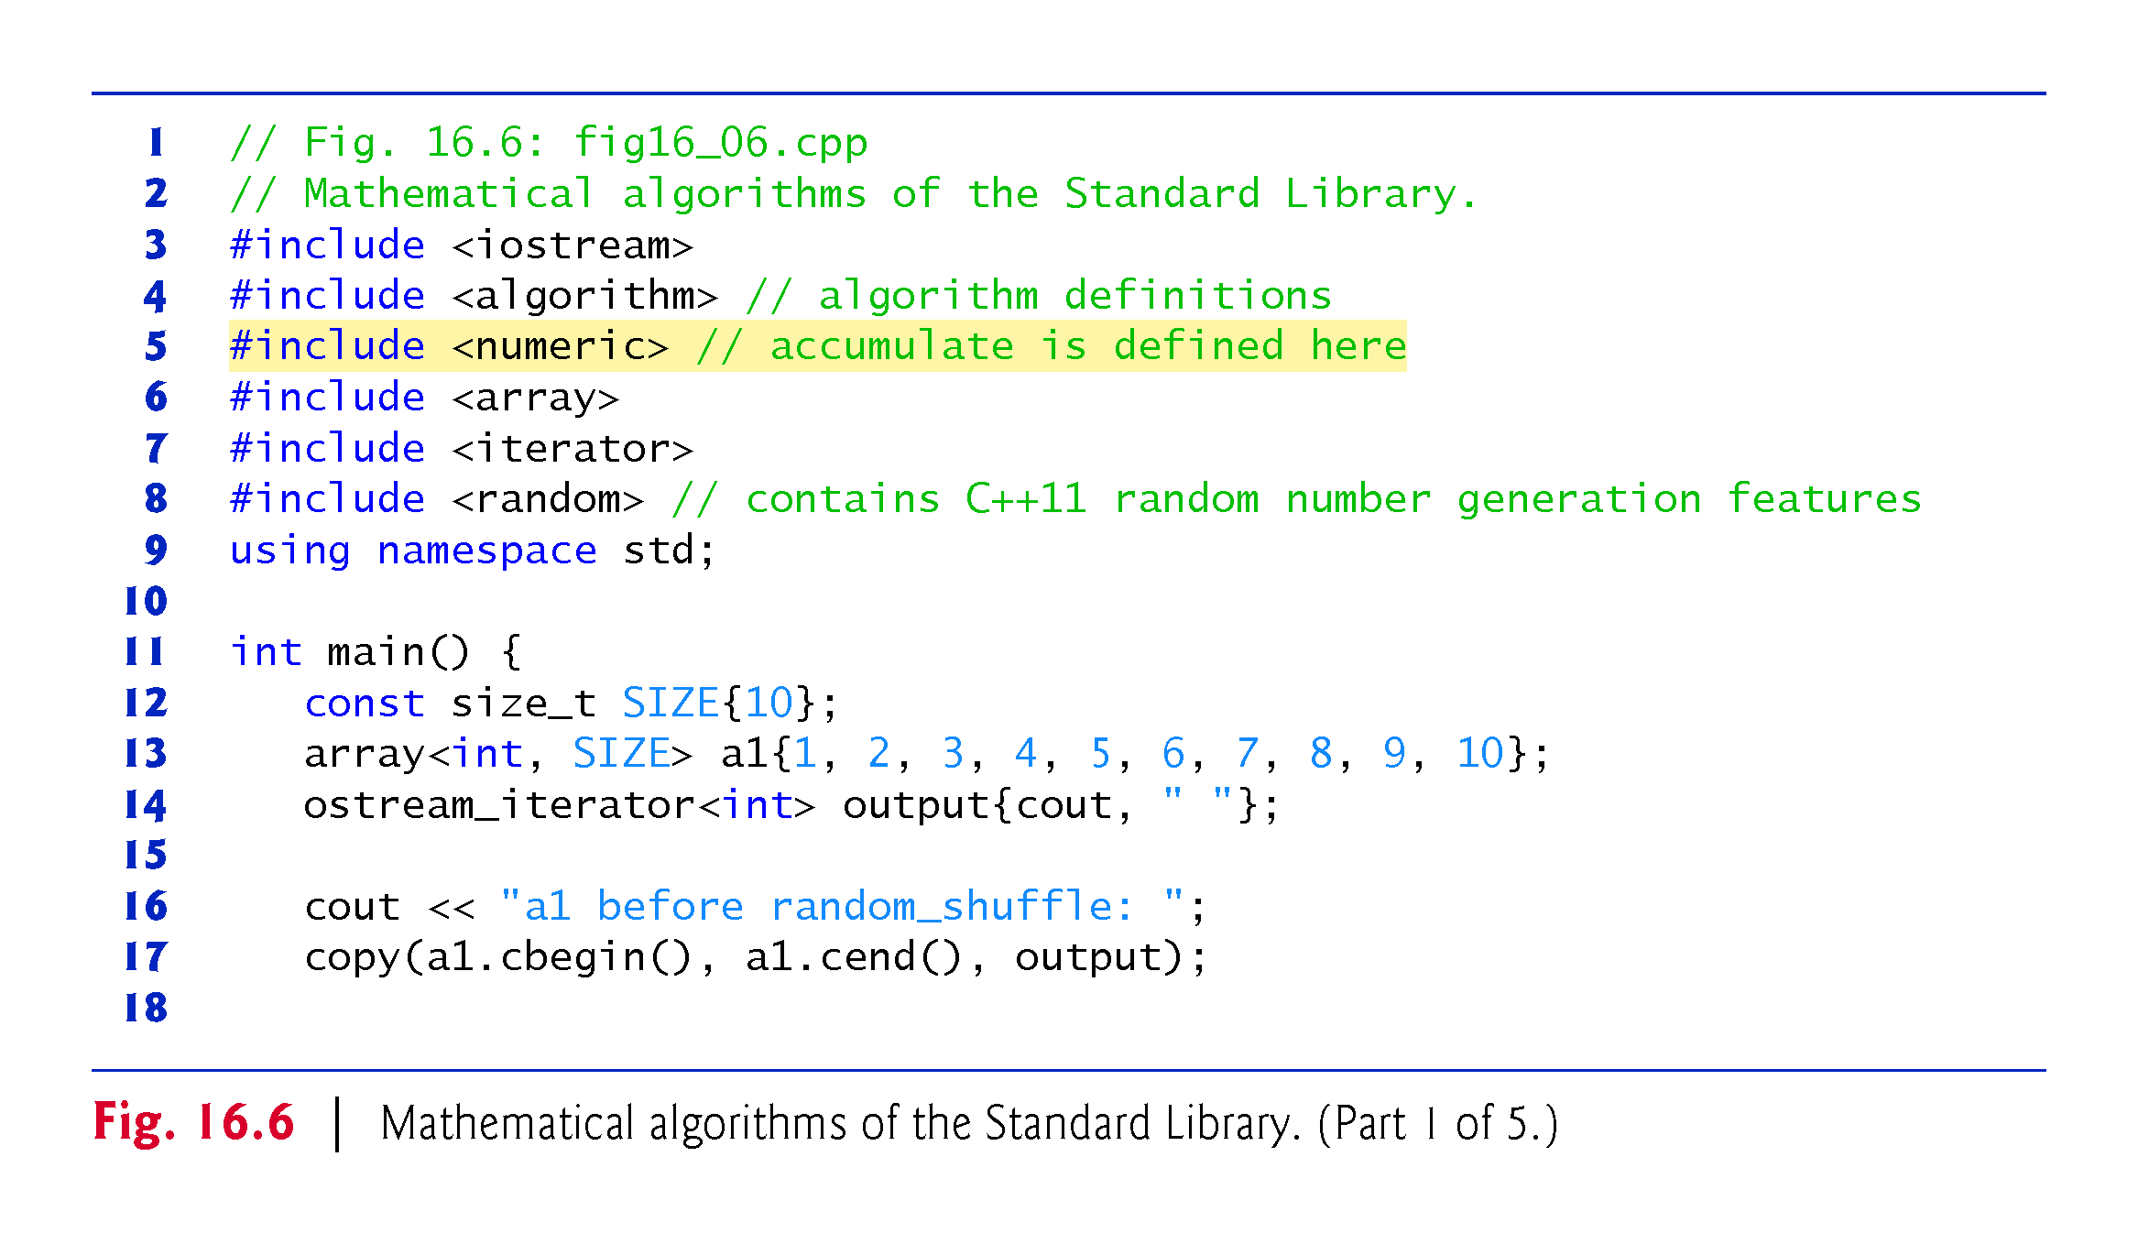

Slide 70
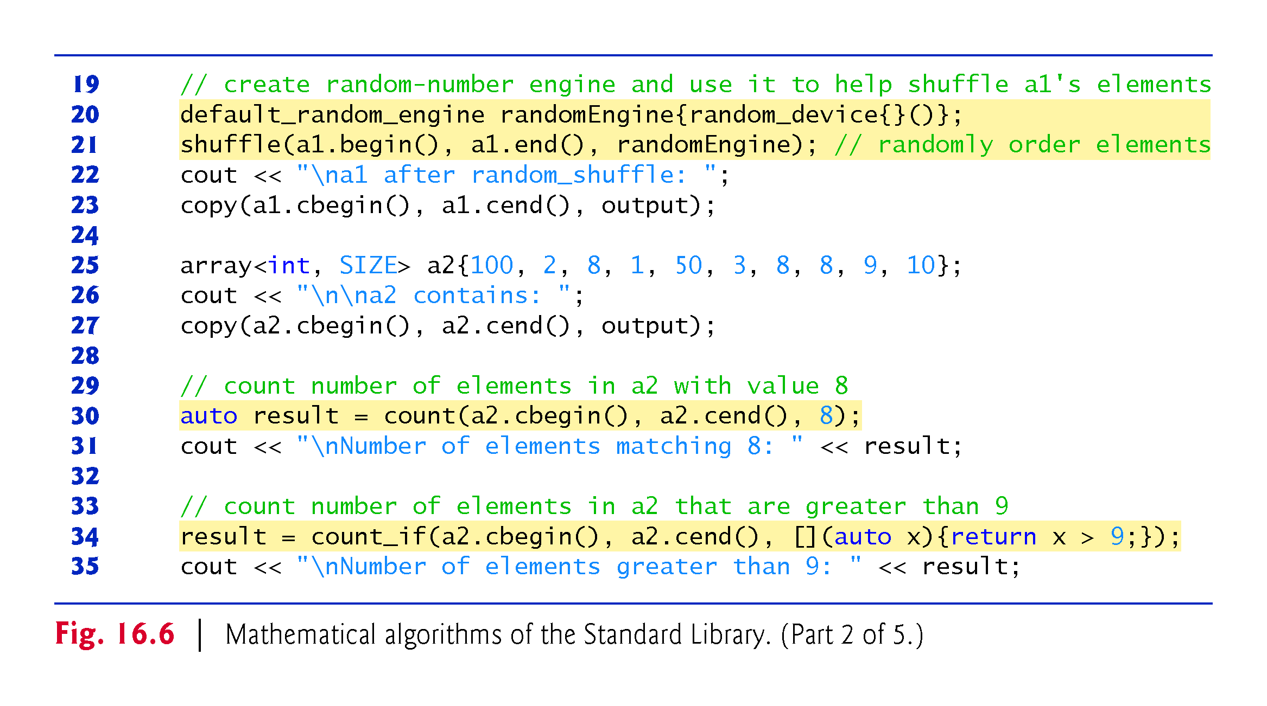

Slide 71
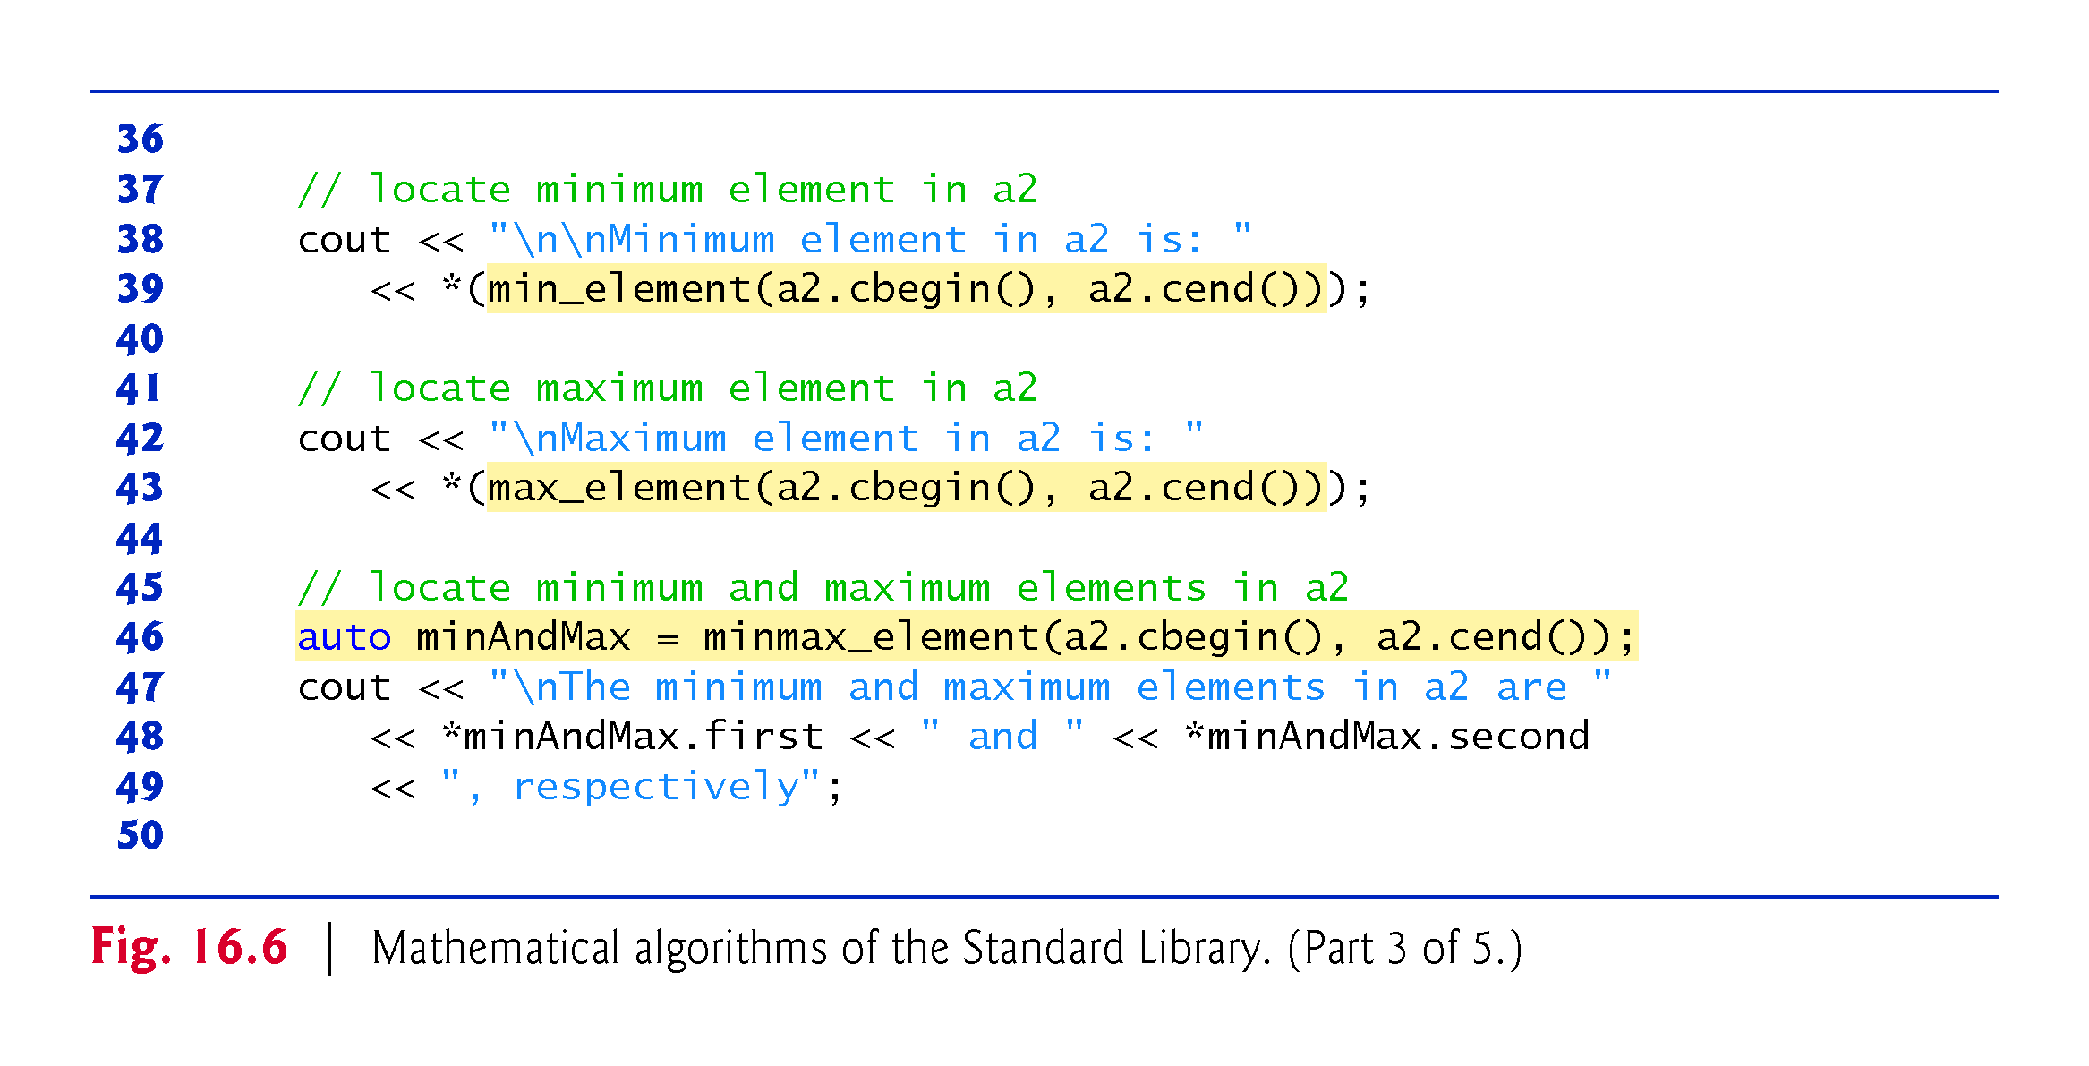

Slide 72
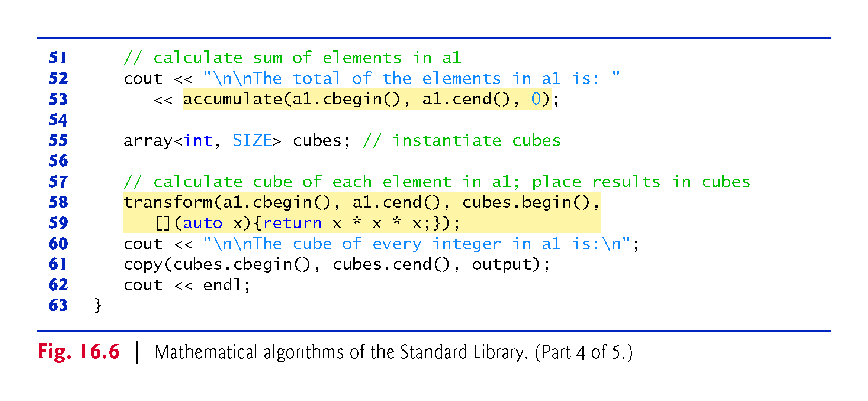

Slide 73
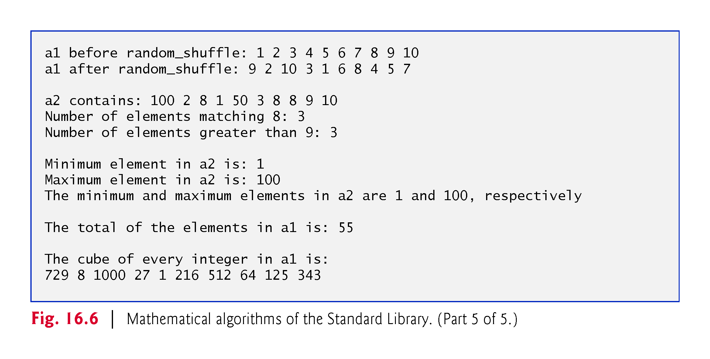

Slide 74
16.4.5 Mathematical Algorithms (Cont.)
shuffle Algorithm
Line 21 uses shuffle to reorder randomly the elements in the range a1.begin() up to, but not including, a1.end().
This algorithm takes two random-access iterator arguments and a C++11 random-number-generator engine.
Line 20 creates a default_random_engine using a C++11 random_device object to seed the random-number generator—typically with a nondeterministic seed (i.e., a seed that cannot be predicted).
default_random_engine randomEngine{random_device{}()};
In the expression random_device{}() the braces initialize the random_device object and the parentheses call its overloaded parentheses operator to get the seed.

Slide 75
16.4.5 Mathematical Algorithms (Cont.)
count Algorithm
Line 30 uses the count algorithm to count the elements with the value 8 in the range a2.cbegin() up to, but not including, a2.cend().
This algorithm requires its two iterator arguments to be at least input iterators.

Slide 76
16.4.5 Mathematical Algorithms (Cont.)
count_if Algorithm
Line 34 uses the count_if algorithm to count elements in the range from a2.cbegin() up to, but not including, a2.cend() for which a unary predicate function returns true.
Algorithm count_if requires its two iterator arguments to be at least input iterators.

Slide 77
16.4.5 Mathematical Algorithms (Cont.)
min_element Algorithm
Line 39 uses min_element to locate the smallest element in the range from a2.cbegin() up to, but not including, a2.cend().
The algorithm returns a forward iterator located at the first smallest element, or a2.end() if the range is empty.
The algorithm’s two iterator arguments must be at least forward iterators.
An overloaded version of this algorithm receives as its third argument a binary predicate function that compares two elements in the sequence and returns true if the first is less than the second.

Slide 78
16.4.5 Mathematical Algorithms (Cont.)
max_element Algorithm
Line 43 uses max_element to locate the largest element in the range from a2.cbegin() up to, but not including, a2.cend().
The algorithm returns a forward iterator located at the first largest element.
The algorithm’s two iterator arguments must be at least forward iterators.
An overloaded version of this algorithm takes as its third argument a binary predicate function that compares the elements in the sequence and returns true if the first is less than the second.

Slide 79
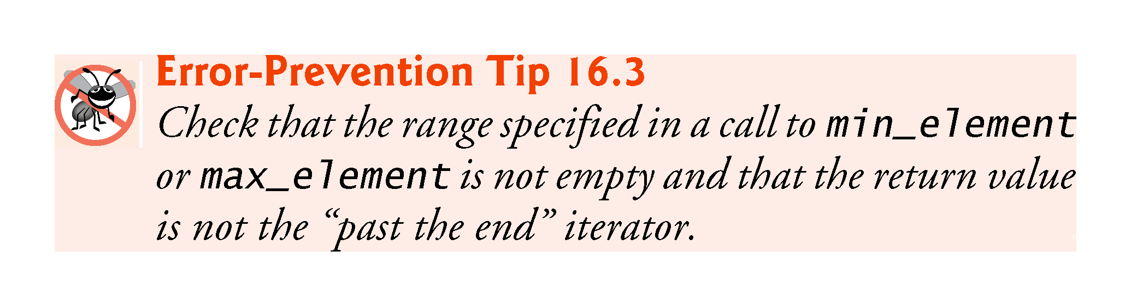

Slide 80
16.4.5 Mathematical Algorithms (Cont.)
C++11: minmax_element Algorithm
Line 46 uses minmax_element to locate both the smallest and largest elements in the range from a2.cbegin() up to, but not including, a2.cend().
The algorithm returns a pair of forward iterators located at the smallest and largest elements, respectively.
If there are duplicate smallest or largest elements, the iterators are located at the first smallest and last largest values. .
The algorithm’s two iterator arguments must be at least forward iterators.
A second version of this algorithm takes as its third argument a binary predicate function that compares the elements in the sequence.
The binary function takes two arguments and returns the bool value true if the first argument is less than the second.

Slide 81
16.4.5 Mathematical Algorithms (Cont.)
accumulate Algorithm
Line 53 uses accumulate (the template of which is in header <numeric>) to sum the values in the range from a1.cbegin() up to, but not including, a1.cend().
The algorithm’s two iterator arguments must be at least input iterators and its third argument represents the initial value of the total.
A second version of this algorithm takes as its fourth argument a general function that determines how elements are accumulated.
The general function must take two arguments and return a result.

Slide 82
16.4.5 Mathematical Algorithms (Cont.)
The first argument to this function is the current value of the accumulation.
The second argument is the value of the current element in the sequence being accumulated.
The function returns the result of the accumulation.

Slide 83
16.4.5 Mathematical Algorithms (Cont.)
transform Algorithm
Lines 58-59 use transform to apply a general function to every element in the range from a1.cbegin() up to, but not including, a1.cend().
The general function (the fourth argument) should take the current element as an argument, must not modify the element and should return the transformed value.
Algorithm transform requires its first two iterator arguments to be at least input iterators and its third argument to be at least an output iterator.
The third argument specifies where the transformed values should be placed.
Note that the third argument can equal the first.

Slide 84
16.4.5 Mathematical Algorithms (Cont.)
An overloaded version of transform accepts five arguments—the first two arguments are input iterators that specify a range of elements from one source container, the third argument is an input iterator that specifies the first element in another source container, the fourth argument is an output iterator that specifies where the transformed values should be placed and the last argument is a general function that takes two arguments and returns a result.
This version of transform takes one element from each of the two input sources and applies the general function to that pair of elements, then places the transformed value at the location specified by the fourth argument.

Slide 85
16.4.6 Basic Searching and Sorting Algorithms
Figure 16.7 demonstrates some basic searching and sorting capabilities of the Standard Library, including find, find_if, sort, binary_search, all_of, any_of, none_of and find_if_not.

Slide 86
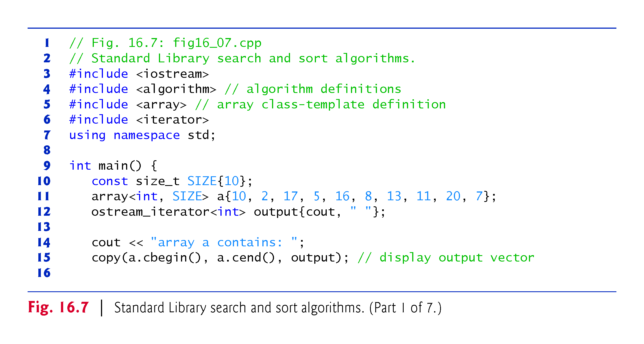

Slide 87
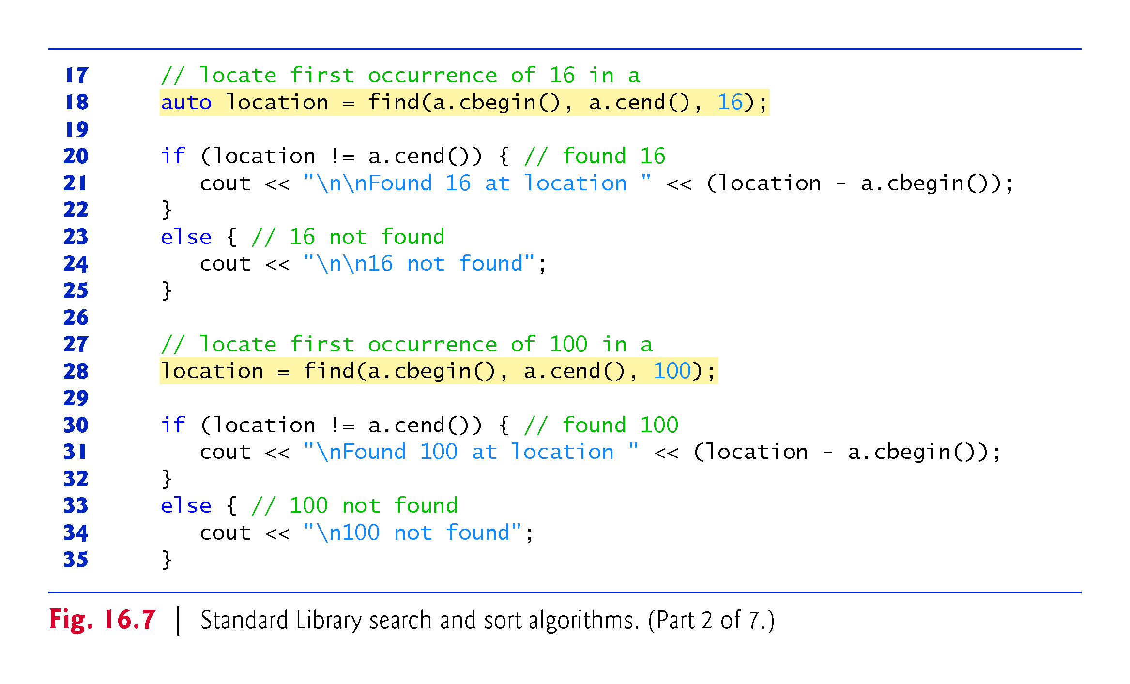

Slide 88
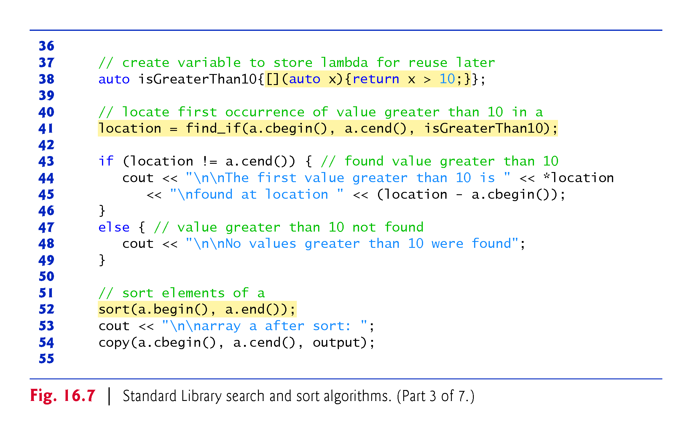

Slide 89
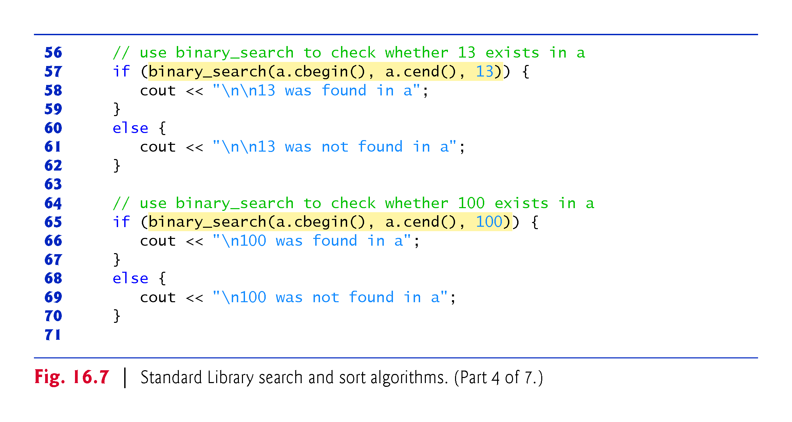

Slide 90
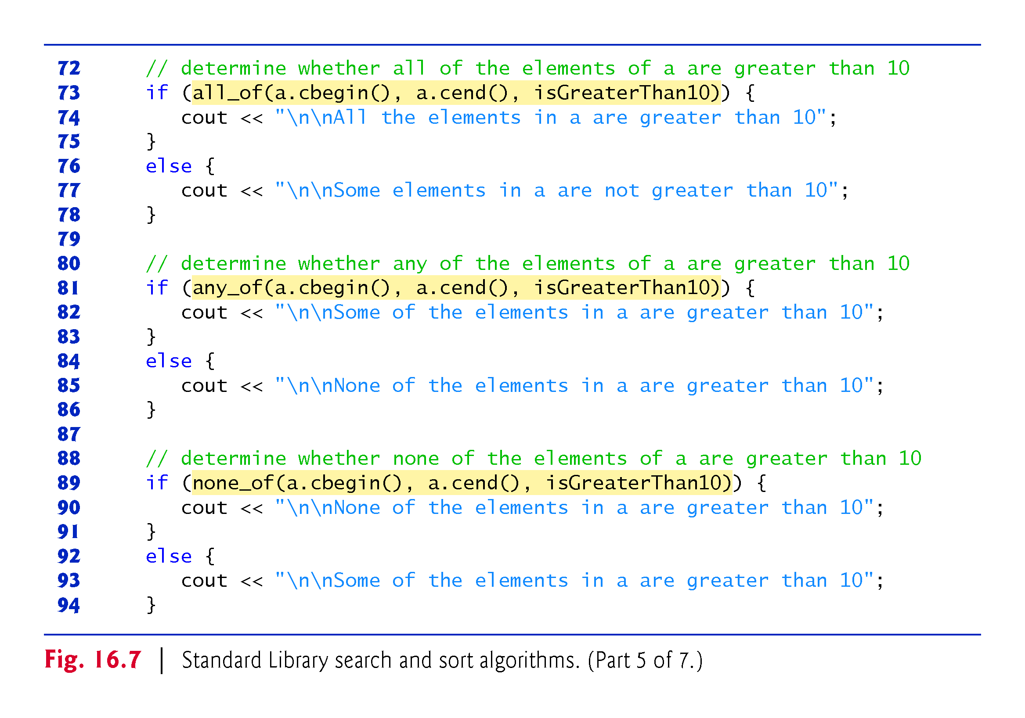

Slide 91
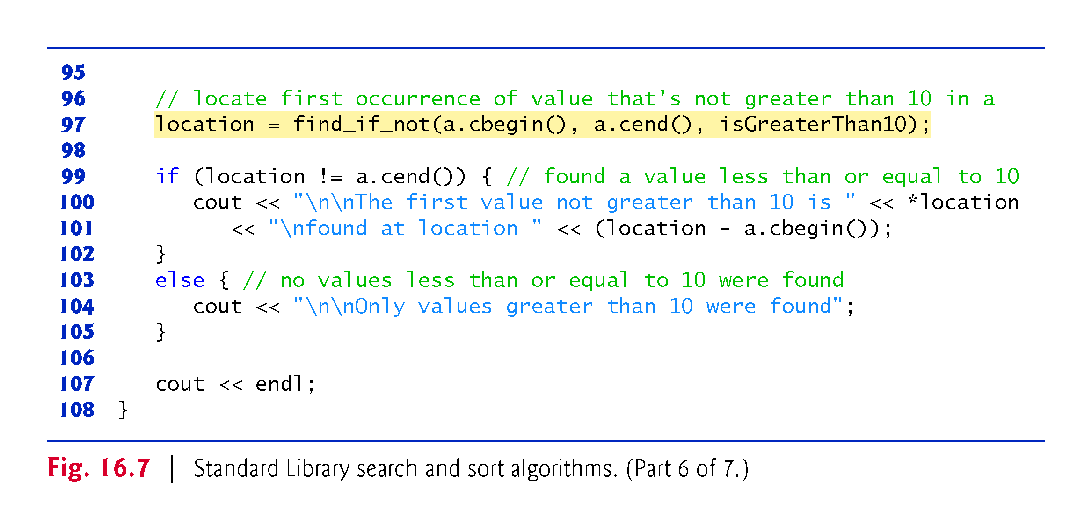

Slide 92
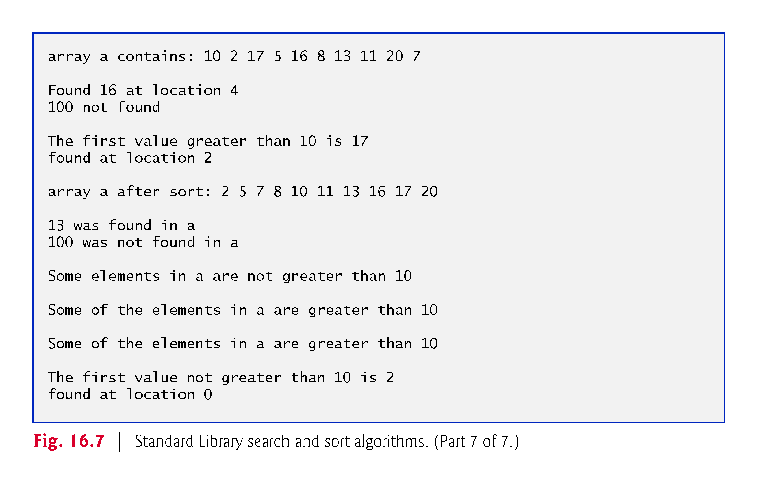

Slide 93
16.4.6 Basic Searching and Sorting Algorithms (Cont.)
find Algorithm
Line 18 uses find to locate the value 16 in the range from a.cbegin() up to, but not including, a.cend().
The algorithm requires its two iterator arguments to be at least input iterators and returns an input iterator that either is positioned at the first element containing the value or indicates the end of the sequence (as is the case in line 29).

Slide 94
16.4.6 Basic Searching and Sorting Algorithms (Cont.)
Storing Lambdas in Variables
Throughout this example, we test multiple times whether elements in the array a are greater than 10. You can store a lambda in a variable, as in:
auto isGreaterThan10 = [](auto x){return x > 10;};
This variable can then be used at a later time to pass the lambda to other functions, as in lines 41, 73, 81, 89 and 97. You can also use the variable like a function name to invoke the lambda, as in
isGreaterThan10(5)
which returns false.

Slide 95
16.4.6 Basic Searching and Sorting Algorithms (Cont.)
find_if Algorithm
Line 41 uses find_if (a linear search) to locate the first value in the range from a.cbegin() up to, but not including, a.cend() for which a unary predicate function returns true.
Algorithm find_if requires its two iterator arguments to be at least input iterators.
The algorithm returns an input iterator that either is positioned at the first element containing a value for which the predicate function returns true or indicates the end of the sequence.

Slide 96
16.4.6 Basic Searching and Sorting Algorithms (Cont.)
sort Algorithm
Line 52 uses sort to arrange the elements in the range from a.begin() up to, but not including, a.end() in ascending order.
This algorithm requires its two iterator arguments to be random-access iterators.
Can be used with built-in arrays and Standard Library containers array, vector and deque
An overloaded version of this algorithm takes a third argument that is a binary predicate function taking two arguments and returning a bool indicating the sorting order.
The predicate compares two values from the sequence being sorted—if the return value is true, the two elements being compared are already in sorted order; otherwise they need to be reordered.

Slide 97
16.4.6 Basic Searching and Sorting Algorithms (Cont.)
binary_search Algorithm
Line 57 uses binary_search to determine whether the value 13 is in the range from a.cbegin() up to, but not including, a.cend().
The values must be sorted in ascending order.
Algorithm binary_search requires its two iterator arguments to be at least forward iterators.
The algorithm returns a bool indicating whether the value was found in the sequence.

Slide 98
16.4.6 Basic Searching and Sorting Algorithms (Cont.)
Line 65 demonstrates a call to binary_search in which the value is not found.
An overloaded version of this algorithm receives as a fourth argument a binary predicate function with two arguments that are values in the sequence and returning a bool.
The predicate function returns true if the two elements being compared are in sorted order.
If you need to know the location of the search key in the container, use the lower_bound or find algorithms.

Slide 99
16.4.6 Basic Searching and Sorting Algorithms (Cont.)
C++11: all_of Algorithm
Line 73 uses all_of to determine whether a unary predicate function returns true for all of the elements in the range from a.cbegin() up to, but not including, a.cend().
Algorithm all_of requires its two iterator arguments to be at least input iterators.

Slide 100
16.4.6 Basic Searching and Sorting Algorithms (Cont.)
C++11: any_of Algorithm
Line 81 uses any_of to determine whether a unary predicate function returns true for at least one of the elements in the range from a.cbegin() up to, but not including, a.cend().
Algorithm any_of requires its two iterator arguments to be at least input iterators.

Slide 101
16.4.6 Basic Searching and Sorting Algorithms (Cont.)
C++11: none_of Algorithm
Line 89 uses none_of to determine whether a unary predicate function returns false for all of the elements in the range from a.cbegin() up to, but not including, a.cend().
Algorithm none_of requires its two iterator arguments to be at least input iterators.

Slide 102
16.4.6 Basic Searching and Sorting Algorithms (Cont.)
C++11: find_if_not Algorithm
Line 97 uses find_if_not to locate the first value in the range from a.cbegin() up to, but not including, a.cend() for which a unary predicate function returns false.
Algorithm find_if requires its two iterator arguments to be at least input iterators.
The algorithm returns an input iterator that either is positioned at the first element containing a value for which the predicate function returns false or indicates the end of the sequence.

Slide 103
16.4.7 swap, iter_swap and swap_ranges
Figure 16.8 demonstrates algorithms swap, iter_swap and swap_ranges for swapping elements.

Slide 104
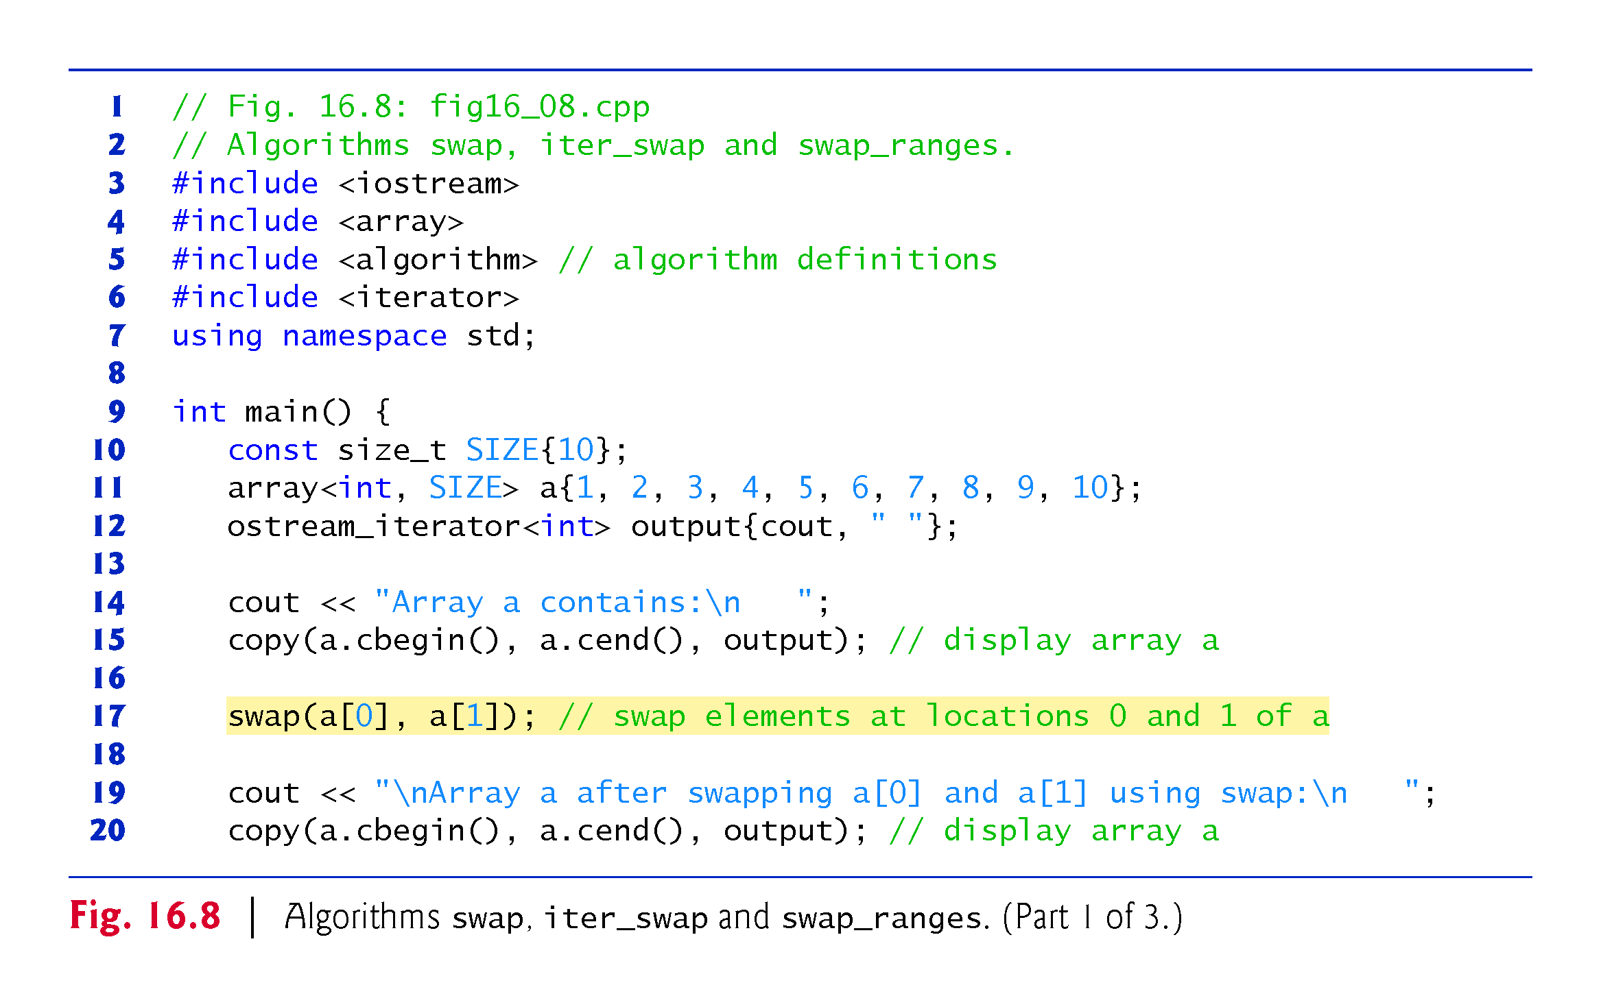

Slide 105
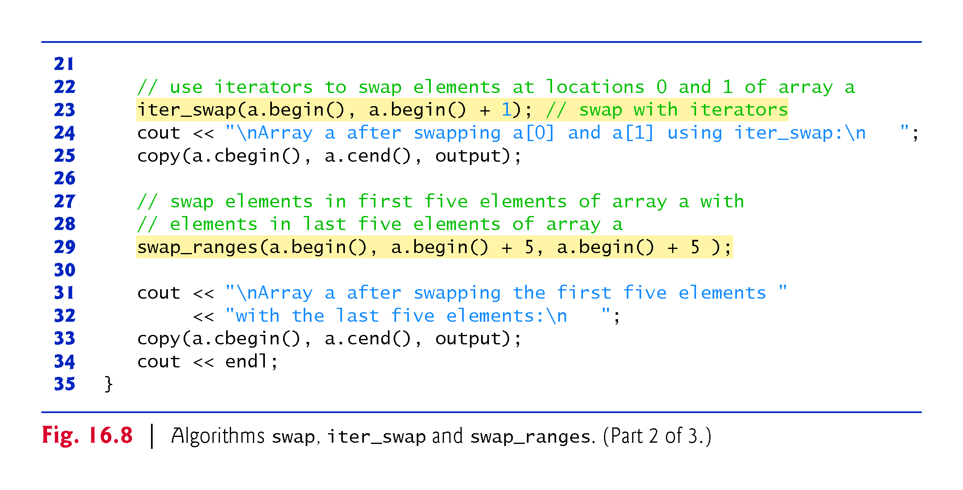

Slide 106
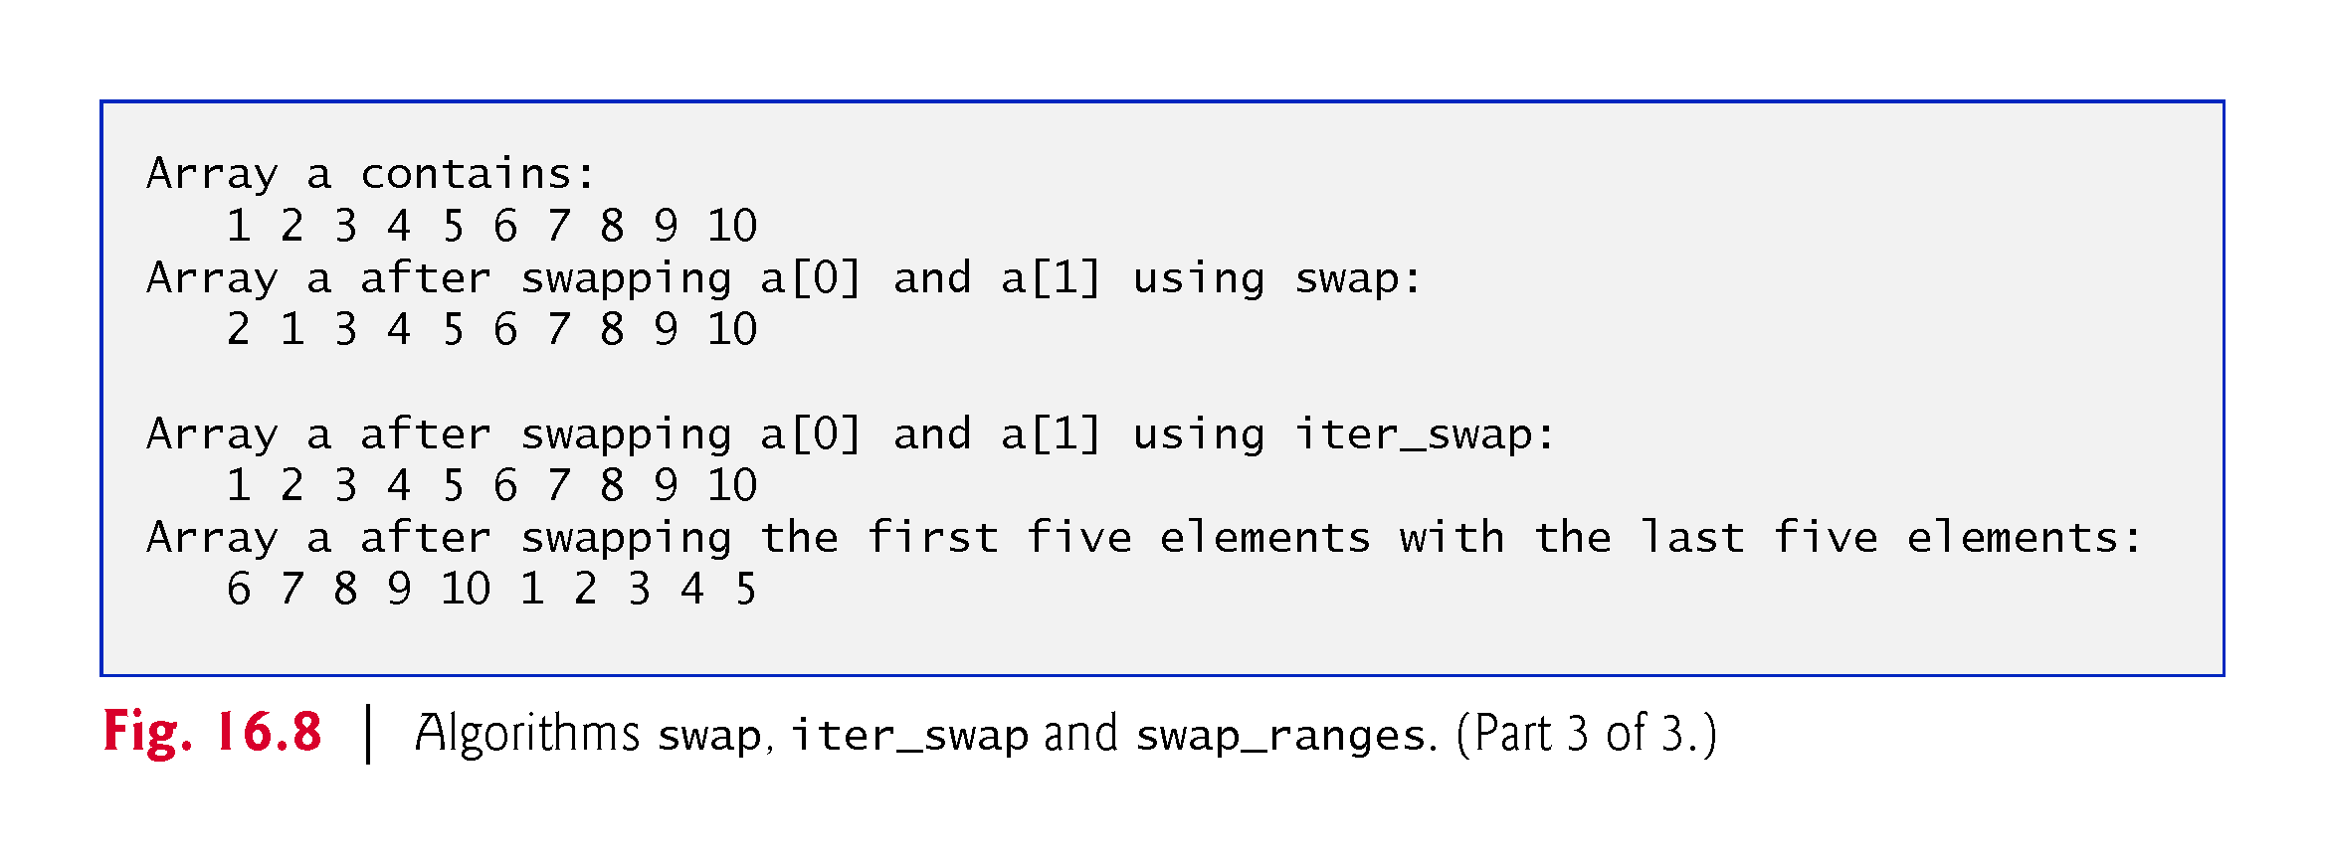

Slide 107
16.4.7 swap, iter_swap and swap_ranges
Line 17 uses the swap algorithm to exchange two values.
In this example, the first and second elements of array a are exchanged.
The function takes as arguments references to the two values being exchanged.

Slide 108
16.4.7 swap, iter_swap and swap_ranges (Cont.)
iter_swap Algorithm
Line 23 uses iter_swap to exchange the two elements.
The function takes two forward iterator arguments (in this case, iterators to elements of an array) and exchanges the values in the elements to which the iterators refer.
Line 29 uses swap_ranges to exchange the elements from a.begin() up to, but not including, a.begin() + 5 with the elements beginning at position a.begin() + 5.

Slide 109
16.4.7 swap, iter_swap and swap_ranges (Cont.)
The function requires three forward iterator arguments.
The first two arguments specify the range of elements in the first sequence that will be exchanged with the elements in the second sequence starting from the iterator in the third argument.
In this example, the two sequences of values are in the same array, but the sequences can be from different arrays or containers.
The sequences must not overlap.
The destination sequence must be large enough to contain all the elements of the ranges being swapped.

Slide 110
16.4.8 copy_backward, merge, unique and reverse
Figure 16.9 demonstrates algorithms copy_backward, merge, unique and reverse.

Slide 111
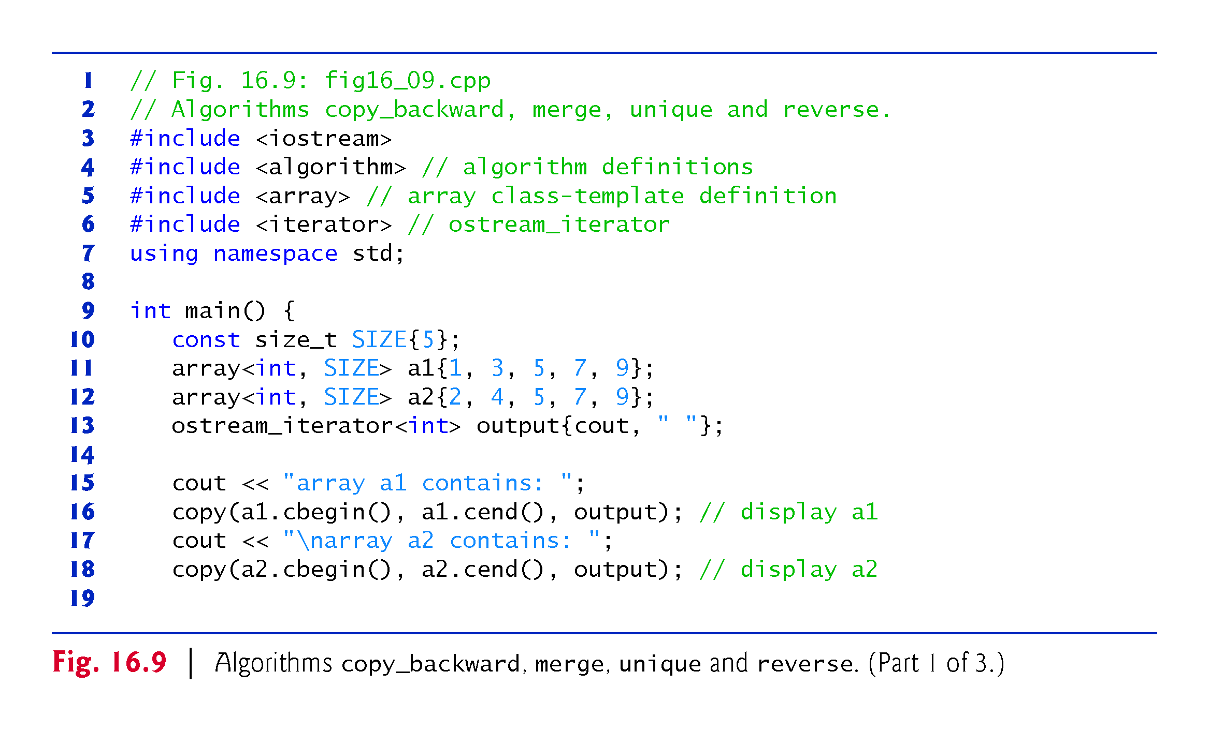

Slide 112
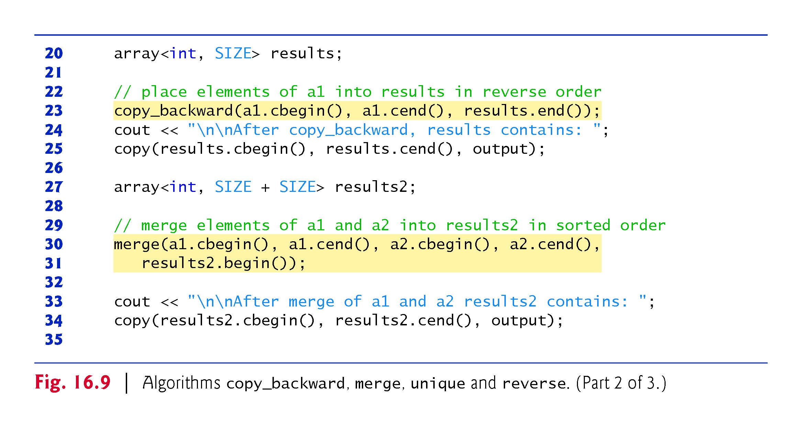

Slide 113
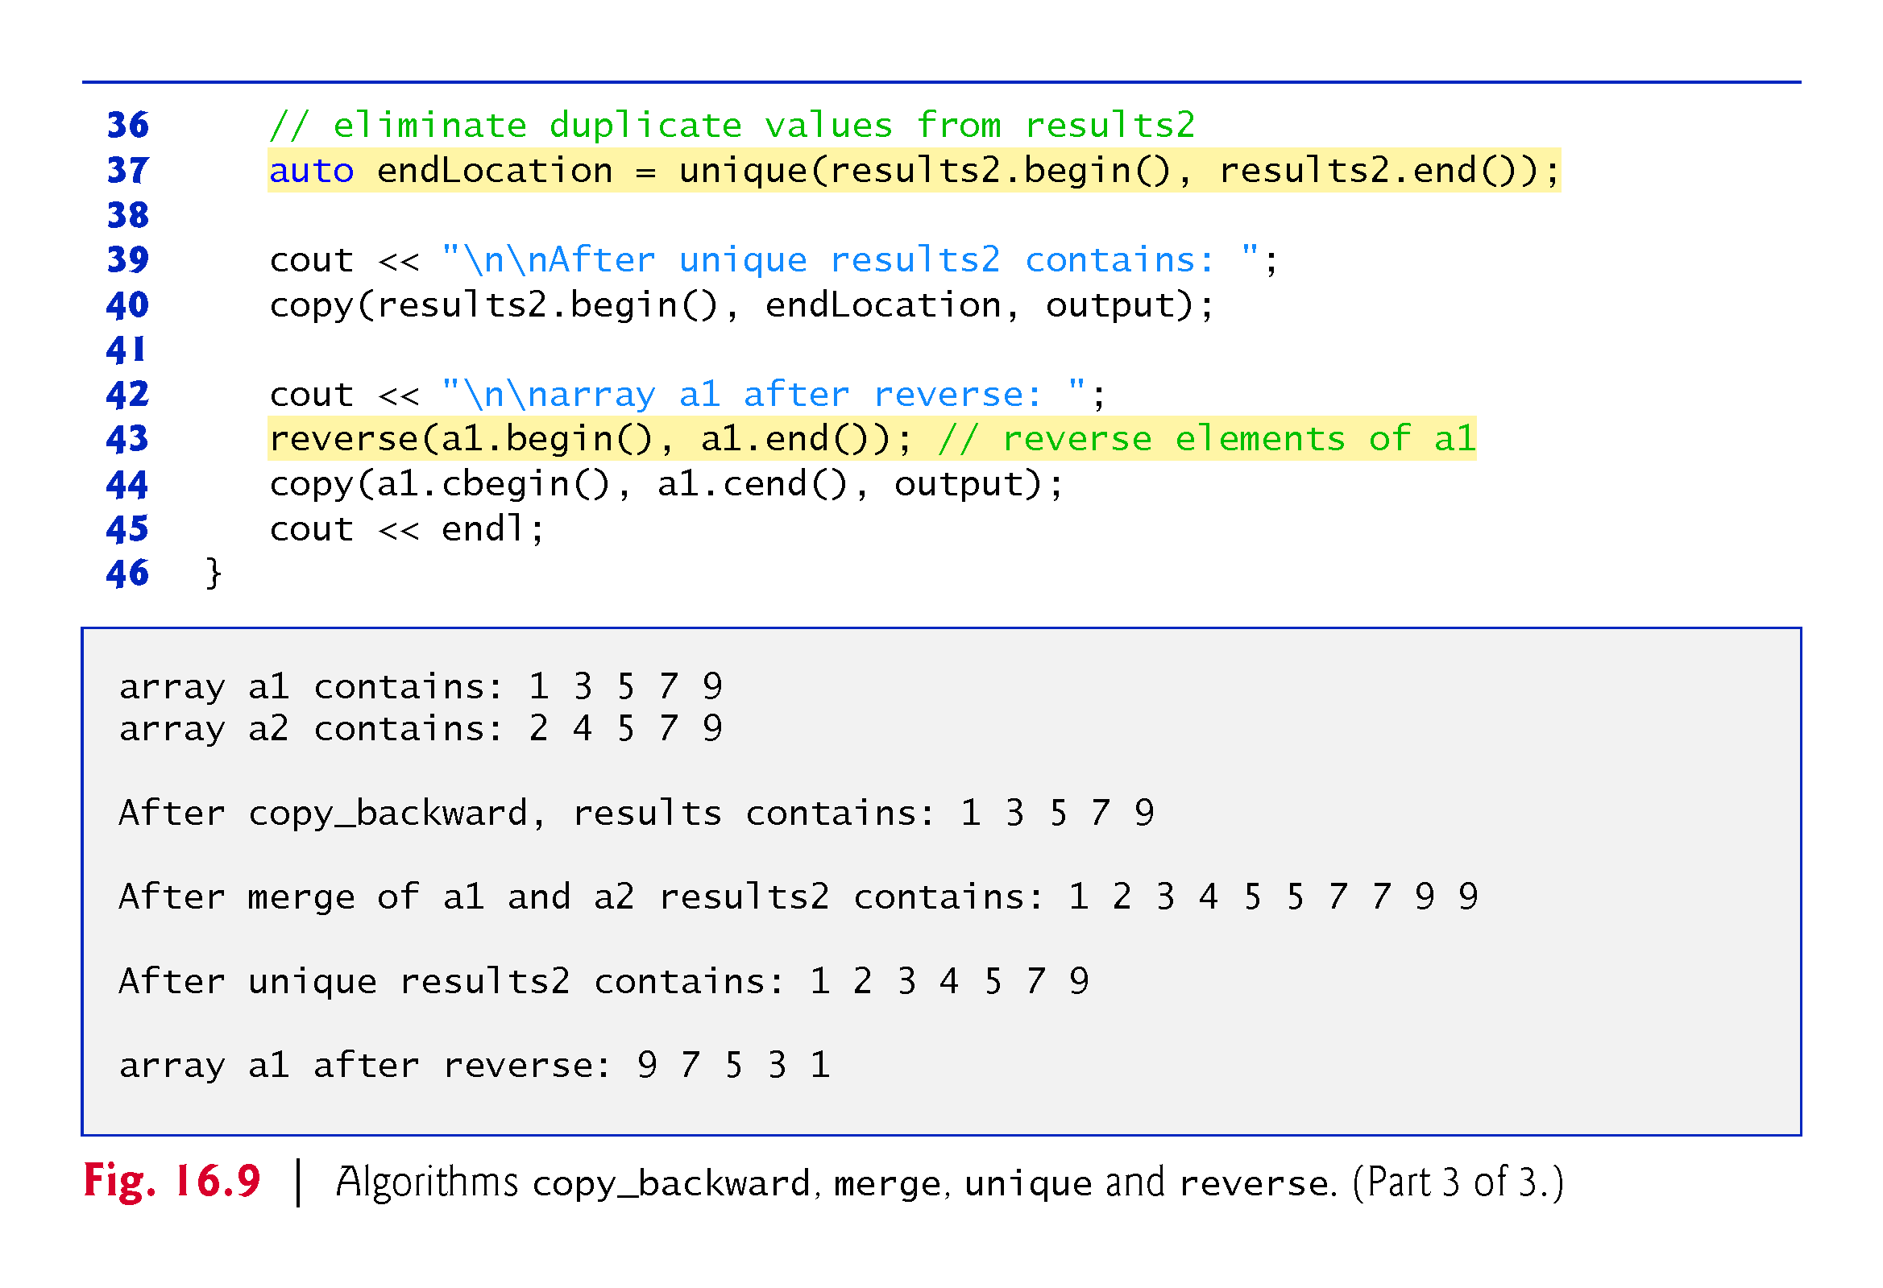

Slide 114
16.4.8 copy_backward, merge, unique and reverse
copy_backward Algorithm
Line 23 uses the copy_backward algorithm to copy elements in the range from a1.cbegin() up to, but not including, a1.cend(), placing the elements in results by starting from the element before results.end() and working toward the beginning of the array.
The algorithm returns an iterator positioned at the last element copied into the results (i.e., the beginning of results, because of the backward copy).
The elements are placed in results in the same order as a1.

Slide 115
16.4.8 copy_backward, merge, unique and reverse (Cont.)
This algorithm requires three bidirectional iterator arguments (iterators that can be incremented and decremented to iterate forward and backward through a sequence, respectively).
One difference between copy_backward and copy is that the iterator returned from copy is positioned after the last element copied and the one returned from copy_backward is positioned at the last element copied (i.e., the first element in the sequence).
Also, copy_backward can manipulate overlapping ranges of elements in a container as long as the first element to copy is not in the destination range of elements.

Slide 116
16.4.8 copy_backward, merge, unique and reverse (Cont.)
In addition to the copy and copy_backward algorithms, C++11’s move and move_backward algorithms use move semantics (discussed in Chapter 24, C++11: Additional Features) to move, rather than copy, objects from one container to another.

Slide 117
16.4.8 copy_backward, merge, unique and reverse (Cont.)
merge Algorithm
Lines 30-31 use the merge algorithm to combine two sorted ascending sequences of values into a third sorted ascending sequence.
The algorithm requires five iterator arguments.
The first four must be at least input iterators and the last must be at least an output iterator.
The first two arguments specify the range of elements in the first sorted sequence (a1), the second two arguments specify the range of elements in the second sorted sequence (a2) and the last argument specifies the starting location in the third sequence (results2) where the elements will be merged.
A second version of this algorithm takes as its sixth argument a binary predicate function that specifies the sorting order by comparing its two arguments and returning true if the first is less than the second.

Slide 118
16.4.8 copy_backward, merge, unique and reverse (Cont.)
back_inserter, front_inserter and inserter Iterator Adapters
Line 27 dreates the array results2 with the total number of elements in both a1 and a2.
Using the merge algorithm requires that the sequence where the results are stored be at least the sum of the sizes of the sequences being merged.
If you do not want to allocate the number of elements for the resulting sequence before the merge operation, you can use a dynamically growable vector and the following statements:
vector<int> results2; merge(a1.begin(), a1.end(), a2.begin(), a2.end(), back_inserter(results2));

Slide 119
16.4.8 copy_backward, merge, unique and reverse (Cont.)
The argument back_inserter(results2) uses function template back_in-serter (header <iterator>) for the vector results2.
A back_in-serter calls the container’s default push_back function to insert an element at the end of the container.
If an element is inserted into a container that has no more space available, the container grows in size—which is why we used a vector in the preceding statements, because arrays are fixed size.
Thus, the number of elements in the container does not have to be known in advance.

Slide 120
16.4.8 copy_backward, merge, unique and reverse (Cont.)
There are two other inserters—front_inserter (uses push_front to insert an element at the beginning of a container specified as its argument) and inserter (uses insert to insert an element at the iterator supplied as its second argument in the container supplied as its first argument).

Slide 121
16.4.8 copy_backward, merge, unique and reverse (Cont.)
unique Algorithm
Line 37 uses the unique algorithm on the sorted sequence of elements in the range from results2.begin() up to, but not including, results2.end().
After this algorithm is applied to a sorted sequence with duplicate values, only a single copy of each value remains in the sequence.
The algorithm takes two arguments that must be at least forward iterators.

Slide 122
16.4.8 copy_backward, merge, unique and reverse (Cont.)
The algorithm returns an iterator positioned after the last element in the sequence of unique values.
The values of all elements in the container after the last unique value are undefined and should not be used.
An overloaded version of this algorithm receives as a third argument a binary predicate function specifying how to compare two elements for equality.

Slide 123
16.4.8 copy_backward, merge, unique and reverse (Cont.)
reverse Algorithm
Line 43 uses the reverse algorithm to reverse all the elements in the range from a1.begin() up to, but not including, a1.end().
The algorithm takes two arguments that must be at least bidirectional iterators.

Slide 124
16.4.8 copy_backward, merge, unique and reverse (Cont.)
C++11: copy_if and copy_n Algorithms
The copy_if algorithm copies each element from a range if the unary predicate function in its fourth argument returns true for that element.
The iterators supplied as the first two arguments must be input iterators.
The iterator supplied as the third argument must be an output iterator so that the element being copied can be written into the destination container.
This algorithm returns an iterator positioned after the last element copied.
The copy_n algorithm copies the number of elements specified by its second argument from the location specified by its first argument (an input iterator).
The elements are output to the location specified by its third argument (an output iterator).

Slide 125
16.4.9 inplace_merge, unique_copy and reverse_copy
Figure 16.10 demonstrates algorithms inplace_merge, unique_copy and reverse_copy.

Slide 126
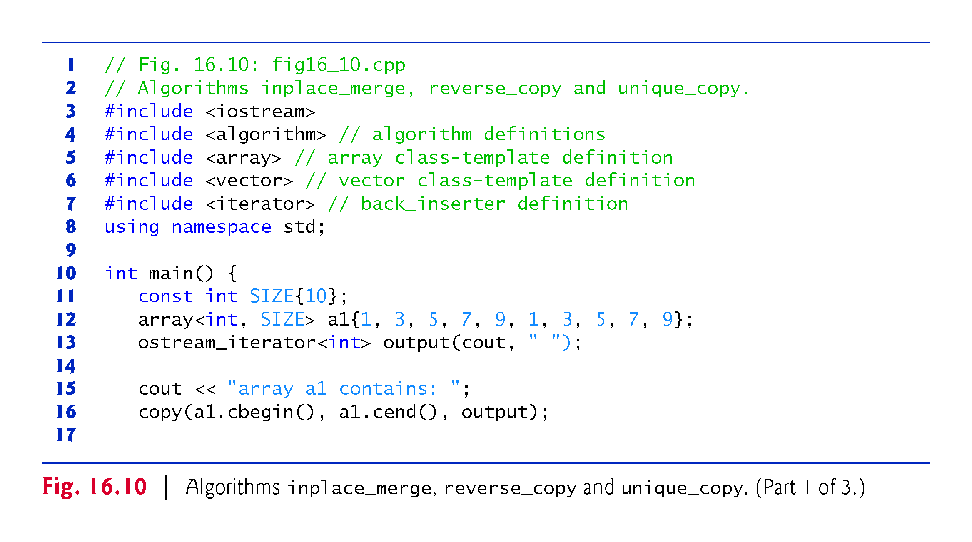

Slide 127
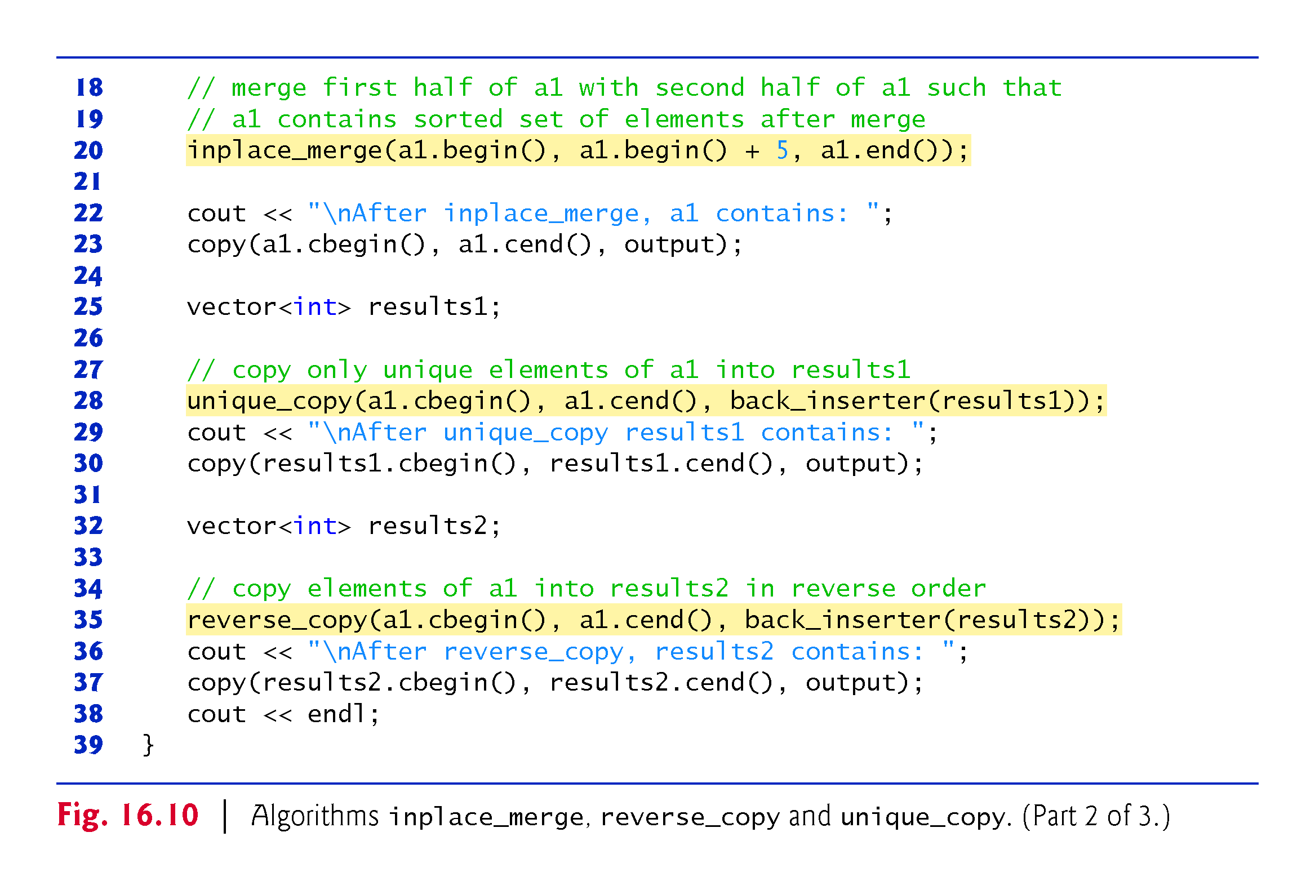

Slide 128
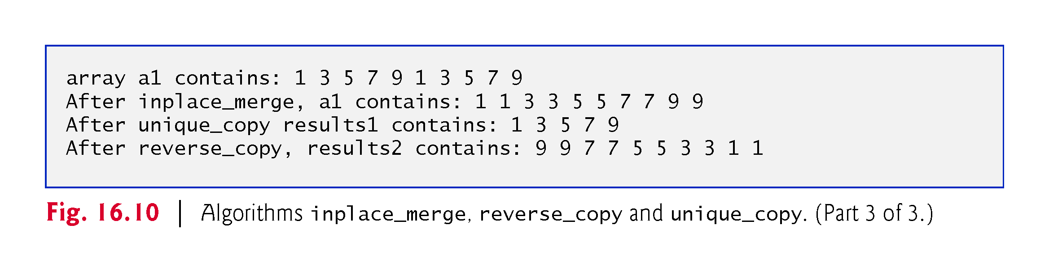

Slide 129
16.4.9 inplace_merge, unique_copy and reverse_copy (Cont.)
inplace_merge Algorithm
Line 20 uses the inplace_merge algorithm to merge two sorted sequences of elements in the same container.
In this example, the elements from a1.begin() up to, but not including, a1.begin() + 5 are merged with the elements from a1.begin() + 5 up to, but not including, a1.end().
This algorithm requires its three iterator arguments to be at least bidirectional iterators.
A second version of this algorithm takes as a fourth argument a binary predicate function for comparing elements in the two sequences.

Slide 130
16.4.9 inplace_merge, unique_copy and reverse_copy (Cont.)
unique_copy Algorithm
Line 28 uses the unique_copy algorithm to make a copy of all the unique elements in the sorted sequence of values from a1.cbegin() up to, but not including, a1.cend().
The copied elements are placed into vector results1.
The first two arguments must be at least input iterators and the last must be at least an output iterator.
In this example, we did not preallocate enough elements in results1 to store all the elements copied from a1.
Instead, we use function back_inserter (defined in header <iterator>) to add elements to the end of results1.

Slide 131
16.4.9 inplace_merge, unique_copy and reverse_copy (Cont.)
The back_inserter uses vector’s push_back member function to insert elements at the end of the vector.
Because the back_inserter inserts an element rather than replacing an existing element’s value, the vector is able to grow to accommodate additional elements.
A second version of the unique_copy algorithm takes as a fourth argument a binary predicate function for comparing elements for equality.

Slide 132
16.4.9 inplace_merge, unique_copy and reverse_copy (Cont.)
reverse_copy Algorithm
Line 35 uses the reverse_copy algorithm to make a reversed copy of the elements in the range from a1.cbegin() up to, but not including, a1.cend().
The copied elements are inserted into results2 using a back_inserter object to ensure that the vector can grow to accommodate the appropriate number of elements copied.
Algorithm reverse_copy requires its first two iterator arguments to be at least bidirectional iterators and its third to be at least an output iterator.

Slide 133
16.4.10 Set Operations
Figure 16.11 demonstrates algorithms includes, set_difference, set_intersection, set_symmetric_difference and set_union for manipulating sets of sorted values.

Slide 134
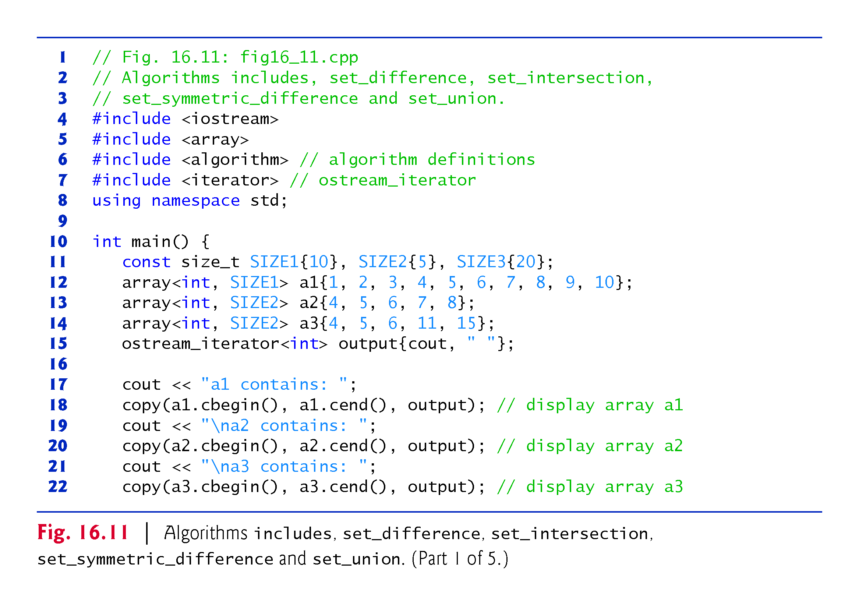

Slide 135
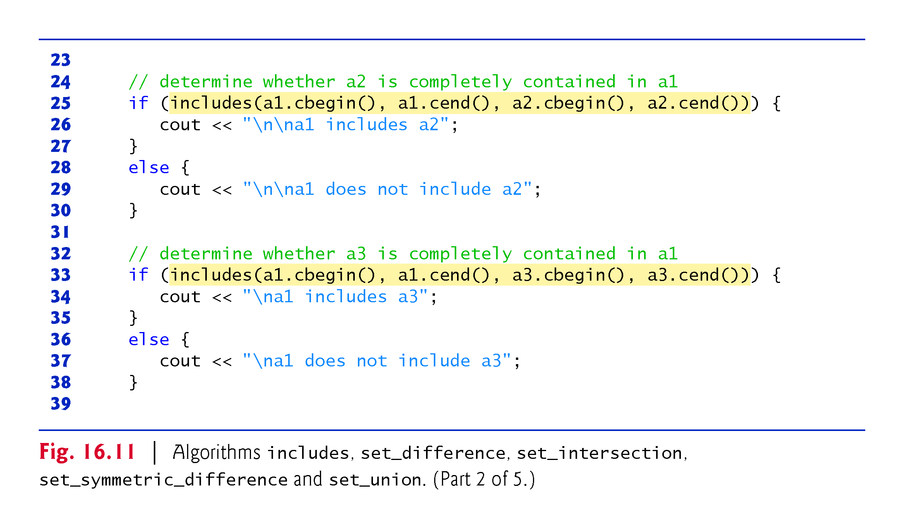

Slide 136
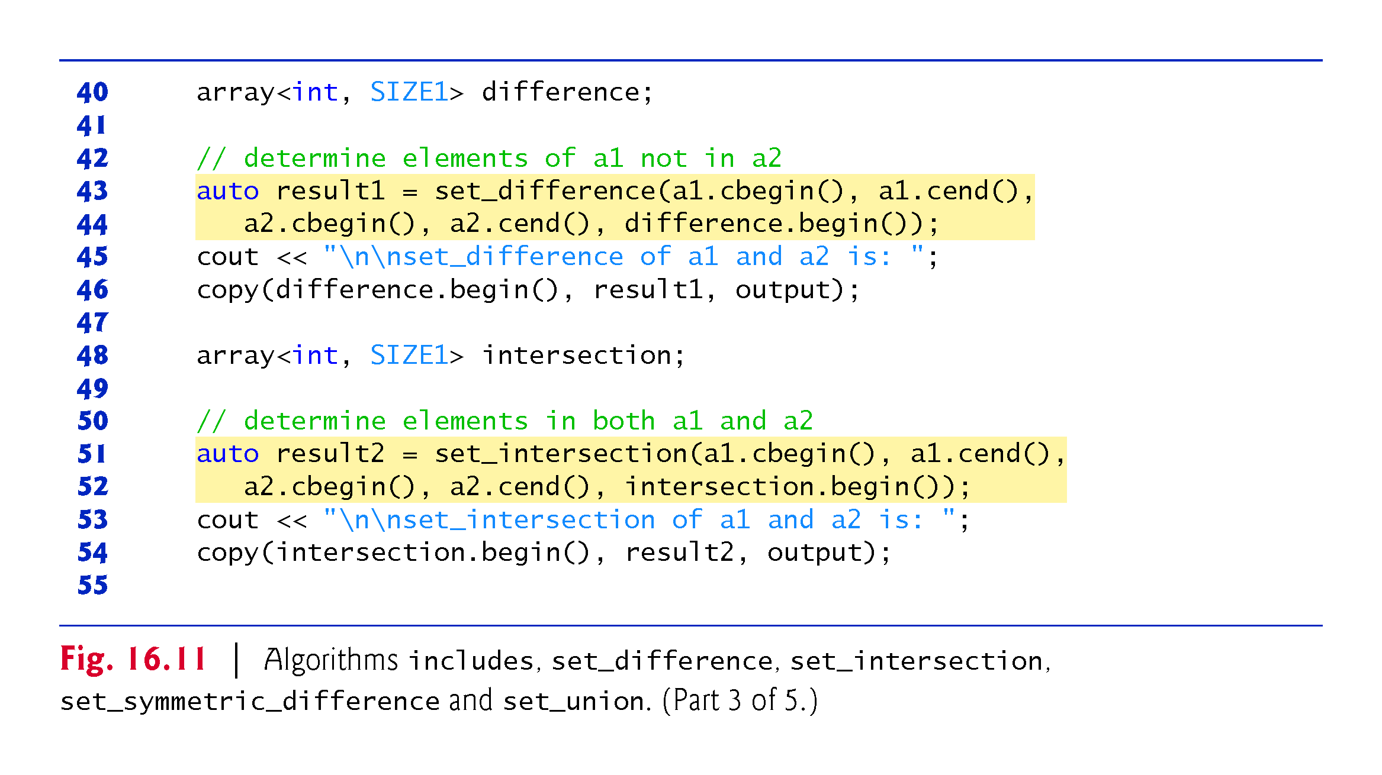

Slide 137


Slide 138


Slide 139
16.4.10 Set Operations
includes Algorithm
Lines 25 and 33 call the includes algorithm which compares two sets of sorted values to determine whether every element of the second set is in the first set.
If so, includes returns true; otherwise, it returns false.
The first two iterator arguments must be at least input iterators and must describe the first set of values.
In line 25, the first set consists of the elements from a1.cbegin() up to, but not including, a1.cend().

Slide 140
16.4.10 Set Operations (Cont.)
The last two iterator arguments must be at least input iterators and must describe the second set of values.
In this example, the second set consists of the elements from a2.cbegin() up to, but not including, a2.cend().
An overloaded version of algorithm includes takes a fifth argument that is a binary predicate function indicating whether its first argument is less than its second.
The two sequences must be sorted using the same comparison function.

Slide 141
16.4.10 Set Operations (Cont.)
set_difference Algorithm
Lines 43-44 use the set_difference algorithm to find the elements from the first set of sorted values that are not in the second set of sorted values (both sets of values must be in ascending order).
The elements that are different are copied into the fifth argument (in this case, the array difference).
The first two iterator arguments must be at least input iterators for the first set of values.
The next two iterator arguments must be at least input iterators for the second set of values.
The fifth argument must be at least an output iterator indicating where to store a copy of the values that are different.

Slide 142
16.4.10 Set Operations (Cont.)
The algorithm returns an output iterator positioned immediately after the last value copied into the set to which the fifth argument points.
An overloaded version of set_difference takes a sixth argument that is a binary predicate function indicating whether its first argument is less than its second.
The two sequences must be sorted using the same comparison function.

Slide 143
16.4.10 Set Operations (Cont.)
set_intersection Algorithm
Lines 51-52 use the set_intersection algorithm to determine the elements from the first set of sorted values that are in the second set of sorted values (both sets of values must be in ascending order).
The elements common to both sets are copied into the fifth argument (in this case, array intersection).
The first two iterator arguments must be at least input iterators for the first set of values.

Slide 144
16.4.10 Set Operations (Cont.)
The next two iterator arguments must be at least input iterators for the second set of values.
The fifth argument must be at least an output iterator indicating where to store a copy of the values that are the same.
The algorithm returns an output iterator positioned immediately after the last value copied into the set to which the fifth argument points.
A second version of set_intersection takes a sixth argument that is a binary predicate function indicating the order in which the elements were originally sorted.
The two sequences must be sorted using the same comparison function.

Slide 145
16.4.10 Set Operations (Cont.)
set_symmetric_difference Algorithm
Lines 60-61 use the set_symmetric_difference algorithm to determine the elements in the first set that are not in the second set and the elements in the second set that are not in the first set (both sets must be in ascending order).
The elements that are different are copied from both sets into the fifth argument (the array symmetric_difference).

Slide 146
16.4.10 Set Operations (Cont.)
The first two iterator arguments must be at least input iterators for the first set of values.
The next two iterator arguments must be at least input iterators for the second set of values.
The fifth argument must be at least an output iterator indicating where to store a copy of the values that are different.
The algorithm returns an output iterator positioned immediately after the last value copied into the set to which the fifth argument points.
An overloaded version of set_symmetric_difference takes a sixth argument that is a binary predicate function indicating whether its first argument is less than its second.
The two sequences must be sorted using the same comparison function.

Slide 147
16.4.10 Set Operations (Cont.)
set_union Algorithm
Lines 68-69 use the set_union algorithm to create a set of all the elements that are in either or both of the two sorted sets (both sets of values must be in ascending order).
The elements are copied from both sets into the fifth argument (in this case the array unionSet).
Elements that appear in both sets are copied only from the first set.
The first two iterator arguments must be at least input iterators for the first set of values.

Slide 148
16.4.10 Set Operations (Cont.)
The next two iterator arguments must be at least input iterators for the second set of values.
The fifth argument must be at least an output iterator indicating where to store the copied elements.
The algorithm returns an output iterator positioned immediately after the last value copied into the set to which the fifth argument points.
An overloaded version of set_union takes a sixth argument that is a binary predicate function indicating whether its first argument is less than its second.
The two sequences must be sorted using the same comparison function.

Slide 149
16.4.11 lower_bound, upper_bound and equal_range
Figure 16.12 demonstrates functions lower_bound, upper_bound and equal_range.

Slide 150


Slide 151


Slide 152


Slide 153


Slide 154


Slide 155
16.4.11 lower_bound, upper_bound and equal_range (cont.)
lower_bound Algorithm
Line 19 uses the lower_bound algorithm to find the first location in a sorted sequence of values at which the third argument could be inserted in the sequence such that the sequence would still be sorted in ascending order.
The first two iterator arguments must be at least forward iterators.
The third argument is the value for which to determine the lower bound.

Slide 156
16.4.11 lower_bound, upper_bound and equal_range (Cont.)
The algorithm returns a forward iterator pointing to the position at which the insert can occur.
A second version of lower_bound takes as a fourth argument a binary predicate function indicating the order in which the elements were originally sorted.

Slide 157
16.4.11 lower_bound, upper_bound and equal_range (Cont.)
upper_bound Algorithm
Line 24 uses the upper_bound algorithm to find the last location in a sorted sequence of values at which the third argument could be inserted in the sequence such that the sequence would still be sorted in ascending order.
The first two iterator arguments must be at least forward iterators.
The third argument is the value for which to determine the upper bound.
The algorithm returns a forward iterator pointing to the position at which the insert can occur.
A second version of upper_bound takes as a fourth argument a binary predicate function indicating the order in which the elements were originally sorted.

Slide 158
16.4.11 lower_bound, upper_bound and equal_range (Cont.)
equal_range Algorithm
Line 30 uses the equal_range algorithm to return a pair of forward iterators containing the results of performing both a lower_bound and an upper_bound operation.
The first two arguments must be at least forward iterators.
The third is the value for which to locate the equal range.
The algorithm returns a pair of forward iterators for the lower bound (eq.first) and upper bound (eq.second), respectively.

Slide 159
16.4.11 lower_bound, upper_bound and equal_range (Cont.)
Locating Insertion Points in Sorted Sequences
Algorithms lower_bound, upper_bound and equal_range are often used to locate insertion points in sorted sequences.
Line 39 uses lower_bound to locate the first point at which 5 can be inserted in order in a.
Line 46 uses upper_bound to locate the last point at which 7 can be inserted in order in a.
Line 54 uses equal_range to locate the first and last points at which 5 can be inserted in order in a.

Slide 160
16.3.12 min, max, minmax and minmax_element
Figure 16.13 demonstrates min, max, minmax and minmax_element.

Slide 161


Slide 162


Slide 163


Slide 164
16.4.12 min, max, minmax and minmax_element (cont.)
Algorithms min and max (demonstrated in lines 9–12) determine the minimum and the maximum of two elements, respectively.

Slide 165
16.4.12 min, max, minmax and minmax_element (cont.)
C++11: min and max Algorithms with initializer_list Parameters
C++11 added overloaded versions of the algorithms min and max that each receive an initializer_list parameter and return the smallest or largest item in the list initializer that’s passed as an argument.
For example, the following statement returns 7:
int minumum = min({10, 7, 14, 21, 17});
Each of these new min and max algorithms is overloaded with a version that takes as a second argument a binary predicate function for determining whether the first argument is less than the second.

Slide 166
16.4.12 min, max, minmax and minmax_element (cont.)
C++11: minmax
C++11 also added the minmax algorithm (line 15) that receives two items and returns a pair in which the smaller item is stored in first and the larger item is stored in second.
A second version of this algorithm takes as a third argument a binary predicate function for determining whether the first argument is less than the second.

Slide 167
16.4.12 min, max, minmax and minmax_element (cont.)
C++11: minmax_element
C++11 added the minmax_element algorithm (line 25) that receives two input iterators representing a range of elements and returns a pair of iterators in which first points to the smallest element in the range and second points to the largest.
A second version of this algorithm takes as a third argument a binary predicate function for determining whether the first argument is less than the second.

Slide 168
16.5 Function Objects
Many Standard Library algorithms allow you to pass a function pointer into the algorithm to help the algorithm perform its task.
For example, the binary_search algorithm that we discussed in Section 16.3.6 is overloaded with a version that requires as its fourth parameter a function pointer that takes two arguments and returns a bool value.
The algorithm uses this function to compare the search key to an element in the collection.
The function returns true if the search key and element being compared are equal; otherwise, the function returns false.

Slide 169
16.5 Function Objects (Cont.)
This enables binary_search to search a collection of elements for which the element type does not provide an overloaded equality < operator.
Any algorithm that can receive a lambda or function pointer can also receive an object of a class that overloads the function-call operator (parentheses) with a function named operator(), provided that the overloaded operator meets the requirements of the algorithm—in the case of binary_search, it must receive two arguments and return a bool.

Slide 170
16.5 Function Objects (Cont.)
An object of such a class is known as a function object and can be used syntactically and semantically like a lambda, a function or a function pointer—the overloaded parentheses operator is invoked by using a function object’s name followed by parentheses containing the arguments to the function.
Most algorithms can use lambdas, function pointers and function objects and functions interchangeably.

Slide 171
16.5 Function Objects (Cont.)
Advantages of Function Objects Over Function Pointers
Function objects provide several advantages over function pointers.
The compiler sometimes can inline a function object’s overloaded operator() to improve performance.
Also, since they’re objects of classes, function objects can have data members that operator() can use to perform its task.

Slide 172
16.5 Function Objects (Cont.)
Predefined Function Objects of the Standard Template Library
Many predefined function objects can be found in the header <functional>.
Figure 16.14 lists several of the dozens of Standard Library function objects, which are all implemented as class templates.
Complete list at
http://en.cppreference.com/w/cpp/utility/functional
We used the function object less<T> in the set and multiset examples.
Recall that many of the overloaded Standard Library algorithms can receive as their last argument a binary function that determines whether its first argument is less than its second—exactly the purpose of the less<T> function object.

Slide 173


Slide 174
16.5 Function Objects (Cont.)
Using the accumulate Algorithm
Figure 16.15 uses the accumulate numeric algorithm (introduced in Fig. 16.30) to calculate the sum of the squares of the elements in an array.
The fourth argument to accumulate is a binary function object (that is, a function object for which operator() takes two arguments) or a function pointer to a binary function (that is, a function that takes two arguments).
Function accumulate is demonstrated three times—once with a function pointer, once with a function object and ones with a lambda.

Slide 175


Slide 176


Slide 177


Slide 178


Slide 179


Slide 180
16.5 Function Objects (Cont.)
Function sumSquares
Lines 13–15 define a function sumSquares that squares its second argument value, adds that square and its first argument total and returns the sum.
Function accumulate will pass each of the elements of the sequence over which it iterates as the second argument to sumSquares in the example.
On the first call to sumSquares, the first argument will be the initial value of the total (which is supplied as the third argument to accumulate; 0 in this program).
All subsequent calls to sumSquares receive as the first argument the running sum returned by the previous call to sumSquares.
When accumulate completes, it returns the sum of the squares of all the elements in the sequence.

Slide 181
16.5 Function Objects (Cont.)
Class SumSquaresClass
Lines 20–27 define SumSquaresClass with an overloaded operator() that has two parameters and returns a value—the requirements for a binary function object.
On the first call to the function object, the first argument will be the initial value of the total (which is supplied as the third argument to accumulate; 0 in this program) and the second argument will be the first element in array integers.
All subsequent calls to operator() receive as the first argument the result returned by the previous call to the function object, and the second argument will be the next element in the array.
When accumulate completes, it returns the sum of the squares of all the elements in the array.

Slide 182
16.5 Function Objects (Cont.)
Passing Function Pointers and Function Objects to Algorithm accumulate
Lines 39–40 call function accumulate with a pointer to function sumSquares as its last argument.
Similarly, the statement in lines 47–48 calls accumulate with an object of class SumSquaresClass as the last argument.
Finally, lines 55–56 call accumulate with an equivalent lambda.
The expression SumSquaresClass<int>() creates (and calls the default constructor for) an instance of class SumSquaresClass (a function object) that is passed to accumulate, which invokes function operator().

Slide 183
16.5 Function Objects (Cont.)
Lines 47-48 could be written as two separate statements, as follows:
SumSquaresClass<int> sumSquaresObject; result = accumulate(integers.cbegin(), integers.cend(), 0, sumSquaresObject);
The first line defines an object of class SumSquaresClass.
That object is then passed to function accumulate.

Slide 184
16.6 Standard Library Algorithm Summary
The C++ standard specifies over 90 algorithms—many overloaded with two or more versions.
The standard separates the algorithms into several categories
mutating sequence algorithms
nonmodifying sequence algorithms
sorting and related algorithms
generalized numeric operations.
To learn about the algorithms that we did not present in this chapter, see your compiler’s documentation or visit sites such as
en.cppreference.com/w/cpp/algorithm

Slide 185
16.6 Standard Library Algorithm Summary (cont.)
Mutating Sequence Algorithms
Figure 16.16 shows many of the mutating-sequence algorithms—i.e., algorithms that modify the containers they operate on.
Algorithms added in C++11 are marked with an * in Figs. 16.17–16.20.
Algorithms presented in this chapter are shown in bold.

Slide 186


Slide 187
16.6 Standard Library Algorithm Summary (cont.)
Nonmodifying Sequence Algorithms
Figure 16.17 shows the nonmodifying sequence algorithms—i.e., algorithms that do not modify the containers they operate on.

Slide 188


Slide 189
16.6 Standard Library Algorithm Summary (cont.)
Sorting and Related Algorithms
Figure 16.18 shows the sorting and related algorithms.

Slide 190


Slide 191
16.6 Standard Library Algorithm Summary (cont.)
Numerical Algorithms
Figure 16.19 shows the numerical algorithms of the header <numeric>.

Slide 192


