Slide 1
Exception Handling: A Deeper Look
Based on Chapter 17 of C++ How to Program, 10/e

Slide 2
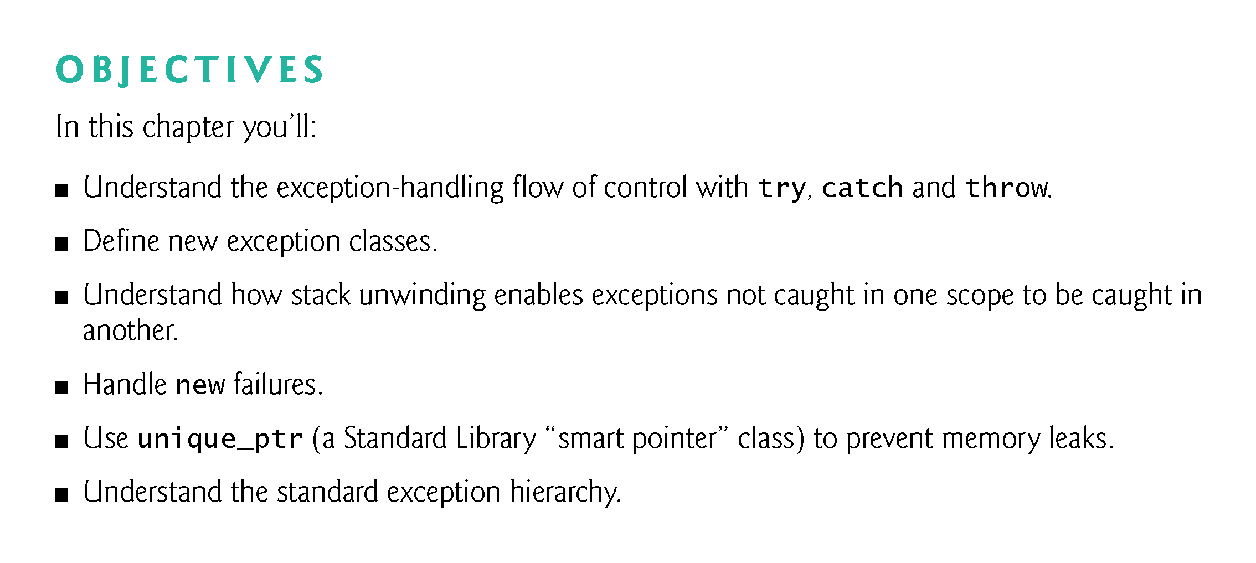

Slide 3
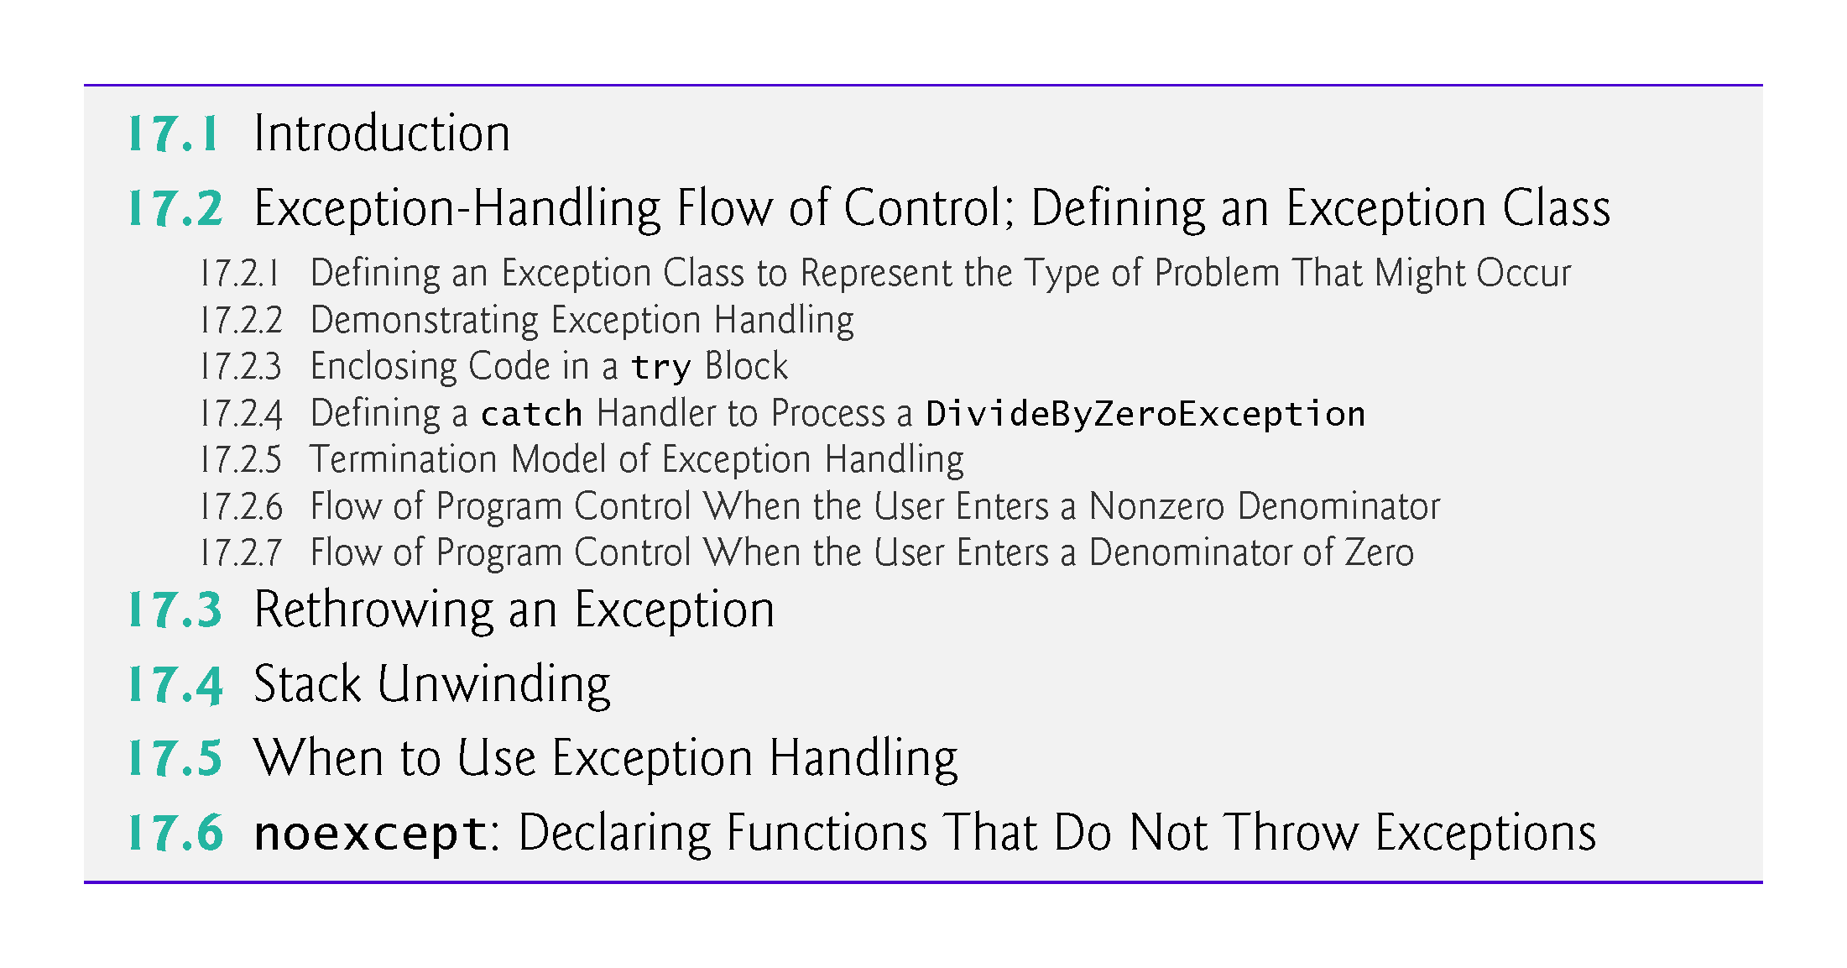

Slide 4
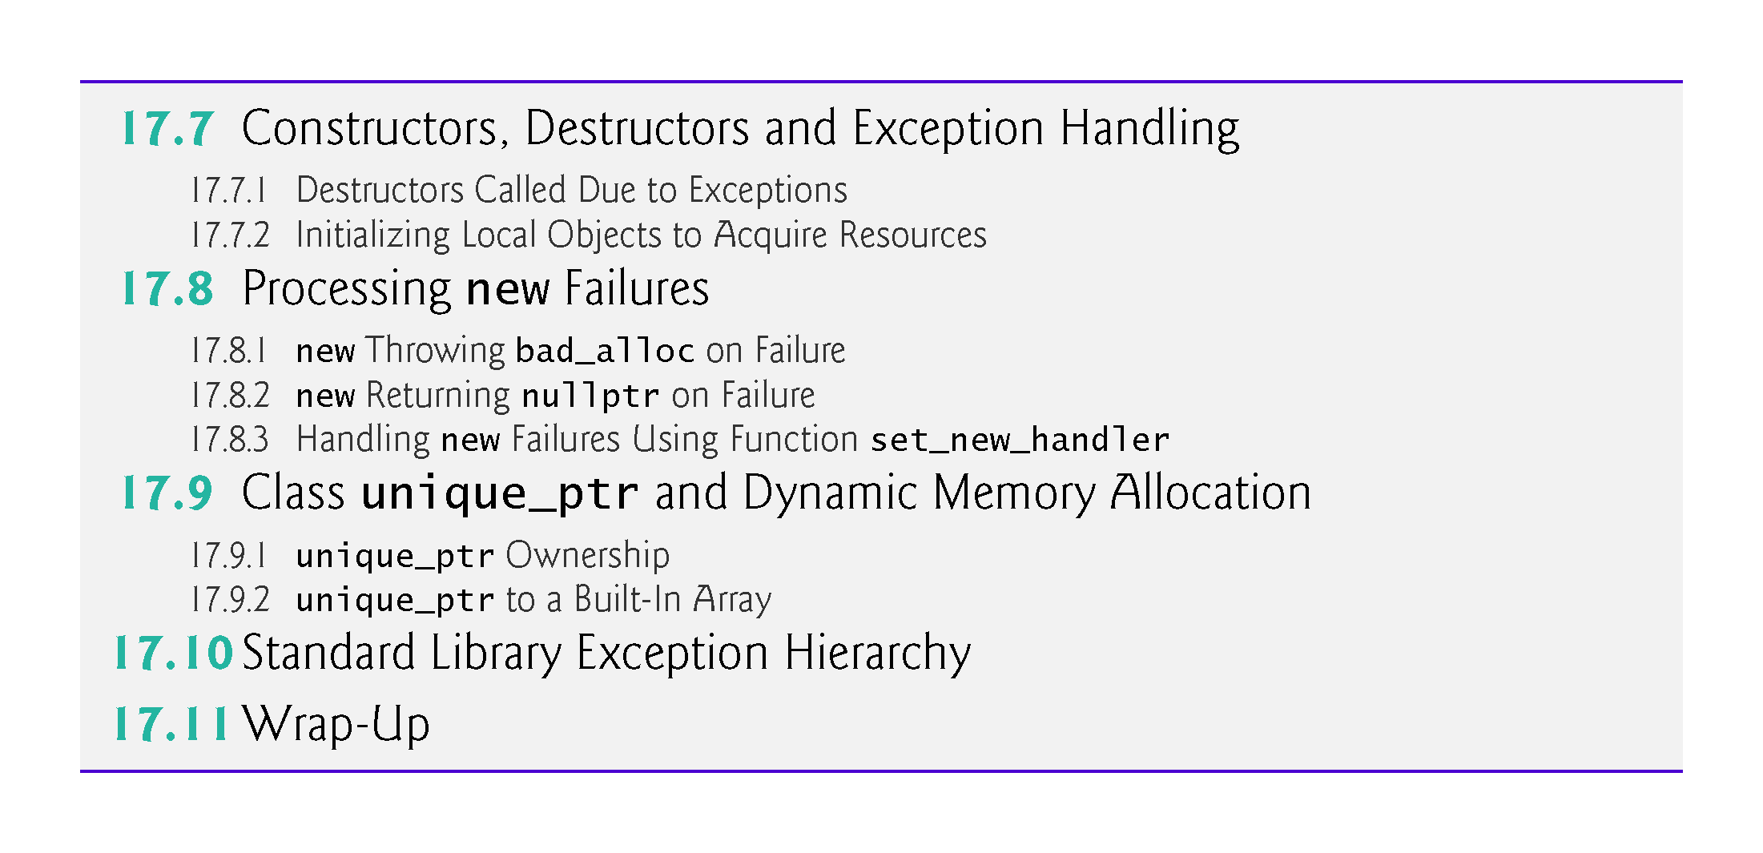

Slide 5
17.1 Introduction
An exception is an indication of a problem that occurs during a program’s execution.
Exception handling enables you to create applications that can handle exceptions and perform appropriate cleanup when an exception that cannot or should not be handled occurs.
In many cases, this allows a program to continue executing as if no problem had been encountered.
The features presented in this chapter enable you to write robust and fault-tolerant programs that can deal with problems that may arise and continue executing or terminate gracefully.

Slide 6
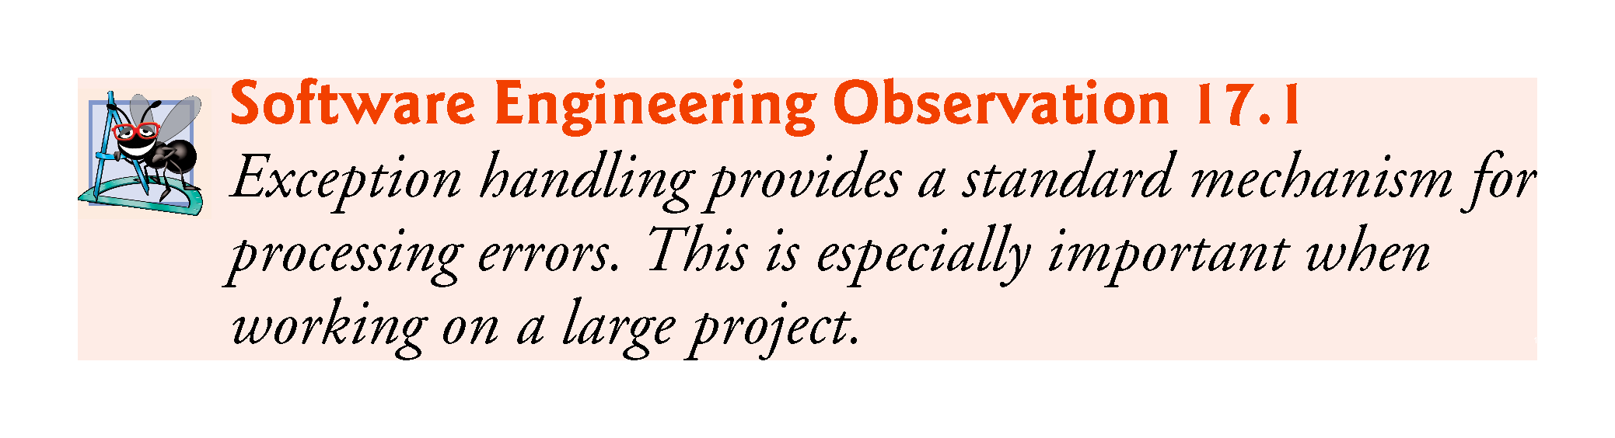

Slide 7
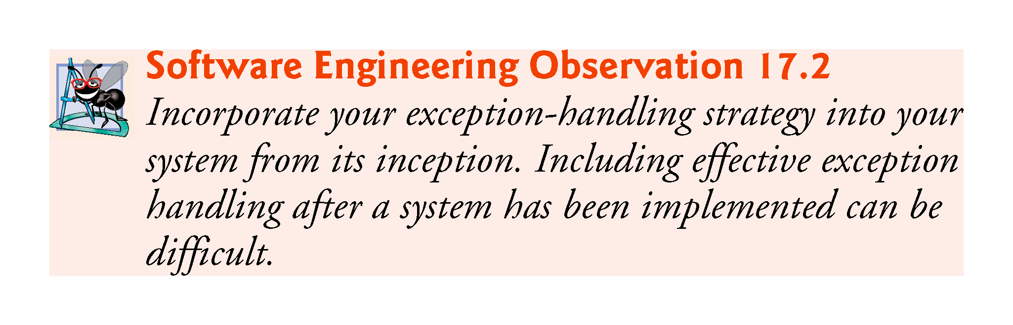

Slide 8
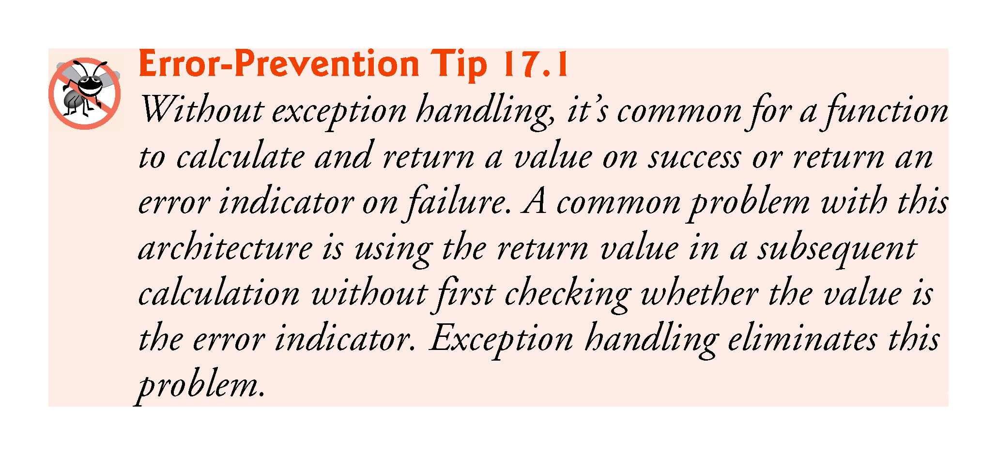

Slide 9
17.2 Exception Handling Flow of Control; Defining an Exception Class
Let’s consider a simple example of exception handling (Figs. 17.1–17.2).
We show how to deal with a common arithmetic problem—division by zero.
Division by zero using integer arithmetic typically causes a program to terminate prematurely.
In floating-point arithmetic, many C++ implementations allow division by zero, in which case positive or negative infinity is displayed as inf or -inf, respectively.
Typically, a program would simply test for division by zero before attempting the calculation—we use exceptions here to present the flow of control when a program executes successfully and when an exception occurs.

Slide 10
17.2 Example: Handling an Attempt to Divide by Zero (cont.)
In this example, we define a function named quotient that receives two integers entered by the user and divides its first int parameter by its second int parameter.
Before performing the division, the function casts the first int parameter’s value to type double.
Then, the second int parameter’s value is promoted to type double for the calculation.
So function quotient actually performs the division using two double values and returns a double result.

Slide 11
17.2 Example: Handling an Attempt to Divide by Zero (cont.)
For the purpose of this example we treat any attempt to divide by zero as an error.
Thus, function quotient tests its second parameter to ensure that it isn’t zero before allowing the division to proceed.
If the second parameter is zero, the function uses an exception to indicate to the caller that a problem occurred.
The caller (main in this example) can then process the exception and allow the user to type two new values before calling function quotient again.
In this way, the program can continue to execute even after an improper value is entered, thus making the program more robust.

Slide 12
17.2 Example: Handling an Attempt to Divide by Zero (cont.)
DivideByZeroException.h (Fig. 17.1) defines an exception class that represents the type of the problem that might occur in the example, and fig17_02.cpp (Fig. 17.2) defines the quotient function and the main function that calls it.
Function main contains the code that demonstrates exception handling.

Slide 13
17.2.1 Defining an Exception Class to Represent the Type of Problem That Might Occur
Figure 17.1 defines class DivideByZeroException as a derived class of Standard Library class runtime_error (from header file <stdexcept>).
Class runtime_error—a derived class of exception (from header file <exception>)—is the C++ standard base class for representing runtime errors.
Class exception is the standard C++ base class for exception in the C++ Standard Library.
Section 17.10 discusses class exception and its derived classes in detail.

Slide 14
17.2.1 Defining an Exception Class to Represent the Type of Problem That Might Occur
A typical exception class that derives from the runtime_error class defines only a constructor (e.g., lines 10–11) that passes an error-message string to the base-class runtime_error constructor.
Every exception class that derives directly or indirectly from exception contains the virtual function what, which returns an exception object’s error message.
You are not required to derive a custom exception class, such as DivideByZeroException, from the standard exception classes provided by C++.
Doing so allows you to use the virtual function what to obtain an appropriate error message and also allows you to polymorphically process the exceptions by catching a reference to the base-class type.
We use an object of this DivideByZeroException class in Fig. 17.2 to indicate when an attempt is made to divide by zero.

Slide 15
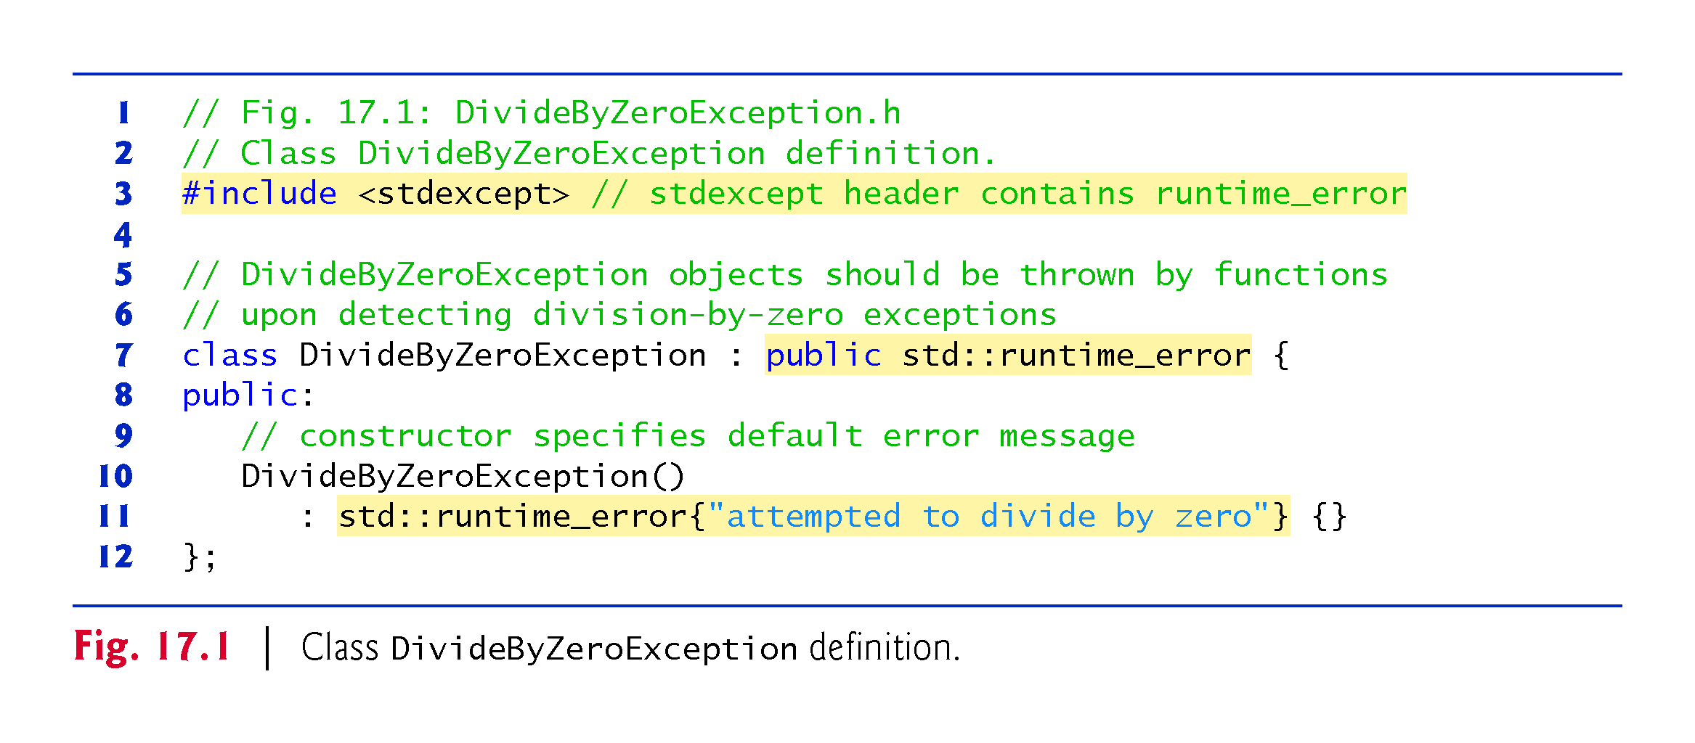

Slide 16
17.2.2 Demonstrating Exception Handling
Fig. 17.2 uses exception handling to wrap code that might throw a DivideByZeroException and to handle that exception, should one occur.
Function quotient divides its first parameter (numerator) by its second parameter (denominator).
Assuming that the user does not specify 0 as the denominator for the division, quotient returns the division result.
However, if the user inputs 0 for the denominator, function quotient throws an exception.

Slide 17
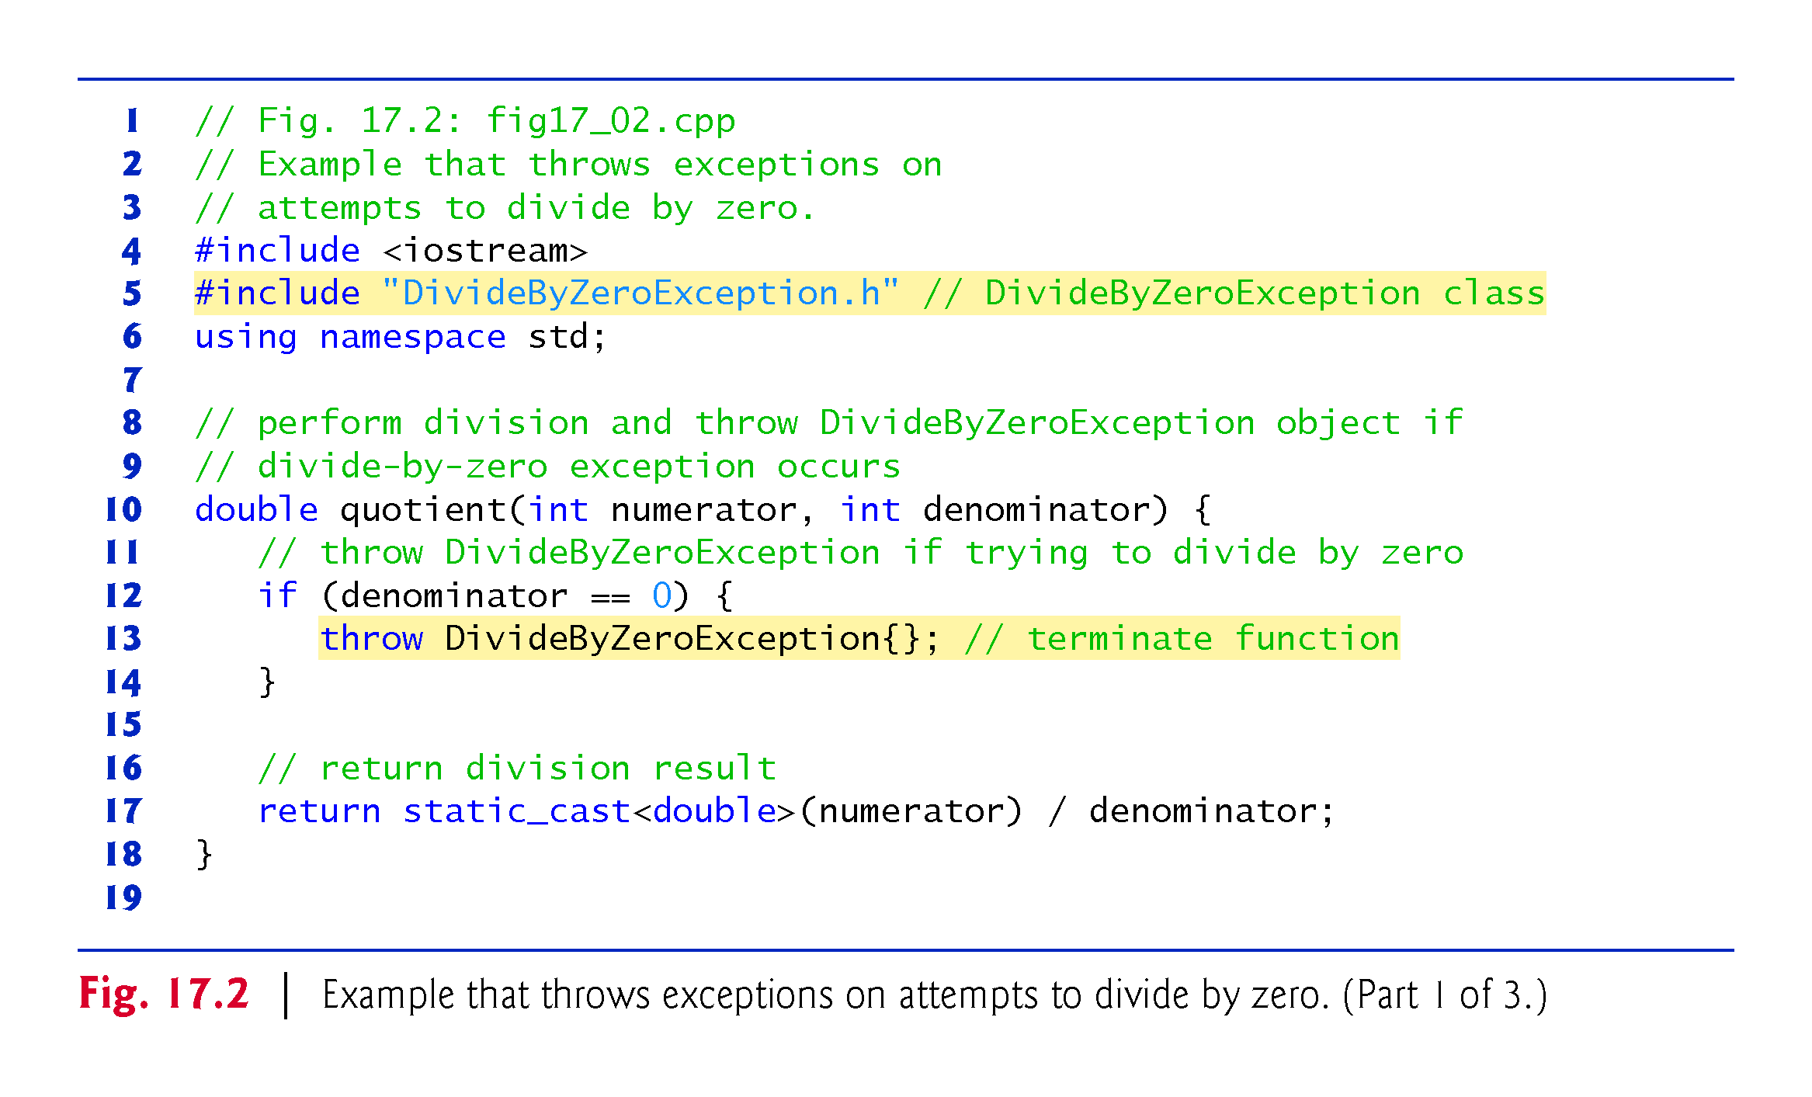

Slide 18
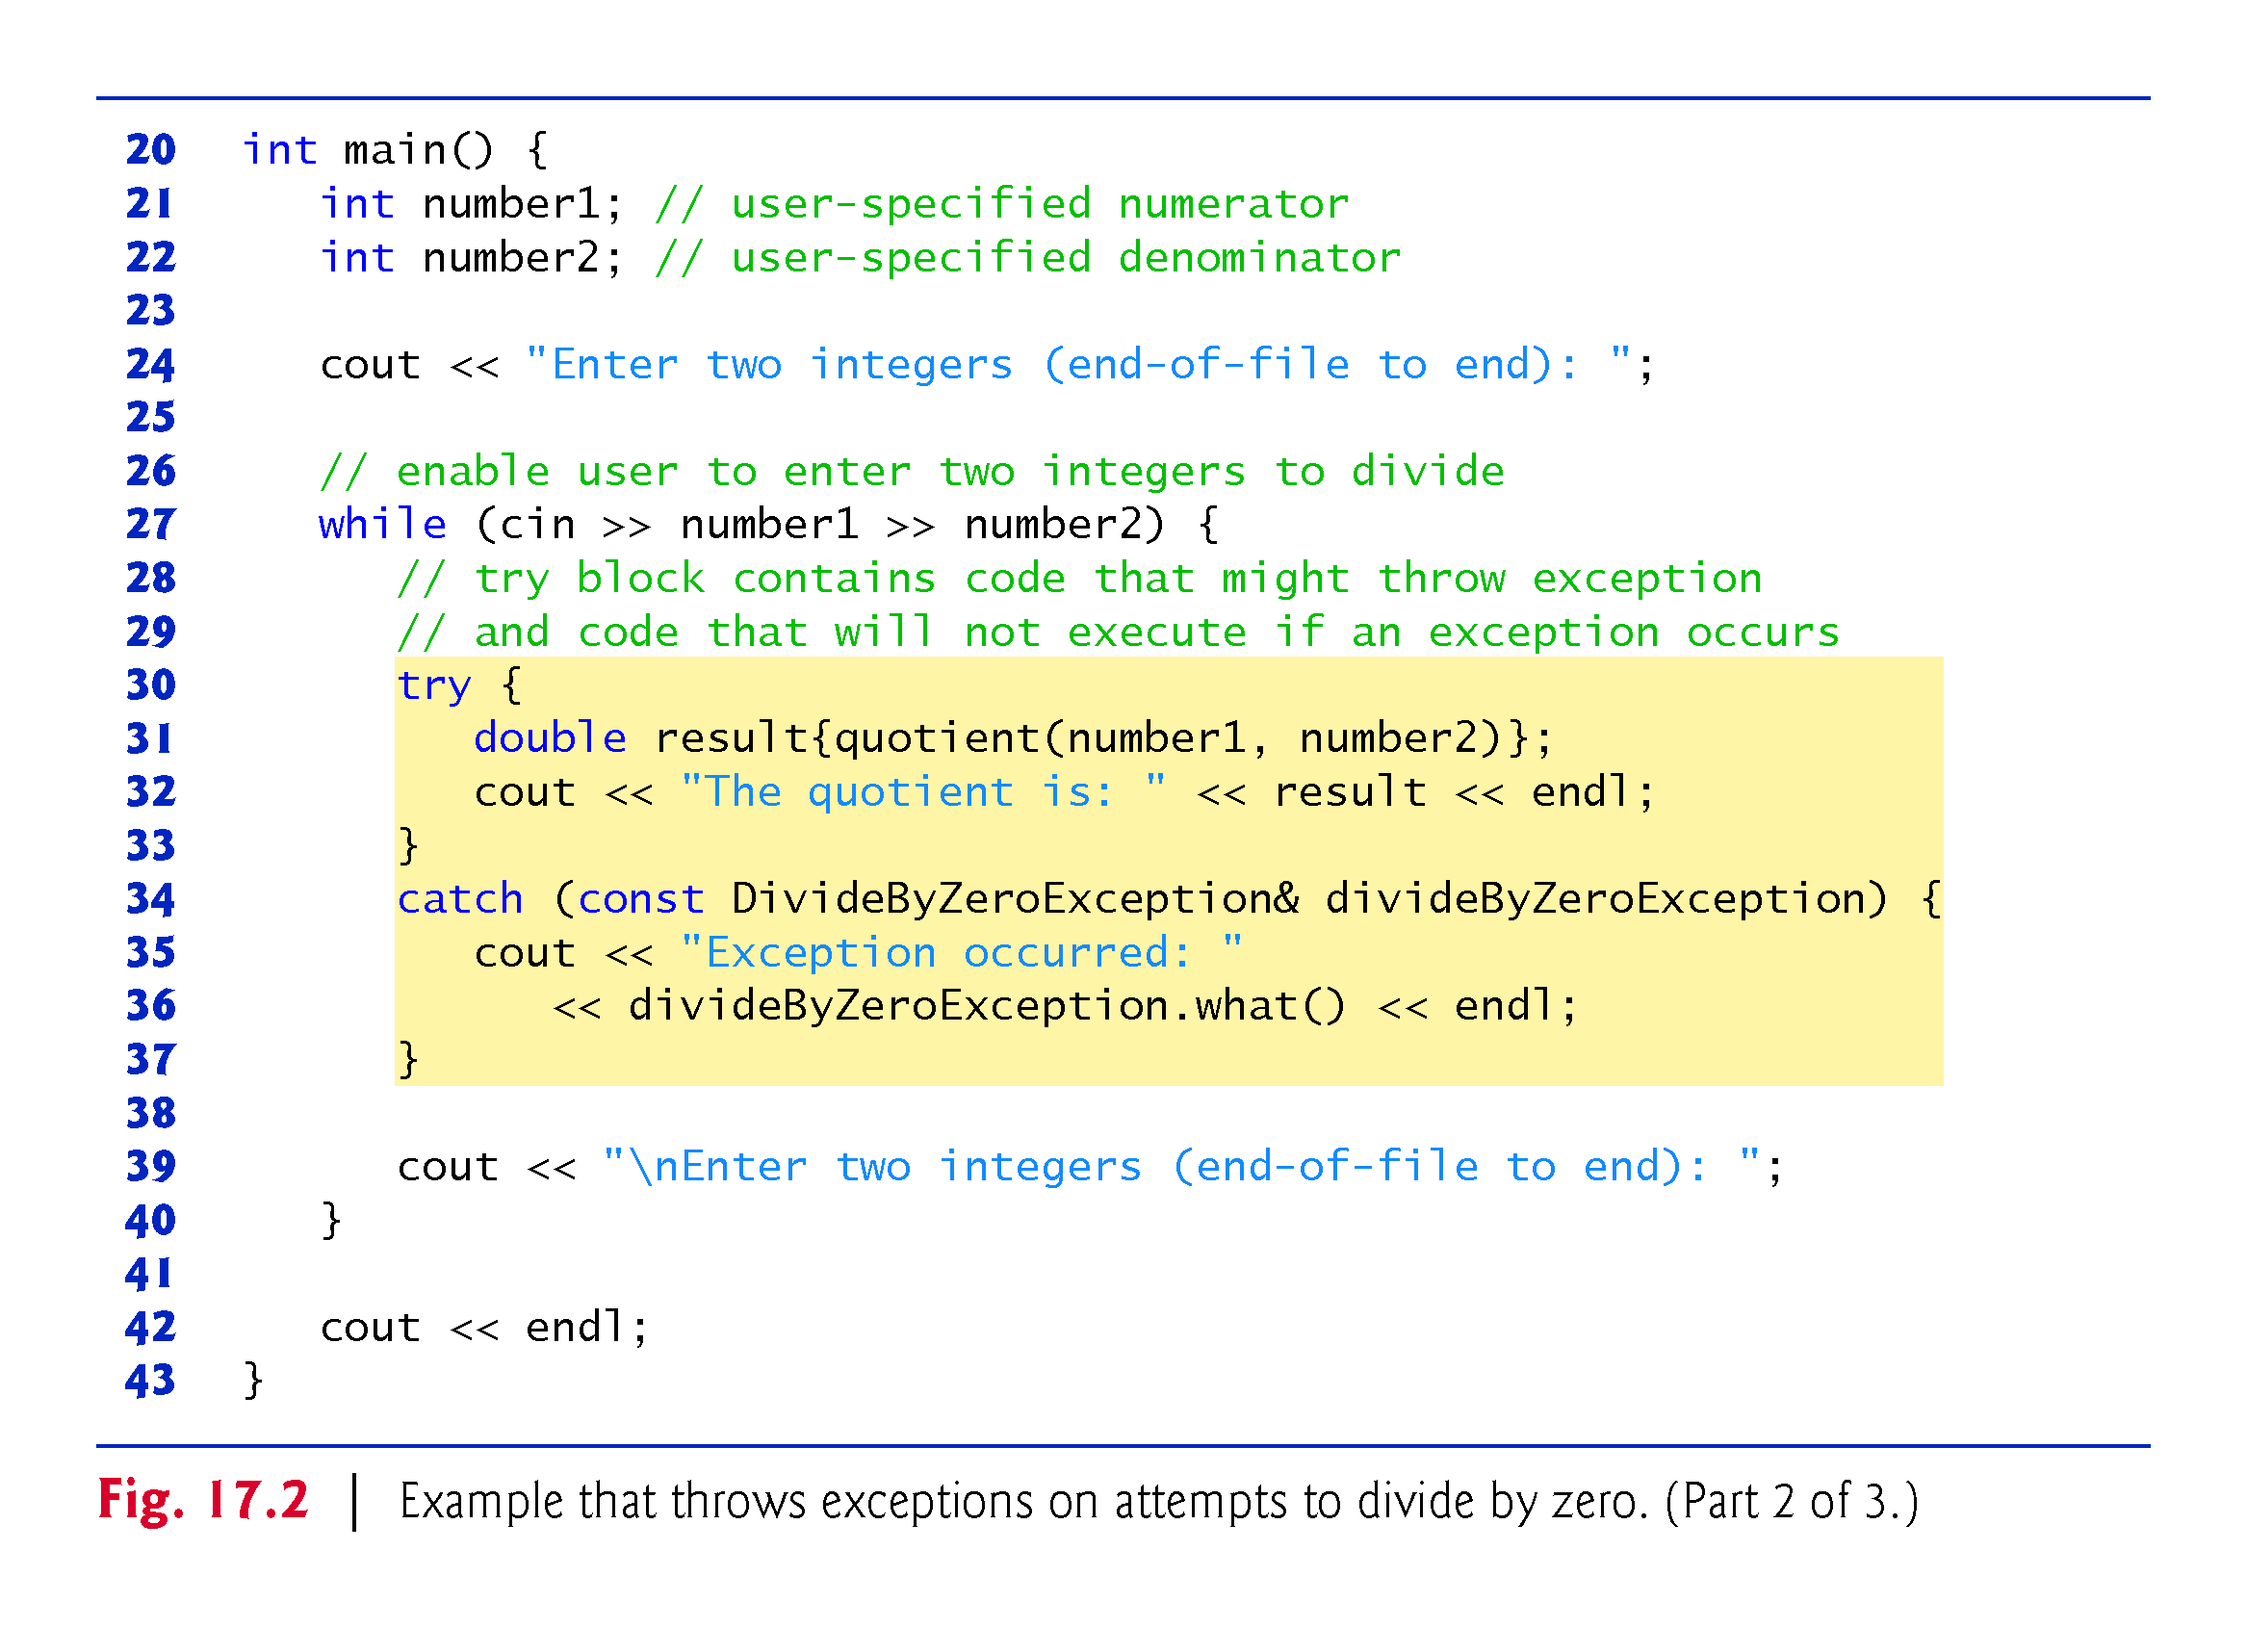

Slide 19
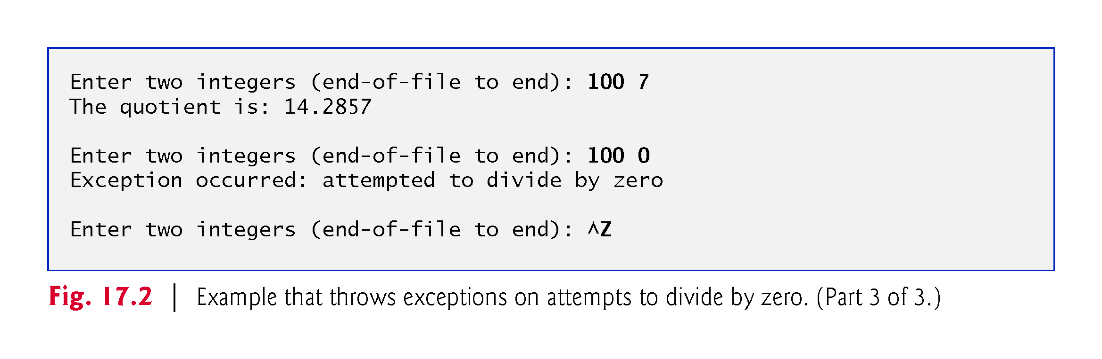

Slide 20
17.2.3 Enclosing Code in a try Block
Exception handling is geared to situations in which the function that detects an error is unable to handle it.
try blocks enable exception handling.
The try block encloses statements that might cause exceptions and statements that should be skipped if an exception occurs.
In this example, because the invocation of function quotient (line 31) can throw an exception, we enclose this function invocation in a try block.
Enclosing the output statement (line 32) in the try block ensures that the output will occur only if function quotient returns a result.

Slide 21
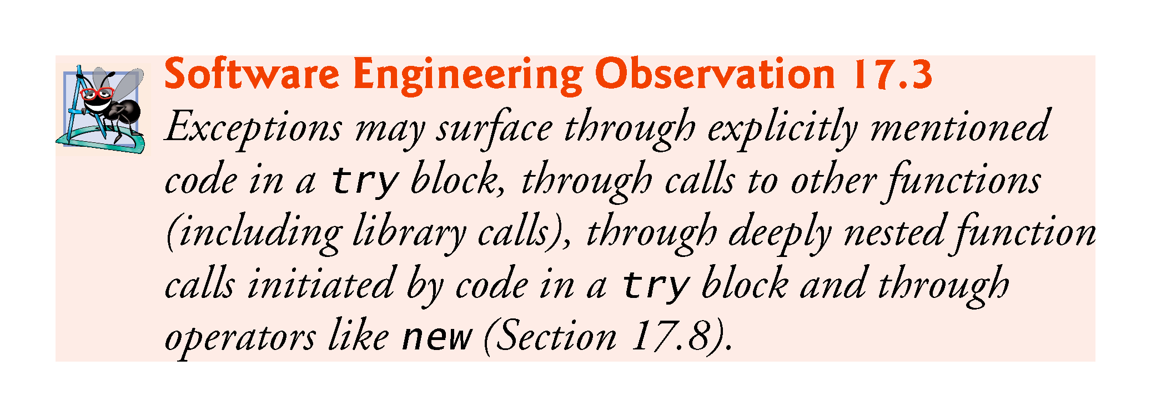

Slide 22
17.2.4 Defining a catch Handler to Process a DivideByZeroException
Exceptions are processed by catch handlers.
At least one catch handler (lines 34–37) must immediately follow each try block.
An exception parameter should always be declared as a reference to the type of exception the catch handler can process (DivideByZeroException in this case)—this prevents copying the exception object when it’s caught and allows a catch handler to properly catch derived-class exceptions as well.
When an exception occurs in a try block, the catch handler that executes is the first one whose type matches the type of the exception that occurred (i.e., the type in the catch block matches the thrown exception type exactly or is a direct or indirect base class of it).

Slide 23
17.2.4 Defining a catch Handler to Process a DivideByZeroException
If an exception parameter includes an optional parameter name, the catch handler can use that parameter name to interact with the caught exception in the body of the catch handler, which is delimited by braces ({ and }).
A catch handler typically reports the error to the user, logs it to a file, terminates the program gracefully or tries an alternate strategy to accomplish the failed task.
In this example, the catch handler simply reports that the user attempted to divide by zero. Then the program prompts the user to enter two new integer values.

Slide 24
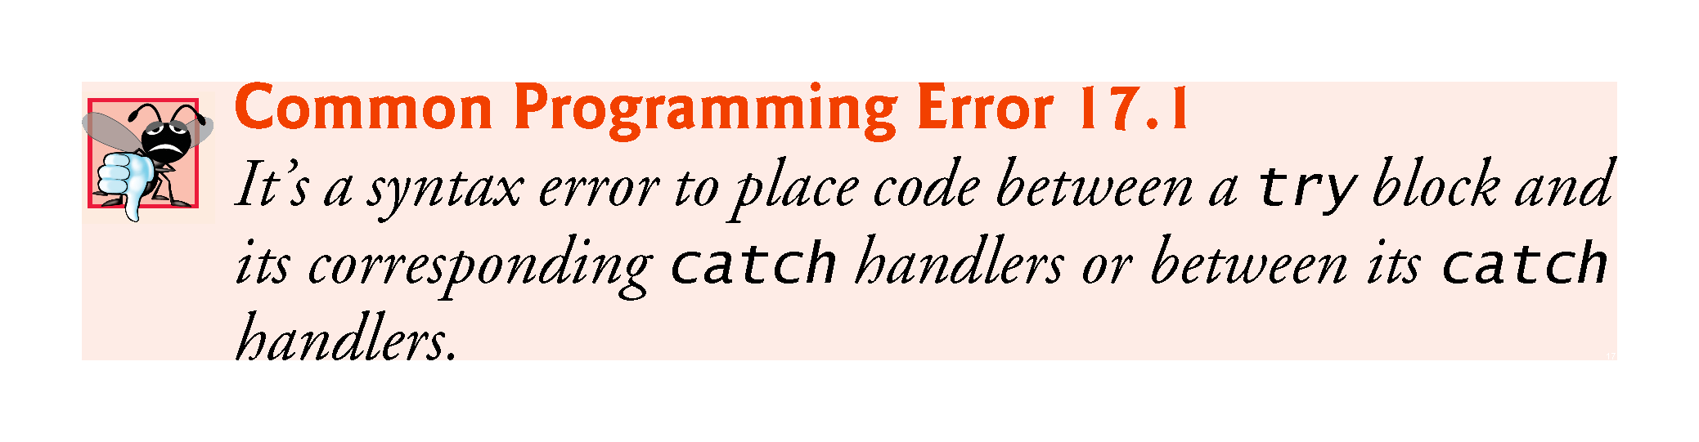

Slide 25
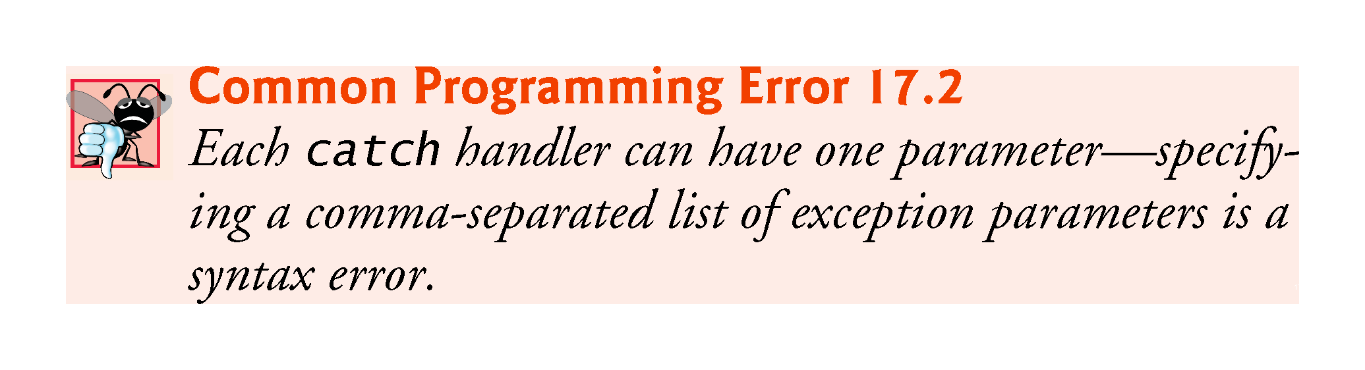

Slide 26
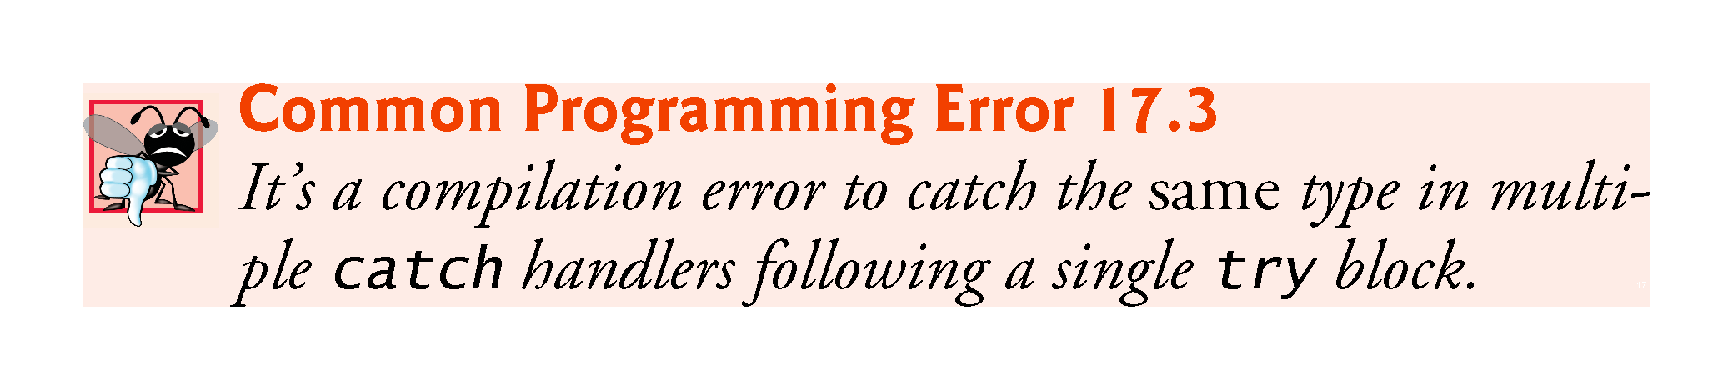

Slide 27
17.2.5 Termination Model of Exception Handling
If an exception occurs as the result of a statement in a try block, the try block expires (i.e., terminates immediately).
Next, the program searches for the first catch handler that can process the type of exception that occurred.
The program locates the matching catch by comparing the thrown exception’s type to each catch’s exception-parameter type until the program finds a match.
A match occurs if the types are identical or if the thrown exception’s type is a derived class of the exception-parameter type.
When a match occurs, the code in the matching catch handler executes.

Slide 28
17.2.5 Termination Model of Exception Handling
When a catch handler finishes processing by reaching its closing right brace (}), the exception is considered handled and the local variables defined within the catch handler (including the catch parameter) go out of scope.
Program control does not return to the point at which the exception occurred (known as the throw point), because the try block has expired.
Rather, control resumes with the first statement after the last catch handler following the try block.
This is known as the termination model of exception handling.
As with any other block of code, when a try block terminates, local variables defined in the block go out of scope.

Slide 29
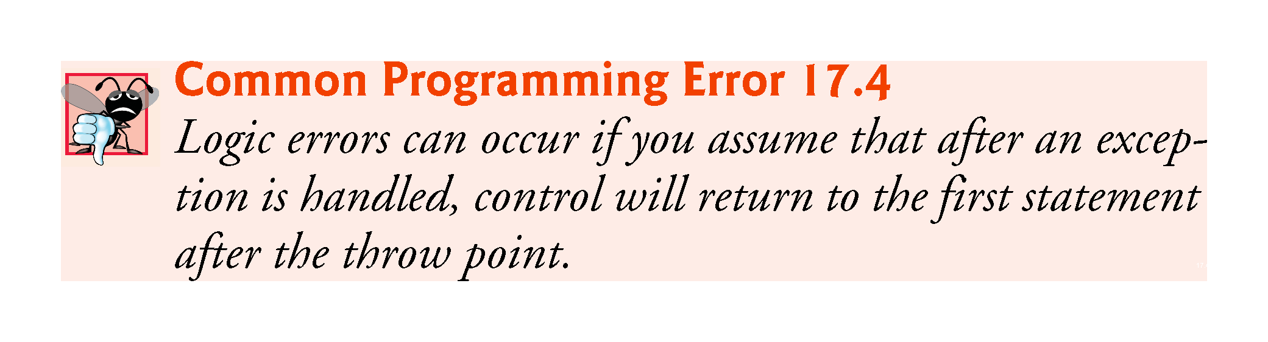

Slide 30
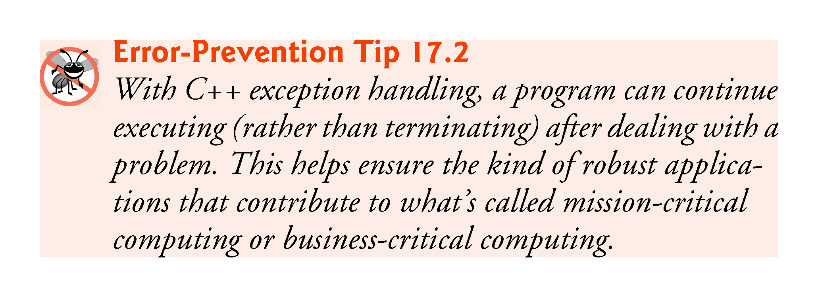

Slide 31
17.2.5 Termination Model of Exception Handling
If the try block completes its execution successfully (i.e., no exceptions occur in the try block), then the program ignores the catch handlers and program control continues with the first statement after the last catch following that try block.
If an exception that occurs in a try block has no matching catch handler, or if an exception occurs in a statement that is not in a try block, the function that contains the statement terminates immediately, and the program attempts to locate an enclosing try block in the calling function.
This process is called stack unwinding and is discussed in Section 17.4.

Slide 32
17.2.7 Flow of Program Control When the User Enters a Denominator of Zero)
As part of throwing an exception, the throw operand is created and used to initialize the parameter in the catch handler, which we discuss momentarily.
Central characteristic of exception handling: If your program explicitly throws an exception, it should do so before the error has an opportunity to occur.
In general, when an exception is thrown within a try block, the exception is caught by a catch handler that specifies the type matching the thrown exception.

Slide 33
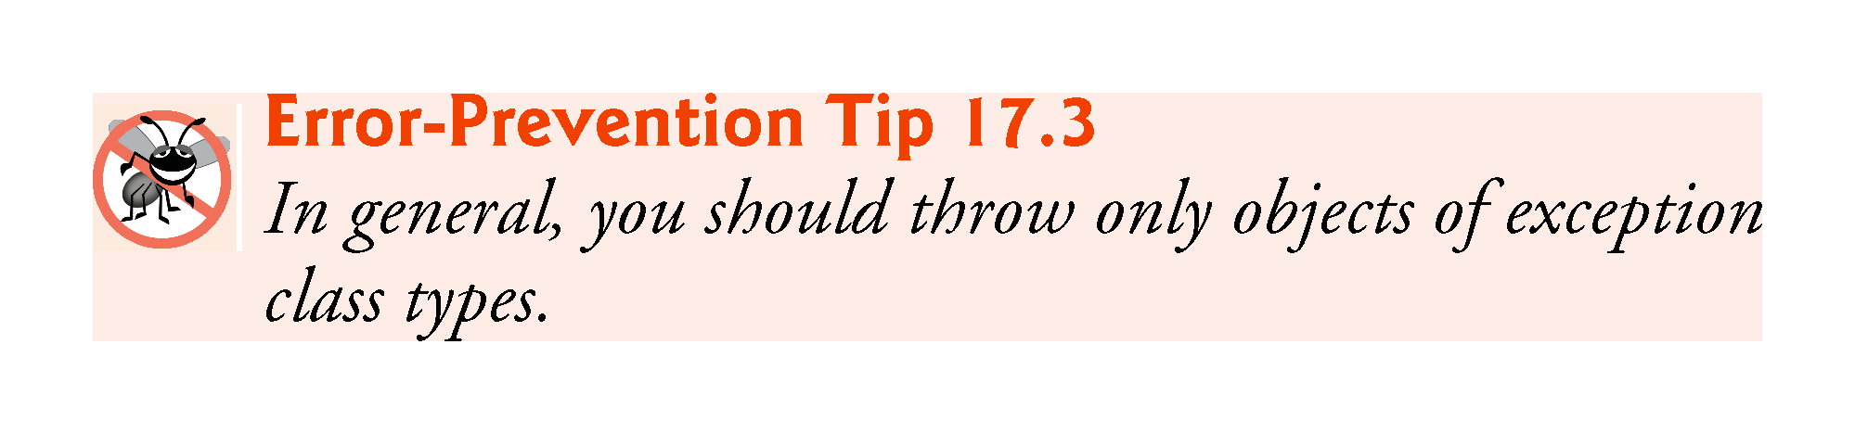

Slide 34
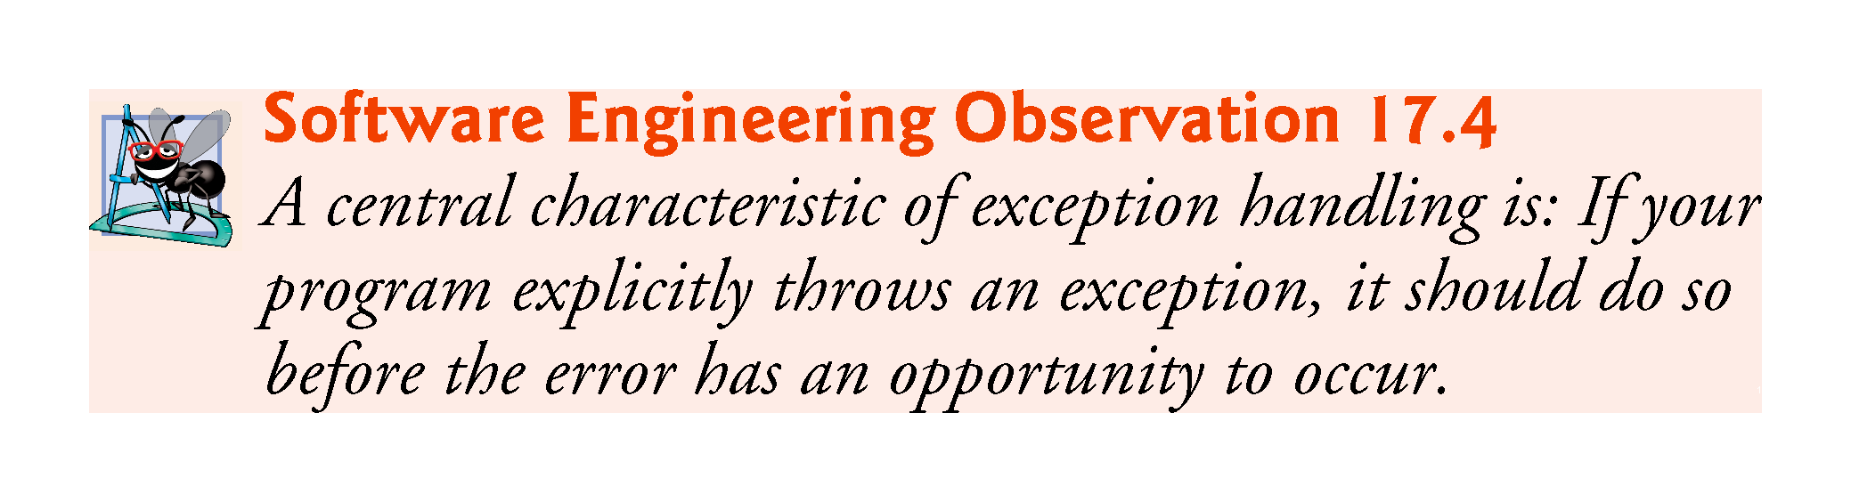

Slide 35
17.2.7 Flow of Program Control When the User Enters a Denominator of Zero)
In this program, the catch handler specifies that it catches DivideByZeroException objects—this type matches the object type thrown in function quotient.
Actually, the catch handler catches a reference to the DivideByZeroException object created by function quotient’s throw statement.
The exception object is maintained by the exception-handling mechanism.

Slide 36
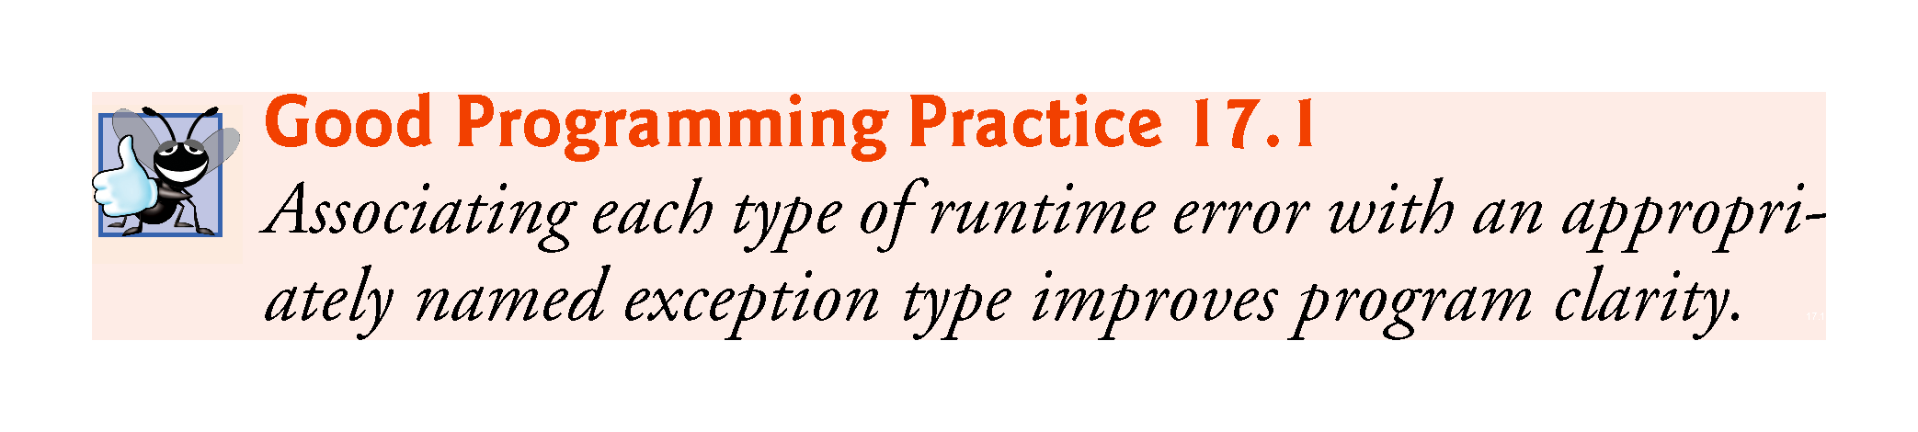

Slide 37
17.3 Rethrowing an Exception
A function might use a resource—like a file—and might want to release the resource (i.e., close the file) if an exception occurs.
An exception handler, upon receiving an exception, can release the resource then notify its caller that an exception occurred by rethrowing the exception via the statement
throw;
Regardless of whether a handler can process an exception, the handler can rethrow the exception for further processing outside the handler.
The next enclosing try block detects the rethrown exception, which a catch handler listed after that enclosing try block attempts to handle.

Slide 38
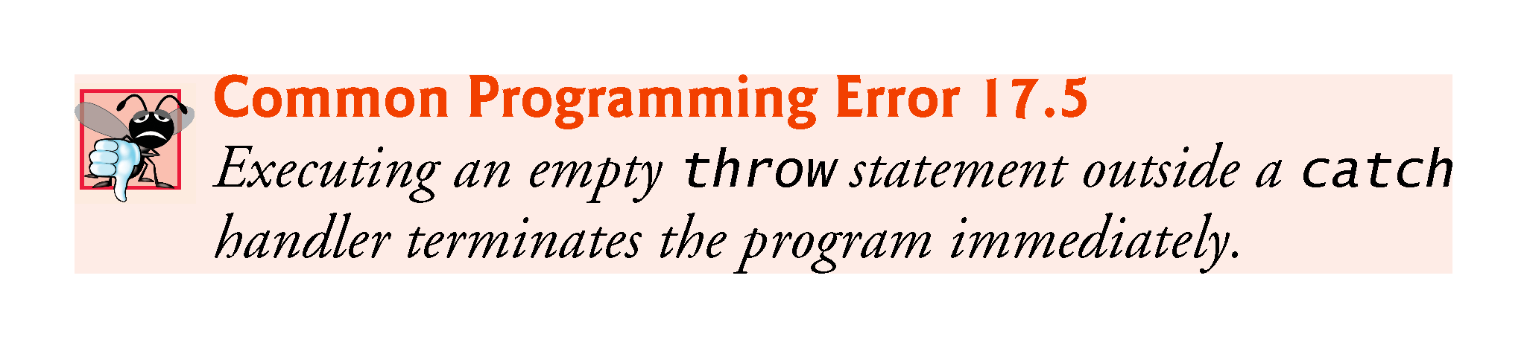

Slide 39
17.3 Rethrowing an Exception (cont.)
Fig. 17.3 demonstrates rethrowing an exception.
Since we do not use the exception parameters in the catch handlers of this example, we omit the exception parameter names and specify only the type of exception to catch (lines 14 and 30).

Slide 40
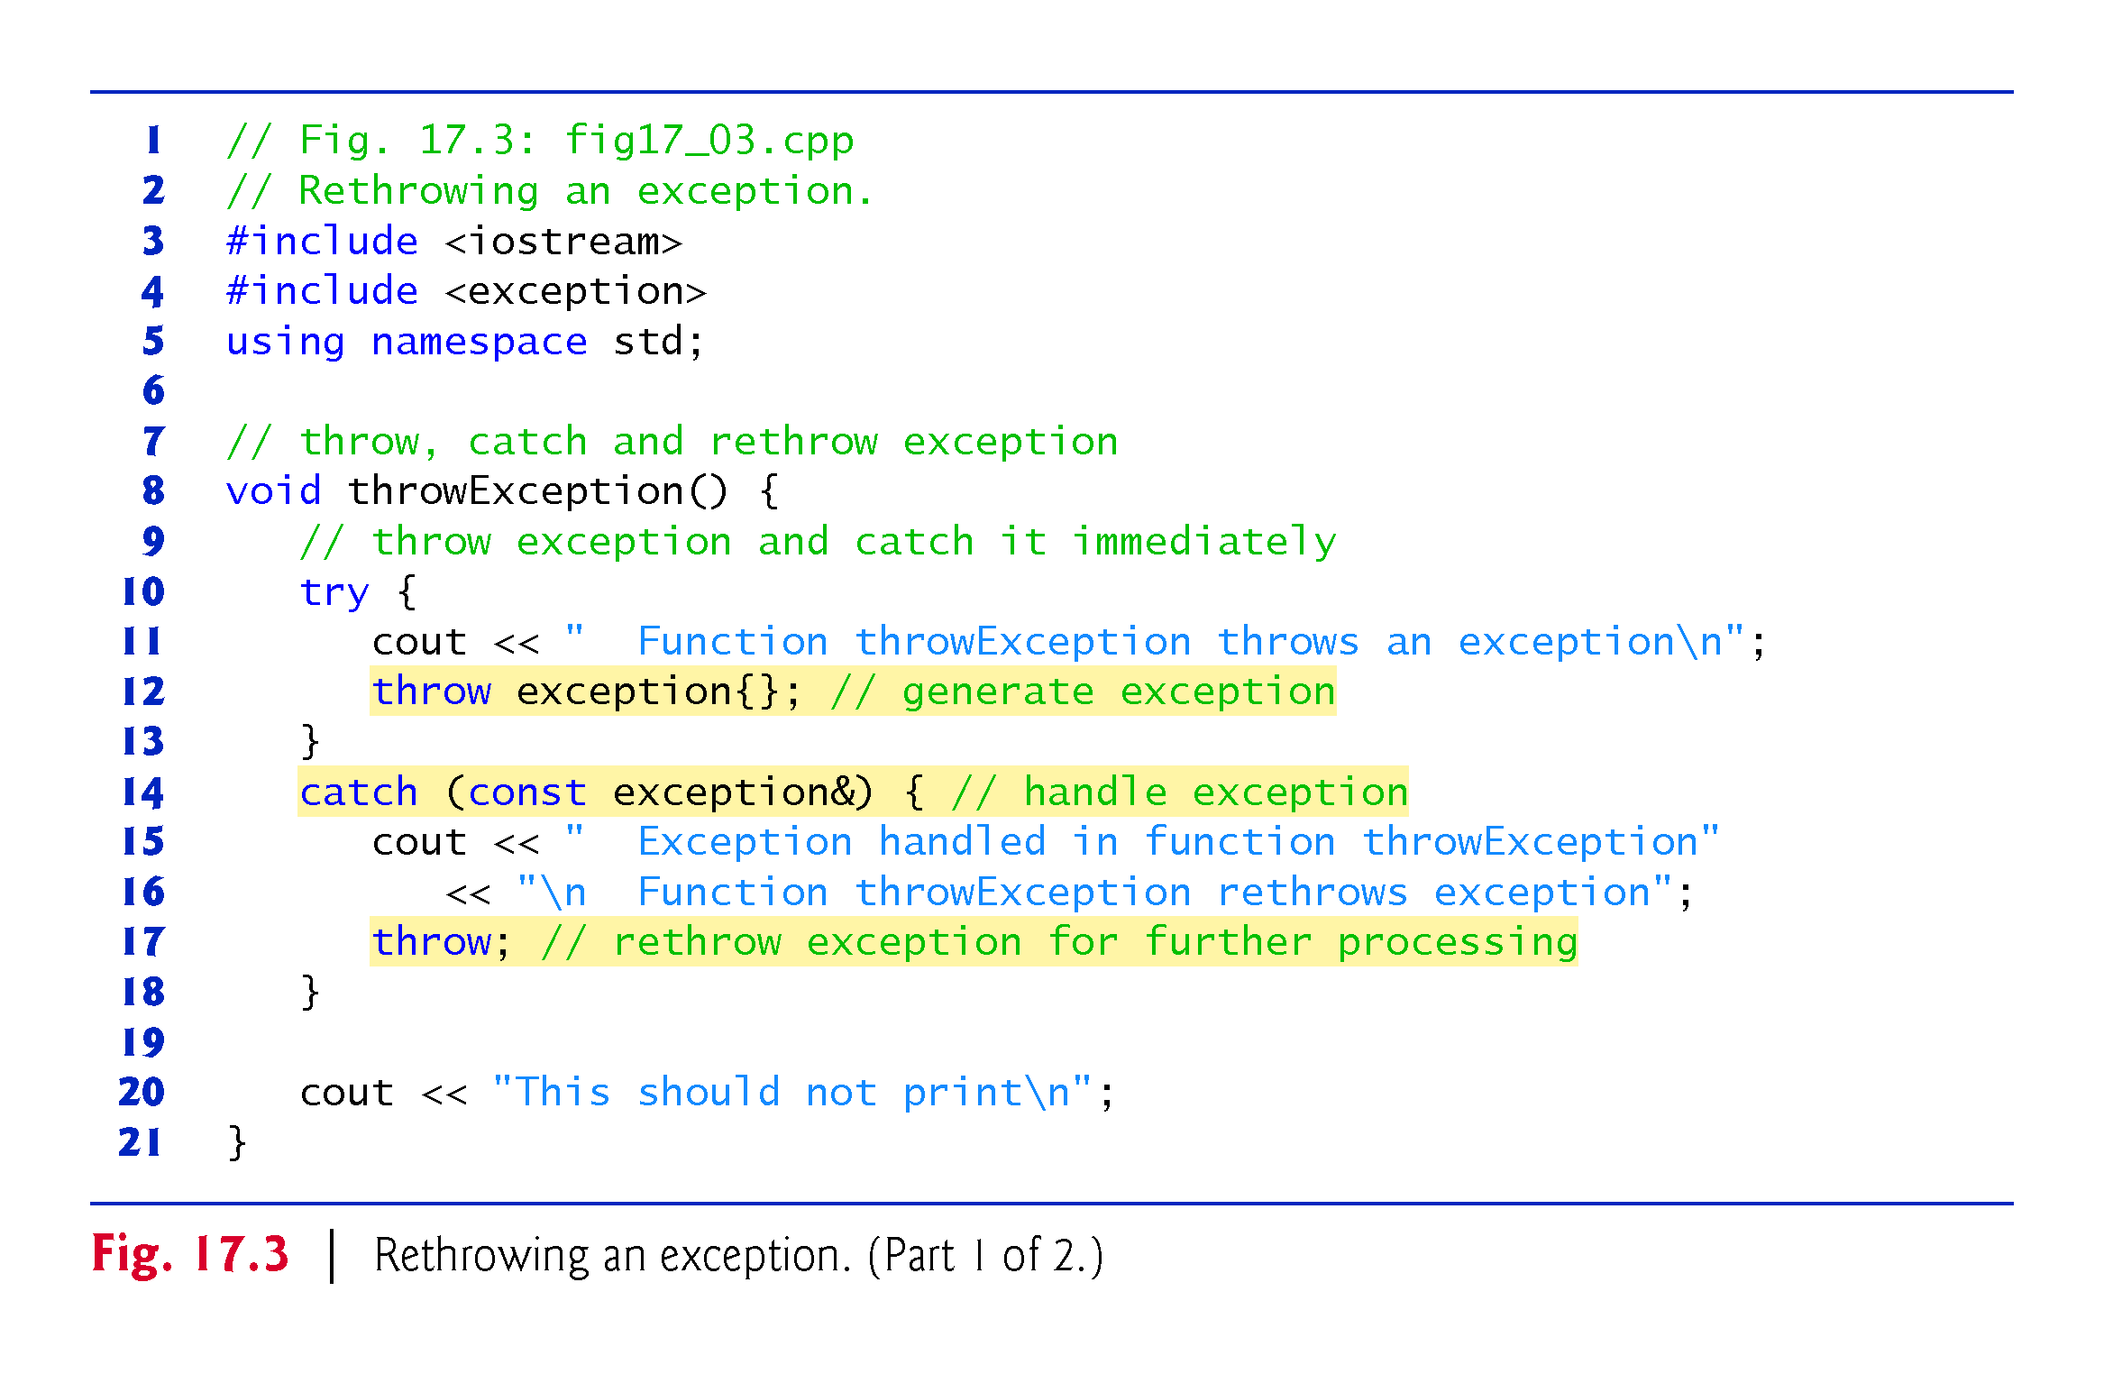

Slide 41
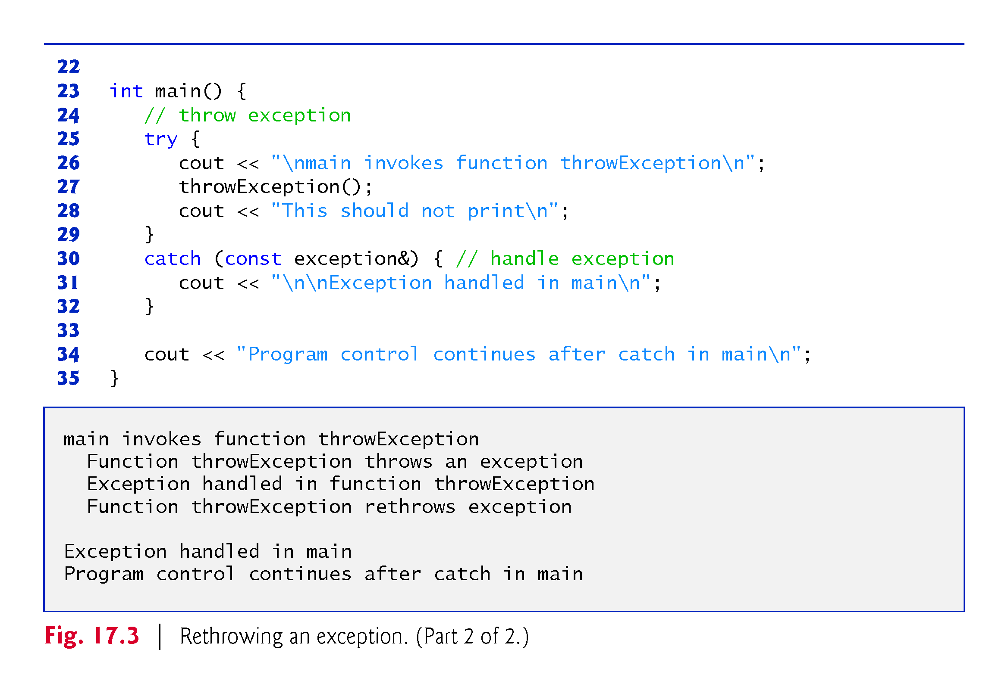

Slide 42
17.4 Stack Unwinding
When an exception is thrown but not caught in a particular scope, the function call stack is “unwound,” and an attempt is made to catch the exception in the next outer try…catch block.
Unwinding the function call stack means that the function in which the exception was not caught terminates, all local variables that have completed intitialization in that function are destroyed and control returns to the statement that originally invoked that function.
If a try block encloses that statement, an attempt is made to catch the exception.
If a try block does not enclose that statement, stack unwinding occurs again.
If no catch handler ever catches this exception, the program terminates.
The program of Fig. 17.4 demonstrates stack unwinding.

Slide 43
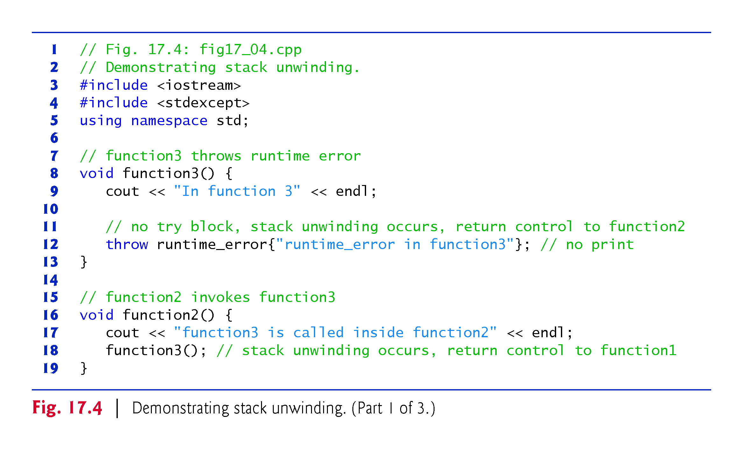

Slide 44
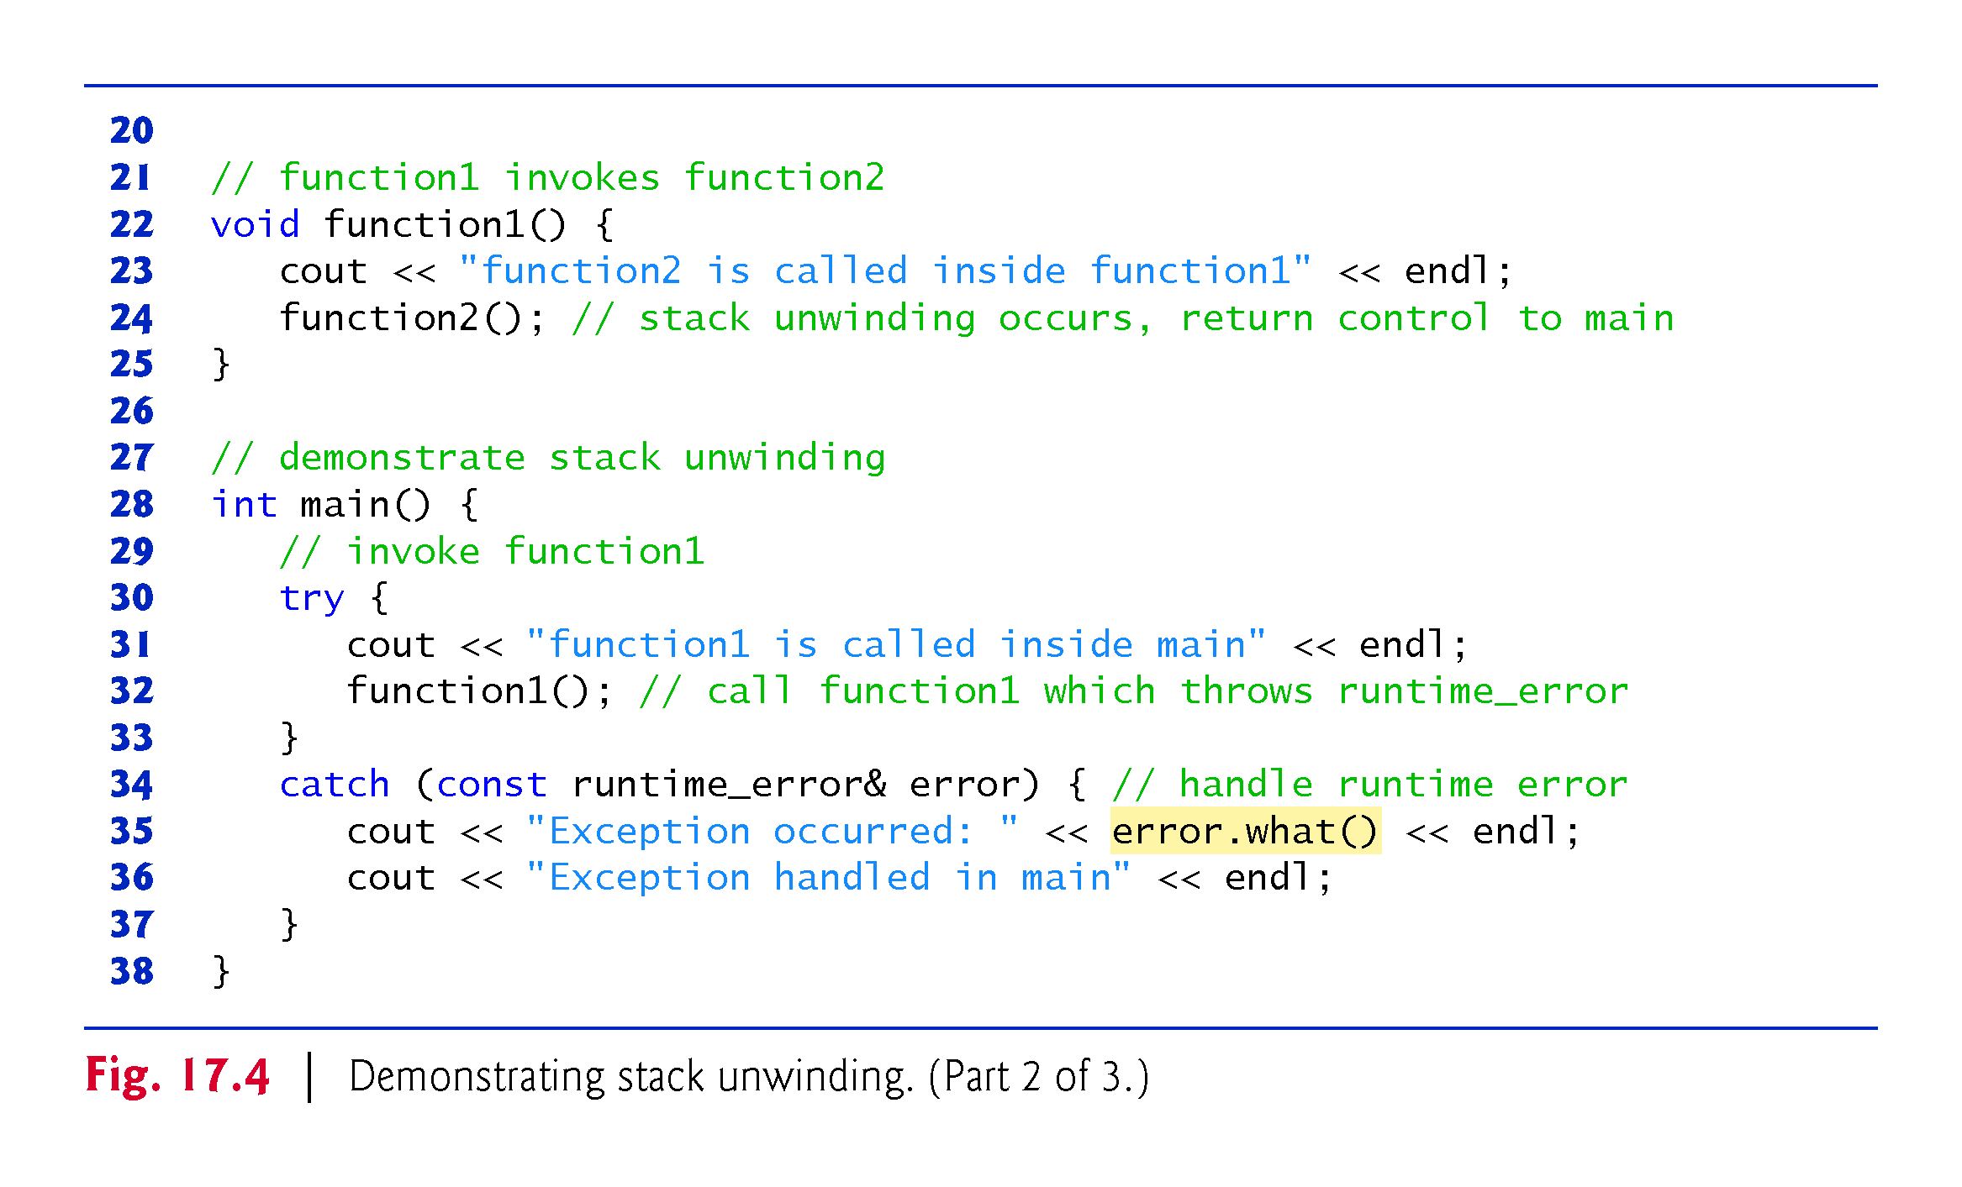

Slide 45
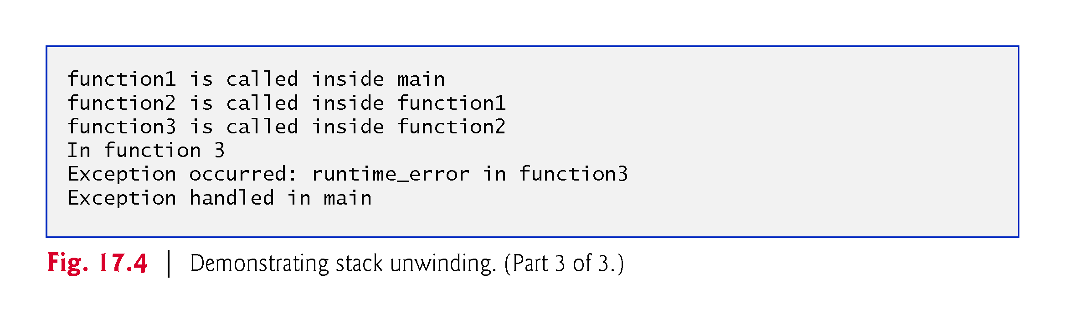

Slide 46
17.4 Stack Unwinding (cont.)
Line 12 of function3 throws a runtime_error object.
However, because no try block encloses the throw statement in line 12, stack unwinding occurs—function3 terminates at line 12, then returns control to the statement in function2 that invoked function3 (i.e., line 18).
Because no try block encloses line 18, stack unwinding occurs again—function2 terminates at line 18 and returns control to the statement in function1 that invoked function2 (i.e., line 24).
Because no try block encloses line 24, stack unwinding occurs one more time—function1 terminates at line 24 and returns control to the statement in main that invoked function1 (i.e., line 32).
The try block of lines 30–33 encloses this statement, so the first matching catch handler located after this try block (line 34–37) catches and processes the exception.

Slide 47
17.5 When to Use Exception Handling
Exception handling is designed to process synchronous errors, which occur when a statement executes, such as out-of-range array subscripts, arithmetic overflow (i.e., a value outside the representable range of values), division by zero, invalid function parameters and unsuccessful memory allocation (due to lack of memory).
Exception handling is not designed to process errors associated with asynchronous events (e.g., disk I/O completions, network message arrivals, mouse clicks and keystrokes), which occur in parallel with, and independent of, the program’s flow of control.

Slide 48
17.5 When to Use Exception Handling (cont.)
Exception-handling also is useful for processing problems that occur when a program interacts with software elements, such as member functions, constructors, destructors and classes.
Software elements often use exceptions to notify programs when problems occur.
This enables you to implement customized error handling for each application.

Slide 49
17.5 When to Use Exception Handling (cont.)
Complex applications normally consist of predefined software components and application-specific components that use the predefined components.
When a predefined component encounters a problem, that component needs a mechanism to communicate the problem to the application-specific component—the predefined component cannot know in advance how each application processes a problem that occurs.

Slide 50
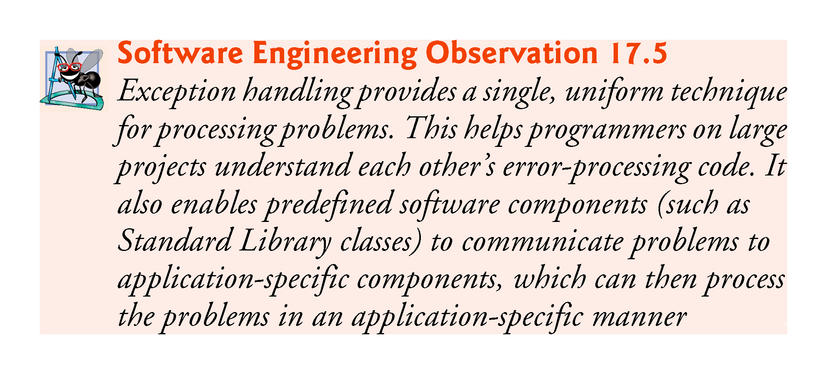

Slide 51
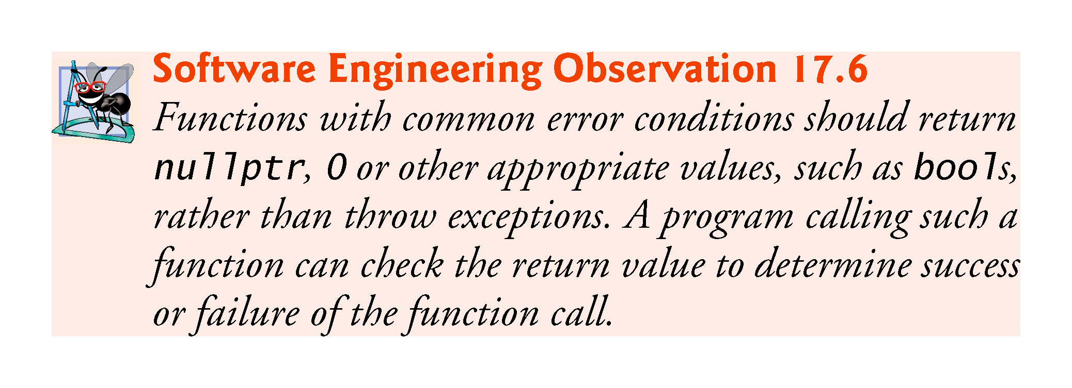

Slide 52
17.6 noexcept: Declaring Functions That Do Not Throw Exceptions
As of C++11, if a function does not throw any exceptions and does not call any functions that throw exceptions, you can explicitly state that a function does not throw exceptions.
This indicates to client-code programmers that there’s no need to call the function in a try block.
Add noexcept to the right of the function’s parameter list in both the prototype and the definition.
For a const member function, place noexcept after const.
If a function that’s declared noexcept calls another function that throws an exception or executes a throw statement, the program terminates.

Slide 53
17.7 Constructors, Destructors and Exception Handling
What happens when an error is detected in a constructor?
For example, how should an object’s constructor respond when it receives invalid data?
Because the constructor cannot return a value to indicate an error, we must choose an alternative means of indicating that the object has not been constructed properly.
One scheme is to return the improperly constructed object and hope that anyone using it would make appropriate tests to determine that it’s in an inconsistent state.
Another scheme is to set some variable outside the constructor.
The preferred alternative is to require the constructor to throw an exception that contains the error information, thus offering an opportunity for the program to handle the failure.

Slide 54
17.7.1 Destructors Called Due to Exceptions
If an exception occurs during object construction, destructors may be called:
If an exception is thrown before an object is fully constructed, destructors will be called for any member objects that have been constructed so far.
If an array of objects has been partially constructed when an exception occurs, only the destructors for the array’s constructed objects will be called.
Destructors are called for every automatic object constructed in a try block before an exception that occurred in that block is caught.
Stack unwinding is guaranteed to have been completed at the point that an exception handler begins executing.
If a destructor invoked as a result of stack unwinding throws an exception, the program terminates.
This has been linked to various security attacks.

Slide 55
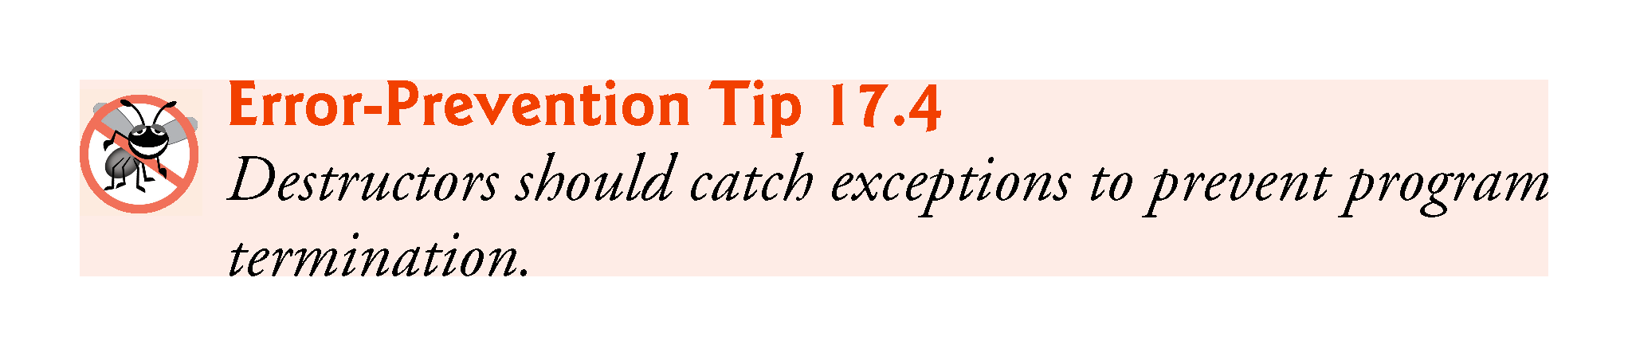

Slide 56
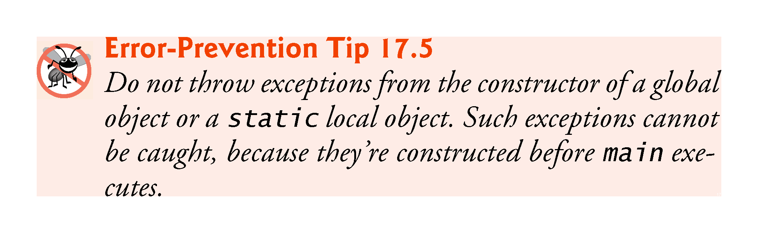

Slide 57
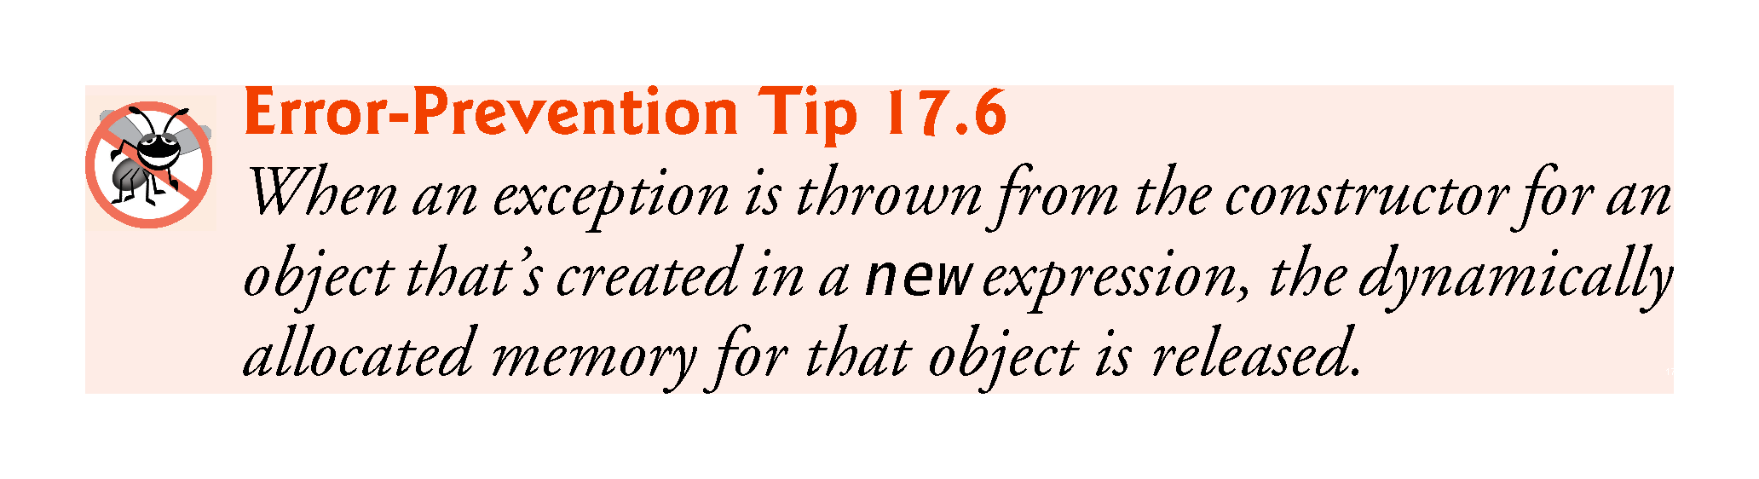

Slide 58
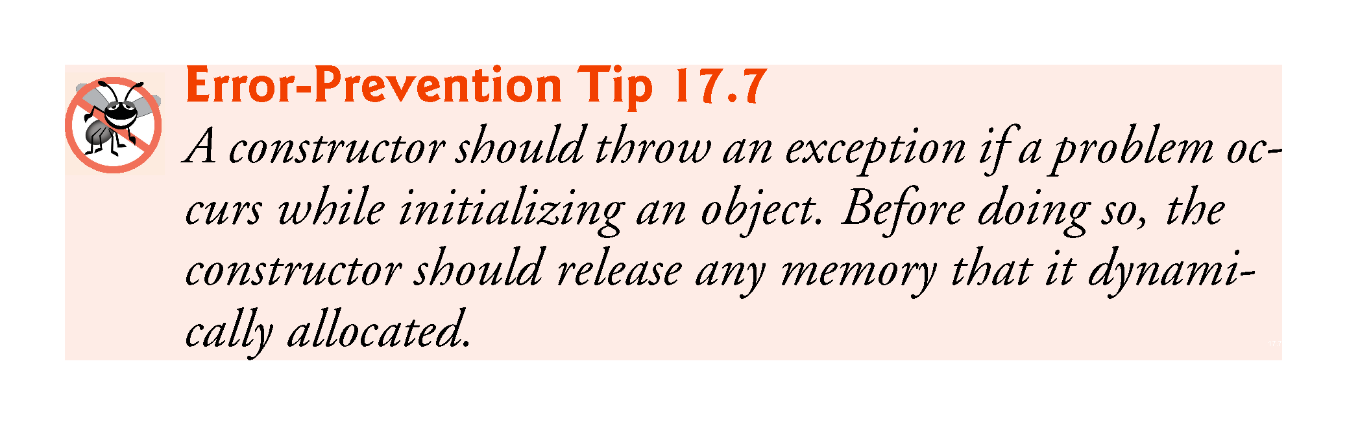

Slide 59
17.7.2 Initializing Local Objects to Acquire Resources
An exception could preclude the operation of code that would normally release a resource (such as memory or a file), thus causing a resource leak that prevents other programs from acquiring the resource.
One technique to resolve this problem is to initialize a local object to acquire the resource.
When an exception occurs, the destructor for that object will be invoked and can free the resource.
This technique is known as resource allocation is initialization (RAII) and is one use of C++11’s unique_ptr

Slide 60
17.8.1 new Throwing bad_alloc on Failure
Figure 17.5 demonstrates new implicitly throwing bad_alloc on failure to allocate the requested memory.
The for statement (lines 14–17) inside the try block should loop 50 times and, on each pass, allocate an array of 50,000,000 double values.
If new fails and throws a bad_alloc exception, the loop terminates, and the program continues in line 19, where the catch handler catches and processes the exception.

Slide 61
17.8.1 new Throwing bad_alloc on Failure
Lines 20–21 print the message "Exception occurred:" followed by the message returned from the base-class-exception version of function what (i.e., an implementation-defined exception-specific message, such as "bad allocation" in Microsoft Visual C++).
The output shows that the program performed only four iterations of the loop before new failed and threw the bad_alloc exception.
Your output might differ based on the physical memory, disk space available for virtual memory on your system and the compiler you are using.

Slide 62
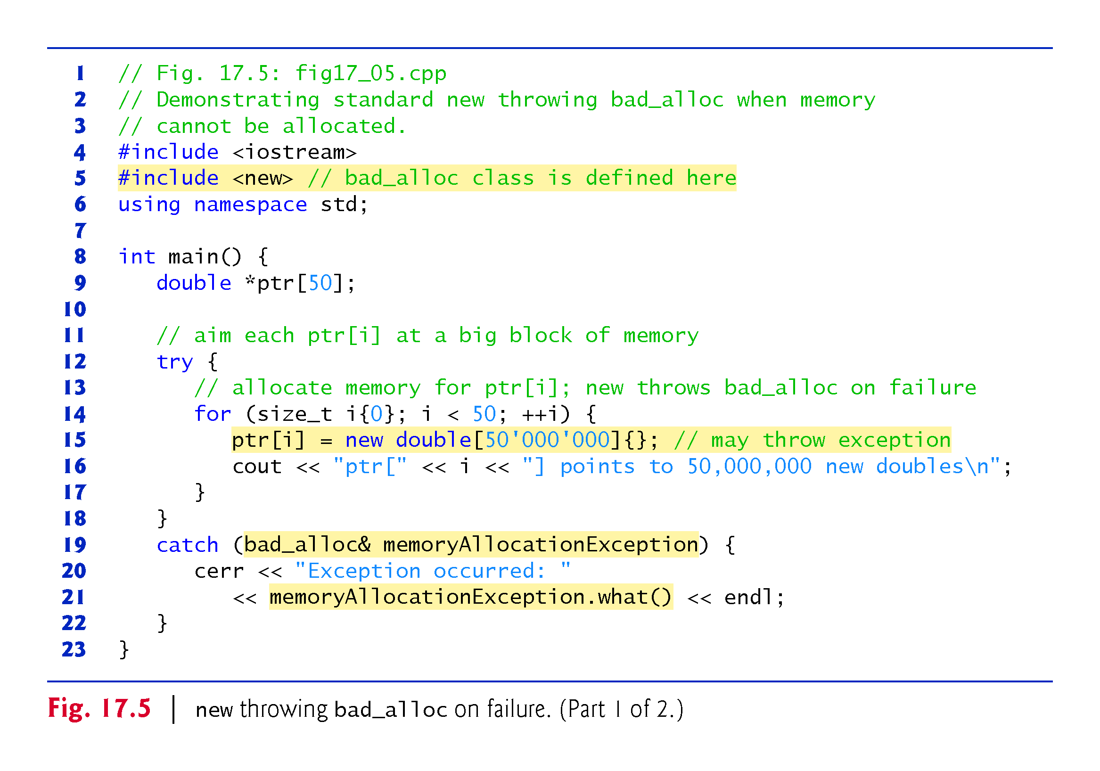

Slide 63
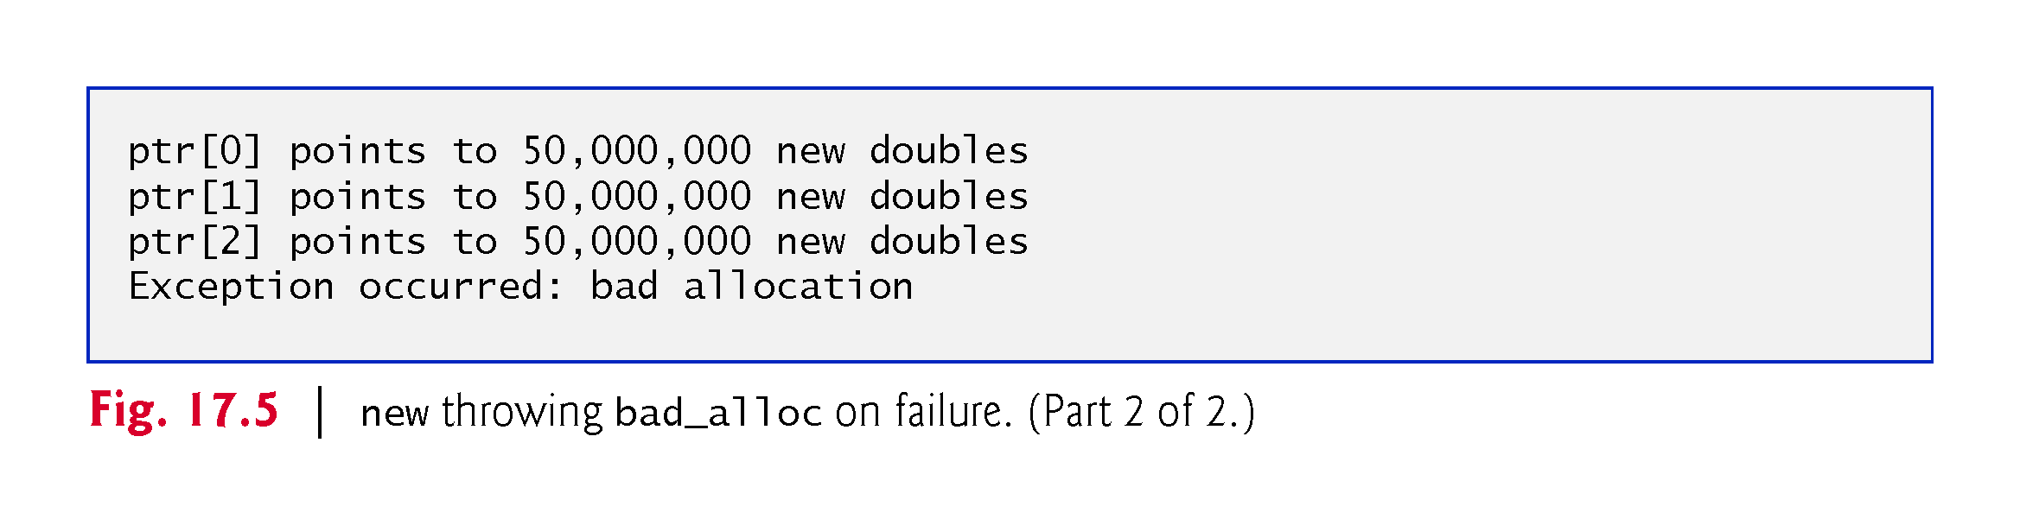

Slide 64
17.8 new Returning nullptr on Failure
The C++ standard specifies that programmers can use an older version of new that returns nullptr upon failure.
For this purpose, header <new> defines object nothrow (of type nothrow_t), which is used as follows:
double* ptr{new(nothrow) double[50000000]};
The preceding statement uses the version of new that does not throw bad_alloc exceptions (i.e., nothrow) to allocate an array of 50,000,000 doubles.

Slide 65
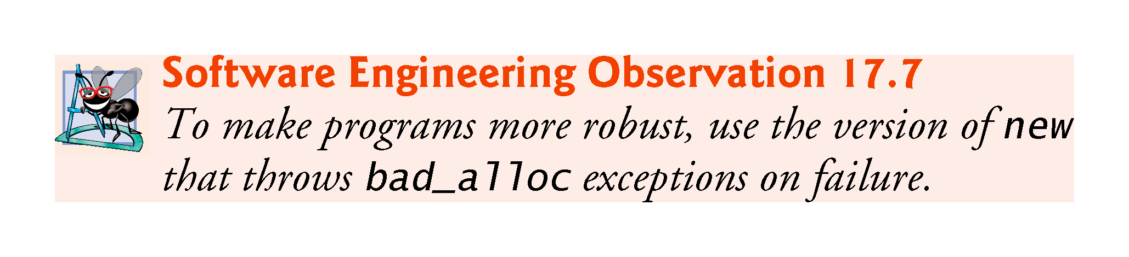

Slide 66
17.8.3 Handling new Failures Using Function set_new_handler
Function set_new_handler (prototyped in standard header file <new>) takes as its argument a pointer to a function that takes no arguments and returns void.
This pointer points to the function that will be called if new fails.
This provides you with a uniform approach to handling all new failures, regardless of where a failure occurs in the program.
Once set_new_handler registers a new handler in the program, operator new does not throw bad_alloc on failure; rather, it delegates the error handling to the new-handler function.
If new fails to allocate memory and set_new_handler did not register a new-handler function, new throws a bad_alloc exception.
If new fails to allocate memory and a new-handler function has been registered, the new-handler function is called.

Slide 67
17.8.3 Handling new Failures Using Function set_new_handler
The new-handler function should perform one of the following tasks:
Make more memory available by deleting other dynamically allocated memory (or telling the user to close other applications) and return to operator new to attempt to allocate memory again.
Throw an exception of type bad_alloc.
Call function abort or exit (both found in header file <cstdlib>) to terminate the program. Figure 17.6 demonstrates set_new_handler.
Function customNewHandler (lines 9–12) prints an error message (line 10), then calls abort (line 11) to terminate the program.
The output shows that the loop iterated three times before new failed and invoked function customNewHandler.

Slide 68
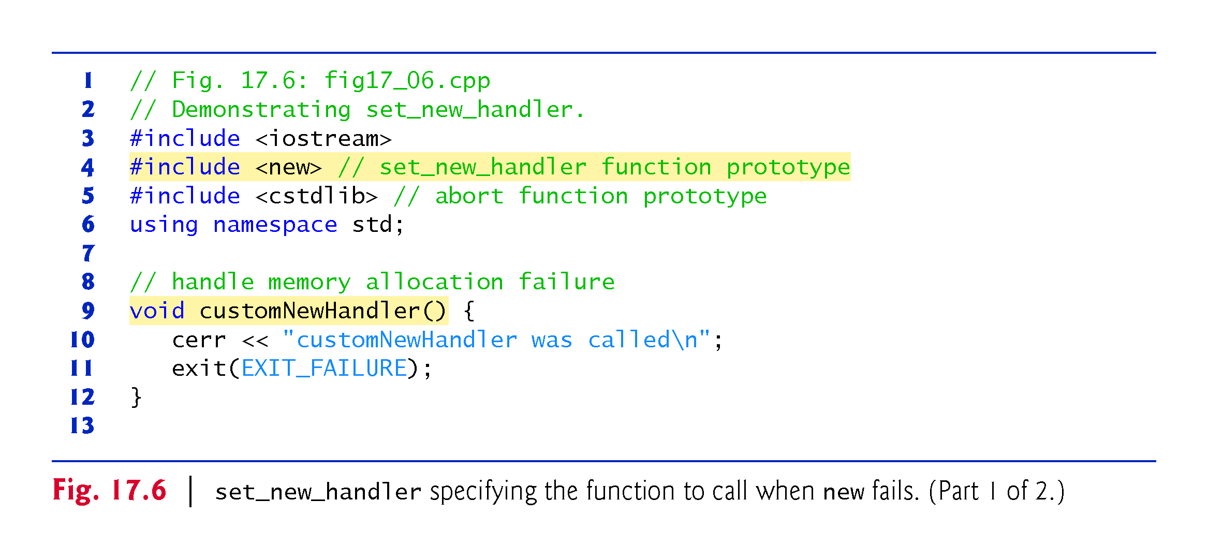

Slide 69
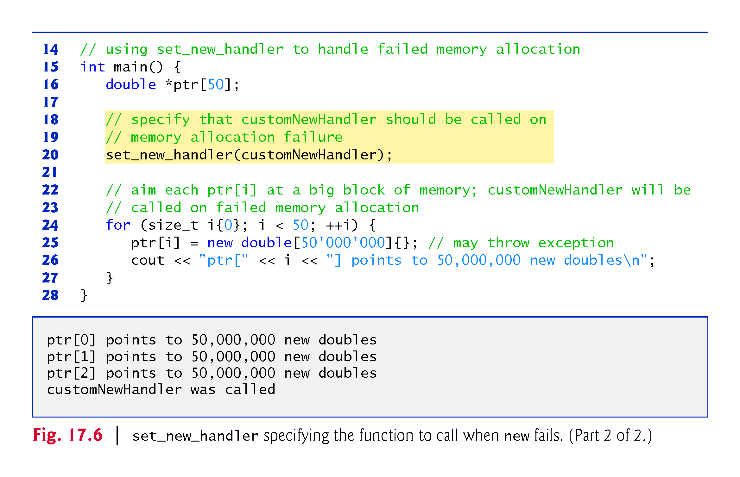

Slide 70
17.9 Class unique_ptr and Dynamic Memory Allocation
A common programming practice is to allocate dynamic memory, assign the address of that memory to a pointer, use the pointer to manipulate the memory and deallocate the memory with delete when the memory is no longer needed.
If an exception occurs after successful memory allocation but before the delete statement executes, a memory leak could occur.
C++ 11 provides class template unique_ptr in header file <memory> to deal with this situation.

Slide 71
17.9 Class unique_ptr and Dynamic Memory Allocation (cont.)
A unique_ptr maintains a pointer to dynamically allocated memory.
When a unique_ptr object’s destructor is called (for example, when an unique_ptr object goes out of scope), it performs a delete operation on its pointer data member.
Class template unique_ptr provides overloaded operators * and -> so that an unique_ptr object can be used just as a regular pointer variable is.
Figure 17.9 demonstrates an unique_ptr object that points to a dynamically allocated object of class Integer (Figs. 17.7–17.8).

Slide 72
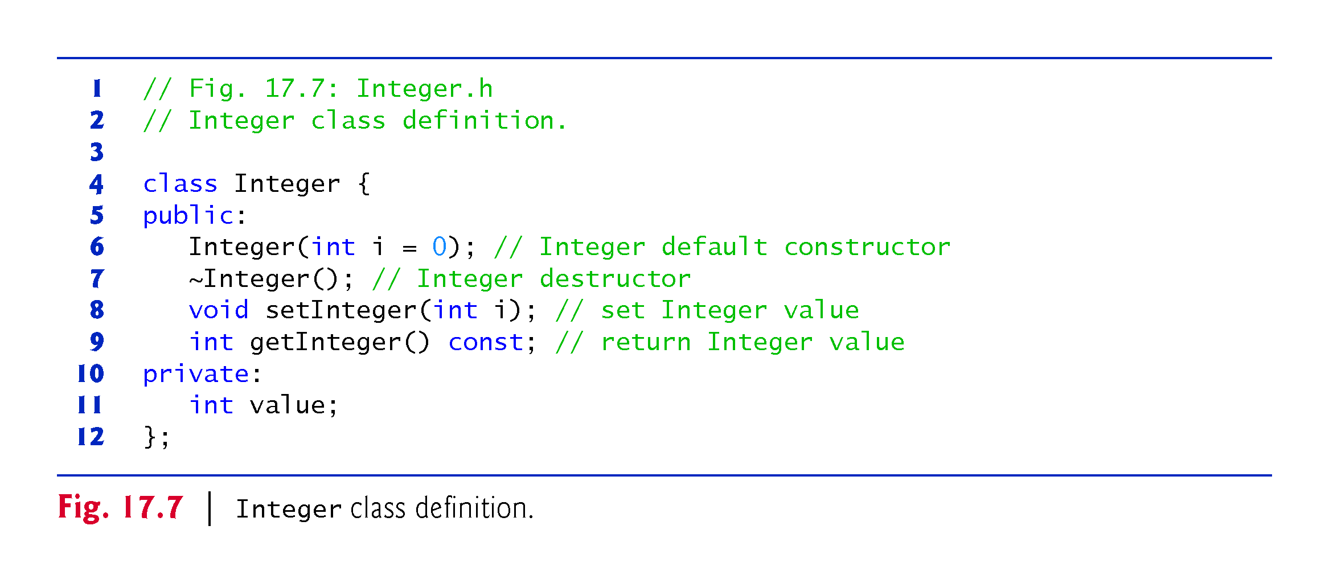

Slide 73
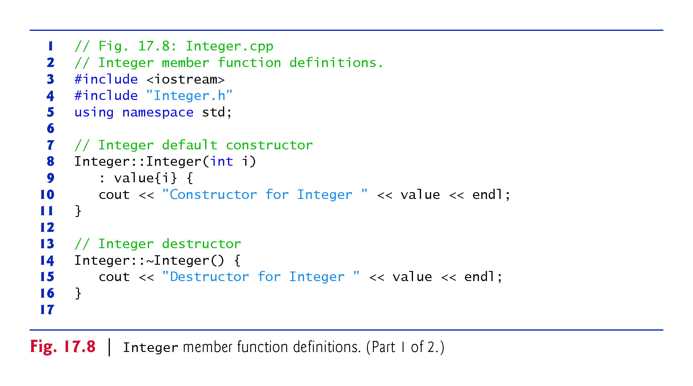

Slide 74
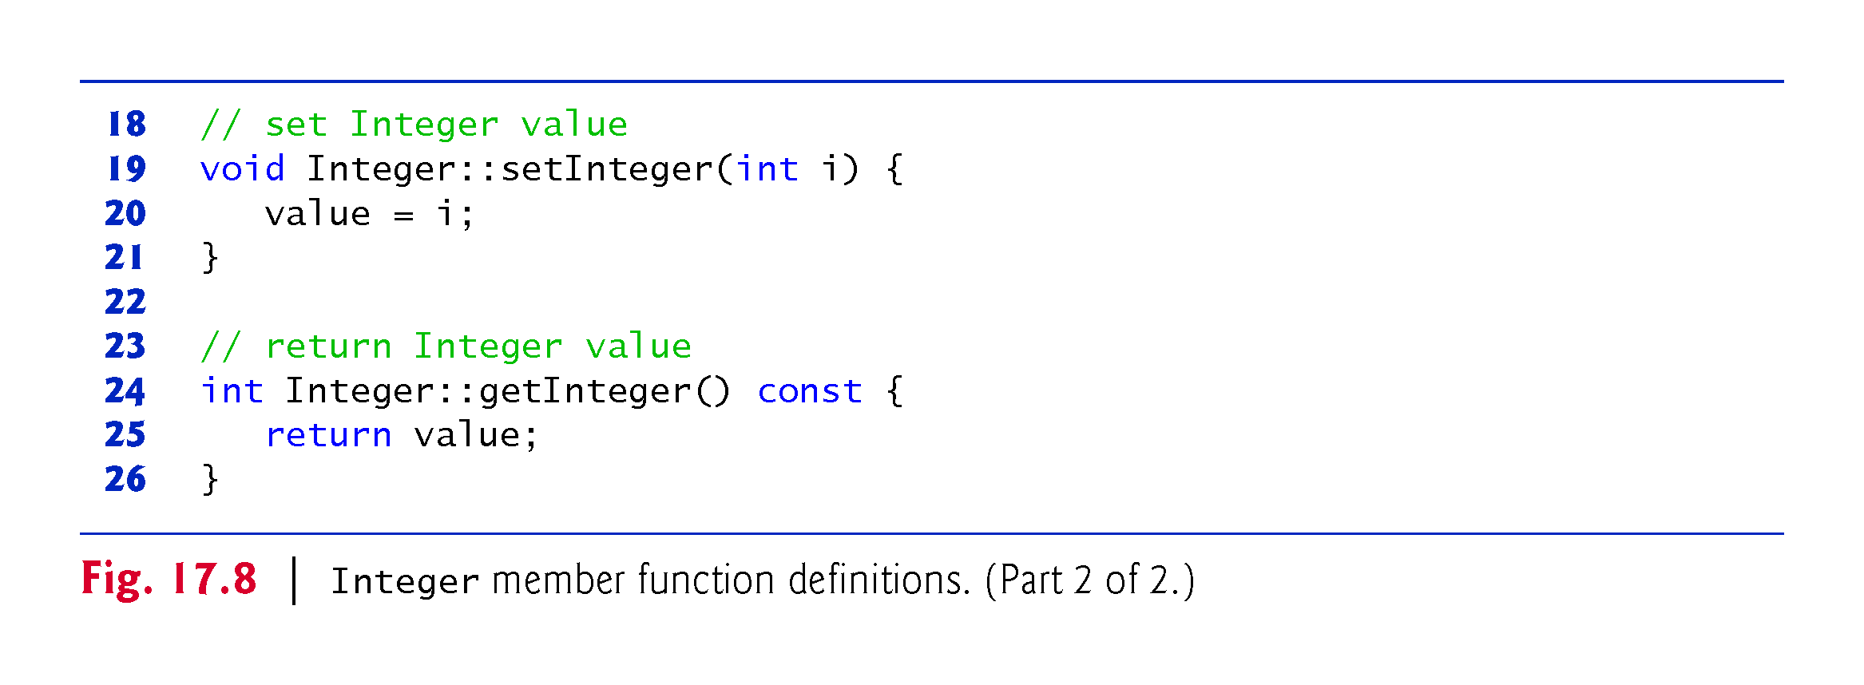

Slide 75
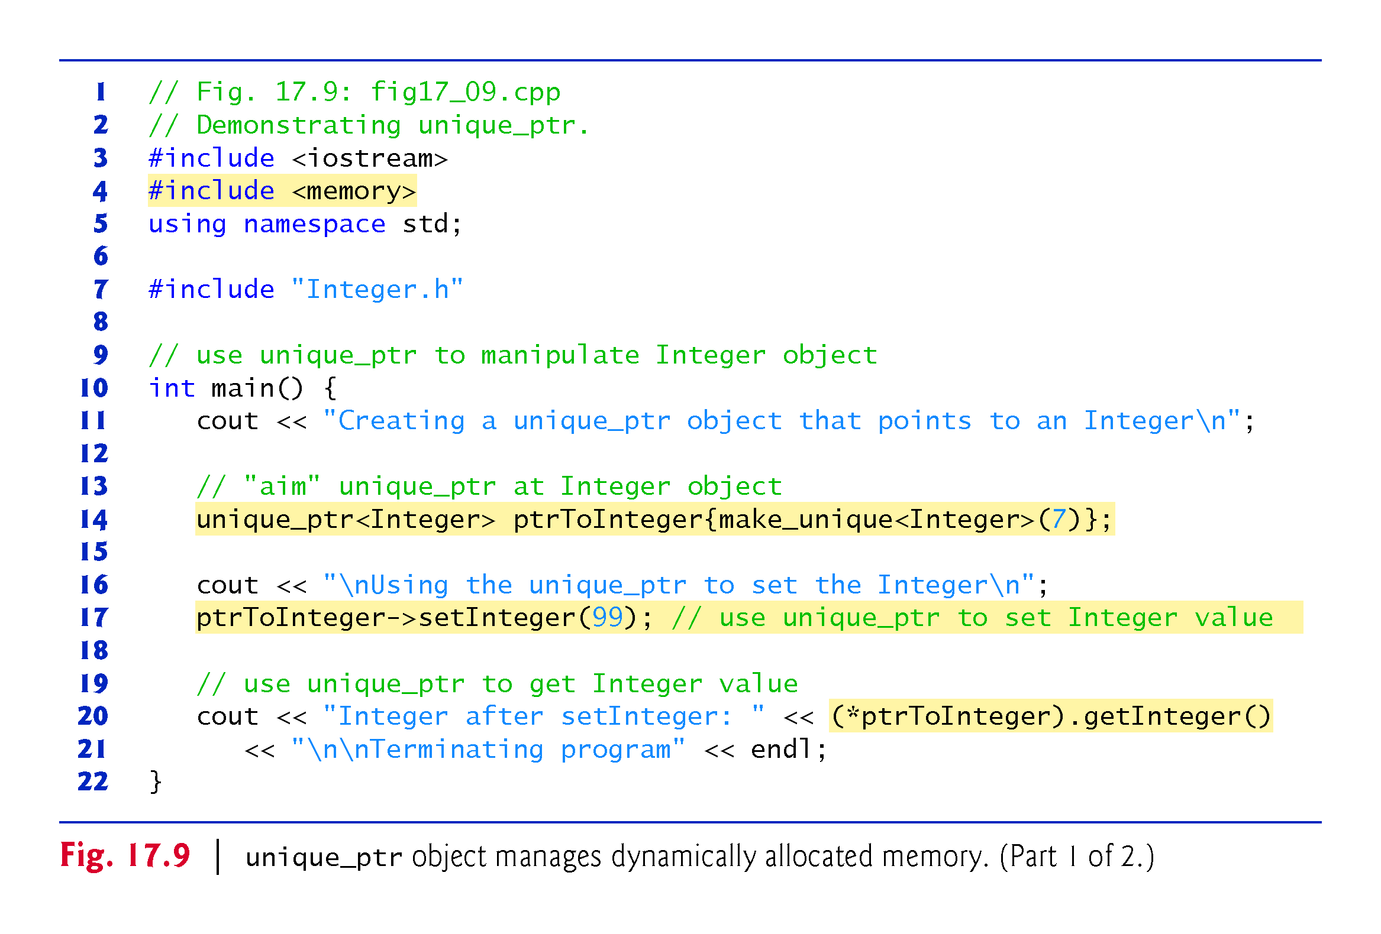

Slide 76
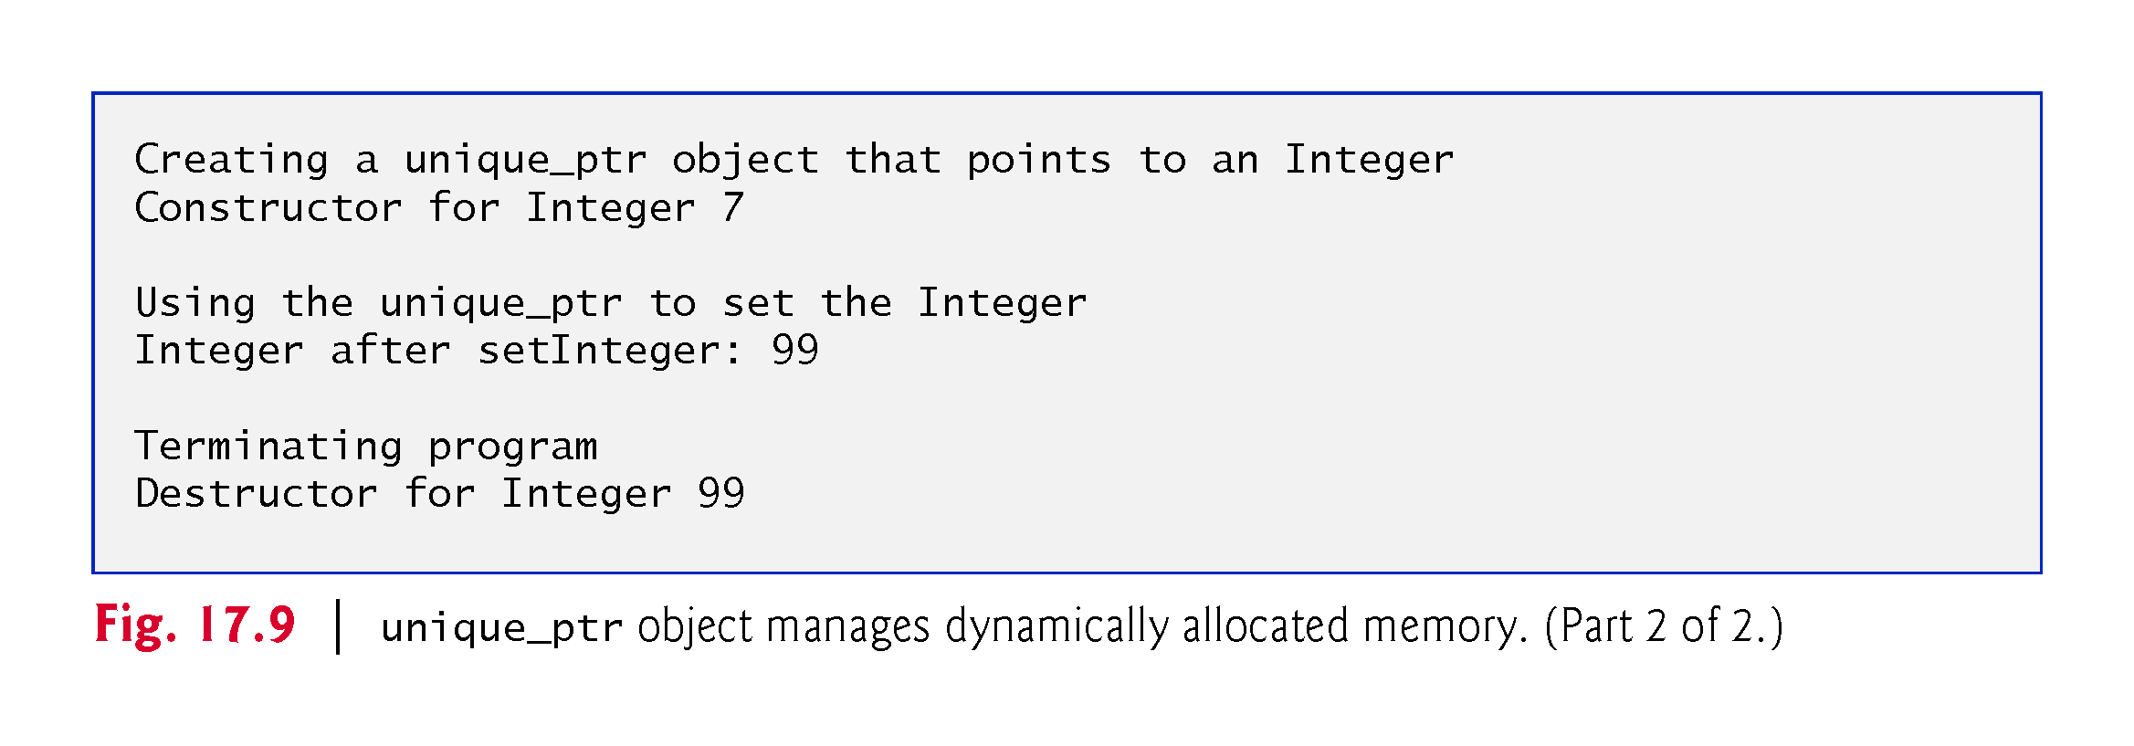

Slide 77
17.9 Class unique_ptr and Dynamic Memory Allocation (cont.)
Because ptrToInteger is a local automatic variable in main, ptrToInteger is destroyed when main terminates.
The unique_ptr destructor forces a delete of the Integer object pointed to by ptrToInteger, which in turn calls the Integer class destructor.
The memory that Integer occupies is released, regardless of how control leaves the block (e.g., by a return statement or by an exception).
Most importantly, using this technique can prevent memory leaks.

Slide 78
17.9.1 unique_ptr Ownership
The class is called unique_ptr because only one unique_ptr at a time can own a dynamically allocated object.
When you assign one unique_ptr to another, the unique_ptr on the assignment’s right transfers ownership of the dynamic memory it manages to the unique_ptr on the assignment’s left.
The same is true when one unique_ptr is passed as an argument to another unique_ptr’s constructor.
The last unique_ptr object that maintains the pointer to the dynamic memory will delete the memory.
This makes unique_ptr an ideal mechanism for returning dynamically allocated memory to client code.
When the unique_ptr goes out of scope in the client code, the unique_ptr’s destructor deletes the dynamically allocated object—if the object has a destructor, it is called before the memory is returned to the system.

Slide 79
17.9.2 unique_ptr to a Built-In Array
You can also use a unique_ptr to manage a dynamically allocated built-in array.
For example, consider the statement
unique_ptr<string[]> ptr{make_unique<string[]>(10)};
Because make_unique’s type is specified as string[], the function obtains a dynamically allocated built-in array of the number of elements specified by its argument (10).
By default, the elements of arrays allocated with make_unique are initialized to 0 for fundamental types, to false for bools or via the default constructor for objects of a class—so in this case, the array would contain 10 string objects initialized with the empty string.

Slide 80
17.9.2 unique_ptr to a Built-In Array
A unique_ptr that manages an array provides an overloaded [] operator for accessing the array’s elements.
For example, the statement
ptr[2] = "hello";
assigns "hello" to the string at ptr[2] and the statement
cout << ptr[2] << endl;
displays that string.

Slide 81
17.10 Standard Library Exception Hierarchy
Experience has shown that exceptions fall nicely into a number of categories.
The C++ Standard Library includes a hierarchy of exception classes, some of which are shown in Fig. 17.10.
As we first discussed in Section 17.2, this hierarchy is headed by base-class exception (defined in header file <exception>), which contains virtual function what that derived classes can override to issue appropriate error messages.
If a catch handler catches a reference to an exception of a base-class type, it also can catch a reference to all objects of classes derived publicly from that base class—this allows for polymorphic processing of related errors

Slide 82
17.10 Standard Library Exception Hierarchy (cont.)
Immediate derived classes of base-class exception include runtime_error and logic_error (both defined in header <stdexcept>), each of which has several derived classes.
Also derived from exception are the exceptions thrown by C++ operators—for example, bad_alloc is thrown by new (Section 17.8), bad_cast is thrown by dynamic_cast (Chapter 12) and bad_typeid is thrown by typeid (Chapter 12).

Slide 83
17.10 Standard Library Exception Hierarchy (cont.)
Class logic_error is the base class of several standard exception classes that indicate errors in program logic.
For example, class invalid_argument indicates that a function received an invalid argument.
Proper coding can, of course, prevent invalid arguments from reaching a function.
Class length_error indicates that a length larger than the maximum size allowed for the object being manipulated was used for that object.
Class out_of_range indicates that a value, such as a subscript into an array, exceeded its allowed range of values.

Slide 84
17.10 Standard Library Exception Hierarchy (cont.)
Class runtime_error, which we used briefly in Section 17.4, is the base class of several other standard exception classes that indicate execution-time errors.
For example, class overflow_error describes an arithmetic overflow error (i.e., the result of an arithmetic operation is larger than the largest number that can be stored in the computer) and class underflow_error describes an arithmetic underflow error (i.e., the result of an arithmetic operation is smaller than the smallest number that can be stored in the computer).

Slide 85
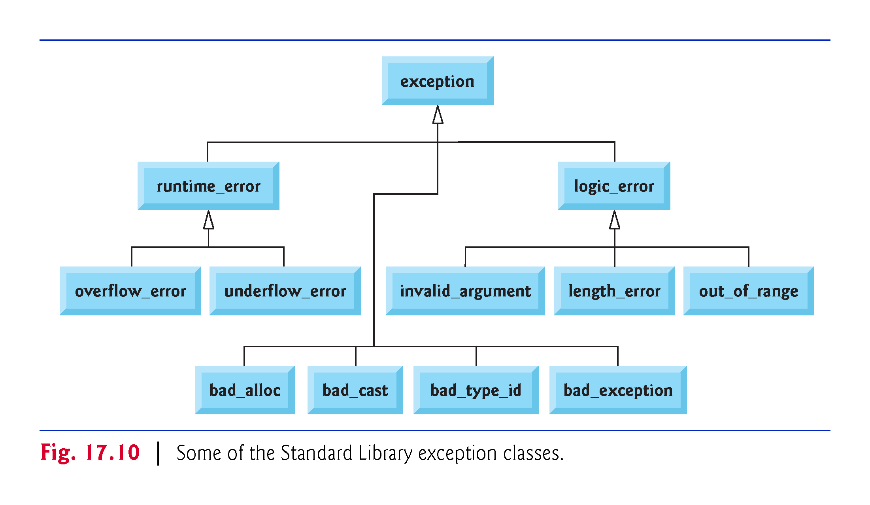

Slide 86
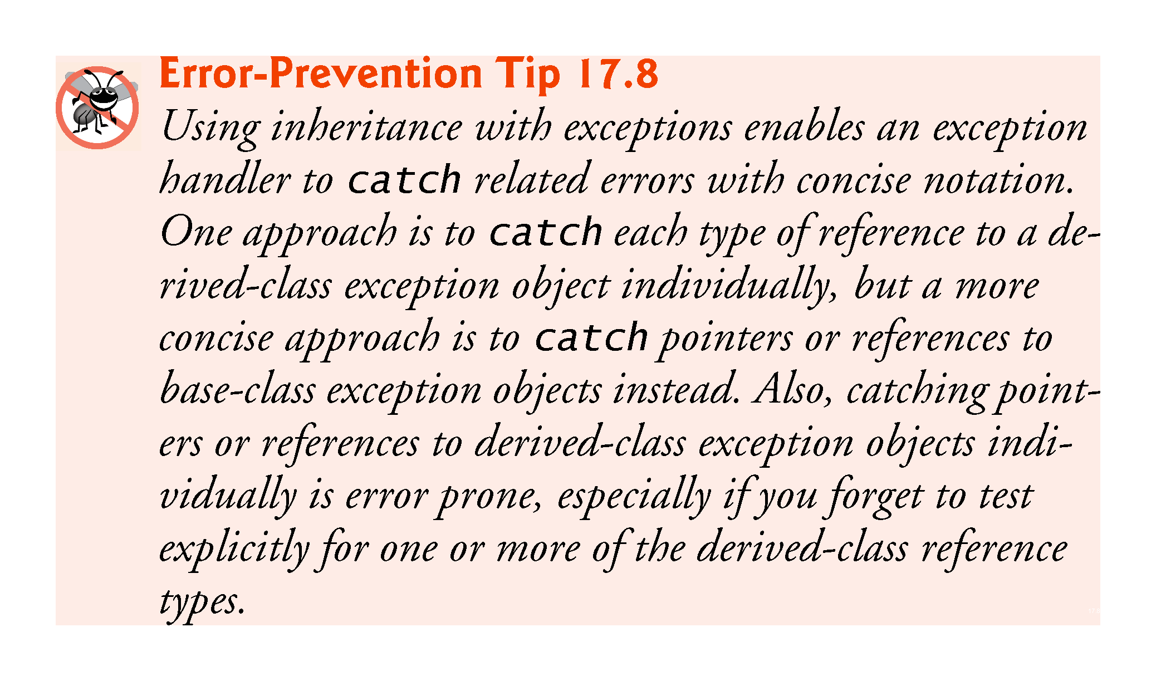

Slide 87
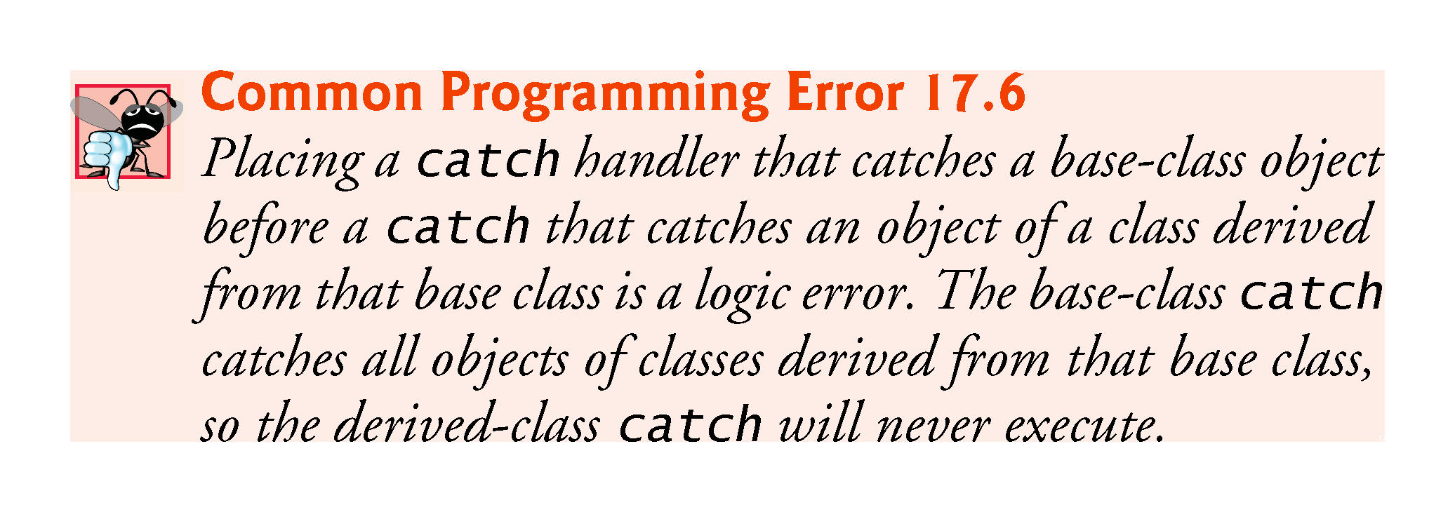

Slide 88
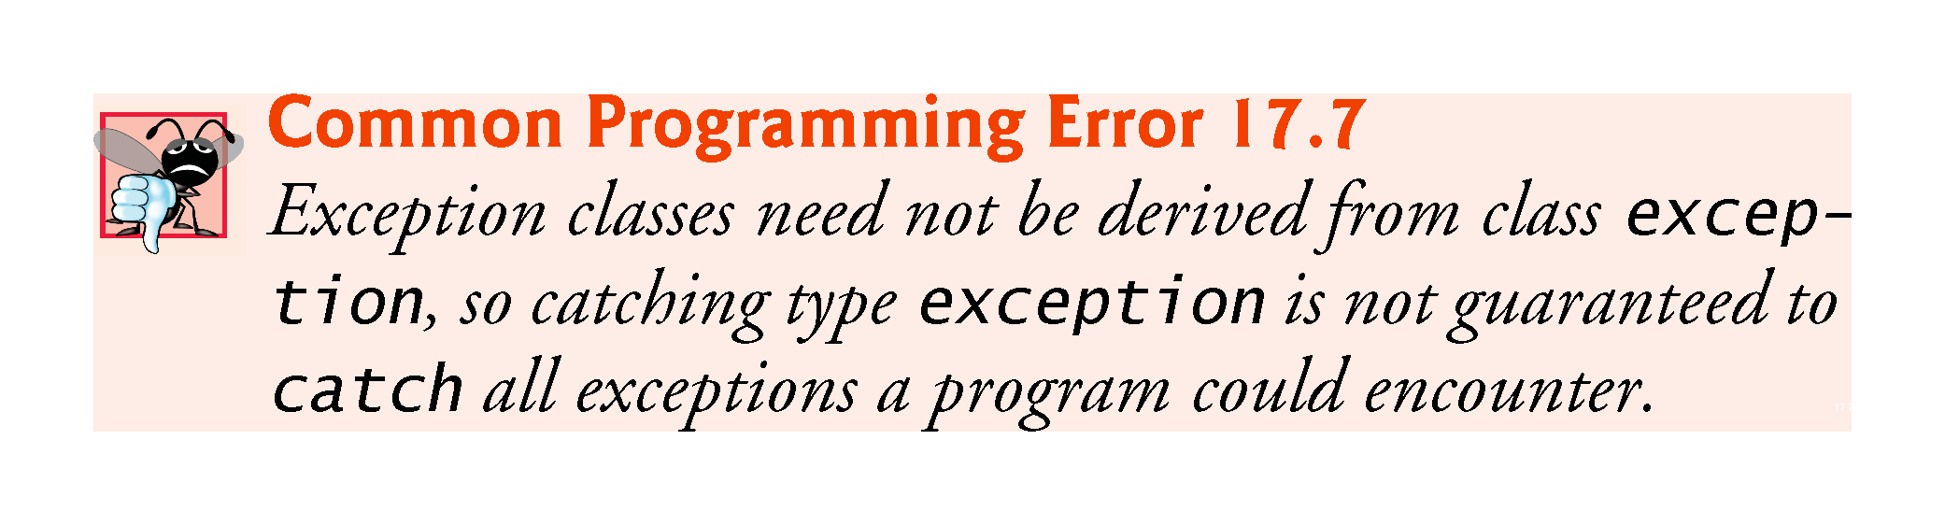

Slide 89
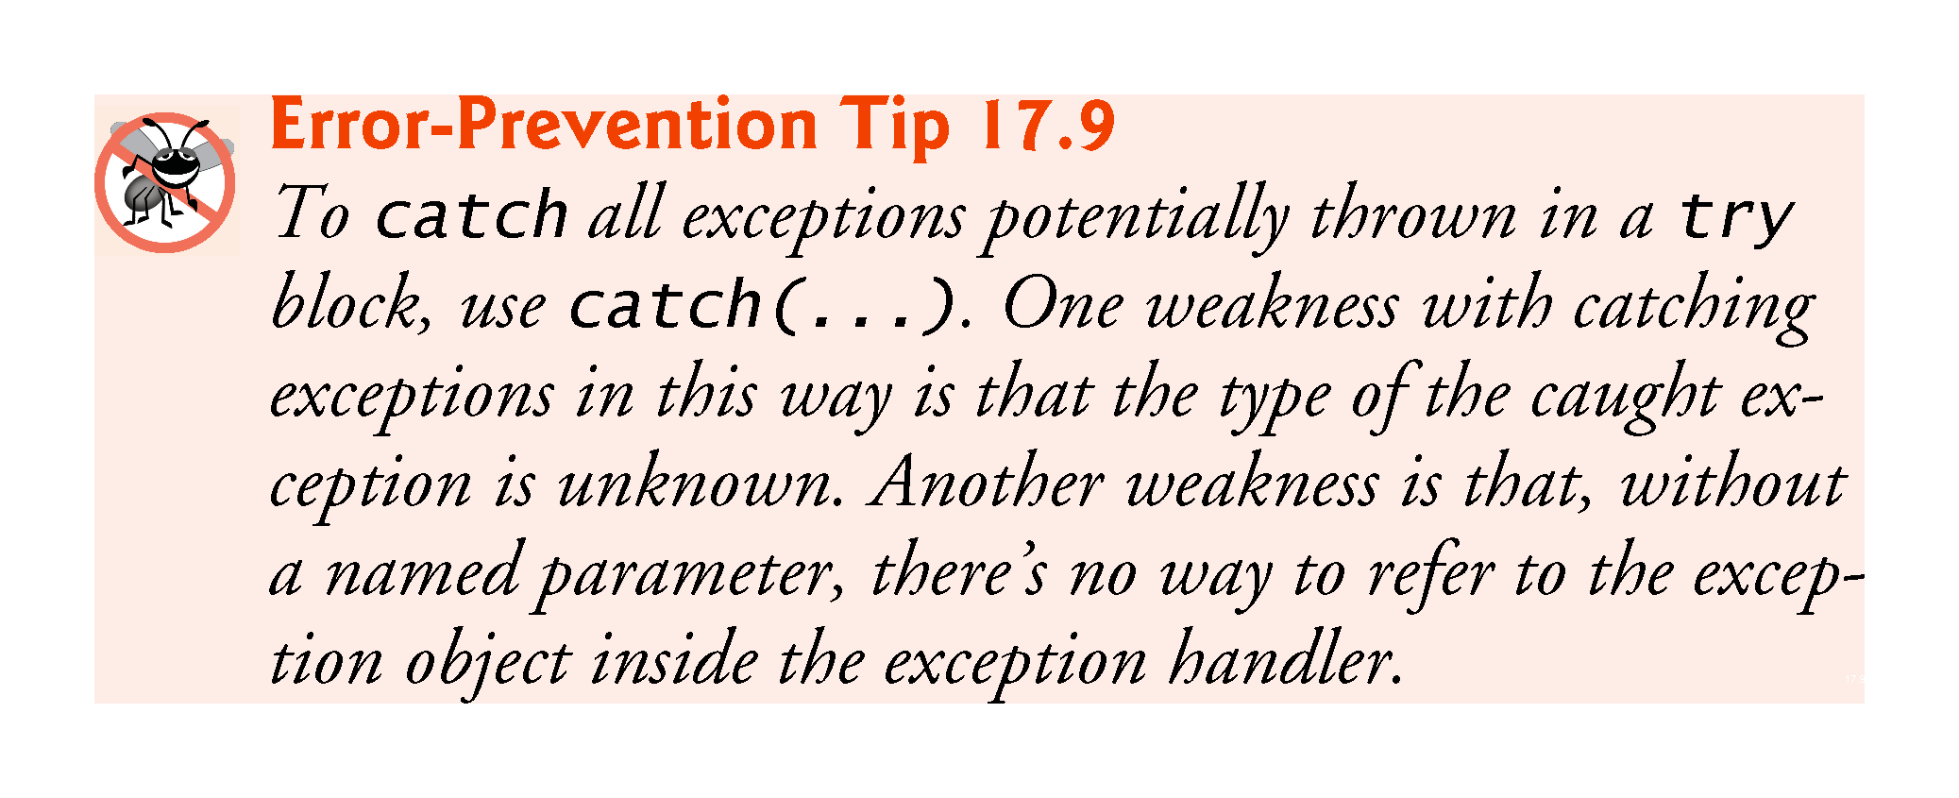

Slide 90
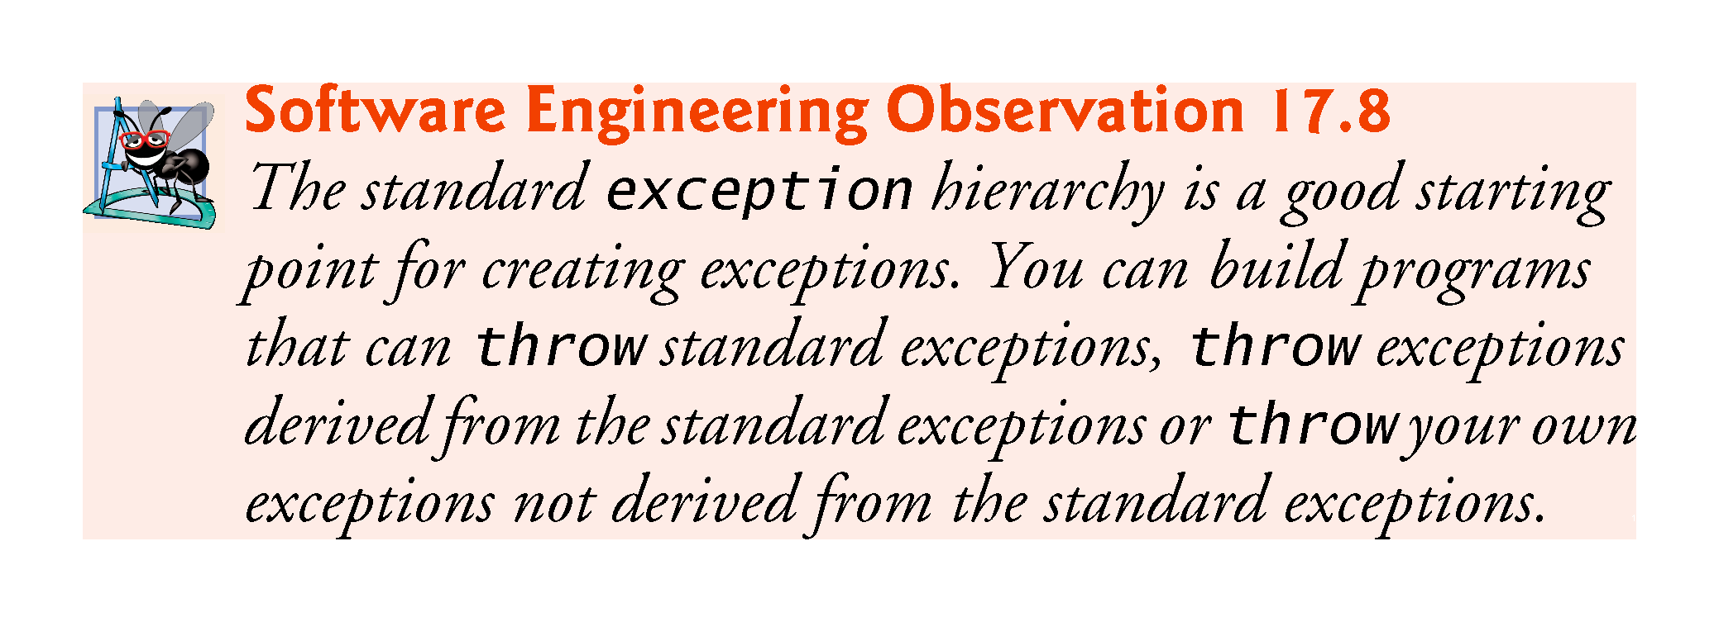

Slide 91
