Slide 1
Introduction to Custom Templates
Based on Chapter 18 of C++ How to Program, 10/e

Slide 2
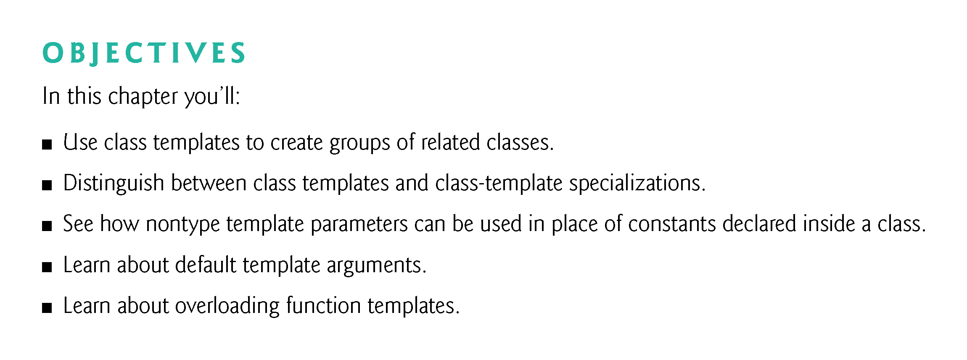

Slide 3
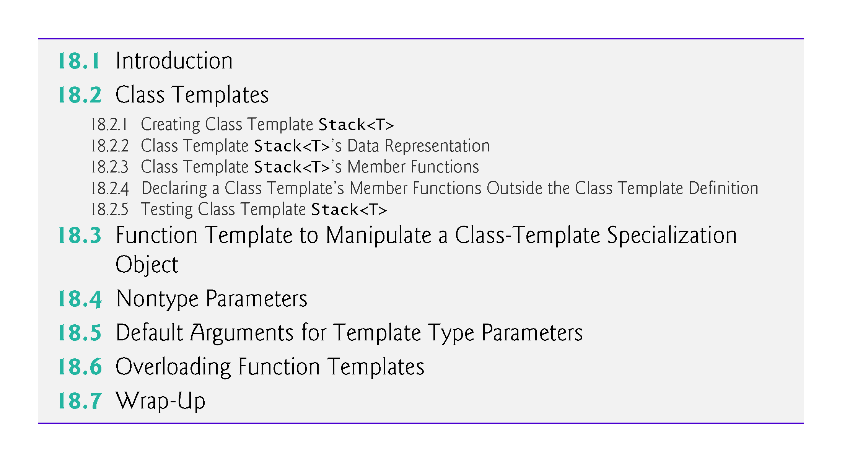

Slide 4
18.1 Introduction
Figure 18.1 summarizes our template coverage.

Slide 5
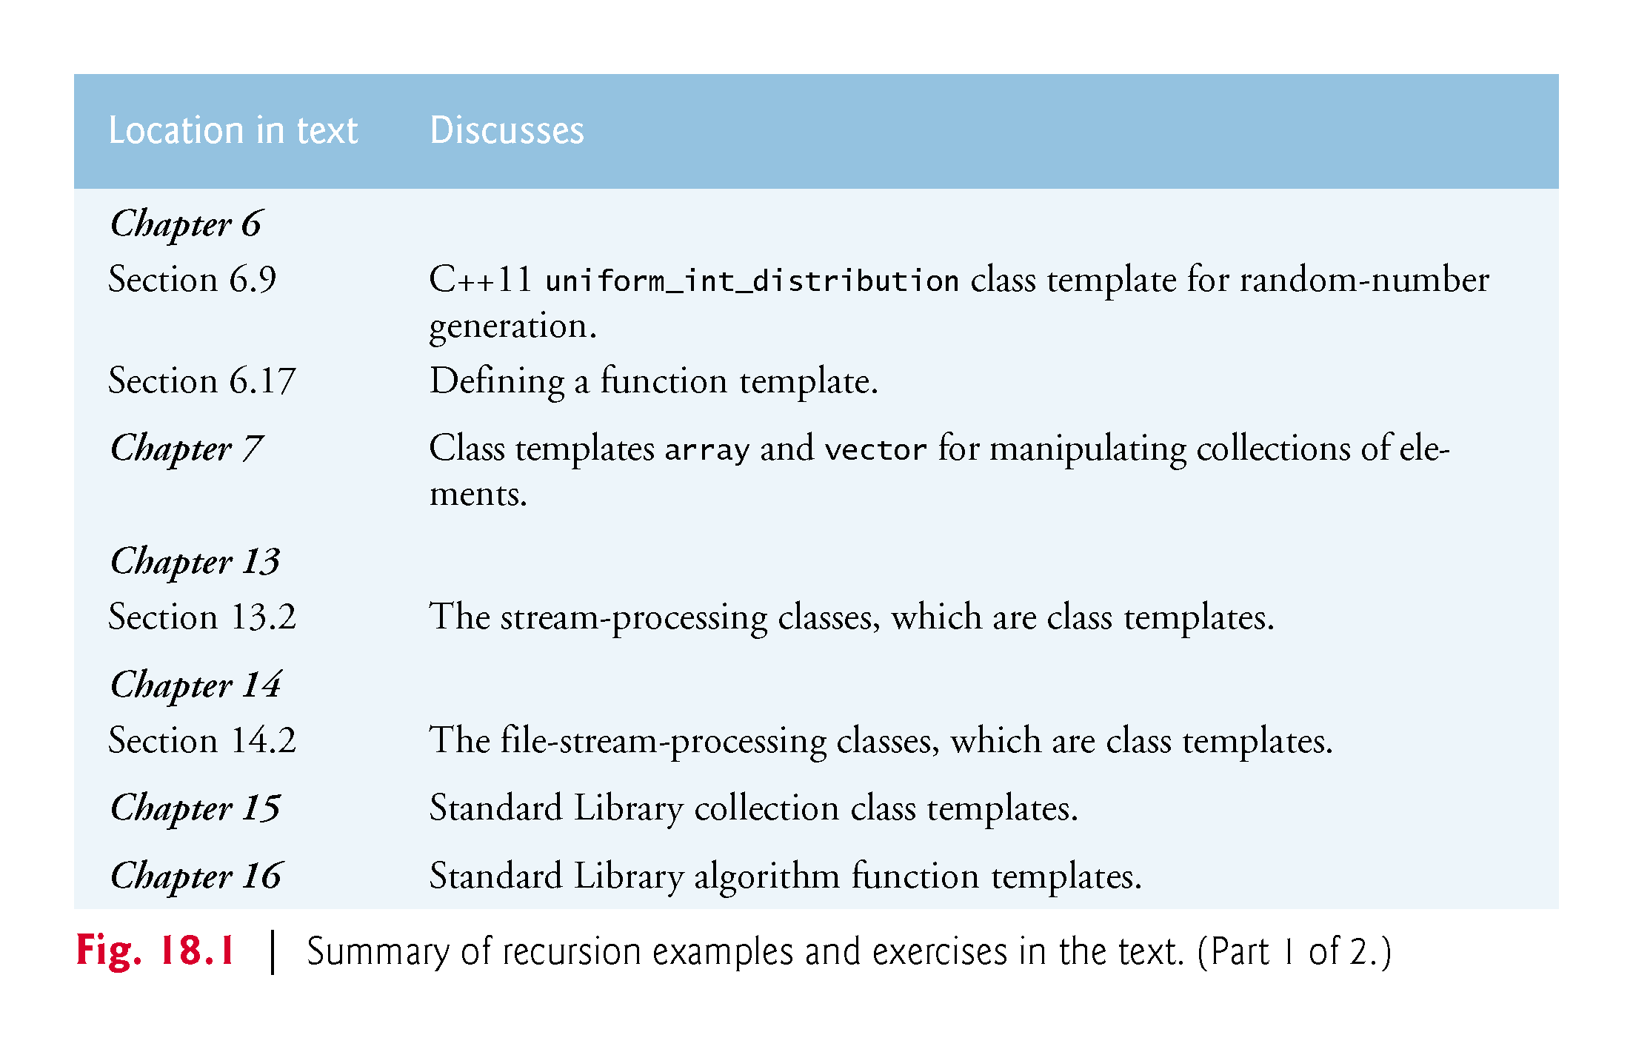

Slide 6
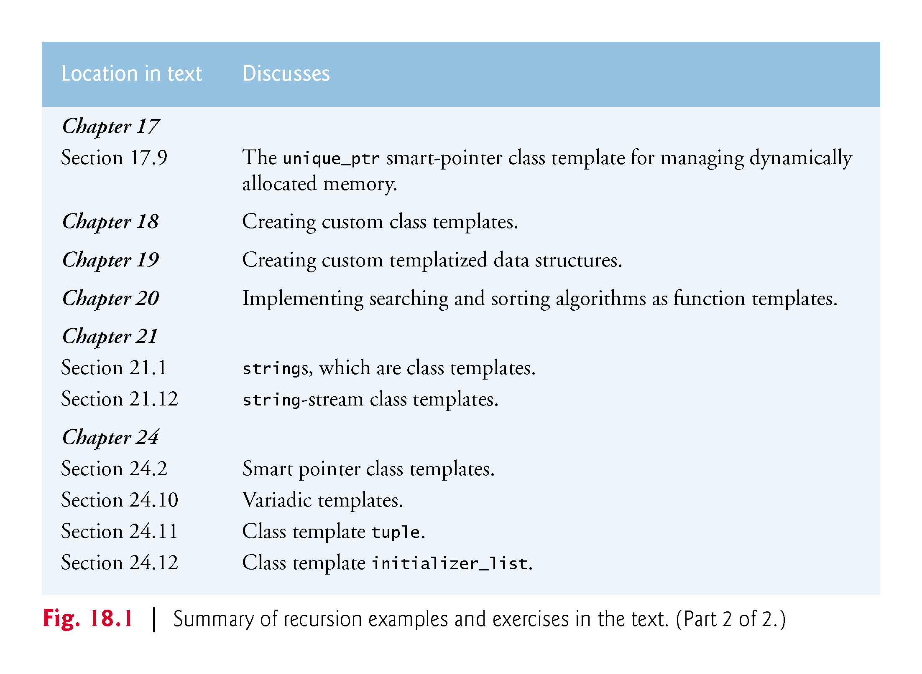

Slide 7
18.1 Introduction
Function templates enable you to conveniently specify a variety of related (overloaded) functions—called function-template specializations.
Class templates enable you to conveniently specify a variety of related classes—called class-template specializations.
Programming with templates is known as generic programming.
Function templates and class templates are like stencils out of which we trace shapes; function-template specializations and class-template specializations are like the separate tracings that all have the same shape, but could, for example, be drawn in different colors , line thickneses and textures.

Slide 8
18.2 Class Templates
It’s possible to understand the concept of a stack (a data structure into which we insert items only at the top and retrieve those items only from the top in last-in, first-out order) independent of the type of the items being placed in the stack.
To instantiate a stack, a data type must be specified.
Nice opportunity for software reusability.
Here, we define a stack generically then use type-specific versions of this generic stack class.

Slide 9
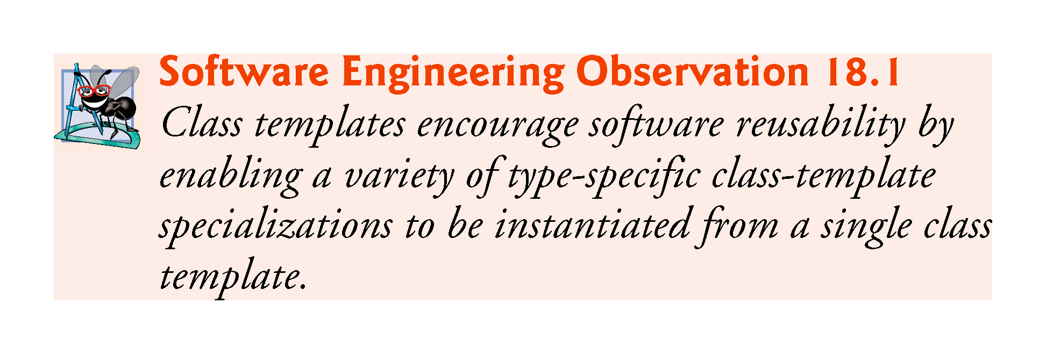

Slide 10
18.2 Class Templates (cont.)
Class templates are called parameterized types, because they require one or more type parameters to specify how to customize a generic class template to form a class-template specialization.
When a particular specialization is needed, you use a concise, simple notation, and the compiler writes the specialization source code.

Slide 11
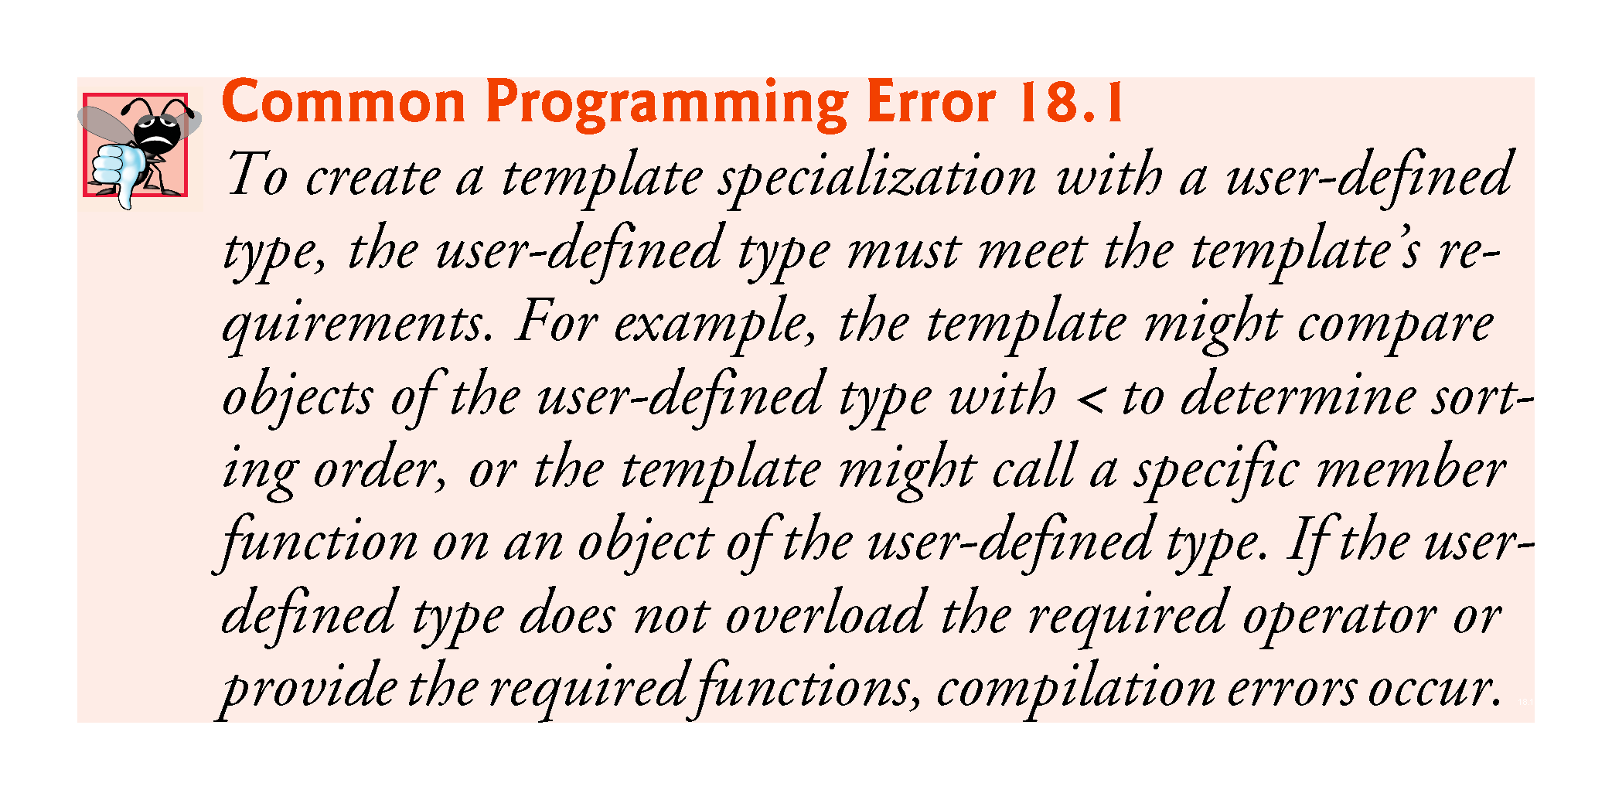

Slide 12
18.2 Class Templates (cont.)
Creating Class Template Stack<T>
The Stack class-template definition in Fig. 18.2 looks like a conventional class definition, with a few key differences.
First, template<typename T>
Class templates begin with template followed by a list of template parameters enclosed in angle brackets (< and >)
Each template parameter that represents a type must be preceded by either of the interchangeable keywords typename or class.
T acts as a placeholder for the Stack’s element type.
Can be any valid identifier
Type parameters names must be unique inside a template definition.

Slide 13
18.2 Class Templates (cont.)
The element type is mentioned generically throughout the Stack class-template definition as T (lines 11, 16 and 36).
The type parameter becomes associated with a specific type when you create an object using the class template—at that point, the compiler generates a copy of the class template in which all occurrences of the type parameter are replaced with the specified type.
Another key difference is that we did not separate the class template’s interface from its implementation.

Slide 14
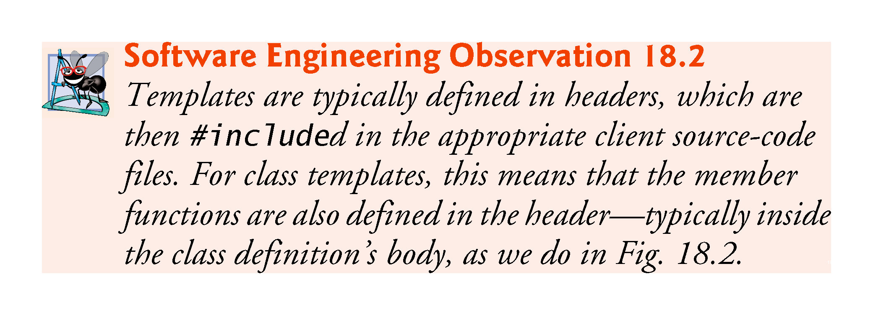

Slide 15
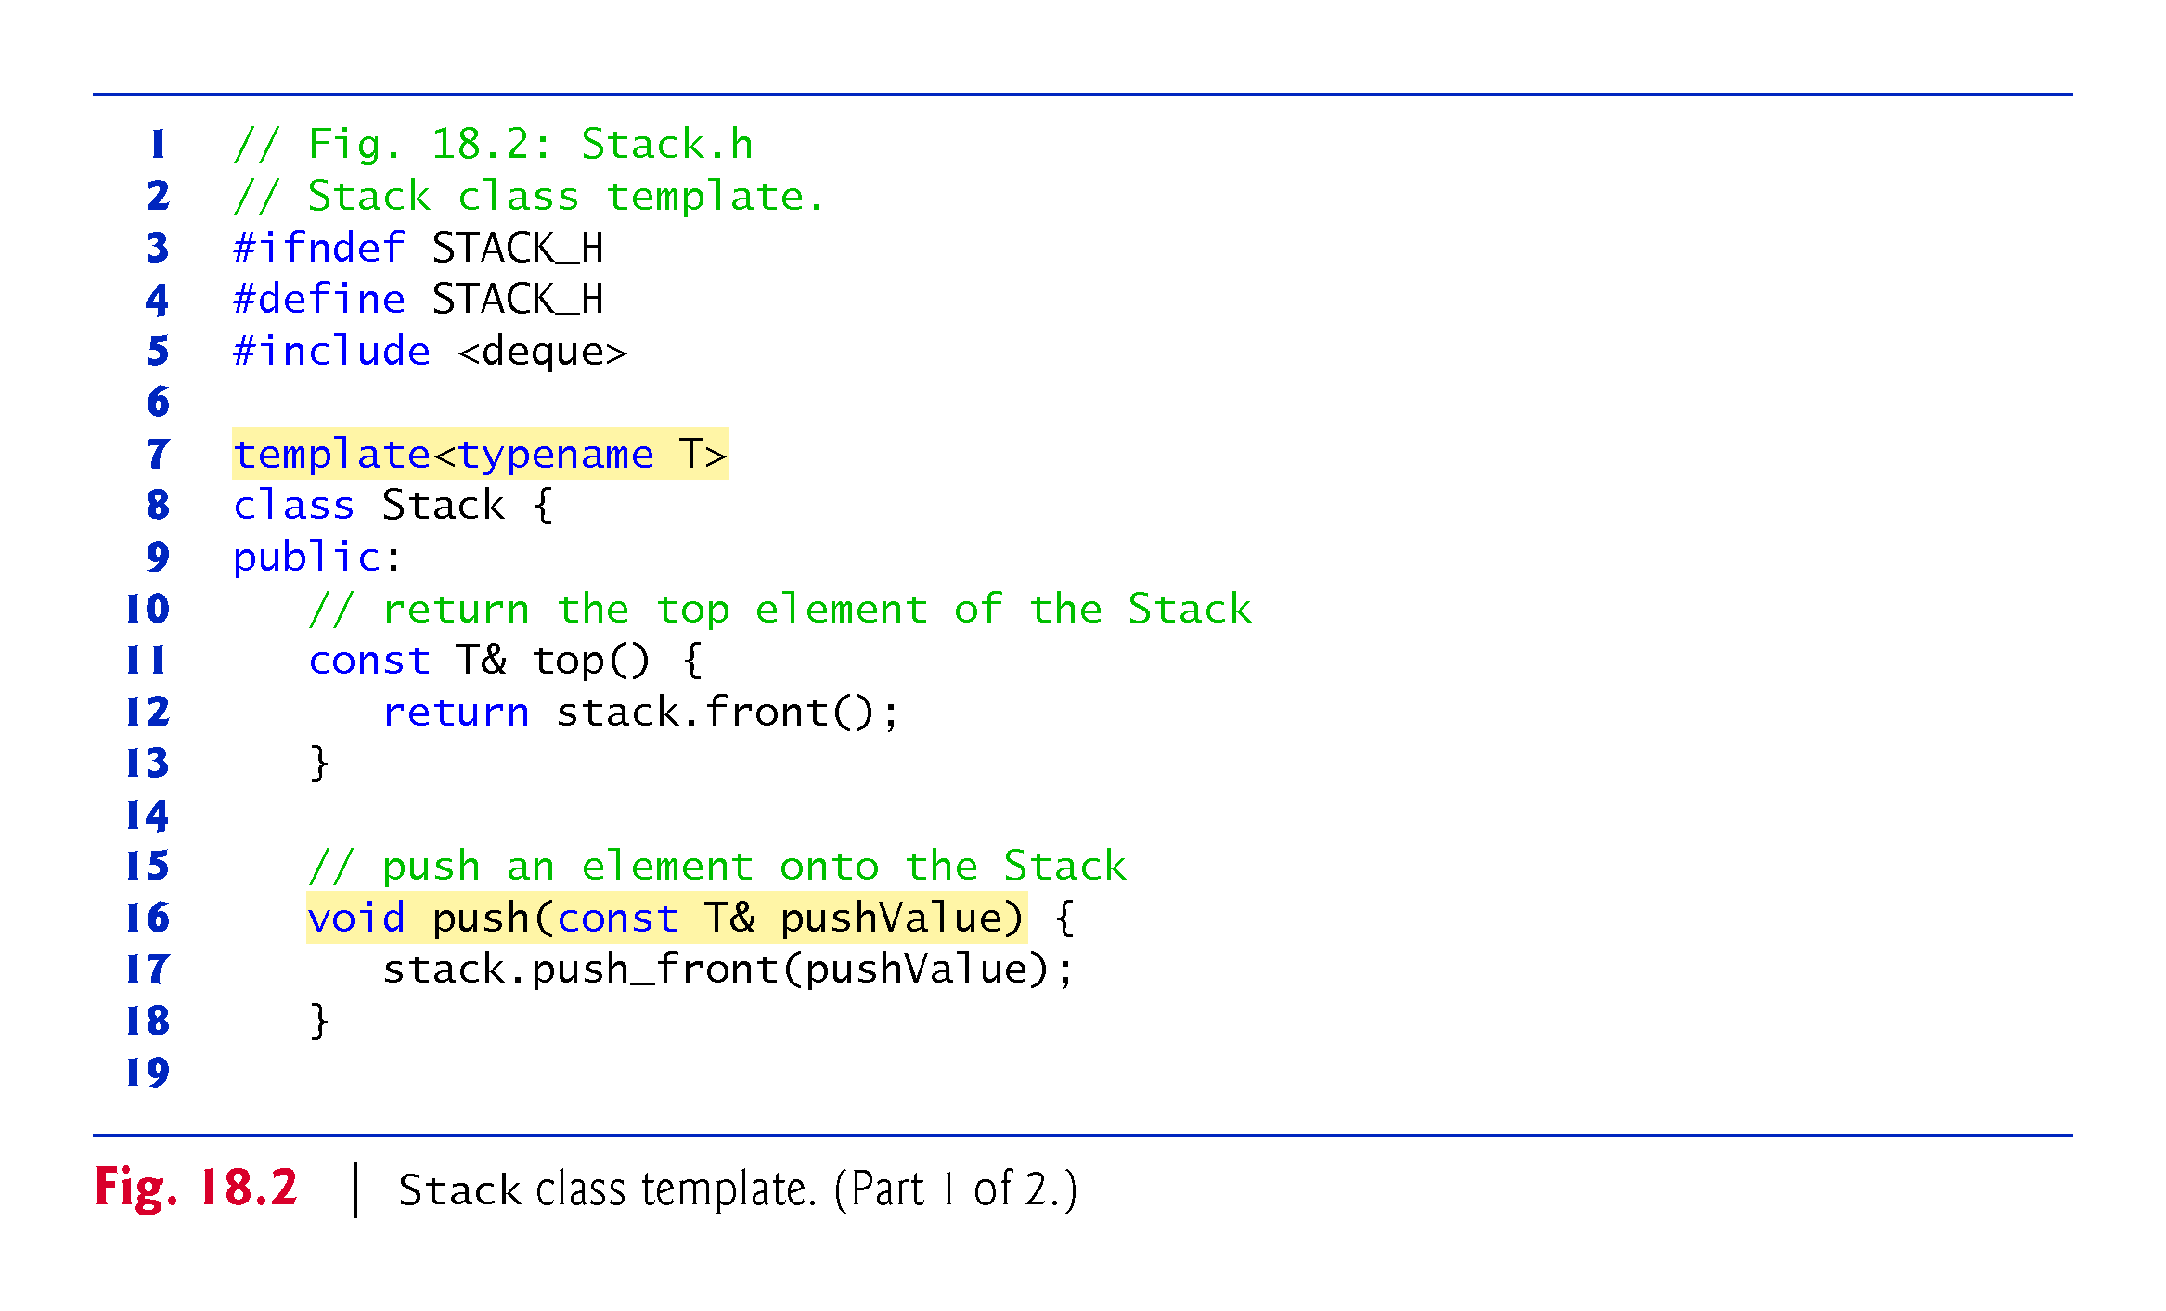

Slide 16
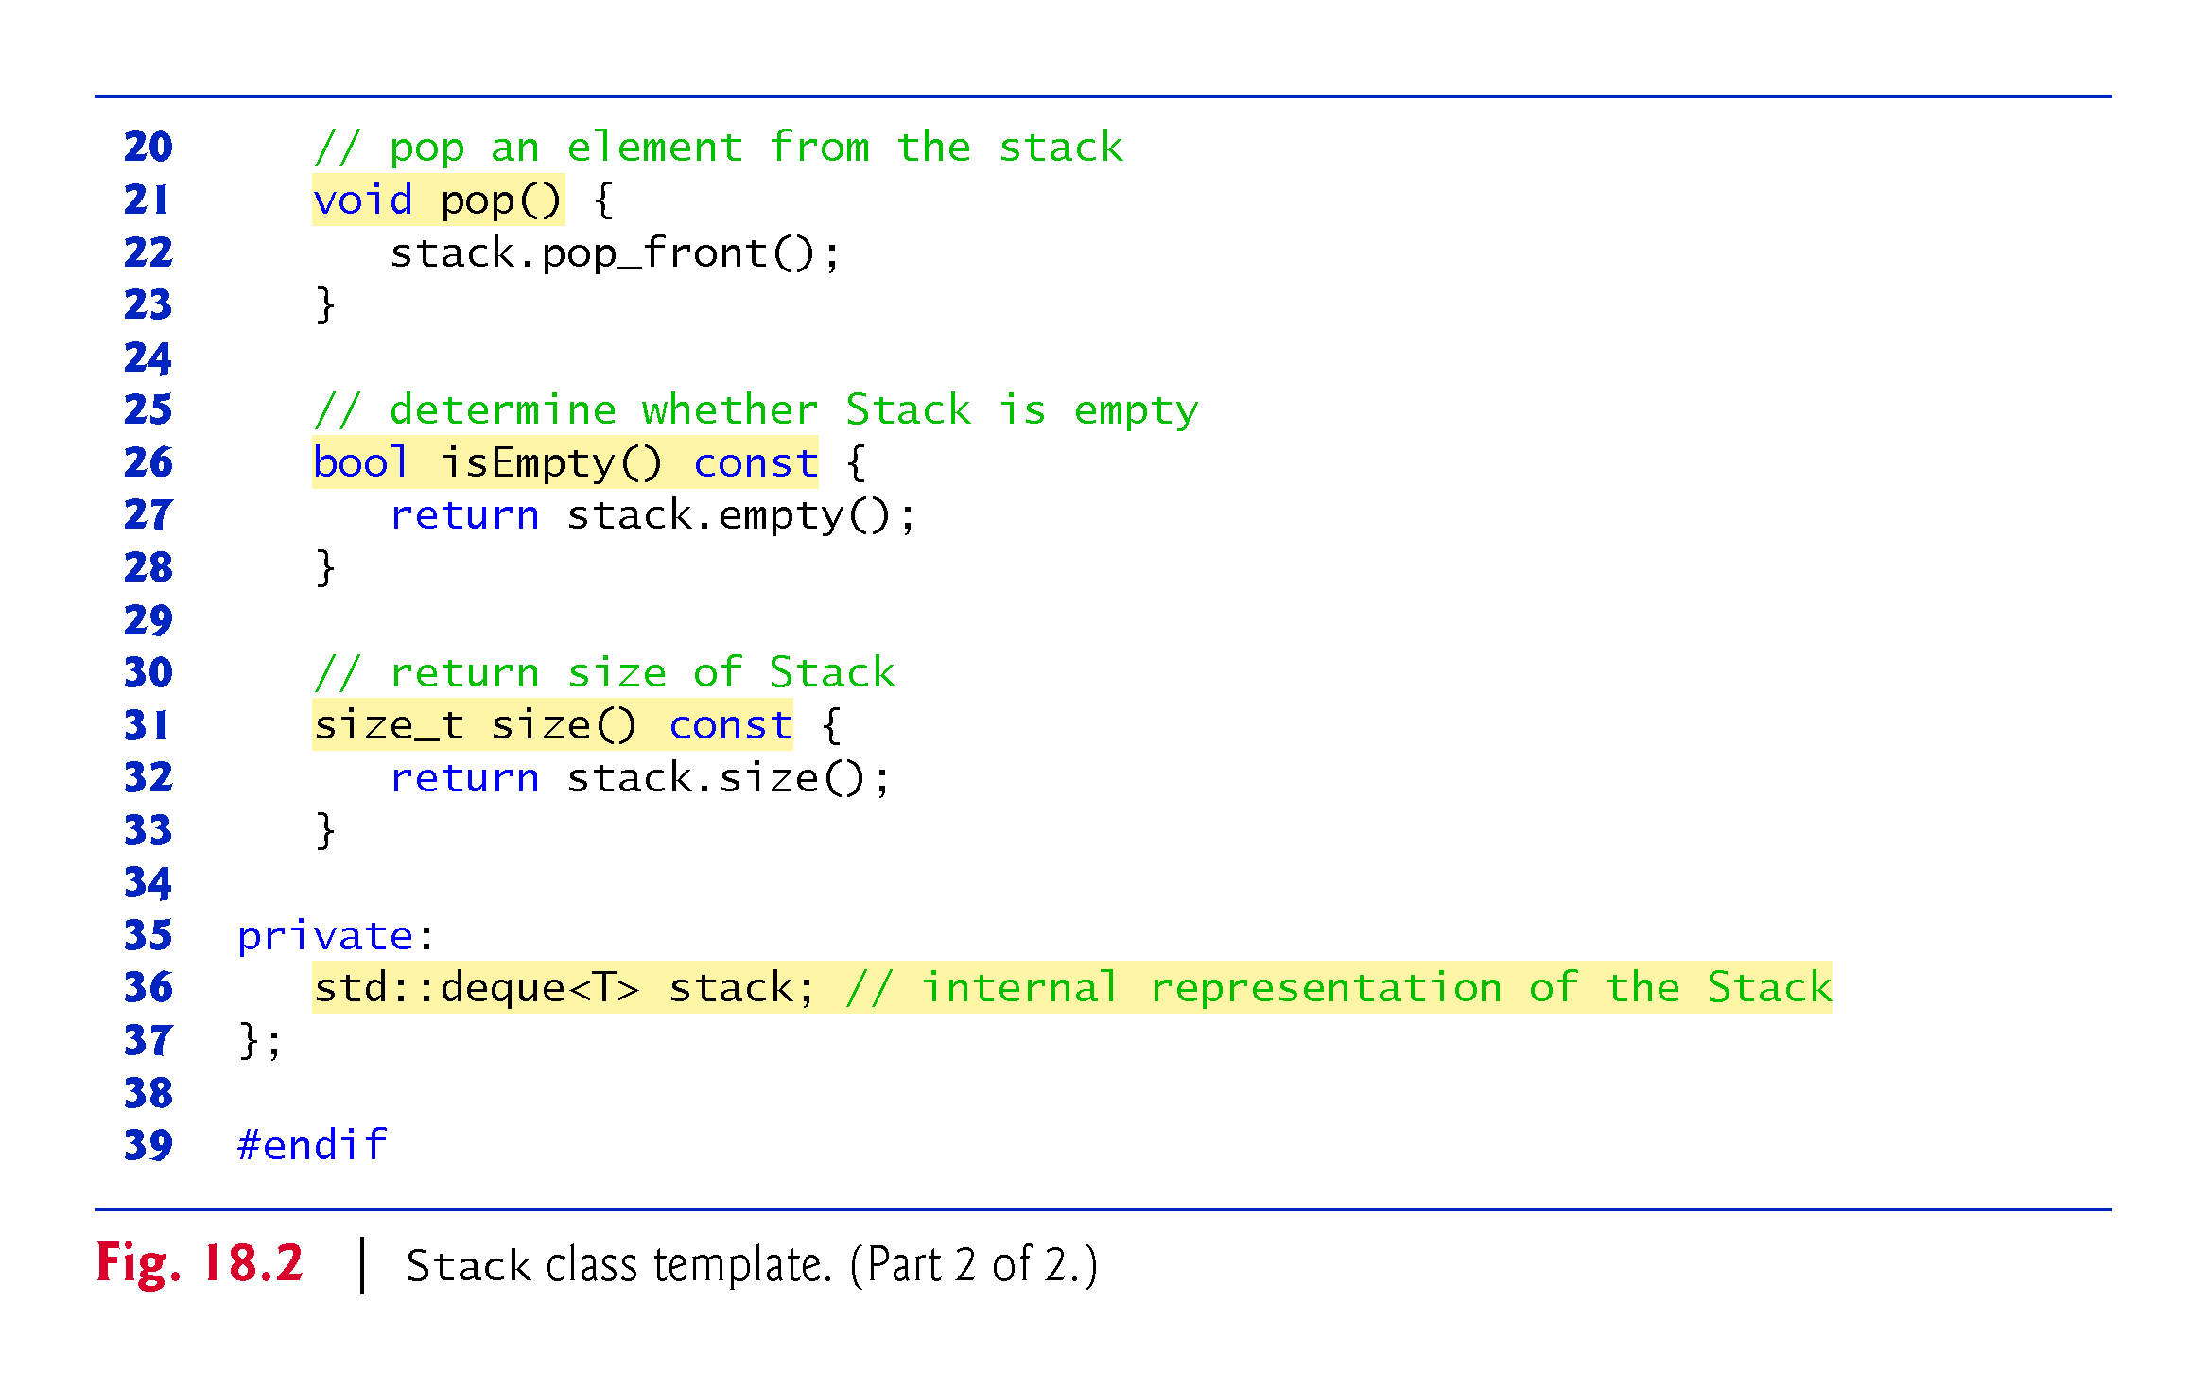

Slide 17
18.2 Class Templates (cont.)
Class Template Stack<T>’s Data Representation
A stack requires insertions and deletions only at its top.
So, for example, a vector or a deque could be used to store the stack’s elements.
A vector supports fast insertions and deletions at its back.
A deque supports fast insertions and deletions at its front and its back.
A deque is the default representation for the Standard Library’s stack adapter because a deque grows more efficiently than a vector.

Slide 18
18.2 Class Templates (cont.)
A vector is maintained as a contiguous block of memory—when that block is full and a new element is added, the vector allocates a larger contiguous block of memory and copies the old elements into that new block.
A deque, on the other hand, is typically implemented as list of fixed-size, built-in arrays—new fixed-size built-in arrays are added as necessary and none of the existing elements are copied when new items are added to the front or back.
For these reasons, we use a deque (line 36) as the underlying container for our Stack class.

Slide 19
18.2 Class Templates (cont.)
Class Template Stack<T>’s Member Functions
The member-function definitions of a class template are function templates, but are not preceded with the template keyword and template parameters in angle brackets (< and >) when they’re defined within the class template’s body.
As you can see, however, they do use the class template’s template parameter T to represent the element type.
Our Stack class template does not define it’s own constructors—the default constructor provided by the compiler will invoke the deque’s default constructor.

Slide 20
18.2 Class Templates (cont.)
Member functions:
top (lines 11–13) returns a reference to the Stack’s top element.
push (lines 16–18) places a new element on the top of the Stack.
pop (lines 21–23) removes the Stack’s top element.
isEmpty (lines 26–28) returns a bool value—true if the Stack is empty and false otherwise.
size (lines 31–33) returns the number if elements in the Stack.
Each delegates its responsibility to the appropriate member function of class template deque—known as delegating.

Slide 21
18.2 Class Templates (cont.)
Declaring a Class Template’s Member Functions Outside the Class Template Definition
Member-function definitions can appear outside a class template definition.
If so, each must begin with template followed by the same set of template parameters as the class template.
In addition, the member functions must be qualified with the class name and scope resolution operator.

Slide 22
18.2 Class Templates (cont.)
For example, you can define the pop function outside the class-template definition as follows:
template<typename T>
inline void Stack<T>::pop() {
stack.pop_front();
}
Stack<T>:: indicates that pop is in the scope of class Stack<T>.
The Standard Library’s container classes tend to define all their member functions inside their class definitions.

Slide 23
18.2 Class Templates (cont.)
Testing Class Template Stack<T>
Now, let’s consider the driver (Fig. 18.3) that exercises the Stack class template.
The driver begins by instantiating object doubleStack (line 8).
This object is declared as a Stack<double> (pronounced “Stack of double”).
The compiler associates type double with type parameter T in the class template to produce the source code for a Stack class with elements of type double that actually stores its elements in a deque<double>.

Slide 24
18.2 Class Templates (cont.)
Lines 15–19 invoke push (line 16) to place the double values 1.1, 2.2, 3.3, 4.4 and 5.5 onto doubleStack.
Next, lines 24–27 invoke top and pop in a while loop to remove the five values from the stack.
Notice in the output that the values do pop off in last-in, first-out order.
When doubleStack is empty, the pop loop terminates.

Slide 25
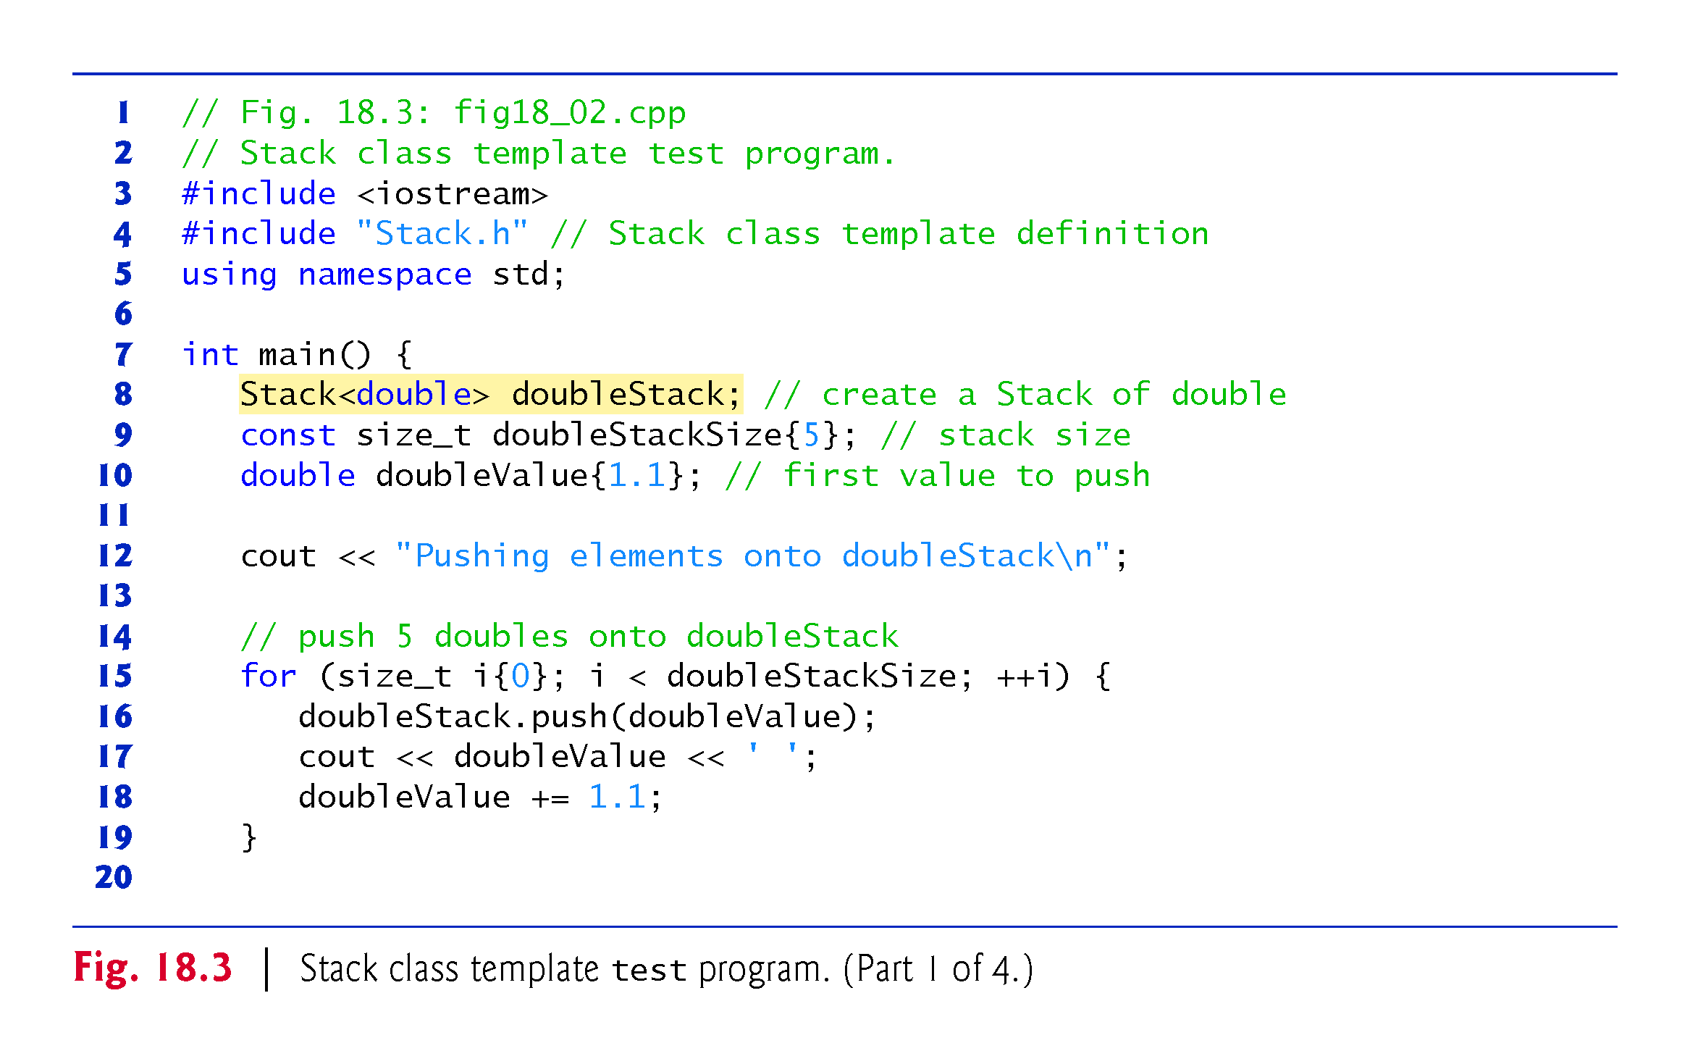

Slide 26
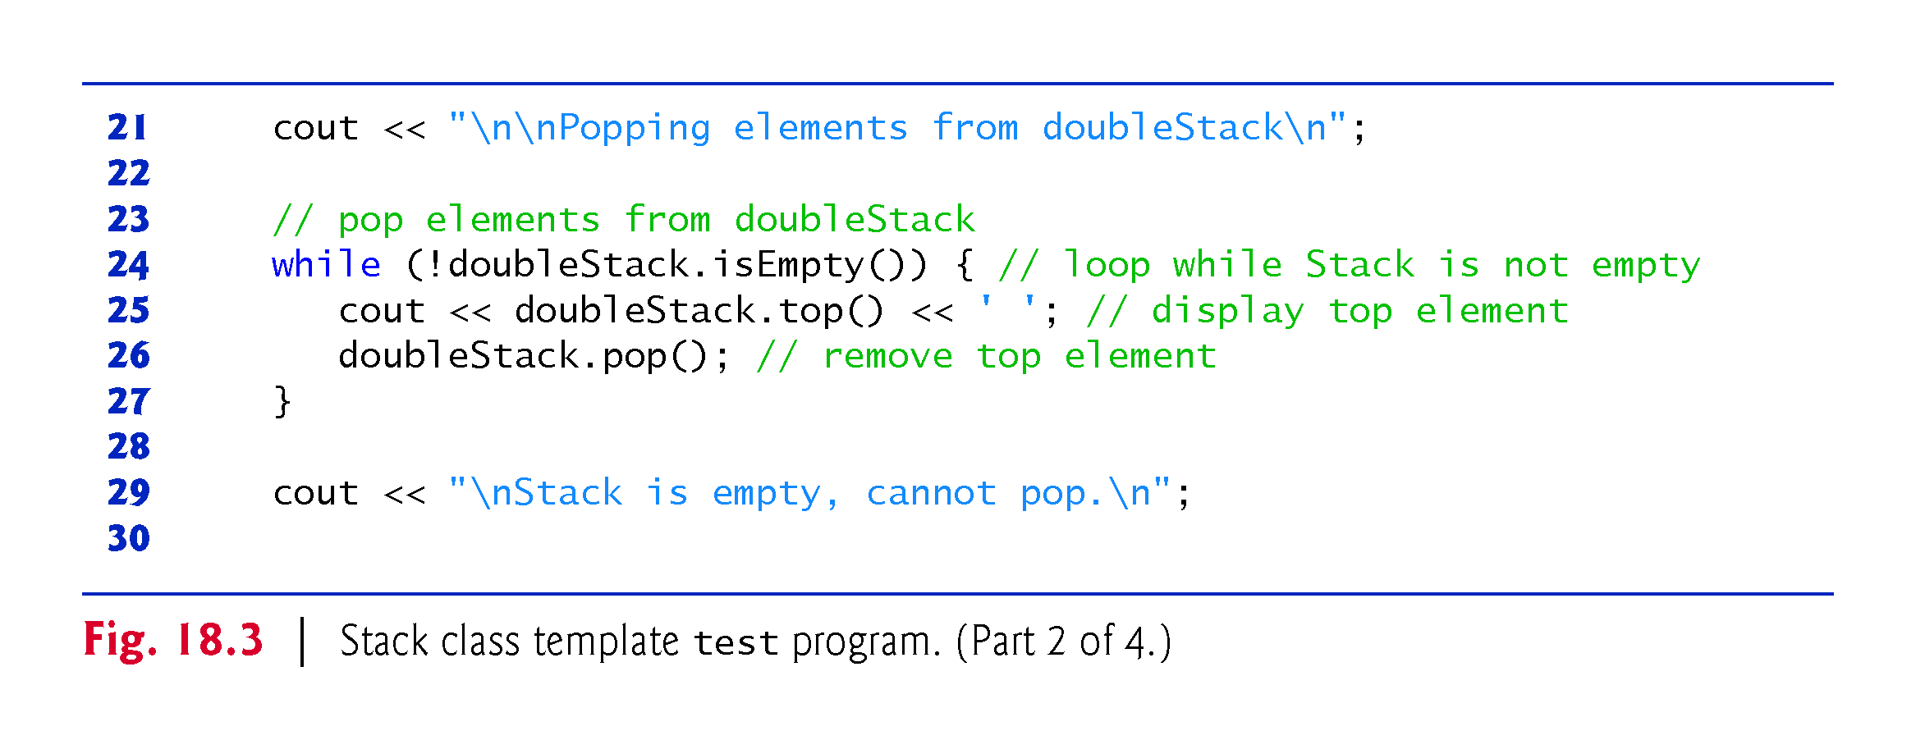

Slide 27
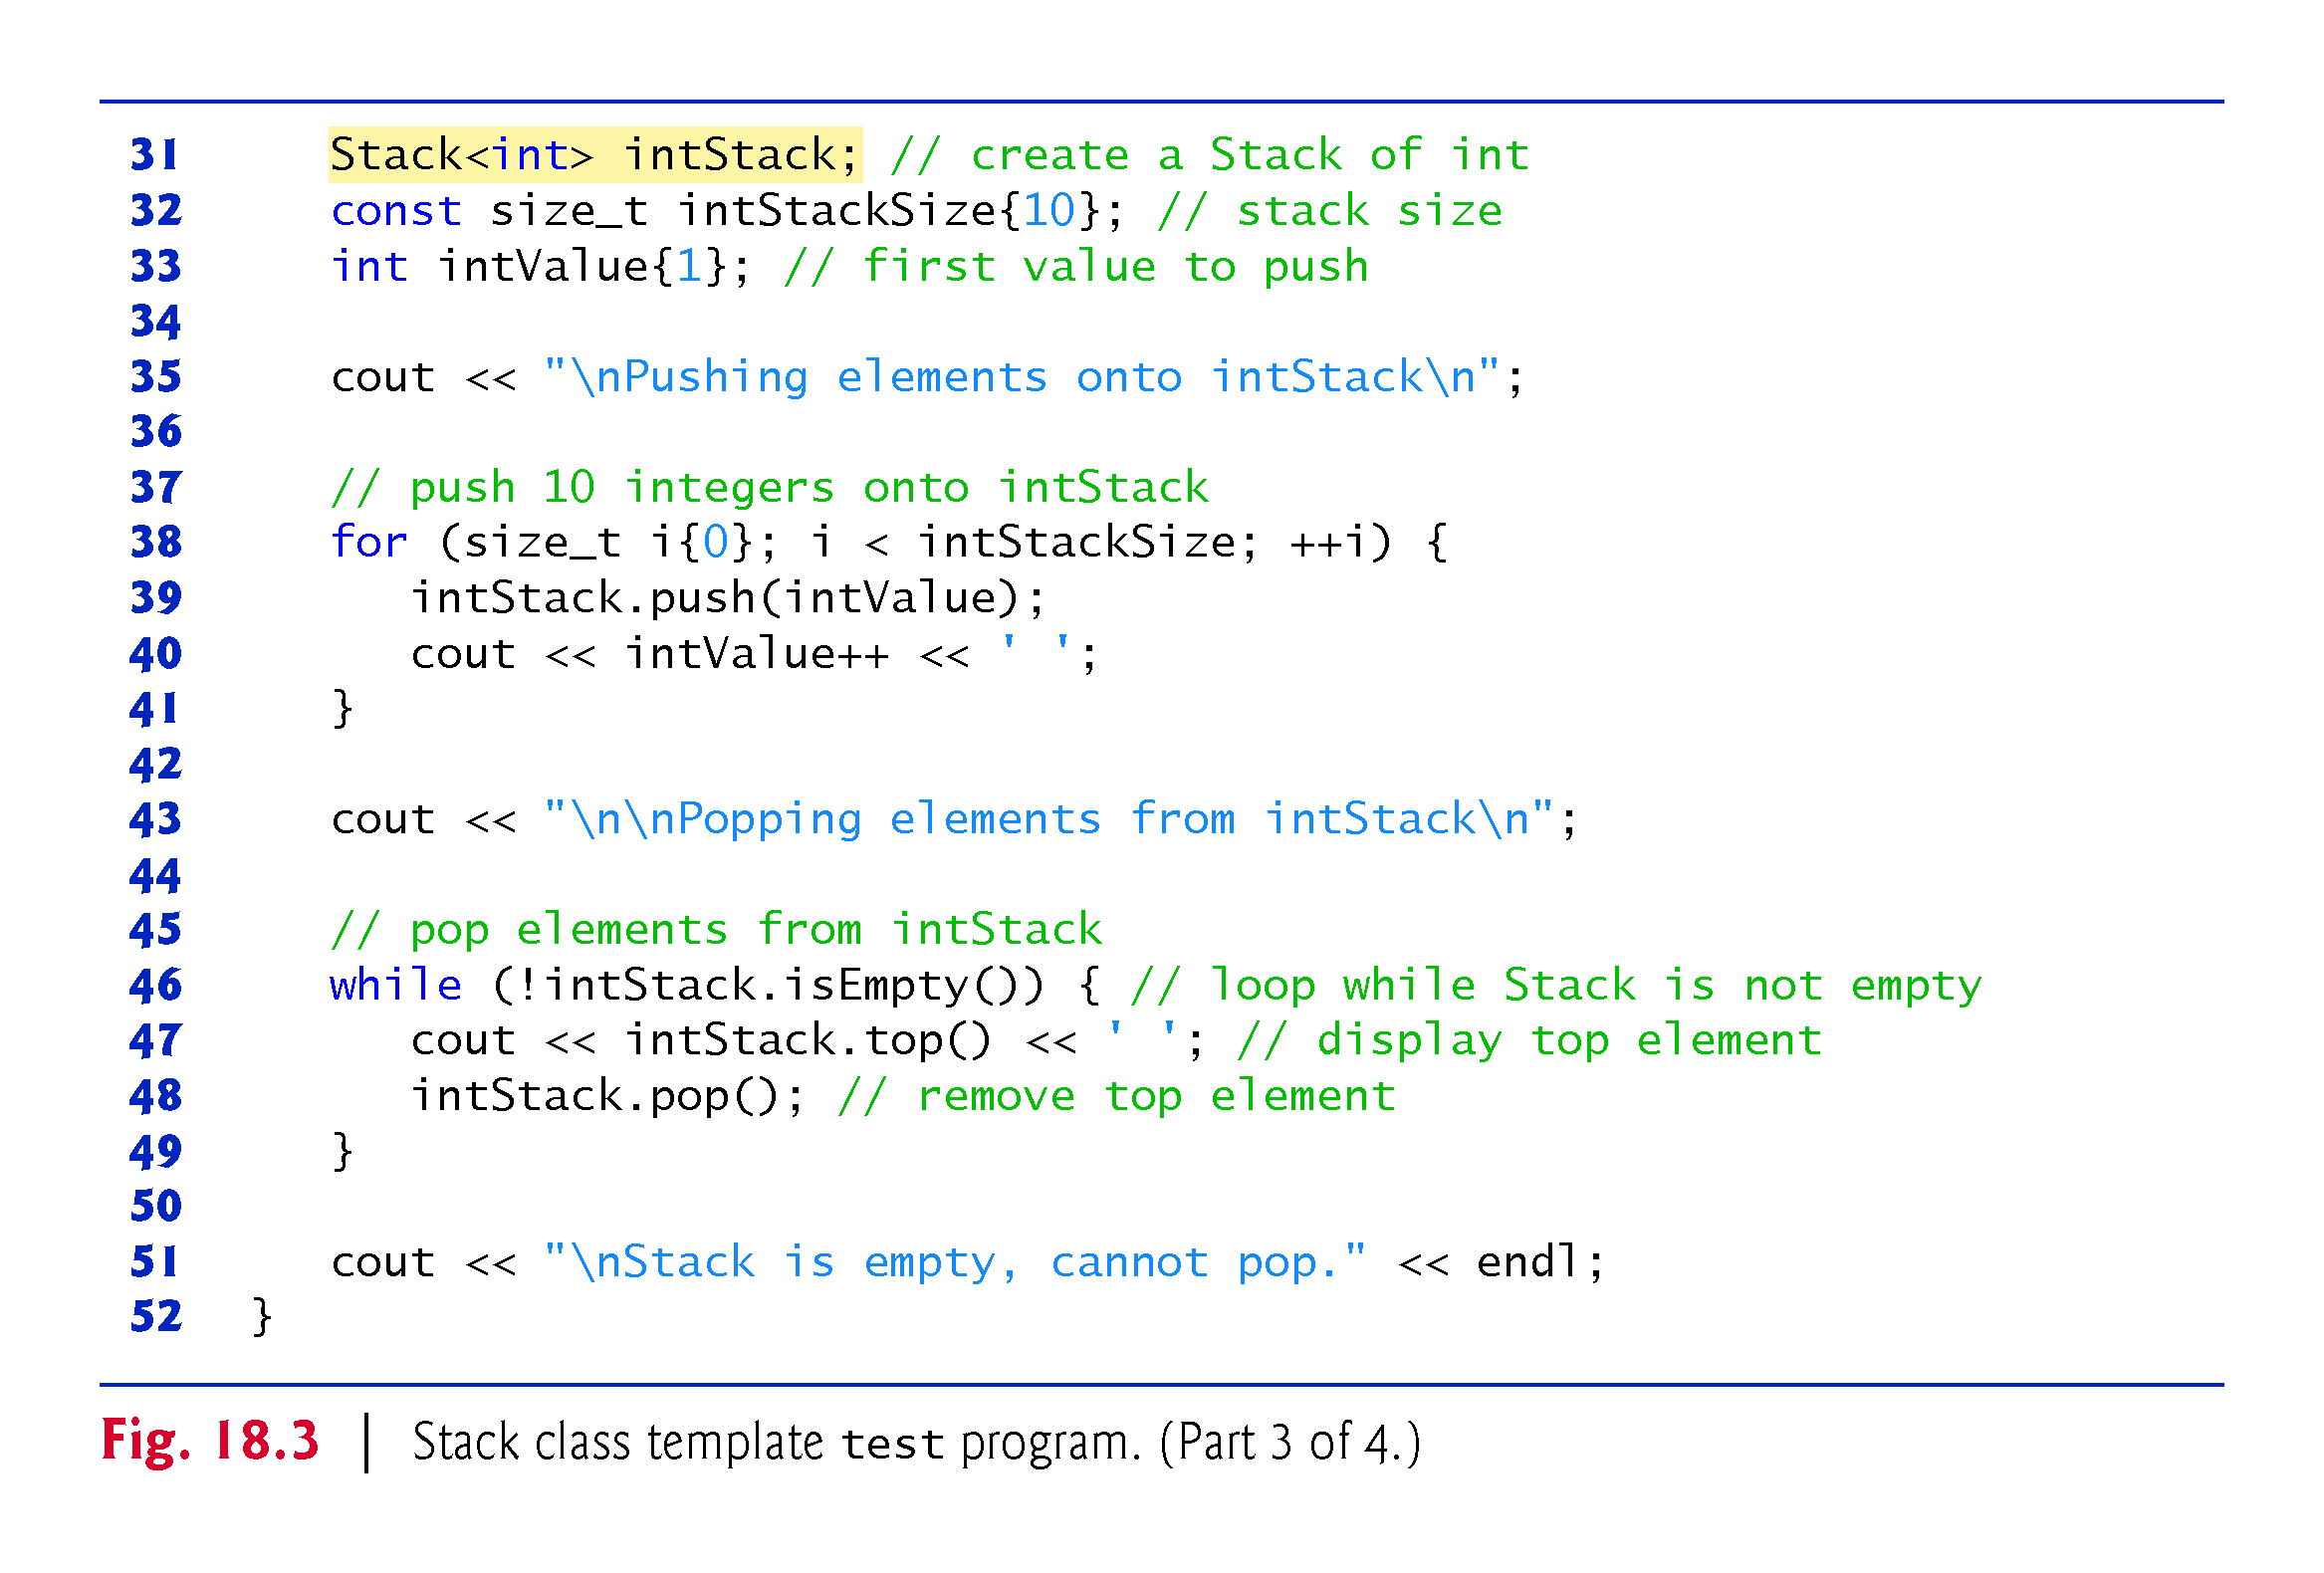

Slide 28
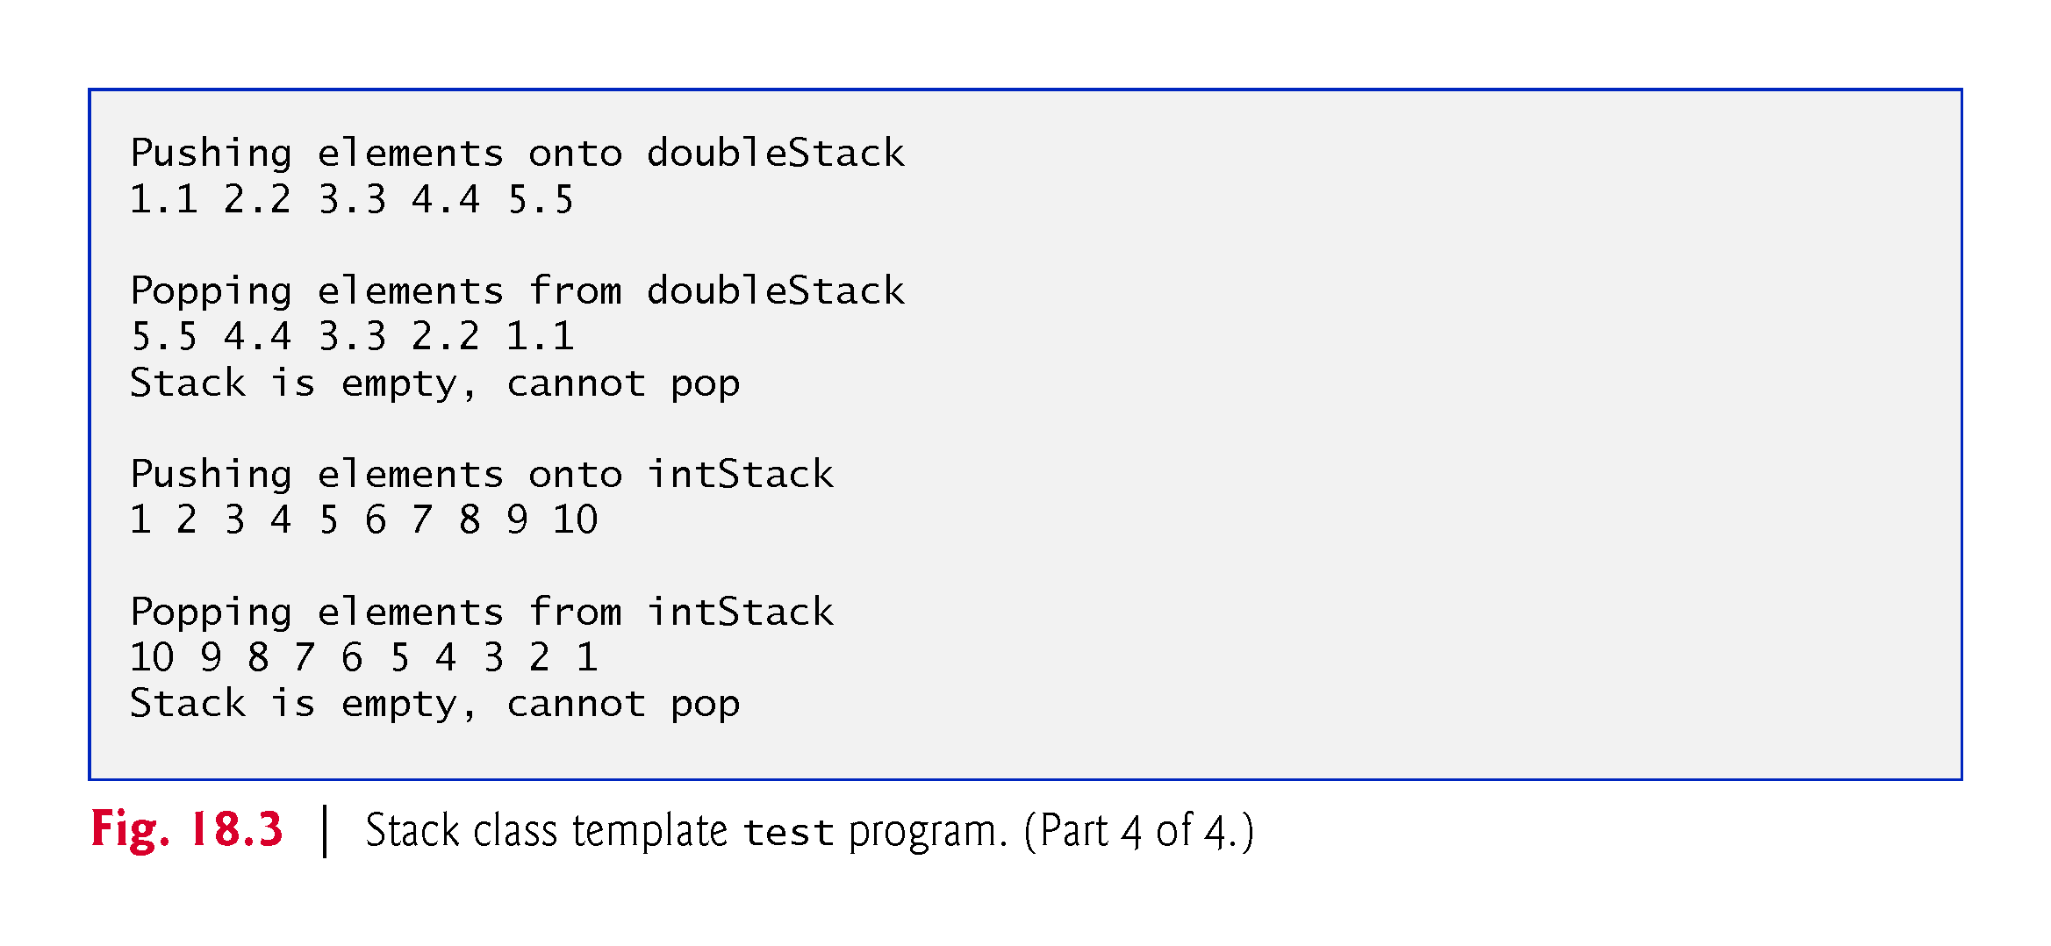

Slide 29
18.2 Class Templates (cont.)
Line 31 instantiates intStack with the declaration
Stack<int> intStack;
Lines 38–41 repeatedly invoke push (line 39) to place values onto intStack, then lines 46–49 repeatedly invoke top and pop to remove values from intStack until it’s empty.
Once again, notice in the output that the values pop off in last-in, first-out order.

Slide 30
18.3 Function Template to Manipulate a Class-Template Specialization Object
The code in function main of Fig. 18.3 is almost identical for both the doubleStack manipulations in lines 8–29 and the intStack manipulations in lines 31–51.
Another opportunity to use a function template.
Figure 18.4 defines function template testStack (lines 10–36) to perform the same tasks as main in Fig. 18.3—push a series of values onto a Stack<T> and pop the values off a Stack<T>.

Slide 31
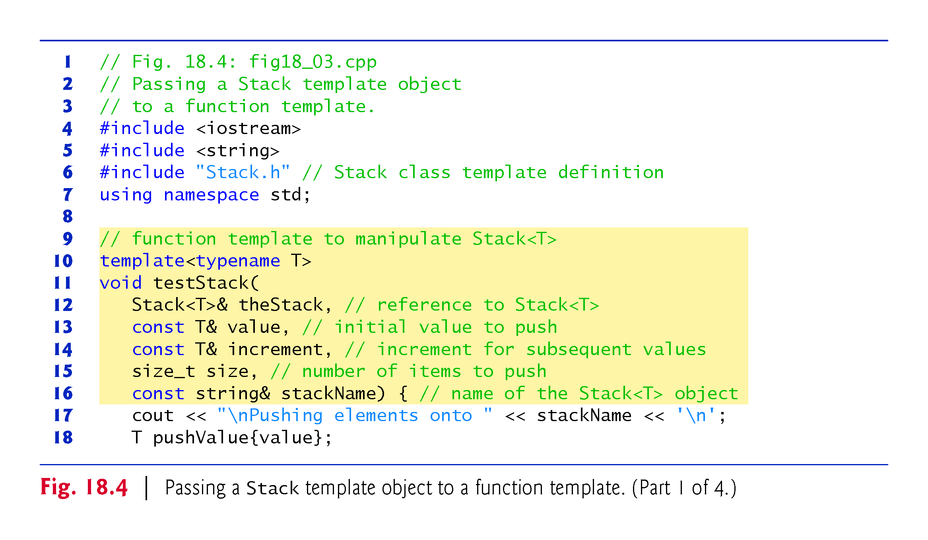

Slide 32
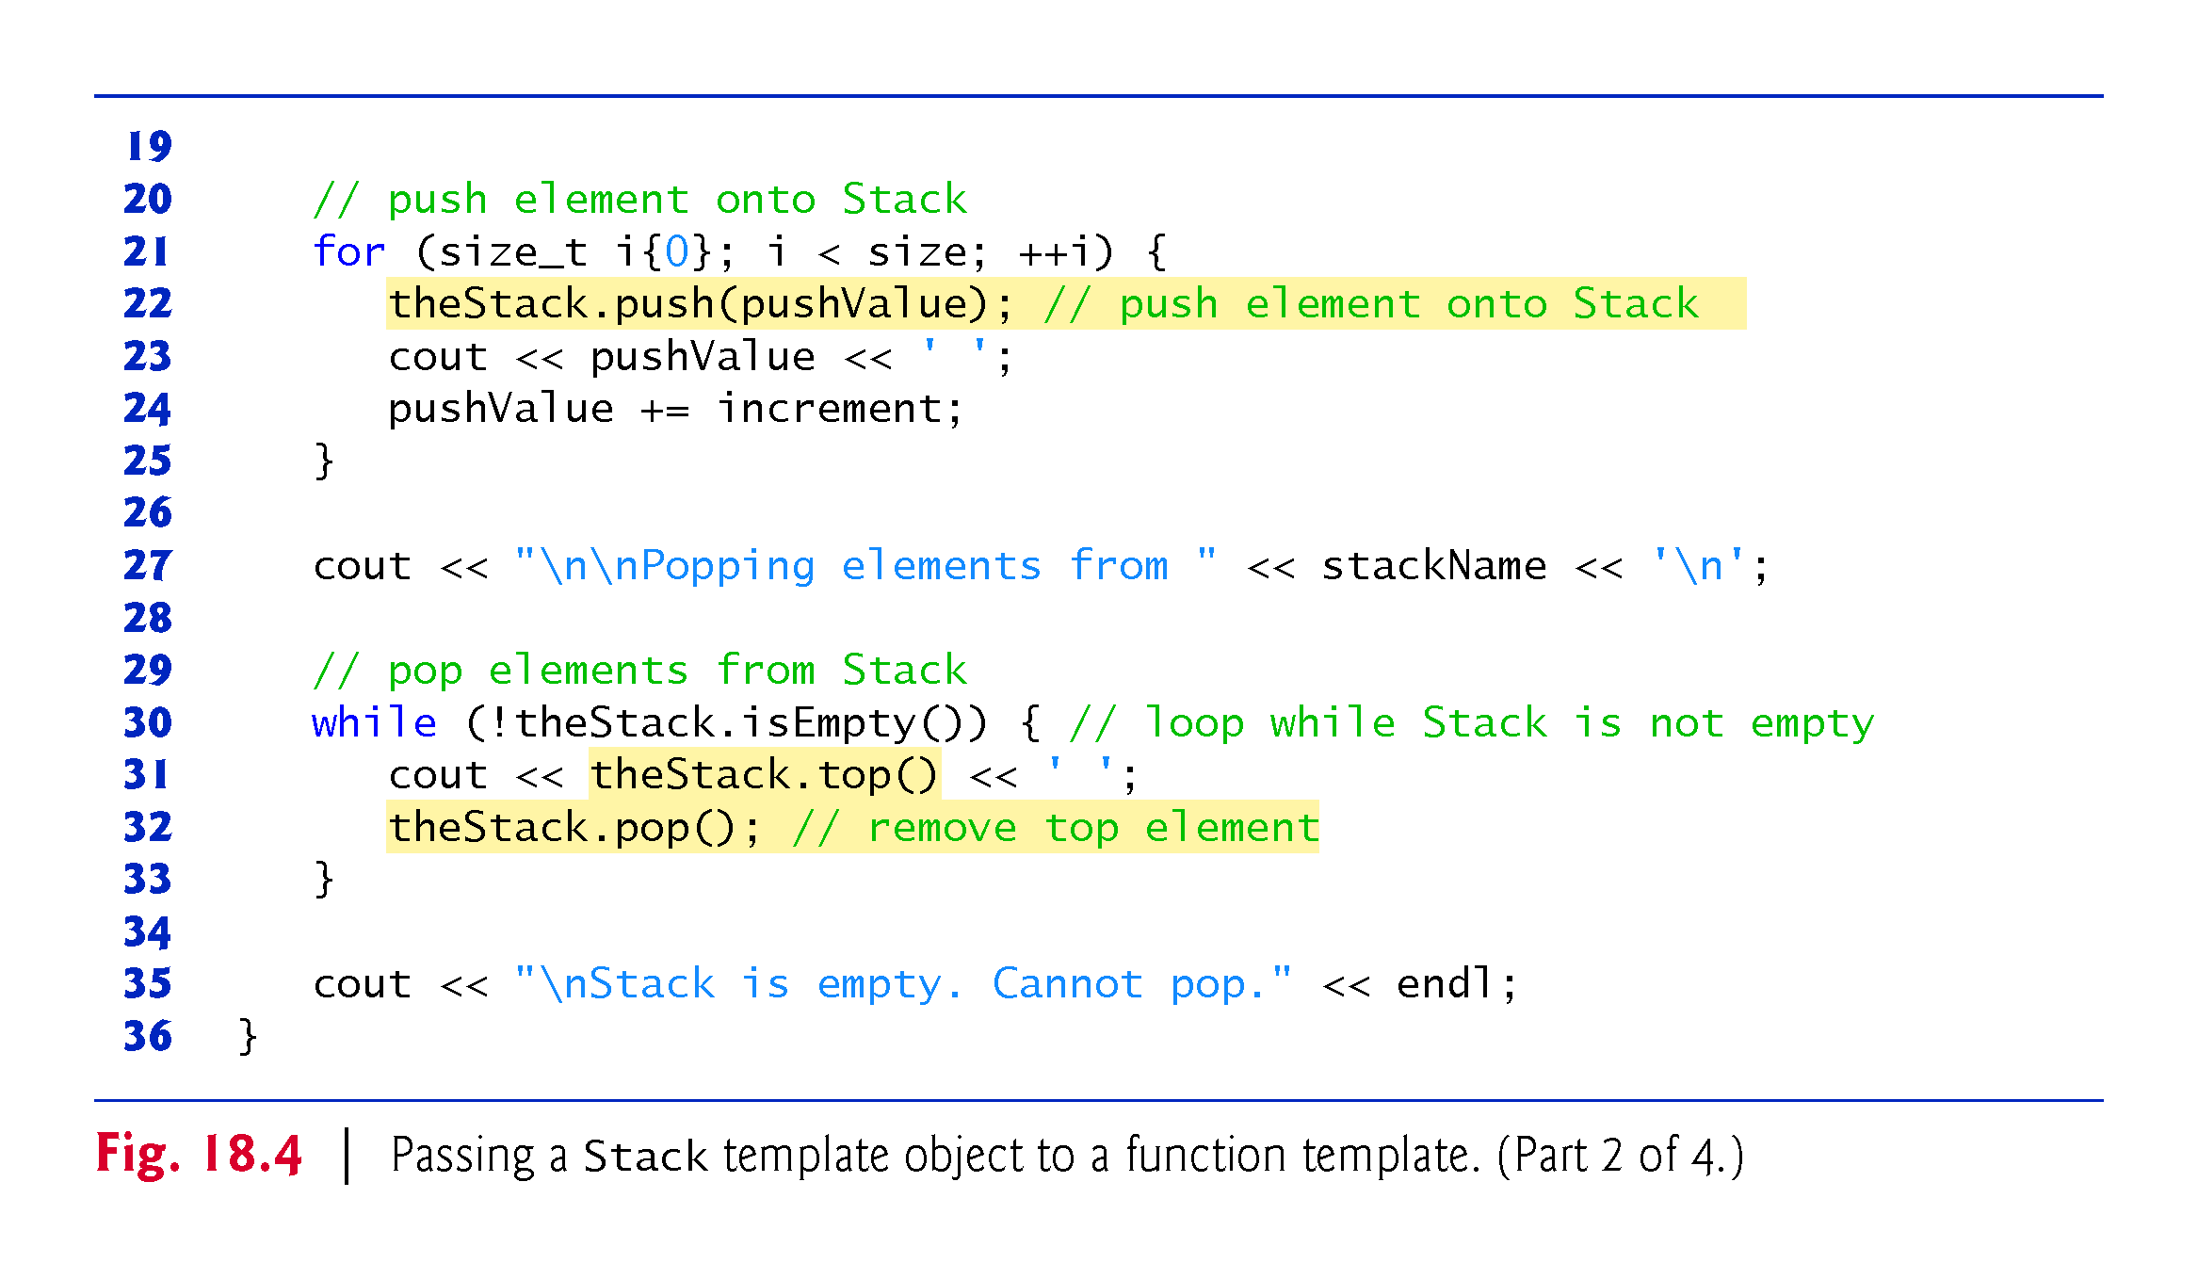

Slide 33
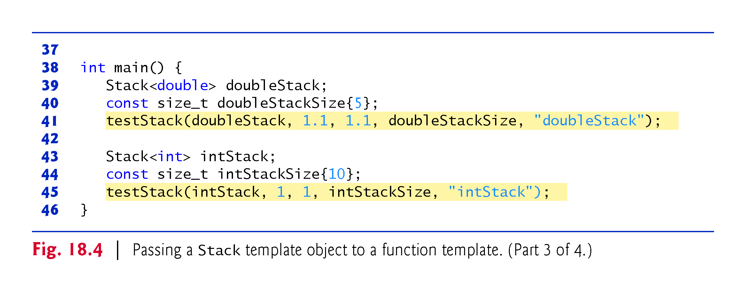

Slide 34
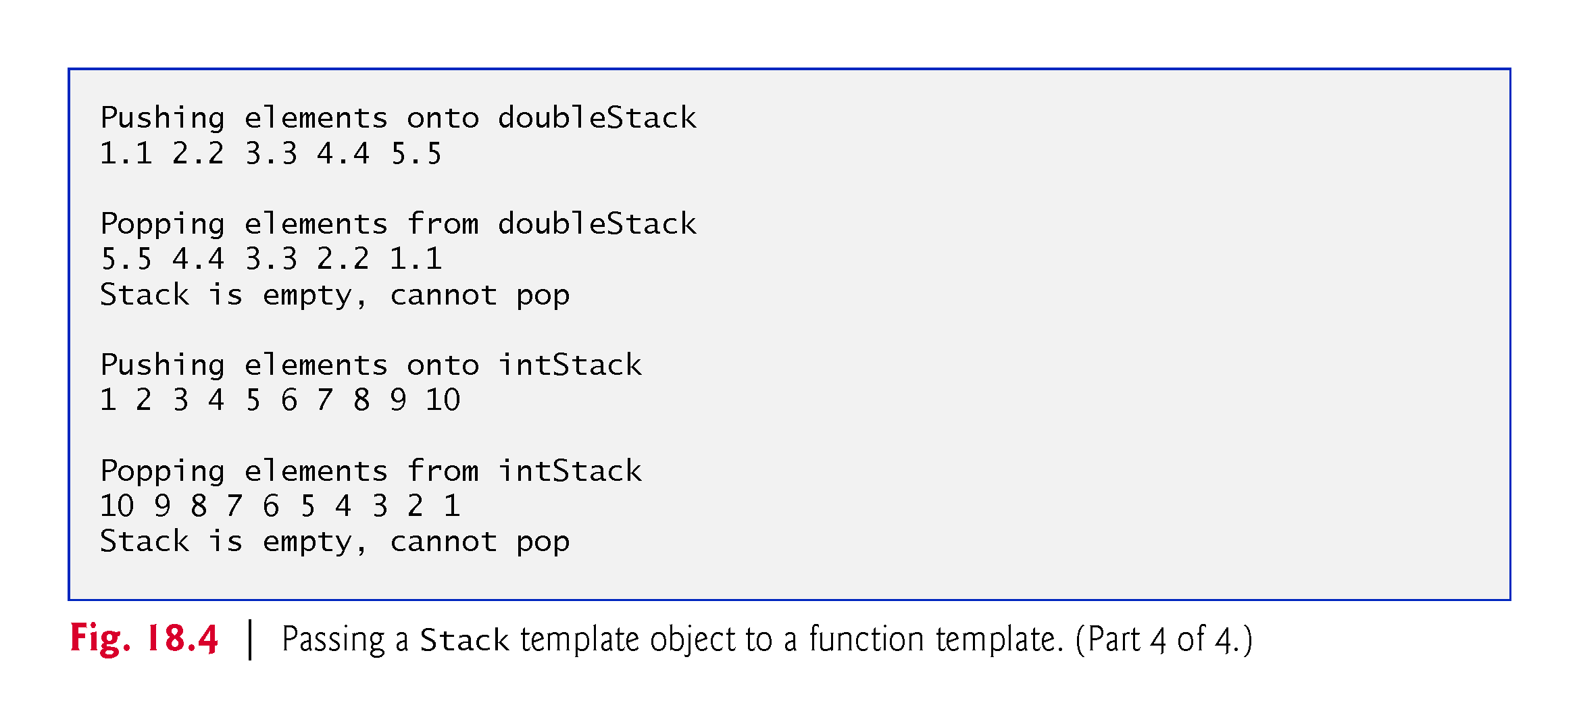

Slide 35
18.3 Function Template to Manipulate a Class-Template Specialization Object (cont.)
Function template testStack uses T (specified at line 10) to represent the data type stored in the Stack<T>.
The function template takes five arguments (lines 12–16):
the Stack<T> to manipulate
a value of type T that will be the first value pushed
a value of type T used to increment the pushed values
the number of elements to push
a string that represents the stack’s name for output purposes

Slide 36
18.3 Function Template to Manipulate a Class-Template Specialization Object (cont.)
Function main (lines 38–46) instantiates an object of type Stack<double> called doubleStack (line 39) and an object of type Stack<int> called intStack (line 43) and uses these objects in lines 41 and 45.
The compiler infers the type of T for testStack from the type used to instantiate the function’s first argument (i.e., the type used to instantiate doubleStack or intStack).

Slide 37
18.4 Nontype Parameters
Class template Stack of Section 18.2 used only a type parameter in its template declaration.
It’s also possible to use nontype template parameters, which can have default arguments and are treated as constants.
For example, the C++ standard’s array class template begins with the template declaration:
template <class T, size_t N>
(Recall that keywords class and typename are interchangeable in template declarations.)

Slide 38
18.4 Nontype Parameters (cont.)
A declaration such as
array<double, 100> salesFigures;
creates a 100-element array of doubles class-template specialization, then uses it to instantiate the object salesFigures.
The array class template encapsulates a built-in array.
When you create an array class-template specialization, the array’s built-in array data member has the type and size specified in the declaration.

Slide 39
18.5 Default Arguments for Template Type Parameters
In addition, a type parameter can specify a default type argument.
For example, the C++ standard’s stack container adapter class template begins with:
template <class T, class Container = deque<T>>
which specifies that a stack uses a deque by default to store the stack’s elements of type T.

Slide 40
18.5 Default Arguments for Template Type Parameters (cont.)
The declaration
stack<int> values;
creates a stack of ints class-template specialization (behind the scenes) and uses it to instantiate the object named values. The stack’s elements are stored in a deque<int>.

Slide 41
18.5 Default Arguments for Template Type Parameters (cont.)
Default type parameters must be the rightmost (trailing) parameters in a template’s type-parameter list.
When you instantiate a template with two or more default arguments, if an omitted argument is not the rightmost, then all type parameters to the right of it also must be omitted.
As of C++11, you can now use default type arguments for template type parameters in function templates.

Slide 42
18.6 Overloading Function Templates
Function templates and overloading are intimately related.
In Section 6.17, you learned that when overloaded functions perform identical operations on different types of data, they can be expressed more compactly and conveniently using function templates.
You can then write function calls with different types of arguments and let the compiler generate separate function-template specializations to handle each function call appropriately.
The function-template specializations generated from a given function template all have the same name, so the compiler uses overload resolution to invoke the proper function.

Slide 43
18.6 Overloading Function Templates (cont.)
You may also overload function templates.
For example, you can provide other function templates that specify the same function name but different function parameters.
A function template also can be overloaded by providing nontemplate functions with the same function name but different function parameters.

Slide 44
18.6 Overloading Function Templates (cont.)
Matching Process for Overloaded Functions
The compiler performs a matching process to determine what function to call when a function is invoked.
It looks at both existing functions and function templates to locate a function or generate a function-template specialization whose function name and argument types are consistent with those of the function call.
If there are no matches, the compiler issues an error message. If there are multiple matches for the function call, the compiler attempts to determine the best match.
If there’s more than one best match, the call is ambiguous and the compiler issues an error message.

