Slide 1

Data Mining with Weka
Rutgers, the State University of New Jersey

Slide 2
Agenda
What is Weka
Getting started with Weka
  Install Weka
  Explore the “Explorer” interface and datasets
  Use filters
  Visualize the data set
Data Mining Task—Classification
  Algorithms/Functions
  Evaluation
The Data Mining Process

Slide 3
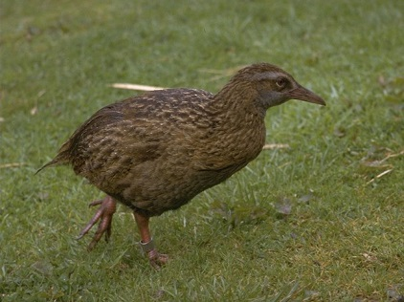
What is Weka?
What is Weka
  --A bird found only in New Zealand
Data mining workbench
  Waikato Environment for Knowledge Analysis
Machine learning algorithms for data mining tasks
  100+ algorithms for classification
  75 for data preprocessing
  25 to assist with feature selection
  20 for clustering, finding association rules, etc

Slide 4
Getting Started with Weka

Slide 5
Getting Started with Weka
Download from
  http://www.cs.waikato.ac.nz/ml/weka
  (for Windows, Mac, Linux)
Weka 3.8
  (the latest stable version of Weka)
  (includes datasets for the course)
  (it’s important to get the right version)

Slide 6
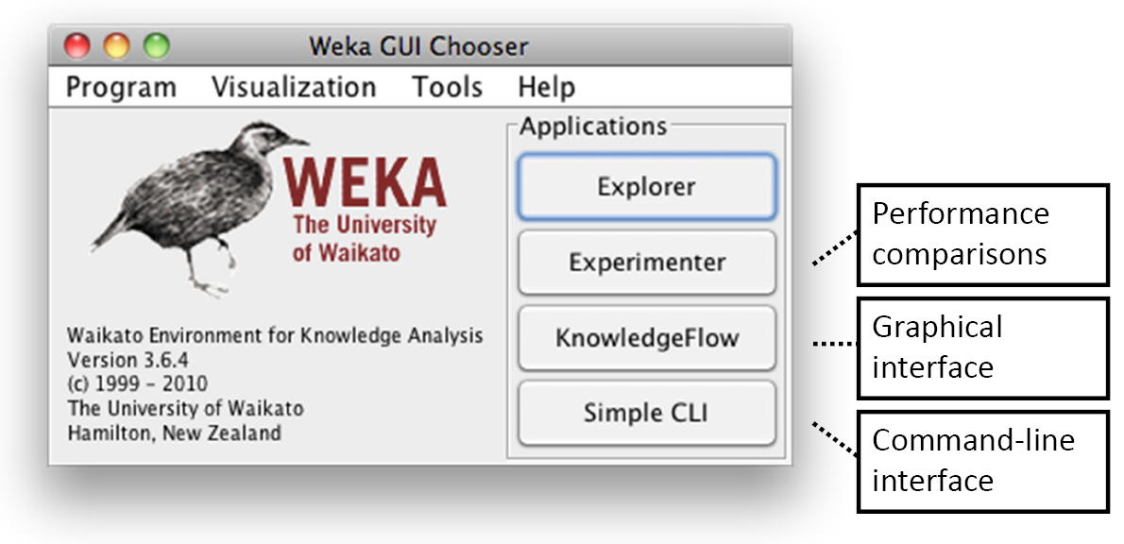
Getting Started with Weka
The Interface

Slide 7
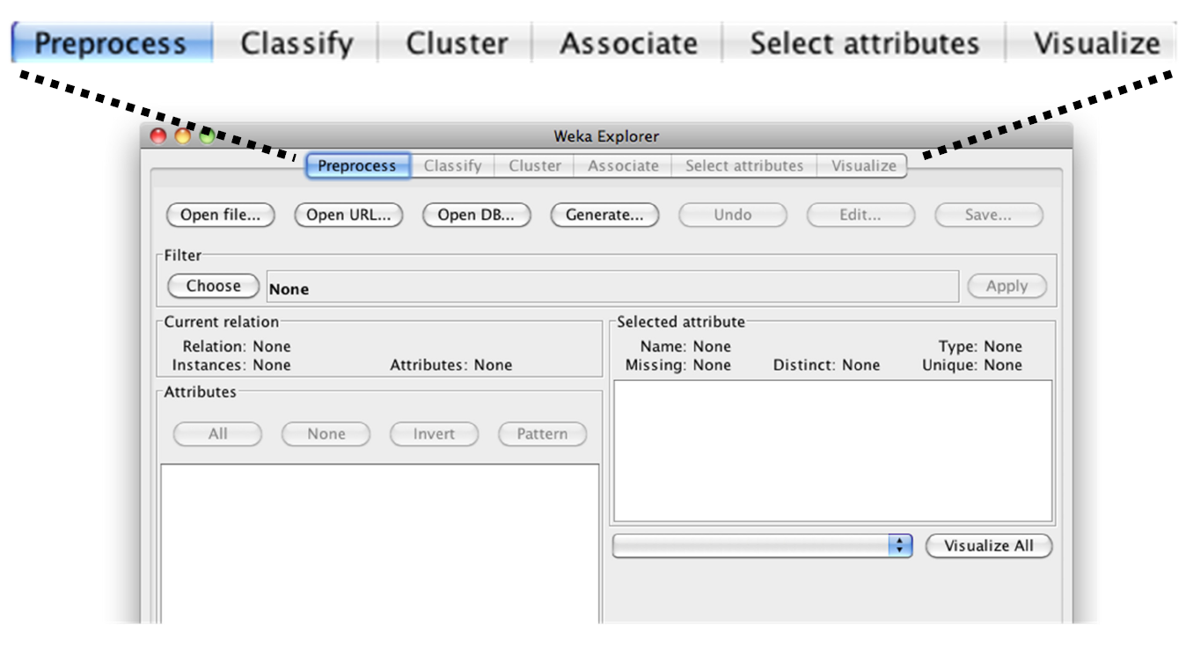
Getting Started with Weka
Exploring the Explorer

Slide 8
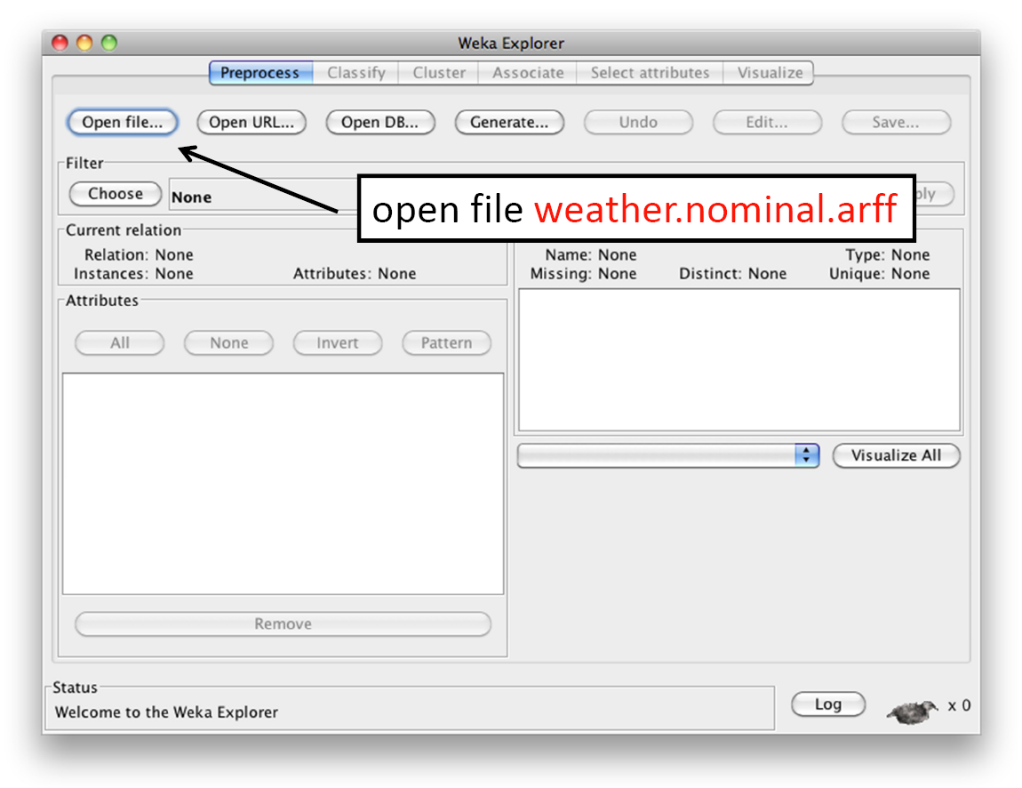
Getting Started with Weka
Explore the Data Set

Slide 9
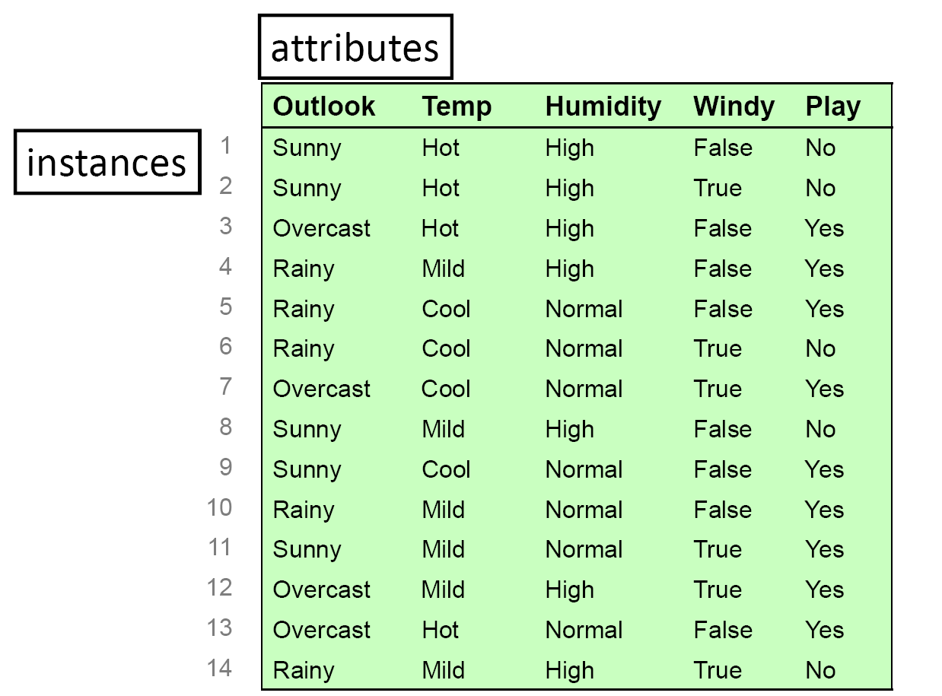
Getting Started with Weka
Explore the Data Set

Slide 10
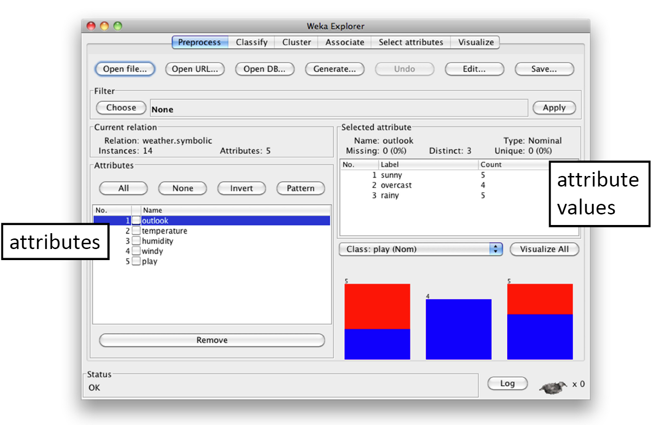
Getting Started with Weka
Edit the data set in the table format

Slide 11
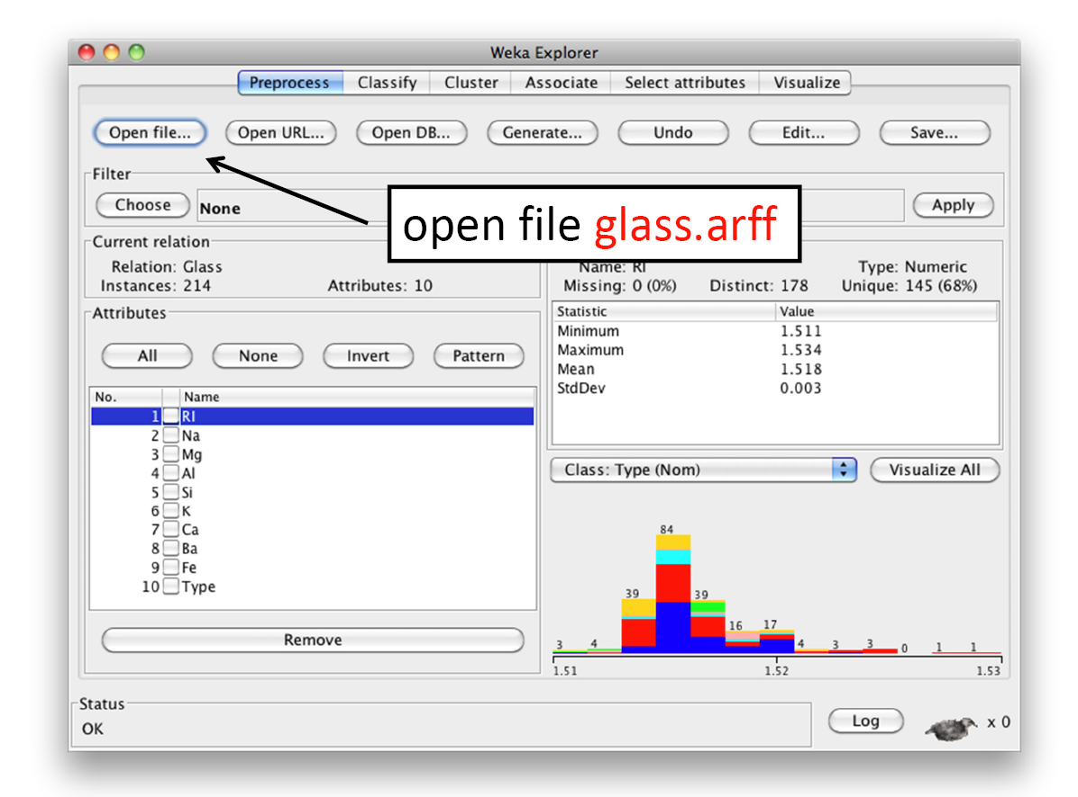
Getting Started with Weka
Explore the Data Set
Notes:
Open the glass.arff to see the description of the dataset. Need to understand the dataset, the attribute, the value meaning( say if it is a percentage valuse, then it should be in range from 0 to 1. Greater than 1 should be error.

Slide 12
Getting Started with Weka
WEKA only deals with “flat” files
  ARFF file ( Attribute Relation File Format) is the default file type in Weka but data can also be imported from various formats.
    ARFF has two sections:
      the Header information defines attribute name, type and relations.
      The Data section lists the data records
    CSV: Comma Separated Values (text file)

Slide 13
Getting Started with Weka
@relation weather
@attribute outlook {sunny, overcast, rainy}
@attribute temperature real
@attribute humidity real
@attribute windy {TRUE, FALSE}
@attribute play {yes, no}
@data
sunny,85,85,FALSE,no
sunny,80,90,TRUE,no
overcast,83,86,FALSE,yes
rainy,70,96,FALSE,yes
rainy,68,80,FALSE,yes
rainy,65,70,TRUE,no
……
nominal attribute
numeric attribute
Flat file in
ARFF format

Slide 14
Getting Started with Weka
Use a filter to remove an attribute
  Open weather.nominal.arff (again!)
  Check the filters
    – supervised vs unsupervised
    – attribute vs instance
  Choose the unsupervised attribute filter Remove
  Check the More information; look at the options
  Set attributeIndices to 3 and click OK
  Apply the filter
  Recall that you can Save the result
  Press Undo

Slide 15
Getting Started with Weka
Remove instances where humidity is high
  Supervised or unsupervised?
  Attribute or instance?
  Select RemoveWithValues
  Set attributeIndex
  Set nominalIndices
  Apply
  Undo

Slide 16
Getting Started with Weka
Using the Visualize panel
  Open iris.arff
  Go to Visualize panel
  Click one of the plots; examine some instances
  Set x axis to petalwidth and y axis to petallength
  Click on Class color to change the color
  Bars on the right change correspond to attributes:
    click for x axis; right‐click for y axis
  Show Select Instance: Rectangle option
  Submit, Reset, Clear and Save

Slide 17
Data Mining Task—Classification

Slide 18
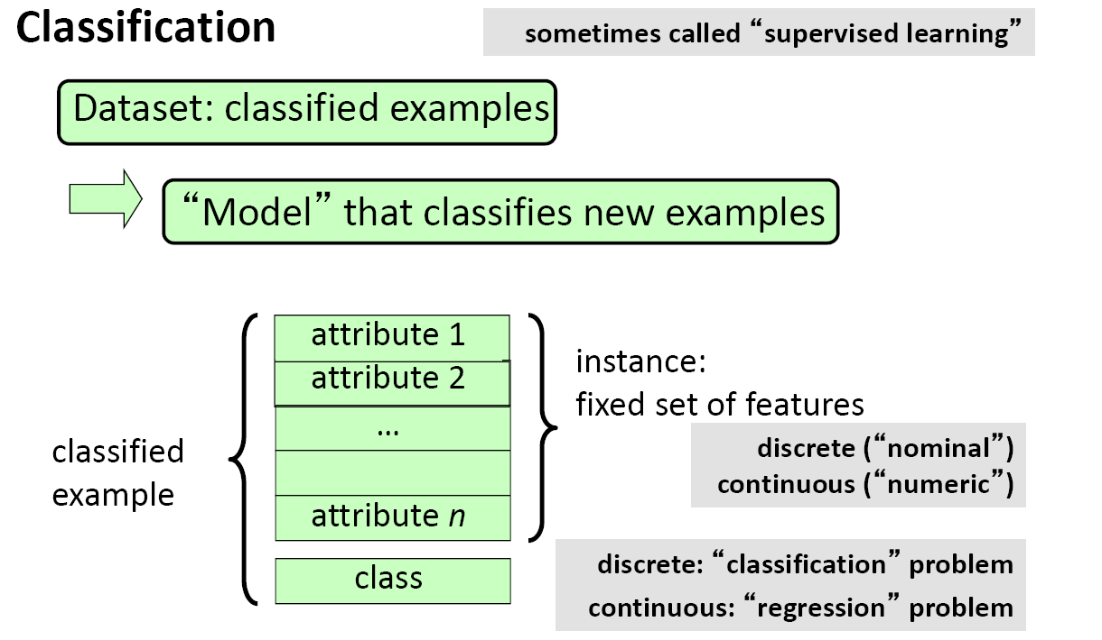
Data Mining Task—Classification

Slide 19
Data Mining Task—Classification
100+ Available Algorithms/Classifiers
  Bayes Classifiers: bayes>NaiveBayes …
  Tree Classifiers: trees>J48 …
  Regression: functions>LinearRegression; Logistic …
  Rule Based: rules>ZeroR; OneR …
  Lazy Learner Classifiers: lazy>IBk …
  SVM (Support Vector Machines): functions>LibSVM …
  Ensemble Classifiers: meta>Bagging; Boosting …

Slide 20
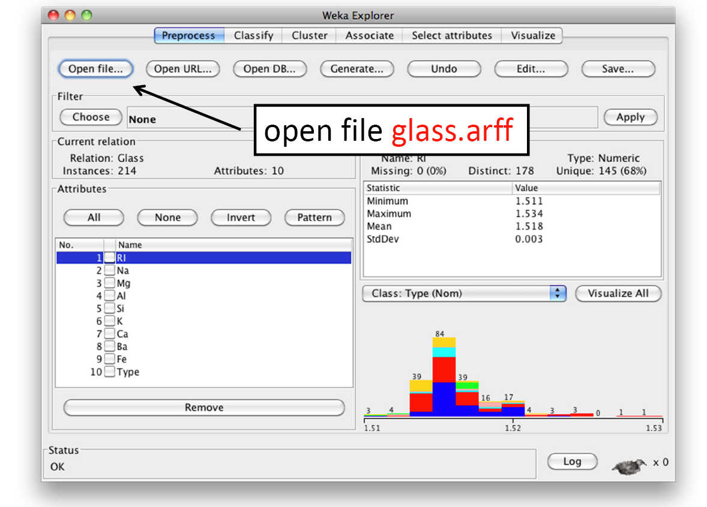
Data Mining Task—Classification

Slide 21
Data Mining Task—Classification
Use J48 to analyze the glass dataset
  Choose the J48 decision tree learner (trees>J48)
    Open the configuration panel
    Check the More information
    Examine the options
  Run it; Examine the output
    Look at the correctly classified instances
    and the confusion matrix
  Visualize tree using right‐click menu
  Look at leaf sizes
  Set minNumObj to 15 to avoid small leaves

Slide 22
Data Mining Task—Classification
Classification Boundaries
  Weka’s Boundary Visualizer
    WEKA GUI Chooser: Visualization>BoundaryVisualizer
    Open iris.arff
    Note: petallength on X, petalwidth on Y
    Classifier: Choose rules>OneR
    Check Plot training data
    Click Start
    In the Explorer, examine OneR’s rule

Slide 23
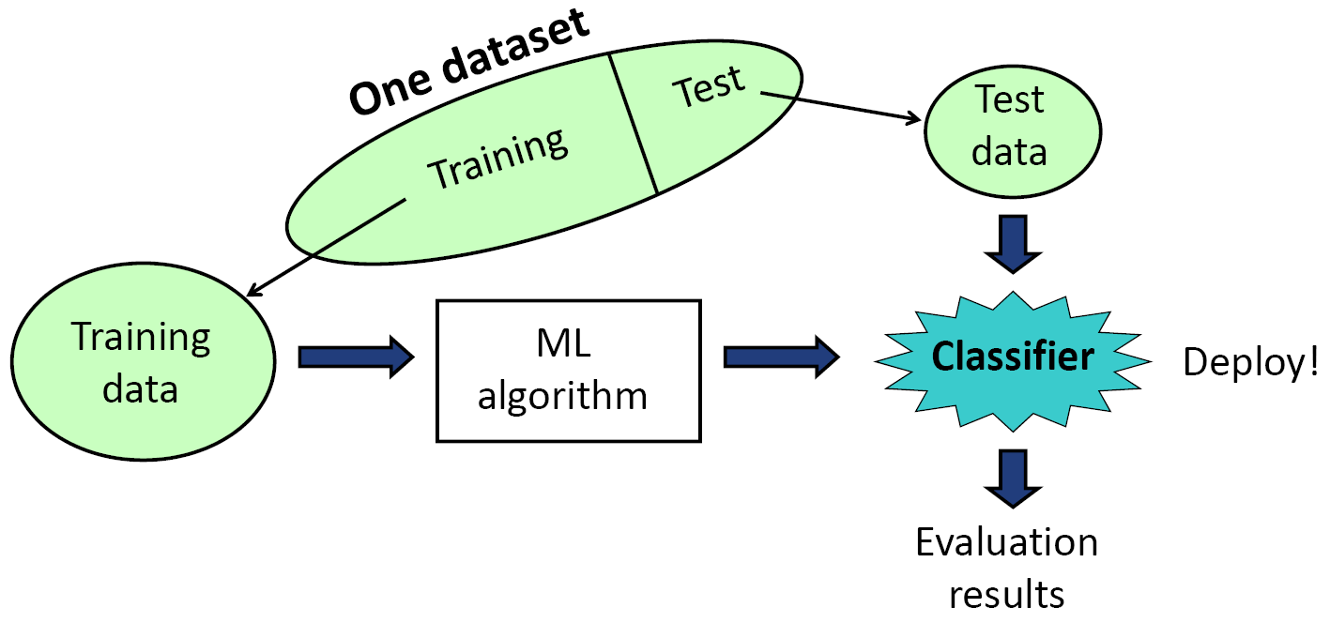
Data Mining Task—Classification
Evaluation: Training and Testing

Slide 24
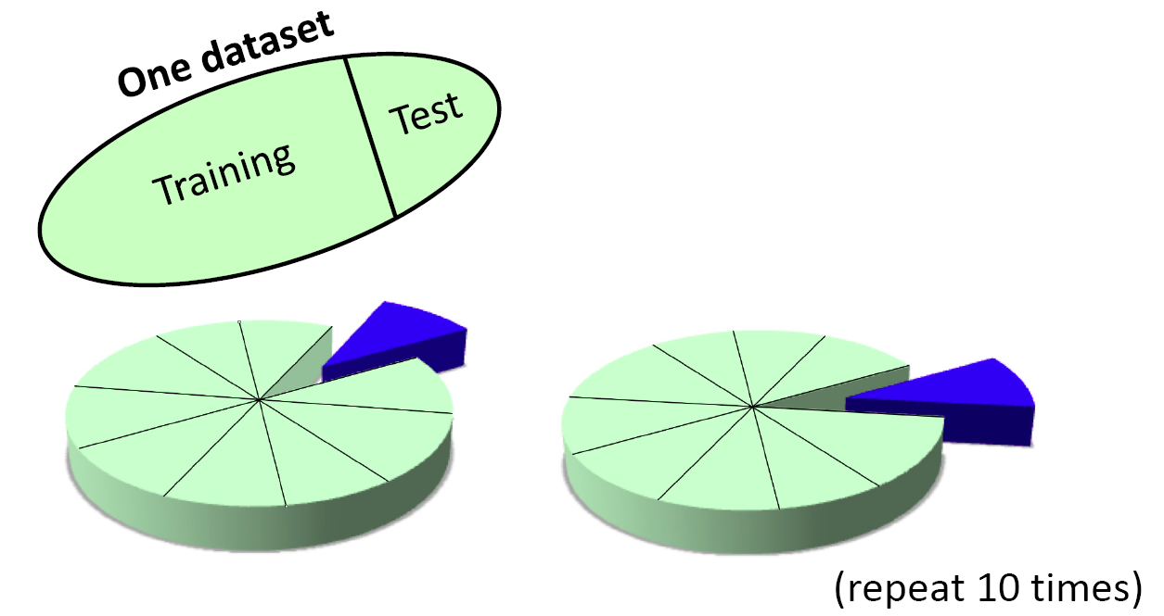
Data Mining Task—Classification
Evaluation: Cross-Validation
  Repeated holdout
    For example: hold out 10% for testing, repeat 10 times)
  Cross-validation really is better than repeated holdout.
  It reduces the variance of the estimate.

Slide 25
The Data Mining Process

Slide 26
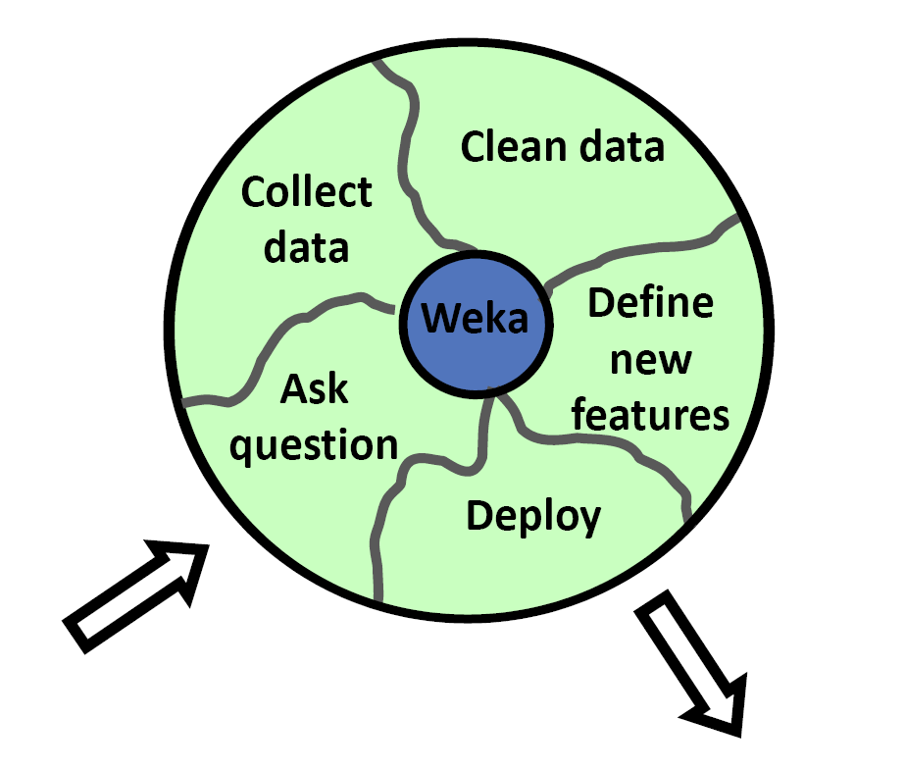
The Data Mining Process
The Data Mining Process

Slide 27
The Data Mining Process
Ask a question
  – what do you want to know
Gather data
  – more data beats a clever algorithm
Clean the data
  – real data is very messy
Define new features
  – feature engineering—the key to data mining
Deploy the result
  – technical implementation
  – convince your boss!

Slide 28
The Data Mining Process
(Selected) filters for feature engineering
  AddExpression (MathExpression)
    Apply a math expression to existing attributes to create new one (or modify existing one)
  Center (Normalize) (Standardize)
    – Transform numeric attributes to have zero mean (or into a given numeric range) (or to have zero mean and unit variance)
  Discretize (also supervised discretization)
    – Discretize numeric attributes to have nominal values
  PrincipalComponents
    – Perform a principal components analysis/transformation of the data
  ……

Slide 29
More Weka Tutorial Resources
Weka MOOC Youtube
  https://www.youtube.com/user/WekaMOOC
Weka—Regression Task Example
  http://www.ibm.com/developerworks/library/os-weka1/

Slide 30
Public Data Repositories
Links to sites with publicly available datasets
  There is overlap among the datasets provided at the different sites:
    University of California Irvine Machine Learning Repository
      a large repository of datasets supplied by individuals
    ACM Data Mining and Knowledge Discovery Cup Center
      contains links to instructions and datasets for the annual KDD contest

Slide 31
Questions?
Thanks!

