Slide 1
Fixed income analysis lecture 3
Tony Zhang
Fall 2019
© 2016 CFA Institute. All rights reserved.

Slide 2
TABLE OF CONTENTS
01
INTRODUCTION
02
BOND PRICES AND THE TIME VALUE OF MONEY
03
PRICES AND YIELDS: CONVENTIONS FOR QUOTES AND CALCULATIONS
04
THE MATURITY STRUCTURE OF INTEREST RATES
05
YIELD SPREADS
06
SUMMARY

Slide 3
1. INTRODUCTION
The fixed-income market is a key source of financing for business and governments.
Similarly, the fixed-income market represents a significant investing opportunity for institutions and individuals.
Understanding how to value fixed-income securities is important to investors, issuers, and financial analysts.
Notes:
1. Introduction

Slide 4
2. BOND PRICES AND THE TIME VALUE OF MONEY
Bond pricing is an application of discounted cash flow analysis.
On an option-free fixed-rate bond, the promised future cash flows are a series of coupon interest payments and repayment of the full principal at maturity.
The market discount rate is used to obtain the present value.
Bond price should be equal to the value of all discounted future cash flows.
The market discount rate is the rate of return required by investors given the risk of the investment in the bond.
Notes:
2. Bond prices and the time value of money
LOS: Calculate a bond’s price given a market discount rate.
The coupon payments are made on regularly scheduled dates, for example, on 15 June and 15 December each year on semiannual coupon paying bonds.
The last coupon is paid together with the face value on the maturity date.
The market discount rate is also called the “required yield” or “required rate of return.”

Slide 5

Formula for calculating the bond price given the market discount rate:
$$PV=\frac{PMT}{{(1+r)}^{1}}+\frac{PMT}{{(1+r)}^{2}}+…+\frac{PMT+FV}{{(1+r)}^{N}}$$
where
PV
is the present value (price) of the bond
PMT
is the coupon payment per period
FV
is the future value paid at maturity, or the bond’s par value
r
is the required rate of return per period
N
is the number of evenly spaced periods to maturity
Notes:
2. Bond prices and the time value of money
LOS: Calculate a bond’s price given a market discount rate.
The formula assumes a fixed coupon payment and single market discount rate.
A more practical formula for bond price is $PV=PMT×\frac{\left[1−\frac{1}{{\left(1+r\right)}^{N}}\right]}{r}+\frac{FV}{{\left(1+r\right)}^{N}}$.

Slide 6
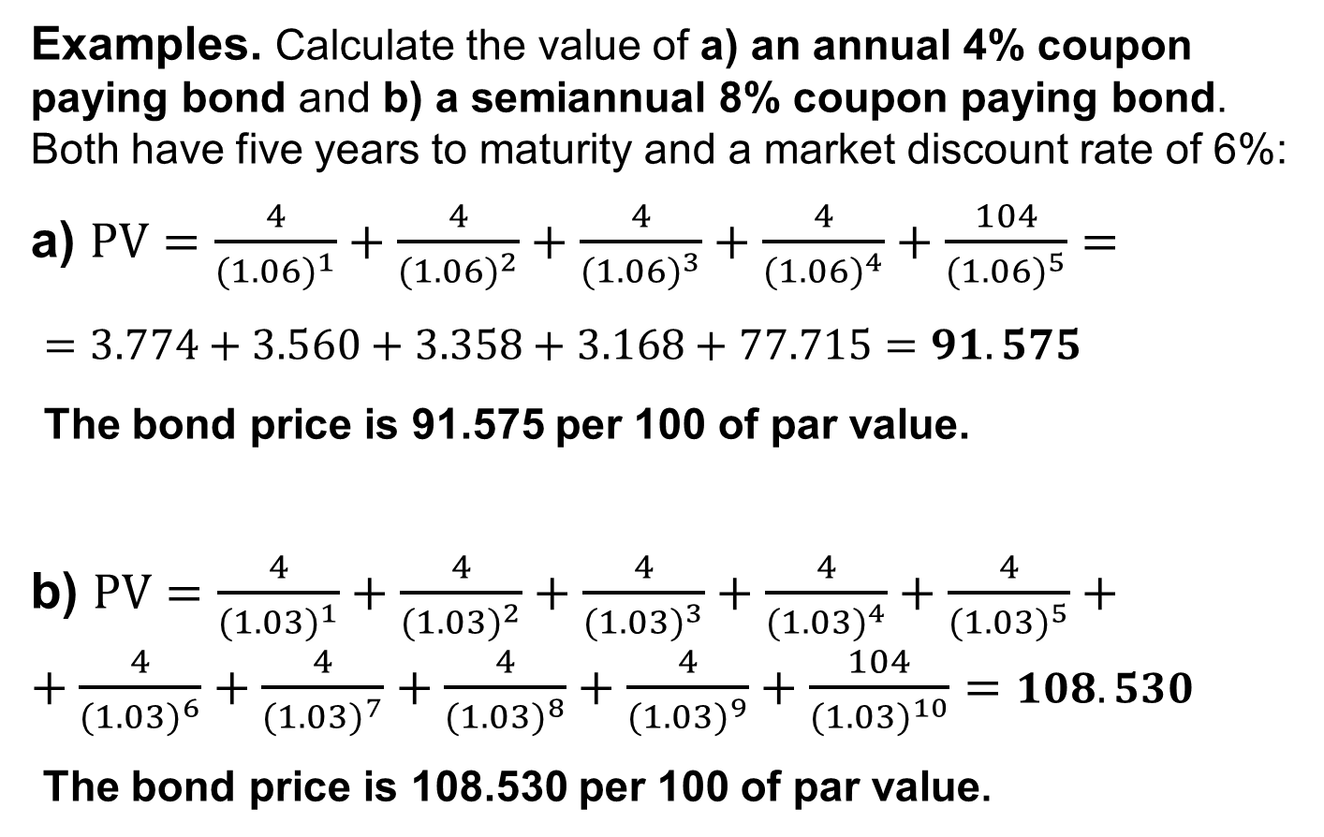
Examples. Calculate the value of a) an annual 4% coupon paying bond and b) a semiannual 8% coupon paying bond. Both have five years to maturity and a market discount rate of 6%:
a) $PV=\frac{4}{{(1.06)}^{1}}+\frac{4}{{(1.06)}^{2}}+\frac{4}{{(1.06)}^{3}}+\frac{4}{{(1.06)}^{4}}+\frac{104}{{(1.06)}^{5}}=$
$=3.774+3.560+3.358+3.168+77.715=91.575$
The bond price is 91.575 per 100 of par value.
b) $PV=\frac{4}{{(1.03)}^{1}}+\frac{4}{{(1.03)}^{2}}+\frac{4}{{(1.03)}^{3}}+\frac{4}{{(1.03)}^{4}}+\frac{4}{{(1.03)}^{5}}++\frac{4}{{(1.03)}^{6}}+\frac{4}{{(1.03)}^{7}}+\frac{4}{{(1.03)}^{8}}+\frac{4}{{(1.03)}^{9}}+\frac{104}{{(1.03)}^{10}}=108.530$
The bond price is 108.530 per 100 of par value.
Notes:
2. Bond prices and the time value of money
LOS: Calculate a bond’s price given a market discount rate.
The bond prices are typically quoted per 100 of par value.
To arrive at the semiannual coupon payment, the annual coupon has to be divided by 2. The discount rate is also divided by 2, and the number of discount periods is calculated by multiplying the remaining years to maturity by 2.
These calculations assume that the bond is priced on a coupon payment date. If the bond is between coupon payment dates, the price paid will include accrued interest, which is interest that has been earned but not yet paid.

Slide 7
• The price of a fixed-rate bond, relative to par value, depends
on the relationship of the coupon rate to the market discount
rate.
If the bond price is higher than par value, the bond is said to be traded at a premium.
This happens when the coupon rate is greater than the market discount rate.
If the bond price is lower than par value, the bond is said to be traded at a discount.
This happens when the coupon rate is less than the market discount rate.
If the bond price is equal to par value, the bond is said to be traded at par.
This happens when the coupon rate is equal to the market discount rate.
Notes:
2. Bond prices and the time value of money
LOS: Calculate a bond’s price given a market discount rate.

Slide 8
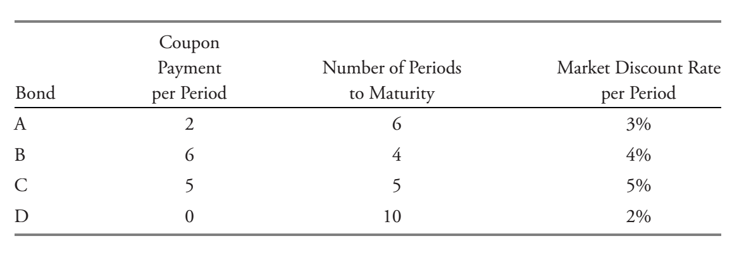
Mini-quiz #1
Identify whether each of the following bonds is trading at a discount, at par value, or at a premium. Calculate the prices of the bonds per 100 in par value. If the coupon rate is deficiency or excessive compared with the market discount rate, calculate the amount of the deficiency or excess per 100 of par value.

Slide 9
If the market price of a bond is known, the equation on slide 5 can be used to calculate its yield-to-maturity.
Therefore, the yield-to-maturity is the promised yield.
The yield-to-maturity is the internal rate of return on a bond’s cash flows. It is the implied market discount rate.
The yield-to-maturity (YTM) is the rate of return on the bond to an investor provided three conditions are met:
The investor holds the bond to maturity.
The issuer does not default on coupon or principal payments.
The investor is able to reinvest coupon payments at that same yield.
Notes:
2. Bond prices and the time value of money
LOS: Calculate a bond’s price given a market discount rate.
The calculation of yield-to-maturity for coupon paying bonds (beyond two periods) is complex and better done using financial calculator or a computing device.
If necessary, the trial-and-error method can be applied.

Slide 10
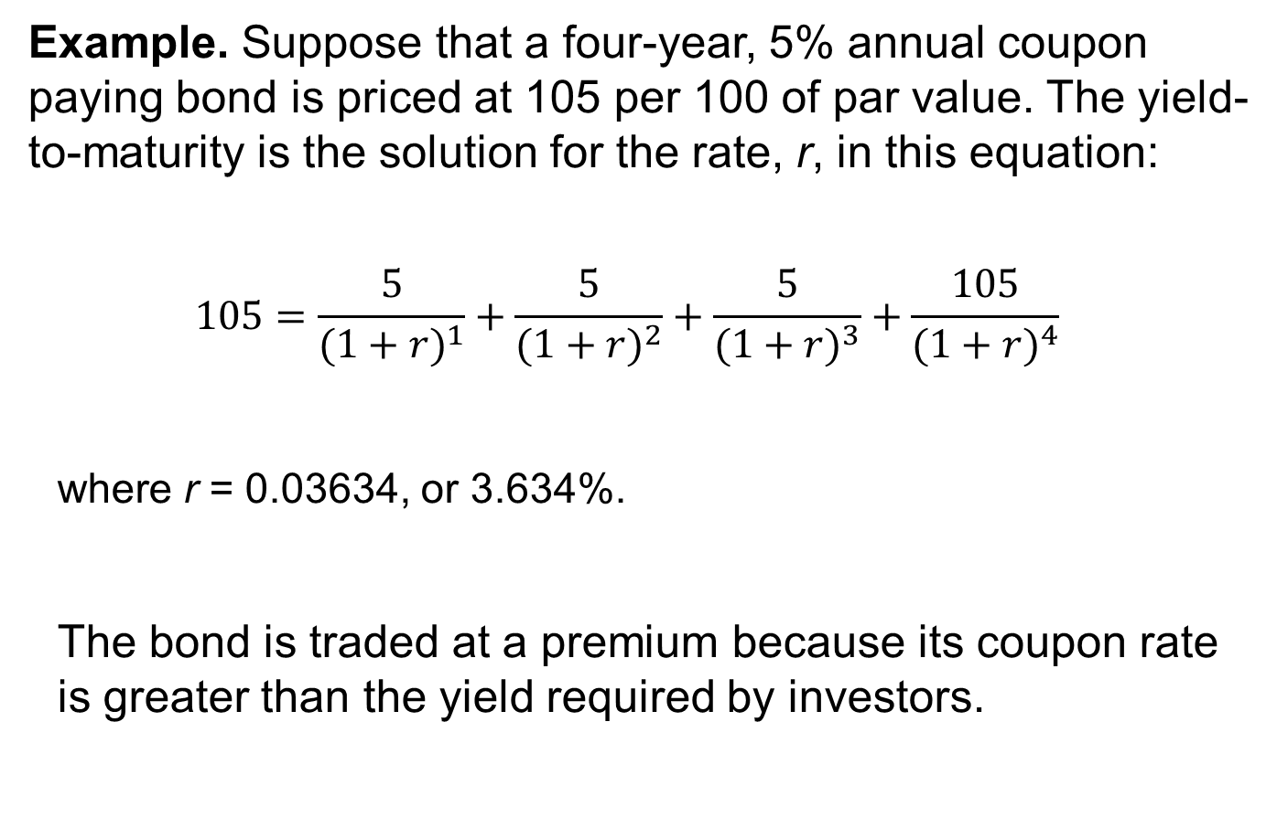
Example. Suppose that a four-year, 5% annual coupon paying bond is priced at 105 per 100 of par value. The yield-to-maturity is the solution for the rate, r, in this equation:
$$105=\frac{5}{{(1+r)}^{1}}+\frac{5}{{(1+r)}^{2}}+\frac{5}{{(1+r)}^{3}}+\frac{105}{{(1+r)}^{4}}$$
where r = 0.03634, or 3.634%.
The bond is traded at a premium because its coupon rate is greater than the yield required by investors.
Notes:
2. Bond prices and the time value of money
LOS: Calculate a bond’s price given a market discount rate.
Calculation can be done with the trial-and-error method, a financial calculator (IRR function), or computer software.

Slide 11
The price of a fixed-rate bond will change whenever the market discount rate changes.
For the same coupon rate and time-to-maturity, the percentage price change is greater when the market discount rate goes down than when it goes up (the convexity effect).
For the same time-to-maturity, a lower-coupon bond has a greater percentage price change than a higher-coupon bond when their market discount rates change by the same amount (the coupon effect).
For the same coupon rate, a longer-term bond has a greater percentage price change than a shorter-term bond when their market discount rates change by the same amount (the maturity effect).
The bond price is inversely related to the market discount rate. When the market discount rate increases, the bond price decreases (the inverse effect).
Notes:
2. Bond prices and the time value of money
LOS: Identify the relationships among a bond’s price, coupon rate, maturity, and market discount rate (yield-to-maturity).

Slide 12
Relationships between Bond Prices and Bond
Characteristics
Bond | Coupon Rate | Maturity | Price at 20% | Discount Rates Go Down |  | Discount Rates Go Up
 |  |  |  | Price at 19% | % Change | Price at 21% | % Change
A | 10% | 10 | 58.075 | 60.950 | 4.95% | 55.405 | –4.60%
B | 20% | 10 | 100.000 | 104.339 | 4.34% | 95.946 | –4.05%
C | 30% | 10 | 141.925 | 147.728 | 4.09% | 136.487 | –3.83%
D | 10% | 20 | 51.304 | 54.092 | 5.43% | 48.776 | –4.93%
E | 20% | 20 | 100.000 | 105.101 | 5.10% | 95.343 | –4.66%
F | 30% | 20 | 148.696 | 156.109 | 4.99% | 141.910 | –4.56%
Notes:
2. Bond prices and the time value of money
LOS: Identify the relationships among a bond’s price, coupon rate, maturity, and market discount rate (yield-to-maturity).
The first relationship is that the bond price and the market discount rate move inversely. All bond prices in Exhibit 1 go up when the rates go down from 20% to 19%, and all prices go down when the rates go up from 20% to 21%.
The second relationship reflects the convexity effect. For each bond, the percentage price increases are greater in absolute value than the percentage price decreases. This implies that the relationship between bond prices and the market discount rate is not linear; instead, it is curved. It is described as being “convex.”
The third relationship is the coupon effect. Consider Bonds A, B, and C, which have 10 years to maturity. For both the decrease and increase in the yield-to-maturity, Bond A has a larger percentage price change than Bond B and Bond B has a larger change than C. The same pattern holds for the 20-year bonds. Therefore, lower-coupon bonds have more price volatility than higher-coupon bonds, other things being equal.
The fourth relationship is the maturity effect. Compare the results for Bonds A and D and for Bonds B and E. The 20-year bonds have greater percentage price changes than the 10-year bonds for either an increase or a decrease in the market discount rate. In general, longer-term bonds have more price volatility than shorter-term bonds, other things being equal.

Slide 13
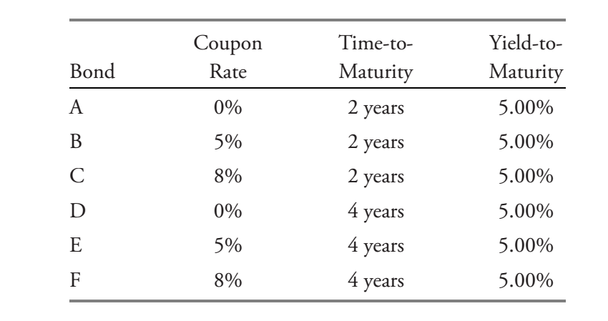
Mini-quiz #2
An investor is considering the following six annual coupon payment government bonds:
Based on the relationships between bond prices and bond characteristics, which bond will go up in price the most on a percentage basis if all yields go down from 5.00% to 4.90%?
Based on the relationships between the bond prices and bond characteristics, which bond will go down in price the least on a percentage basis if all yields go up from 5.00% to 5.10%?

Slide 14

Because the market discount rates for the cash flows with different maturities are rarely the same, it is fundamentally better to calculate the price of a bond by using a sequence of market discount rates that correspond to the cash flow dates.
General formula for calculating a bond price given the sequence of spot rates:
$$PV=\frac{PMT}{{(1+Z_{1})}^{1}}+\frac{PMT}{{(1+Z_{2})}^{2}}+…+\frac{PMT+FV}{{(1+Z_{N})}^{N}}$$
where Z₁, Z₂, and Z_{N} are spot rates for period 1, 2, and N, respectively.
These market discount rates are called “spot rates.”
Spot rates are yields-to-maturity on zero-coupon bonds maturing at the date of each cash flow.
Notes:
2. Bond prices and the time value of money
LOS: Define spot rates and calculate the price of a bond using spot rates.
Spot rates are sometimes called “zero rates.”
Bond price (or value) determined using the spot rates is sometimes referred to as the bond’s “no-arbitrage value.” If a bond’s price differs from its no-arbitrage value, an arbitrage opportunity exists in the absence of transaction costs.

Slide 15
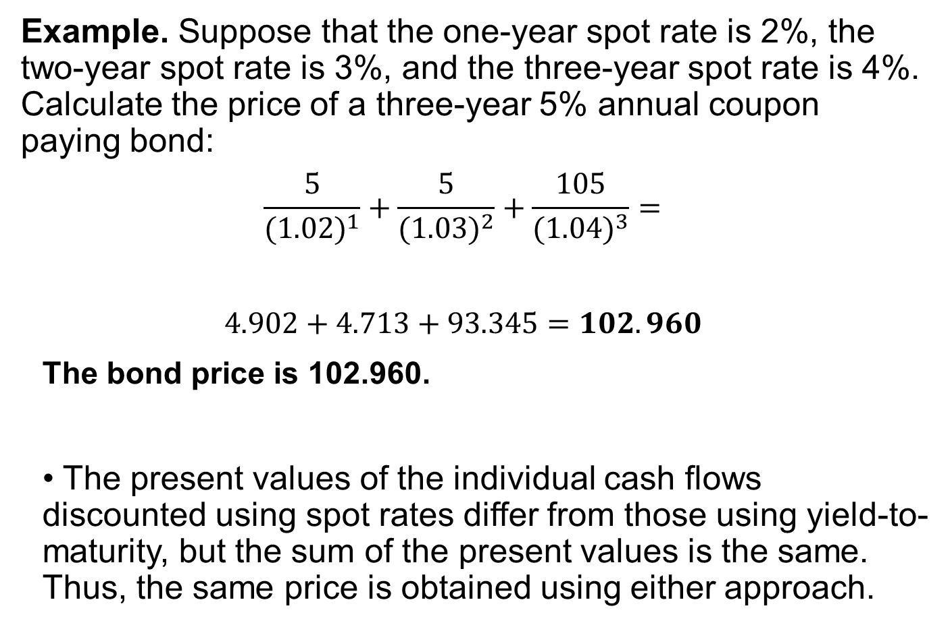
Example. Suppose that the one-year spot rate is 2%, the two-year spot rate is 3%, and the three-year spot rate is 4%. Calculate the price of a three-year 5% annual coupon paying bond:
$$\frac{5}{{(1.02)}^{1}}+\frac{5}{{(1.03)}^{2}}+\frac{105}{{(1.04)}^{3}}=$$
$$4.902+4.713+93.345=102.960$$
The bond price is 102.960.
• The present values of the individual cash flows discounted using spot rates differ from those using yield-to-maturity, but the sum of the present values is the same. Thus, the same price is obtained using either approach.
Notes:
2. Bond prices and the time value of money
LOS: Define spot rates and calculate the price of a bond using spot rates.

Slide 16

3. Prices and yields: conventions for quotes and calculations
Bond price consists of two components
Flat (clean) price (P_{c})
Accrued interest (AI)
The sum of flat price and accrued interest is the full (dirty) price (P_{f}).
$$P_{f}=P_{c}+AI$$
Bond dealers usually quote the flat price.
Buyers pay the full price for the bond on the settlement date.
Notes:
3. Prices and yields: Conventions for quotes and calculations
LOS: Describe and calculate the flat price, accrued interest, and the full price of a bond.
If a bond sold on the coupon payment date, its accrued interest is equal to zero (i.e., full price = clean price).
The reason to use the flat price for the quotation is to avoid misleading investors about the market price trend for the bond. If the full price were quoted by dealers, investors would see the price rise day after day even if the yield-to-maturity did not change. That is because the amount of accrued interest increases each day. Then, after the coupon payment is made, the quoted price would drop dramatically. Using the flat price for quotation avoids that misrepresentation.

Slide 17
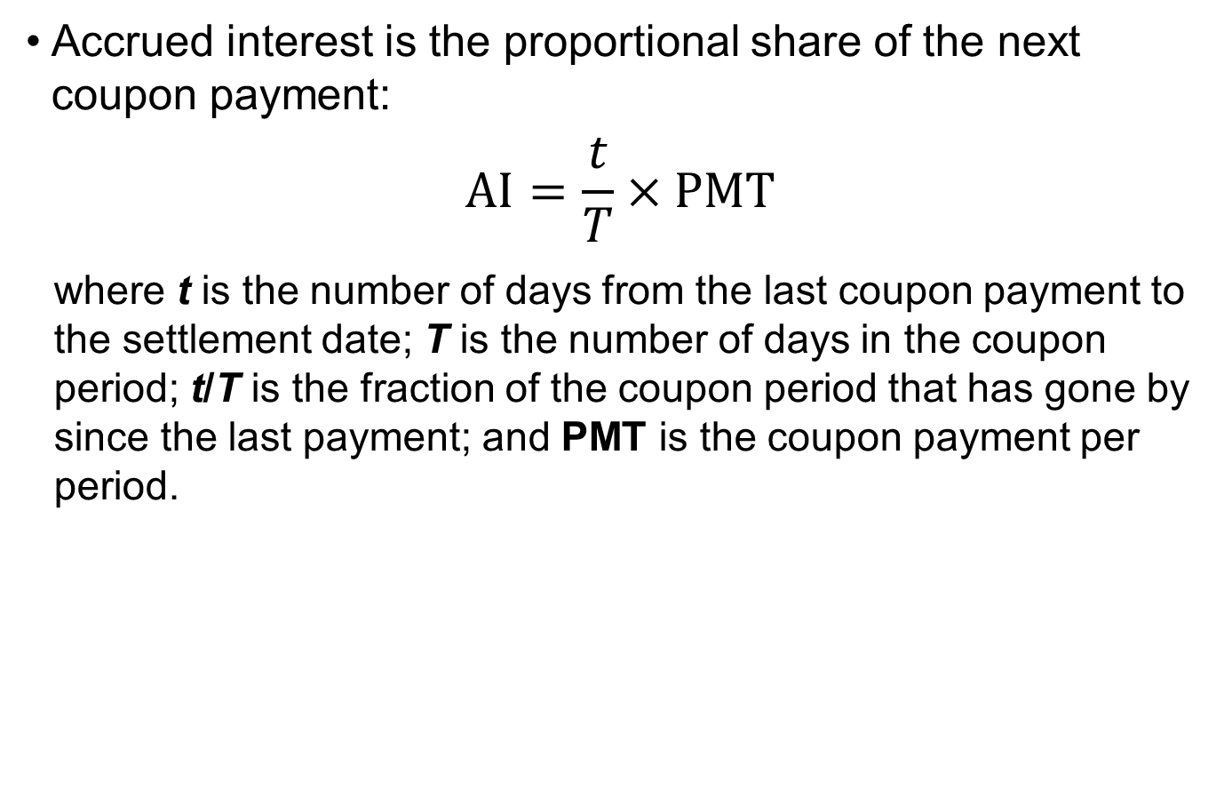
Accrued interest is the proportional share of the next coupon payment:
$$AI=\frac{t}{T}×PMT$$
where t is the number of days from the last coupon payment to the settlement date; T is the number of days in the coupon period; t/T is the fraction of the coupon period that has gone by since the last payment; and PMT is the coupon payment per period.
The two most common conventions to count days in bond markets:
(Days in the month/Days in a year)
Actual/actual is common for government bonds.
30/360 is common for corporate bonds.
Notes:
3. Prices and yields: Conventions for quotes and calculations
LOS: Describe and calculate the flat price, accrued interest, and the full price of a bond.
For the actual/actual method, the actual number of days is used, including weekends, holidays, and leap days.
The 30/360 day-count convention assumes that each month has 30 days and that a full year has 360 days.

Slide 18
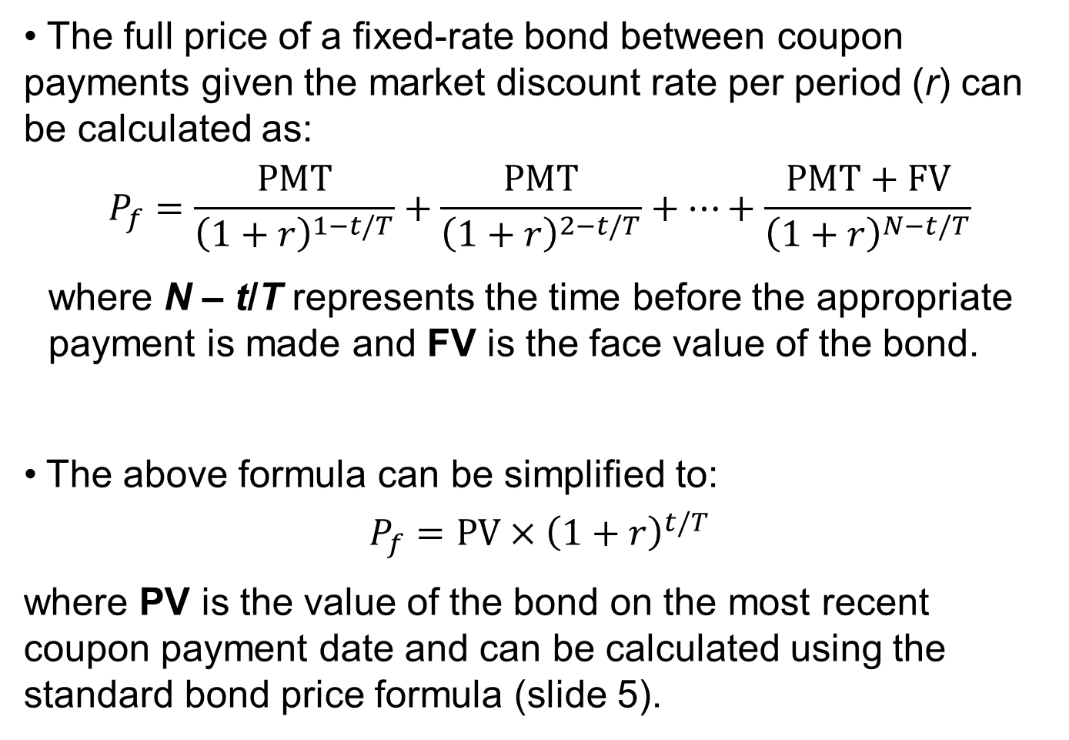
• The full price of a fixed-rate bond between coupon payments given the market discount rate per period (r) can be calculated as:
$$P_{f}=\frac{PMT}{{\left(1+r\right)}^{1−t/T}}+\frac{PMT}{{\left(1+r\right)}^{2−t/T}}+…+\frac{PMT+FV}{{\left(1+r\right)}^{N−t/T}}$$
where N – t/T represents the time before the appropriate payment is made and FV is the face value of the bond.
The above formula can be simplified to:
$$P_{f}=PV×{\left(1+r\right)}^{t/T}$$
where PV is the value of the bond on the most recent coupon payment date and can be calculated using the standard bond price formula (slide 5).
Notes:
3. Prices and yields: conventions for quotes and calculations
LOS: Describe and calculate the flat price, accrued interest, and the full price of a bond.
PV would typically be close in value to P_{c}, but conceptually, it is not the same as a flat/clean price.

Slide 19
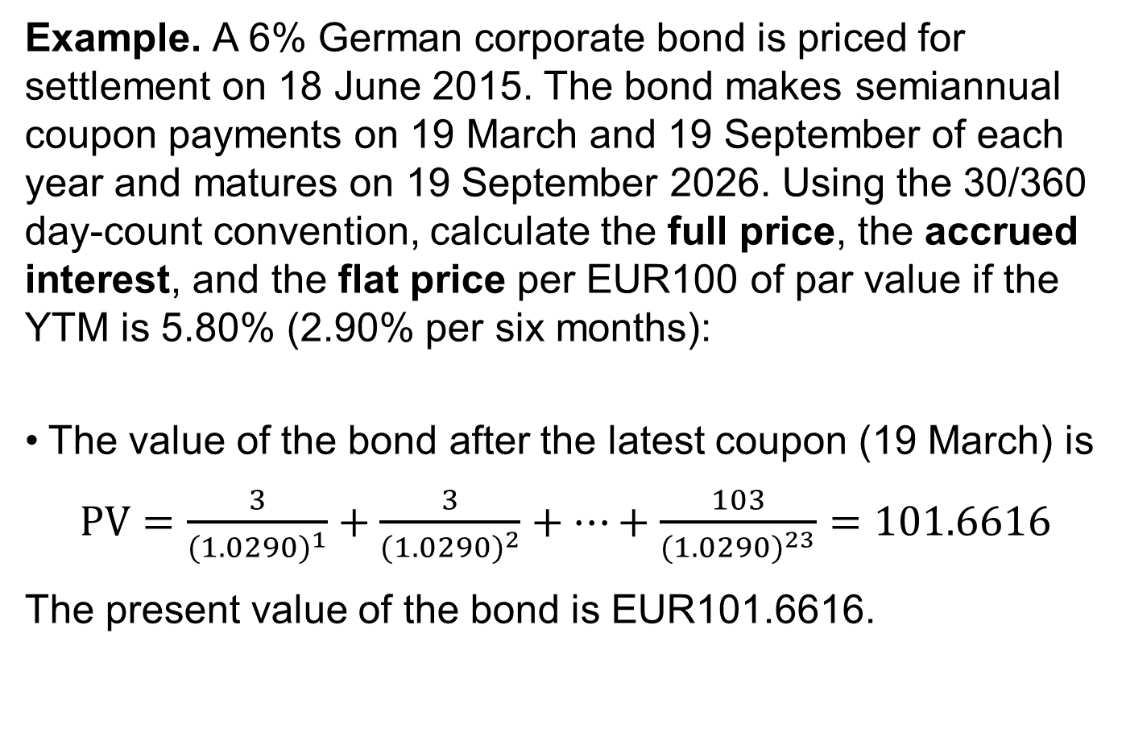
Example. A 6% German corporate bond is priced for settlement on 18 June 2015. The bond makes semiannual coupon payments on 19 March and 19 September of each year and matures on 19 September 2026. Using the 30/360 day-count convention, calculate the full price, the accrued interest, and the flat price per EUR100 of par value if the YTM is 5.80% (2.90% per six months):
The value of the bond after the latest coupon (19 March) is
$PV=\frac{3}{{(1.0290)}^{1}}+\frac{3}{{(1.0290)}^{2}}+…+\frac{103}{{(1.0290)}^{23}}=101.6616$
The present value of the bond is EUR101.6616.
Notes:
3. Prices and yields: Conventions for quotes and calculations
LOS: Describe and calculate the flat price, accrued interest, and the full price of a bond.
The price is in euros per 100 euros of par value.
There are 23 semiannual coupon payments (periods) to maturity, 11 years, and one six-month period.
The coupon payment is 3 euros per 100 euros of value (6% × 100/2).

Slide 20
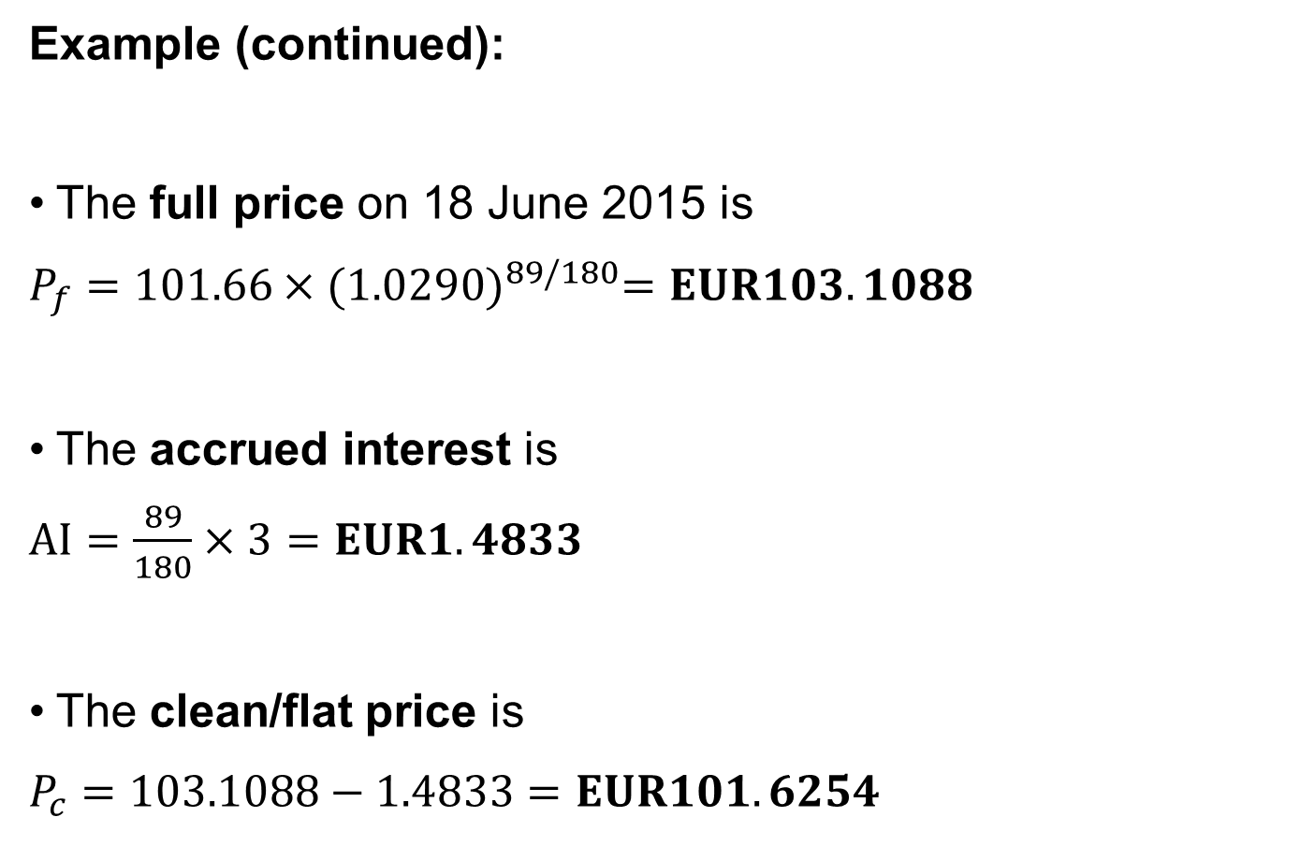
Example (continued):
The full price on 18 June 2015 is
$P_{f}=101.66×{(1.0290)}^{89/180}=EUR103.1088$
The accrued interest is
$AI=\frac{89}{180}×3=EUR1.4833$
The clean/flat price is
$P_{c}=103.1088−1.4833=EUR101.6254$
Notes:
3. Prices and yields: Conventions for quotes and calculations
LOS: Describe and calculate the flat price, accrued interest, and the full price of a bond.
T is 180 days because the six-month period is 180 days in the 30/360 convention.
t is 89 days = 3 months x 30 days minus 1 day.
The accrued interest does not depend on YTM.

Slide 21
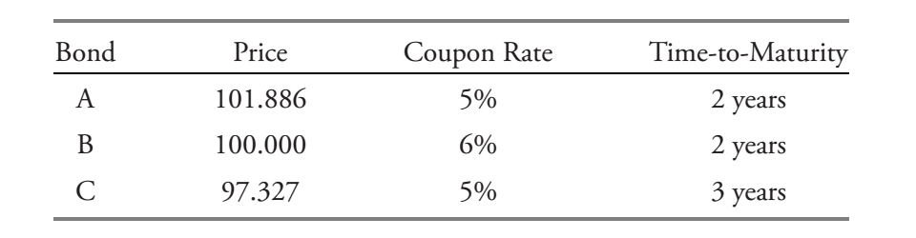
Mini-quiz #3
Which bond offers the lowest yield-to-maturity?
Which bond will most likely experience the smallest percent change in price if the market discount rates for all three bonds increase by 100 bps?
A rabbit wants to jump to a 10-step tower. It can either jump 1 step or 2 steps. How many ways this rabbit can reach the top?

Slide 22
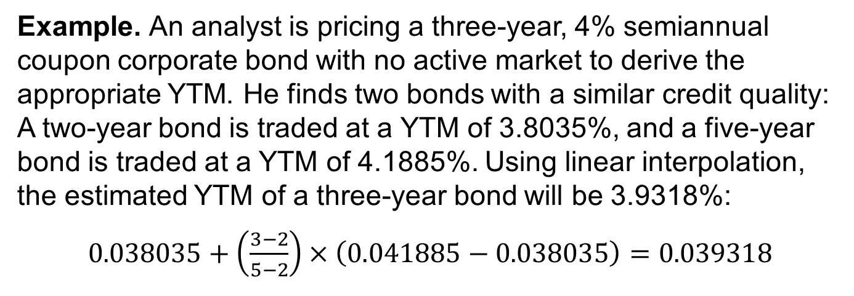
Matrix pricing is an estimation process used for bonds that are not actively traded.
In matrix pricing, market discount rates are extracted from comparable bonds (i.e., bonds with similar time-to-maturity, coupon rate, and credit quality).
Example. An analyst is pricing a three-year, 4% semiannual coupon corporate bond with no active market to derive the appropriate YTM. He finds two bonds with a similar credit quality: A two-year bond is traded at a YTM of 3.8035%, and a five-year bond is traded at a YTM of 4.1885%. Using linear interpolation, the estimated YTM of a three-year bond will be 3.9318%:
$0.038035+\left(\frac{3−2}{5−2}\right)×\left(0.041885−0.038035\right)=0.039318$
Notes:
3. Prices and yields: Conventions for quotes and calculations
LOS: Describe matrix pricing.
Once the appropriate discount rate (YTM) is found for the bond, the bond price can be calculated.

Slide 23
Matrix pricing is also used in underwriting new bonds to get an estimate of the required yield spread over the benchmark rate.
The benchmark rate is typically the yield-to-maturity on a government bond having the same, or close to the same, time-to-maturity.
The spread is the difference between the yield-to-maturity on the new bond and the benchmark rate.
The yield spread is the additional compensation required by investors for the difference in the credit risk, liquidity risk, and tax status of the bond relative to the government bond. This spread is sometimes called the “spread over the benchmark.”
Notes:
3. Prices and yields: Conventions for quotes and calculations
LOS: Describe matrix pricing.
Yield spreads are often stated in terms of basis points (bps).
There is usually a different yield spread for each maturity and for each credit rating.
The term structure of credit spreads is the relationship between the spreads over the “risk-free” (or benchmark) rates and times-to-maturity.

Slide 24
Yield Measures for Fixed-Rate Bonds
Investors use standardized yield measures to allow for comparison between bonds with varying maturities.
An annualized and compounded yield on a fixed-rate bond depends on the periodicity of the annual rate.
The periodicity of the annual market discount rate for a zero-coupon bond is arbitrary because there are no coupon payments.
The effective annual rate helps to overcome the problem of varying periodicity. It assumes there is just one compounding period per year.
For bonds maturing in more than one year:
For money market instruments of less than one year to maturity:
These are annualized but not compounded.
An annualized and compounded yield-to-maturity is used.
Notes:
3. Prices and yields: Conventions for quotes and calculations
LOS: Calculate and interpret yield measures for fixed-rate bonds, floating-rate notes, and money market instruments.
Typically, the periodicity matches the frequency of coupon payments.
For example, five-year zero-coupon bond priced at 80 per 100 par value, depending on periodicity, may have a YTM of 4.564% (annual), 4.513% (semiannual), 4.488% (quarterly), or 4.4712% (monthly).

Slide 25
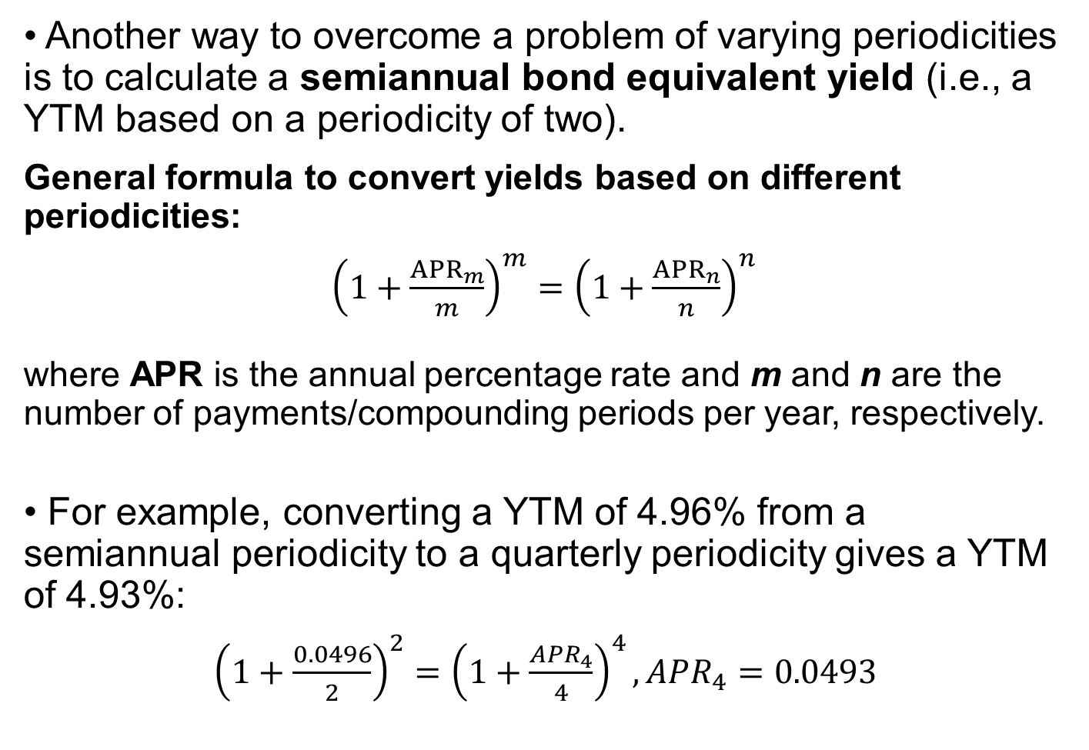
• Another way to overcome a problem of varying periodicities is to calculate a semiannual bond equivalent yield (i.e., a YTM based on a periodicity of two).
General formula to convert yields based on different periodicities:
${\left(1+\frac{{APR}_{m}}{m}\right)}^{m}={\left(1+\frac{{APR}_{n}}{n}\right)}^{n}$
where APR is the annual percentage rate and m and n are the number of payments/compounding periods per year, respectively.
• For example, converting a YTM of 4.96% from a semiannual periodicity to a quarterly periodicity gives a YTM of 4.93%:
${\left(1+\frac{0.0496}{2}\right)}^{2}={\left(1+\frac{{APR}_{4}}{4}\right)}^{4}, {APR}_{4}=0.0493$
Notes:
3. Prices and yields: Conventions for quotes and calculations
LOS: Calculate and interpret yield measures for fixed-rate bonds, floating-rate notes, and money market instruments.
A semiannual bond equivalent yield is also known as a semiannual bond basis yield.
Semiannual periodicity is most common in the USD bond market.

Slide 26
Other yield measures
Street convention yield-to-maturity:
The internal rate of return on the cash flows, assuming the payments are made on the scheduled dates (no weekends or holidays)
True yield-to-maturity:
The internal rate of return on the cash flows using the actual calendar of weekends and bank holidays
Current yield:
The sum of coupon payments received over the year divided by the flat price
Simple yield:
The sum of coupon payments plus the straight-line amortized share of the gain or loss, divided by the flat price
Government equivalent yield:
Restatement of a yield-to-maturity based on a 30/360 day-count to one based on actual/actual
Notes:
3. Prices and yields: Conventions for quotes and calculations
LOS: Calculate and interpret yield measures for fixed-rate bonds, floating-rate notes, and money market instruments.
The true yield is never higher than the street convention yield because weekends and holidays delay the time to payment.
The government equivalent yield on a corporate bond can be used to obtain the spread over the government yield. Doing so keeps the yields stated on the same day-count convention basis.
Current yield is also called the “income” or “interest yield.” The current yield is a crude measure of the rate of return to an investor because it neglects the frequency of coupon payments in the numerator and any accrued interest in the denominator.
Simple yields are used mostly to quote Japanese government bonds, known as “JGBs.”

Slide 27
Yield measures for floating-rate Notes
The interest payments on a floating-rate note vary from period to period depending on the current level of a reference interest rate.
The principal on the floater is typically non-amortizing and is redeemed in full at maturity.
The reference rate is determined at the beginning of the period, and the interest payment is made at the end of the period.
The most common day-count conventions for calculating accrued interest on floaters are actual/360 and actual/365.
Notes:
3. Prices and yields: Conventions for quotes and calculations
LOS: Calculate and interpret yield measures for fixed-rate bonds, floating-rate notes, and money market instruments.
A floating-rate note is also called a floater or an “FRN.”
The reference rate on a floating-rate note usually is a short-term money market rate, such as three-month Libor (the London Interbank Offered Rate).

Slide 28
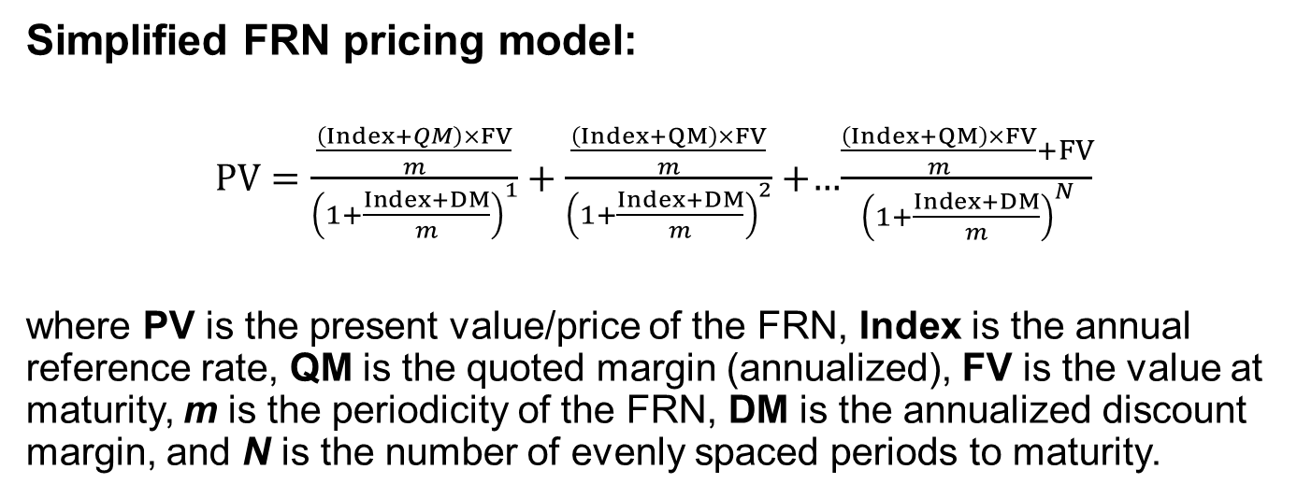
The specified yield spread over the reference rate is called the “quoted margin” on the FRN.
The required margin (i.e., discount margin) is the yield spread over, or under, the reference rate such that the FRN is priced at par value on a rate reset date.
Simplified FRN pricing model:
$PV=\frac{\frac{\left(Index+QM\right)×FV}{m}}{{\left(1+\frac{Index+DM}{m}\right)}^{1}}+\frac{\frac{\left(Index+QM\right)×FV}{m}}{{\left(1+\frac{Index+DM}{m}\right)}^{2}}+$…$\frac{\frac{\left(Index+QM\right)×FV}{m}+FV}{{\left(1+\frac{Index+DM}{m}\right)}^{N}}$
where PV is the present value/price of the FRN, Index is the annual reference rate, QM is the quoted margin (annualized), FV is the value at maturity, m is the periodicity of the FRN, DM is the annualized discount margin, and N is the number of evenly spaced periods to maturity.
Notes:
3. Prices and yields: conventions for quotes and calculations
LOS: Calculate and interpret yield measures for fixed-rate bonds, floating-rate notes, and money market instruments.
The role of the quoted margin is to compensate the investor for the difference between the credit risk of the issuer and that implied by the reference rate.
The required margin is the yield spread over, or under, the reference rate such that the FRN is priced at par value on a rate reset date.
Changes in the required margin usually come from changes in the issuer’s credit risk. Changes in liquidity or tax status also could affect the required margin.
This is a simplified FRN pricing model for several reasons. First, PV is for a rate reset date when there are N evenly spaced periods to maturity. There is no accrued interest so that the flat price is the full price. Second, the model assumes a 30/360 day-count convention so that the periodicity is an integer. Third, and most important, the same reference rate (Index) is used for all payment periods in both the numerators and denominators.

Slide 29
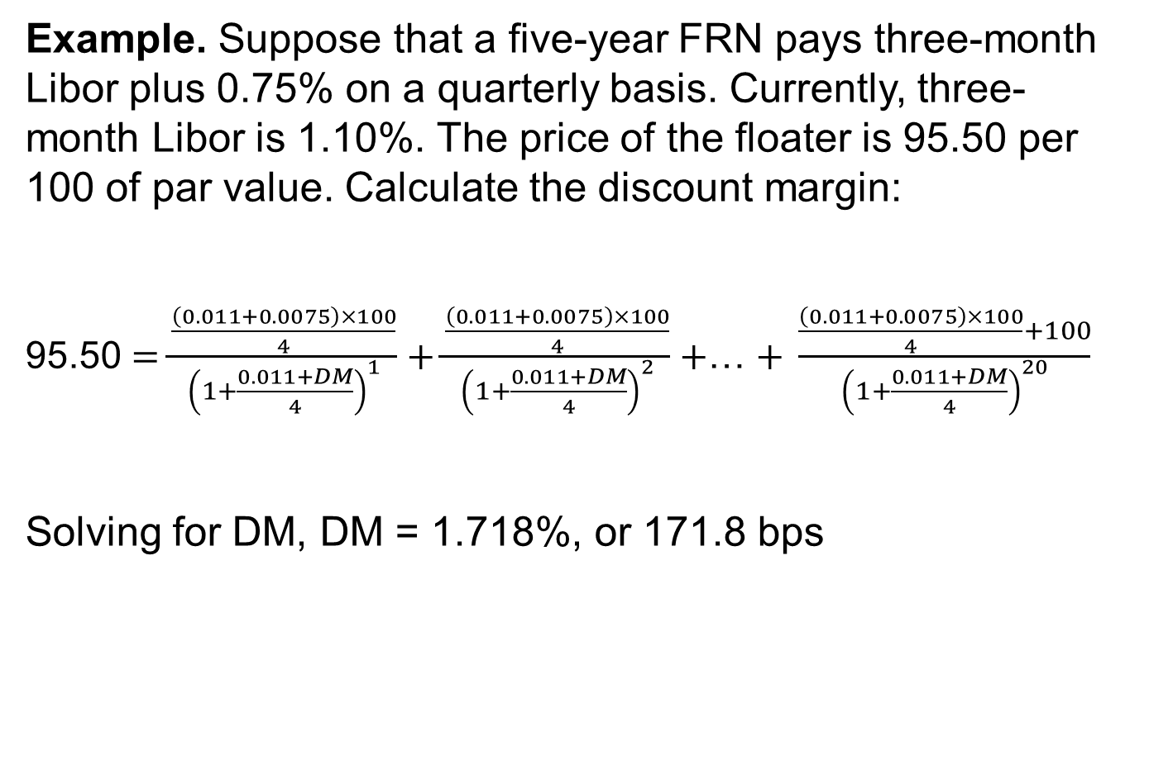
Example. Suppose that a five-year FRN pays three-month Libor plus 0.75% on a quarterly basis. Currently, three-month Libor is 1.10%. The price of the floater is 95.50 per 100 of par value. Calculate the discount margin:
95.50 $=\frac{\frac{\left(0.011+0.0075\right)×100}{4}}{{\left(1+\frac{0.011+DM}{4}\right)}^{1}}+\frac{\frac{\left(0.011+0.0075\right)×100}{4}}{{\left(1+\frac{0.011+DM}{4}\right)}^{2}}+$… $+ \frac{\frac{\left(0.011+0.0075\right)×100}{4}+100}{{\left(1+\frac{0.011+DM}{4}\right)}^{20}}$
Solving for DM, DM = 1.718%, or 171.8 bps
Notes:
3. Prices and yields: Conventions for quotes and calculations
LOS: Calculate and interpret yield measures for fixed-rate bonds, floating-rate notes, and money market instruments.
Solving step by step—numerator first, followed by the assumption of annuity with discount rate of (1+r)^n—will help solve the problem.

Slide 30
• There are several important differences in yield measures between the money market and the bond market:
• Quoted money market rates are either discount rates or add-on rates.
“Discount rate” has a unique meaning in the money market. It is a specific type of quoted rate.
The rate of return on a money market instrument is stated on a simple interest basis.
Money market instruments often are quoted using nonstandard interest rates and require different pricing equations than those used for bonds.
Money market instruments having different times-to-maturity have different periodicities for the annual rate.
Notes:
3. Prices and yields: Conventions for quotes and calculations
LOS: Calculate and interpret yield measures for fixed-rate bonds, floating-rate notes, and money market instruments.
Although market conventions vary around the world, commercial paper, Treasury bills (a US government security issued with a maturity of one year or less), and bankers’ acceptances are often quoted on a discount rate basis.
Bank certificates of deposit, repos, and such indices as Libor and Euribor are quoted on an add-on rate basis.

Slide 31
Pricing formula for money market instruments quoted on a discount rate basis:
$PV=FV×\left(1−\frac{Days}{Year}×DR\right)$
PV=FV×(1−Days/Year×DR)
Pricing formula for money market instruments quoted on an add-on rate basis:
$$PV=\frac{FV}{\left(1+\frac{Days}{Year} × AOR\right)}$$
PV=FV/((1+Days/Year × AOR) )
where Days is the number of days between settlement and maturity; Year is the number of days in a year (365 or 360); DR is the discount rate, stated as an annual percentage rate; and AOR is the add-on rate, stated as an annual percentage rate.
Notes:
3. Prices and yields: Conventions for quotes and calculations
LOS: Calculate and interpret yield measures for fixed-rate bonds, floating-rate notes, and money market instruments.

Slide 32
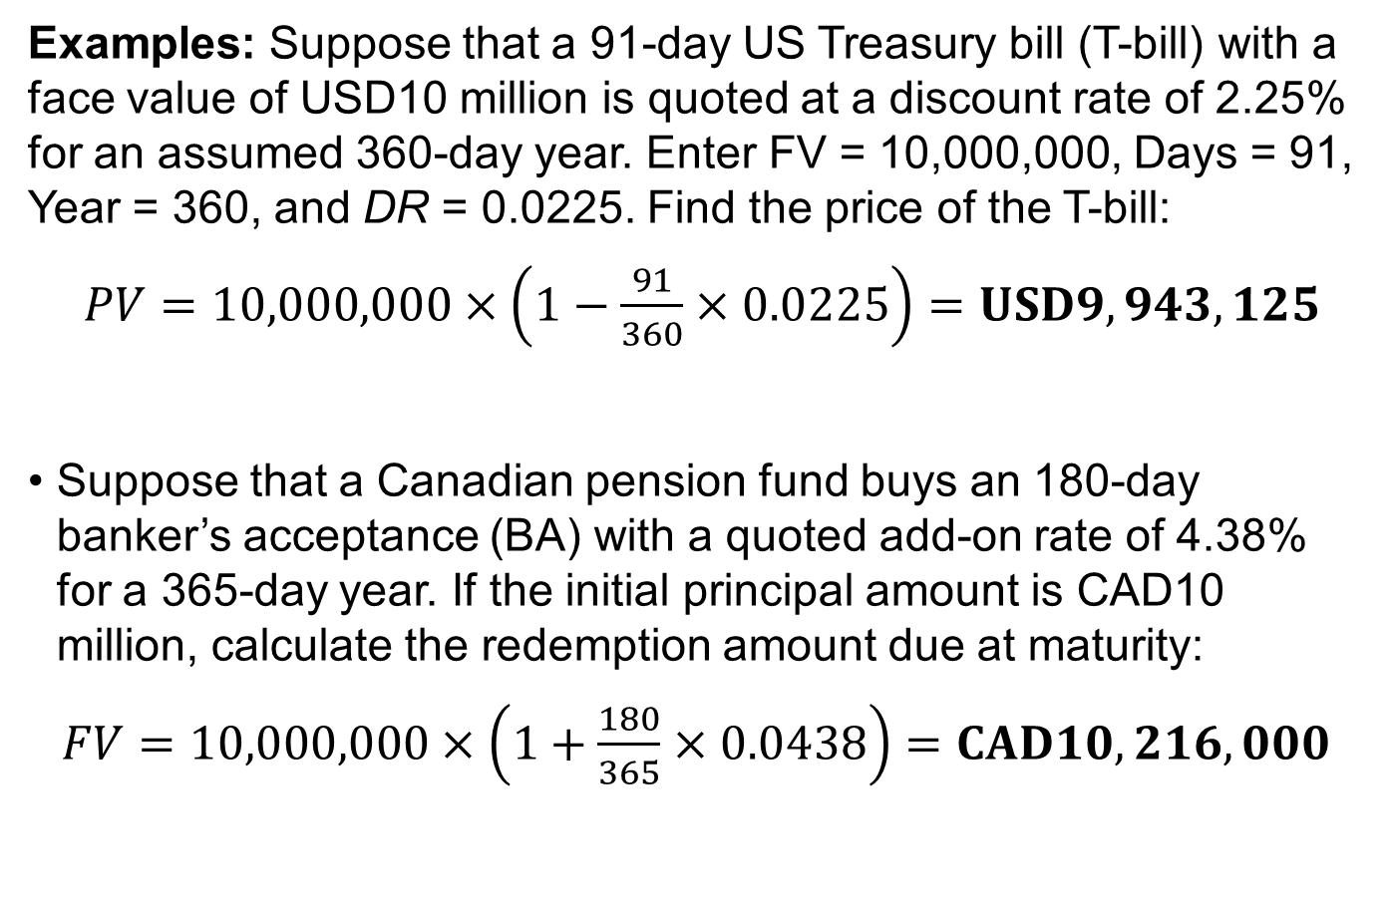
Examples: Suppose that a 91-day US Treasury bill (T-bill) with a face value of USD10 million is quoted at a discount rate of 2.25% for an assumed 360-day year. Enter FV = 10,000,000, Days = 91, Year = 360, and DR = 0.0225. Find the price of the T-bill:
$PV=10,000,000×\left(1−\frac{91}{360}×0.0225\right)=USD9,943,125$
Suppose that a Canadian pension fund buys an 180-day banker’s acceptance (BA) with a quoted add-on rate of 4.38% for a 365-day year. If the initial principal amount is CAD10 million, calculate the redemption amount due at maturity:
$FV=10,000,000×\left(1+\frac{180}{365}×0.0438\right)=CAD10,216,000$
Notes:
3. Prices and yields: Conventions for quotes and calculations
LOS: Calculate and interpret yield measures for fixed-rate bonds, floating-rate notes, and money market instruments.
In the second example, we arrange the pricing formula of money market instruments quoted on an add-on rate basis to solve for the FV rate.

Slide 33
The discount rate is calculated using the formula:
$$DR=\left(\frac{Year}{Days}\right)×\left(\frac{FV−PV}{FV}\right)$$
DR=(Year/Days)×((FV−PV)/FV)
The add-on rate is calculated using the formula:
$$AOR=\left(\frac{Year}{Days}\right)×\left(\frac{FV−PV}{PV}\right)$$
AOR=(Year/Days)×((FV−𝑃𝑉)/PV)
The first term for both formulas, Year/Days, is the periodicity of the annual rate.
The second term for the add-on rate is the interest earned, FV – PV, divided by PV, the amount invested.
However, for the discount rate, the denominator in the second term is FV, not PV. Therefore, by design, a money market discount rate understates the rate of return to the investor.
Notes:
3. Prices and yields: Conventions for quotes and calculations
LOS: Calculate and interpret yield measures for fixed-rate bonds, floating-rate notes, and money market instruments.
An add-on rate is a reasonable yield measure for a money market investment.
The add-on rate formula allows calculation of the so-called bond equivalent yield, or an “investment yield.” A bond equivalent yield is a money market rate stated on a 365-day add-on rate basis.

Slide 34
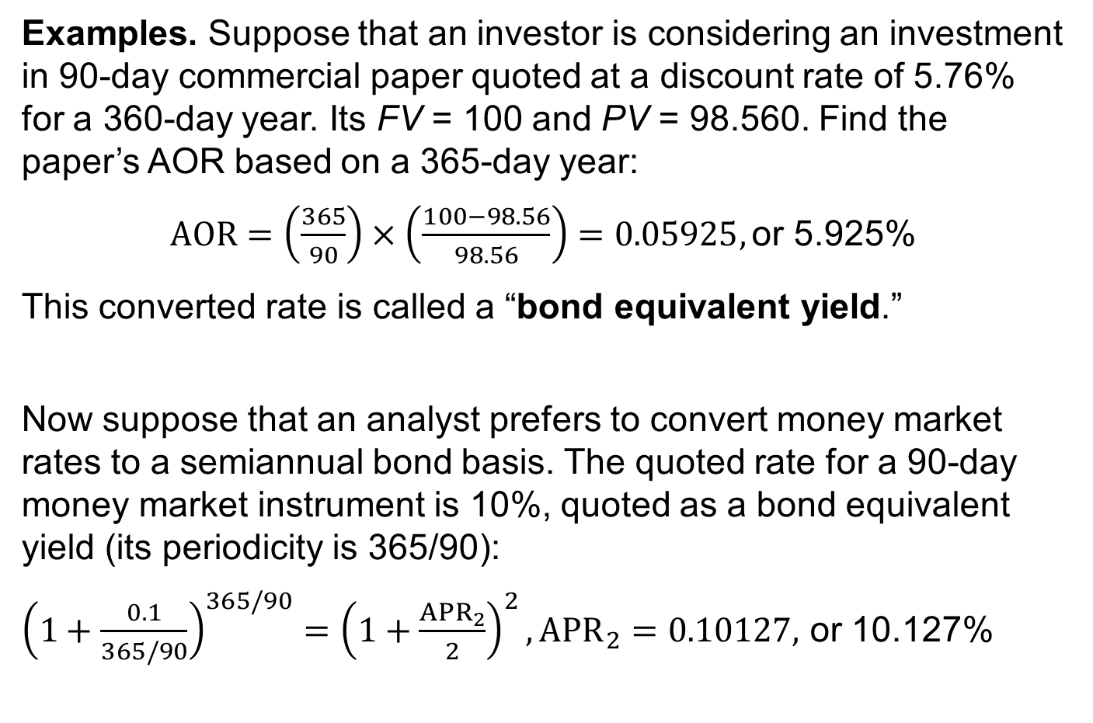
Examples. Suppose that an investor is considering an investment in 90-day commercial paper quoted at a discount rate of 5.76% for a 360-day year. Its FV = 100 and PV = 98.560. Find the paper’s AOR based on a 365-day year:
$AOR=\left(\frac{365}{90}\right)×\left(\frac{100−98.56}{98.56}\right)=0.05925,$ or 5.925%
This converted rate is called a “bond equivalent yield.”
Now suppose that an analyst prefers to convert money market rates to a semiannual bond basis. The quoted rate for a 90-day money market instrument is 10%, quoted as a bond equivalent yield (its periodicity is 365/90):
${\left(1+\frac{0.1}{365/90}\right)}^{365/90}={\left(1+\frac{{APR}_{2}}{2}\right)}^{2}, {APR}_{2}=0.10127,$ or 10.127%
Notes:
3. Prices and yields: conventions for quotes and calculations
LOS: Calculate and interpret yield measures for fixed-rate bonds, floating-rate notes, and money market instruments.
In the first example, 5.925% is the bond equivalent yield.
In the second example, we use the formula from slide 22.

Slide 35
Mini-quiz #4
Matrix pricing allows investors to estimate market discount rates and prices for bonds: A . with different coupon rates. B . that are not actively traded. C . with different credit quality.
When underwriting new corporate bonds, matrix pricing is used to get an estimate of the: A . required yield spread over the benchmark rate. B . market discount rate of other comparable corporate bonds. C . yield-to-maturity on a government bond having a similar time-to-maturity

Slide 36
4. The maturity structure of interest rates
The difference between yields on two bonds might be due to various reasons, such as:
periodicity • varying time-to maturity
liquidity • tax status
currency denomination • credit risk
The term structure of interest rates is the factor that explains the differences between yields. It involves the analysis of yield curves, which are relationships between yields-to-maturity and times-to-maturity.
Examples of yield curves
The (government bond) spot curve is a sequence of yields-to-maturity on zero-coupon (government) bonds.
The yield curve on coupon bonds is a sequence of yields-to-maturity on coupon paying (government) bonds.
Notes:
4. The maturity structure of interest rates.
LOS: Define and compare the spot curve, yield curve on coupon bonds, par curve, and forward curve.
The government bond spot curve is sometimes called the “zero” or “strip” curve (because the coupon payments are “stripped” off of the bonds).
Often, these government spot rates are interpreted as the “risk-free” yields; in this context, “risk-free” refers only to default risk. There still could be a significant amount of inflation risk to the investor, as well as liquidity risk.
This spot curve is upward sloping and flattens for longer times-to-maturity. Longer-term government bonds usually have higher yields than shorter-term bonds. This pattern is typical under normal market conditions. Sometimes, a spot curve is downward sloping in that shorter-term yields are higher than longer-term yields. This downward-sloping spot curve is called an “inverted yield curve.”
Analysts usually use only the most recently issued and actively traded government bonds to build a yield curve. These bonds have similar liquidity, and because they are priced closer to par value, they have fewer tax effects.

Slide 37

A par curve is a sequence of yields-to-maturity such that each bond is priced at par value.
The par curve is obtained from a spot curve using the following formula and solving for PMT (z is the spot rate for the period):
$$100=\frac{PMT}{{\left(1+z_{1}\right)}^{1}}+\frac{PMT}{{\left(1+z_{2}\right)}^{2}}+…+\frac{PMT+100}{{\left(1+z_{N}\right)}^{N}}$$
A forward curve is a series of forward rates, each having the same time frame. These forward rates might be observed on transactions in the derivatives market.
Notes:
4. The maturity structure of interest rates
LOS: Define and compare the spot curve, yield curve on coupon bonds, par curve, and forward curve.
Often, the forward rates are implied from transactions in the cash market.

Slide 38
A forward rate
An implied forward rate (also known as a forward yield)
is the interest rate on a bond or money market instrument traded in a forward market (future delivery).
is calculated from spot rates and is a break-even reinvestment rate
links the return on an investment in a shorter-term zero-coupon bond to the return on an investment in a longer-term zero-coupon bond.
Although finance textbook authors use varying notation, the most common market practice is to name forward rates as in this example: “2y5y” — pronounced “the two-year into five-year rate.” The first number (two) refers to the length of the forward period in years from today, and the second number (five) refers to the tenor (time-to-maturity) of the underlying bond.
Notes:
4. The maturity structure of interest rates
LOS: Define forward rates and calculate spot rates from forward rates, forward rates from spot rates, and the price of a bond using forward rates.
The formula might be used to calculate an implied forward rate from two spot rates or a spot rate from another spot rate and an forward rate.

Slide 39
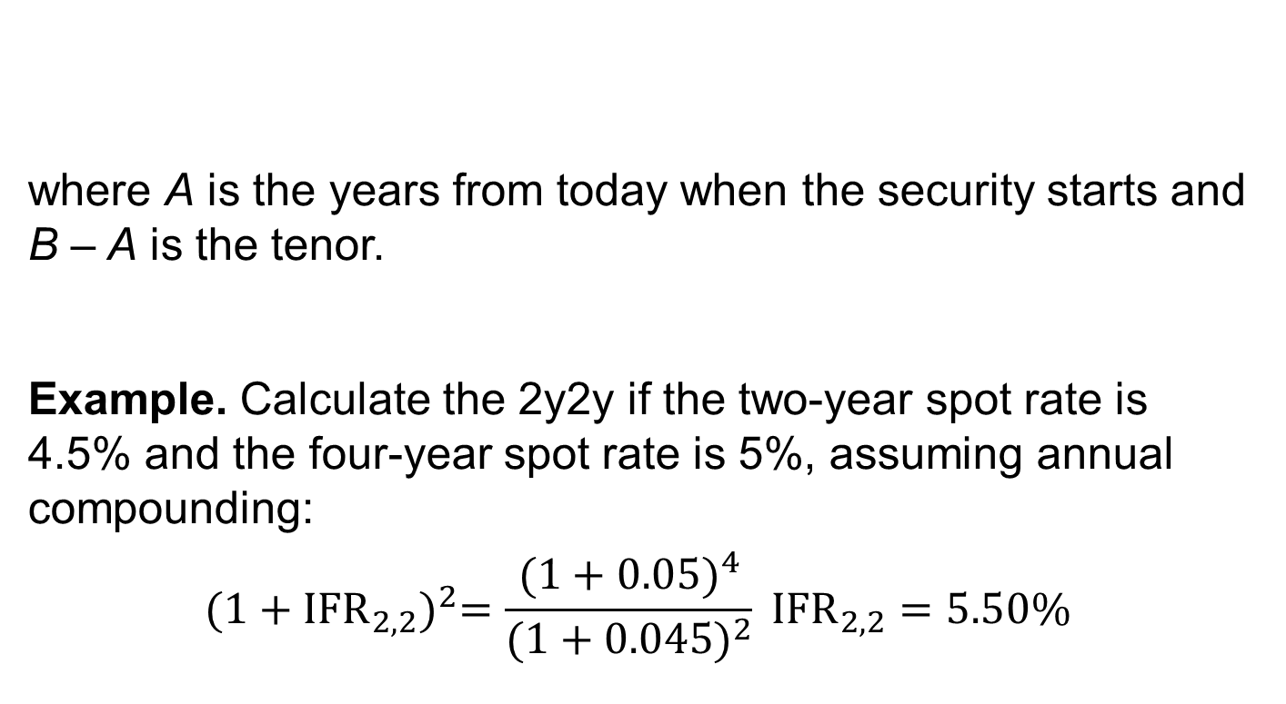
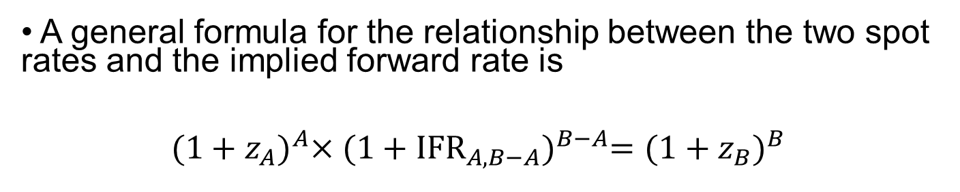
• A general formula for the relationship between the two spot rates and the implied forward rate is
$${(1+z_{A})}^{A}×{(1+{IFR}_{A,B−A})}^{B−A}={(1+z_{B})}^{B}$$
where A is the years from today when the security starts and B – A is the tenor.
Example. Calculate the 2y2y if the two-year spot rate is 4.5% and the four-year spot rate is 5%, assuming annual compounding:
$${(1+{IFR}_{2,2})}^{2}=\frac{{(1+0.05)}^{4}}{{(1+0.045)}^{2}} {IFR}_{2,2}=5.50\%$$
Notes:
4. The maturity structure of interest rates.
LOS: Define forward rates and calculate spot rates from forward rates, forward rates from spot rates, and the price of a bond using forward rates.
Notes:
The first number (two) refers to the length of the forward period in years from today and the second number (four) refers to the tenor of the underlying bond (or a derivative contract),

Slide 40
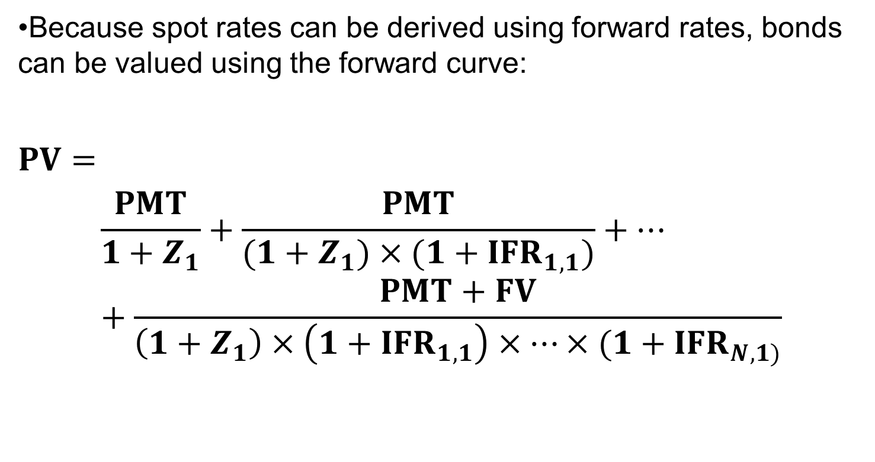
•Because spot rates can be derived using forward rates, bonds can be valued using the forward curve:
$$PV=$$
$$\frac{PMT}{1+Z_{1}}+\frac{PMT}{(1+Z_{1})×(1+{IFR}_{1,1})}+…+\frac{PMT+FV}{\left(1+Z_{1}\right)×\left(1+{IFR}_{1,1}\right)×…×(1+{IFR}_{N,1)}}$$
Notes:
4. The maturity structure of interest rates
LOS: Define forward rates and calculate spot rates from forward rates, forward rates from spot rates, and the price of a bond using forward rates.

Slide 41
5. Yield Spreads
The spread is the difference between the yield-to-maturity and the benchmark.
The benchmark is often called the “risk-free rate of return.” Fixed-rate bonds often use a government benchmark (on-the-run) security with the same time-to-maturity as, or the closest time-to-maturity to, the specified bond.
A frequently used benchmark for floating-rate notes is Libor. As a composite interbank rate, it is not a risk-free rate.
Notes:
5. Yield spreads
LOS: Compare, calculate, and interpret yield spread measures.
The spread captures the microeconomic factors specific to the bond issuer and the bond itself: the credit risk of the issuer and changes in the quality rating on the bond, liquidity and trading in comparable securities, and the tax status of the bond.
The most recently issued government bond is called the “on-the-run security.”

Slide 42
Yield-to-Maturity Building Blocks
Spread
Risk Premium
Taxation
Liquidity
Credit Risk
Benchmark
“Risk-Free” Rate of Return
Expected Inflation Rate
Expected Real Rate
Notes:
4. The maturity structure of interest rates
LOS: Compare, calculate, and interpret yield spread measures.

Slide 43
G-spread
The yield spread in basis points over an actual or interpolated government bond
$$PV=\frac{PMT}{{(1+z_{1}+Z)}^{1}}+\frac{PMT}{{(1+z_{2}+Z)}^{2}}+…+\frac{PMT+FV}{{(1+z_{N}+Z)}^{N}}$$
𝐏𝐕=𝐏𝐌𝐓/〖(𝟏+𝒛_𝟏+𝒁)〗^𝟏 +𝐏𝐌𝐓/〖(𝟏+𝒛_𝟐+𝒁)〗^𝟐 +…+(𝐏𝐌𝐓+𝐅𝐕)/〖(𝟏+𝒛_𝑵+𝒁)〗^𝑵
A zero volatility spread (Z-spread) of a bond
I-spread or interpolated spread to the swap curve
The yield spread of a specific bond over the standard swap rate in that currency of the same tenor
Calculated as a constant yield spread over a government (or interest rate swap) spot curve — as opposed to the G-spread and I-spread, which use the same discount rate for each cash flow
The Z-spread is also used to calculate the option-adjusted spread (OAS) on a callable bond.
Notes:
5. Yield spreads
LOS: Compare, calculate, and interpret yield spread measures.
Notes:
This yield spread over Libor (I-spread) allows comparison of bonds with differing credit and liquidity risks against an interbank lending benchmark.
OAS = Z-spread – Option value (in basis points per year)

Slide 44
6. SUMMARY
Bond’s price given a market discount rate
Relationships among a bond’s price, coupon rate, maturity, and market discount rate
A bond price moves inversely with its market discount rate.
The market discount rate is the rate of return required by investors given the risk of the investment in the bond.
A bond is priced at a premium above par value when the coupon rate is greater than the market discount rate.
Generally, the price of a longer-term bond is more volatile than the price of a shorter-term bond, other things being equal.
The price of a lower-coupon bond is more volatile than the price of a higher-coupon bond, other things being equal.
A bond is priced at a discount below par value when the coupon rate is less than the market discount rate.
Notes:
LOS: Calculate a bond’s price given a market discount rate
LOS: Identify the relationships among a bond’s price, coupon rate, maturity, and market discount rate

Slide 45
SUMMARY
Spot rate
A spot rate is the yield-to-maturity on a zero-coupon bond.
Flat price, accrued interest, and the full bond price
Matrix pricing is used to value illiquid bonds by using prices and yields on comparable securities having the same or similar credit risk, coupon rate, and maturity.
Between coupon dates, the full (or invoice, or “dirty”) price of a bond is split between the flat (or quoted, or “clean”) price and the accrued interest.
Accrued interest is calculated as a proportional share of the next coupon payment using either the actual/actual or 30/360 method to count days.
Matrix pricing
Notes:
LOS: Define spot rates and calculate the price of a bond using spot rates.
LOS: Describe and calculate the flat price, accrued interest, and the full price of a bond.

Slide 46
SUMMARY
Yield measures for fixed-rate bonds, floating-rate notes, and money market instruments
The current yield is the annual coupon payment divided by the flat price.
The simple yield is like the current yield but includes the straight-line amortization of the discount or premium.
A yield quoted on a semiannual bond basis is an annual rate for a periodicity of two. It is the yield per semiannual period times two.
The quoted margin on a floater is typically the specified yield spread over or under the reference rate, which often is LIBOR.
Money market instruments, having one year or less time-to-maturity, are quoted on a discount rate or add-on rate basis.
Notes:
LOS: Calculate and interpret yield measures for fixed-rate bonds, floating-rate notes, and money market instruments.

Slide 47
SUMMARY
A forward rate is the interest rate on a bond or money market instrument traded in a forward market.
Spot curve, yield curve on coupon bonds, par curve, and forward curve
Forward rates and spot rates
A spot curve is a series of yields-to-maturity on zero-coupon bonds.
A frequently used yield curve is a series of yields-to-maturity on coupon bonds.
A par curve is a series of yields-to-maturity assuming the bonds are priced at par value.
An implied forward curve can be calculated from the spot curve.
Notes:
LOS: Define and compare the spot curve, yield curve on coupon bonds, par curve, and forward curve.
LOS: Define forward rates and calculate spot rates from forward rates, forward rates from spot rates, and the price of a bond using forward rate.

Slide 48
SUMMARY
Changes in spreads typically capture microeconomic factors that affect the particular bond—credit risk, liquidity, and tax effects.
Benchmark rates are usually yields-to-maturity on government bonds or fixed rates on interest rate swaps.
Forward rates and spot rates (continued)
An implied forward rate is the breakeven reinvestment rate linking the return on an investment in a shorter-term zero-coupon bond to the return on an investment in a longer-term zero-coupon bond.
A fixed-income bond can be valued using a market discount rate, a series of spot rates, or a series of forward rates.
A bond yield-to-maturity can be separated into a benchmark and a spread.
Yield spread measures
Notes:
LOS: Define forward rates and calculate spot rates from forward rates, forward rates from spot rates, and the price of a bond using forward rate.
LOS: Compare, calculate, and interpret yield spread measures.

Slide 49
Homework
Game: you are asked to write down a number (between 0-100). The number is only kept to yourself. The one who is closet the half of the class average (1/2 of all the numbers of classmates) wins the game. Think carefully what number you want to write down. Special prize will be given to the winner.
A portfolio manager is considering the purchase of a bond with a 5.5% coupon rate that pays interest annually and matures in three years. If the required rate of return on the bond is 5%, the price of the bond per 100 of par value is closest to: A . 98.65. B . 101.36. C . 106.43
Suppose a bond’s price is expected to increase by 5% if its market discount rate decreases by 100 bps. If the bond’s market discount rate increases by 100 bps, the bond price is most likely to change by: A . 5%. B . less than 5%. C . more than 5%.
A bond with 20 years remaining until maturity is currently trading for 111 per 100 of par value. The bond offers a 5% coupon rate with interest paid semiannually. The bond’s annual yield-to-maturity is closest to: A . 2.09%. B .4.18%. C .4.50%

Slide 50
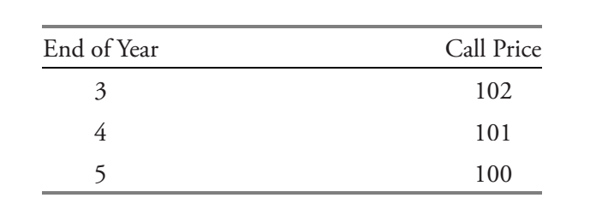
homework
A bond with 5 years remaining until maturity is currently trading for 101 per 100 of par value. The bond offers a 6% coupon rate with interest paid semiannually. The bond is first callable in 3 years, and is callable after that date on coupon dates according to the following schedule:
The bond’s annual yield-to-maturity is closest to: A . 2.88%. B . 5.77%. C . 5.94%.
The bond’s annual yield-to-first-call is closest to: A . 3.12%. B . 6.11%. C . 6.25%.
The bond’s annual yield-to-second-call is closest to: A . 2.97%. B . 5.72%. C .5.94%.
The bond’s yield-to-worst is closest to: A . 2.88%. B .5.77%. C . 6.25%.

