Slide 1
Fixed income analysis lecture 4
Tony Zhang
Fall 2019
© 2016 CFA Institute. All rights reserved.

Slide 2
TABLE OF CONTENTS
01
INTRODUCTION
02
SOURCES OF RETURN
03
INTEREST RATE RISK ON FIXED-RATE BONDS
04
INTEREST RATE RISK AND THE INVESTMENT HORIZON
05
CREDIT AND LIQUIDITY RISK
06
SUMMARY

Slide 3
1. INTRODUCTION
Any analysis of fixed-rate securities starts with an understanding of their risk and return characteristics.
The yield-to-maturity, or internal rate of return on future cash flows, is of particular focus.
The return on a fixed-rate bond is affected by many factors, such as credit risk (potential default on payments) and interest rate risk (varying coupon reinvestment rate and sale price).
Notes:
1. Introduction

Slide 4
2. SOURCES OF RETURN
A fixed-rate bond has three sources of return:
1.
2.
3.
Receipt of the promised coupon and principal payments on the scheduled dates
Reinvestment of coupon payments
Potential capital gains or losses on the sale of the bond prior to maturity
A horizon yield
A carrying value
the internal rate of return between the total return for the investment horizon and the purchase price of the bond
the purchase price plus (minus) the amortized amount of the discount (premium) if the bond is purchased at a price below (above) par value
Notes:
2. Sources of return
LOS: Calculate and interpret the sources of return from investing in a fixed-rate bond.
A discount bond offers the investor a “deficient” coupon rate, or one below the market discount rate. The amortization of the discount in each period brings the return in line with the market discount rate as the bond’s carrying value is “pulled to par.”
For a premium bond, the coupon rate exceeds the market discount rate and the amortization of the premium adjusts the return to match the market discount rate. Through amortization, the bond’s carrying value reaches par value at maturity.

Slide 5
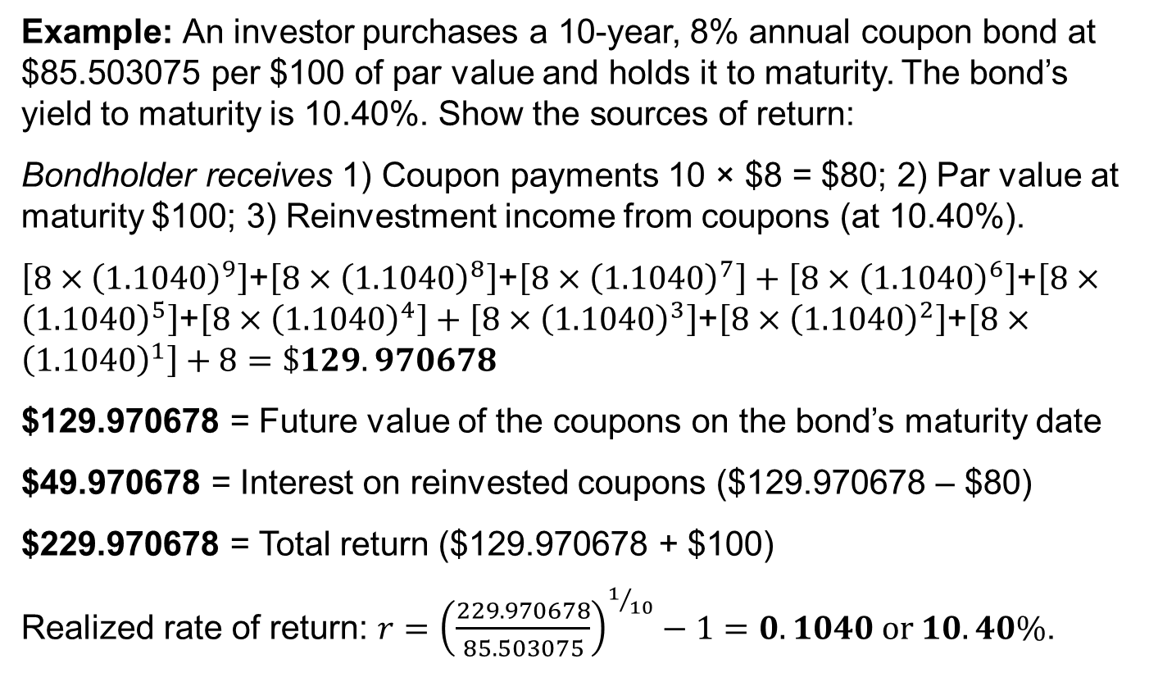
SOURCES OF RETURN
Example: An investor purchases a 10-year, 8% annual coupon bond at $85.503075 per $100 of par value and holds it to maturity. The bond’s yield to maturity is 10.40%. Show the sources of return:
Bondholder receives 1) Coupon payments 10 × $8 = $80; 2) Par value at maturity $100; 3) Reinvestment income from coupons (at 10.40%).
$\left[8×{\left(1.1040\right)}^{9}\right]$+$\left[8×{\left(1.1040\right)}^{8}\right]$+$\left[8×{\left(1.1040\right)}^{7}\right]+\left[8×{\left(1.1040\right)}^{6}\right]$+$\left[8×{\left(1.1040\right)}^{5}\right]$+$\left[8×{\left(1.1040\right)}^{4}\right]+\left[8×{\left(1.1040\right)}^{3}\right]$+$\left[8×{\left(1.1040\right)}^{2}\right]$+$\left[8×{\left(1.1040\right)}^{1}\right]+8=\$129.970678$
$129.970678 = Future value of the coupons on the bond’s maturity date
$49.970678 = Interest on reinvested coupons ($129.970678 – $80)
$229.970678 = Total return ($129.970678 + $100)
Realized rate of return: $r={\left(\frac{229.970678}{85.503075}\right)}^{1/{10}}−1=0.1040 or 10.40\%$.
Notes:
2. Sources of return
LOS: Calculate and interpret the sources of return from investing in a fixed-rate bond.
There are two potential impacts on the return from the change in interest rates. The future value of reinvested coupon payments goes up because now coupons are reinvested at 11.40%. The value is 0.552613 ( = 37.899724 – 37.347111) per 100 of par value. $37.347111 is the value of reinvested coupons if the yield-to-maturity (YTM) stays at 10.40%. But there is a capital loss of 3.888362 (= 89.668770 – 85.780408) per 100 of par value. $89.66877 is the sale value if interest rates stay at 10.4%.
The capital loss is greater than increase in interest from the reinvested coupon. The overall impact of an increased interest rate in this example would be negative (i.e., reduction from 10.4% realized return to 9.67% realized return).

Slide 6
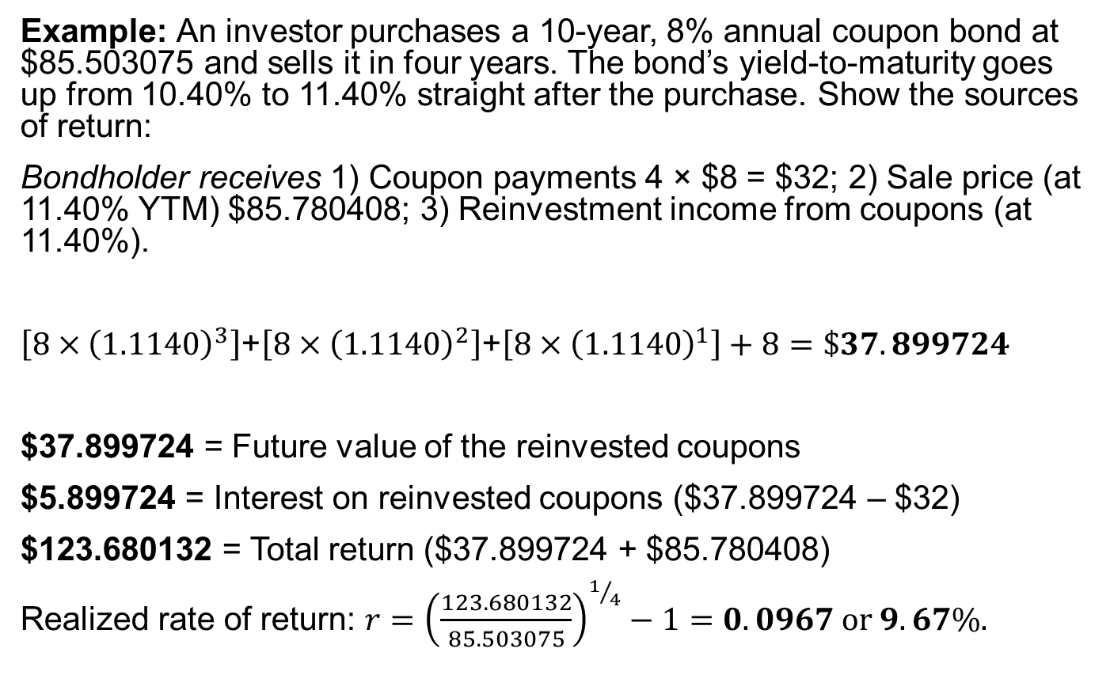
SOURCES OF RETURN
Example: An investor purchases a 10-year, 8% annual coupon bond at $85.503075 and sells it in four years. The bond’s yield-to-maturity goes up from 10.40% to 11.40% straight after the purchase. Show the sources of return:
Bondholder receives 1) Coupon payments 4 × $8 = $32; 2) Sale price (at 11.40% YTM) $85.780408; 3) Reinvestment income from coupons (at 11.40%).
$\left[8×{\left(1.1140\right)}^{3}\right]$+$\left[8×{\left(1.1140\right)}^{2}\right]$+$\left[8×{\left(1.1140\right)}^{1}\right]+8=\$37.899724$
$37.899724 = Future value of the reinvested coupons
$5.899724 = Interest on reinvested coupons ($37.899724 – $32)
$123.680132 = Total return ($37.899724 + $85.780408)
Realized rate of return: $r={\left(\frac{123.680132}{85.503075}\right)}^{1/4}−1=0.0967 or 9.67\%.$
Notes:
2. Sources of return
LOS: Calculate and interpret the sources of return from investing in a fixed-rate bond.
There are two potential impacts on the return from the change in interest rates. The future value of reinvested coupon payments goes up because now coupons are reinvested at 11.40%. The value is 0.552613 ( = 37.899724 – 37.347111) per 100 of par value. $37.347111 is the value of reinvested coupons if the yield-to-maturity (YTM) stays at 10.40%. But there is a capital loss of 3.888362 (= 89.668770 – 85.780408) per 100 of par value. $89.66877 is the sale value if interest rates stay at 10.4%.
The capital loss is greater than increase in interest from the reinvested coupon. The overall impact of an increased interest rate in this example would be negative (i.e., reduction from 10.4% realized return to 9.67% realized return).

Slide 7
Investment horizon and interest rate risk
A few important points about fixed-rate bonds:
The investment horizon is at the heart of understanding interest rate risk and return.
There are two offsetting types of interest rate risk
Coupon reinvestment risk
Market price risk
Notes:
2. Sources of return
LOS: Calculate and interpret the sources of return from investing in a fixed-rate bond.
A buy-and-hold investor only has coupon reinvestment risk.
Market price risk matters more when the investor has a short-term horizon relative to the time-to-maturity.
Therefore, two investors holding the same bond (or bond portfolio) can have different exposures to interest rate risk if they have different investment horizons.

Slide 8
Coupon reinvestment risk and market price risk
The future value of reinvested coupon payments (and in a portfolio, the principal on bonds that mature before the horizon date) increases when interest rates go up and decreases when rates go down.
The sale price on a bond that matures after the horizon date (and thus needs to be sold) decreases when interest rates go up and increases when rates go down.
Coupon reinvestment risk matters more when the investor has a long-term horizon relative to the time-to-maturity of the bond.
Notes:
2. Sources of return
LOS: Calculate and interpret the sources of return from investing in a fixed-rate bond.
A buy-and-hold investor only has coupon reinvestment risk.
Market price risk matters more when the investor has a short-term horizon relative to the time-to-maturity.
Therefore, two investors holding the same bond (or bond portfolio) can have different exposures to interest rate risk if they have different investment horizons.

Slide 9
3. Interest rate risk on fixed-rate bonds
The duration of a bond measures the sensitivity of the bond’s full price (including accrued interest) to changes in the bond’s yield-to-maturity or, more generally, to changes in benchmark interest rates.
There are several types of bond duration. In general, these can be divided into yield duration and curve duration.
Yield duration is the sensitivity of the bond price with respect to the bond’s own yield-to-maturity.
Curve duration is the sensitivity of the bond price (or more generally, the market value of a financial asset or liability) with respect to a benchmark yield curve.
Notes:
3. Interest rate risk on fixed-rate bond
LOS: Define, calculate, and interpret Macaulay, modified, and effective durations.
Duration estimates changes in the bond price, assuming that variables other than the yield-to-maturity or benchmark rates are held constant.
The duration of zero-coupon bond equals maturity.
The duration of a coupon bond is less than maturity.

Slide 10
Yield duration statistics
where t is the number of days from the last coupon payment to the settlement date; T is the number of days in the coupon period; PMT is the coupon payment per period; FV is par value; r is YTM/discount rate per period; and N is the number of coupon periods to maturity.
Yield duration statistics used in fixed-income analysis include
Modified duration
Money duration
Price value of a basis point (PVBP)
Macaulay duration
The Macaulay duration (D) formula (for the period)
$D=\left[\frac{\frac{(1−\frac{t}{T})×PMT}{{(1+r)}^{1−t/T}}+\frac{(2−\frac{t}{T})×PMT}{{(1+r)}^{2−t/T}}+…+\frac{(N−\frac{t}{T})×(PMT+FV)}{{(1+r)}^{N−t/T}}}{\frac{PMT}{{(1+r)}^{1−t/T}}+\frac{PMT}{{(1+r)}^{2−t/T}}+…+\frac{PMT+FV}{{(1+r)}^{N−t/T}}}\right]$
𝐷=[(((1−𝑡/𝑇)×PMT)/〖(1+𝑟)〗^(1−𝑡/𝑇) +((2−𝑡/𝑇)×PMT)/〖(1+𝑟)〗^(2−𝑡/𝑇) +…+((𝑁−𝑡/𝑇)×(PMT+FV))/〖(1+𝑟)〗^(𝑁−𝑡/𝑇) )/(PMT/〖(1+𝑟)〗^(1−𝑡/𝑇) +PMT/〖(1+𝑟)〗^(2−𝑡/𝑇) +…+(PMT+FV)/〖(1+𝑟)〗^(𝑁−𝑡/𝑇) )]
Notes:
3. Interest rate risk on fixed-rate bond
LOS: Define, calculate, and interpret Macaulay, modified, and effective durations.
Macaulay duration is named after Frederick Macaulay, the Canadian economist who first wrote about the statistic in a book published in 1938.
The denominator in the equation is the full price (PV^{Full}) of the bond, including accrued interest.

Slide 11
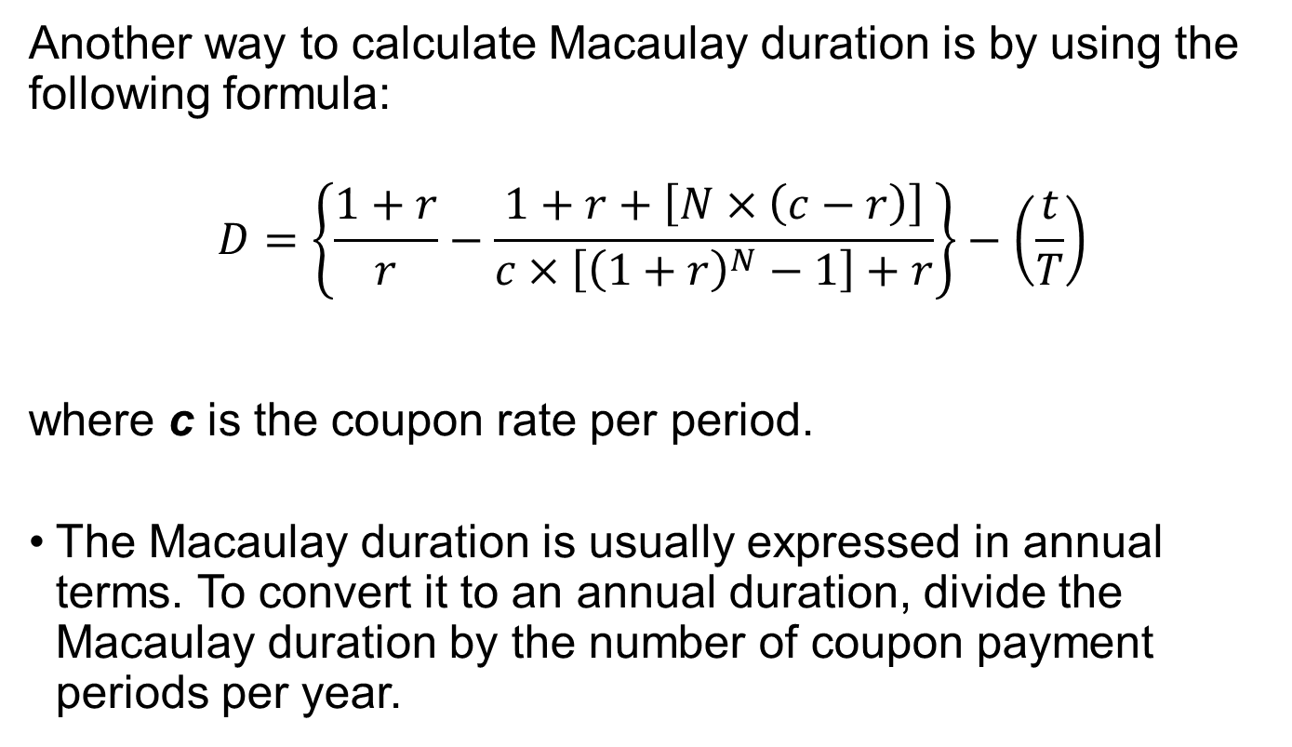
Macaulay duration
Another way to calculate Macaulay duration is by using the following formula:
$$D=\left\{\frac{1+r}{r}−\frac{1+r+\left[N×\left(c−r\right)\right]}{c×\left[{\left(1+r\right)}^{N}−1\right]+r}\right\}−\left(\frac{t}{T}\right)$$
where c is the coupon rate per period.
The Macaulay duration is usually expressed in annual terms. To convert it to an annual duration, divide the Macaulay duration by the number of coupon payment periods per year.
Notes:
3. Interest rate risk on fixed-rate bond
LOS: Define, calculate, and interpret Macaulay, modified, and effective durations.
The formula in the slide is derived from the general formula using calculus.

Slide 12
Calculating the macaulay duration
Example: A 6% annual payment bond matures on 14 February 2022 and is purchased for settlement on 11 April 2014. The YTM is 4%. Calculate the bond’s Macaulay duration (actual/actual convention):
Period | Time to Receipt | CF (cash flow) | PV of CF | Time-Weighted PV of CF
1 | 309/365 = 0.8466 | 6 | 6/(1 + 0.04)^0.8466 = 5.80 | 0.8466 × 5.80 = 4.91
2 | 1.8466 | 6 | 5.58 | 10.31
3 | 2.8466 | 6 | 5.37 | 15.28
4 | 3.8466 | 6 | 5.16 | 19.85
5 | 4.8466 | 6 | 4.96 | 24.05
6 | 5.8466 | 106 | 84.28 | 492.74
 |  |  | 111.15 | 567.13
D = 567.13/111.15 = 5.1 years
Notes:
3. Interest rate risk on fixed-rate bond
LOS: Define, calculate, and interpret Macaulay, modified, and effective durations.
If the 30/360 convention is used, the time to receipt will be 303/360 = 0.841667.

Slide 13
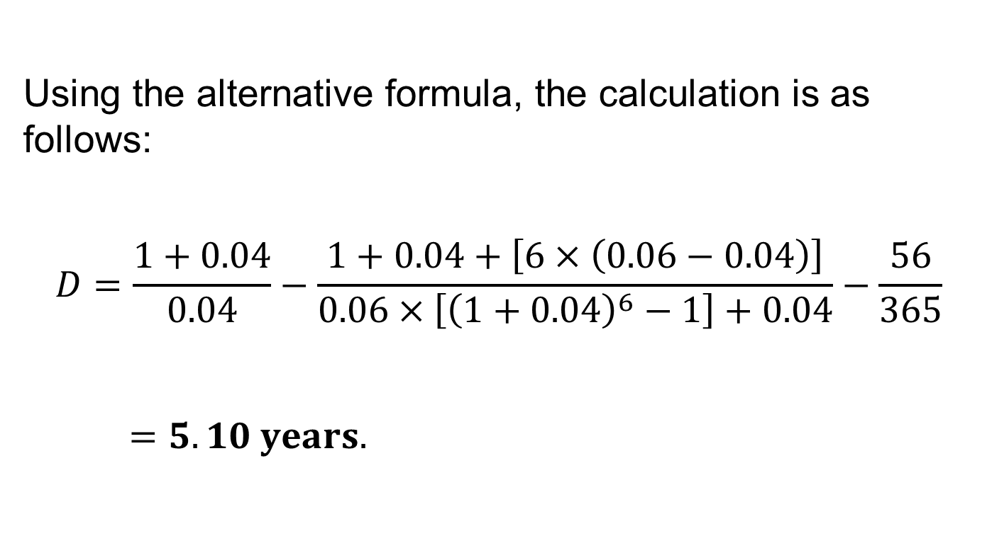
Calculating the macaulay duration with the alternative formula
Using the alternative formula, the calculation is as follows:
$$D=\frac{1+0.04}{0.04}−\frac{1+0.04+\left[6×\left(0.06−0.04\right)\right]}{0.06×\left[{\left(1+0.04\right)}^{6}−1\right]+0.04}−\frac{56}{365}$$
$=5.10 years.$
Notes:
3. Interest rate risk on fixed-rate bond
LOS: Define, calculate, and interpret Macaulay, modified, and effective durations.
Microsoft Excel users can obtain the Macaulay duration using the DURATION financial function: DURATION (“4/11/2014,” “2/14/2022,” 0.06, 0.06, 2, 0). The inputs are the settlement date, maturity date, annual coupon rate as a decimal, annual yield-to-maturity as a decimal, periodicity, and the code for the day count (0 for 30/360, 1 for actual/actual).

Slide 14
Modified duration
Modified duration (MD) is a direct measure of the interest rate sensitivity of a bond. It assumes that yield changes do not change the expected cash flows.
$$MD=\frac{D}{1+r}$$
where r is the yield per period.
MD=𝐷/(1+𝑟)
where r is the yield per period.
Modified duration provides a linear estimate of the percentage price change for a bond given a change in its yield-to-maturity.
$$\%∆{PV}^{Full}≈−MD×∆Yield(\%)$$
%∆PV^𝐹𝑢𝑙𝑙≈−MD×∆Yield(%)
Note: MD is expressed in annual terms.
To get the % change in bond price, the % change must be multiplied by the original bond price.
Notes:
3. Interest rate risk on fixed-rate bond
LOS: Define, calculate, and interpret Macaulay, modified, and effective durations.
The ΔYield term is the change in the annual yield-to-maturity. The ≈ sign indicates that this calculation is an estimation. The minus sign indicates that bond prices and yields-to-maturity move inversely.
Modified duration provides a linear estimate of the percentage price change.

Slide 15
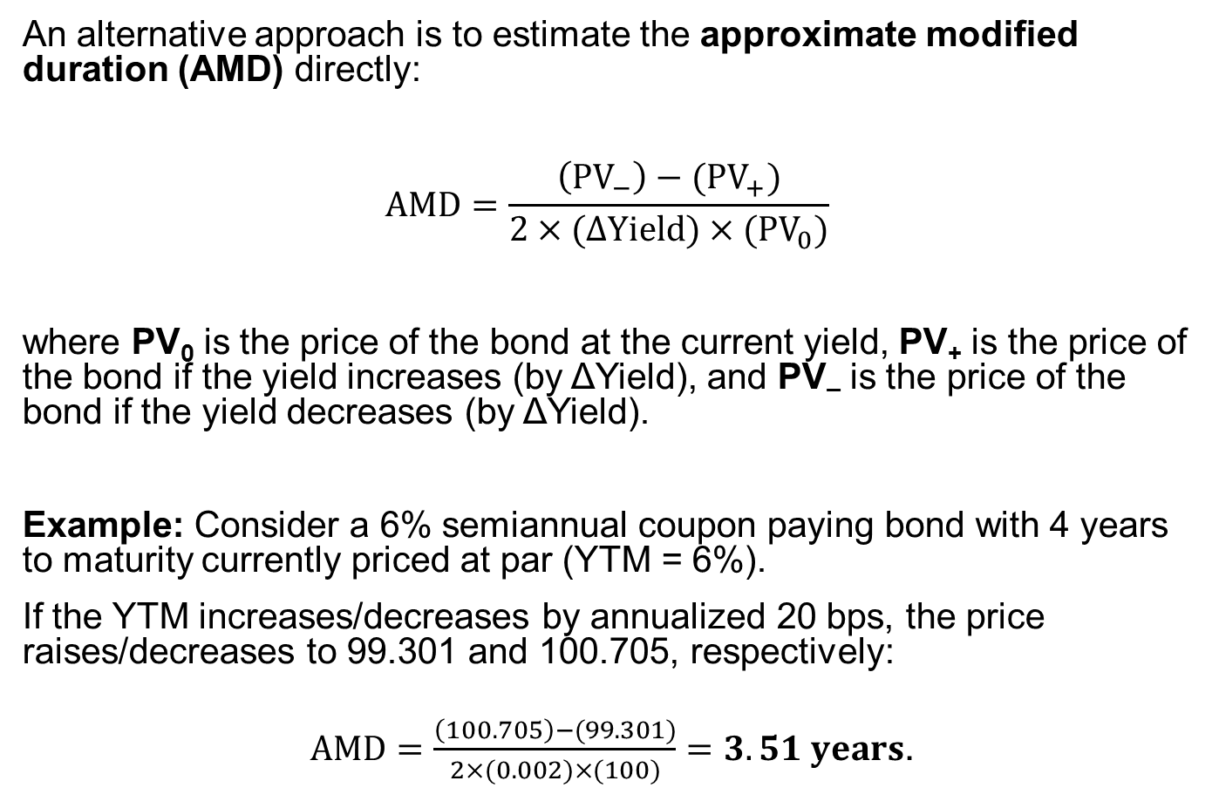
Approximate modified duration
An alternative approach is to estimate the approximate modified duration (AMD) directly:
$$AMD=\frac{\left({PV}_{−}\right)−({PV}_{+})}{2×(∆Yield)×({PV}_{0})}$$
where PV₀ is the price of the bond at the current yield, PV₊ is the price of the bond if the yield increases (by ΔYield), and PV– is the price of the bond if the yield decreases (by ΔYield).
Example: Consider a 6% semiannual coupon paying bond with 4 years to maturity currently priced at par (YTM = 6%).
If the YTM increases/decreases by annualized 20 bps, the price raises/decreases to 99.301 and 100.705, respectively:
$AMD=\frac{\left(100.705\right)−(99.301)}{2×(0.002)×(100)}=3.51 years$.
Notes:
3. Interest rate risk on fixed-rate bond
LOS: Define, calculate, and interpret Macaulay, modified, and effective durations.
The objective of the approximation is to estimate the slope of the line tangent to the price/yield curve.
The smaller the change in yield, the more accurate is approximation.

Slide 16
Approximate modified duration
Price
The approximate modified duration is a linear approximation of the price/yield curve. The difference is due to the convexity of the bond.
Tangent line
Yield
Notes:
3. Interest rate risk on fixed-rate bond
LOS: Define, calculate, and interpret Macaulay, modified, and effective durations.
Notes:
The price/yield relationship is convex.

Slide 17
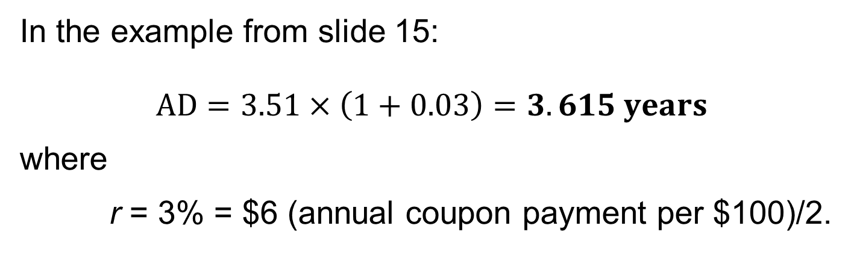
Approximate macaulay duration
The approximate Macaulay duration (AD) is calculated from the approximate modified duration (AMD).
$$AD=AMD×(1+r)$$
AD=AMD×(1+𝑟)
In the example from slide 15:
$$AD=3.51×\left(1+0.03\right)=3.615 years$$
where
r = 3% = $6 (annual coupon payment per $100)/2.
Notes:
3. Interest rate risk on fixed-rate bond
LOS: Define, calculate, and interpret Macaulay, modified, and effective durations.
The approximation formulas produce results for annualized modified and Macaulay durations. The frequency of coupon payments and the periodicity of the yield-to-maturity are included in the bond price calculations.

Slide 18
Game Time
You are playing a game with 3 doors. Behind one of the doors, there is a big prize (a nice car). The other two are empty. You pick one of the door. Now the show host looks at the remaining two doors, and he opens a door which is empty. Now there are two days. Do you switch your original choice?

Slide 19
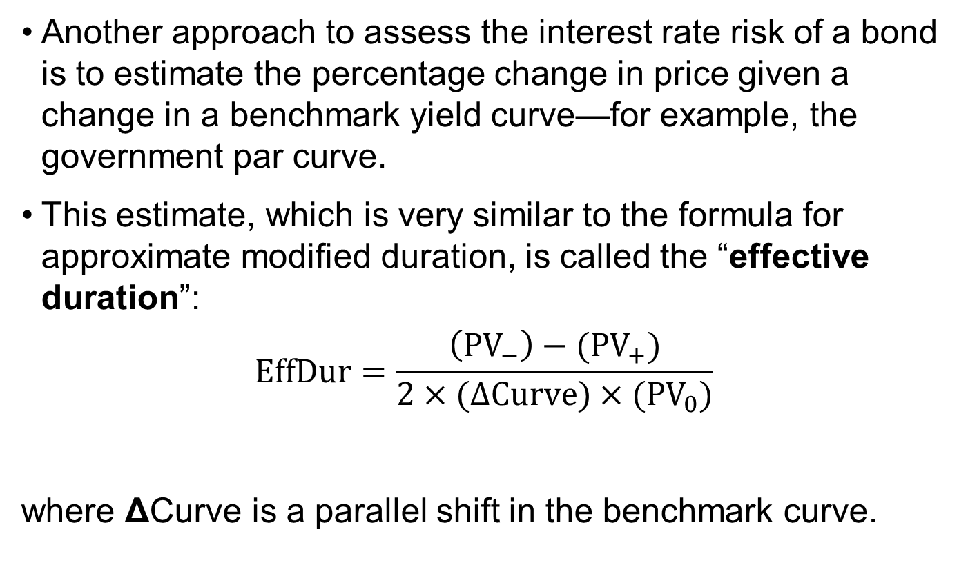
Effective duration
Another approach to assess the interest rate risk of a bond is to estimate the percentage change in price given a change in a benchmark yield curve—for example, the government par curve.
This estimate, which is very similar to the formula for approximate modified duration, is called the “effective duration”:
$$EffDur=\frac{\left({PV}_{−}\right)−({PV}_{+})}{2×(∆Curve)×({PV}_{0})}$$
where ΔCurve is a parallel shift in the benchmark curve.
Notes:
3. Interest rate risk on fixed-rate bond
LOS: Define, calculate, and interpret Macaulay, modified, and effective durations.
The effective duration of a bond is the sensitivity of the bond’s price to a change in a benchmark yield curve.
The difference between approximate modified duration and effective duration is in the denominator. Modified duration is a yield duration statistic in that it measures interest rate risk in terms of a change in the bond’s own yield-to-maturity (ΔYield). Effective duration is a curve duration statistic in that it measures interest rate risk in terms of a parallel shift in the benchmark yield curve (ΔCurve).

Slide 20
When to use effective duration
Effective duration is essential to the measurement of the interest rate risk of a complex bond, such as a bond with an embedded option.
A callable/putable bond does not have a well-defined internal rate of return (yield-to-maturity). Therefore, yield duration statistics, such as modified and Macaulay durations, do not apply. Effective duration is the appropriate duration measure.
Notes:
3. Interest rate risk on fixed-rate bond
LOS: Explain why effective duration is the most appropriate measure of interest rate risk for bonds with embedded options.
The effective duration as a curve duration measure indicates the bond’s sensitivity to the benchmark yield curve—in particular, the government par curve—assuming no change in the credit spread.
A practical consideration in using effective duration is in setting the change in the benchmark yield curve. Small change is not necessary best option.

Slide 21
Key rate duration
A key rate duration (or partial duration) is a measure of a bond’s sensitivity to a change in the benchmark yield curve at a specific maturity segment.
In contrast to effective duration, key rate durations help identify “shaping risk” for a bond—that is, a bond’s sensitivity to changes in the shape of the benchmark yield curve (e.g., the yield curve becoming steeper or flatter).
Notes:
3. Interest rate risk on fixed-rate bond
LOS: Define key rate duration and describe the key use of key rate durations in measuring the sensitivity of bonds to changes in the shape of the benchmark yield curve.
For parallel shifts in the benchmark yield curve, key rate durations will indicate the same interest rate sensitivity as effective duration.

Slide 22
Properties of bond duration
Bond duration is the basic measure of interest rate risk on a fixed-rate bond.
The duration for a fixed-rate bond is a function of these input variables.
Yield-to-maturity per period
Time-to-maturity (as of the beginning of the period)
Fraction of the period that has gone by
Presence and nature of embedded options
Coupon rate or payment per period
Notes:
3. Interest rate risk on fixed-rate bond
LOS: Explain how a bond’s maturity, coupon, embedded options, and yield level affect its interest rate risk.
The coupon payments are made on regularly scheduled dates—for example, on 15 June and 15 December each year on a semiannual coupon paying bond.
The last coupon is paid together with the face value on the maturity date.
The market discount rate is also called the “required yield” or “required rate of return.”

Slide 23
coupon rate and yield-to-maturity relation to macaulay duration
The coupon rate is inversely related to the Macaulay duration.
A lower-coupon bond has a higher duration and more interest rate risk than a higher-coupon bond.
The Macaulay duration of a zero-coupon bond is equal to its time-to-maturity.
The yield-to-maturity is inversely related to the Macaulay duration.
A higher yield-to-maturity reduces the weighted average of the time to receipt of cash flow.
Notes:
3. Interest rate risk on fixed-rate bond
LOS: Explain how a bond’s maturity, coupon, embedded options, and yield level affect its interest rate risk.
With a higher yield-to-maturity, there is more weight on the cash flows received in the near term, and less weight is on the cash flows received in the more-distant future periods if those cash flows are discounted at a higher rate.

Slide 24
Time-to-maturity and fraction of the period relation to macaulay duration
Time-to-maturity is typically directly related to the Macaulay duration.
This pattern always holds for bonds trading at par value or at a premium above par.
The exception is deep-discount bonds, where the relationship does not hold for a long time-to-maturity.
From the equation on slide 11, it is clear that the fraction of the period that has gone by (t/T) is inversely related to the Macaulay duration.
Macaulay duration decreases smoothly as t goes from t = 0 to t = T and then jumps upward after the coupon is paid.
Notes:
3. Interest rate risk on fixed-rate bond
LOS: Explain how a bond’s maturity, coupon, embedded options, and yield level affect its interest rate risk.
The duration of perpetuity (consol bond) is the constant.

Slide 25
Bonds with embedded options
Bonds with embedded options (e.g., callable, putable) require the use of effective duration because Macaulay and modified yield duration statistics are not relevant.
The yield-to-maturity for callable and putable bonds is not well defined because future cash flows are uncertain.
When benchmark yields are high (low), the effective durations of the callable (putable) and non-callable (non-putable) bonds are very similar. There is a large discrepancy in durations for callable (putable) and non-callable (non-putable) bonds when yields are low (high).
In summary, the presence of an embedded option reduces the sensitivity of the bond price to changes in the benchmark yield curve (lower duration), assuming no change in credit risk.
Notes:
3. Interest rate risk on fixed-rate bond
LOS: Explain how a bond’s maturity, coupon, embedded options, and yield level affect its interest rate risk.
Effective duration measures are also used for bonds with other embedded options, such as asset-backed securities.

Slide 26
Calculating the duration of a bond portfolio
Bonds are typically held in a portfolio.
There are two ways to calculate the duration of a bond portfolio.
The weighted average of time to receipt of the aggregate cash flows
The weighted average of the individual bond durations that comprise the portfolio
This method is commonly used by fixed-income portfolio managers, but it has its own limitations.
This method is the theoretically correct approach, but it is difficult to use in practice.
Notes:
3. Interest rate risk on fixed-rate bond
LOS: Calculate the duration of a portfolio and explain the limitations of portfolio duration.
Although the first approach is theoretically correct, it is difficult to use in practice. First, the cash flow yield is not commonly calculated for bond portfolios. Second, the amount and timing of future coupon and principal payments are uncertain if the portfolio contains callable or putable bonds or floating-rate notes. Third, interest rate risk is usually expressed as a change in benchmark interest rates, not as a change in the cash flow yield. Fourth, the change in the cash flow yield is not necessarily the same amount as the change in the yields-to-maturity on the individual bonds.
The main advantage to the second approach is that it is easily used as a measure of interest rate risk. However, this advantage also indicates a limitation: This measure of portfolio duration implicitly assumes a parallel shift in the yield curve. A parallel yield curve shift implies that all rates change by the same amount in the same direction. In reality, interest rate changes frequently result in a steeper or flatter yield curve.

Slide 27

Money duration
The money duration of a bond is a measure of the price change in units of the currency in which the bond is denominated.
The money duration can be stated per 100 of par value or in terms of the actual position size of the bond in the portfolio.
The estimated change in the bond price in currency units is calculated by the following:
$$∆{PV}^{Full}≈−MonD×∆Yield$$
Money duration (MoneyDur) is calculated as follows:
$$MoneyDur=AMD×{PV}^{Full}$$
MoneyDur=AMD×PV^𝐹𝑢𝑙𝑙
Notes:
3. Interest rate risk on fixed-rate bond
LOS: Calculate and interpret the money duration of a bond and price value of a basis point (PVBP).
In the United States, money duration is commonly called “dollar duration.”

Slide 28
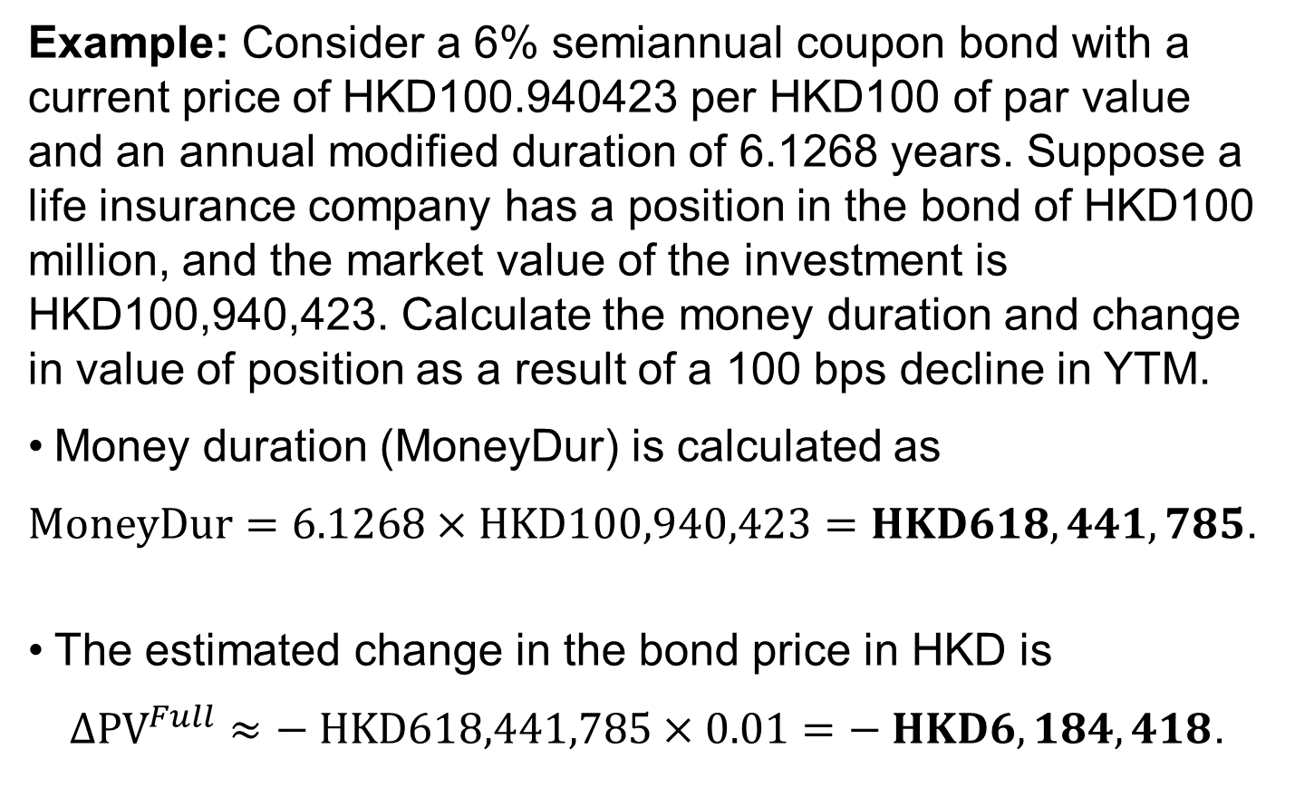
Money duration calculation
Example: Consider a 6% semiannual coupon bond with a current price of HKD100.940423 per HKD100 of par value and an annual modified duration of 6.1268 years. Suppose a life insurance company has a position in the bond of HKD100 million, and the market value of the investment is HKD100,940,423. Calculate the money duration and change in value of position as a result of a 100 bps decline in YTM.
Money duration (MoneyDur) is calculated as
$MoneyDur=6.1268×HKD100,940,423=HKD618,441,785$.
The estimated change in the bond price in HKD is
$∆{PV}^{Full}≈− HKD618,441,785×0.01=− HKD6,184,418$.
Notes:
3. Interest rate risk on fixed-rate bond
LOS: Calculate and interpret the money duration of a bond and price value of a basis point (PVBP).
The “convexity adjustment” introduced in the next section makes these estimates more accurate.

Slide 29

Price value of a basis point (pvbp)
The price value of a basis point (PVBP) is an estimate of the change in the full price given a 1 bp change in the yield-to-maturity.
Example: Assume a T-note is priced at 99.561006 and yields 0.723368%. An increase and decrease in 1 bp results in the price changing to 99.512707 and 99.609333, respectively. Calculate the PVBP:
$PVBP=\frac{99.609333−99.512707}{2}=0.04831$.
The PVBP is calculated as follows:
$$PVBP=\frac{{(PV}_{−})−{(PV}_{+})}{2}$$
PVBP=(〖(PV〗_−)−〖(PV〗_+))/2
Notes:
3. Interest rate risk on fixed-rate bond
LOS: Calculate and interpret the money duration of a bond and price value of a basis point (PVBP).
The PVBP is also called the “PV01,” standing for the “price value of an 01” or “present value of an 01,” where “01” means 1 bp.
In the United States, it is commonly called the “DV01,” or the “dollar value of a 01.”
A related statistic, sometimes called a “basis point value” (or BPV), is the money duration times 0.0001 (1 bp).
Another money duration statistic reported on the Bloomberg YAS (yield and spread analysis) page is “risk.” It would be 4.831. Bloomberg’s risk statistic is simply the PVBP (or PV01) times 100.

Slide 30

Convexity statistic
The true relationship between the bond price and the yield-to-maturity is the curved (convex) line, which shows the actual bond price given its market discount rate.
The convexity statistic for the bond is used to improve the estimate of the percentage price change provided by modified duration alone. There are various ways to estimate convexity:
$$\%∆{PV}^{Full}≈\left(−AMD×∆Yield\right)+\left[\frac{1}{2}×Conv×{(∆Yield)}^{2}\right]$$
The linear approximation of estimated price change offered by duration is good for small yield-to-maturity changes. But for larger changes, the difference becomes significant.
Notes:
3. Interest rate risk on fixed-rate bond
LOS: Estimate the percentage price change of a bond for a specified change in yield, given the bond’s approximate duration and convexity.
The coupon payments are made on regularly scheduled dates—for example, on 15 June and 15 December each year on a semiannual coupon paying bond.
The last coupon is paid together with the face value on the maturity date.
The market discount rate is also called the “required yield” or “required rate of return.”

Slide 31
Calculating a bond’s convexity
Example: A 6% annual payment bond matures on 14 February 2022 and is purchased for settlement on 11 April 2014. The YTM is 4%. Calculate the bond’s convexity (actual/actual convention):
Period | Time to Receipt | CF | PV of CF | t^2+t | (t^2+t) × PV of CF
1 | 0.8466 | 6 | 5.80 | 1.56 | 9.07
2 | 1.8466 | 6 | 5.58 | 5.26 | 29.34
3 | 2.8466 | 6 | 5.37 | 10.95 | 58.76
4 | 3.8466 | 6 | 5.16 | 18.64 | 96.19
5 | 4.8466 | 6 | 4.96 | 28.34 | 140.58
6 | 5.8466 | 106 | 84.28 | 40.03 | 3373.63
 |  |  | 111.15 |  | 3707.57
Conv = 1/(1 + 0.04)^2 × 3707.57/111.15 = 30.84
Notes:
3. Interest rate risk on fixed-rate bond
LOS: Calculate and interpret approximate convexity and distinguish between approximate and effective convexity.
The formula for traditional convexity is $Conv=\frac{1}{{(1+r)}^{2}}×\frac{\sum_{t=1}^{T}{\frac{{CF}_{t}}{{(1+r)}^{t}}×\left(t^{2}+t\right)}}{P_{0}}$.

Slide 32
Approximate, money, and effective convexity
Like modified duration, convexity can be accurately approximated.
•The money convexity of the bond is the annual convexity multiplied by the full price.
• The approximate convexity is calculated by the following:
$$AConv=\frac{{(PV}_{−})+{(PV}_{+})−\left[2×\left({PV}_{0}\right)\right]}{{(∆Yield)}^{2}×\left({PV}_{0}\right)}$$
AConv=(〖(PV〗_−)+〖(PV〗_+)−[2×(PV_0 )])/(〖(∆Yield)〗^2×(PV_0 ) )
•The effective convexity of a bond is a curve convexity statistic that measures the secondary effect of a change in a benchmark yield curve.
$EffConv=\frac{\left[{(PV}_{−})+{(PV}_{+})\right]−\left[2×\left({PV}_{0}\right)\right]}{{(∆Curve)}^{2}×\left({PV}_{0}\right)}$
EffConv=([〖(PV〗_−)+〖(PV〗_+)]−[2×(PV_0 )])/(〖(∆Curve)〗^2×(PV_0 ) )
Notes:
3. Interest rate risk on fixed-rate bond
LOS: Calculate and interpret approximate convexity and distinguish between approximate and effective convexity.
The factors that lead to greater convexity are the same as for duration. A fixed-rate bond with a longer time-to-maturity, a lower coupon rate, and a lower yield-to-maturity has greater convexity than a bond with a shorter time-to-maturity, a higher coupon rate, and a higher yield-to-maturity.
For the same decrease in yield-to-maturity, the more convex bond appreciates more in price. And for the same increase in yield-to-maturity, the more convex bond depreciates less in price. The conclusion is that the more convex bond outperforms the less convex bond in both bull (rising price) and bear (falling price) markets.

Slide 33
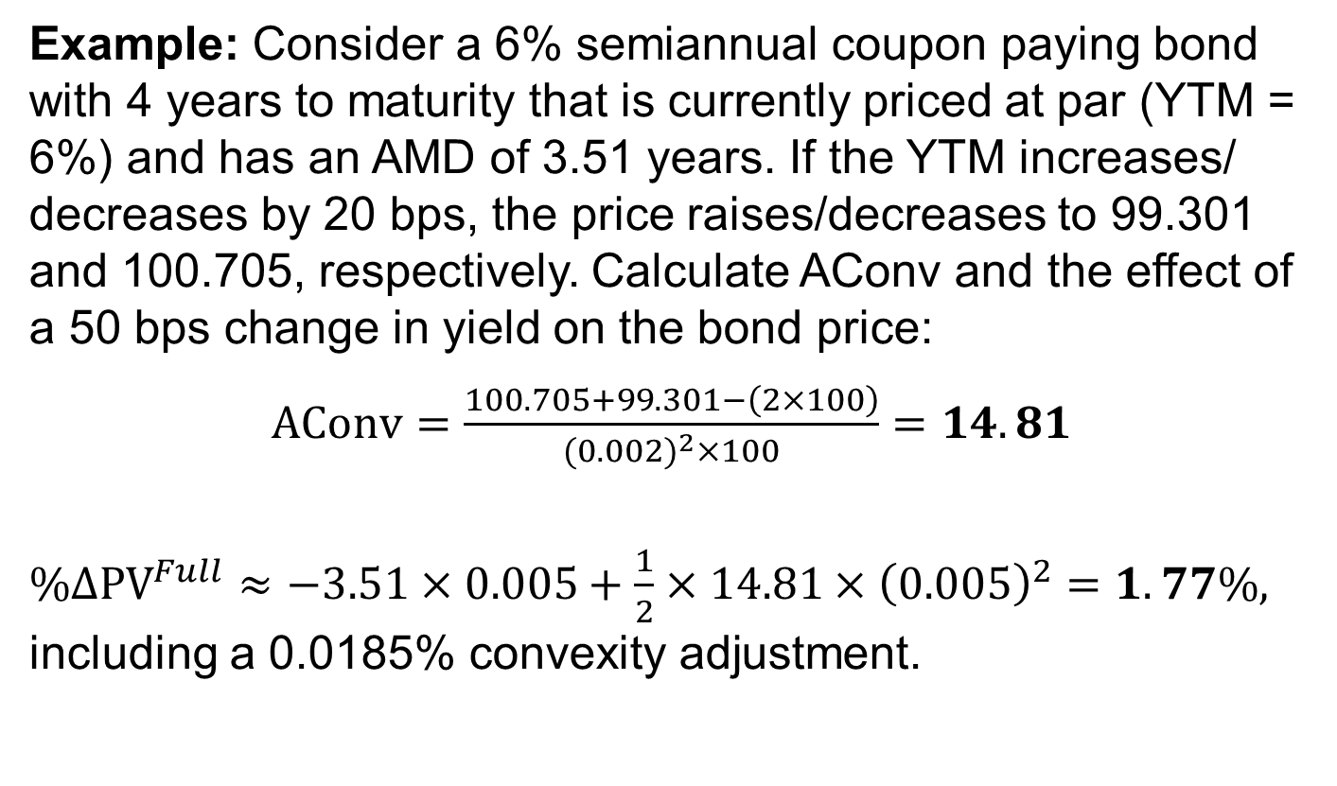
Calculating approximate convexity
Example: Consider a 6% semiannual coupon paying bond with 4 years to maturity that is currently priced at par (YTM = 6%) and has an AMD of 3.51 years. If the YTM increases/ decreases by 20 bps, the price raises/decreases to 99.301 and 100.705, respectively. Calculate AConv and the effect of a 50 bps change in yield on the bond price:
$AConv=\frac{100.705+99.301−\left(2×100\right)}{{(0.002)}^{2}×100}=14.81$
$\%∆{PV}^{Full}≈−3.51×0.005+\frac{1}{2}×14.81×{\left(0.005\right)}^{2}=1.77\%,$ including a 0.0185% convexity adjustment.
Notes:
3. Interest rate risk on fixed-rate bond
LOS: Calculate and interpret approximate convexity and distinguish between approximate and effective convexity.
The example from slide 14 is used here.

Slide 34
Effects of convexity on bonds
For the same decrease in yield-to-maturity, the more convex bond appreciates more in price. And for the same increase in yield-to-maturity, the more convex bond depreciates less in price.
The conclusion is that the more convex bond outperforms the less convex bond in both bull (rising price) and bear (falling price) markets.
Option-free bonds always have positive convexity.
The negative convexity is present in callable bonds but not in putable bonds.
Notes:
3. Interest rate risk on fixed-rate bond
LOS: Calculate and interpret approximate convexity and distinguish between approximate and effective convexity.
The coupon payments are made on regularly scheduled dates—for example, on 15 June and 15 December each year on a semiannual coupon paying bond.
The last coupon is paid together with the face value on the maturity date.
The market discount rate is also called the “required yield” or “required rate of return.”

Slide 35
price–yield relationship for a callable bond
Option-free bond
Price
Area of negative
convexity
Callable bond
r*
Yield
Notes:
3. Interest rate risk on fixed-rate bond
LOS: Calculate and interpret approximate convexity and distinguish between approximate and effective convexity.
In the slide, as the benchmark yield goes down, the slope of the line tangent to the curve for the non-callable bond steepens, which indicates positive convexity. But the slope of the line tangent to the callable bond flattens as the benchmark yield goes down. Technically, it reaches an inflection point, which is when the effective convexity shifts from positive to negative.

Slide 36
Game Time
5 pirates looted a chest full of 100 gold coins. They agree on the following method to divide the root: The most senior pirate will propose a distribution of coins. All pirates vote. If at lease 50% of the pirates (3 in this case) agree, the gold is divided as proposed. If not, the most senior pirate will be killed and process goes to next senior pirate… until a plan is approved. Assume all pirates and perfectly rationale. They want to stay alive first, but also want to get as much gold as possible. Finally, being blood-thirsty, they want to have fewer pirates if given a choice between otherwise equal outcomes. How will the gold coins be divided in the end?

Slide 37
4. interest rate risk and the investment horizon
An important aspect in understanding the interest rate risk and return characteristics of an investment in a fixed-rate bond is the time horizon.
Bond duration is the primary measure of risk arising from a change in the yield-to-maturity; convexity is the secondary risk measure.
The common assumption in interest rate risk analysis is a parallel shift in the yield curve. In reality, the shape of the yield curve changes based on factors affecting the supply and demand of shorter-term versus longer-term securities.
Notes:
4. Interest rate risk and the investment horizon
LOS: Describe how the term structure of yield volatility affects the interest rate risk of a bond.
Notes:
This section considers a short-term horizon. A primary concern for the investor is the change in the price of the bond given a sudden (i.e., same-day) change in its yield-to-maturity. The accrued interest does not change, so the impact of the change in the yield is on the flat price of the bond.

Slide 38
Yield volatility
The term structure of yield volatility is the relationship between the volatility of bond yields-to-maturity and times-to-maturity.
The importance of yield volatility in measuring interest rate risk is that bond price changes are products of two factors.
The impact per basis point change in the yield-to-maturity
The number of basis points in the yield-to-maturity change
The second factor is the yield volatility.
The first factor is duration or the combination of duration and convexity.
Notes:
4. Interest rate risk and the investment horizon
LOS: Describe how the term structure of yield volatility affects the interest rate risk of a bond.
For example, a central bank engaging in expansionary monetary policy might cause the yield curve to steepen by reducing short-term interest rates. But this policy might cause greater volatility in short-term bond yields-to-maturity than in longer-term bonds, resulting in a downward-sloping term structure of yield volatility.
Longer-term bond yields are mostly determined by future inflation and economic growth expectations. Those expectations often tend to be less volatile.

Slide 39
General relationships among interest rate risk, the macaulay duration, and the investment horizon
>
When the investment horizon is greater than the Macaulay duration of a bond, coupon reinvestment risk dominates market price risk. The investor’s risk is to lower interest rates.
When the investment horizon is equal to the Macaulay duration of a bond, coupon reinvestment risk offsets market price risk.
When the investment horizon is less than the Macaulay duration of a bond, market price risk dominates coupon reinvestment risk. The investor’s risk is to higher interest rates.
=
<
• The difference between the Macaulay duration of a bond and the investment horizon is called the “duration gap.”
Notes:
4. Interest rate risk and the investment horizon
LOS: Describe the relationships among a bond’s holding period return, its duration, and the investment horizon.
If the investor has a duration gap equal to zero, he/she is currently hedged against interest rate risk.
The word “currently” is important because interest rate risk is connected to an immediate change in the bond’s yield-to-maturity and the coupon reinvestment rates. As time passes, the investment horizon is reduced and the Macaulay duration of the bond also changes. Therefore, the duration gap changes as well.

Slide 40
5. Credit and liquidity risk
The yield-to-maturity on a corporate bond is composed of a government benchmark yield and a spread over that benchmark. A change in the bond’s yield-to-maturity can originate in either component or a combination of the two.
A change in the benchmark yield can arise from a change in either the expected inflation rate or the expected real rate of interest.
The inflation duration would indicate the change in the bond price if expected inflation were to change by a certain amount.
The real rate duration would indicate the bond price change if the real rate were to go up or down.
Notes:
5. Credit and liquidity risk
LOS: Explain how changes in credit spread and liquidity affect yield-to-maturity of a bond and how duration and convexity can be used to estimate the price effect of the changes.
Credit risk includes the probability of default as well as the recovery of assets if default does occur. A credit rating downgrade or an adverse change in the ratings outlook for a borrower reflects a higher risk of default.
Liquidity risk refers to the transaction costs associated with selling a bond.

Slide 41
Impact of changes in yield-to-maturity
A change in the spread can arise from a change in the credit risk of the issuer or in the liquidity of the bond.
For a bond with a given duration and convexity, the impact of changes in yield-to-maturity on the bond’s price will be the same regardless of the source of the yield-to-maturity change.
The problem for a fixed-income analyst is that it is rare for the changes in the components of the overall yield-to-maturity to occur in isolation.
Notes:
5. Credit and liquidity risk
LOS: Explain how changes in credit spread and liquidity affect yield-to-maturity of a bond and how duration and convexity can be used to estimate the price effect of the changes.
In practice, the analyst is concerned with the interaction between changes in benchmark yields and spreads, between changes in expected inflation and the expected real rate, and between changes in credit and liquidity risk.
For example, during a financial crisis, a “flight to quality” can cause government benchmark yields to fall as credit spreads widen.
An unexpected credit downgrade on a corporate bond can result in greater credit as well as liquidity risk.

Slide 42
6. SUMMARY
Sources of a bond’s return
Macaulay, modified, and effective durations
Macaulay duration is the weighted average of the time to receipt of coupon interest and principal payments, in which the weights are the shares of the full price corresponding to each payment. This statistic is annualized by dividing by the periodicity.
The three sources of return on a fixed-rate bond purchased at par value are (1) receipt of the promised coupon and principal payments on the scheduled dates, (2) reinvestment of coupon payments, and (3) potential capital gains, as well as losses, on the sale of the bond prior to maturity.
For a bond purchased at a discount or premium, the rate of return also includes the effect of the price being “pulled to par” as maturity nears, assuming no default.
Notes:
LOS: Calculate and interpret the sources of return from investing in a fixed-rate bond.
LOS: Define, calculate, and interpret Macaulay, modified, and effective durations.

Slide 43
SUMMARY
Macaulay, modified, and effective durations (continued)
Modified duration provides a linear estimate of the percentage price change for a bond given a change in its yield-to-maturity.
Approximate modified duration approaches modified duration as the change in the yield-to-maturity approaches zero.
Effective duration is a curve duration statistic that measures interest rate risk assuming a parallel shift in the benchmark yield curve.
Notes:
LOS: Define, calculate, and interpret Macaulay, modified, and effective durations.
LOS: Explain why effective duration is the most appropriate measure of interest rate risk for bonds with embedded options.

Slide 44
SUMMARY
Bonds with an embedded option do not have a meaningful internal rate of return because future cash flows are contingent on interest rates. Therefore, effective duration, not modified duration, is the appropriate interest rate risk measure.
Effective duration is the most appropriate measure of interest rate risk for bonds with embedded options
Notes:
LOS: Define, calculate, and interpret Macaulay, modified, and effective durations.
LOS: Explain why effective duration is the most appropriate measure of interest rate risk for bonds with embedded options.

Slide 45
SUMMARY
Key rate duration
Key rate duration is a measure of a bond’s sensitivity to a change in the benchmark yield curve at specific maturity segments. Key rate durations can be used to measure a bond’s sensitivity to changes in the shape of the yield curve.
Notes:
LOS: Define key rate duration and describe the key use of key rate durations in measuring the sensitivity of bonds to changes in the shape of the benchmark yield curve.
LOS: Explain how a bond’s maturity, coupon, embedded options, and yield level affect its interest rate risk.

Slide 46
SUMMARY
Macaulay and modified durations are inversely related to the coupon rate and the yield-to-maturity.
Time-to-maturity and durations are usually positively related. The exception is on long-term, low-coupon bonds, on which it is possible to have a lower duration than on an otherwise comparable shorter-term bond.
A bond’s maturity, coupon, embedded options, and yield level affect its interest rate risk
Notes:
LOS: Define key rate duration and describe the key use of key rate durations in measuring the sensitivity of bonds to changes in the shape of the benchmark yield curve.
LOS: Explain how a bond’s maturity, coupon, embedded options, and yield level affect its interest rate risk.

Slide 47
SUMMARY
A bond’s embedded options affect its interest rate risk
The presence of an embedded call/put option reduces a bond’s effective duration compared with that of an otherwise comparable non-callable/non-putable bond.
Notes:
LOS: Explain how a bond’s maturity, coupon, embedded options, and yield level affect its interest rate risk.
LOS: Calculate the duration of a portfolio and explain the limitations of portfolio duration.

Slide 48
SUMMARY
The duration of a portfolio and its limitations
The first method cannot be used for bonds with embedded options or for floating-rate notes.
The second method is simpler to use and quite accurate when the yield curve is relatively flat. Its main limitation is that it assumes a parallel shift in the yield curve in that the yields on all bonds in the portfolio change by the same amount.
The duration of a bond portfolio can be calculated in two ways: (1) the weighted average of the time to receipt of aggregate cash flows and (2) the weighted average of the durations of individual bonds that compose the portfolio.
Notes:
LOS: Explain how a bond’s maturity, coupon, embedded options, and yield level affect its interest rate risk.
LOS: Calculate the duration of a portfolio and explain the limitations of portfolio duration.

Slide 49
SUMMARY
Money duration of a bond and price value of a basis point
Money duration is a measure of the price change in terms of units of the currency in which the bond is denominated.
The price value of a basis point (PVBP) is an estimate of the change in the full price of a bond given a 1 bp change in the yield-to-maturity.
Notes:
LOS: Calculate and interpret the money duration of a bond and price value of a basis point (PVBP).
LOS: Calculate and interpret approximate convexity and distinguish between approximate and effective convexity.

Slide 50
SUMMARY
Convexity is the secondary, or second-order, effect on a bond’s percentage price change given a change in the yield-to-maturity. It indicates the change in the modified duration as the yield-to-maturity changes.
Effective convexity is the second-order effect on a bond price given a change in the benchmark yield curve.
Approximate convexity and effective convexity
Notes:
LOS: Calculate and interpret the money duration of a bond and price value of a basis point (PVBP).
LOS: Calculate and interpret approximate convexity and distinguish between approximate and effective convexity.

Slide 51
SUMMARY
For a particular assumption about yield volatility, the Macaulay duration indicates the investment horizon for which coupon reinvestment risk and market price risk offset each other. The assumption is a one-time parallel shift to the yield curve in which the yield-to-maturity and coupon reinvestment rates change by the same amount in the same direction.
Price change of a bond for a specified change in yield
Term structure of yield volatility and the interest rate risk of a bond
The change in a bond price is the product of (1) the impact per basis point change in the yield-to-maturity and (2) the number of basis points in the yield change.
Notes:
LOS: Estimate the percentage price change of a bond for a specified change in yield, given the bond’s approximate duration and convexity.
LOS: Describe how the term structure of yield volatility affects the interest rate risk of a bond.

Slide 52
SUMMARY
Relationships among a bond’s holding period return, duration, and investment horizon
When the investment horizon is greater than the Macaulay duration of the bond, coupon reinvestment risk dominates price risk.
When the investment horizon is equal to the Macaulay duration of the bond, coupon reinvestment risk offsets price risk.
When the investment horizon is less than the Macaulay duration of the bond, price risk dominates coupon reinvestment risk.
Notes:
LOS: Describe the relationships among a bond’s holding period return, its duration, and the investment horizon.
LOS: Explain how changes in credit spread and liquidity affect yield-to-maturity of a bond and how duration and convexity can be used to estimate the price effect of the changes.

Slide 53
SUMMARY
For a traditional (option-free) fixed-rate bond, the same duration and convexity statistics apply if a change occurs in the benchmark yield or a change occurs in the spread. The change in the spread can result from a change in credit risk or liquidity risk.
Changes in credit spread and liquidity affect yield-to-maturity; duration and convexity can estimate the effects
Notes:
LOS: Describe the relationships among a bond’s holding period return, its duration, and the investment horizon.
LOS: Explain how changes in credit spread and liquidity affect yield-to-maturity of a bond and how duration and convexity can be used to estimate the price effect of the changes.

Slide 54
Homework
Read chapter 3 and 4
Read the material for Ethics
The (flat) price on a fixed-rate corporate bond falls one day from 92.25 to 91.25 per 100 of par value because of poor earnings and an unexpected ratings downgrade of the issuer. The (annual) modified duration for the bond is 7.24. What is the estimated change in the credit spread on the corporate bond, assuming benchmark yields are unchanged?
An investor buys a three-year bond with a 5% coupon rate paid annually. Th e bond, with a yield-to-maturity of 3%, is purchased at a price of 105.657223 per 100 of par value. Assuming a 5 bp change in yield-to-maturity, find the bond’s approximate modified duration.
The interest rate risk of a fixed-rate bond with an embedded call option is best measured by: A. effective duration. B. modified duration. C. Macaulay duration.
Which of the following is most appropriate for measuring a bond’s sensitivity to shaping risk? A. Key rate duration B. Effective duration C. Modified duration
A bond has an annual modified duration of 7.020 and annual convexity of 65.180. If the bond’s yield-to-maturity decreases by 25 bps, the expected percentage price change is closest to: A . 1.73%. B . 1.76%. C . 1.78%.

