Slide 1
Fixed Income Analysis
Tony Zhang
Fall 2019
© 2016 CFA Institute. All rights reserved.

Slide 2
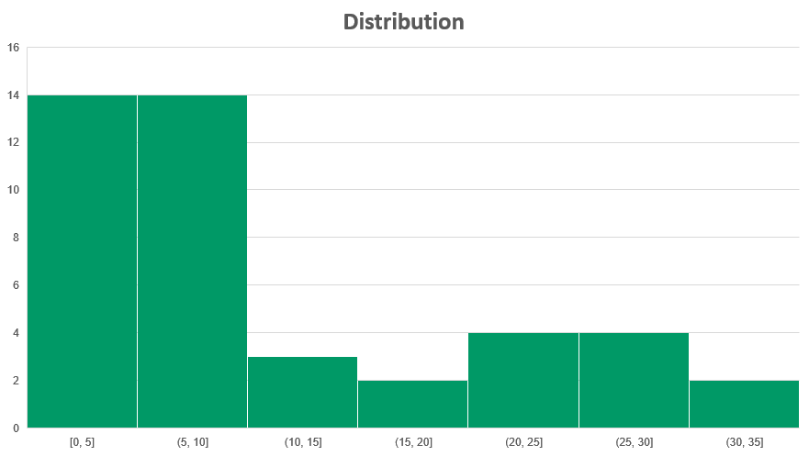
Write a number game
Avg = 11
ZENG HAILONG
GLENN CHRISTOPHER
GUAN SHUKE

Slide 3
TABLE OF CONTENTS
01
INTRODUCTION
02
CREDIT RISK
03
CAPITAL STRUCTURE, SENIORITY RANKING, AND RECOVERY RATES
04
RATINGS AGENCIES, CREDIT RATINGS, AND THEIR ROLE IN THE DEBT MARKETS
05
TRADITIONAL CREDIT ANALYSIS: CORPORATE DEBT SECURITIES
06
CREDIT RISK VS. RETURN: YIELDS AND SPREADS
07
SPECIAL CONSIDERATIONS OF HIGH-YIELD, SOVEREIGN, AND NON-SOVEREIGN CREDIT ANALYSIS
08
SUMMARY

Slide 4
1. INTRODUCTION
Credit analysis has a crucial function in the debt capital markets—efficiently allocating capital by properly assessing credit risk, pricing it accordingly, and repricing it as risks change.
Credit analysis helps to answer the following questions:
How do fixed-income investors determine the riskiness of that debt?
How do they decide what they need to earn as compensation for that risk?
Notes:
1. Introduction

Slide 5
2. Credit risk
Credit Risk
It is the risk of loss resulting from the borrower (issuer of debt) failing to make full and timely payments of interest and/or principal.
Credit Risk Components:
Default Risk
Loss Severity
the probability that a borrower defaults—that is, fails to meet its obligation to make full and timely payments of principal and interest, according to the terms of the debt security
in the event of default, the portion of a bond’s value (including unpaid interest) an investor loses
Notes:
2. Credit risk
LOS: Describe credit risk and credit-related risks affecting corporate bonds.
LOS: Describe default probability and loss severity as components of credit risk.
Default risk is also known as default probability; loss severity is also known as loss given default.
Because default risk (default probability) is quite low for most high-quality debt issuers, bond investors tend to focus primarily on assessing this probability and devote less effort to assessing the potential loss severity arising from default. However, as an issuer’s default risk rises, investors will focus more on what the recovery rate might be in the event of default.

Slide 6
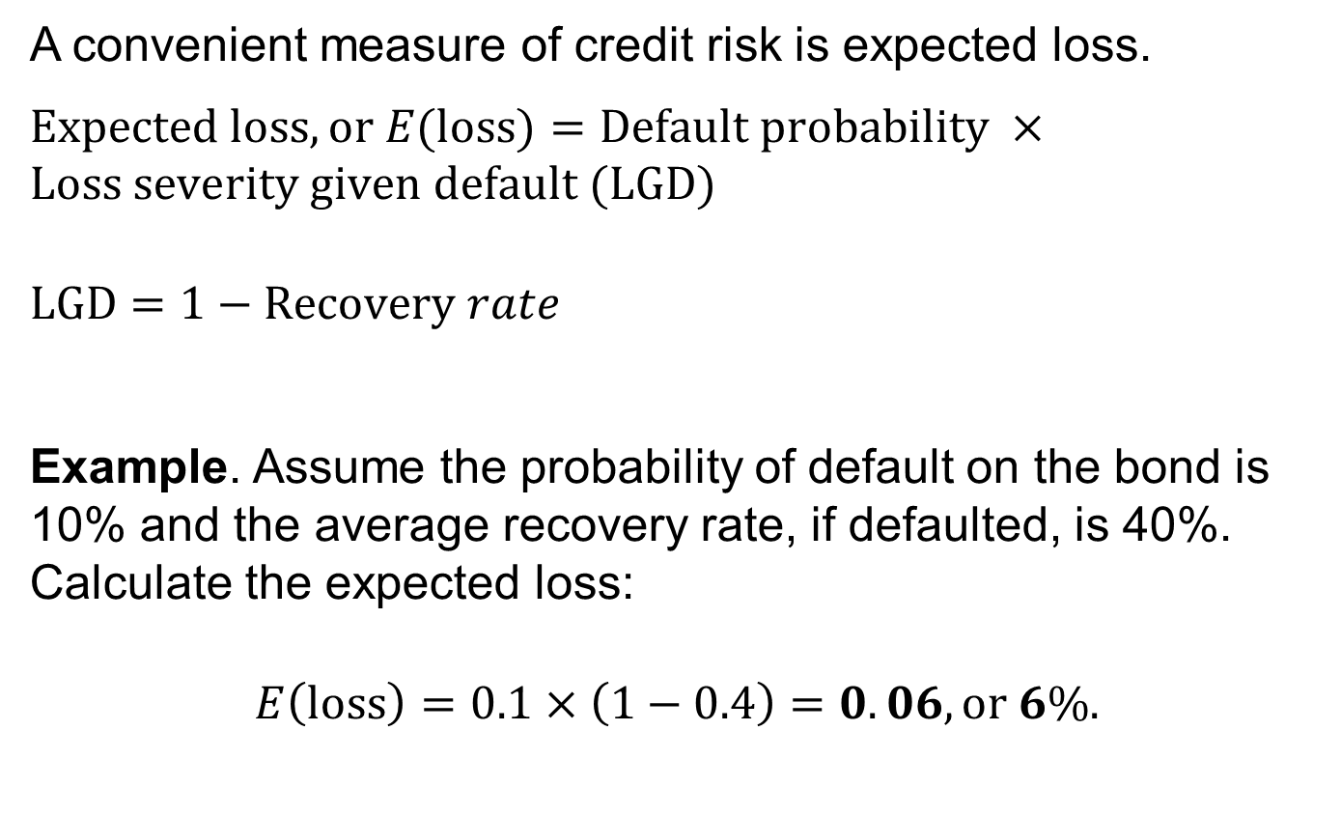
Expected loss
A convenient measure of credit risk is expected loss.
$Expected loss, or E(loss)=Default probability ×Loss severity given default (LGD)$
$$LGD=1−Recovery rate$$
Example. Assume the probability of default on the bond is 10% and the average recovery rate, if defaulted, is 40%. Calculate the expected loss:
$$E\left(loss\right)=0.1×\left(1−0.4\right)=0.06, or 6\%.$$
Notes:
2. Credit risk
LOS: Describe default probability and loss severity as components of credit risk.
The recovery rate is the percentage of the principal amount recovered in the event of default.

Slide 7
Important Credit-related risks
Important credit-related risks include the following:
Spread risk: The risk of changing (widening) the credit spread on the bond over a certain benchmark. As a result, the spread may change
Downgrade risk: The risk that a bond issuer’s creditworthiness deteriorates
Market liquidity risk: The risk that the price at which investors can actually transact—buy or sell—may differ from the price indicated in the market
Notes:
2. Credit risk
LOS: Describe credit risk and credit-related risks affecting corporate bonds.
Downgrade risk (i.e., credit migration risk) results from the action of credit rating agencies and may lead investors to believe the risk of default is higher, thus causing the yield spreads on the issuer’s bonds to widen and the price of its bonds to fall.
The spread or yield premium on corporate bonds includes a market liquidity component in addition to a credit risk component to compensate investors for the risk that there may not be sufficient market liquidity for them to buy or sell bonds in the quantity they desire.
Market liquidity is directly related to the size of the issue and quality of the issuer.

Slide 8
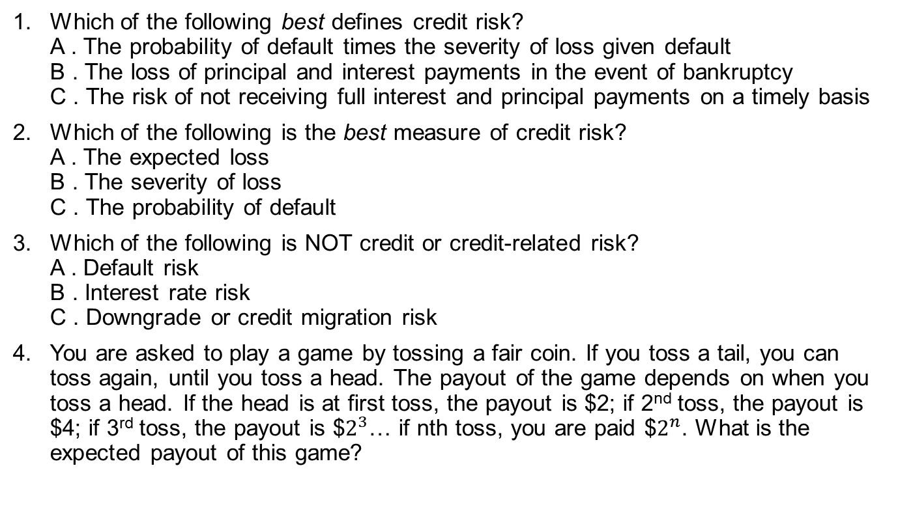
Mini-quiz #1
Which of the following best defines credit risk? A . The probability of default times the severity of loss given default B . The loss of principal and interest payments in the event of bankruptcy C . The risk of not receiving full interest and principal payments on a timely basis
Which of the following is the best measure of credit risk? A . The expected loss B . The severity of loss C . The probability of default
Which of the following is NOT credit or credit-related risk? A . Default risk B . Interest rate risk C . Downgrade or credit migration risk
You are asked to play a game by tossing a fair coin. If you toss a tail, you can toss again, until you toss a head. The payout of the game depends on when you toss a head. If the head is at first toss, the payout is $2; if 2nd toss, the payout is $4; if 3rd toss, the payout is $$2^{3}$… if nth toss, you are paid $$2^{n}$. What is the expected payout of this game?

Slide 9
3. Capital structure, seniority ranking, and recovery rates
The seniority ranking refers to the priority of payment, with the most senior or highest-ranking debt having the first claim on the cash flows and assets of the issuer.
This level of seniority can affect the value of an investor’s claim in the event of default and restructuring.
Broadly, there is secured debt and unsecured debt
Secured debt means the debtholder has a direct claim, a pledge from the issuer, on certain assets and their associated cash flows.
Unsecured debt means the debtholder has only a general claim on an issuer’s assets and cash flow.
Notes:
3. Capital structure, seniority ranking, and recovery rates
LOS: Describe seniority rankings of corporate debt and explain the potential violation of the priority of claims in a bankruptcy proceeding.
The composition and distribution across operating units of a company’s debt and equity—including bank debt, bonds of all seniority rankings, preferred stock, and common equity—is referred to as its capital structure.
Unsecured bonds are often referred to as debentures.
In the event of default, unsecured debtholders’ claims rank below (i.e., get paid after) those of secured creditors under what’s known as the priority of claims.

Slide 10
seniority ranking
First Lien Loan—Senior Secured
Second-Lien Loan—Secured
Senior Unsecured
Junior Subordinated
Senior Subordinated
Subordinated
Notes:
3. Capital structure, seniority ranking, and recovery rates
LOS: Describe seniority rankings of corporate debt and explain the potential violation of the priority of claims in a bankruptcy proceeding.
Within each category of debt, there are finer gradations of types and rankings.
There are many reasons why companies issue—and investors buy—debt with different seniority rankings. Issuers are interested in optimizing their cost of capital—finding the right mix of the various types of both debt and equity—for their industry and type of business.

Slide 11
recovery rates
All creditors at the same level of the capital structure are treated as one class. This provision is referred to as bonds ranking pari passu (“on an equal footing”) in right of payment.
Recovery rates vary by seniority of ranking in a company’s capital structure, under the priority of claims treatment in bankruptcy.
In theory, the priority of claims in bankruptcy—the idea that the highest-ranked creditors get paid out first, followed by the next level, and so on—is well established. In practice, there might be violations.
Notes:
3. Capital structure, seniority ranking, and recovery rates
LOS: Describe seniority rankings of corporate debt and explain the potential violation of the priority of claims in a bankruptcy proceeding.
Recovery rates can vary widely by industry.
Recovery rates can also vary depending on when they occur in a credit cycle.
Recovery rates are averages; there can be wide variability from case to case.
In principle, in the event of bankruptcy or liquidation:
Creditors with a secured claim have the right to the value of that specific property before any other claim. If the value of the pledged property is less than the amount of the claim, then the difference becomes a senior unsecured claim.
Unsecured creditors have a right to be paid in full before holders of equity interests (common and preferred shareholders) receive value on their interests.
Senior unsecured creditors take priority over all subordinated creditors. A creditor is senior unsecured unless expressly subordinated.

Slide 12
Classes of claimants in bankruptcy
In bankruptcy, there are different classes of claimants, and all classes that are impaired (that is, receive less than full claims) get to vote to confirm the plan of reorganization.
There may be disputes over the value of various assets in the bankruptcy estate or the present value or timing of payouts.
Thus, to avoid the time, expense, and uncertainty over disputed issues, the various claimants have an incentive to negotiate and compromise.
This frequently leads to creditors with lower seniority and other claimants (e.g., even shareholders) receiving more consideration than they are legally entitled to receive.
Resolution of these disputes takes time, and cases can drag on for months and years.
Notes:
3. Capital structure, seniority ranking, and recovery rates
LOS: Describe seniority rankings of corporate debt and explain the potential violation of the priority of claims in a bankruptcy proceeding.
Bankruptcy and bankruptcy laws are very complex and can vary greatly by country, so it is difficult to generalize about how creditors will fare. Senior unsecured creditors take priority over all subordinated creditors. A creditor is senior unsecured unless expressly subordinated.

Slide 13
Mini-quiz #2
Under which circumstance is a subordinated bondholder most likely to recover some value in a bankruptcy without a senior creditor getting paid in full? When: A . absolute priority rules are enforced. B . the various classes of claimants agree to it. C . the company is liquidated rather than reorganized.
In the event of bankruptcy, claims at the same level of the capital structure are: A . on an equal footing, regardless of size, maturity, or time outstanding. B . paid in the order of maturity from shortest to longest, regardless of size or time outstanding. C . paid on a first-in, first-out (FIFO) basis so that the longest-standing claims are satisfied first, regardless of size or maturity.
You have 2 ropes, each of which takes 1 hour to burn. But either rope has different densities at different points, so there is no guarantee of consistency in the time it takes different sections within the rope to burn. How do you use these 2 ropes to measure 45 minutes?

Slide 14
4. Rating agencies, Credit rating, and their role in the debt markets
The three major global credit rating agencies— Moody’s Investors Service, S&P, and Fitch Ratings—use symbol-based ratings that are basically an assessment of a bond issue’s risk of default.
Rating agencies will also typically provide outlooks on their respective ratings: positive, stable, or negative.
Rating agencies will typically provide both issuer and issue ratings, particularly as they relate to corporate debt.
Issuer credit ratings
Issue ratings
address an obligor’s overall creditworthiness—its ability and willingness to make timely payments of interest and principal on its debt.
refer to specific financial obligations of an issuer and take into consideration such factors as ranking in the capital structure.
Notes:
4. Rating agencies, credit ratings, and their role in the debt market
LOS: Distinguish between corporate issuer credit ratings and issue credit ratings and describe the rating agency practice of “notching.”
In support of their ratings, the rating agencies provide extensive written commentary and financial analysis on the obligors they rate, as well as summary industry statistics.
The issuer credit rating usually applies to its senior unsecured debt.
Although cross-default provisions—whereby events of default such as non-payment of interest on one bond trigger default on all outstanding debt—implies the same default probability for all issues, specific issues may be assigned different credit ratings.

Slide 15
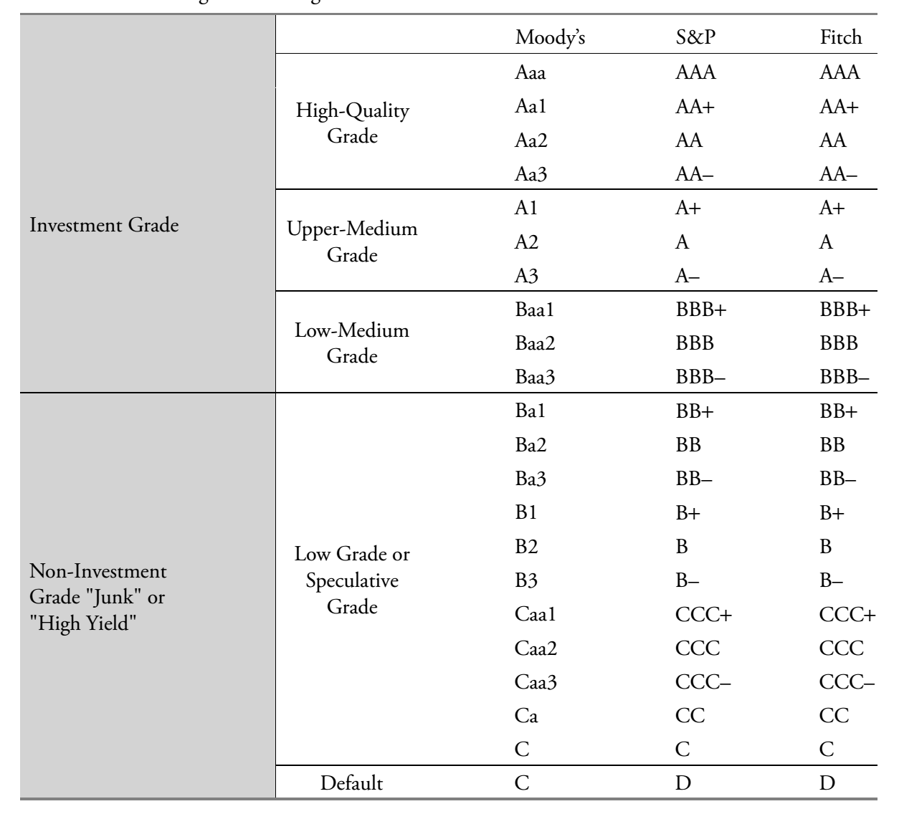
Ratings

Slide 16
Notching process
For the rating agencies, the likelihood of default—default risk—is the primary factor in assigning their ratings.
The secondary factors include the priority of payment in the event of a default as well as the potential loss severity in the event of default.
Recognizing these different payment priorities, and thus the potential for higher (or lower) loss severity in the event of default, the rating agencies have adopted a notching process whereby their credit ratings on issues can be moved up or down from the issuer rating, which is usually the rating applied to its senior unsecured debt.
Notes:
4. Rating agencies, credit ratings, and their role in the debt market
LOS: Distinguish between corporate issuer credit ratings and issue credit ratings and describe the rating agency practice of “notching.”
Notes:
As a general rule, the higher the senior unsecured rating, the smaller the notching adjustment will be. The reason behind this is that the higher the rating, the lower the perceived risk of default, so the need to “notch” the rating to capture the potential difference in loss severity is greatly reduced.
For lower-rated credits, however, the risk of default is greater and thus the potential difference in loss from a lower (or higher) priority ranking is a bigger consideration in assessing an issue’s credit riskiness.

Slide 17
Risks in relying on agency ratings
The ratings of the three major rating agencies have proved quite accurate as a relative measure of default risk, apart from a few exceptions.
There are limitations and risks, however, to relying on credit rating agency ratings, including the following:
Credit ratings can change over time.
Credit ratings tend to lag the market’s pricing of credit risk.
Rating agencies may make mistakes.
Some risks are difficult to capture in credit ratings.
Notes:
4. Rating agencies, credit ratings, and their role in the debt market
LOS: Explain risks in relying on ratings from credit rating agencies.
Over a long time period (e.g., many years), credit ratings can migrate—move up or down—significantly from what they were at the time of bond issuance. Therefore, bond investors should not assume an issuer’s credit rating will remain the same from the time of purchase through the entire holding period.
Bond prices and credit spreads frequently move more quickly because of changes in perceived creditworthiness than rating agencies change their ratings (or even outlooks) up or down.
An example of difficult-to-capture risk is litigation risk, such as that that can affect tobacco companies, or environmental and business risks faced by chemical companies and utility power plants.

Slide 18
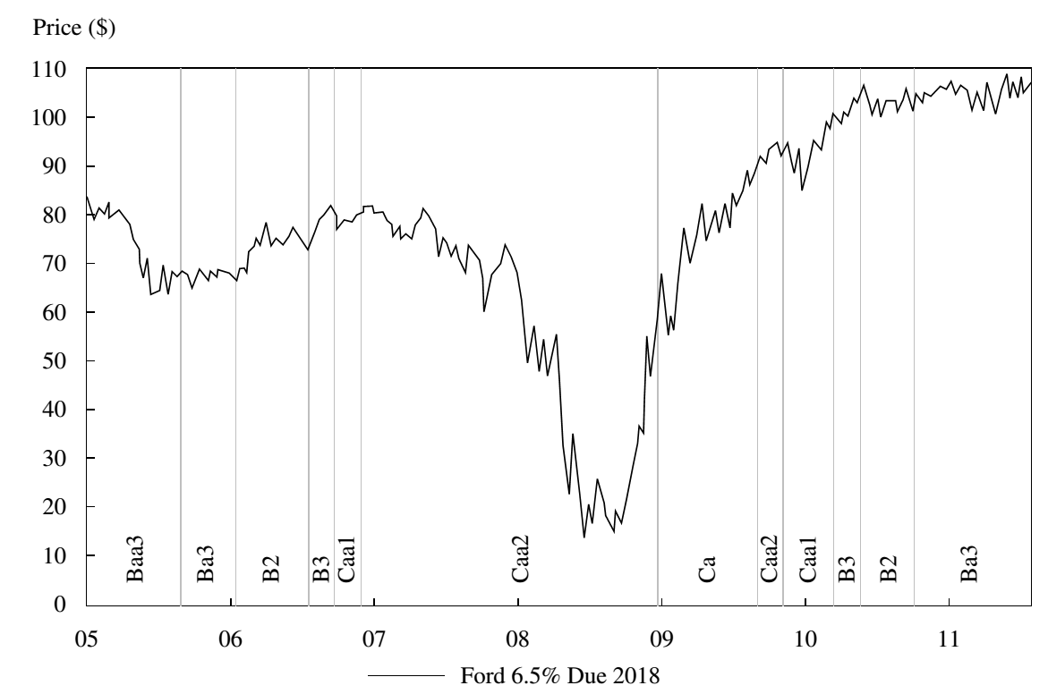
Credit ratings tend to lag the market’s pricing of credit risk

Slide 19
Mini-quiz #3
Using both Moody’s and S&P ratings, which of the following pairs of ratings is considered high yield, also known as “below investment grade,” “speculative grade,” or “junk”? A . Baa1/BBB– B . B3/CCC+ C . Baa3/BB+
What is the difference between an issuer rating and an issue rating? A . The issuer rating applies to all of an issuer’s bonds, whereas the issue rating considers a bond’s seniority ranking. B . The issuer rating is an assessment of an issuer’s overall creditworthiness, whereas the issue rating is always higher than the issuer rating. C . The issuer rating is an assessment of an issuer’s overall creditworthiness, typically reflected as the senior unsecured rating, whereas the issue rating considers a bond’s seniority ranking (e.g., secured or subordinated).
Based on the practice of notching by the rating agencies, a subordinated bond from a company with an issuer rating of BB would likely carry what rating? A . B+ B . BB C . BBB–
The fixed-income portfolio manager you work with asked you why a bond from an issuer you cover didn’t rise in price when it was upgraded by Fitch from B+ to BB. Which of the following is the most likely explanation? A . Bond prices never react to rating changes. B . The bond doesn’t trade often so the price hasn’t adjusted to the rating change yet. C . The market was expecting the rating change, and so it was already “priced in” to the bond.
Amalgamated Corp. and Widget Corp. each have bonds outstanding with similar coupons and maturity dates. Both bonds are rated B2, B–, and B by Moody’s, S&P, and Fitch, respectively. The bonds, however, trade at very different prices—the Amalgamated bond trades at €89, whereas the Widget bond trades at €62. What is the most likely explanation of the price (and yield) difference? A . Widget’s credit ratings are lagging the market’s assessment of the company’s credit deterioration. B . The bonds have similar risks of default (as reflected in the ratings), but the market believes the Amalgamated bond has a higher expected loss in the event of default. C . The bonds have similar risks of default (as reflected in the ratings), but the market believes the Widget bond has a higher expected recovery rate in the event of default.

Slide 20
5. Traditional credit analysis: corporate debt securities
The goal of credit analysis is to assess an issuer’s ability to satisfy its debt obligations, including bonds and other indebtedness, such as bank loans.
Many analysts perform a so-called 4C analysis:
Capacity
Collateral
Covenants
Character
refers to the ability of the borrower to make its debt payments on time.
refers to the quality and value of the assets supporting the issuer’s indebtedness.
are the terms and conditions of lending agreements that the issuer must comply with.
refers to the quality of management.
Notes:
5. Traditional credit analysis: Corporate debt securities
LOS: Explain the four Cs (Capacity, Collateral, Covenants, and Character) of traditional credit analysis.
The main focus in credit analysis is to understand a company’s ability to generate cash flow over the term of its debt obligations. In so doing, analysts must assess both the credit quality of the company and the fundamentals of the industry in which the company operates.
Traditional credit analysis considers the sources, predictability, and sustainability of cash generated by a company to service its debt obligations.

Slide 21
capacity
1C
Capacity is the ability of a borrower to service its debt. To determine that, credit analysis starts with industry analysis and then turns to examination of the specific issuer.
Porter’s framework of analyzing five competitive forces is useful for the analysis of an industry structure:
Threat of entry
Power of suppliers
Power of buyers/ customers
Threat of substitutes
Rivalry among existing competitors
Notes:
5. Traditional credit analysis: corporate debt securities
LOS: Explain the four Cs (Capacity, Collateral, Covenants, and Character) of traditional credit analysis.
The threat of entry depends on the extent of barriers to entry and the expected response from incumbents to new entrants.
An industry that relies on just a few suppliers tends to be less profitable and to have greater credit risk than an industry that has multiple suppliers.
Industries that rely heavily on just a few main customers have greater credit risk because the negotiating power lies with the buyers.
Industries (and companies) that offer products and services that provide great value to their customers, and for which there are not good or cost-competitive substitutes, typically have strong pricing power, generate substantial cash flows, and represent less credit risk than other industries or companies.
Industries with strong rivalry—because of numerous competitors, slow industry growth, or high barriers to exit—tend to have less cash.

Slide 22
capacity
After understanding an industry’s structure, the next step is to assess its fundamentals, including its sensitivity to macroeconomic factors, its growth prospects, its profitability, and its business need—or lack thereof—for high credit quality.
Judgments about these can be made by looking at the following:
Cyclical or non-cyclical industry
The industry’s growth prospects
Published industry statistics
Notes:
5. Traditional credit analysis: Corporate debt securities
LOS: Explain the four Cs (Capacity, Collateral, Covenants, and Character) of traditional credit analysis.
Notes:
Industries that are cyclical—that is, have greater sensitivity to broader economic performance—have more volatile revenues, margins, and cash flows and thus are inherently riskier than non-cyclical industries.
Industries that have little or no growth tend to consolidate via mergers and acquisitions. Depending on how these are financed (e.g., using stock or debt) and the economic benefits (or lack thereof) of the merger, they may or may not be favorable to corporate bond investors.
Analysts can get an understanding of an industry’s fundamentals and performance by researching statistics that are published by and available from a number of different sources, including the rating agencies, investment banks, industry publications, and frequently, government agencies.

Slide 23
capacity
Following analysis of an industry’s structure and fundamentals, the next step is to assess the fundamentals of the company: the corporate borrower.
Analysts should examine the following:
Competitive position
Track record/operating history
Management’s strategy and execution
Ratios and ratio analysis
Notes:
5. Traditional credit analysis: Corporate debt securities
LOS: Explain the four Cs (Capacity, Collateral, Covenants, and Character) of traditional credit analysis.
Analysis of a company’s competitive position within the industry includes answering the following questions: What is its market share? How has it changed over time: Is it increasing, decreasing, or holding steady? Is it well above (or below) its peers? How does it compare with respect to cost structure? How might it change its competitive position? What sort of financing might that require?
Analysis of a company’s track record includes answering the following questions: How has the company performed over time? What are the trends in revenues, profit margins, and cash flow? Capital expenditures represent what percent of revenues? What are the trends on the balance sheet—use of debt versus equity? Was this track record developed under the current management team? If not, when did the current management team take over?
Analysis of management’s strategy includes answering the following questions: What is management’s strategy for the company—to compete and to grow? Does it make sense, and is it plausible? How risky is it, and how differentiated is it from its industry peers? Is it venturing into unrelated businesses? Does the analyst have confidence in management’s ability to execute? What is management’s track record, both at this company and at previous ones? Does management plan to manage the balance sheet prudently, in a manner that doesn’t adversely affect bondholders?

Slide 24
capacity
To provide context to the analysis and understanding of a company’s fundamentals—based on the industry in which it operates, its competitive position, its strategy and execution—a number of financial measures derived from the company’s principal financial statements are examined.
Key credit analysis measures can be split into the following three groups:
Profitability and cash flow
Leverage
Coverage
Notes:
5. Traditional credit analysis: Corporate debt securities
LOS: Calculate and interpret financial ratios used in credit analysis.
It is from profitability and cash flow generation that companies can service their debt. Credit analysts typically look at operating profit margins and operating income to get a sense of a company’s underlying profitability and see how it varies over time.
The leverage ratios represent a measure of financial risk.
Coverage ratios measure an issuer’s ability to meet—to “cover”—its interest payments.

Slide 25
capacity
There are several measures of cash flow used in credit analysis, including the following:
Earnings before interest, taxes, depreciation, and amortization (EBITDA)
is equal to operating income plus depreciation and amortization expense.
Funds from operations (FFO)
is equal to net income from continuing operations plus depreciation, amortization, deferred income taxes, and other non-cash items.
Free cash flow before dividends (FCF before dividends)
can be calculated as net income (excluding non-recurring items) plus depreciation and amortization minus increase in non-cash working capital minus capital expenditures.
Free cash flow after dividends
(FCF after dividends)
is equal to free cash flow before dividends minus dividend payments.
Notes:
5. Traditional credit analysis: Corporate debt securities
LOS: Calculate and interpret financial ratios used in credit analysis.
EBITDA is a somewhat crude measure of cash flow because it excludes certain cash-related expenses of running a business, such as capital expenditures and changes in (non-cash) working capital.
FCF measures excess cash flow generated by the company (excluding non-recurring items) before payments to shareholders or that could be used to pay down debt or pay dividends. Companies that have negative free cash flow before payments to shareholders will be consuming cash they have or will need to rely on additional financing—from banks, bond investors, or equity investors. This obviously represents higher credit risk.

Slide 26
capacity
The most common leverage ratios are the following:
Debt/Capital
Debt/EBITDA
FFO/Debt
FCF after Dividends/Debt
Capital is calculated as total debt plus shareholders equity. This ratio shows the percent of a company’s capital base that is financed with debt. A lower percentage of debt indicates lower credit risk.
A higher ratio indicates more leverage and thus higher credit risk.
A higher ratio indicates a greater ability to pay debt by funds from operations.
A higher ratio indicates that a greater amount of debt can be paid off from free cash flow after dividend payments.
Notes:
5. Traditional credit analysis: Corporate debt securities
LOS: Calculate and interpret financial ratios used in credit analysis.
LOS: Evaluate the credit quality of a corporate bond issuer and a bond of that issuer, given key financial ratios of the issuer and the industry.
The debt/capital ratio is generally used for investment-grade corporate issuers. Where goodwill or other intangible assets are significant (and subject to obsolescence, depletion, or impairment), it is often informative to also compute the debt/capital ratio after assuming a write-down of the after-tax value of such assets.
The debt/EBITDA ratio can be very volatile for companies with high cash flow variability, such as those in cyclical industries and with high operating leverage (fixed costs).

Slide 27
capacity
The two most common coverage ratios are the following:
EBITDA/Interest expense
EBIT/Interest expense
This measurement of interest coverage is a bit more liberal than the one that uses EBIT because it does not subtract out the impact of (non-cash) depreciation and amortization expense. A higher ratio indicates higher credit quality.
Because EBIT does not include depreciation and amortization, it is considered a more conservative measure of interest coverage. This ratio is now used less frequently than EBITDA/interest expense.
Notes:
5. Traditional credit analysis: Corporate debt securities
LOS: Calculate and interpret financial ratios used in credit analysis.
LOS: Evaluate the credit quality of a corporate bond issuer and a bond of that issuer, given key financial ratios of the issuer and the industry.

Slide 28
capacity
An issuer’s access to liquidity is also an important consideration in credit analysis. When assessing an issuer’s liquidity, credit analysts tend to look at the following:
Cash on the balance sheet
Net working capital
Operating cash flow
Committed bank lines
Debt coming due and committed capital expenditures in the next one to two years
Notes:
5. Traditional credit analysis: corporate debt securities
LOS: Calculate and interpret financial ratios used in credit analysis.
LOS: Evaluate the credit quality of a corporate bond issuer and a bond of that issuer, given key financial ratios of the issuer and the industry.
Cash holdings provide the greatest assurance of having sufficient liquidity to make promised payments.
The big US automakers used to have enormous negative working capital, despite having high levels of cash on the balance sheet. This proved disastrous when the financial crisis hit in 2008 and the economy contracted sharply. Auto sales— and thus revenues—fell, the auto companies cut production, and working capital consumed billions of dollars in cash as accounts payable came due when the companies most needed liquidity.
Committed but untapped lines of credit provide contingent liquidity in the event that the company is unable to tap other, potentially cheaper, financing in the public debt markets.
Analysts will compare the sources of liquidity with the amount of debt coming due as well as with committed capital expenditures to ensure that companies can repay their debt and still invest in the business if the capital markets are somehow not available.

Slide 29
Collateral and covenants
2C
Collateral, or asset value, analysis is typically emphasized more with lower-credit-quality companies. Only when the default probability rises to a sufficient level do analysts typically consider asset or collateral value in the context of loss severity in the event of default.
Covenants are meant to protect creditors while also giving management sufficient flexibility to operate its business on behalf and for the benefit of the shareholders. They spell out what the issuer’s management is (1) obligated to do (affirmative) and (2) limited in doing (negative).
3C
Notes:
5. Traditional credit analysis: Corporate debt securities
LOS: Explain the four Cs (Capacity, Collateral, Covenants, and Character) of traditional credit analysis.
Analysts do think about the value and quality of a company’s assets; however, these are difficult to observe directly. Factors to consider include the nature and amount of intangible assets on the balance sheet.
Covenants are an important but underappreciated part of credit analysis. Strong covenants protect bond investors from the possibility of management taking actions that would hurt an issuer’s creditworthiness.

Slide 30
character
4C
Credit analysts can make judgments about management’s character in the following ways:
An assessment of the soundness of management’s strategy
Management’s track record in executing past strategies, particularly if they led to bankruptcy or restructuring
Use of aggressive accounting policies and/or tax strategies
Any history of fraud or malfeasance
Previous poor treatment of bondholders
Notes:
5. Traditional credit analysis: Corporate debt securities
LOS: Explain the four Cs (Capacity, Collateral, Covenants, and Character) of traditional credit analysis.
A company run by executives whose prior positions/ventures resulted in significant distress might still be able to borrow in the debt markets, but it would likely have to borrow on a secured basis and/or pay a higher rate of interest.
Examples of aggressive accounting might include using a significant amount of off-balance-sheet financing, capitalizing versus immediately expensing items, recognizing revenue prematurely, and/or frequently changing auditors.
Examples of poor treatment of bondholders may include such actions as a debt-financed acquisition, a large special dividend to shareholders, or a major debt-financed stock buyback program.

Slide 31
Mini-quiz #4
Given a hotel company, a chemical company, and a consumer products company, which is most likely to be able to support a high debt load over an economic cycle? A . The hotel company, because people need a place to stay when they travel. B . The chemical company, because chemicals are a key input to many products. C . The consumer products company, because consumer products are typically resistant to recessions.
Heavily regulated monopoly companies, such as utilities, often carry high debt loads. Which of the following statements about such companies is most accurate? A . Regulators require them to carry high debt loads. B . They generate strong and stable cash flows, enabling them to support high levels of debt. C . They are not very profitable and need to borrow heavily to maintain their plant and equipment.
XYZ Corp. manufactures a commodity product in a highly competitive industry in which no company has significant market share and where there are low barriers to entry. Which of the following best describes XYZ’s ability to take on substantial debt? A . Its ability is very limited because companies in industries with those characteristics generally cannot support high debt loads. B . Its ability is high because companies in industries with those characteristics generally have high margins and cash flows that can support significant debt. C . We don’t have enough information to answer the question.

Slide 32

6. Credit risk vs. return: Yields and Spreads
Typically, the higher the credit risk, the greater the return potential and the higher the volatility of that return.
The yield on a bond can be decomposed as
$$Yield={RFR}_{r}+E\left(i\right)+mp+lp+cs$$
$$Yield spread =lp+cs$$
Some government bonds do not have credit risk and liquidity risk components.
RFR_{r}
is the real risk-free rate.
E(i)
is the expected inflation rate.
mp, lp
is the maturity premium, liquidity premium.
cs
is the credit spread.
Notes:
6. Credit risk vs. return: Yields and spreads
LOS: Describe factors that influence the level and volatility of yield spreads.
The market’s willingness to bear risk will affect each of these components. In general, however, it is not possible to directly observe the market’s assessment of the components separately—analysts can only observe the total yield spread/yield.

Slide 33
Factors that affect spreads on corporate bonds
Spreads on bonds can be affected by these factors.
Credit cycle
Broader economic conditions
Financial market performance overall, including equities
Broker/dealers’ willingness to provide sufficient capital for market making
General market supply and demand
Notes:
6. Credit risk vs. return: Yields and spreads
LOS: Describe factors that influence the level and volatility of yield spreads.
As the credit cycle improves, credit spreads will narrow.
Weakening economic conditions will push investors to desire a greater risk premium and drive overall credit spreads wider.
In weak financial markets, credit spreads will widen, whereas in strong markets, credit spreads will narrow.
In periods of heavy new issue supply, credit spreads will widen if there is insufficient demand.

Slide 34
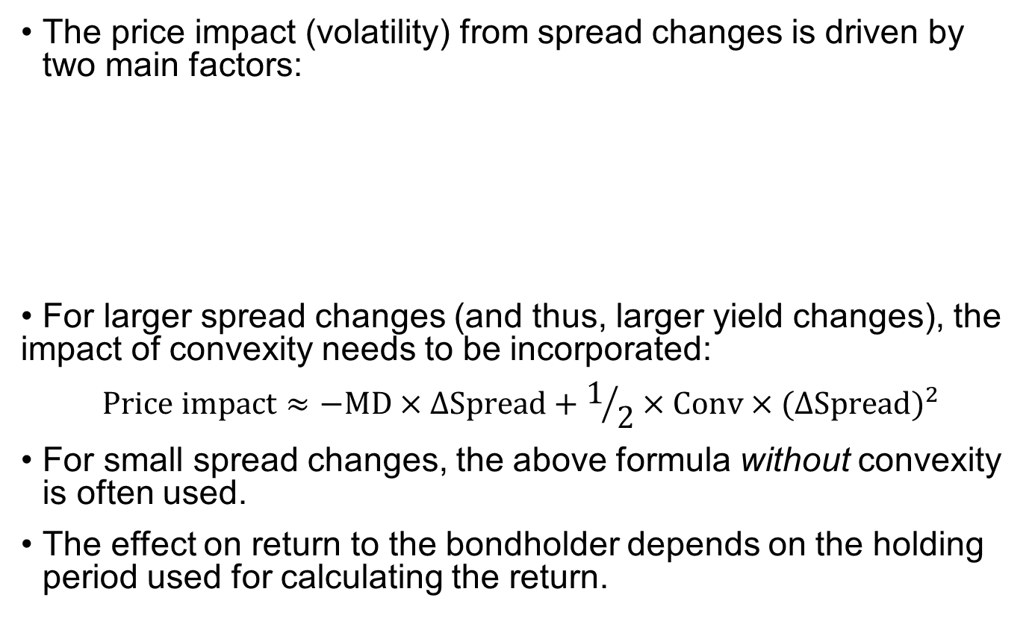
Factors that affect the price impact from spread changes
The price impact (volatility) from spread changes is driven by two main factors:
• For larger spread changes (and thus, larger yield changes), the impact of convexity needs to be incorporated:
$$Price impact≈−MD×∆Spread+1/2×Conv×(∆{Spread)}^{2}$$
For small spread changes, the above formula without convexity is often used.
The effect on return to the bondholder depends on the holding period used for calculating the return.
Modified duration (price sensitivity with respect to changes in interest rates) of the bond
Magnitude of the spread change
Notes:
6. Credit risk vs. return: Yields and spreads
LOS: Describe factors that influence the level and volatility of yield spreads.
Because default risk is very low, most investors in investment-grade debt focus on spread risk—that is, the effect on prices and return from changes in spreads.
The negative sign in this equation reflects the fact that because bond prices and yields move in opposite directions, narrower spreads have a positive impact on bond prices and thus returns, whereas wider spreads have a negative impact on bond returns.

Slide 35
Mini-quiz #5
Which bonds are likely to exhibit the greatest spread volatility? A . Bonds from issuers rated AA B . Bonds from issuers rated BB C . Bonds from issuers rated A
If investors become increasingly worried about the economy—say, as shown by de-lining stock prices—what is the most likely impact on credit spreads? A . There will be no change to credit spreads. They aren’t affected by equity markets. B . Narrower spreads will occur. Investors will move out of equities into debt securities. C . Wider spreads will occur. Investors are concerned about weaker creditworthiness.

Slide 36
7. Special considerations of high-yield, sovereign, and non-sovereign credit analysis
High-yield analysis is typically more in-depth than investment-grade analysis and thus has special considerations, including the following:
• Greater focus on issuer liquidity and cash flow
• Detailed financial projections
• Detailed understanding and analysis of the debt structure
• Understanding of an issuer’s corporate structure
• Covenants
• Equity-like approach to high-yield analysis
Notes:
7. Special considerations on high-yield, sovereign, and non-sovereign credit analysis
LOS: Explain special considerations when evaluating the credit of high-yield, sovereign, and non-sovereign government debt issuers and issues.
Companies with weak balance sheets and/or business profiles have a lower margin for error and greater risk of default relative to higher-quality investment-grade names. And the higher risk of default means more attention must be paid to recovery analysis (or loss severity, in the event of default).
Key covenants for high-yield issuers may include the following:
Change of control put
Restricted payments
Limitations on liens and additional indebtedness
Restricted versus unrestricted subsidiaries

Slide 37
Sovereign credit analysis
Important considerations in sovereign credit analysis
Institutional effectiveness and political risks
Effectiveness, stability, and predictability of policymaking and institutions
Perceived commitment to honor debts
Economic structure and growth prospects
Income per capita
Trend growth prospects
Sources and stability of growth
Size of the public sector relative to private sector
Growth and age distribution of population
Notes:
7. Special considerations on high-yield, sovereign, and non-sovereign credit analysis
LOS: Explain special considerations when evaluating the credit of high-yield, sovereign, and non-sovereign government debt issuers and issues.
The category “effectiveness, stability, and predictability of policymaking and institutions” may include the following:
Successful management of past political, economic, and/or financial crises
Ability and willingness to implement reforms to address fiscal challenges
Predictable policy framework
Absence of challenges to political institutions
Checks and balances in the system
Absence of corruption
Unbiased law enforcement and respect for rule of law and property rights
Independent/unfettered media and sources of economic data

Slide 38
sovereign credit analysis
Important considerations in sovereign credit analysis (continued)
External liquidity and international investment position
Monetary flexibility
Fiscal performance, flexibility, and debt burden
Status of currency
External liquidity
External debt
Ability to use monetary policy to address domestic economic objectives (e.g., growth), including exchange rate regime
Credibility of monetary policy
Effectiveness of monetary policy transmission via domestic capital markets
Notes:
7. Special considerations on high-yield, sovereign, and non-sovereign credit analysis
LOS: Explain special considerations when evaluating the credit of high-yield, sovereign, and non-sovereign government debt issuers and issues.
The “fiscal performance, flexibility, and debt burden” category includes the following:
Trend change in general government debt as a percent of GDP
Perceived willingness and ability to increase revenue or cut expenditure to ensure debt service
General government interest expense as a percent of revenue
Net general government debt as a percent of GDP
Contingent liabilities arising from the financial sector, public enterprises, and guarantees
The “credibility of monetary policy: category includes the following:
Operationally independent central bank
Clear central bank mandate/objectives
Track record of low and stable inflation
Central government’s ability to issue substantial long-term, fixed-rate debt in domestic currency
The “effectiveness of monetary policy transmission via domestic capital markets” category includes the following:
Well-developed banking system
Active money market and corporate bond market
Greater reliance on market-based policy tools and limited reliance on blunt, administrative policy tools
Credit rating agencies often distinguish between domestic and foreign bonds, with domestic bond ratings as much as two notches higher.

Slide 39
non-sovereign credit analysis
The credit analysis of non-sovereign general obligation (GO) bonds is similar to sovereign debt analysis.
The economic analysis of non-sovereign government GO bonds focuses on employment, per capita income, per capita debt, the tax base, demographics, net population growth, and the local infrastructure.
Analysis should look at the volatility and variability of revenues during times of both economic strength and weakness.
Revenue bonds, which are issued to finance a specific project, have a higher degree of risk than GO bonds because they are dependent on a single source of revenue.
The analysis of these bonds is a combination of an analysis of the project and the finances around the particular project.
Notes:
7. Special considerations on high-yield, sovereign, and non-sovereign credit analysis
LOS: Explain special considerations when evaluating the credit of high-yield, sovereign, and non-sovereign government debt issuers and issues.
In the credit analysis of non-sovereign bonds, it should be noted that some municipalities must balance their operating budgets (i.e., exclusive of long-term capital projects) annually. Also, non-sovereign governments are unable to use monetary policy the way many sovereigns can.
Disclosure by non-sovereign governments varies widely, with some of the smaller issuers providing limited financial information. Reporting requirements are inconsistent, so the financial reports may not be available for six months or more after the closing of a reporting period.
The project analysis focuses on the need and projected utilization of the project, as well as on the economic base supporting the project.

Slide 40
8. SUMMARY
Credit risk and credit-related risks
Default probability and loss severity
The key components of credit risk are risk of default and loss severity in the event of default.
Credit risk is the risk of loss resulting from the borrower failing to make full and timely payments of interest and/or principal.
Credit-related risks include downgrade risk (also called “credit migration risk”) and market liquidity risk.
The product of the two is expected loss.
Loss severity = (1 – Recovery rate).
Notes:
LOS: Describe credit risk and credit-related risks affecting corporate bonds.
LOS: Describe default probability and loss severity as components of credit risk.

Slide 41
SUMMARY
Seniority rankings of corporate debt and the potential violation of the priority of claims
Debt ranks ahead of all types of equity with respect to priority of payment, and within the debt component of the capital structure, there can be varying levels of seniority.
Corporate issuer credit ratings and issue credit ratings
The ratings agencies rate both issuers and issues. Issuer ratings are meant to address an issuer’s overall creditworthiness. Ratings for issues incorporate such factors as their rankings in the capital structure.
A higher priority of claim implies a higher recovery rate—lower loss severity—in the event of default.
The priority of claims in bankruptcy can be violated due to some leeway accorded to bankruptcy judges, government involvement, or a desire on the part of the more senior creditors to settle with the more junior creditors and allow the issuer to emerge from bankruptcy as a going concern.
Notes:
LOS: Describe seniority rankings of corporate debt and explain the potential violation of the priority of claims in a bankruptcy proceeding.
LOS: Distinguish between corporate issuer credit ratings and issue credit ratings and describe the rating agency practice of “notching.”

Slide 42
SUMMARY
Risks in relying on ratings from credit ratings agencies
There are risks in relying too much on credit agency ratings: (i) Creditworthiness may change over time; (ii) valuations often adjust before ratings change; (iii) ratings do not necessary reflect the severity of loss given default; and (iv) credit ratings agencies may have difficulty forecasting certain credit-negative outcomes.
The four Cs of traditional credit analysis
The “4 Cs” of credit—capacity, collateral, covenants, and character—provide a useful framework for evaluating credit risk.
Notes:
LOS: Explain risks in relying on ratings from credit rating agencies.
LOS: Explain the four Cs (Capacity, Collateral, Covenants, and Character) of traditional credit analysis.

Slide 43
SUMMARY
Financial ratios used in credit analysis
Credit measures are used to calculate an issuer’s creditworthiness, as well as to compare its credit quality with that of peer companies. Key credit ratios focus on leverage and interest coverage and use such measures as EBITDA, free cash flow, funds from operations, interest expense, and balance sheet debt.
Level and volatility of yield spreads
The yield on a credit-risky bond comprises the yield on a default risk–free bond with a comparable maturity plus a yield premium, or “spread,” that comprises a credit spread and a liquidity premium.
The impact of spread changes on holding period returns for credit-risky bonds is a product of two primary factors: the basis point spread change and the sensitivity of price to yield as reflected by (end-of-period) modified duration and convexity.
Notes:
LOS: Calculate and interpret financial ratios used in credit analysis.
LOS: Evaluate the credit quality of a corporate bond issuer and a bond of that issuer, given key financial ratios of the issuer and the industry.
LOS: Describe factors that influence the level and volatility of yield spreads.

Slide 44
SUMMARY
Special considerations when evaluating the credit of high-yield, sovereign, and non-sovereign government debt issuers and issues
The credit analysis of non-sovereign general obligation bonds has some similarities to sovereign analysis: debt burden per capita versus income per capita, tax burden, demographics, and economic diversity. For revenue bonds, a project analysis methodology is used.
Covenants analysis is especially important for high-yield bonds.
In assessing sovereign credit risk, a helpful framework is to focus on five broad areas: (1) institutional effectiveness and political risks; (2) economic structure and growth prospects; (3) external liquidity and international investment position; (4) fiscal performance, flexibility, and debt burden; and (5) monetary flexibility.
For high-yield bonds, with their greater risk of default, more emphasis should be placed on an issuer’s sources of liquidity, as well as on its debt structure and corporate structure.
Notes:
LOS: Explain special considerations when evaluating the credit of high-yield, sovereign, and non-sovereign government debt issuers and issues.

Slide 45
Homework
The risk that a bond’s creditworthiness declines is best described by: A. credit migration risk. B. market liquidity risk. C. spread widening risk.
Stedsmart Ltd and Fignermo Ltd are alike with respect to financial and operating characteristics, except that Stedsmart Ltd has less publicly traded debt outstanding than Fignermo Ltd. Stedsmart Ltd is most likely to have: A. no market liquidity risk. B. lower market liquidity risk. C. higher market liquidity risk.
In the event of default, debentures’ claims will most likely rank: A. above that of secured debt holders. B. below that of secured debt holders. C. the same as that of secured debt holders.

Slide 46
Homework
In the event of default, the recovery rate of which of the following bonds would most likely be the highest? A. First mortgage debt B. Senior unsecured debt C. Junior subordinate debt
If goodwill makes up a large percentage of a company’s total assets, this most likely indicates that: A. the company has low free cash flow before dividends. B. there is a low likelihood that the market price of the company’s common stock is below book value. C. a large percentage of the company’s assets are not of high quality.
In order to analyze the collateral of a company a credit analyst should assess the: A. cash flows of the company. B. soundness of management’s strategy. C. value of the company’s assets in relation to the level of debt

