Slide 1
Fixed income analysis
Tony Zhang
Fall 2019
© 2016 CFA Institute. All rights reserved.

Slide 2
TABLE OF CONTENTS
01
INTRODUCTION
02
MEASURES OF CREDIT RISK
03
TRADITIONAL CREDIT MODELS
04
STRUCTURAL MODELS
05
REDUCED FORM MODELS
06
THE TERM STRUCTURE OF CREDIT SPREADS
07
ASSET-BACKED SECURITIES
08
SUMMARY

Slide 3
1. INTRODUCTION
Since 1990, credit-related financial crises and consequent defaults by governments, companies, and individuals have spurred developments in credit risk analysis.
Traditional credit ratings were only partially effective in capturing the changes in the default risks.
As a result, additional tools to quantify and manage risks have been developed.
Notes:
1. Introduction
Crises include the following:
1) The collapse of the Japanese bubble and its aftermath (1989−present).
2) The Mexican “tequila crisis” (1994−1995).
3) The Asian crisis, also known as the Asian contagion (1997−1998).
4) The Russian debt crisis (1998).
5) The global financial crisis (began in 2008).

Slide 4
2. MEASURES OF Credit risk
Four measures are often estimated to quantify the credit risk.
Loss given default
Expected loss on the bond
Present value of the expected loss
Probability of default
Notes:
2. Credit risk measures
LOS: Explain probability of default, loss given default, expected loss, and present value of the expected loss, and describe the relative importance of each across the credit spectrum.
Loss given default is the amount of the remaining coupon and principal payments lost in the event of default.
Loss given default is equal to 1 – Recovery rate
Recovery rate is the percentage of the position received or recovered in default.
The expected loss is equal to the probability of default multiplied by the loss given default.
The present value of the expected loss is conceptually the largest price one would be willing to pay on a bond to a third party (e.g., an insurer) to entirely remove the credit risk of purchasing and holding the bond.

Slide 5
PRESENT VALUE OF THE EXPECTED LOSS
The present value of the expected loss is the most complex credit risk measure to calculate because it involves two modifications to the expected loss:
The present value of the expected loss is the most important credit risk measure, followed by expected loss and, finally, probability of default.
The first modification is to explicitly adjust the probabilities to account for the risk of the cash flows (the risk premium).
The second modification is to include the time value of money in the calculation—that is, the discounting of the future cash flows to the present.
Notes:
2. Credit risk measures
LOS: Explain probability of default, loss given default, expected loss, and present value of the expected loss, and describe the relative importance of each across the credit spectrum.
The present value of the expected loss is the most important credit risk measure because when one considers the purchase or sale of the bond, one is interested in the exact dollar difference one should pay or receive on the bond relative to an otherwise identical and riskless government bond.
Also, the present value of the expected loss is the preferred measure because it includes the probability of default, the loss given default, the time value of money, and the risk premium in its computation. The expected loss is second best, including both the default probability and loss given default. The default probability is the least inclusive measure.

Slide 6
Mini-quiz #1
The risk-neutral probabilities are not the same as the true real-world probabilities of the future states. True or False?
The rating agency’s ratings are based on real-world default probabilities, rather than risk-neural probabilities. True or False?
Credit default swap (CDS) is priced based on real-world default probabilities, rather than risk-neural probabilities. True or False?

Slide 7
3. TRADITIONAL CREDIT MODELS
Credit scoring and credit ratings, two traditional approaches to credit risk analysis, apply to different types of borrowers.
They are called “ordinal ranking” because they only “order” borrowers’ riskiness from highest to lowest.
Credit scoring
Credit ratings
is used for small owner-operated businesses and individuals.
are used for companies, sovereigns, sub-sovereigns, and those entities’ securities, as well as asset-backed securities.
Notes:
3. Traditional credit models
LOS: Explain credit scoring and credit ratings, including why they are called ordinal rankings.
The traditional approaches to credit risk (i) are widely used and (ii) provide a link between the traditional, financial statement–based credit analysis methods and the structural and reduced form credit risk models.

Slide 8
Credit scoring
Credit scoring ranks a borrower’s credit riskiness. It does not provide an estimate of a borrower’s default probability.
The main features of credit scoring
It does not explicitly depend on current economic conditions.
It is not the percentile ranking of the borrower among a universe of borrowers.
It has different implications for the probability of default depending on the borrower and the nature of the loan that has been extended.
There is emphasis on credit scoring stability over time.
Notes:
3. Traditional credit models
LOS: Explain credit scoring and credit ratings, including why they are called ordinal rankings.
Credit scores are used in many markets in the world, but scoring varies considerably across markets. In some markets, only negative information, such as a default, is reported. Therefore, no score or information is positive because it means no news has been reported about the borrower.
In other markets, such factors as payment history and debt outstanding are used to develop a credit score, but the weighting of the factors can differ across countries.

Slide 9
CREDIT RATINGS
Credit ratings rank the credit risk of a company, government (sovereign), quasi-government, or asset-backed security.
Credit ratings do not provide an estimate of the loan’s default probability.
The number of rating grades and their definitions vary among third-party rating agencies and among financial services firms, but their objective is the same:
• Rating agencies like Standard & Poor’s and Moody’s Investors Service use more than 20 rating grades, from AAA to D.
Create an ordinal ranking of borrowers by riskiness as an aid to portfolio selection and risk management.
Notes:
3. Traditional credit models
LOS: Explain credit scoring and credit ratings, including why they are called ordinal rankings.
Internal ratings are created and heavily used by financial institutions to control their credit risk.
Major credit rating agencies are Standard and Poor’s, Moody’s Investors Service, and Fitch Ratings.

Slide 10
Strengths and weaknesses of CREDIT RATINGS
Relative strengths:
Simplicity
Stability
Inconsistent link with default probability
No explicit link with the business cycle
Compensation system with potential conflict of interest that may distort the accuracy of credit ratings
Relative weaknesses:
Notes:
3. Traditional credit models
LOS: Explain strengths and weaknesses of credit ratings.
Strengths: (i) Credit ratings provide a simple statistic that summarizes a complex credit analysis of a potential borrower and (ii) they tend to be stable over time and across the business cycle, which reduces debt market price volatility.
Weaknesses: (i) Credit ratings tend to be stable over time, which reduces the correspondence to a debt offering’s default probability; (ii) they do not explicitly depend on the business cycle, whereas a debt offering’s default probability does; and (iii) the issuer-pays model for compensating credit-rating agencies has a potential conflict of interest that may distort the accuracy of credit ratings.

Slide 11
Mini-quiz #2
A bank analyst is considering the loan applications of three individuals. Each is requesting a personal loan of $55,000. The bank can lend to only one of them. The bank’s criteria emphasize the FICO score. Which individual is the bank analyst most likely to recommend lending to?
A. Individual A has a salary of $157,000, a net worth of $300,000, five credit cards, and a FICO score of 550. B. Individual B has a salary of $97,000, a net worth of $105,000, two credit cards, and a FICO score of 700.
C. Individual C has a salary of $110,000, a net worth of $300,000, no credit cards, and a FICO score of 600.

Slide 12
4. STRUCTURAL MODELS
Structural models aim to understand the economics of a company’s liabilities and build on the insights of option pricing theory.
The link between option pricing theory and structural models comes from the call option analogy for equity.
The company’s owners (equity holders) have limited liability.
If the equity holders default on the debt payment at time T, the debtholders’ only recourse is to the company’s assets. They have no additional claim on the equity holders’ personal wealth.
Notes:
4. Structural models
LOS: Explain structural models of corporate credit risk, including why equity can be viewed as a call option on the company’s assets.
Structural models are called “structural” because they are based on the structure of a company’s balance sheet.

Slide 13
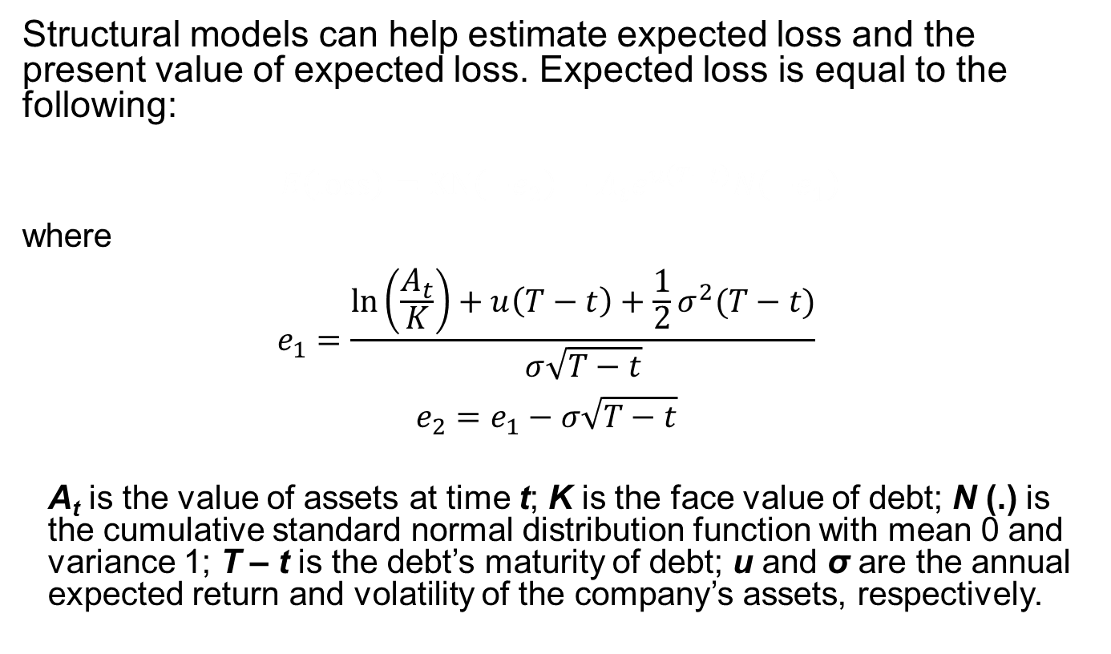
EXPECTED LOSS
Structural models can help estimate expected loss and the present value of expected loss. Expected loss is equal to the following:
$E\left(loss\right)=KN\left({−e}_{2}\right)−A_{t}e^{u\left(T−t\right)}N\left({−e}_{1}\right)$
where
$$e_{1}=\frac{ln\left(\frac{A_{t}}{K}\right)+u\left(T−t\right)+\frac{1}{2}σ^{2}(T−t)}{σ\sqrt{T−t}}$$
$$e_{2}=e_{1}−σ\sqrt{T−t}$$
A_{t} is the value of assets at time t; K is the face value of debt; N (.) is the cumulative standard normal distribution function with mean 0 and variance 1; T – t is the debt’s maturity of debt; u and σ are the annual expected return and volatility of the company’s assets, respectively.
Notes:
4. Structural models
LOS: Explain structural models of corporate credit risk, including why equity can be viewed as a call option on the company’s assets.
The assumptions of the model are (i) the company’s assets trade in frictionless markets that are arbitrage free, (ii) the riskless rate of interest, r , is constant over time, and (iii) the time T value of the company’s assets has a lognormal distribution with mean uT and variance σ²T.

Slide 14
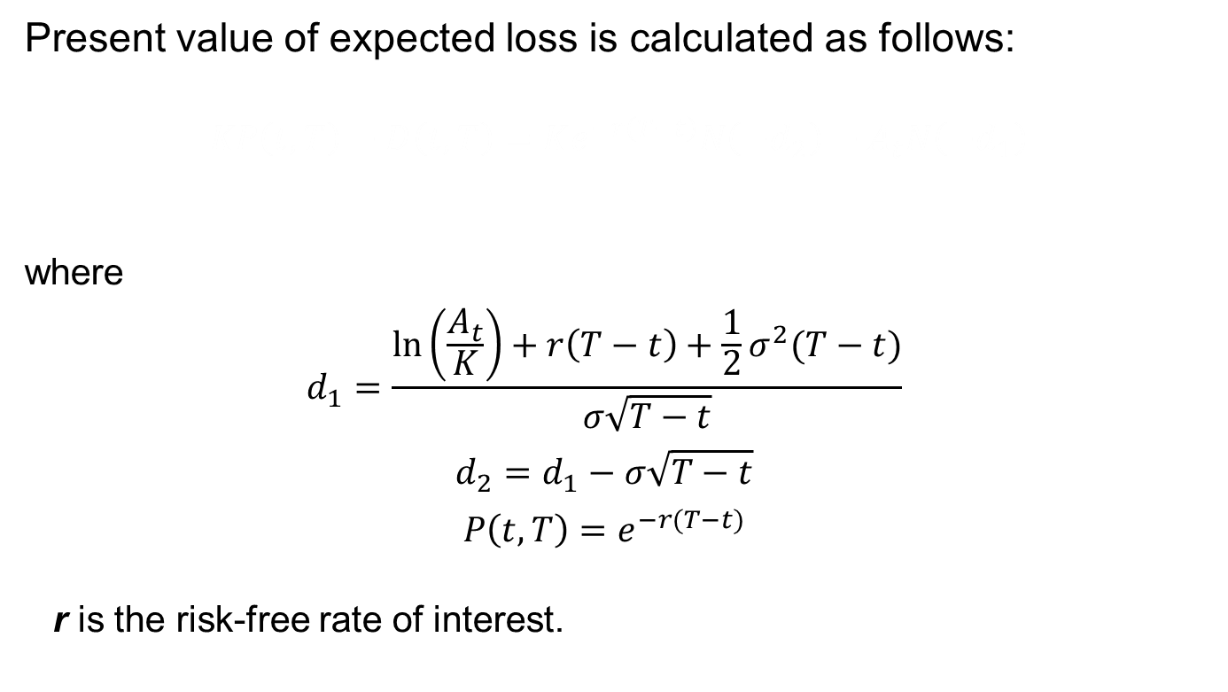
PRESENT VALUE OF EXPECTED LOSS
Present value of expected loss is calculated as follows:
$KP\left(t,T\right)−D\left(t,T\right)=Ke^{−r\left(T−t\right)}N\left(−d_{2}\right)−A_{t}N\left({−d}_{1}\right)$
where
$$d_{1}=\frac{ln\left(\frac{A_{t}}{K}\right)+r\left(T−t\right)+\frac{1}{2}σ^{2}(T−t)}{σ\sqrt{T−t}}$$
$$d_{2}=d_{1}−σ\sqrt{T−t}$$
$$P\left(t,T\right)=e^{−r(T−t)}$$
r is the risk-free rate of interest.
Notes:
4. Structural models
LOS: Explain structural models of corporate credit risk, including why equity can be viewed as a call option on the company’s assets.

Slide 15
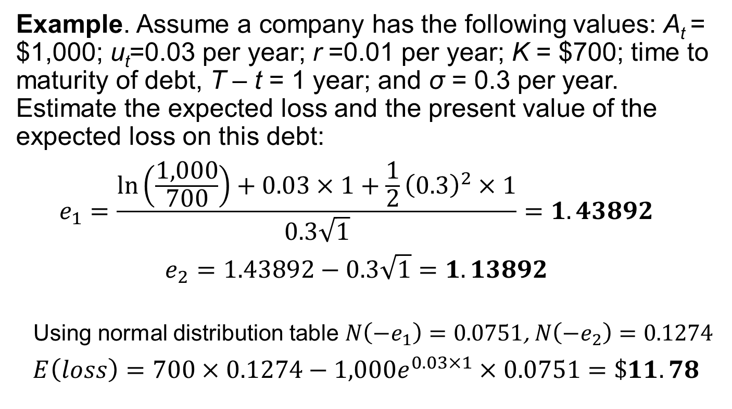
Calculating expected loss
Example. Assume a company has the following values: A_{t} = $1,000; u_{t}=0.03 per year; r =0.01 per year; K = $700; time to maturity of debt, T – t = 1 year; and σ = 0.3 per year. Estimate the expected loss and the present value of the expected loss on this debt:
$$e_{1}=\frac{ln\left(\frac{1,000}{700}\right)+0.03×1+\frac{1}{2}{\left(0.3\right)}^{2}×1}{0.3\sqrt{1}}=1.43892$$
$$e_{2}=1.43892−0.3\sqrt{1}=1.13892$$
Using normal distribution table $N\left({−e}_{1}\right)=0.0751$, $N\left({−e}_{2}\right)=0.1274$
$$E\left(loss\right)=700×0.1274−1,000e^{0.03×1}×0.0751=\$11.78$$
Notes:
4. Structural models
LOS: Explain structural models of corporate credit risk, including why equity can be viewed as a call option on the company’s assets.

Slide 16
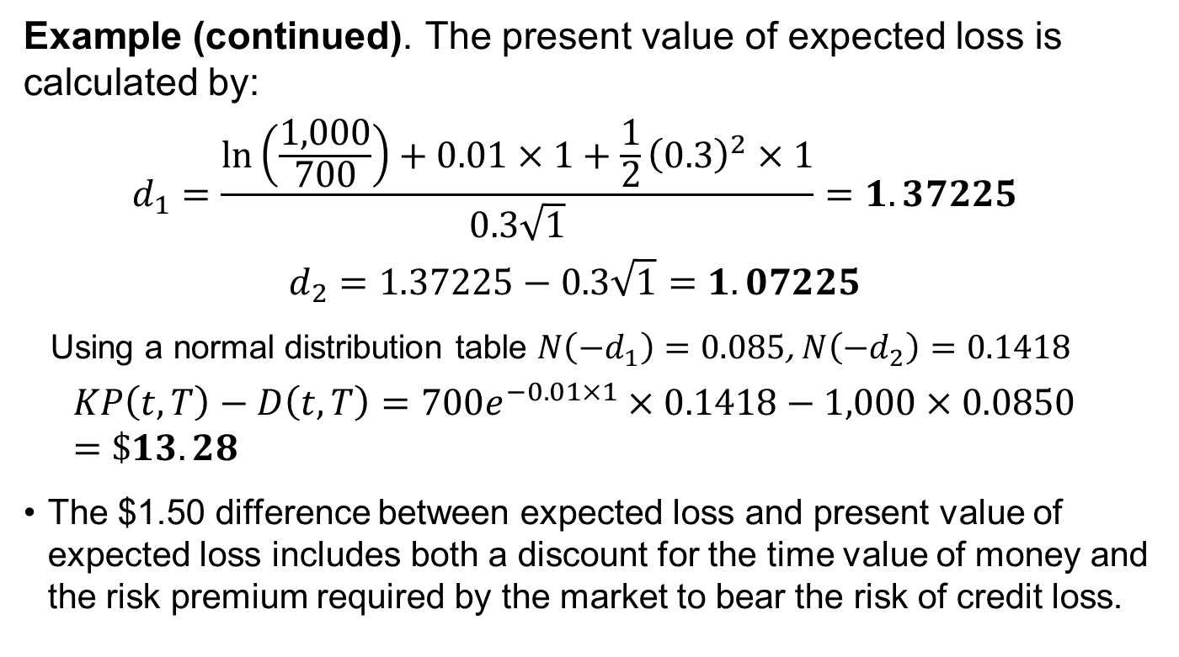
CALCULATING PRESENT VALUE OF EXPECTED LOSS
Example (continued). The present value of expected loss is calculated by:
$$d_{1}=\frac{ln\left(\frac{1,000}{700}\right)+0.01×1+\frac{1}{2}{\left(0.3\right)}^{2}×1}{0.3\sqrt{1}}=1.37225$$
$$d_{2}=1.37225−0.3\sqrt{1}=1.07225$$
Using a normal distribution table $N\left({−d}_{1}\right)=0.085$, $N\left({−d}_{2}\right)=0.1418$
$$KP\left(t,T\right)−D\left(t,T\right)=700e^{−0.01×1}×0.1418−1,000×0.0850=\$13.28$$
The $1.50 difference between expected loss and present value of expected loss includes both a discount for the time value of money and the risk premium required by the market to bear the risk of credit loss.
Notes:
4. Structural models
LOS: Explain structural models of corporate credit risk, including why equity can be viewed as a call option on the company’s assets.
In this case, the present value of the expected loss exceeds the expected loss. This means that the risk premium must dominate the difference because the time-value-of-money discount will reduce the present value of the expected loss compared with the expected loss. In other words, in the absence of a risk premium, the present value of the expected loss will be less than the expected loss.

Slide 17
Strengths and weaknesses of STRUCTURAL MODELS
Strengths:
Optional analogy of a company’s default probability and recovery rate
Estimated using current market prices
Weaknesses:
Balance sheets hard to model
Can be estimated only using implied estimation
Inherit errors in the model’s formulation
Business cycles are not taken into account
Notes:
4. Structural models
LOS: Explain assumptions, strengths, and weaknesses of both structural and reduced form models of corporate credit risk.
Strengths: (i) The structural model provides an option analogy for understanding a company’s default probability and recovery rate and (ii) it can be estimated using only current market prices.
Weaknesses: (i) The default probability and recovery rate depend crucially on the assumed balance sheet of the company, and realistic balance sheets cannot be modeled; (ii) its credit risk measures can be estimated only by using implicit estimation procedures because the company’s asset value is unobservable; (iii) its credit risk measures are biased because implicit estimation procedures inherit errors in the model’s formulation; and (iv) the credit risk measures do not explicitly consider the business cycle.

Slide 18
5. REDUCED FORM MODELS
Reduced form models were originated to overcome a key weakness of the structural model—the assumption that the company’s assets trade.
Reduced form models replace this assumption with a more robust one—that some of the company’s debt trades.
They are called “reduced form models” because they impose their assumptions on the outputs of a structural model—the probability of default and the loss given default—rather than on the balance sheet structure itself.
This change in perspective gives reduced form models tremendous flexibility in matching actual market conditions.
Notes:
5. Reduced form models
LOS: Explain reduced form models of corporate credit risk, including why debt can be valued as the sum of expected discounted cash flows after adjusting for risk.
Reduced form models make the following assumptions:
The company’s zero-coupon bond trades in frictionless markets that are arbitrage free;
The riskless rate of interest, r_{t} , is stochastic;
The state of the economy can be described by a vector of stochastic variables X_{t} that represent the macroeconomic factors influencing the economy at time t;
The company defaults at a random time t, where the probability of default over [t , t + Δ] when the economy is in state X_{t} is given by λ(X)_{t}Δ;
Given the vector of macroeconomic state variables X_{t} a company’s default represents idiosyncratic risk; and
Given default, the percentage loss on the company’s debt is 0 ≤ ι(X_{t}) ≤ 1.

Slide 19
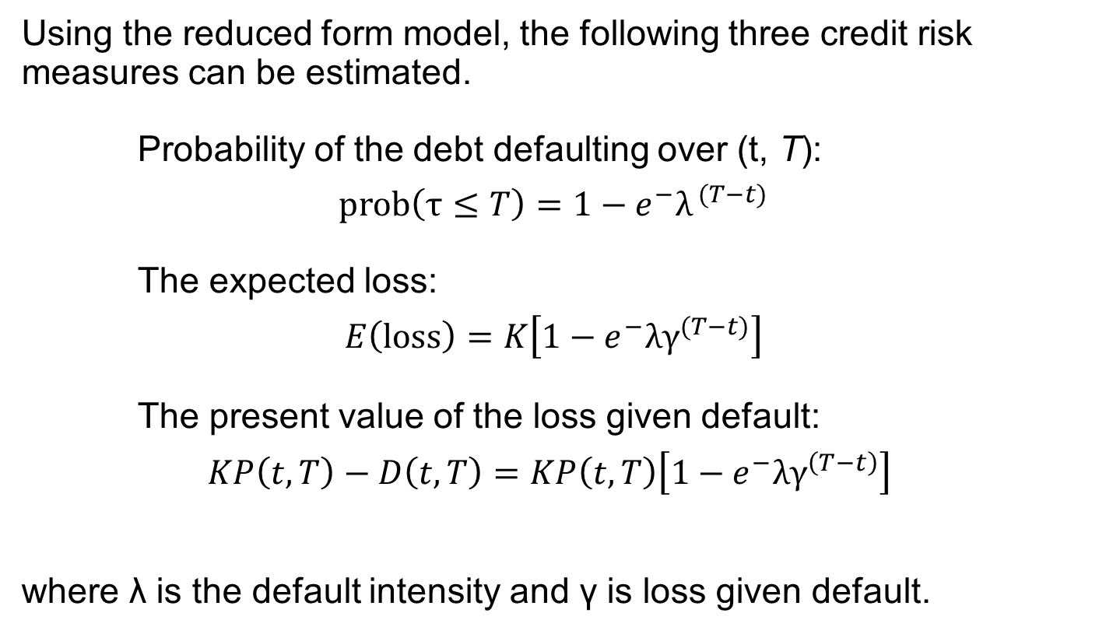
REDUCED FORM MODEL estimations
Using the reduced form model, the following three credit risk measures can be estimated.
Probability of the debt defaulting over (t, T):
$$prob\left(τ≤T\right)=1−{e^{−}λ}^{ (T−t)}$$
The expected loss:
$$E\left(loss\right)=K\left[1−{e^{−}λγ}^{(T−t)}\right]$$
The present value of the loss given default:
$$KP\left(t,T\right)−D\left(t,T\right)=KP\left(t,T\right)\left[{1−e^{−}λγ}^{\left(T−t\right)}\right]$$
where λ is the default intensity and γ is loss given default.
1
2
3
Notes:
5. Reduced form models
LOS: Explain reduced form models of corporate credit risk, including why debt can be valued as the sum of expected discounted cash flows after adjusting for risk.
Default intensity is also known as the approximate probability of default per year.

Slide 20
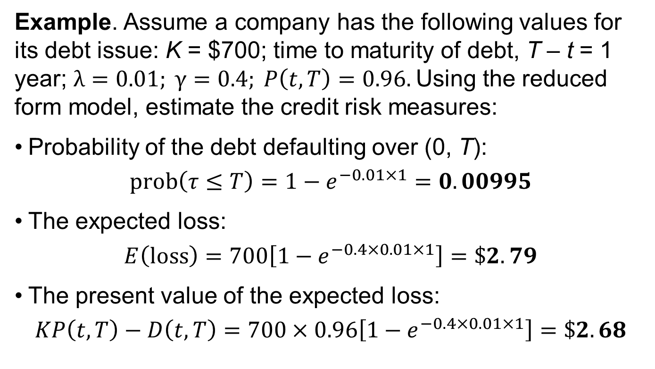
Calculating REDUCED FORM MODELS
Example. Assume a company has the following values for its debt issue: K = $700; time to maturity of debt, T – t = 1 year; $λ=0.01; γ=0.4; P\left(t,T\right)=0.96.$Using the reduced form model, estimate the credit risk measures:
Probability of the debt defaulting over (0, T):
$$prob\left(τ≤T\right)=1−e^{−0.01×1}=0.00995$$
The expected loss:
$$E\left(loss\right)=700\left[1−e^{−0.4×0.01×1}\right]=\$2.79$$
The present value of the expected loss:
$$KP\left(t,T\right)−D\left(t,T\right)=700×0.96\left[{1−e}^{−0.4×0.01×1}\right]=\$2.68$$
Notes:
5. Reduced form models
LOS: Explain reduced form models of corporate credit risk, including why debt can be valued as the sum of expected discounted cash flows after adjusting for risk.
In this case, the present value of the expected loss is less than the expected loss. The time value of money dominates the risk premium.

Slide 21
estimation
Two approaches to estimate a model’s parameters
The implicit approach can be used for both structural and reduced form models. To use implicit estimation, one must completely specify the inputs to the model and the probability distributions for the macroeconomic state variables.
The historical approach can be used only for reduced form models because the economy’s macroeconomic state variables and the company’s debt prices are both observable. Estimating a reduced form model’s parameters using historical estimation is an application of hazard rate estimation.
Notes:
5. Reduced form models
LOS: Explain reduced form models of corporate credit risk, including why debt can be valued as the sum of expected discounted cash flows after adjusting for risk.
Hazard rate estimation is a technique for estimating the probability of a binary event, like default/no default, mortality/no mortality, car crash/no car crash, prepay/no prepay, and so on.

Slide 22
Strengths and weaknesses of REDUCED FORM MODELS
Strengths:
The model inputs are observable
Business cycle is taken into account
No need for specification of balance sheet structure
Weaknesses:
Hard to properly formulate the model and back test it
Notes:
4. Structural models
LOS: Explain assumptions, strengths, and weaknesses of both structural and reduced form models of corporate credit risk.
Strengths: (i) The model’s inputs are observable, so historical estimation procedures can be used for the credit risk measures; (ii) the model’s credit risk measures reflect the changing business cycle; and (iii) the model does not require a specification of the company’s balance sheet structure.
Weaknesses: (i) hazard rate estimation procedures use past observations to predict the future. For this to be valid, the model must be properly formulated and back tested.

Slide 23



Mini-quiz #3
You are estimating a simple regression:
and find that Y = 0.05 + 1.91 X . $R^{2} =0.92$
Now you are asked to estimate the simple regression:
with the same data. What will be $β^{′}$?
$$Y=α+βX+ε$$
X$=α′+β^{′}Y+ε$

Slide 24
6. THE TERM STRUCTURE OF Credit Spreads
The term structure of credit spreads corresponds to the spread between the yields on default-free and credit risky zero-coupon bonds.
Using either the structural or reduced form model, under the frictionless market assumption, the credit spread is entirely due to credit risk.
Credit spread is equal to the difference between the average yields on the risky zero-coupon bond and the riskless zero-coupon bond.
In practical applications, the “true” credit spread will consist of both
Expected percentage loss (as in the structural and reduced form models)
Liquidity risk premium
Notes:
6. The term structure of credit spreads
LOS: Explain the determinants of the term structure of credit spreads.
The credit spread is equal to the expected percentage loss per year on the risky zero-coupon bond: $y_{D}\left(t,T\right)−y_{p}\left(t,T\right)=λγ$
“True” credit spread: $y_{D}\left(t,T\right)−y_{p}\left(t,T\right)=E\left(Percentage loss\right)+Liquidity premium$

Slide 25
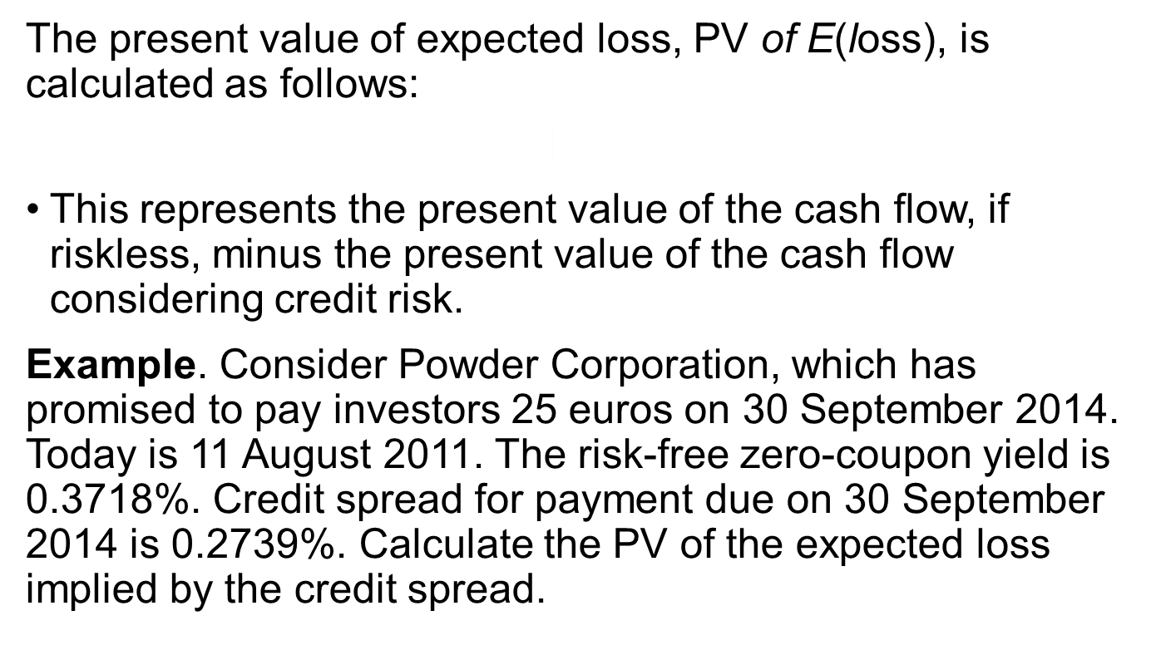
Computing the present value of expected loss using THE TERM STRUCTURE OF Credit Spreads
The present value of expected loss, PV of E(loss), is calculated as follows:
$$PV of E\left(loss\right)=\left[P\left(t,T\right)−D\left(t,T\right)\right]X_{T}$$
This represents the present value of the cash flow, if riskless, minus the present value of the cash flow considering credit risk.
Example. Consider Powder Corporation, which has promised to pay investors 25 euros on 30 September 2014. Today is 11 August 2011. The risk-free zero-coupon yield is 0.3718%. Credit spread for payment due on 30 September 2014 is 0.2739%. Calculate the PV of the expected loss implied by the credit spread.
Notes:
6. The term structure of credit spreads
LOS: Calculate and interpret the present value of the expected loss on a bond over a given time horizon.

Slide 26
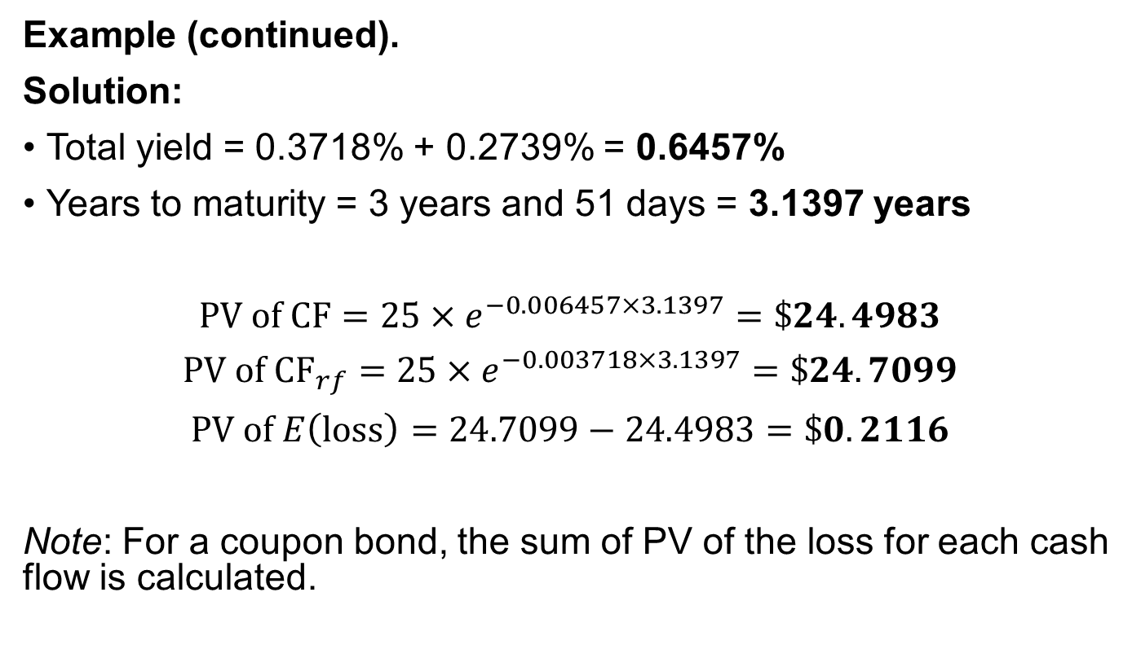
Computing the present value of expected loss using THE TERM STRUCTURE OF Credit Spreads
Example (continued).
Solution:
Total yield = 0.3718% + 0.2739% = 0.6457%
Years to maturity = 3 years and 51 days = 3.1397 years
$$PV of CF=25×e^{−0.006457×3.1397}=\$24.4983$$
$$PV of {CF}_{rf}=25×e^{−0.003718×3.1397}=\$24.7099$$
$$PV of E\left(loss\right)=24.7099−24.4983=\$0.2116$$
Note: For a coupon bond, the sum of PV of the loss for each cash flow is calculated.
Notes:
6. The term structure of credit spreads
LOS: Calculate and interpret the present value of the expected loss on a bond over a given time horizon.
PV of CF = D(t/T) × X_{t}
PV of CF_{rf} = P(t/T) × X_{t}

Slide 27
7. ASSET-BACKED SECURITIES
An asset-backed security (ABS) is a type of bond issued by a legal entity called a “special purpose vehicle” (SPV).
An SPV is formed to own a collection of assets, called its “collateral pool.”
The collateral pool usually consists of a collection of loans of a particular type.
Unlike corporate debt, an asset-backed security does not default when an interest payment is missed.
Notes:
7. Special considerations on high-yield, sovereign, and non-sovereign credit analysis
LOS: Compare the credit analysis required for asset-backed securities to analysis of corporate debt.
A default in the collateral pool does not cause a default to either the SPV or a bond tranche.
For an ABS, the bond continues to trade until either its maturity date or all of its face value is eliminated because of the accumulated losses in the collateral pool or through early loan prepayments.
Because of the complexity of the cash flows to an ABS, they are better characterized as credit derivatives than simple bonds.

Slide 28
Measures for ASSET-BACKED SECURITIES
The credit risk measures used for corporate or sovereign bonds can be applied.
Probability of loss
Expected loss
Present value of the expected loss
In ABS, the probability of default does not apply, so it is replaced by the probability of loss.
To calculate these measures, a model analogous to those used for corporate and sovereign debt is used.
However, the calculations are much more complex.
Notes:
7. Special considerations on high-yield, sovereign, and non-sovereign credit analysis
LOS: Compare the credit analysis required for asset-backed securities to analysis of corporate debt.
With respect to the credit ratings of ABS, the credit-rating agencies use the same rating scale as that used for corporate and sovereign debt, although the fact that they are structured debt is always noted.
Given the complexity of ABS, the use of the same credit rating scales may be inappropriate.

Slide 29
8. SUMMARY
Credit measures of a bond
There are four credit risk measures of a bond: the probability of default, the loss given default, the expected loss, and the present value of the expected loss.
The present value of the expected loss is the most important because it incorporates an adjustment for risk and the time value of money.
Credit scoring and credit ratings
Credit scoring and credit ratings are traditional approaches to credit risk assessment and are used to rank retail borrowers versus companies, governments, and structured products.
Notes:
LOS: Explain probability of default, loss given default, expected loss, and present value of the expected loss, and describe the relative importance of each across the credit spectrum.
LOS: Explain credit scoring and credit ratings, including why they are called ordinal rankings.

Slide 30
SUMMARY
Structural models of corporate credit risk
Structural models of credit risk assume a simple balance sheet for the company consisting of a single liability, a zero-coupon bond.
In a structural model, the company’s equity can be viewed as a European call option on the assets of the company, with a strike price equal to the debt’s face value.
Reduced form models of corporate credit risk
Reduced form models of credit risk consider a company’s traded liabilities.
Using option pricing methodology, reduced form models provide insights into the debt’s expected loss and the present value of the expected loss.
Notes:
LOS: Explain structural models of corporate credit risk, including why equity can be viewed as a call option on the company’s assets.
LOS: Explain reduced form models of corporate credit risk, including why debt can be valued as the sum of expected discounted cash flows after adjusting for risk.

Slide 31
SUMMARY
Determinants of the term structure of credit spreads
The term structure of credit spreads is the difference between yields on risky bonds and default-free zero-coupon bonds.
These yields can be estimated from the market prices of traded coupon bonds of both types.
Present value of the expected loss
The present value of the expected loss on any bond can be estimated using the term structure of credit spreads.
Notes:
LOS: Explain the determinants of the term structure of credit spreads.
LOS: Calculate and interpret the present value of the expected loss on a bond over a given time horizon.

Slide 32
SUMMARY
Credit analysis required for asset-backed securities
Asset-backed securities (ABS) are liabilities issued by a special purpose vehicle (SPV). The SPV’s assets, called a “collateral pool,” consist of a collection of loans.
ABS do not default, but they can lose value as the SPV’s collateral pool incurs defaults. Modeling an ABS’s credit risk—the probability of loss, the loss given default, the expected loss, and the present value of the loss—is a complex exercise.
Notes:
LOS: Compare the credit analysis required for asset-backed securities to analysis of corporate debt.

