Slide 1
Fixed Income analysis Lecture 8
Tony Zhang
Fall 2019
© 2016 CFA Institute. All rights reserved.

Slide 2
Agenda
Credit Derivative and Methods
Credit Default Swap
Collateralized Debt Obligation
Copula

Slide 3
Credit Default Swap (CDS)
Credit default swaps allow one party to "buy" protection from another party for losses that might be incurred as a result of default by a specified reference credit (or credits).
The "buyer" of protection pays a premium for the protection, and the "seller" of protection agrees to make a payment to compensate the buyer for losses incurred upon the occurrence of any one of several specified "credit events."

Slide 4
Example
Suppose Bank A buys a bond which issued by a Steel Company.
To hedge the default of Steel Company:
Bank A buys a credit default swap from Insurance Company C.
Bank A pays a fixed periodic payments to C, in exchange for default protection.

Slide 5
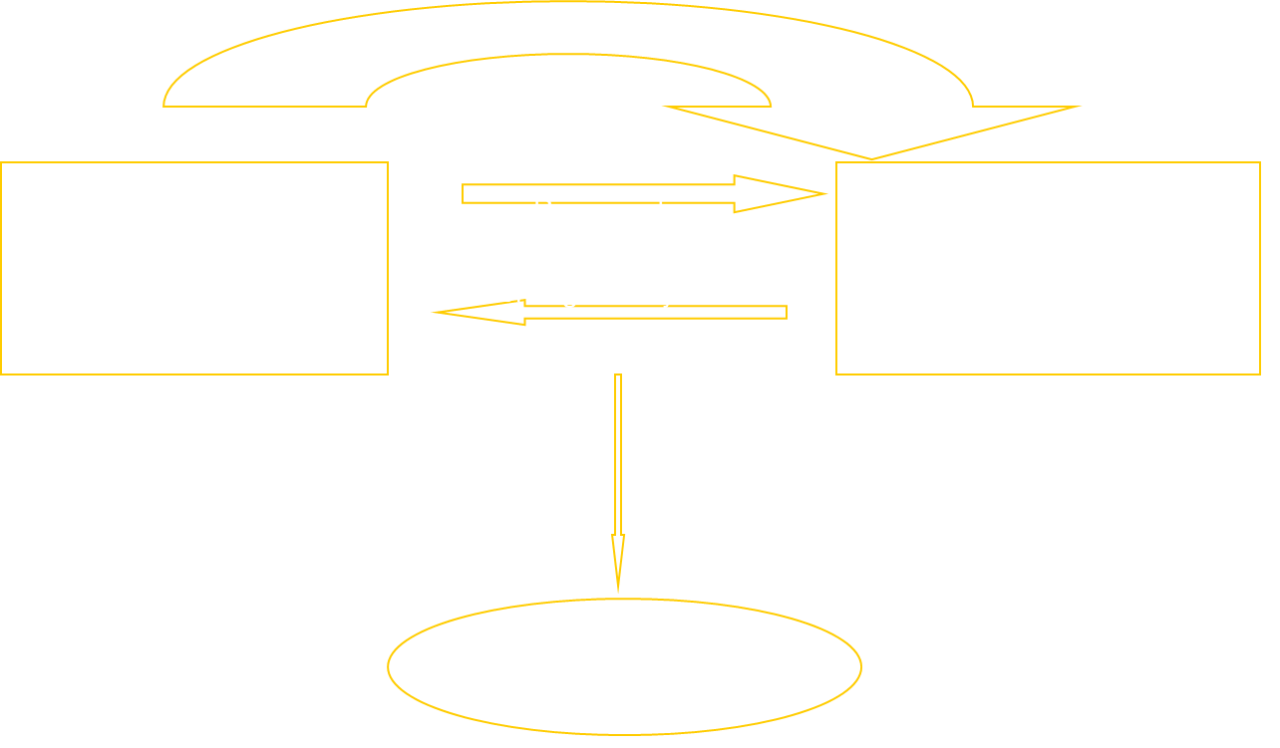
Example

Slide 6
Attractions of the CDS
Allows credit risks to be traded in the same way as market risks
Can be used to transfer credit risks to a third party
Can be used to diversify credit risks

Slide 7
Using a CDS to Hedge a Bond Position
Portfolio consisting of a 5-year par yield corporate bond that provides a yield of 6% and a long position in a 5-year CDS costing 100 basis points per year is (approximately) a long position in a riskless instrument paying 5% per year
This shows that bond yield spreads (measured relative to LIBOR) should be close to CDS spreads

Slide 8
CDS Valuation
Hazard rate for reference entity is 2%.
Assume payments are made annually in arrears, that defaults always happen half way through a year, and that the expected recovery rate is 40%, risk free rate 5%
Suppose that the breakeven CDS rate is s per dollar of notional principal

Slide 9
Unconditional Default and Survival Probabilities
Time (years) | Survival Probability | Default Probability
1 | 0.9802 | 0.0198
2 | 0.9608 | 0.0194
3 | 0.9418 | 0.0190
4 | 0.9231 | 0.0186
5 | 0.9048 | 0.0183

Slide 10
Calculation of PV of Payments
Time (yrs) | Survival Prob | Expected Payment | Discount Factor | PV of Exp Pmt
1 | 0.9802 | 0.9802s | 0.9512 | 0.9324s
2 | 0.9608 | 0.9608s | 0.9048 | 0.8694s
3 | 0.9418 | 0.9418s | 0.8607 | 0.8106s
4 | 0.9231 | 0.9231s | 0.8187 | 0.7558s
5 | 0.9048 | 0.9048s | 0.7788 | 0.7047s
Total |  |  |  | 4.0728s

Slide 11
Present Value of Expected Payoff
Time (yrs) | Default Probab. | Rec. Rate | Expected Payoff | Discount Factor | PV of Exp. Payoff
0.5 | 0.0198 | 0.4 | 0.0119 | 0.9753 | 0.0116
1.5 | 0.0194 | 0.4 | 0.0116 | 0.9277 | 0.0108
2.5 | 0.0190 | 0.4 | 0.0114 | 0.8825 | 0.0101
3.5 | 0.0186 | 0.4 | 0.0112 | 0.8395 | 0.0094
4.5 | 0.0183 | 0.4 | 0.0110 | 0.7985 | 0.0088
Total |  |  |  |  | 0.0506

Slide 12
Putting it all together
PV of expected payments is 4.0728s
The breakeven CDS spread is given by
4.0728s = 0.0506 or s = 0.0124 (124 bps)

Slide 13
Implying Default Probabilities from CDS spreads
Suppose that the mid market spread for a 5 year newly issued CDS is 100bps per year
We can reverse engineer our calculations to conclude that the hazard is 1.63% per year.
Is this 1.63% risk neutral default rate or real world default rate?

Slide 14
Mini-Quiz #1
Suppose risk free rate is 5% per year with continuous compounding. There is a 2-year credit default swap with 30% recovery rate and default probability each year conditional on no earlier default is 3%. Estimate the credit default swap spread. Assume payments are made annually and defaults can occur at the end of each year.

Slide 15
Break

Slide 16
Asset Backed Securities
Securities created from a portfolio of loans, bonds, credit card receivables, mortgages, auto loans, aircraft leases, music royalties, etc
Usually the income from the assets is tranched
A “waterfall” defines how income is first used to pay the promised return to the senior tranche, then to the next most senior tranche, and so on.

Slide 17
Collateralized Debt Obligations
A cash CDO is an ABS where the underlying assets are debt obligations
A synthetic CDO involves forming a similar structure with short CDS contracts
In a synthetic CDO most junior tranche bears losses first. After it has been wiped out, the second most junior tranche bears losses, and so on

Slide 18
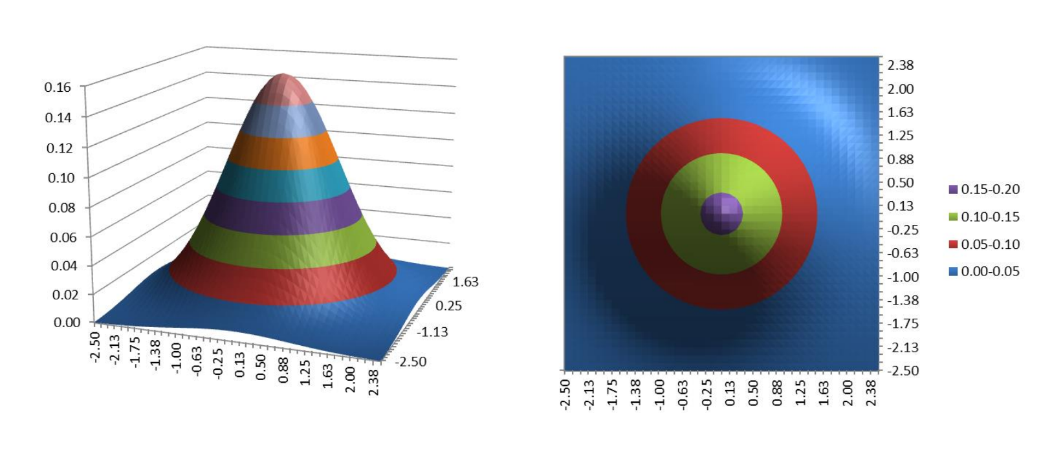
Multivariate Distributions

Slide 19
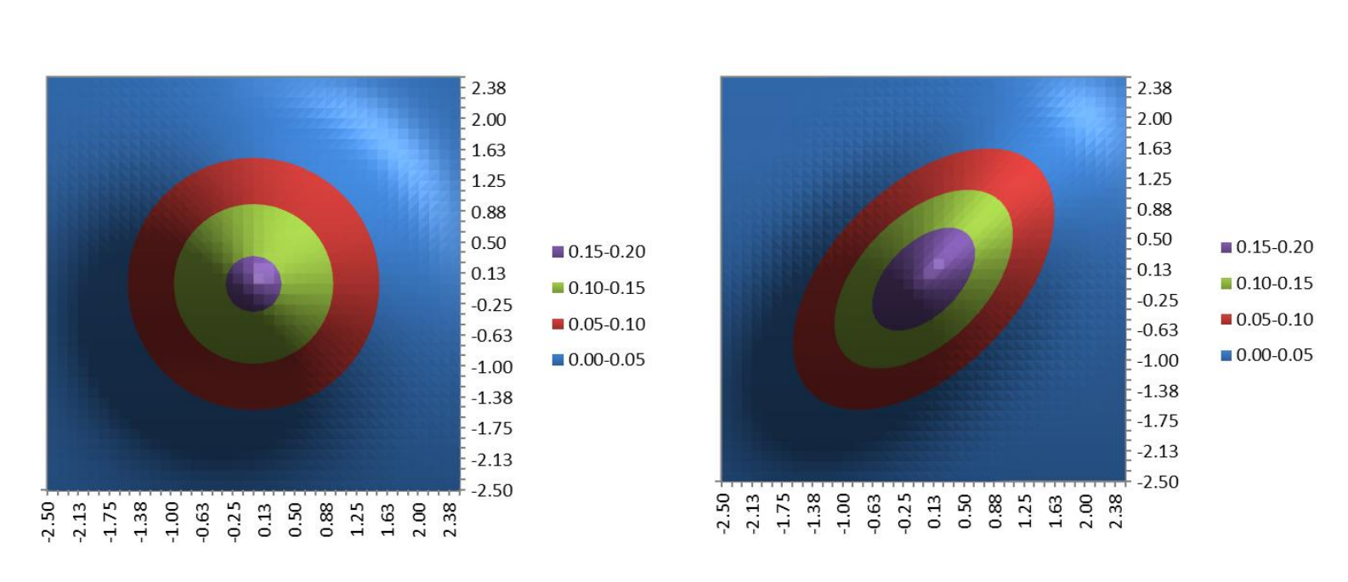
Multivariate Distributions
No Correlation vs. Correlation

Slide 20
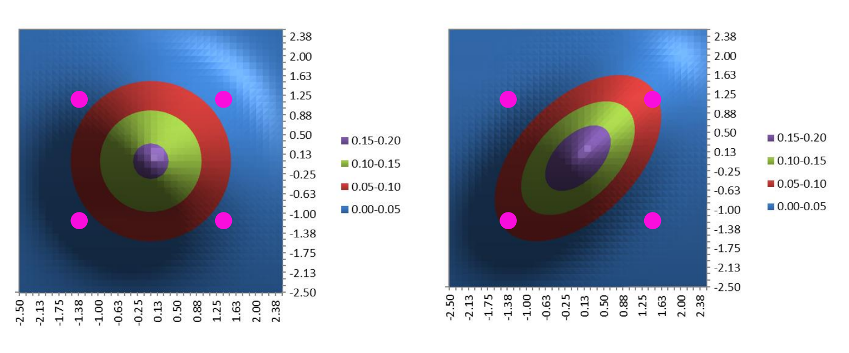
Multivariate Distributions
No Correlation vs. Correlation

Slide 21
Mini-Quiz #2
What would the multivariate distribution look like for two variables with +100% correlation?
-100%?

Slide 22
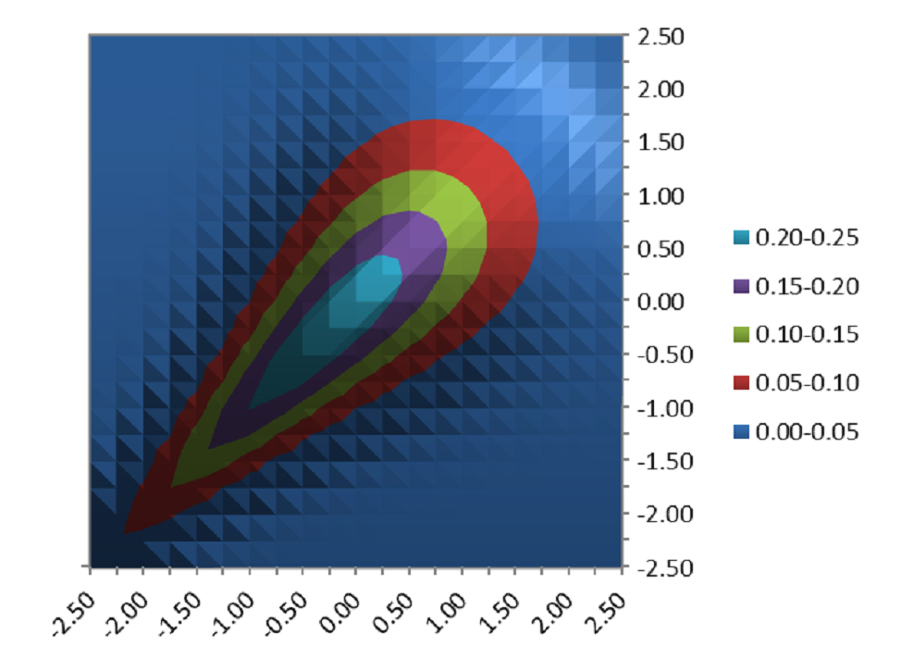
Copula
Clayton Copula

Slide 23
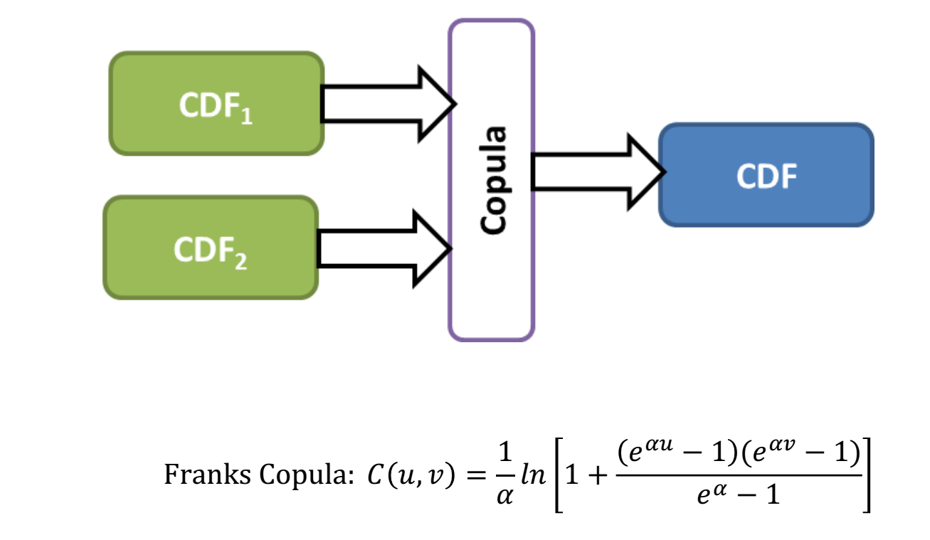
Copula

Slide 24
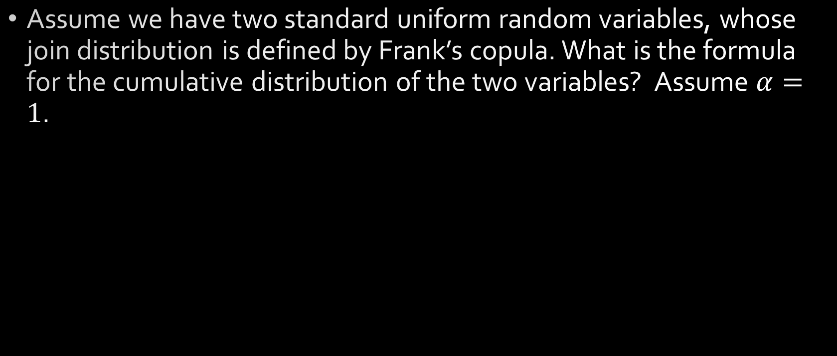
Mini-Quiz #3
Assume we have two standard uniform random variables, whose join distribution is defined by Frank’s copula. What is the formula for the cumulative distribution of the two variables? Assume $α=1$.

Slide 25
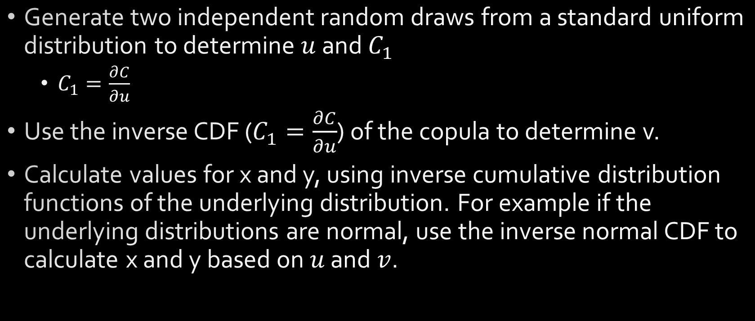
Monte-Carlo Simulation in Copula
Generate two independent random draws from a standard uniform distribution to determine $u$ and $C_{1}$
$C_{1}=\frac{∂C}{∂u}$
Use the inverse CDF ($C_{1}=\frac{∂C}{∂u}$) of the copula to determine v.
Calculate values for x and y, using inverse cumulative distribution functions of the underlying distribution. For example if the underlying distributions are normal, use the inverse normal CDF to calculate x and y based on $u$ and $v$.

Slide 26
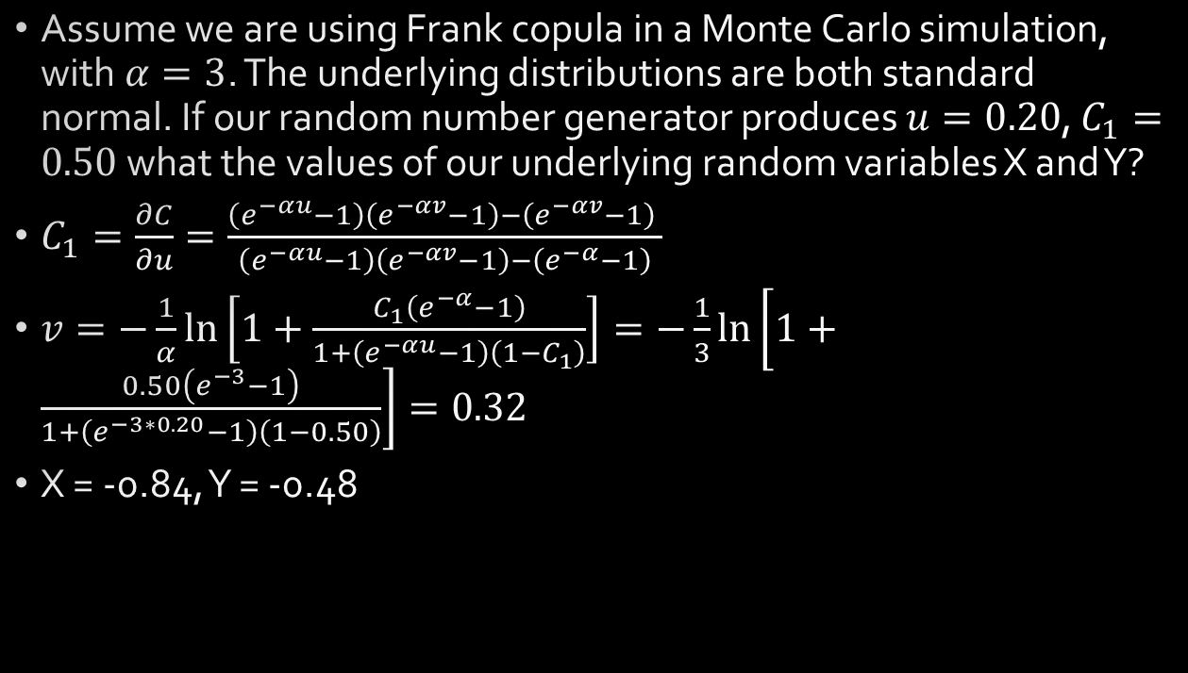
Example
Assume we are using Frank copula in a Monte Carlo simulation, with $α=3$. The underlying distributions are both standard normal. If our random number generator produces $u=0.20$, $C_{1}=0.50$what the values of our underlying random variables X and Y?
$C_{1}=\frac{∂C}{∂u}=\frac{\left(e^{−αu}−1\right)\left(e^{−αv}−1\right)−\left(e^{−αv}−1\right) }{\left(e^{−αu}−1\right)\left(e^{−αv}−1\right)−\left(e^{−α}−1\right)}$
$v=−\frac{1}{α}\ln\left[1+\frac{C_{1}\left(e^{−α}−1\right)}{1+\left(e^{−αu}−1\right)\left(1−C_{1}\right)}\right]=−\frac{1}{3}\ln\left[1+\frac{0.50\left(e^{−3}−1\right)}{1+\left(e^{−3∗0.20}−1\right)\left(1−0.50\right)}\right]=0.32$
X = -0.84, Y = -0.48

Slide 27
Copula
Pros
Very flexible
Used in Structured products
Cons
Math is complicated
Not Intuitive

Slide 28
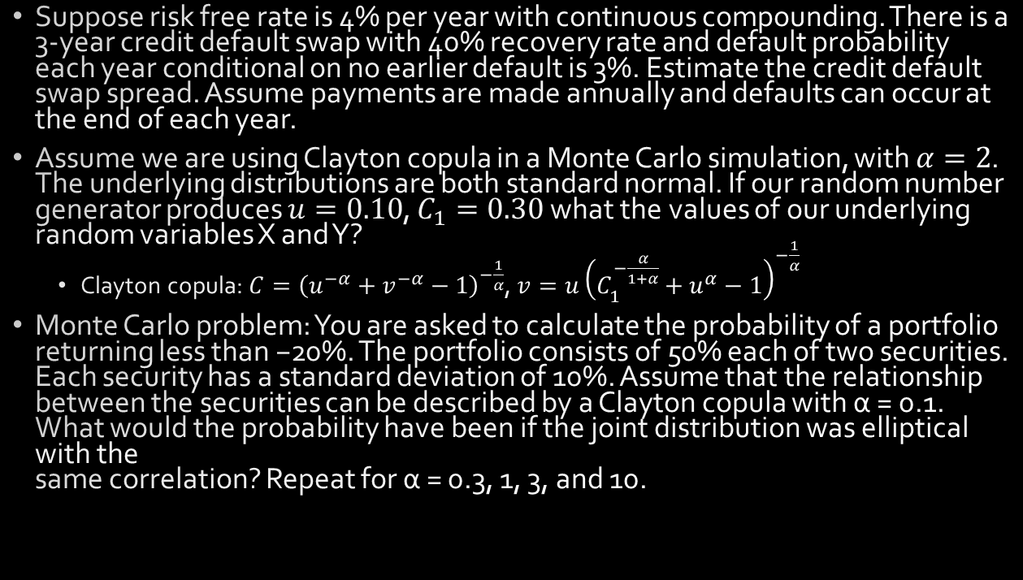
Homework
Suppose risk free rate is 4% per year with continuous compounding. There is a 3-year credit default swap with 40% recovery rate and default probability each year conditional on no earlier default is 3%. Estimate the credit default swap spread. Assume payments are made annually and defaults can occur at the end of each year.
Assume we are using Clayton copula in a Monte Carlo simulation, with $α=2$. The underlying distributions are both standard normal. If our random number generator produces $u=0.10$, $C_{1}=0.30$what the values of our underlying random variables X and Y?
Clayton copula: $C={\left(u^{−α}+v^{−α}−1\right)}^{−\frac{1}{α}}$, $v=u{\left(C_{1}^{−\frac{α}{1+α}}+u^{α}−1\right)}^{−\frac{1}{α}}$
Monte Carlo problem: You are asked to calculate the probability of a portfolio returning less than −20%. The portfolio consists of 50% each of two securities. Each security has a standard deviation of 10%. Assume that the relationship between the securities can be described by a Clayton copula with α = 0.1. What would the probability have been if the joint distribution was elliptical with the same correlation? Repeat for α = 0.3, 1, 3, and 10.

