Slide 1
FIXED INCOME ANALYSIS
FALL 2019

Slide 2
Agenda
Ask the Fed
Intro to Machine Learning

Slide 3
AI & Machine Learning
Will AI replace us in the future?
Two types of jobs:
Research, Design and develop AI tools
Help and maintenance of AI, e.g.
Mechanical engineers and maintenance technicians
Manufacturing and electrical engineers
Surgical technicians working with robotic tools

Slide 4
Machine Learning
Machine learning is programming computers to optimize a performance criterion using example data or past experience.
There is no need to “learn” to calculate payroll
Learning is used when:
Human expertise does not exist (navigating on Mars)
Humans are unable to explain their expertise (speech recognition)
Solution changes in time (routing on a computer network)
Solution needs to be adapted to particular cases (user biometrics)

Slide 5
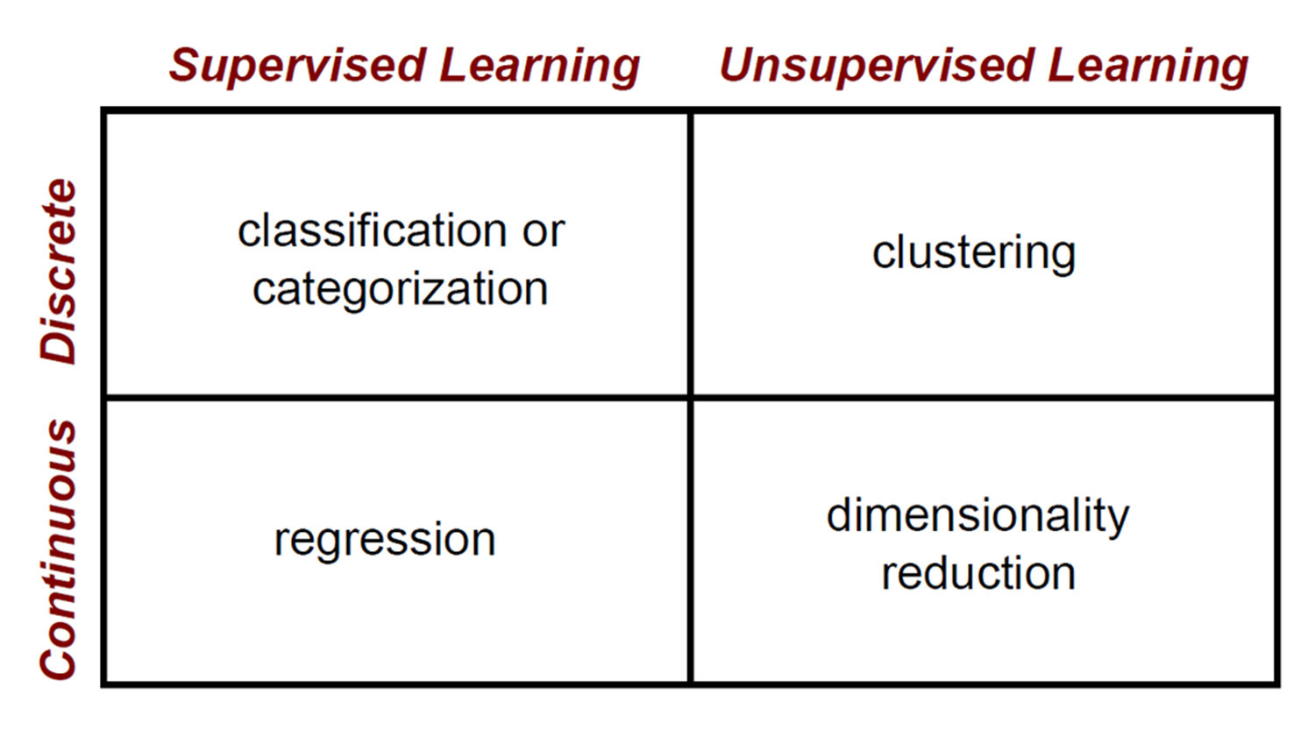
Machine Learning

Slide 6



Machine Learning
Apply a prediction function to a feature representation of the image to get the desired output:
f( ) = “apple”
f( ) = “tomato”
f( ) = “cow”

Slide 7
Machine Learning
y = f(x)
Training: given a training set of labeled examples {(x₁,y₁), …, (x_{N},y_{N})}, estimate the prediction function f by minimizing the prediction error on the training set
Testing: apply f to a never before seen test example x and output the predicted value y = f(x)
output
prediction function
Image feature

Slide 8
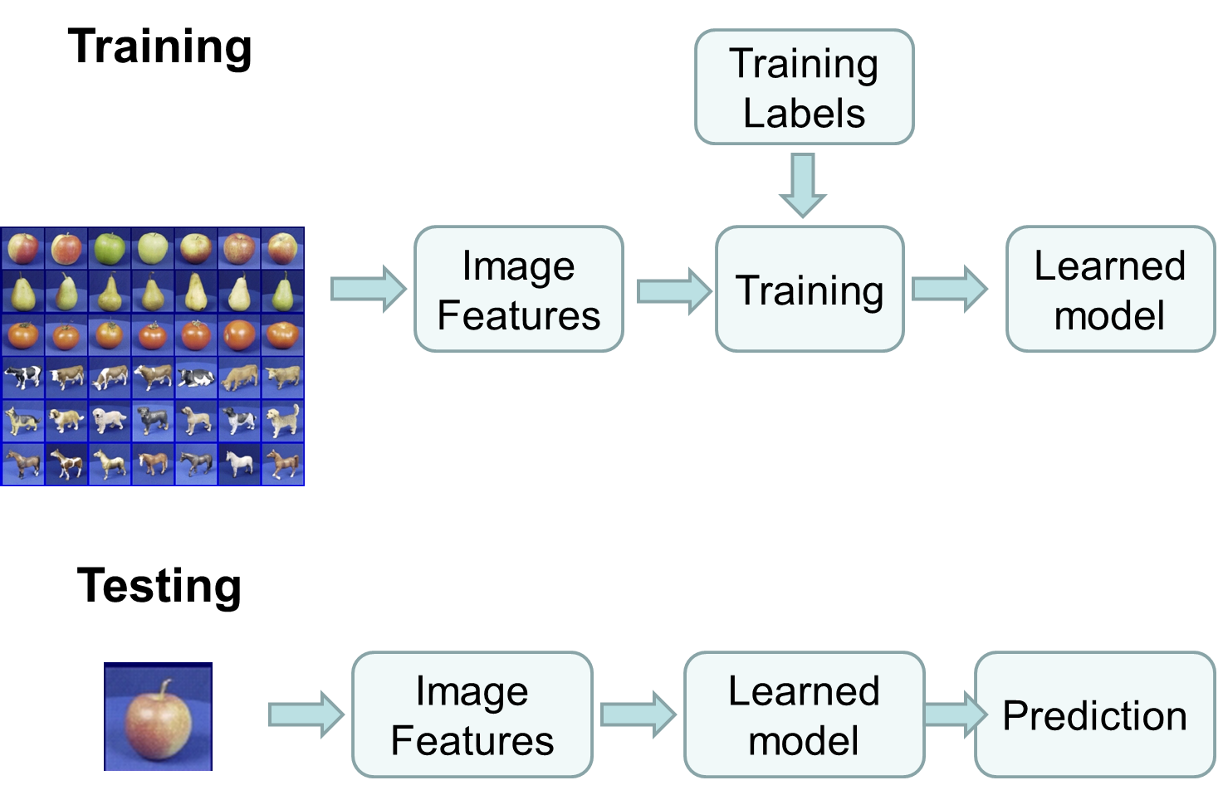
Machine Learning
Training Images
Test Images

Slide 9
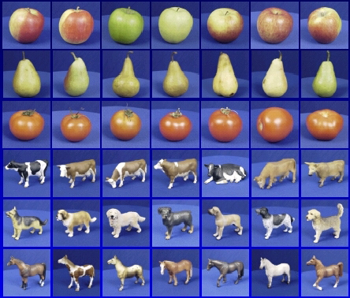

Generalization
Training set (labels known)
Test set (labels unknown)
How well does a learned model generalize from the data it was trained on to a new test set?
Slide credit: L. Lazebnik

Slide 10
Generalization
Components of generalization error
Bias: how much the average model over all training sets differ from the true model?
Error due to inaccurate assumptions/simplifications made by the model
Variance: how much models estimated from different training sets differ from each other
Underfitting: model is too “simple” to represent all the relevant class characteristics
High bias and low variance
High training error and high test error
Overfitting: model is too “complex” and fits irrelevant characteristics (noise) in the data
Low bias and high variance
Low training error and high test error
Slide credit: L. Lazebnik

Slide 11
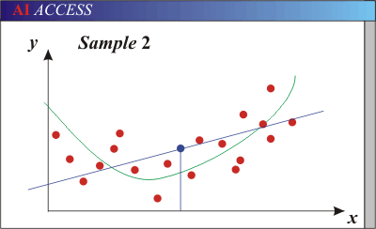
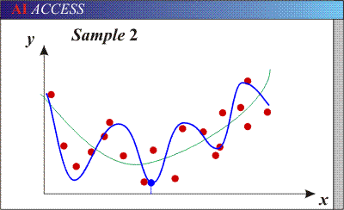
Bias-Variance Trade-off
Models with too few parameters are inaccurate because of a large bias (not enough flexibility).
Models with too many parameters are inaccurate because of a large variance (too much sensitivity to the sample).
Slide credit: D. Hoiem
Notes:
http://www.aiaccess.net/English/Glossaries/GlosMod/e_gm_bias_variance.htm

Slide 12
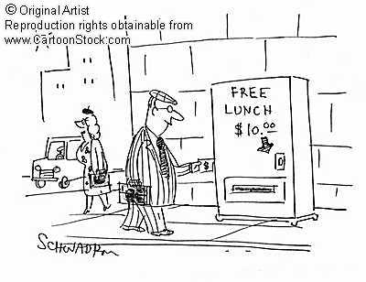
No Free Lunch Theorem
Notes:
You can only get generalization through assumptions.

Slide 13
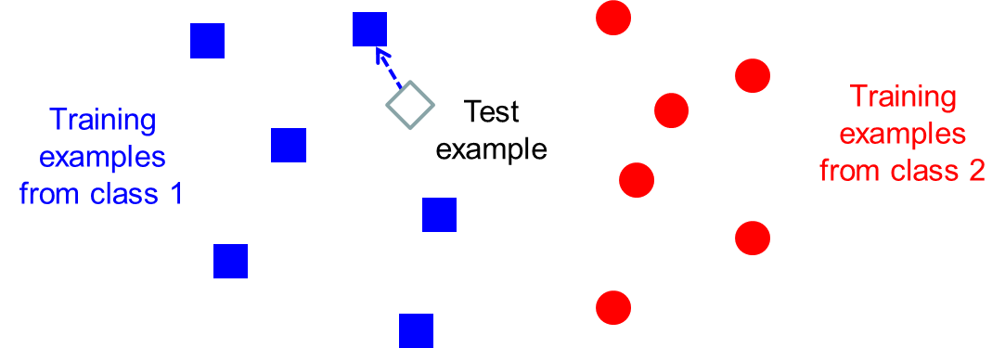
Classifiers: Nearest neighbor
f(x) = label of the training example nearest to x
All we need is a distance function for our inputs
No training required!

Slide 14
Classifiers: Linear
Find a linear function to separate the classes:
f(x) = sgn(w ⋅ x + b)
Slide credit: L. Lazebnik

Slide 15
Many classifiers to choose from
SVM
Neural networks
Naïve Bayes
Bayesian network
Logistic regression
Randomized Forests
Boosted Decision Trees
K-nearest neighbor
RBMs
Etc.
Which is the best one?
Slide credit: D. Hoiem

Slide 16
Very brief tour of some classifiers
K-nearest neighbor
SVM
Boosted Decision Trees
Neural networks
Naïve Bayes
Bayesian network
Logistic regression
Randomized Forests
RBMs
Etc.

Slide 17
Classification
Assign input vector to one of two or more classes
Any decision rule divides input space into decision regions separated by decision boundaries
Slide credit: L. Lazebnik

Slide 18
K-nearest neighbor
x
x
x
o
x
x
x
+
o
o
x
x
o
o
+
o
o
x2
x1

Slide 19
1-nearest neighbor
x
x
x
o
x
x
x
+
o
o
x
x
o
o
+
o
o
x2
x1

Slide 20
3-nearest neighbor
x
x
x
o
x
x
x
+
o
o
x
x
o
o
+
o
o
x2
x1

Slide 21
5-nearest neighbor
x
x
x
o
x
x
x
+
o
o
x
x
o
o
+
o
o
x2
x1

Slide 22
Classifiers: Linear SVM
x
x
x
x
x
x
o
x
x
o
o
o
o
x2
x1
Find a linear function to separate the classes:
f(x) = sgn(w ⋅ x + b)

Slide 23
Classifiers: Linear SVM
x
x
x
x
x
x
o
x
x
o
o
o
o
x2
x1
Find a linear function to separate the classes:
f(x) = sgn(w ⋅ x + b)
Notes:
Maximizes a margin

Slide 24
Classifiers: Linear SVM
x
x
x
o
x
x
x
o
x
x
o
o
o
o
x2
x1
Find a linear function to separate the classes:
f(x) = sgn(w ⋅ x + b)

Slide 25
Nonlinear SVMs
Datasets that are linearly separable work out great:
But what if the dataset is just too hard?
We can map it to a higher-dimensional space:
0
x
0
x
x²
0
x

Slide 26
Nonlinear SVMs
General idea: the original input space can always be mapped to some higher-dimensional feature space where the training set is separable:
Φ: x → φ(x)

Slide 27
Nonlinear SVMs
The kernel trick: instead of explicitly computing the lifting transformation φ(x), define a kernel function K such that K(x_{i} , x_{j}) = φ(x_{i} ) · φ(x_{j})
(to be valid, the kernel function must satisfy Mercer’s condition)
This gives a nonlinear decision boundary in the original feature space:
C. Burges, A Tutorial on Support Vector Machines for Pattern Recognition, Data Mining and Knowledge Discovery, 1998

Slide 28
Nonlinear kernel: Example
Consider the mapping
x²

Slide 29
SVMs: Pros and cons
Pros
Many publicly available SVM packages: http://www.kernel-machines.org/software
Kernel-based framework is very powerful, flexible
SVMs work very well in practice, even with very small training sample sizes
Cons
No “direct” multi-class SVM, must combine two-class SVMs
Computation, memory
During training time, must compute matrix of kernel values for every pair of examples
Learning can take a very long time for large-scale problems

