Slide 1
Chapter 5
Errors
Thiago W. Alves
Based (Heavily) on Material From:
Bjarne Stroustrup
www.stroustrup.com/Programming

Slide 2
Abstract
When we program, we have to deal with errors. Our most basic aim is correctness, but we must deal with incomplete problem specifications, incomplete programs, and our own errors. Here, we’ll concentrate on a key area: how to deal with unexpected function arguments. We’ll also discuss techniques for finding errors in programs: debugging and testing.
FE 522 C++ Programming in Finance

Slide 3
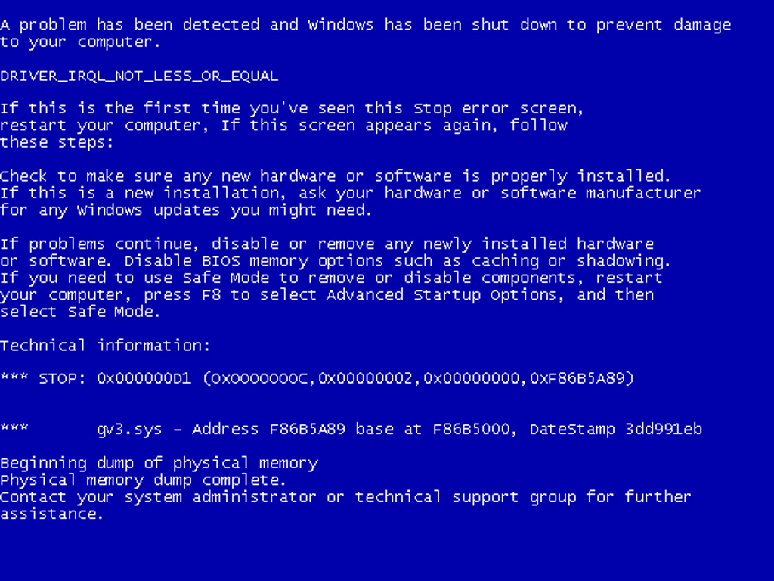
Overview
Kinds of errors
Argument checking
  Error reporting
  Error detection
  Exceptions
Debugging
Testing
FE 522 C++ Programming in Finance

Slide 4
Errors
“ … I realized that from now on a large part of my life would be spent finding and correcting my own mistakes.”
  Maurice Wilkes, 1949
When we write programs, errors are natural and unavoidable; the question is, how do we deal with them?
  Organize software to minimize errors.
  Eliminate most of the errors we made anyway.
    Debugging
    Testing
  Make sure the remaining errors are not serious.
Avoiding, finding, and correcting errors is 95% or more of the effort for serious software development.
  You can do much better for small programs.
    or worse, if you’re sloppy
FE 522 C++ Programming in Finance

Slide 5
Your Program
Should produce the desired results for all legal inputs
Should give reasonable error messages for illegal inputs
Need not worry about misbehaving hardware
Need not worry about misbehaving system software
Is allowed to terminate after finding an error
3, 4, and 5 are true for beginner’s code; often, we have to worry about those in real software.
FE 522 C++ Programming in Finance

Slide 6
Sources of errors
Poor specification
  “what’s this supposed to do?”
Incomplete programs
  “but I’ll not get around to doing that until tomorrow”
Unexpected arguments
  “but sqrt() isn’t supposed to be called with -1 as its argument”
Unexpected input
  “but the user was supposed to input an integer”
Code that simply doesn’t do what it was supposed to do
  “so fix it!”
FE 522 C++ Programming in Finance

Slide 7
Kinds of Errors
Compile-time errors
  Syntax errors
  Type errors
Link-time errors
Run-time errors
  Detected by computer (crash)
  Detected by library (exceptions)
  Detected by user code
Logic errors
  Detected by programmer (code runs, but produces incorrect output)
FE 522 C++ Programming in Finance

Slide 8
Check your inputs
Before trying to use an input value, check that it meets your expectations/requirements
  Function arguments
  Data from input (istream)
FE 522 C++ Programming in Finance

Slide 9
Bad function arguments
The compiler helps:
  Number and types of arguments must match
  int area(int length, int width)
  {
  return length*width;
  }
  int x1 = area(7); // error: wrong number of arguments
  int x2 = area("seven", 2); // error: 1st argument has a wrong type
  int x3 = area(7, 10); // ok
  int x5 = area(7.5, 10); // ok, but dangerous: 7.5 truncated to 7;
  // most compilers will warn you
  int x = area(10, -7); // this is a difficult case:
  // the types are correct,
  // but the values make no sense
FE 522 C++ Programming in Finance

Slide 10
Bad Function Arguments
So, how about int x = area(10, -7); ?
Alternatives
  Just don’t do that
    Rarely a satisfactory answer
  The caller should check
    Hard to do systematically
  The function should check
    Return an “error value” (not general, problematic)
    Set an error status indicator (not general, problematic – don’t do this)
    Throw an exception
Note: sometimes we can’t change a function that handles errors in a way we do not like
  Someone else wrote it and we can’t or don’t want to change their code
FE 522 C++ Programming in Finance

Slide 11
Bad function arguments
Why worry?
  You want your programs to be correct
  Typically the writer of a function has no control over how it is called
    Writing “do it this way” in the manual (or in comments) is no solution – many people don’t read manuals
  The beginning of a function is often a good place to check
    Before the computation gets complicated
When to worry?
  If it doesn’t make sense to test every function, test some
FE 522 C++ Programming in Finance

Slide 12
How to report an error
Return an “error value” (not general, problematic)
    int area(int length, int width) // return a negative value for bad input
    {
    if(length <=0 || width <= 0) return -1;
    return length*width;
    }
So, “let the caller beware”
  int z = area(x,y);
  if (z<0) error("bad area computation");
  // …
Problems
  What if I forget to check that return value?
  For some functions there isn’t a “bad value” to return (e.g., max())
FE 522 C++ Programming in Finance

Slide 13
How to report an error
Set an error status indicator (not general, problematic, don’t!)
    int errno = 0; // used to indicate errors
    int area(int length, int width)
    {
    if (length<=0 || width<=0) errno = 7; // || means or
    return length*width;
    }
So, “let the caller check”
  int z = area(x,y);
  if (errno==7) error("bad area computation");
  // …
Problems
  What if I forget to check errno?
  How do I pick a value for errno that’s different from all others?
  How do I deal with that error?
FE 522 C++ Programming in Finance

Slide 14
How to report an error
Report an error by throwing an exception
    class Bad_area { }; // a class is a user defined type
    // Bad_area is a type to be used as an exception
    int area(int length, int width)
    {
    if (length<=0 || width<=0) throw Bad_area{}; // note the {} – a value
    return length*width;
    }
Catch and deal with the error (e.g., in main())
    try {
    int z = area(x,y); // if area() doesn’t throw an exception
    } // make the assignment and proceed
    catch(Bad_area) { // if area() throws Bad_area{}, respond
    cerr << "oops! Bad area calculation – fix program\n";
    }
FE 522 C++ Programming in Finance

Slide 15
Exceptions
Exception handling is general
  You can’t forget about an exception: the program will terminate if someone doesn’t handle it (using a try … catch)
  Just about every kind of error can be reported using exceptions
You still have to figure out what to do about an exception (every exception thrown in your program)
  Error handling is never really simple
FE 522 C++ Programming in Finance

Slide 16
Out of range
Try this
  vector<int> v(10); // a vector of 10 ints,
  // each initialized to the default value, 0,
  // referred to as v[0] .. v[9]
  for (int i = 0; i<v.size(); ++i) v[i] = i; // set values
  for (int i = 0; i<=10; ++i) // print 10 values (???)
  cout << "v[" << i << "] == " << v[i] << endl;
vector’s operator[ ] (subscript operator) reports a bad index (its argument) by throwing a Range_error if you use #include "std_lib_facilities.h"
  The default behavior can differ
  You can’t make this mistake with a range-for
FE 522 C++ Programming in Finance

Slide 17
Exceptions – for now
For now, just use exceptions to terminate programs gracefully, like this
  int main()
  try
  {
  // …
  }
  catch (out_of_range&) { // out_of_range exceptions
  cerr << "oops – some vector index out of range\n";
  }
  catch (…) { // all other exceptions
  cerr << "oops – some exception\n";
  }
FE 522 C++ Programming in Finance

Slide 18
A function error()
Here is a simple error() function as provided in std_lib_facilities.h
This allows you to print an error message by calling error()
It works by disguising throws, like this:
  void error(string s) // one error string
  {
  throw runtime_error(s);
  }
  void error(string s1, string s2) // two error strings
  {
  error(s1 + s2); // concatenates
  }
FE 522 C++ Programming in Finance

Slide 19
Using error( )
Example
cout << "please enter integer in range [1..10]\n";
int x = -1; // initialize with unacceptable value (if possible)
cin >> x;
if (!cin) // check that cin read an integer
error("didn’t get a value");
if (x < 1 || 10 < x) // check if value is out of range
error("x is out of range");
// if we get this far, we can use x with confidence
FE 522 C++ Programming in Finance

Slide 20
How to look for errors
When you have written (drafted?) a program, it’ll have errors (commonly called “bugs”)
  It’ll do something, but not what you expected
  How do you find out what it actually does?
  How do you correct it?
  This process is usually called “debugging”
FE 522 C++ Programming in Finance

Slide 21
Debugging
How not to do it
  while (program doesn’t appear to work) { // pseudo code
  Randomly look at the program for something that “looks odd”
  Change it to “look better”
  }
Key question
  How would I know if the program actually worked correctly?
FE 522 C++ Programming in Finance

Slide 22
Program structure
Make the program easy to read so that you have a chance of spotting the bugs
  Comment
    Explain design ideas
  Use meaningful names
  Indent
    Use a consistent layout
    Your IDE tries to help (but it can’t do everything)
      You are the one responsible
  Break code into small functions
    Try to avoid functions longer than a page
  Avoid complicated code sequences
    Try to avoid nested loops, nested if-statements, etc.
      (But, obviously, you sometimes need those)
  Use library facilities
FE 522 C++ Programming in Finance

Slide 23
First get the program to compile
Is every string literal terminated?
  cout << "Hello, << name << '\n'; // oops!
Is every character literal terminated?
  cout << "Hello, " << name << '\n; // oops!
Is every block terminated?
  if (a>0) { /* do something */
  else { /* do something else */ } // oops!
Is every set of parentheses matched?
  if (a // oops!
  x = f(y);
The compiler generally reports this kind of error “late”
  It doesn’t know you didn’t mean to close “it” later
FE 522 C++ Programming in Finance

Slide 24
First get the program to compile
Is every name declared?
  Did you include needed headers? (e.g., std_lib_facilities.h)
Is every name declared before it’s used?
  Did you spell all names correctly?
    int count; /* … */ ++Count; // oops!
    char ch; /* … */ Cin>>c; // double oops!
Did you terminate each expression statement with a semicolon?
  x = sqrt(y)+2 // oops!
  z = x+3;
FE 522 C++ Programming in Finance

Slide 25
Debugging
Carefully follow the program through the specified sequence of steps
  Pretend you’re the computer executing the program
  Does the output match your expectations?
  If there isn’t enough output to help, add a few debug output statements
      cerr << "x == " << x << ", y == " << y << '\n';
Be very careful
  See what the program specifies, not what you think it should say
    That’s much harder to do than it sounds
    for (int i=0; 0<month.size(); ++i) { // oops!
    for (int i=0; i<=max; ++j) { // oops! (twice)
FE 522 C++ Programming in Finance

Slide 26
Debugging
When you write the program, insert some checks (“sanity checks”) that variables have “reasonable values”
  Function argument checks are prominent examples of this
    if (number_of_elements<0)
    error("impossible: negative number of elements");
    if (largest_reasonable<number_of_elements)
    error("unexpectedly large number of elements");
    if (x<y) error("impossible: x<y");
Design these checks so that some can be left in the program even after you believe it to be correct
  It’s almost always better for a program to stop than to give wrong results
FE 522 C++ Programming in Finance

Slide 27
Debugging
Pay special attention to “end cases” (beginnings and ends)
  Did you initialize every variable?
    To a reasonable value
  Did the function get the right arguments?
    Did the function return the right value?
  Did you handle the first element correctly?
    The last element?
  Did you handle the empty case correctly?
    No elements
    No input
  Did you open your files correctly?
    more on this in chapter 11
  Did you actually read that input?
    Write that output?
FE 522 C++ Programming in Finance

Slide 28
Debugging
“If you can’t see the bug, you’re looking in the wrong place”
  It’s easy to be convinced that you know what the problem is and stubbornly keep looking in the wrong place
  Don’t just guess, be guided by output
    Work forward through the code from a place you know is right
      so what happens next? Why?
    Work backwards from some bad output
      how could that possibly happen?
Once you have found “the bug” carefully consider if fixing it solves the whole problem
  It’s common to introduce new bugs with a “quick fix”
“I found the last bug”
  is a programmer’s joke
FE 522 C++ Programming in Finance

Slide 29
Note
Error handling is fundamentally more difficult and messy than “ordinary code”
  There is basically just one way things can work right
  There are many ways that things can go wrong
The more people use a program, the better the error handling must be
  If you break your own code, that’s your own problem
    And you’ll learn the hard way
  If your code is used by your friends, uncaught errors can cause you to lose friends
  If your code is used by strangers, uncaught errors can cause serious grief
    And they may not have a way of recovering
FE 522 C++ Programming in Finance

Slide 30
Pre-conditions
What does a function require of its arguments?
  Such a requirement is called a pre-condition
  Sometimes, it’s a good idea to check it
    int area(int length, int width) // calculate area of a rectangle
    // length and width must be positive
    {
    if (length<=0 || width <=0) throw Bad_area{};
    return length*width;
    }
FE 522 C++ Programming in Finance

Slide 31
Post-conditions
What must be true when a function returns?
  Such a requirement is called a post-condition
    int area(int length, int width) // calculate area of a rectangle
    // length and width must be positive
    {
    if (length<=0 || width <=0) throw Bad_area{};
    // the result must be a positive int that is the area
    // no variables had their values changed
    return length*width;
    }
FE 522 C++ Programming in Finance

Slide 32
Pre- and post-conditions
Always think about them
If nothing else write them as comments
Check them “where reasonable”
Check a lot when you are looking for a bug
This can be tricky
  How could the post-condition for area() fail after the pre-condition succeeded (held)?
FE 522 C++ Programming in Finance

Slide 33
Testing
How do we test a program?
  Be systematic
    “pecking at the keyboard” is okay for very small programs and for very initial tests, but is insufficient for real systems
  Think of testing and correctness from the very start
    When possible, test parts of a program in isolation
      E.g., when you write a complicated function write a little program that simply calls it with a lot of arguments to see how it behaves in isolation before putting it into the real program (this is typically called “unit testing”)
FE 522 C++ Programming in Finance

Slide 34
The next lecture
In the next two lectures, we’ll discuss the design and implementation of a complete small program – a simple “desk calculator.”
FE 522 C++ Programming in Finance

