Slide 1
Final Report Group6 FE 620: Pricing and hedging Yifu He, You Yu, Zepu Li, Heng Lu

Slide 3


Hedging an equity portfolio using market index futures
The leader in new energy auto industry.
One of the biggest manufactures and merchants of integrated circuits.

Slide 4

Hedging an equity portfolio using market index futures
$$The beta β_{i}=\frac{Cov(R_{i},R_{F})}{{Var(R}_{F})}$$
$$Number of futures=\sum_{i=a,b,…}{β_{i}×\frac{V_{i}}{V_{F}}}$$

Slide 5


Hedging an equity portfolio using market index futures
Oct 27th AMD -8%

Slide 6
Hedging an equity portfolio using market index futures
Profit
For up to one and a half months, this portfolio contributed more than 100,000 profits.
Improvement
set up our portfolio more comprehensively
include more stocks in each kind of industry field

Slide 8
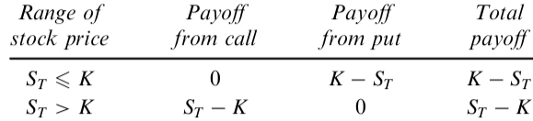


Straddle
Theorem
E($r_{m}$)
A
SML
$$β$$

Slide 9
Straddle
Application
Result

Slide 10
Straddle
Outcome and Profit
Improvement
(1) Actually, the option straddle relies on the high vibration of the underlying stock price. This strategy usually works well during the timing of quarters’ publishment. It is more like a speculation rather than a hedging strategy. However, considering time is also a precious capital, it is not bad to play as a speculator sometime.
(2) There is an obvious way to decrease the risk of this strategy. That is to buy the cheap option, which means to buy the call options with a higher strike price and put options with a lower strike price. By this means, we can control our costs within a smaller percentage.

Slide 12
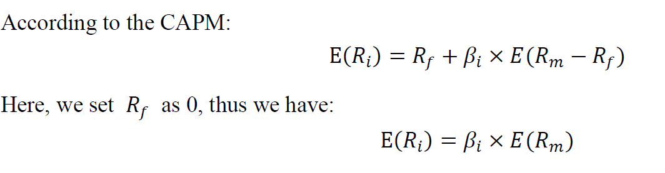
Pair Trading Strategy
1.Ideas

Slide 13
Pair Trading Strategy
2.Inplementation

Slide 14
Pair Trading Strategy
3.Feedback
1.For the first pair, both these companies are medical and biological incorporations, and according to their highly similar trends in daily price, we held the same weight in their values. However, as the volatility of them were extremely large and seemed almost unpredictable, we unloaded them just after holding them a short time.
2.For the second pair, the BLUE underwent an extremely fluctuation which exceeded our expectation and caused our heavy loss. And we closed this portfolio to stop loss just in time.
3.While for the third pair, as this portfolio has just been set up for a few days, it turns out a moderate behavior.

Slide 15
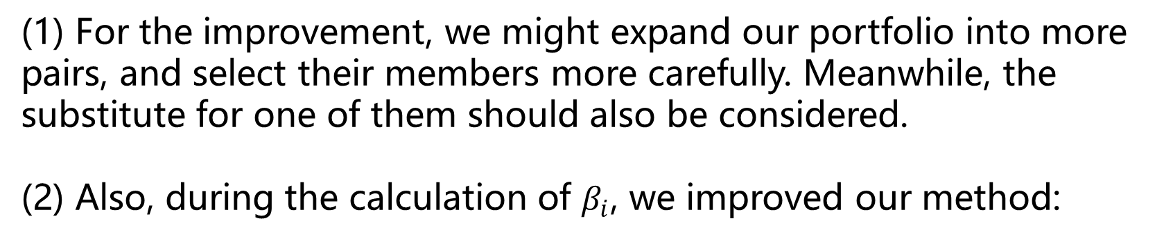
Pair Trading Strategy
4.Improvement
(1) For the improvement, we might expand our portfolio into more pairs, and select their members more carefully. Meanwhile, the substitute for one of them should also be considered.
(2) Also, during the calculation of $β_{i}$, we improved our method:

