Slide 1
DFA Minimization: Hopcroft’s Algorithm
Advanced Algorithms Kai dove, Peter Tessier, Kenneth Nguyen Wikipedia and some youtube videos

Slide 2
DFA Minimization
In this deck we will look at: - Intro: Problem/Motivation/Application - Naïve Approach - Hopcroft’s Algorithm Overview and Definitions - Time Complexity - Conclusion

Slide 3
Review: DFAs

Slide 4
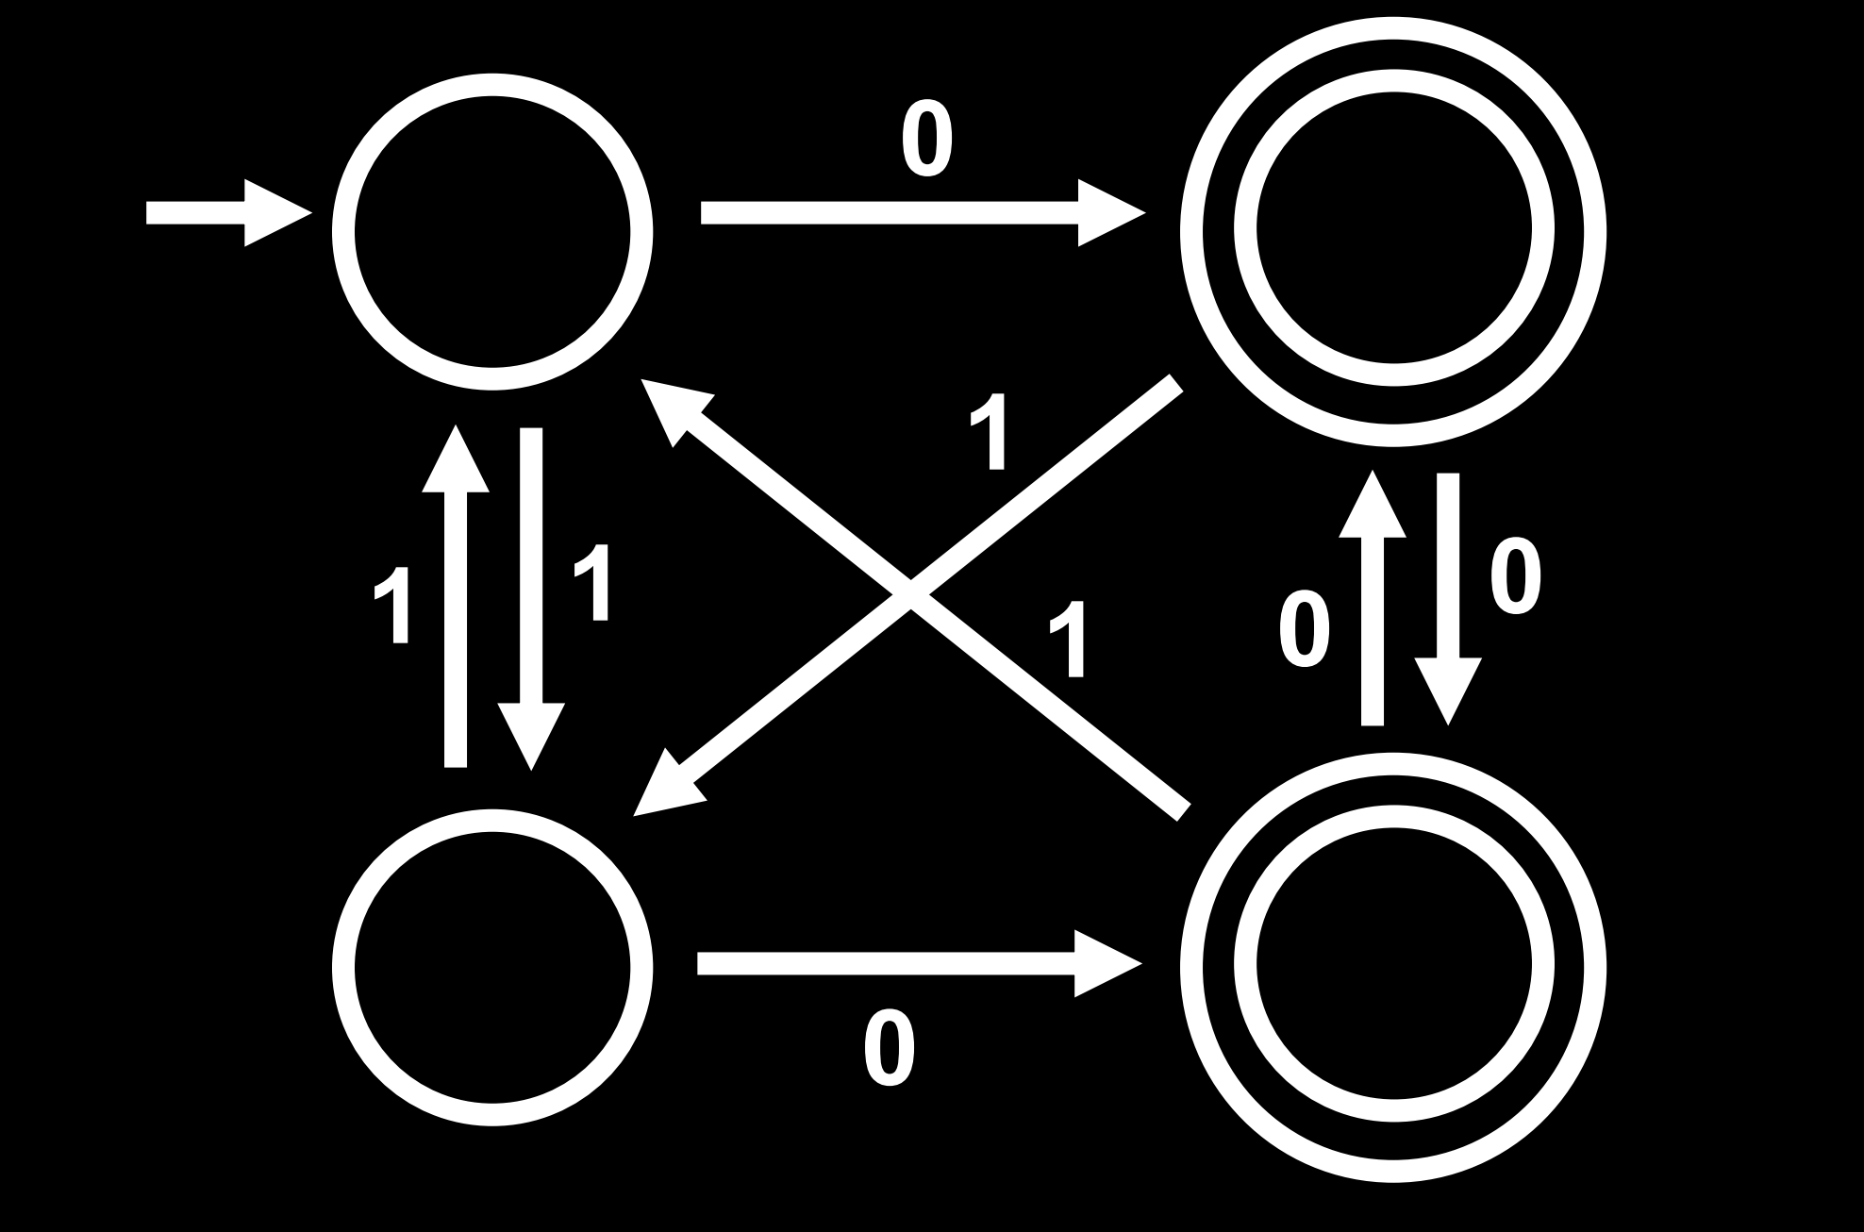
Recap: What is a Deterministic Finite Automata (DFA)?
A 5-tuple M = (Q, Σ, δ, q₀, F), where
Q is finite set (states)
Σ is finite set (alphabet)
δ: Q × Σ → Q is the transition function
q₀ is the starting state
F ⊆ Q are the final or accepting states

Slide 5
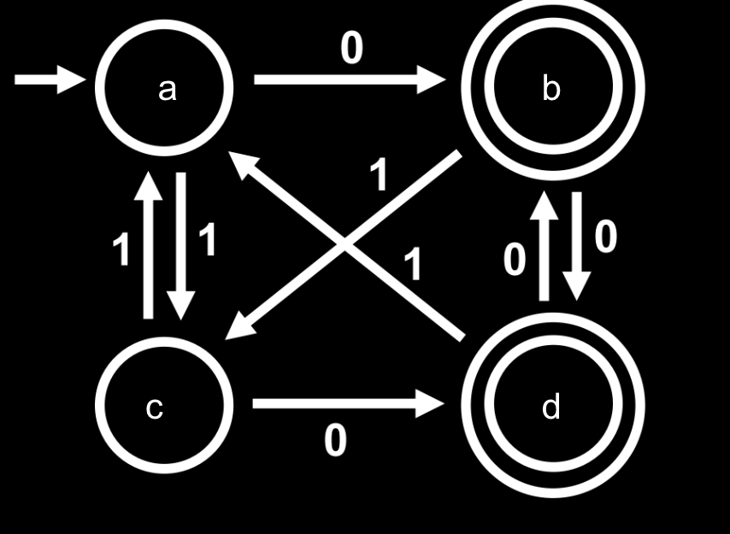
Recap: What is a Deterministic Finite Automata (DFA)?
A 5-tuple M = (Q, Σ, δ, q₀, F), where
Q = {a, b, c, d}
Σ = {0, 1}
δ(a,0) = b
δ(a,1) = c
δ(b,0) = d
…
q₀ = a
F = {b, d}

Slide 6
Recap: What is a Deterministic Finite Automata (DFA)?
Extended transition function:
δ*: Q × Σ* → Q
δ*(q, w) gives the resulting state after starting at state q and feeding the word w into the DFA
For convenience, we also let δ*(w) = δ*(q₀, w)

Slide 7
Recap: What is a Deterministic Finite Automata (DFA)?
Language
L(M) = {w ∈ Σ* | δ*(w) ∈ F} is the language recognized by M
I.e., if we end up in an accepting state after feeding w into M, then w is in the language. We also say that M accepts w. If w is not in the language, then M rejects w.

Slide 8

Recap: What is a Deterministic Finite Automata (DFA)?
What is the language of this DFA?
What about this one?
{w | w ends in 0}

Slide 9
Introduction: DFA Minimization

Slide 10
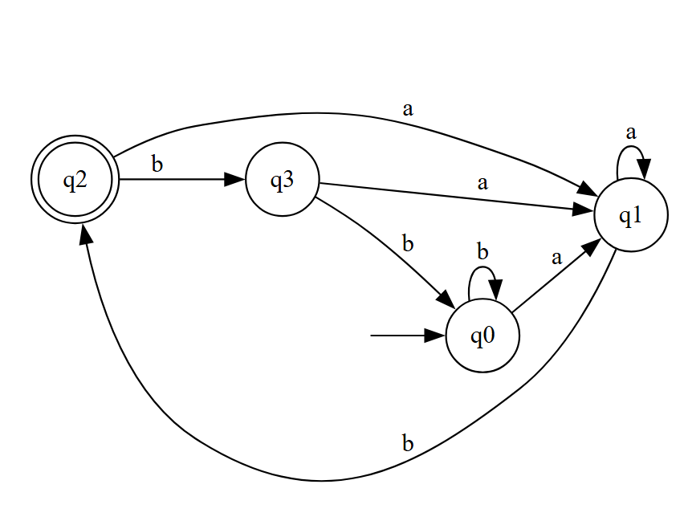
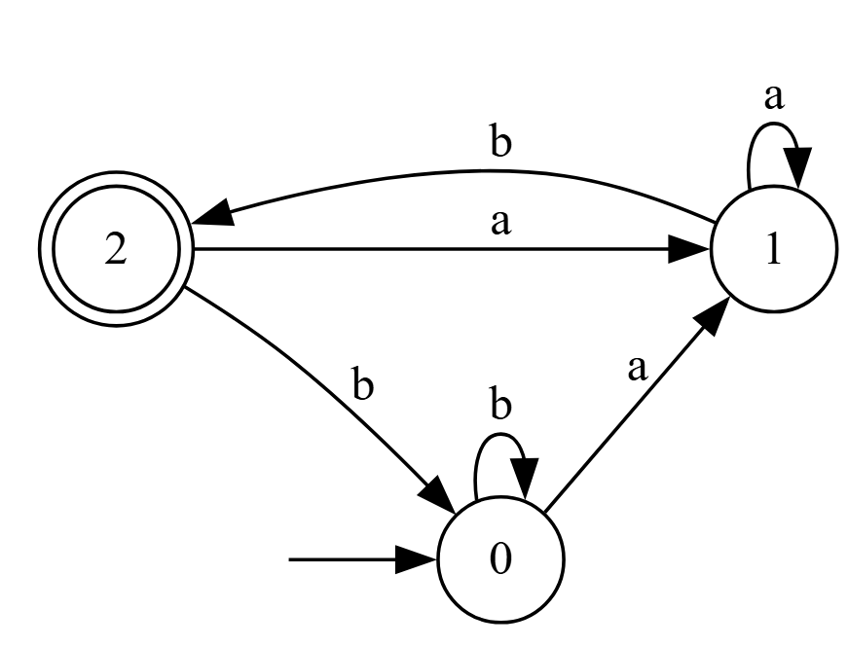
Problem: DFA Minimization
Given any DFA M = (Q, Σ, δ, q0, F), can we find a minimal DFA M_{min} = (Q_{min}, Σ, δ_{min,} q0_{min}, F_{min}) that recognizes the same language and can run in non-quadratic time?
I.e., L(M_{min}) = L(M), and if any other M’ = (Q’, Σ, δ’, q0’, F’) satisfies L(M’) = L(M_{min}), then we have |Q_{min}| ≤ |Q’|.
Bloated DFA (4 states)
Minimized DFA (3 states)
DFAs can quickly become bloated with redundant states and tangled edges
Indistinguishable states have been merged

Slide 11
First, Some quick Definitions
Indistinguishable
Two states, p and q, are indistinguishable if, for every word w∈ Σ*, the DFA either accepts both from p and q or rejects both. Thus, they can be merged.
Inaccessible
A state, q, is inaccessible if the DFA is never in the state for any word w∈ Σ* that is fed into it.
s
the size of the input alphabet Σ
n
The number of states in the DFA.

Slide 12
Indistinguishable, a deeper look
We say p, q ∈ Q are indistinguishable if δ*(p, w) ∈ F ⟺ δ*(q, w) ∈ F for all w ∈ Σ*
I.e., for any word w, accepts_starting_at_q(w) = accepts_starting_at_p(w)
Equivalently, L((Q, Σ, δ, q, F)) = L((Q, Σ, δ, p, F))
Forms an equivalence relation ∼ (so we write p ∼ q)
Reflexivity: p ∼ p
Symmetry: p ∼ q ⇒ q ∼ p
Transitivity: p ∼ q, q ∼ r ⇒ p ∼ r
So we can define equivalence classes [q] = {p | p ∼ q}
p and q are distinguishable if they are not indistinguishable

Slide 13
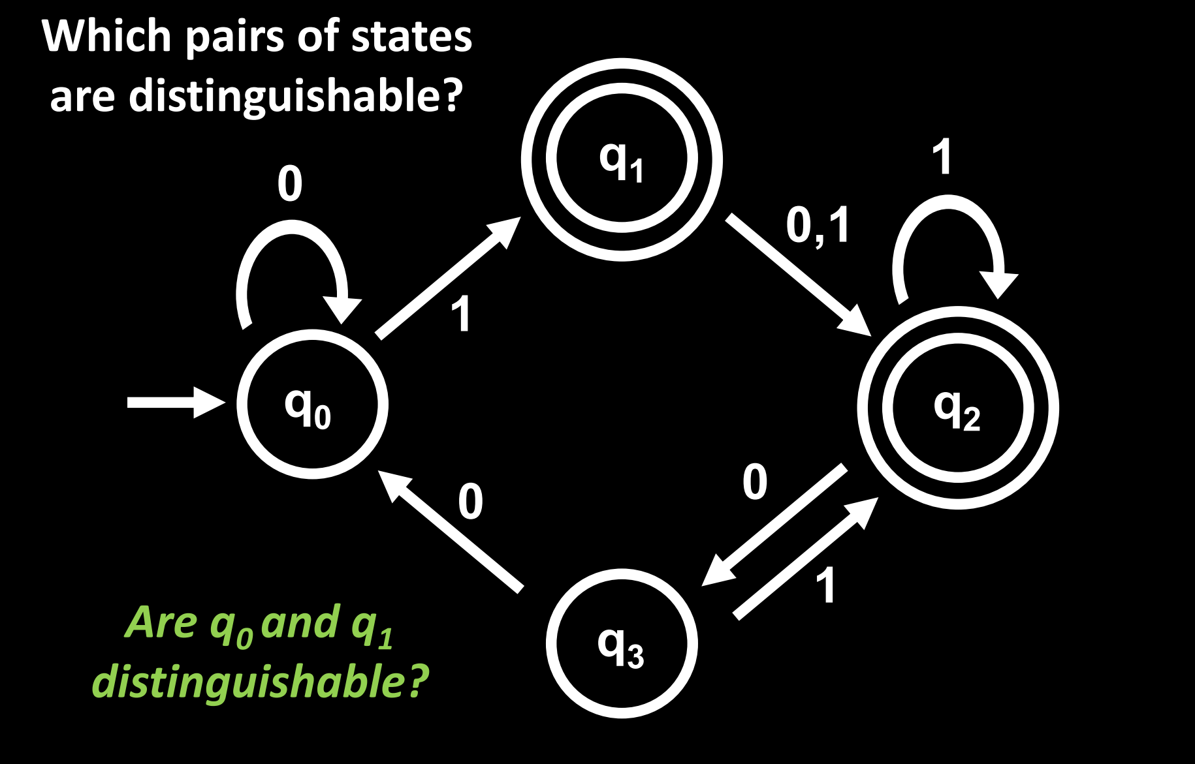
Indistinguishable, a deeper look
How to tell if p and q are distinguishable
p ∈ F, q ∉ F
p ∉ F, q ∈ F
δ(p, a) and δ(q, a) are distinguishable for some a ∈ Σ

Slide 14
Naïve Approach
Why is this Naïve?
Checks all pairs, even inaccessible states
Repeated checks for transitions
Brute-forces the workload
Worst case: O(n²s) time
Create a table of every pair of states
 | q0 | q1 | q2 | q3
q1 | x
q2 | x | x
q3 |  | x | x
For every state, check transition behavior and mark if distinguishable
If a transition goes to distinguishable states, also mark them
Loop until no new cells are marked, unmarked cells are merged

Slide 15
Motivation: DFA Minimization So Far
 | Moore’s Algorithm (Naïve approach) | Brzozowski’s Algorithm
Description | Exhaustively check all state pairs for distinguishability | Reverse the DFA twice and determinize it each time
Time Complexity | O(n²s) | O(2^{n}) (determinization step)
GOAL: Minimize the given DFA in a time complexity of O(n s log n)

Slide 16
Hopcroft’s Algorithm

Slide 17
DFA Minimization Algorithm Overview
Note: Before running the algorithm, you must remove inaccessible states. Do so by:
Performing a BFS:
Initialize sets reachable_states and new_states to {q0}
Set explored_states = {δ(q, σ) for σ in Σ for q in new_states}
Set new_states = explored_states \ reachable_states
Add all the new_states to reachable_states
Unless new_states is empty, go back to step 2
Now that no new states were found, reachable_states is guaranteed to indeed have all reachable states. So return Q\reachable_states

Slide 18
DFA Minimization Algorithm Overview
Overall Approach:
Start with two blocks: accepting vs. non-accepting states
Use a queue, W, to track which blocks might cause further splits
Repeatedly split blocks based on which states transition into others on each symbol
Only split when necessary: skip blocks that behave the same
Always pick the smaller splitter to keep the algorithm fast
Stop when no more splits can be made
Final blocks = groups of equivalent (indistinguishable) states. Each block is a state in the minimized DFA
Define M_{min} = (Q_{min}, Σ, δ_{min,} q0_{min}, F_{min}) in terms of these blocks
Hopcroft's Algorithm used here

Slide 19
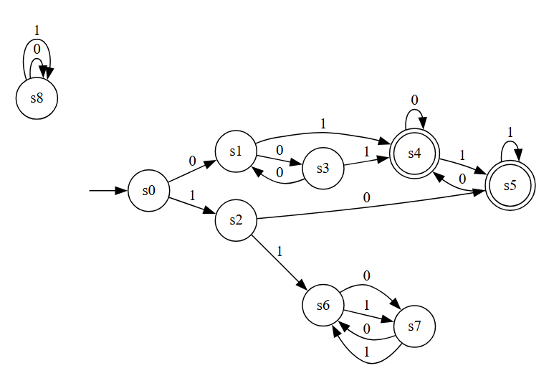
Hopcroft’s Algorithm Example
1. Create a list of the current partitions, P, using the remaining accepting and non-accepting states
s0 | s1 | s2 | s3 | s6 | s7 | s4 | s5

Slide 20
Hopcroft’s Algorithm Example
1. Create a list of the current partitions, P, using the remaining accepting and non-accepting states
P
s0 | s1 | s2 | s3 | s6 | s7 | s4 | s5
2. Create the queue of splitters, W
W
s4 | s5

Slide 21
Hopcroft’s Algorithm Example
1. Create a list of the current partitions, P, using the remaining accepting and non-accepting states
P
s0 | s1 | s2 | s3 | s6 | s7 | s4 | s5
2. Create the queue of splitters, W
W
s4 | s5
3. Split blocks further based on the transitions into the splitters given the inputs (0,1).

Slide 22
Hopcroft’s Algorithm Example
4. Split blocks further based on the transitions into the splitters given the inputs (0,1).
P
s0 | s1 | s2 | s3 | s6 | s7 | s4 | s5
W
s4 | s5
 | 0 | 1
s0 | s1 | s2
s1 | s3 | s4
s2 | s5 | s6
s3 | s1 | s4
s4 | s4 | s5
s5 | s4 | s5
s6 | s7 | s7
s7 | s6 | s6
States that transition into the splitter states are marked for the next partitioning

Slide 23
Hopcroft’s Algorithm Example
4/5/6. Split the block accordingly based on the marked states and choose the smallest splitter to use next
P
s0 | s6 | s7 | s2 | s1 | s3 | s4 | s5
W
s2
 | 0 | 1
s0 | s1 | s2
s2 | s5 | s6
s6 | s7 | s7
s7 | s6 | s6

Slide 24
Hopcroft’s Algorithm Example
4/5/6. Split the block accordingly based on the marked states
and choose the smallest splitter to use next
P
s6 | s7 | s0 | s2 | s1 | s3 | s4 | s5
W
s0
 | 0 | 1
s0 | s1 | s2
s6 | s7 | s7
s7 | s6 | s6
7. No states enter s0 on either of the inputs of 0 or 1, the algorithm can no longer partition any blocks

Slide 25
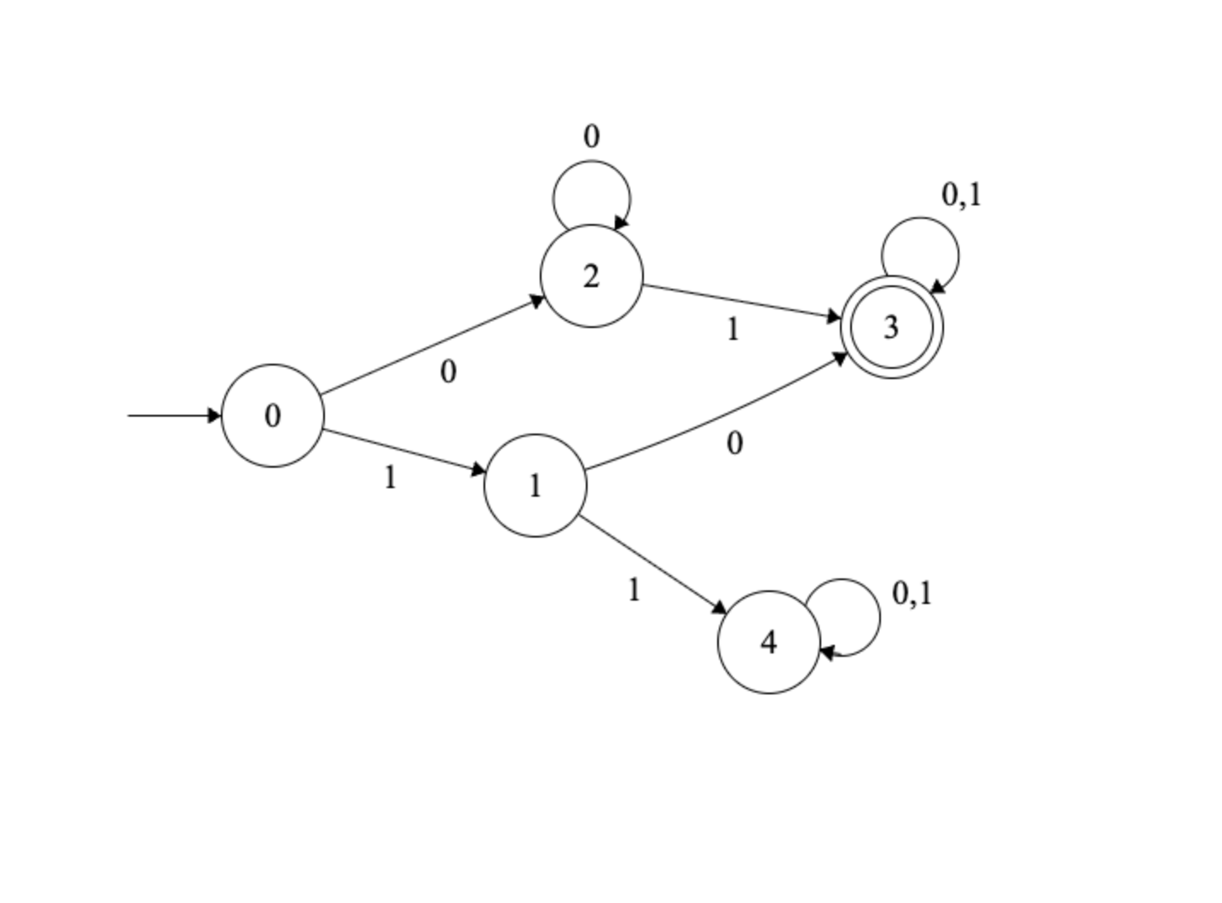
Hopcroft’s Algorithm Example
8. Each block can now be represented as it’s own state in the minimized DFA
P
s6 | s7 | s0 | s2 | s1 | s3 | s4 | s5
Original | Minimized
s0 | 0
s2 | 1
s1,s3 | 2
s4,s5 | 3
s6,s7 | 4
L = Strings that do not start with a 11

Slide 26
Using Hopcroft's Blocks
Define M_{min} = (Q_{min}, Σ, δ_{min,} q0_{min}, F_{min}) in terms of these blocks​
0,1
0
Q_{min} = exactly those blocks
δ_{min}([q], a) = [δ(q,a)]
q0_{min} = [q0]
F_{min} = {[q] for q in Q}
1
0,1

Slide 27
Hopcroft’s Algorithm Time Complexity and Pseudocode
Time Complexity:
Hopcroft’s algorithm works by refining “blocks” of states with transition-focused “splitters”
It only processes transitions when they cause a new split and since we’re only using the smaller split half, no state is checked more than log n times.
Each DFA has n states and s symbols in the alphabet, so there are n × s transitions. Since each transition is only affected by at most log n splits, total time is O(n s log n). Much faster than either Moore’s or Brzozowski’s.
P := {F, Q \ F}
W := {F, Q \ F}
while (W is not empty) do
choose and remove a set A from W
for each c in Σ do
let X be the set of states for which a transition on c leads to a state in A
for each set Y in P for which X ∩ Y is nonempty and Y \ X is nonempty do
replace Y in P by the two sets X ∩ Y and Y \ X
if Y is in W
replace Y in W by the same two sets
else
if |X ∩ Y| <= |Y \ X|
add X ∩ Y to W
else
add Y \ X to W

