Slide 1
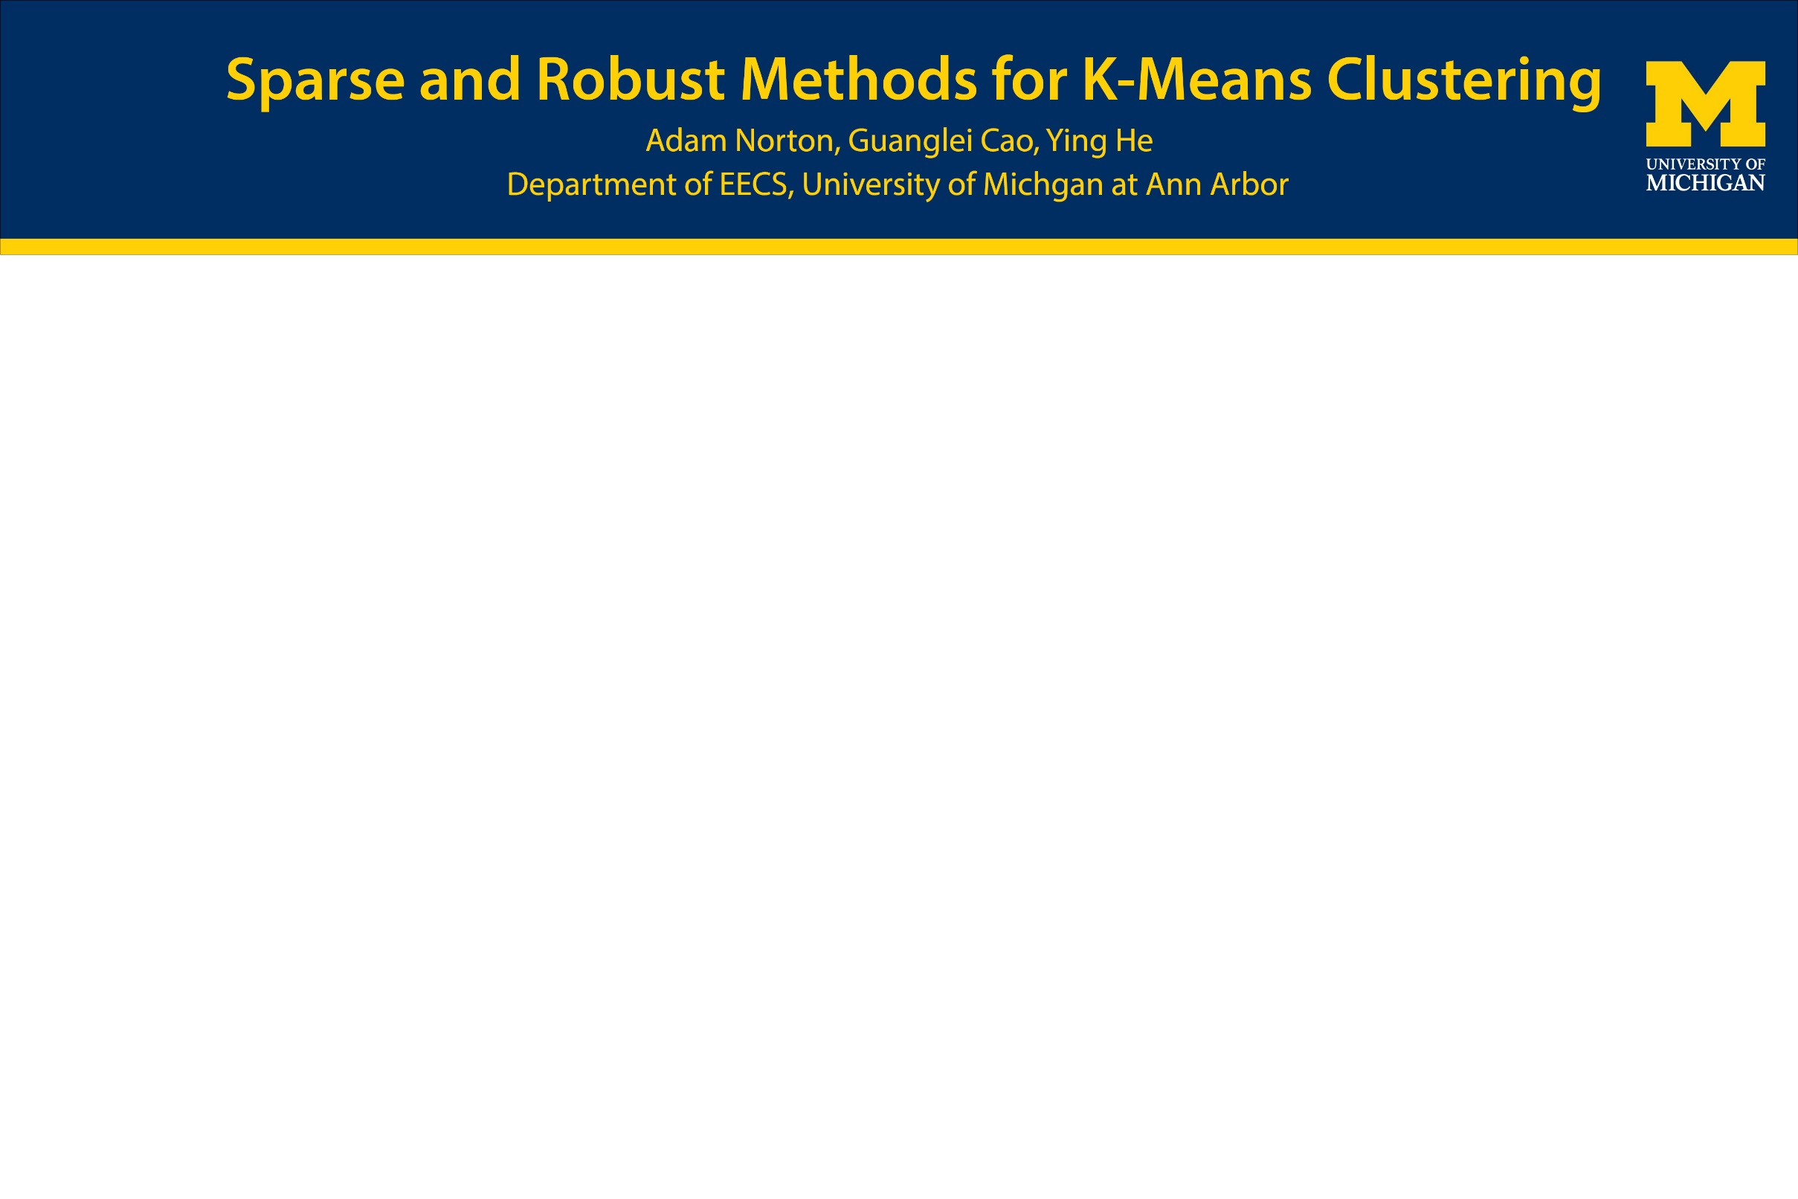
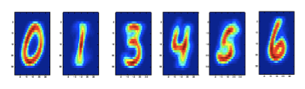
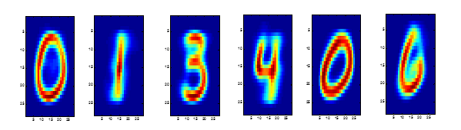
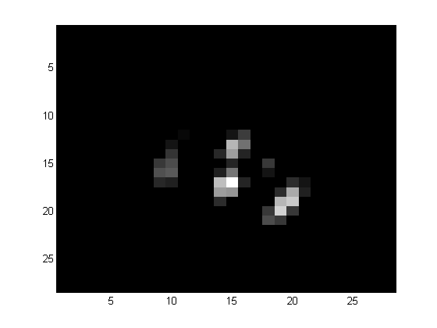
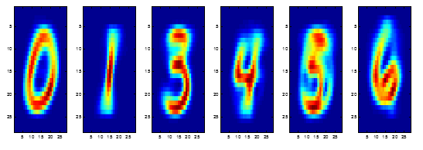
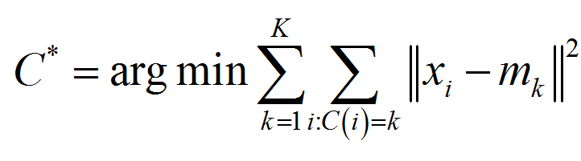
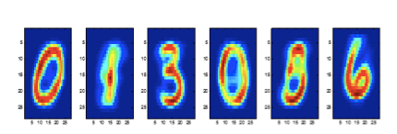
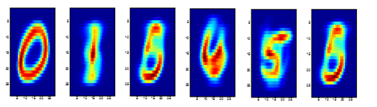
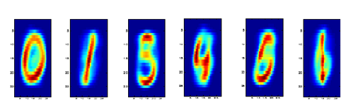
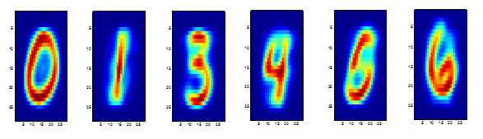
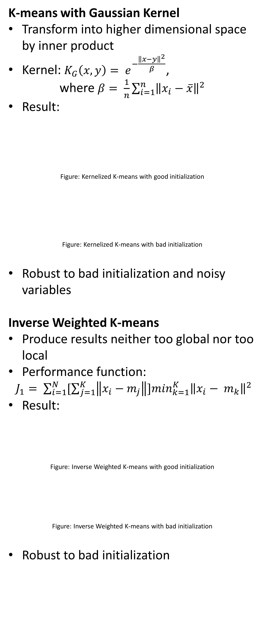
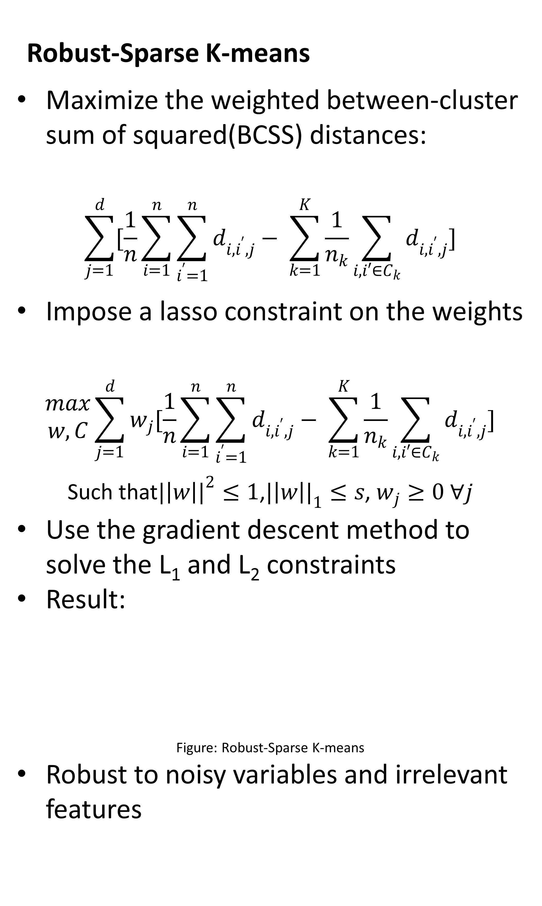
Motivation
Traditional K-means
Performs poorly with large number of noisy variables
Not robust to data with many irrelevant features
Sensitive to different initializations
Datasets for training
Handwritten digit numbers 0,1,3,4,5,6
Apply pattern recognition by k-means and variations
K-means and variations
Traditional K-means
K-means center:
Result:
Figure: Naïve K-means with good initialization
Figure: Naïve K-means with bad initialization
To solve this,
K-means with Gaussian Kernel
Inversed Weighted K-means
Robust-Sparse K-means
Robust-Sparse K-means
Maximize the weighted between-cluster sum of squared(BCSS) distances:
$$\sum_{j=1}^{d}{[\frac{1}{n}\sum_{i=1}^{n}{\sum_{i^{′}=1}^{n}{d_{i, i^{′},j}− \sum_{k=1}^{K}{\frac{1}{n_{k}}\sum_{i,i′∈C_{k}}{d_{i,i^{′},j}}}}}]}$$
Impose a lasso constraint on the weights
$$\begin{matrix}max \\ w,C\end{matrix}\sum_{j=1}^{d}{w_{j}[\frac{1}{n}\sum_{i=1}^{n}{\sum_{i^{′}=1}^{n}{d_{i, i^{′},j}− \sum_{k=1}^{K}{\frac{1}{n_{k}}\sum_{i,i′∈C_{k}}{d_{i,i^{′},j}}}}}]}$$
Such that${|\left|w\right||}^{2}≤1$,${|\left|w\right||}_{1}≤s$, $w_{j}≥0 ∀j$
Use the gradient descent method to solve the L₁ and L₂ constraints
Result:
Figure: Robust-Sparse K-means
Robust to noisy variables and irrelevant features
K-means with Gaussian Kernel
Transform into higher dimensional space by inner product
Kernel: $K_{G}\left(x, y\right)= e^{−\frac{{\left\|x−y\right\|}^{2}}{β}}$,
where $β= \frac{1}{n}\sum_{i=1}^{n}{{\left\|x_{i}−\overline{x}\right\|}^{2}}$
Result:
Figure: Kernelized K-means with good initialization
Figure: Kernelized K-means with bad initialization
Robust to bad initialization and noisy variables
Inverse Weighted K-means
Produce results neither too global nor too local
Performance function:
$J_{1}= \sum_{i=1}^{N}{[\sum_{j=1}^{K}{\left\|x_{i}−m_{j}\right\|}}]\min_{k=1}^{K}{\left\|x_{i}− m_{k}\right\|}^{2}$
Result:
Figure: Inverse Weighted K-means with good initialization
Figure: Inverse Weighted K-means with bad initialization
Robust to bad initialization
Conclusion and Comparison
Compare different classification results by purity function
Relevant features
Figure: Relevant Features
K-means with Gaussian Kernel provide the best result by assigning best weights
References
[1] Barbakh, Wesam, and Colin Fyfe. ”Online Clustering Algorithms.” (n.d.): n. pag. University of Paisley. Web.
[2] Boyd, S.”Linear and Quadratic Problems.” University of Siena. Web.
[3] Duchi, John, Shai Shalev-Shwartz, Yoram Singer, and Tushar Chandra.” Efficient Projections onto the 1-Ball for Learning in High Dimensions.” N Proceedings of the 25th International Conference on Machine Learning (2008): n. pag. Web.
[4] Kondo, Yumi, Matias Salibian-Barrera, and Ruben Zamar. ”A Robust and Sparse K-means Clustering Algorithm.” (n.d.): n. pag. Web.
[5]Kondo, Yumi. Robustication of the Sparse K-means Clustering Algorithm. Thesis.The University Of British Columbia, 2011.N.p.: n.p., n.d. Print.
[6] LeCun, Yann, Corinna Cortes, and Christopher J.C. Burges.” THE MNIST DATABASE.” N.p., n.d. Web.
[7] Yung-Kang, Tainan. ”Kernelized K-Means Algorithm Based on Gaussian Kernel.” Advances in Control and Communication 137 (2012): 657-64. Web.
[8] Zou, Hui, and Trevor Hastie.” Regularization and Variable Selection via the Elastic Net.” Journal of the Royal Statistical Society 67 (2005): 301-20. Web
 | Naïve(GI) | Naïve(GI) | Kern(GI) | Kern(BI)
Purity | 0.4967 | 0.4741 | 0.7742 | 0.5867
 | WKM(GI) | WKM(GI) | RSK
Purity | 0.6872 | 0.5766 | 0.6535

