Slide 1
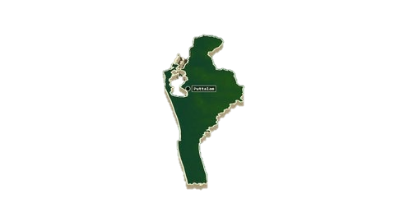
Deforestation and Land Cover
Change Analysis
COURSE
Image Processing
Kalpitiya, Sri Lanka
PROGRAMME
Lat 8.00° – 8.65° N Lon 79.68° – 79.90° E
HND IN COMPUTER SCIENCE WITH AI
Using Landsat Satellite Imagery, Machine Learning Classification
and Vegetation Trend Forecasting
MEMBERS
D M I N DISSANAYAKE M M ABDULLAH
M F M AFRAR R M AFLAL
INSTITUTION
NIBM (Kandy Innovation Centre)
DATE
19th May, 2026
Notes:
“Good morning everyone.
Today we are presenting our Image Processing group project titled Deforestation and Land Cover Change Analysis in the Kalpitiya Peninsula, Sri Lanka using Landsat Satellite Imagery, Machine Learning Classification and Vegetation Trend Forecasting.
In this project, we analysed land cover changes from 2016 to 2025 using satellite imagery and machine learning techniques.”
“First, I will introduce the environmental problem and background of the study.”

Slide 2
MEMBER1
01 Introduction
20
What is Deforestation?
Landsat Scenes
Permanent removal of forest or dense vegetation, often for agriculture, aquaculture, or urban development.
scenes analysed
Why Does It Matter?
9
Study Period
Loss of vegetation disrupts ecosystems, increases carbon emissions, affects water cycles, and threatens coastal stability.
years (2016 – 2025)
Why Monitor It Remotely?
30m
Ground surveys are expensive and slow. Satellite imagery provides consistent, repeatable, wide-area observations over decades.
Resolution
Landsat pixel size
Our Study Area – Kalpitiya
A coastal peninsula in Sri Lanka's North Western Province, bordered by the Indian Ocean and Puttalam Lagoon. Home to scrubland, mangroves, salt pans, and small settlements.
4
Land Classes
Water · Veg · Soil · Built
2
Notes:
“Deforestation means the permanent removal of forests or vegetation, usually due to agriculture, aquaculture, settlements, or urban development.
This is an important environmental issue because vegetation loss affects biodiversity, coastal stability, water cycles, and even carbon emissions.
Traditional field surveys are expensive and time-consuming, especially across large regions. Because of this, satellite remote sensing has become a practical solution since it provides repeatable observations over long periods of time.
Our study area is the Kalpitiya Peninsula in Sri Lanka, a coastal region located between the Indian Ocean and Puttalam Lagoon. It contains scrubland, mangroves, salt pans, and settlements that are under increasing environmental pressure.
For this study, we analysed 20 Landsat scenes covering 9 years, from 2016 to 2025.”

Slide 3
MEMBER 1
02 Background
Environmental Context
Remote Sensing
Sri Lanka has faced ongoing vegetation loss in coastal and semi-arid regions due to aquaculture, agriculture, and settlement expansion. Kalpitiya is one of the most pressured coastal zones.
Satellites like Landsat provide consistent global observations since 1972. They detect spectral information beyond human vision – critical for vegetation and water mapping.
Spectral Indices
Machine Learning Classification
Mathematical band combinations (NDVI, NDWI, NDBI, NBR, EVI) transform raw reflectance data into meaningful measurements of vegetation health, water, and built-up areas.
Random Forest classifiers can map land cover from satellite features at scale, removing the need for expensive manual pixel labelling.
Change Detection & Forecasting
Comparing multi-temporal classified maps reveals how land has changed. Regression models allow us to project future vegetation trends – useful for environmental planning.
3
Notes:
“In Sri Lanka, vegetation loss has become an increasing issue in coastal and semi-arid regions due to development and land-use change. Kalpitiya is one of the regions experiencing this pressure.
To monitor these changes, we used satellite remote sensing. Landsat satellites have provided Earth observations since 1972 and can capture spectral information beyond normal human vision.
We also used spectral indices such as NDVI for vegetation, NDWI for water, and NDBI for built-up areas. These mathematical combinations help transform raw satellite data into meaningful environmental measurements.
For classification, we used a Random Forest machine learning model to automatically map land cover types. Finally, we used change detection and forecasting methods to understand how vegetation changed over time and predict future trends.”

Slide 4
03 Project Objectives
What we set out to achieve
Organise and preprocess multi-temporal Landsat imagery from 2016 to 2025
Detect land cover and vegetation changes across the study period
01
04
Compute spectral indices (NDVI, NDWI, NDBI, NBR, EVI) per scene
Forecast future NDVI trends using Linear, Polynomial, and Gradient Boosting regression
02
05
Classify land cover using Random Forest (Water, Vegetation, Bare Soil, Built-Up)
Provide meaningful environmental insights for the Kalpitiya Peninsula
03
06
4
Notes:
“The main objective of this project was to build a complete end-to-end environmental monitoring pipeline.
First, we organised and preprocessed satellite imagery. Then we calculated spectral indices and classified land cover into four categories: water, vegetation, bare soil, and built-up land.
Finally, we detected vegetation changes over time and forecasted future NDVI trends up to 2030.”
“Now I’ll hand over to Member 2, who will explain our dataset and preprocessing stage.”

Slide 5
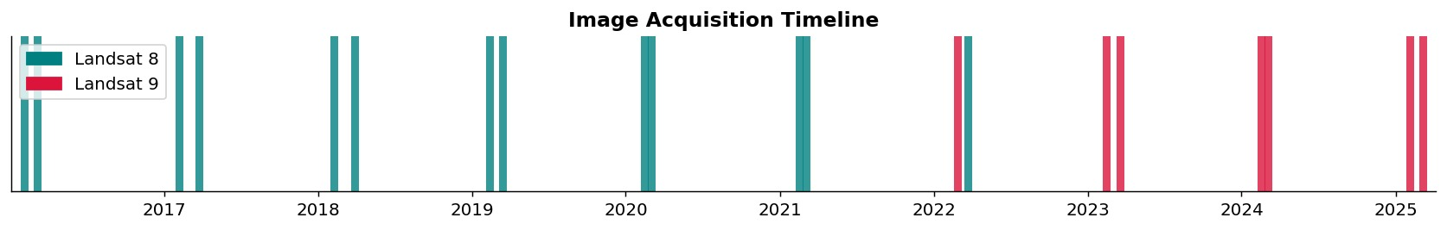
MEMBER 2
04 Dataset Description
Figure 1 – Acquisition timeline: 20 Landsat scenes (teal = Landsat 8, crimson = Landsat 9)
Sensor
Period
Scenes
Resolution
Data Type
Landsat 8 & 9
(OLI-TIRS)
Feb 2016 –
Mar 2025
20 scenes
(Feb & Mar dry season)
30 m native
(60 m after downsampling)
Level-2 SR
GeoTIFF bands
Imagery was acquired during the North Western Province dry season (February–March) to minimise cloud contamination. Both Landsat 8 and 9 use the same OLI sensor, ensuring spectral consistency across the dataset.
5
Notes:
“For this project, we used Landsat 8 and Landsat 9 Level-2 Surface Reflectance imagery obtained from USGS.
We selected images between February 2016 and March 2025, giving us a total of 20 scenes. We mainly selected February and March because these months belong to the dry season in North Western Sri Lanka, which reduces cloud cover and improves image quality.
The native image resolution was 30 metres, and both Landsat 8 and 9 use the same OLI sensor, which ensures spectral consistency for long-term comparison.
The timeline shown here illustrates all image acquisition dates used throughout the study.”

Slide 6
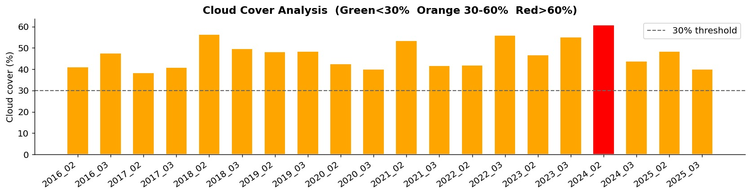
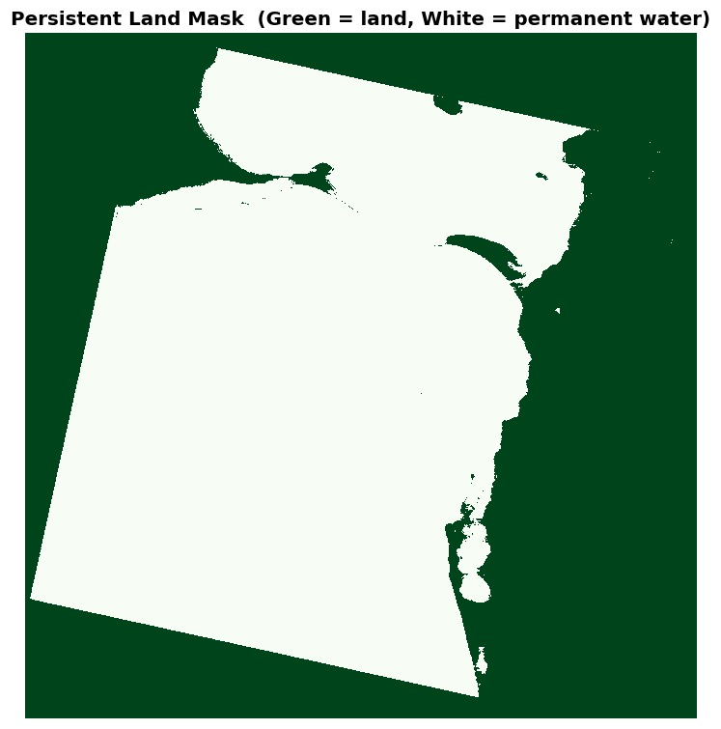
MEMBER 2
05 Data Preprocessing
1
Data Organisation
catogirizingData.py groups raw TIF files by YYYY_MM date from filename
2
Reflectance Scaling
DN × 0.0000275 − 0.2, clipped to [0, 1]
3
Downsampling
Figure 2 – Cloud cover per scene. Green = <30% (clean), Orange = 30–60%, Red = >60%
Bilinear 2× resize: 30 m → 60 m (reduces compute load)
4
Cloud Masking
QA_PIXEL bit flags remove cloud, cirrus, shadow pixels → set to NaN
5
Persistent Land Mask
NDWI across all scenes identifies permanent water (lagoon, ocean) – excluded from classification
6
Fig 3 – Persistent land mask
Notes:
“Before analysis, the satellite images had to be preprocessed.
First, we organised the raw files using a Python script called categorizingData.py, which automatically grouped files into folders based on acquisition date.
Next, we converted Landsat digital numbers into actual surface reflectance values using reflectance scaling.
Then we reduced image resolution from 30 metres to 60 metres using bilinear downsampling to reduce computational load and memory usage.
One of the most important preprocessing steps was cloud masking. Using the QA_PIXEL band, we removed cloud, shadow, and cirrus pixels to improve reliability.
Finally, we created a persistent land mask using NDWI to permanently exclude ocean and lagoon regions from vegetation analysis.”
“Next, Member 3 will explain our methodology and machine learning process.”

Slide 7
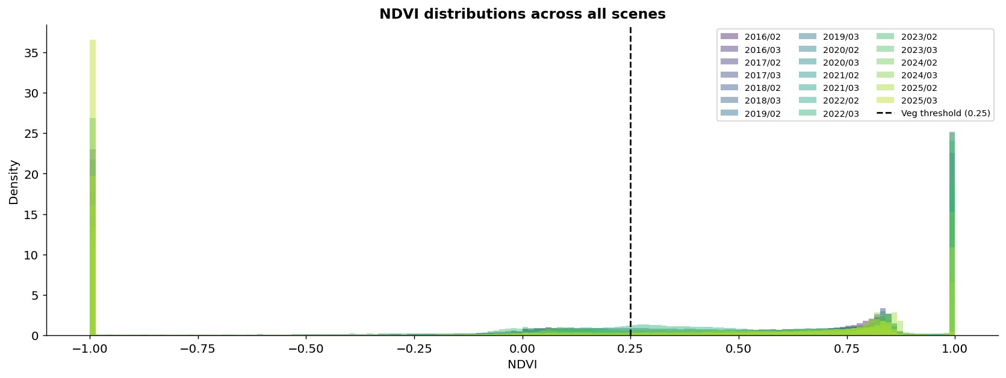
MEMBER 3
06 Methodology Overview
1. Data
Collection
2. Pre-
processing
3. Spectral
Indices
4. Classifi-
cation
5. Change
Detection
6. Fore-
casting
7. Analysis
& Insights
20 Landsat scenes
2016–2025
Scaling · Masking
Downsampling
NDVI NDWI
NDBI NBR EVI
Random Forest
4 classes
NDVI delta
Transition matrix
Lin · Poly
Grad Boost
Environmental
findings
All steps were implemented in Python using a single Jupyter Notebook (retrain.ipynb). Each scene was processed sequentially through the full pipeline.
7
Figure 6 – NDVI histogram distributions across all 20 scenes. Dashed line = vegetation threshold (NDVI = 0.25)
Notes:
“Our entire workflow was implemented in Python using a single Jupyter Notebook called retrain.ipynb.
The process followed seven stages. We first collected Landsat data, then carried out preprocessing and spectral index computation.
After that, we performed land cover classification using machine learning, followed by change detection and forecasting.
Finally, we analysed the outputs to identify environmental trends.
The NDVI histogram shown here already hints at vegetation decline over time because the distribution shifts toward lower values in later years.”

Slide 8
MEMBER 3
07 Spectral Indices
NDVI
NDWI
NDBI
NBR
EVI
Normalized Difference Vegetation Index
Normalized Difference Water Index
Normalized Difference Built-Up Index
Normalized Burn Ratio
Enhanced Vegetation Index
(NIR − Red) / (NIR + Red)
(Green − NIR) / (Green + NIR)
(SWIR1 − NIR) / (SWIR1 + NIR)
(NIR − SWIR2) / (NIR + SWIR2)
2.5 × (NIR − Red) / (NIR + 6R − 7.5B + 1)
Vegetation health & density. Threshold > 0.25 = vegetation.
Identifies open water bodies. Used to build persistent land mask.
Highlights impervious and built-up surfaces.
Sensitive to dry soil and previously burnt land.
Improves NDVI in dense canopy; corrects for atmosphere and soil.
8
NDVI maps – all 20 scenes (green = dense vegetation, red/yellow = bare/non-vegetated)
Notes:
“We calculated five spectral indices for every scene.
The most important was NDVI, which measures vegetation health and density and was our main indicator of vegetation change.
NDWI was used to detect water bodies and create the land mask. NDBI highlighted built-up areas, while NBR helped identify dry or stressed land.
We also used EVI, which improves vegetation detection in dense canopy regions by correcting atmospheric and soil effects.
At the bottom, the NDVI maps show visible vegetation changes across all 20 scenes.”

Slide 9
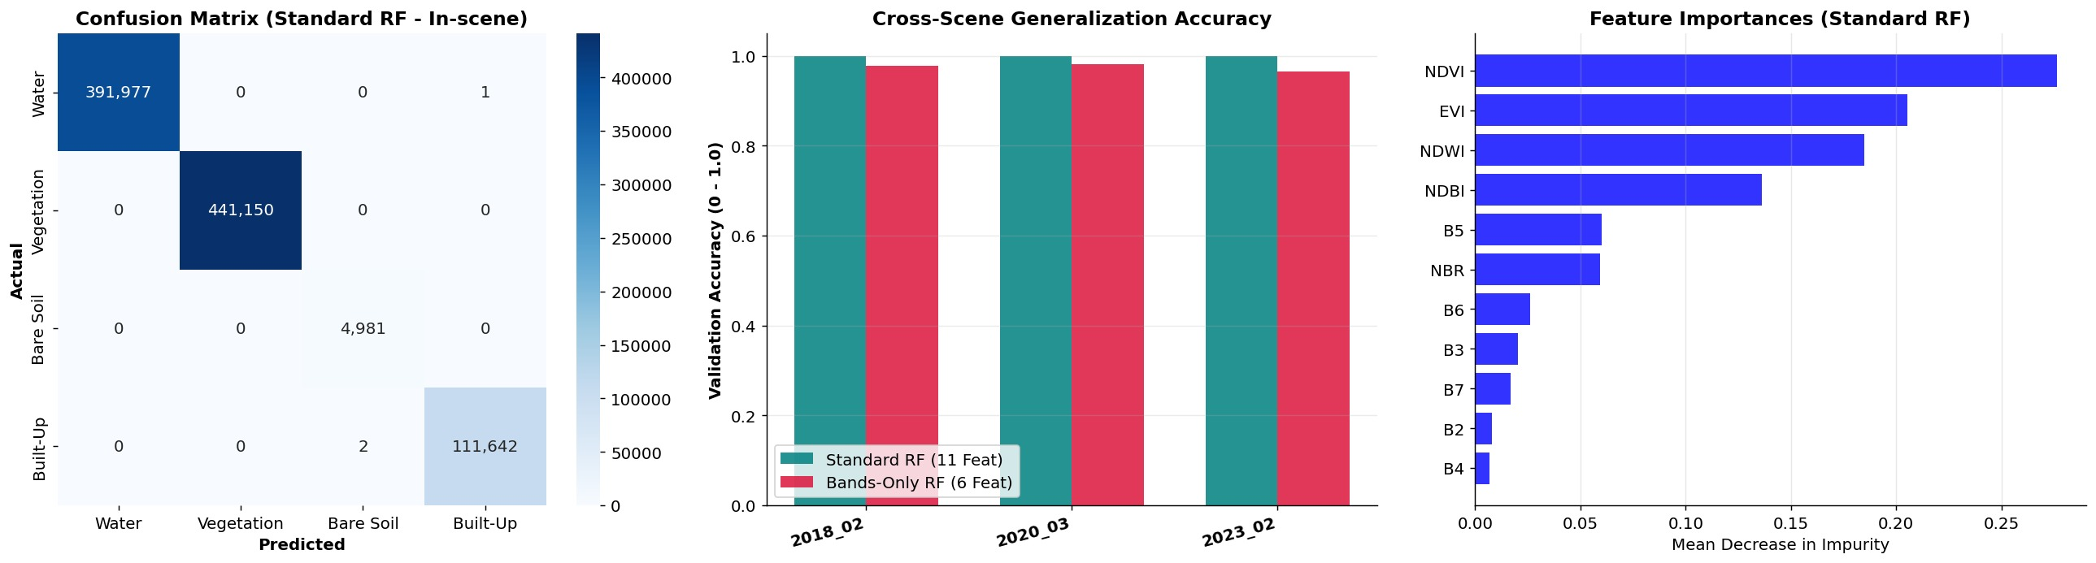
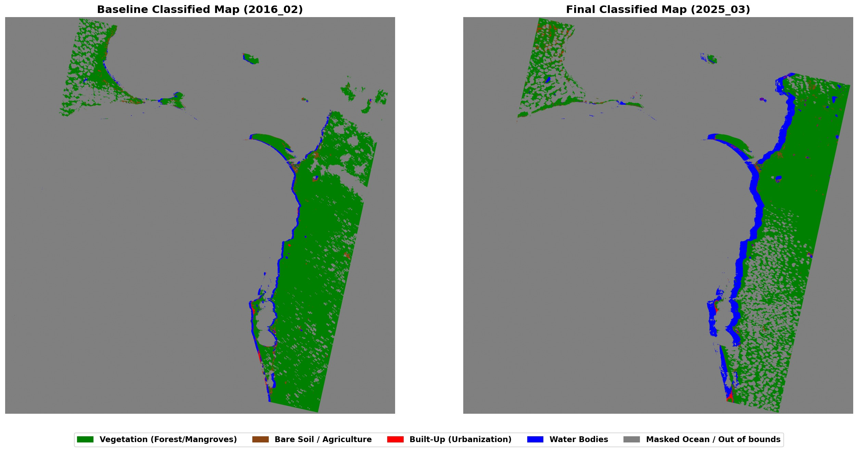
MEMBER 3
08 Land Cover Classification
Random Forest Classifier
Trees:
200 | Max depth: 15
Features:
11 (6 bands + 5 spectral indices)
Training:
Auto pseudo-labelling (spectral thresholds)
Split:
75 / 25 train / test · stratified
Classes:
Water · Vegetation · Bare Soil · Built-Up
Figure 7 – Confusion matrix · Cross-scene validation accuracy · Feature importances
Pseudo-label rules
💧 Water: NDWI > 0.15 AND NDVI < 0.02
🌿 Vegetation: NDVI > 0.32 AND NDWI < −0.05
🏗️ Built-Up: NDBI > 0.08 AND NDVI < 0.12
🟤 Bare Soil: Remaining moderate NDVI pixels
9
Figure 9 – Classified map 2016 (left) vs 2025 (right) — Green = Vegetation, Brown = Bare Soil
Notes:
“To classify land cover, we used a Random Forest machine learning classifier.
The model used 11 features: six Landsat bands plus five spectral indices.
Since manual labelling of millions of pixels is extremely difficult, we used a pseudo-labelling approach. This means training labels were automatically generated using spectral thresholds.
For example, high NDVI values represented vegetation, while high NDWI values indicated water.
The model classified pixels into four categories: water, vegetation, bare soil, and built-up land.
We also validated the model on unseen scenes, and results showed that the full 11-feature model performed better than using raw bands alone.”
“Now Member 4 will discuss our results and key findings.”

Slide 10
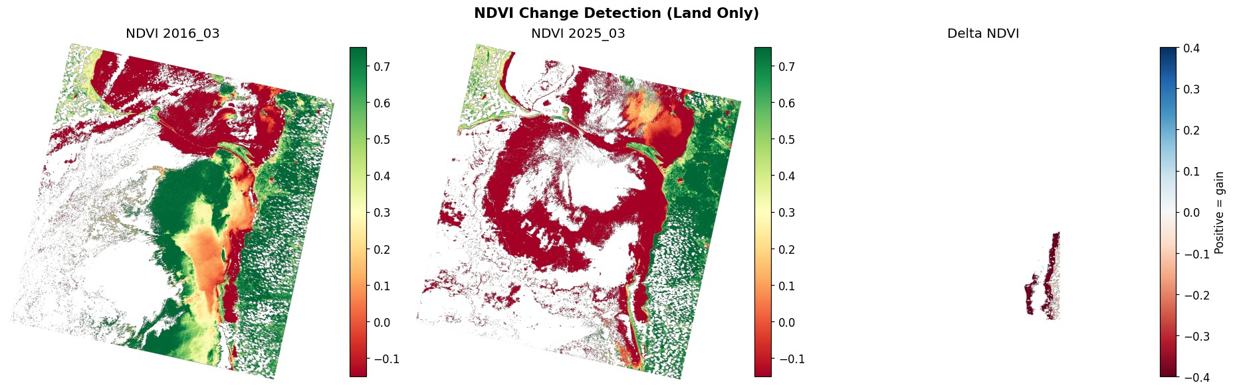
MEMBER 4
09 Change Detection Results
Figure 10 – Seasonal-adjusted NDVI change detection. Left: 2016 baseline NDVI. Centre: 2025_03 NDVI. Right: Delta NDVI (red = loss, blue = gain)
2022–2023
−0.152
+11,271 ha
Decline
Peak loss period
Delta NDVI
Recovery
Overall trend
−11,042 ha net loss (82.6%)
Largest single-step NDVI drop
Between 2024/03 and 2025/02
Interior & south most affected
10
Notes:
“This slide presents our NDVI change detection results.
On the left is the baseline NDVI map from 2016, while the centre image shows the matching period in 2025.
On the right is the delta NDVI map, where red indicates vegetation loss and blue indicates vegetation gain.
The results clearly show an overall decline in vegetation, especially in the southern and interior regions.
The largest vegetation loss occurred between 2022 and 2023, with over 11,000 hectares of net loss.”

Slide 11
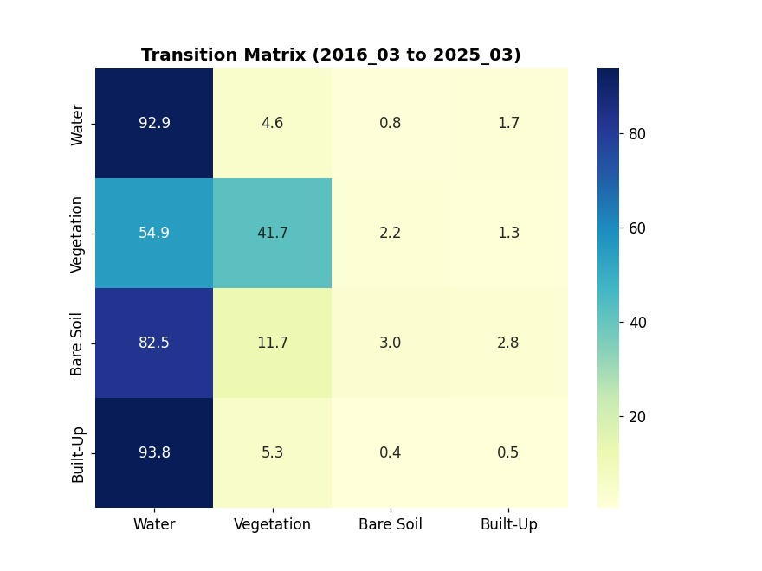
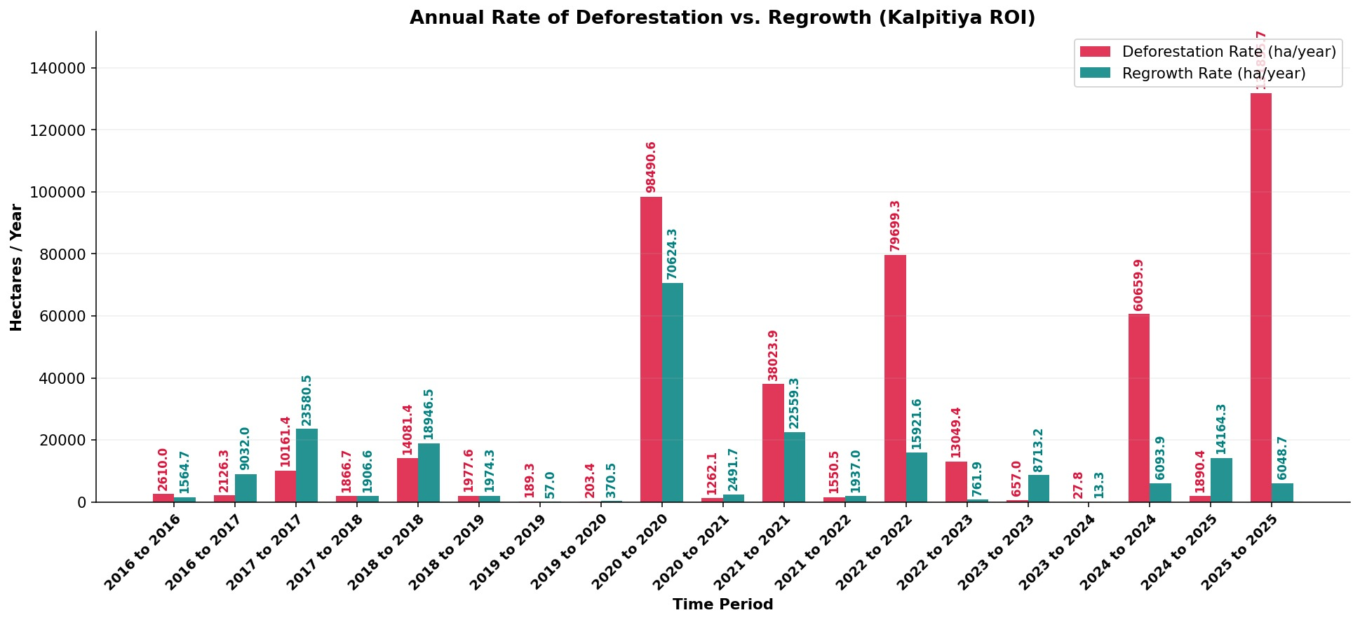
MEMBER 4
10 Land Cover Transitions & Hotspots
Figure 11 – Annualised deforestation vs regrowth rates (ha/year) by time period
Key Observations
▸ A large share of 2016 vegetation pixels became Water/Bare Soil by 2025
Figure 12 – Normalised transition matrix: % of 2016 pixels moved to each 2025 class
▸ 2022–2023 saw the sharpest deforestation spike across all periods
Transition Matrix Insight: Of the 40,334 pixels vegetated in 2016, 53,134 pixels (from the Vegetation row) shifted to Water by 2025. This partly reflects lagoon boundary fluctuation but also indicates genuine vegetation-to-water conversion along the lagoon edge.
▸ Partial regrowth visible in 2024/03 to 2025/02 +11,271 ha
▸ Interior and southern zones are persistent loss hotspots
11
Notes:
“The transition matrix helps explain how land cover changed from 2016 to 2025.
A large proportion of vegetation changed into water and bare soil, indicating land clearance and lagoon-related changes.
The graph also shows that vegetation loss was not constant but occurred in spikes, especially between 2022 and 2023.
Some partial recovery appeared between late 2024 and early 2025.”

Slide 12
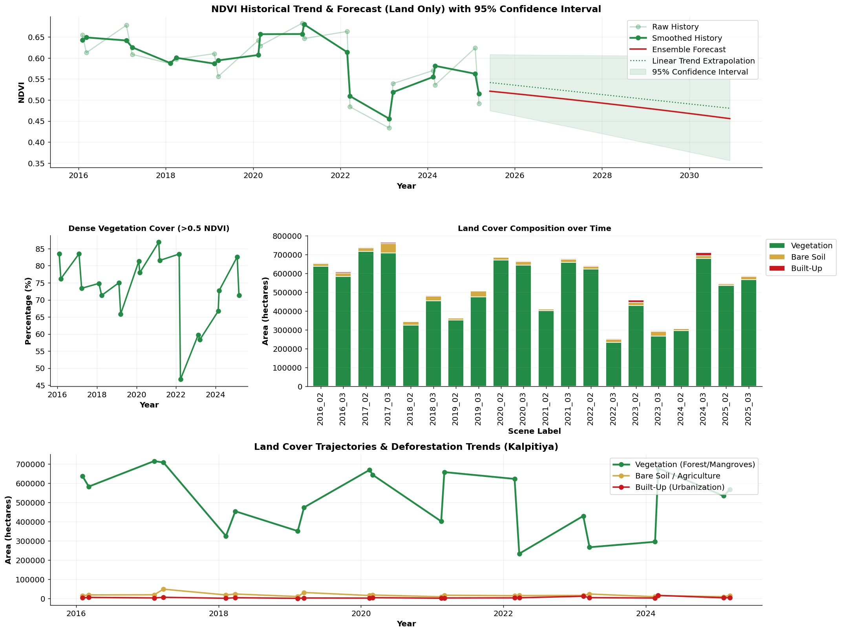
11 Forecasting Results
MEMBER 4
Linear Regression
Captures the overall downward trend. Long-term slope is negative, confirming vegetation decline.
Polynomial Regression
Degree-2 fit. Shows acceleration of loss in 2022–2023 and potential levelling after 2024.
Gradient Boosting
Non-parametric approach. Fits the complex, episodic historical patterns more closely.
Ensemble Forecast
Average of all three models. Red line in top panel. Widening CI shows forecast uncertainty grows toward 2030.
12
Figure 14 – NDVI forecast to 2030 (top), dense veg %, land cover area, and deforestation trends
⚠ Models are trend extrapolations — not scenario-based. They don't include rainfall or policy factors.
Notes:
“To forecast future vegetation trends, we used three regression models: Linear Regression, Polynomial Regression, and Gradient Boosting.
We combined them into an ensemble forecast to improve reliability.
The forecast suggests that vegetation may continue to decline if current land-use patterns continue.
However, the confidence interval widens over time, showing that uncertainty increases toward 2030.

Slide 13
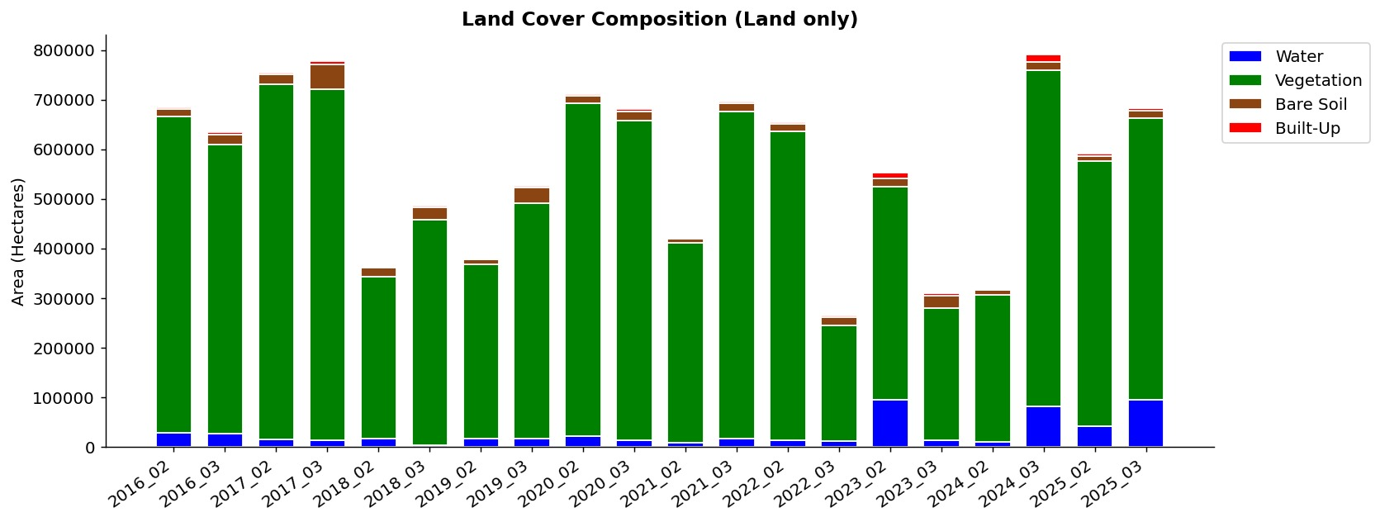
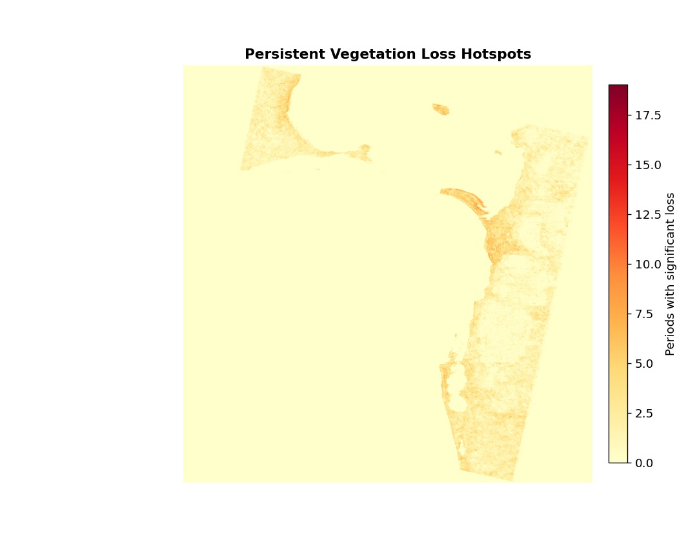
MEMBER 4
12 Results & Discussion
Vegetation Decline
Overall NDVI trend is negative 2016–2025. Most pronounced loss in interior and southern zones.
2022–2023 Spike
Largest vegetation loss on record: ~82.6% of initial area. Likely combined effect of land clearance, drought stress, and cloud effects.
Figure 8 – Land cover area composition (ha) per scene
Partial Recovery (2025)
Encouraging regrowth of ~11,271 ha between late 2024 and early 2025. May reflect natural regeneration.
Classifier Performance
11-feature Random Forest outperformed bands-only model in cross-scene validation. Spectral indices add genuine value.
13
Sequential vegetation gain vs loss by period
Notes:
“Overall, the project shows a negative vegetation trend between 2016 and 2025.
The strongest decline occurred around 2022–2023, while 2025 showed some signs of recovery.
The Random Forest classifier also performed better when spectral indices were included, proving that feature engineering improved classification quality.”

Slide 14
13 Limitations and Future Improvements
Limitations
Future Work
• 60 m resolution misses fine-scale changes
• Use Sentinel-2 (10 m) for higher resolution
• Pseudo-labels = circular validation (no field truth)
• Collect ground truth for true accuracy validation
• Cloud cover limits valid observations in some years
• Incorporate rainfall & land-use policy into forecasts
• Forecasts exclude rainfall & policy variables
• Extend study to broader North Western Province
14
Notes:
“Like any study, there were limitations. Our 60-metre resolution could miss small land changes, cloud cover reduced usable observations, and pseudo-labelling lacks real ground truth validation.
In future work, higher-resolution Sentinel-2 imagery and field validation could improve results.
To conclude, vegetation in Kalpitiya has generally declined over the last nine years, and remote sensing combined with machine learning proved to be a useful and low-cost approach for environmental monitoring.”

Slide 15
14 Conclusion
1
Vegetation in Kalpitiya has shown an overall declining trend between 2016 and 2025, with the steepest losses in 2022–2023.
2
The Random Forest classifier successfully mapped four land cover classes using automated pseudo-labels — no manual annotation was needed.
3
Ensemble forecasting (Linear + Polynomial + Gradient Boosting) projects continued decline unless land use patterns change.
4
Remote sensing provides a practical, low-cost method for environmental monitoring in coastal Sri Lanka.
15
Notes:
Wrap up the project. Run through the four main findings quickly.
The key takeaway is that vegetation has declined, the method worked, and the forecasting points to continued pressure if nothing changes.
Be honest about the limitations – particularly the pseudo-labelling issue and the 60 m resolution.
End on a positive note – remote sensing like this is genuinely useful for countries like Sri Lanka where field monitoring is limited and expensive.
Mention future work briefly, especially the upgrade to Sentinel-2. Thank the lecturer and audience.

Slide 16
?
Questions & Answers
Thank you for listening!
Notes:
“Thank you for listening. We are now happy to take any questions.”

