Slide 1
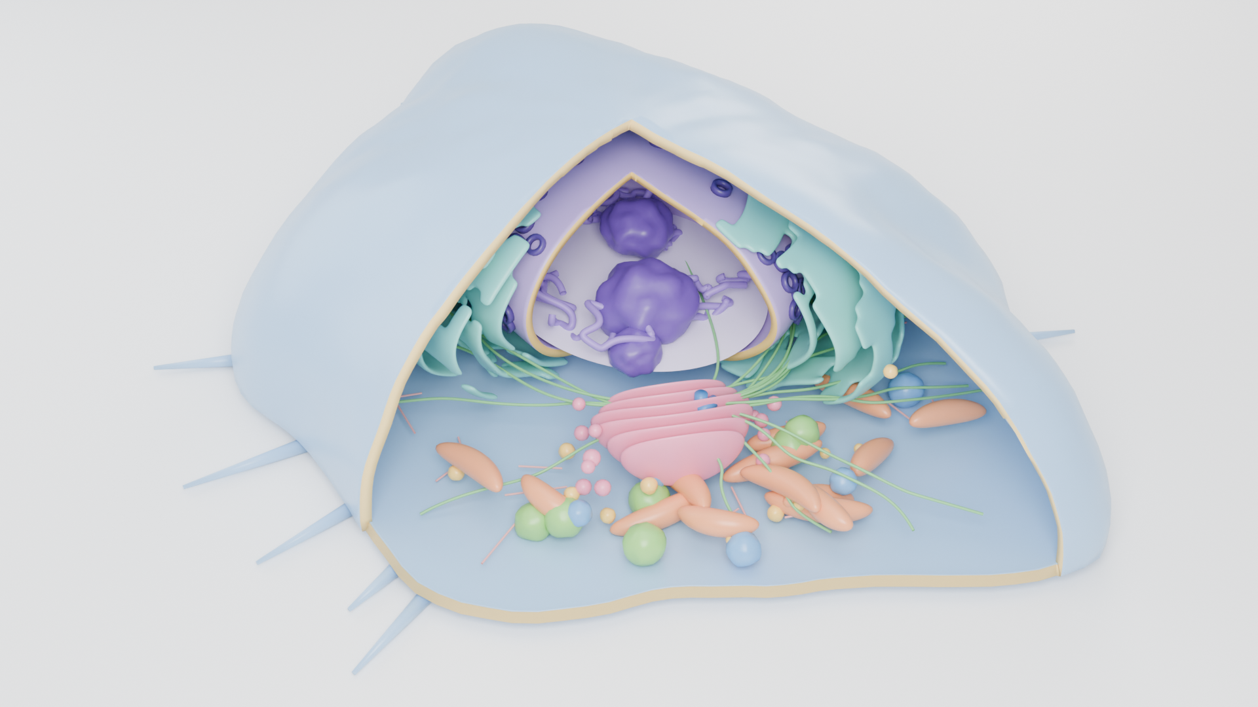
HEK293T — producer cell overview
Option B · pre-rendered (click to zoom with Morph)

Slide 2
Nucleus — zoomed view
In the final deck this becomes a new close-up render or a short fly-in video

Slide 3
Option A · native 3D model
Click the cell and drag the centre handle to rotate it live

Slide 4
Option A · Morph between two 3D views
Same model, rotated and enlarged — Morph animates the camera move

