Slide 1
The Agile Approach
Janai Cano
Domonique.cano@snhu.edu
December 7, 2022

Slide 2
What is Agile?
Developed in 2001, Agile is an adaptive approach to software development
Agile Manifesto values
Individuals & interactions over processes & tools
Working software over comprehensive documentation
Customer collaboration over contract negotiation
Responding to change over following a plan

Slide 3
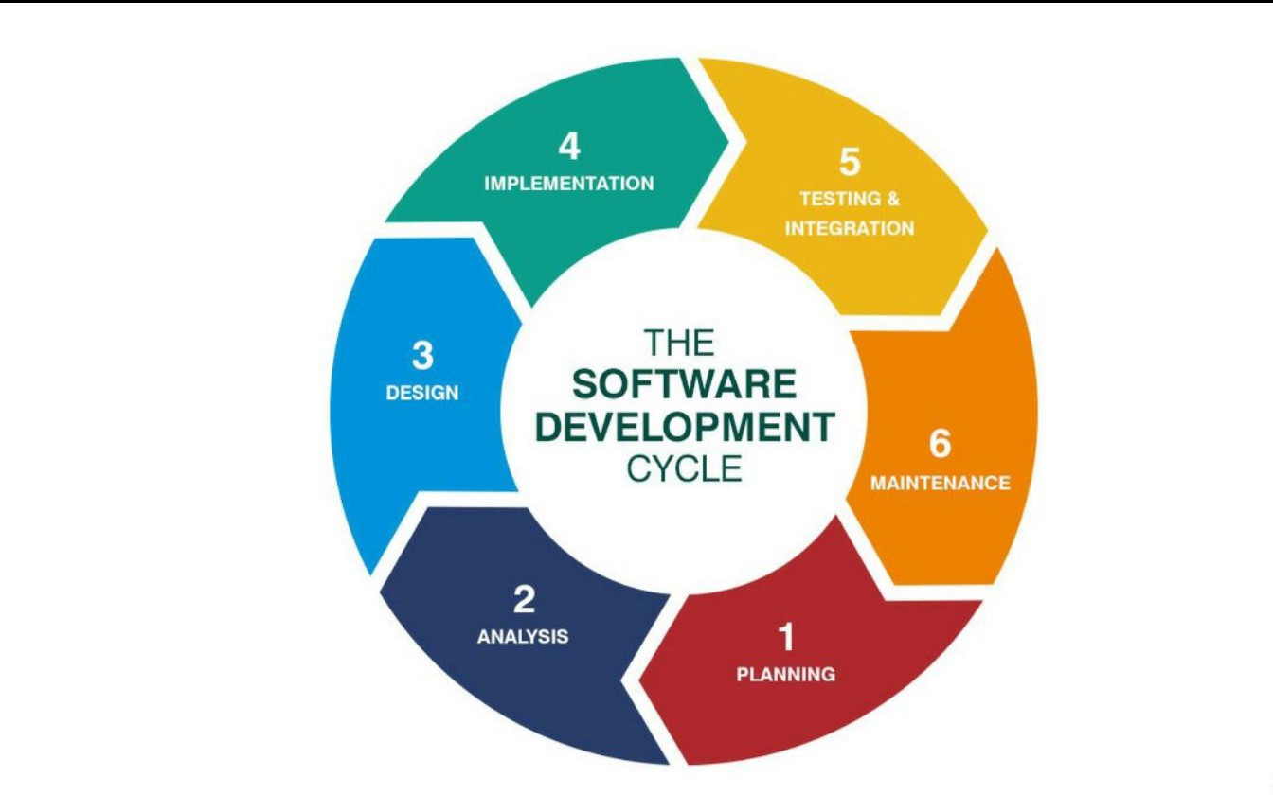
SDLC & Agile
How does agile fit into this software development lifecycle?¹

Slide 4
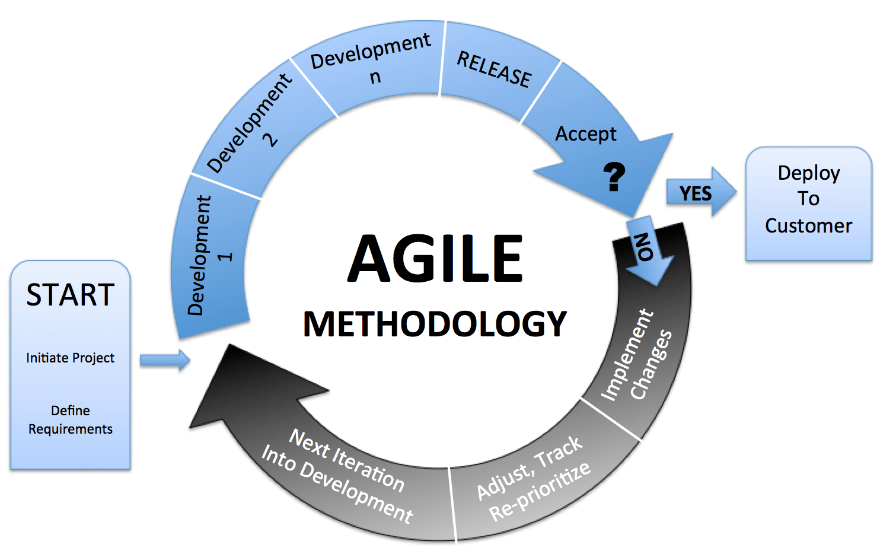
By always developing & testing, products are continuously being changed, fine-tuned to customers and clients needs and wants. Planning is done in terms of Sprints (smaller, scalable deadlines based on development teams estimates). ²

Slide 5
Scrum Method
Scrum is an Agile method that is comprised of teams with roles:
Product Owner: a liaison between the client & development team, lends expertise to both sides, develops user stories based on client’s needs, refines backlog, communicates with everyone within the project.
Scrum Master: develops Sprints based on the backlog (along with Product Owner), sits in on Daily Scrum meetings with the team to discuss day-to-day to-dos, helps the team with any issues that come up during development, keeps team on track.
Tester: creates test cases based on user stories & client requirements, works closely with developers & Scrum Master in refining user stories/product requirements.
Developer: codes software that passes test cases based on the backlog. Works closely with the tester & Scrum Master in refining requirements/user stories.
Each role works closely together, using information radiators that keeps communications transparent. Any changes that occur, whether foreseen or unforeseen, are welcome using this method, as most of the planning happens along the way as changes come. ³

Slide 6
Agile vs. Waterfall
Agile
Waterfall
Developed in 2001
Thrives on change
Planning is done based on how little/how much is known beforehand about the project
Testing is done throughout development
Collaboration-based, with clients having an idea of what they need, developers & clients fine-tuning what the product should have
Changes are done thru backlog refinement, which is part of the agile process & is welcome!
Developed in the 1970s
Has little to no room for change
Planning is all done in Phase One of this method
Testing is done last, once the product is complete
Contract-based, with clients listing out needs & developers fulfilling those needs
Any change in plans results in the entire project going back to Phase One: planning

Slide 7
Final Thoughts
With the rise of technology, the need for swift, working software has also risen. Developing using Agile is a guarantee that the product is:
what the client wants
what the user wants
working & successful
Spending less time planning & more time collaborating, communicating, & developing ensures that the software being developed is as fast, productive, & successful as possible!

Slide 8
References
1. Best Practices to Secure Your SDLC Process. (2022). Retrieved 9 December 2022, from https://dzone.com/articles/best-practices-to-secure-your-sdlc-process
2. Charles G. Cobb. (2015). The Project Manager’s Guide to Mastering Agile : Principles and Practices for an Adaptive Approach. Wiley.
3. Hardik Patel. Essential Clients’ Guide to Agile Development Methodology. (2022). Retrieved 9 December 2022, from https://www.newsforpublic.com/agile- development-methodology/

