Slide 1


Basketball Analytics
Anthony Nguyen & Diego Jones

Slide 2


Our Vision
Initial Objective – Classifying NBA All Stars based on traditional statistics.
New Objective – Re-Classify players using advanced statistics based on positions they play on the court rather than the traditional counting statistics for position names.
Stat URLs: 1. https://www.basketball-reference.com/leagues/NBA_2020_advanced.html
2. http://nbashotcharts.com/home
3. https://www.bball-index.com/current-pipm/
Advanced Metrics – BPM, Win Shares, True Shooting Percentage, 3 Point Attempt Rates
Real Adjusted Four Factors – Regularized Adjusted Plus Minus (RAPM), Luck Adjusted RAPM, 4 Categories
PIPM – Player Impact Plus-Minus

Slide 3

Data Extract
Clean data
Machine Learning
Visualize

Slide 4

K Means Cluster
Unsupervised learning project
Categorize players into groups of similarity
from sklearn.cluster import KMeans

Slide 5
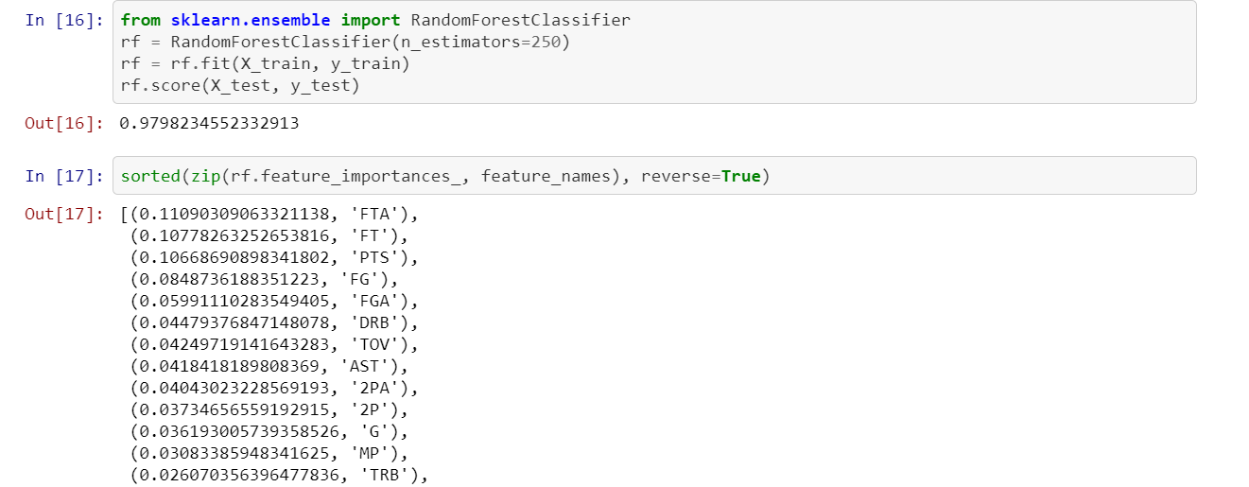
Random Forest
Supervised learning project
From sklearn.ensemble import RandomForestClassifier

Slide 6


Principal Component Analysis (PCA)
from sklearn.decomposition import PCA

Slide 7
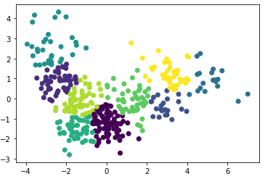
Visualization - Clusters
https://public.tableau.com/profile/anthony.nguyen6771#!/vizhome/nba-tableau/PCAChart
https://public.tableau.com/profile/diego5248#!/vizhome/MLproject/Sheet1

Slide 8
Looking Back
More Advanced Metrics – RAPTOR
In Game Actions – Posts Ups, isolations, Catch and Shoot Frequency.
Larger Sample Size

