Slide 1
VRFramework Framework
By Mike Brascome

Slide 2
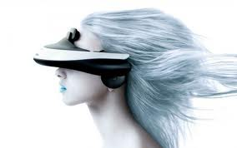
Virtual Reality Visor

Slide 3

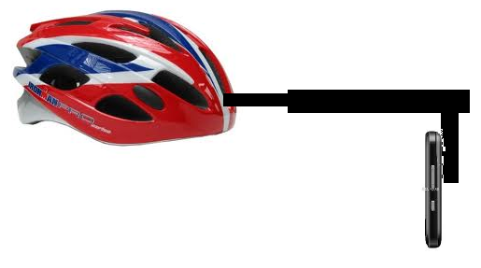
Economy Virtual Reality Visor

Slide 4
The Plan
Hard Hat
3D Engine (Unity 3D)
Smart Phone (Android)
Connector
Holodeck Framework

Slide 5
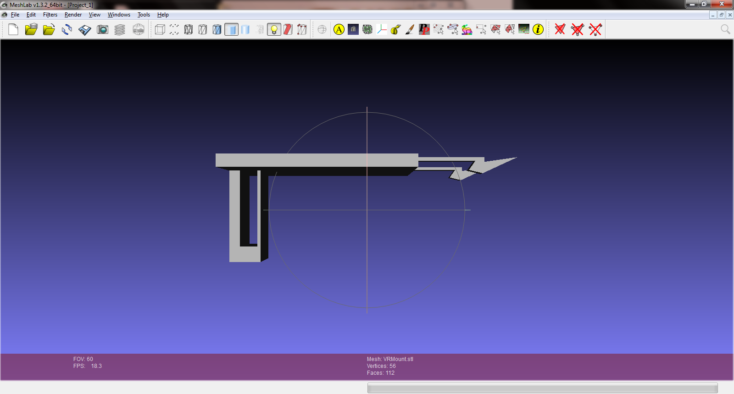
VR Mount

Slide 6
Holodeck Code Structure
Client Code
Holodeck Framework
I Socket
Unity 3D

Slide 7
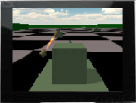
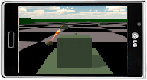
WiFi/USB Communication
Video stream of 3D view
Accelerometer Data

Slide 8
Data from phone arrives in a single data structure
Accelerometer
Magnetometer
Key Press Events
Touch Events
Track Events

Slide 9
Extremely Simple Integration
void Awake()
{
//Open a connectoin to the phone through USB
VRUtilities.StartVRClient(this);
}
void Update ()
{
//send the video to the phone
VRUtilities.SendVideoStream(intHeight, intWidth);
//Use ControllerMessages to position the 3D camera
Position3DCamera(cntlMsgs);
}

Slide 10
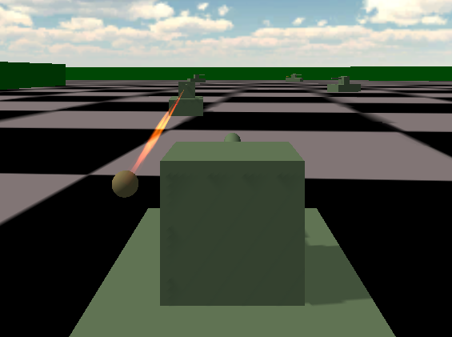
Tank Arena

Slide 11
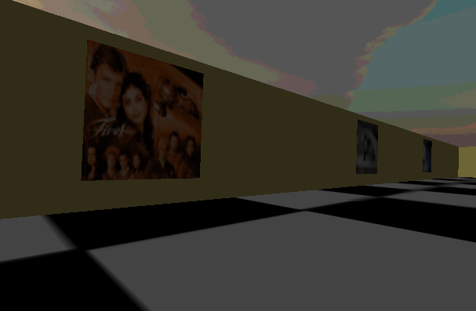
Virtual Gallery

Slide 12
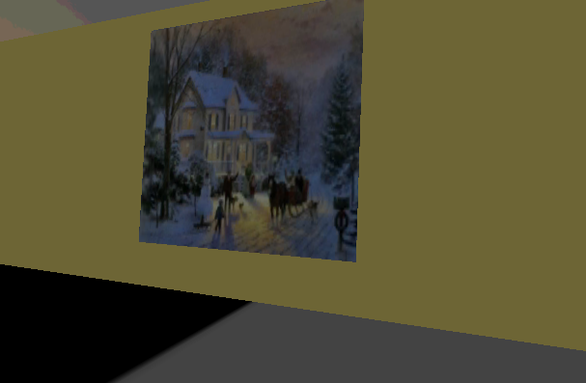
Virtual Gallery

Slide 13
Future Application Plans
3D Art Gallery
Step through the picture frame
Martian Landscape Explorer
Walk around the rover landing sites
Cloud Walker

