Slide 1

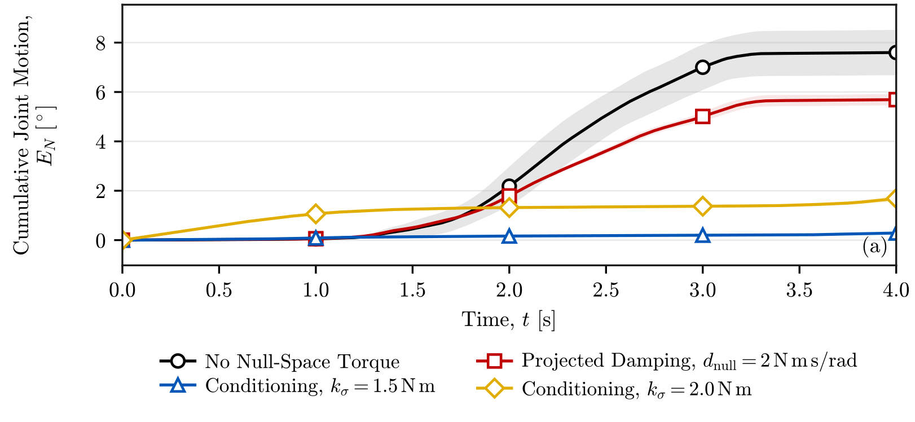
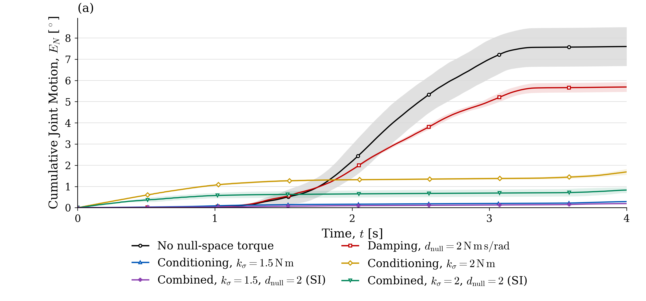
Effect of conditioning torque
Cumulative joint motion · Three-trial means
Conditioning torque [N m] | Conditioning alone [°] | Combined [°]
1.5 | 0.29 | 0.19
2 | 1.69 | 0.83
Combined damping: 2 N m s/rad
At 1.5 N m, both settings produced less cumulative motion.
Adding damping reduced motion at both tested torque magnitudes.
Design and Implementation of a Real-Time Impedance Controller for a 7-DOF Collaborative Robot
23
Master Thesis · Heykel Khadhraoui
Notes:
The previous slides used 2 newton metres to make the contrasting responses visible. The lower tested conditioning torque of 1.5 newton metres produced less cumulative motion in both conditions.
Conditioning alone gives 0.29 and 1.69 degrees at the two magnitudes. With the same damping coefficient of 2 newton metre seconds per radian, the combined values are 0.19 and 0.83 degrees.
These are three-trial means. The complete curves and their sample standard deviations are retained in the backup slides.
Increasing conditioning torque did not reduce motion in these trials. Its magnitude and damping should be considered together.
[Sources]
MyOwn/figures/ch05/MAIN_NS_nullspace_automatic.pdf, panels (a)--(c)
MyOwn/chapters/05_results_and_discussion.tex, Null-Space Pose-Hold Results
MyOwn/code/python/figures/make_nullspace_figure.py
Thesis_Final_Control/experiments/derived/MAIN_NS_automatic_summary.csv. Three trials per setting
one sample standard deviation. Figure provenance: Final Presentation/figures_and_images/manifest.json.
All null-space result metrics use the recorded samples from original t = 5.000 s to 9.000 s inclusive. The displayed time is t_d = t - 5 s, spanning 0 to 4 s after disturbance onset. Cumulative joint motion, net joint motion and minimum-singular-value change use this same interval. The time integrals use actual recorded timestamps. Three trials per setting. Shading and error bars show one sample standard deviation.
[Combined experiment]
Mode 3: tau_null = tau_sigma + tau_damping. k_sigma = 1.5 or 2 N m, d_null = 2 N m s/rad. Three trials per combined setting on 2026-09-16. Exact archived controller revision 0210e7f2 and saved parameters, with only mode 2 changed to mode 3. Original 5–9 s interval, displayed as 0–4 s. Later acquisition session: session effects were not independently controlled.
experiments/h_mode_combined/README.md
experiments/h_mode_combined_1p5/README.md
figures_and_images/sources/combined_nullspace_provenance.json
figures_and_images/sources/make_combined_nullspace.py
[Narrative]
Main comparison: no torque, damping 2, conditioning 2, combined 2+2. Parameter comparison: conditioning 1.5 and 2, each with and without damping 2. Original 18 measured trials retained. Main plots use the same processing as six-setting backups. Combined trials were acquired in a later session, so session effects are not independently controlled.
figures_and_images/sources/make_nullspace_narrative.py

