Slide 1

Hochschule München University of Applied Sciences
Master Thesis Defense
Computational Engineering (M.Sc.)
Heykel Khadhraoui
Design and Implementation of a Real-Time Impedance Controller for a 7-DOF Collaborative Robot
Supervisors: Prof. Norbert Nitzsche · Prof. Ruth Otto
2026
Notes:
Title
Target time: 0:30
Introduce yourself, the degree programme and the thesis. State the application in one phrase: a rectangular tool approaching a planar surface. The measured study concerns compliant contact entry; sustained grinding is the intended subsequent application.
Source: gg0(1).pptx, title slide; Thesis title page

Slide 2
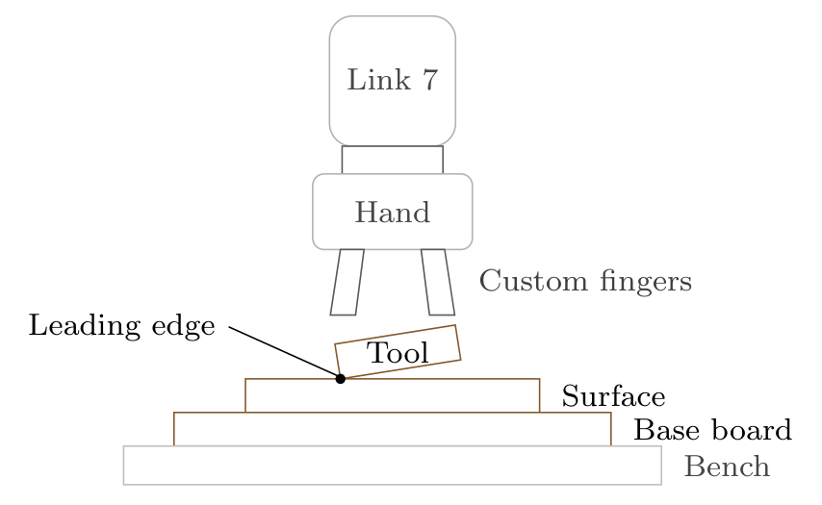
Motivation
Problem
Tilted tool → edge-first contact
Rigid tracking resists corrective rotation
Main thesis question
How do stiffness and the compliance centre affect passive alignment?
Idea
Apply the press; let contact rotate the tool
Design and Implementation of a Real-Time Impedance Controller for a 7-DOF Collaborative Robot
1
Master Thesis · Heykel Khadhraoui
Notes:
Motivation
Target time: 1:20
Begin with the leading edge in the illustration. Small placement and mounting errors mean the tool may meet the plate at an edge rather than across its face. A rigid pose controller resists rotation. The intended behaviour is to keep pressing while allowing contact to rotate the tool. The specific research question is how directional stiffness and the virtual centre of compliance affect that response. Introduce those two settings gradually in the next slides.
Source: Thesis, Sections 1.1–1.3; figures/ch04/setup_schematic.tex

Slide 3
Overview
Cartesian impedance
Virtual centre of compliance
Experiments and results
Conclusion
Design and Implementation of a Real-Time Impedance Controller for a 7-DOF Collaborative Robot
2
Master Thesis · Heykel Khadhraoui
Notes:
Overview
Target time: 0:25
Outline the sequence once: how compliance is generated, how its reference point changes the moment, what was measured, and the main conclusion. Do not repeat the motivation.
Source: Presentation structure

Slide 4








Cartesian impedance
Translational spring–damper
•
commanded force / moment
•
position / orientation errors
Rotational spring–damper
•
translational / rotational stiffness
•
translational / rotational damping
•
linear / angular velocity
Stiffness resists pose errors
Damping reduces oscillation
•
desired / measured end effector
Compliant contact instead of rigid tracking
Design and Implementation of a Real-Time Impedance Controller for a 7-DOF Collaborative Robot
3
Master Thesis · Heykel Khadhraoui
Notes:
Cartesian impedance
Target time: 1:50
Explain the virtual spring and damper before reading the equations. A pose error creates a commanded force or moment through stiffness; a velocity difference contributes damping. Briefly introduce the symbols in the right column. K and D are directional matrices, not just scalar gains. The dot over p means velocity. The subscript d is desired and EE denotes the measured end effector. The real-time implementation maps the resulting wrench to joint torque. Avoid deriving the Jacobian or the full rigid-body dynamics in the main talk.
Source: Thesis, Equations (2.19)–(2.21), Section 3.1

Slide 5

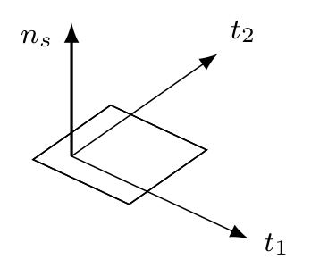
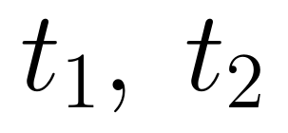
Surface-relative compliance
•
outward surface normal
•
two perpendicular surface tangents
Translation
Softer normal pressing
Stiffer motion along the surface
Rotation
Softer tilting about the tangents
Stiffer turning about the normal
Design and Implementation of a Real-Time Impedance Controller for a 7-DOF Collaborative Robot
4
Master Thesis · Heykel Khadhraoui
Notes:
Surface-relative compliance
Target time: 1:15
Use the three arrows to define the surface frame. Normal means perpendicular to the plane, while the two tangents lie in the plane. For translation, the controller should yield more in the pressing direction and retain tangential position. For rotation, it should allow tilt about either tangent but retain the in-plane orientation through greater stiffness about the normal. These directional choices are more important here than the numerical gains.
Source: Thesis, Sections 2.5, 3.2.5 and Table 4.2

Slide 6

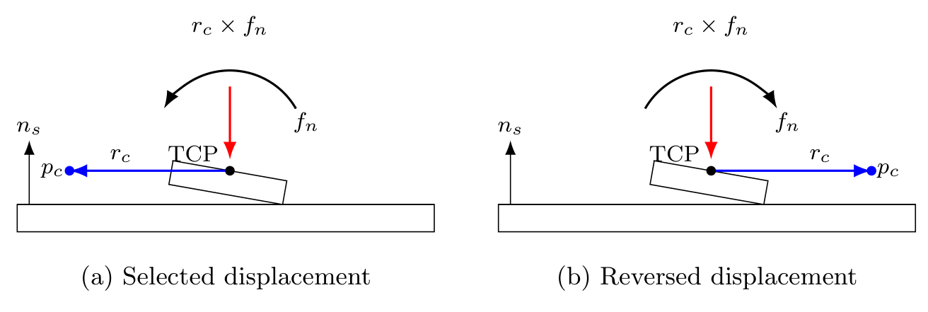




Centre of compliance (CoC)
•
TCP
tool centre point; controlled reference
•
virtual compliance centre
•
displacement from TCP to centre
•
normal part of commanded force
Tangential shift → preferred rotation
•
rotational spring–damper moment
Reversed shift → reversed additional moment
Design and Implementation of a Real-Time Impedance Controller for a 7-DOF Collaborative Robot
5
Master Thesis · Heykel Khadhraoui
Notes:
Centre of compliance
Target time: 1:55
Introduce the TCP as the controlled reference attached to the end effector. The centre of compliance is a virtual reference for the impedance, not a physical hinge. r_c points from the TCP to the virtual centre; p_c is its position. Shifting the reference introduces translation–rotation coupling. The moment is the ordinary rotational spring–damper moment plus r_c cross f. The sketch isolates the normal-force contribution for a tangential displacement. Reversing the displacement reverses that contribution. At the TCP the additional term vanishes, but rotational stiffness remains active. This explains why one displaced centre can assist one tilt direction while opposing the other.
Source: Thesis, Equations (2.35), (2.42), (2.49); figures/ch02/compliance_lever_moment.tex

Slide 7
Experimental procedure
Tool orientation
→
Surface approach
→
Contact establishment
→
Pre-grinding hold
Contact study
Controlled comparison
Rectangular tool: 40 × 120 mm
A: centre at the TCP
B / C: rotational / translational stiffness
Five-second contact phase
D: tangential compliance-centre position
Fixed entry orientation reference
57 trials; three repetitions per setting
Design and Implementation of a Real-Time Impedance Controller for a 7-DOF Collaborative Robot
6
Master Thesis · Heykel Khadhraoui
Notes:
Experimental procedure
Target time: 1:15
Show the four phases. The robot first orients and approaches the tool, then applies the pressing trajectory during the five-second Contact Establishment phase. The desired orientation is held at the measured entry orientation, so the observed rotation is generated through compliant contact. Explain the matched comparisons A to D without listing every numerical setting. The 57 contact trials are 19 settings repeated three times; the separate null-space study adds 12 trials. Sustained grinding is outside the quantified contact-entry study.
Source: Thesis, Sections 4.1, 4.3 and 4.4

Slide 8

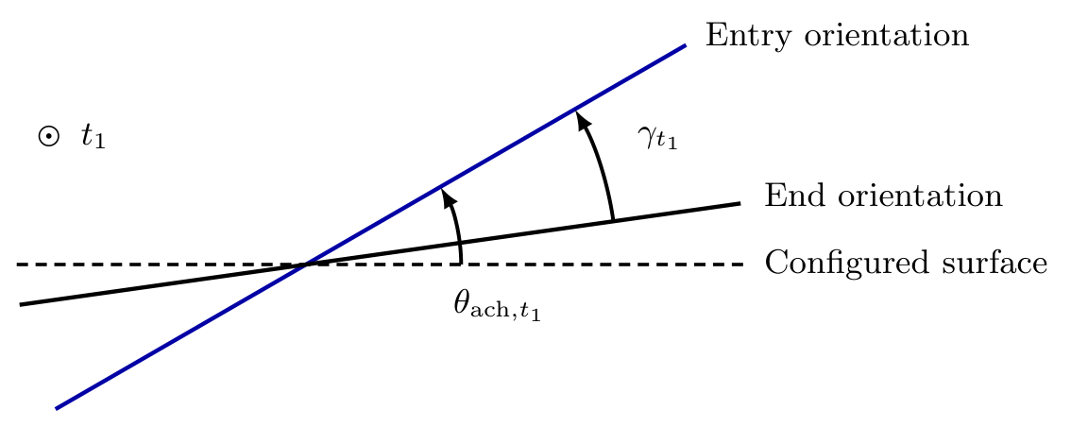
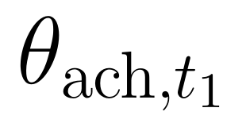
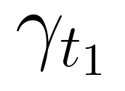
Angular quantities
•
commanded tilt before contact
•
achieved tilt at contact entry
•
signed contact response about the first tangent
Alignment: response has the same sign as the entry tilt
Angles inferred from measured end-effector orientation
Design and Implementation of a Real-Time Impedance Controller for a 7-DOF Collaborative Robot
7
Master Thesis · Heykel Khadhraoui
Notes:
Angular quantities
Target time: 1:20
Distinguish command, achieved entry condition and measured contact response. The configured tilt is what is requested before contact; the achieved tilt is what the pose-based tool direction shows at entry. The response gamma is calculated from the relative end-effector rotation from the measured end orientation back to the held entry reference. Therefore its sign is opposite to the physical start-to-end rotation. In the single-axis illustration, a positive entry tilt and positive gamma correspond to rotation towards alignment. The illustration is a schematic one-axis example; it is not a new general three-dimensional subtraction rule. Physical tool–surface angle is not independently measured.
Source: Thesis, Section 4.5, Equations (4.1)–(4.6)

Slide 9
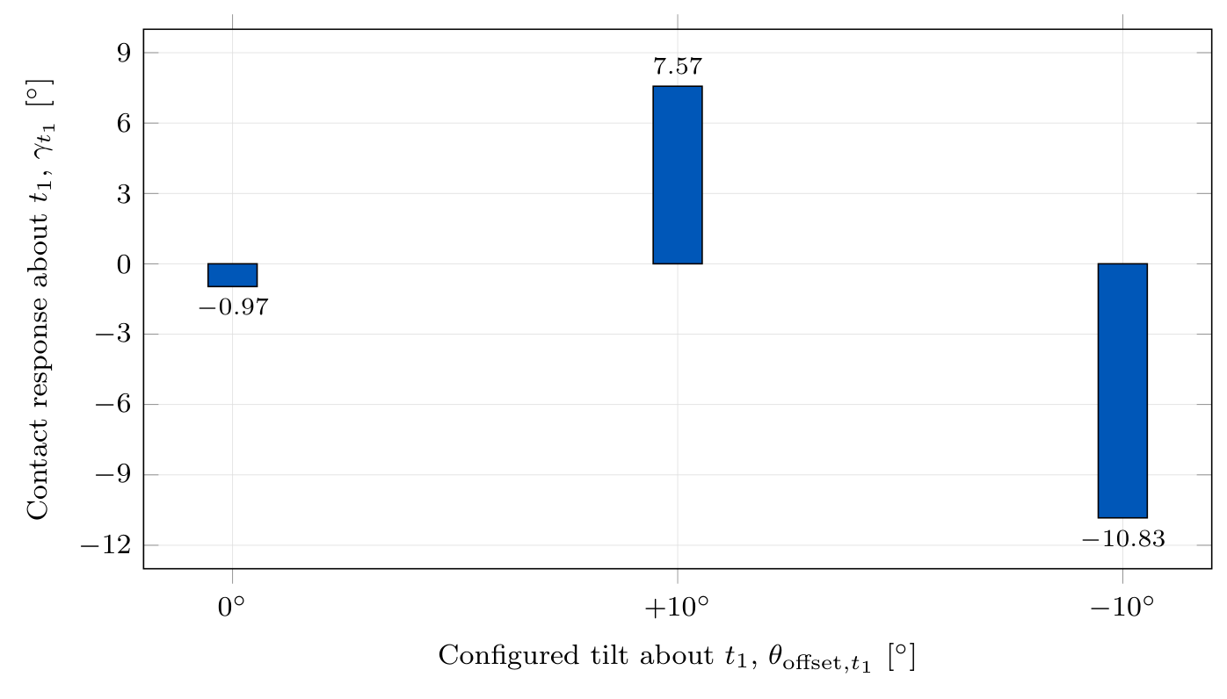
Baseline contact response
Centre of compliance at the TCP
Alignment response for both tilt signs
Unequal response magnitudes
Design and Implementation of a Real-Time Impedance Controller for a 7-DOF Collaborative Robot
8
Master Thesis · Heykel Khadhraoui
Notes:
Baseline contact response
Target time: 1:00
Explain the baseline before parameter changes. The command categories are nominal zero, positive ten degrees and negative ten degrees about the first tangent. The original measured responses are -0.97, +7.57 and -10.83 degrees. Both nonzero-tilt conditions rotate towards the configured surface-parallel orientation, although their response magnitudes differ. The plot intentionally uses configured-tilt categories for all three bars. It does not relabel the former 0.74-degree total mismatch as a signed achieved component; that near-zero achieved component has not been recalculated here.
Source: Thesis, Section 5.2.1 and Table D.1; figures/ch05/results_case_a_bars.tex

Slide 10
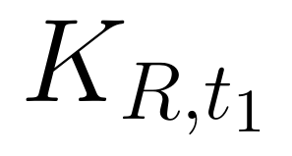
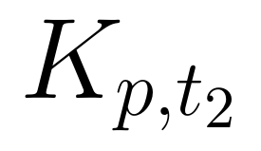
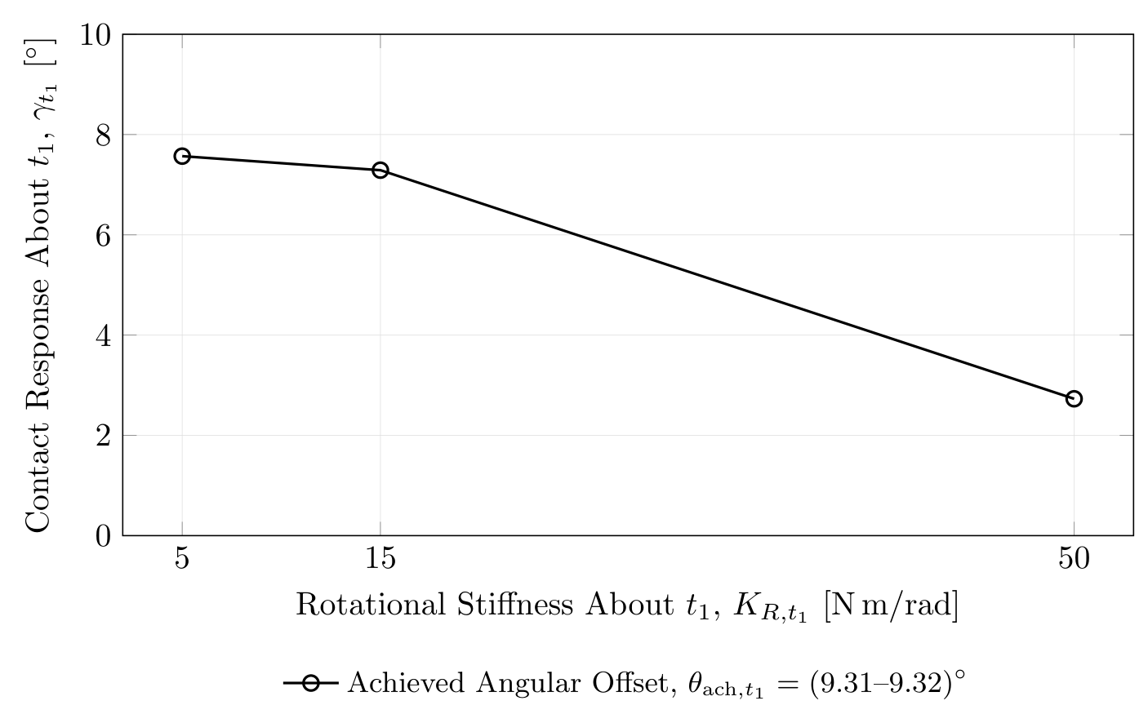
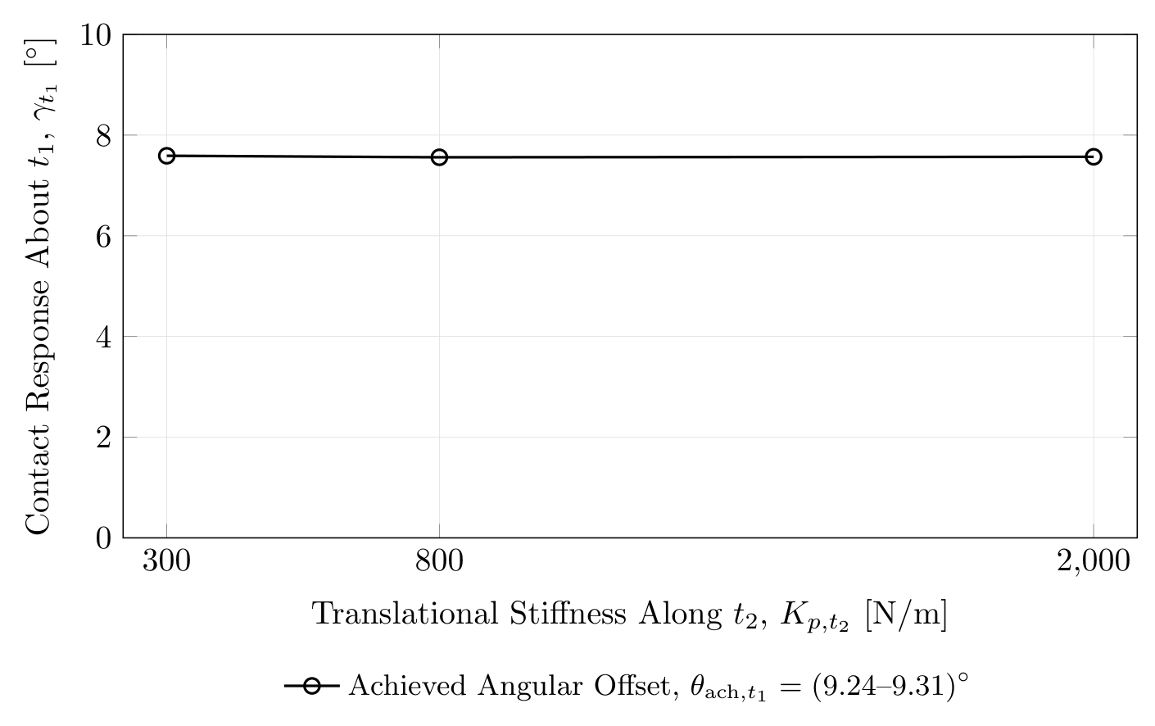
Effect of stiffness
•
resistance to tilting about the first tangent
•
resistance to sliding along the second tangent
Rotational stiffness: 63.9% lower response
Tangential stiffness: 0.4% response span
Design and Implementation of a Real-Time Impedance Controller for a 7-DOF Collaborative Robot
9
Master Thesis · Heykel Khadhraoui
Notes:
Effect of stiffness
Target time: 1:25
First read the left plot. Increasing rotational stiffness from 5 to 50 newton metres per radian reduces the contact response from 7.57 to 2.73 degrees, a 63.9-percent reduction. A stiffer rotational spring resists the aligning rotation. Then contrast the nearly flat right plot: changing tangential translational stiffness from 300 to 2000 newtons per metre produces only a 0.03-degree span, or 0.4 percent of the baseline. State this conclusion within the tested parameter range rather than as a universal rule for contact mechanics.
Source: Thesis, Section 5.2.2; Tables D.2 and D.3

Slide 11
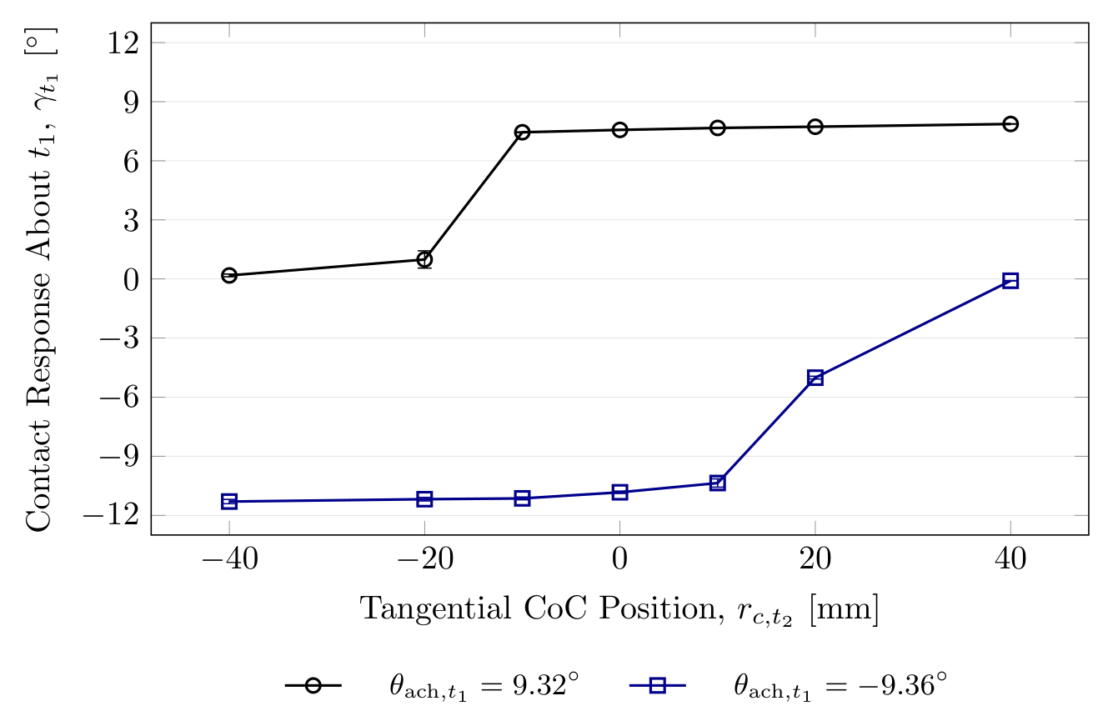
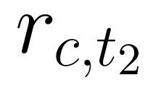
Effect of CoC position
•
CoC displacement along the second tangent
Selected side: about 4% higher response
Opposite side: 98–99% lower response
Required side reverses with the entry tilt
Design and Implementation of a Real-Time Impedance Controller for a 7-DOF Collaborative Robot
10
Master Thesis · Heykel Khadhraoui
Notes:
Effect of CoC position
Target time: 1:40
Introduce the horizontal axis as the signed tangential CoC coordinate along the second tangent. Read one tilt direction at a time. For the positive entry tilt, a positive displacement supports the response and a negative displacement strongly suppresses it. For the negative entry tilt the required side reverses. Compared with the TCP baseline, the supporting side increases the final magnitude by only about four percent, while the opposing side suppresses it by about 98 to 99 percent. The main result is directional preference, not a general increase in compliance or a universally optimal offset. All tested nonzero offsets are tool-fixed; the reported coordinates are the surface projections in the flat target configuration.
Source: Thesis, Section 5.2.3 and Table D.4

Slide 12


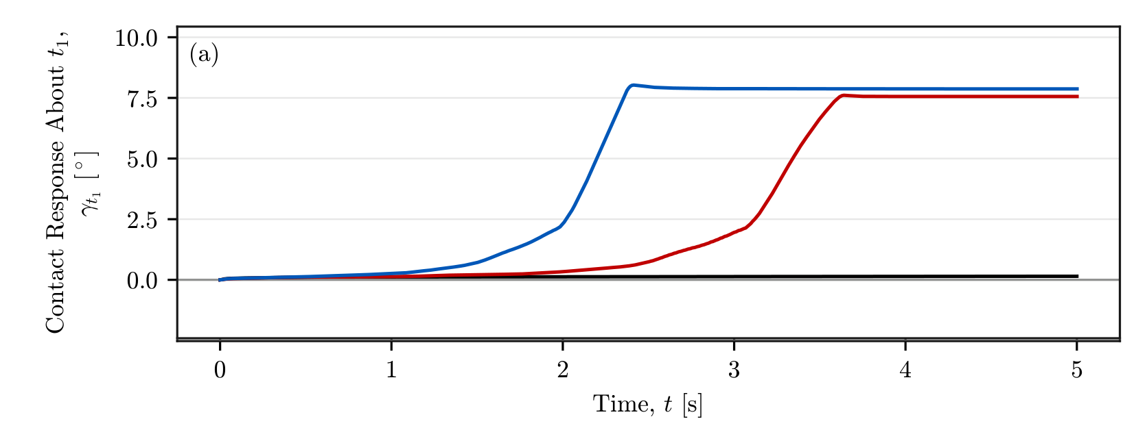
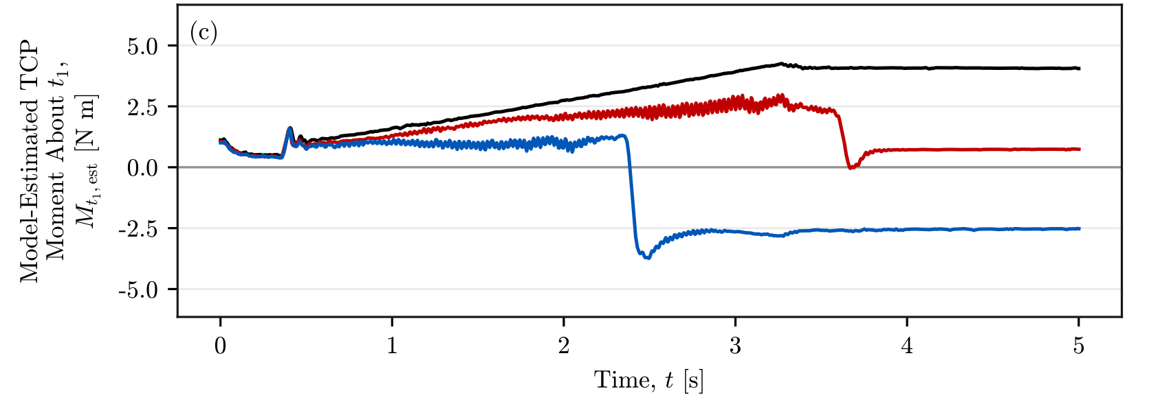
Contact response and interaction moment
•
elapsed contact time [s]
•
model-estimated moment about the first tangent
Similar normal-force levels across the three positions
Moment reversal; selected side reaches its steady response about 1.3 s earlier
Design and Implementation of a Real-Time Impedance Controller for a 7-DOF Collaborative Robot
11
Master Thesis · Heykel Khadhraoui
Notes:
Contact response and interaction moment
Target time: 1:35
The figure panels are extracted as vectors from the original thesis figure, not screen captures. Point out the common black, red and blue CoC settings. The selected side develops its approximately steady response around 2.3 seconds, compared with around 3.6 seconds at the TCP. The interaction moment changes sign between the two displaced settings. The original normal-force panel and the thesis report similar final force levels, approximately -82.9, -79.0 and -78.0 newtons. The moment values are approximately +4.07, +0.73 and -2.54 newton metres. Retain the est qualifier: these are the robot’s model-based external-wrench estimates, not an independent force/torque sensor. The 1.3-second comparison is from these representative traces, not a universal rise-time statistic.
Source: Thesis, Figure 5.8 and Section 5.2.3; figures/ch05/MAIN_D_wrench.pdf

Slide 13


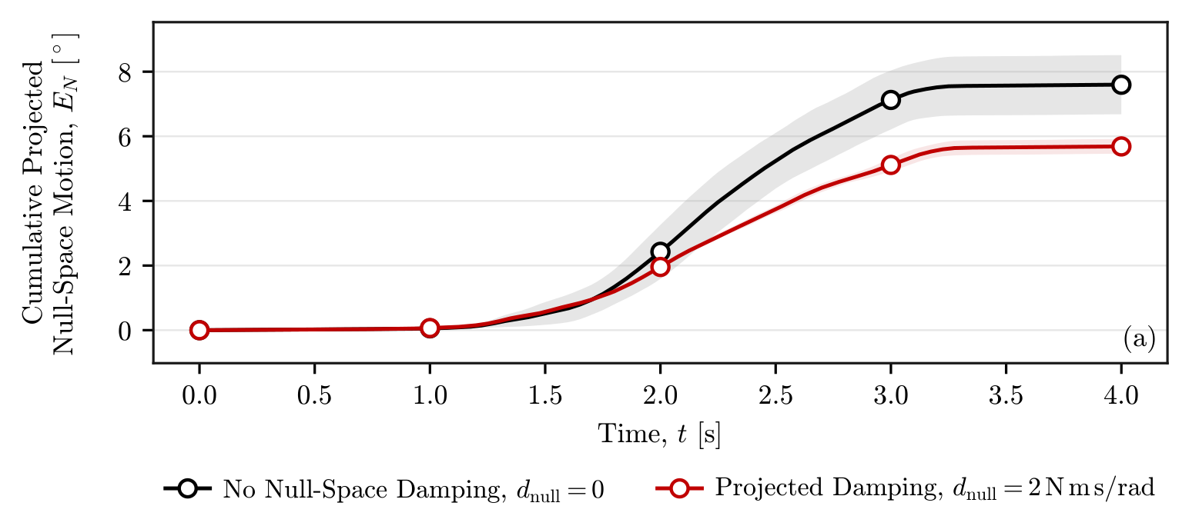
Secondary study: null-space motion
•
cumulative projected joint motion
Null space
•
null-space damping coefficient
Extra joint motion while the tool pose is held
Damping: about 25% less total motion
Conditioning: almost zero final drift
Stronger conditioning: more back-and-forth motion
Design and Implementation of a Real-Time Impedance Controller for a 7-DOF Collaborative Robot
12
Master Thesis · Heykel Khadhraoui
Notes:
Secondary study: null-space motion
Target time: 1:25
Explain redundancy in plain language: seven joints allow internal joint motion while approximately retaining the tool pose. This was a separate pose-hold study, not another contact case. The robot received the same internally commanded disturbance in twelve trials. The plot compares total projected joint motion, not just final drift: damping reduces it from 7.596 to 5.687 degrees, approximately 25 percent. The configuration-conditioning settings leave net projected displacements of 0.015 and -0.006 degrees in the tested direction. The larger conditioning torque produces more back-and-forth motion even though its final drift is small. The largest measured position error over the study is 1.304 mm, below the 2 mm criterion. No derivation of the projector is needed for the main presentation.
Source: Thesis, Sections 4.7 and 5.3; figures/ch05/MAIN_NS_nullspace_automatic.pdf

Slide 14
Scope and next steps
Scope
Next steps
One tool, plane and robot configuration
Independent tool-angle measurement
Tool angle inferred from robot pose
Select the CoC from the entry tilt
Evaluation focused on contact entry
Return to the TCP; test sustained grinding
Design and Implementation of a Real-Time Impedance Controller for a 7-DOF Collaborative Robot
13
Master Thesis · Heykel Khadhraoui
Notes:
Scope and next steps
Target time: 0:50
Keep the limitations proportionate. The repeatable contact comparison concerns one geometry and primarily one surface-tangent rotation. Robot orientation and calibrated tool geometry provide the angle estimate, so tool-mount motion is not independently separated. The next step is direct angle measurement and a tested adaptive strategy: select the useful tangential displacement during alignment, then return to the TCP. Clearly label that strategy as future work.
Source: Thesis, Sections 6.2 and 6.3

Slide 15
Conclusion
Passive alignment through Cartesian impedance
Thank you
Rotational stiffness sets response magnitude
Questions and discussion
CoC displacement creates a preferred direction
Adaptive displacement: next step to evaluate
Design and Implementation of a Real-Time Impedance Controller for a 7-DOF Collaborative Robot
14
Master Thesis · Heykel Khadhraoui
Notes:
Conclusion
Target time: 0:50
Close with the general answer. Cartesian compliance allows passive contact-induced rotation. Rotational stiffness changes how much the tool can respond. A tangential virtual CoC displacement primarily selects the preferred rotational direction by introducing an additional commanded moment. It must therefore be chosen with respect to the angular-offset direction; one fixed nonzero shift is not neutral for both signs. The adaptive strategy remains a proposal to test. Finish and invite questions.
Source: Thesis, Section 6.1

Slide 16
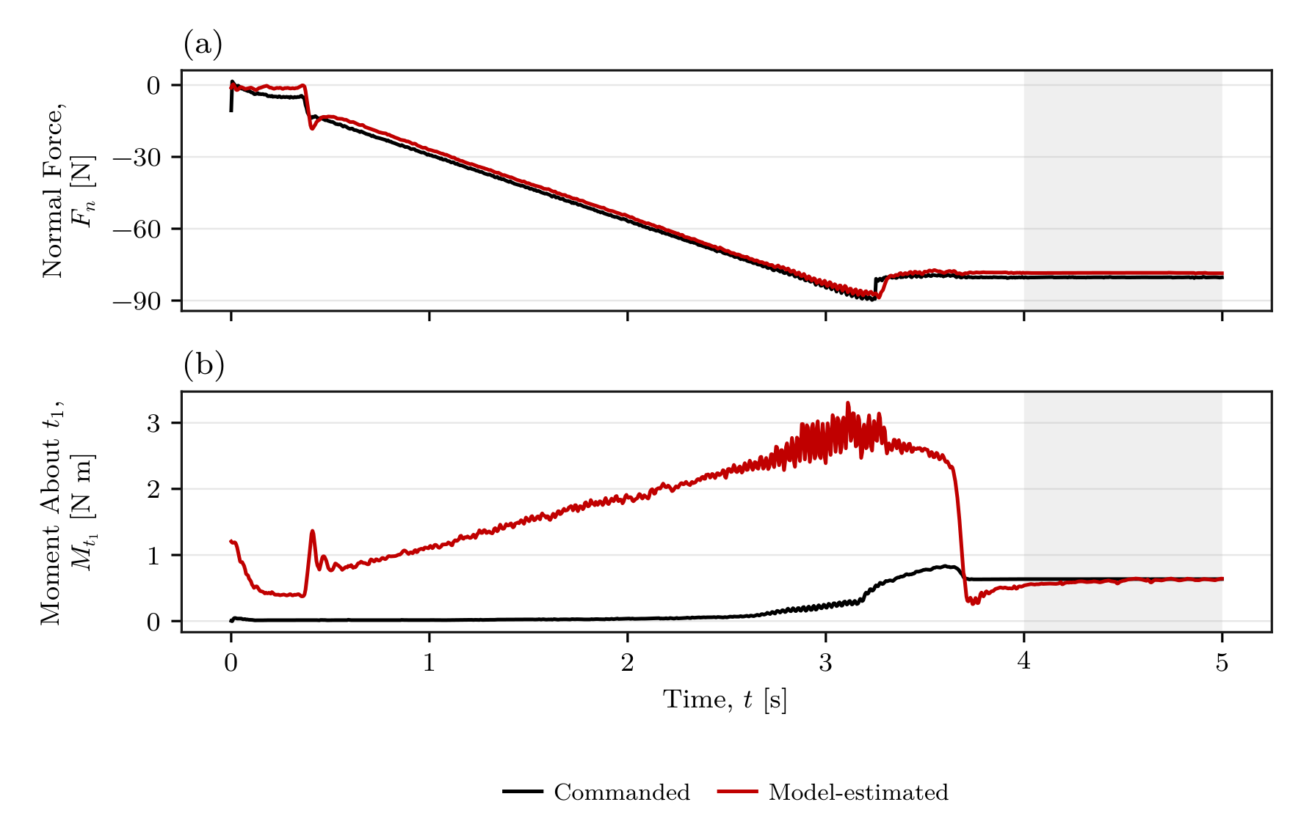



Commanded and estimated wrench
•
commanded normal-force component
•
commanded moment about the first tangent
•
model estimate from the robot
Stationary force difference: 2.32%
Stationary moment difference: 4.87%
Supplementary plausibility evidence
Design and Implementation of a Real-Time Impedance Controller for a 7-DOF Collaborative Robot
B1
Master Thesis · Heykel Khadhraoui
Notes:
Commanded and estimated wrench
Target time: 0:00 (optional backup; outside main talk)
Optional answer to a question about the wrench estimate. Compare the final stationary portion only when quoting the percentages. This does not establish independent sensor accuracy; the command and estimate share the robot model and sign/reference-point conventions defined in the thesis. During the transient the traces need not coincide.
Source: Thesis, Sections 4.6.1 and 5.1.1; Figure 5.1

Slide 17
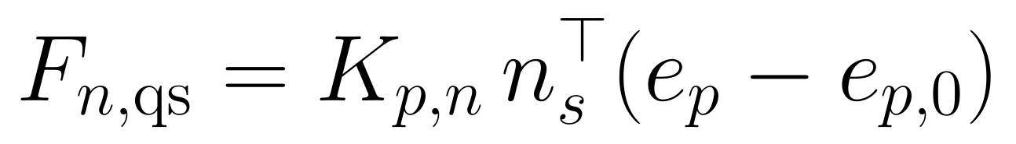
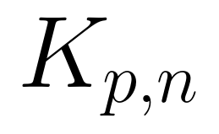
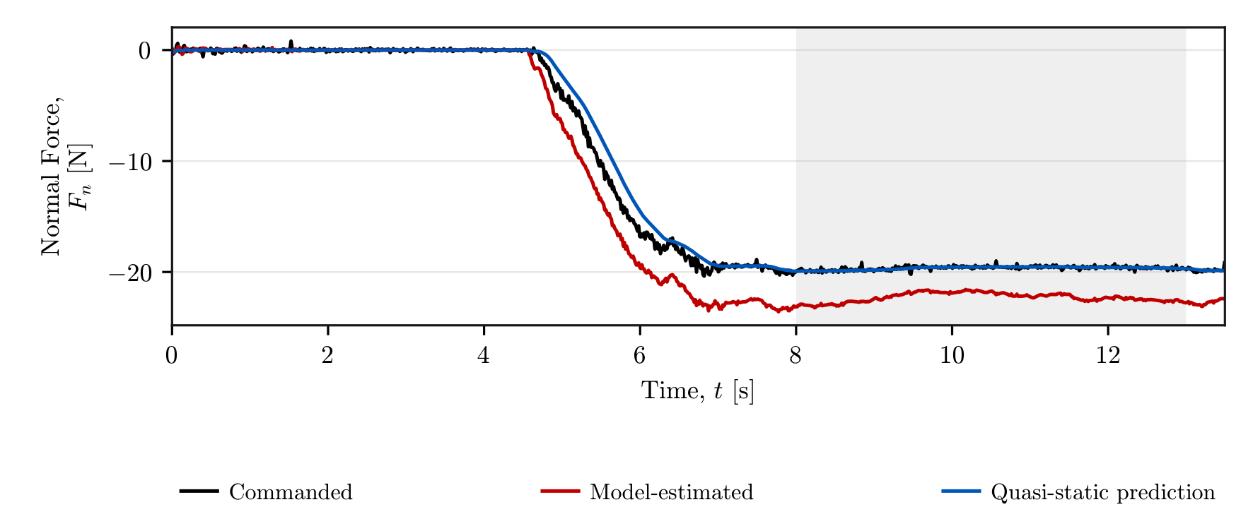
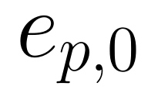

Normal-force plausibility assessment
•
normal translational stiffness
•
position error before perturbation
•
quasi-static spring prediction
Spring vs command: 0.05% difference
Estimate vs command: 13.50% difference
Design and Implementation of a Real-Time Impedance Controller for a 7-DOF Collaborative Robot
B2
Master Thesis · Heykel Khadhraoui
Notes:
Normal-force plausibility assessment
Target time: 0:00 (optional backup; outside main talk)
Optional deeper explanation. The test uses the CoC at the TCP, inactive null-space torque and a held reference. The baseline before manual displacement is subtracted from the evaluated response. With normal stiffness 1000 N/m and measured displacement -19.65 mm, the spring prediction is -19.650 N. The commanded mean is -19.640 N and the model-estimated mean -22.292 N. This supports the implemented spring relation; it is not an independent sensor calibration.
Source: Thesis, Sections 4.6.2 and 5.1.2; Figure 5.2

Slide 18
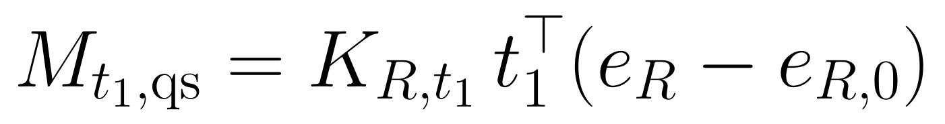
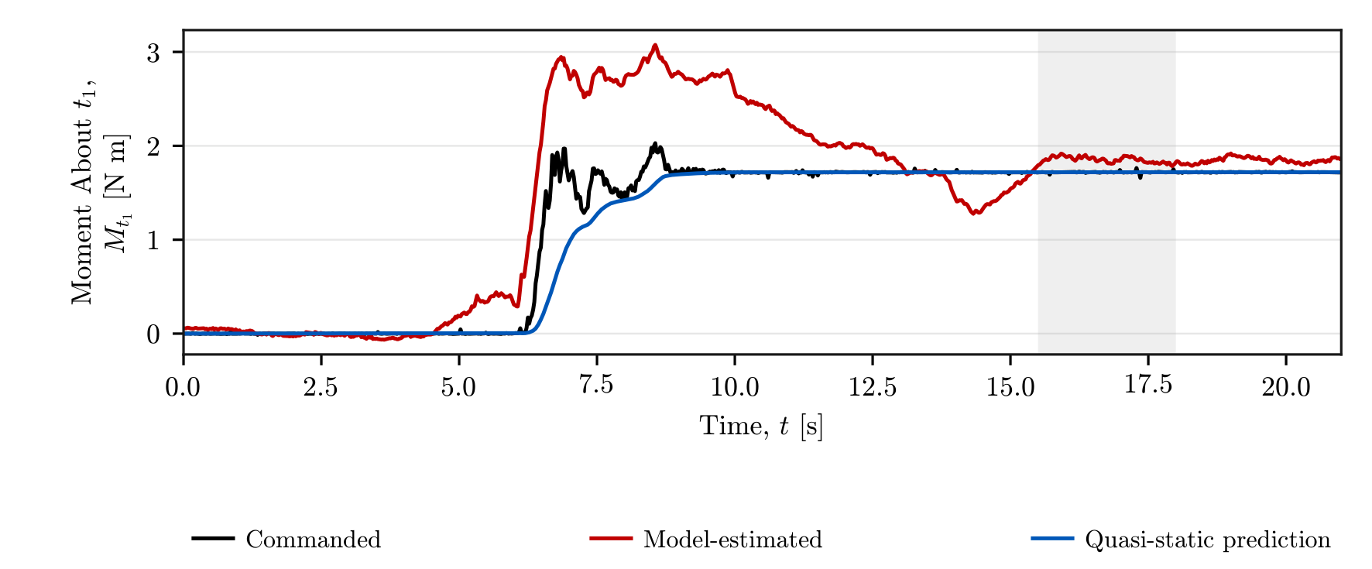
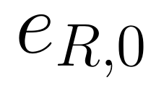
Moment plausibility assessment
•
rotational stiffness about the first tangent
•
orientation error before perturbation
•
quasi-static spring prediction
Spring and commanded mean: 1.719 N m
Model-estimated mean: 1.852 N m
Design and Implementation of a Real-Time Impedance Controller for a 7-DOF Collaborative Robot
B3
Master Thesis · Heykel Khadhraoui
Notes:
Moment plausibility assessment
Target time: 0:00 (optional backup; outside main talk)
Optional deeper explanation. The rotational perturbation starts from the loaded stationary state. Subtracting that reference removes the pre-existing load-related moment from the comparison. The measured rotation is 6.565 degrees and rotational stiffness 15 N m/rad. The spring prediction and commanded mean are both 1.719 N m to reported precision. The model-estimated mean is 1.852 N m, a 7.75-percent difference. Time is local to this evaluation; it is not evidence of a separately recorded trial.
Source: Thesis, Sections 4.6.2 and 5.1.2; Figure 5.3

