Slide 1

Hochschule München University of Applied Sciences
Master Thesis Defense
Computational Engineering (M.Sc.)
Heykel Khadhraoui
Design and Implementation of a Real-Time Impedance Controller for a 7-DOF Collaborative Robot
Passive contact-induced alignment of a rectangular grinding tool on a planar surface
Supervisors: Prof. Norbert Nitzsche · Prof. Ruth Otto
2026

Slide 2
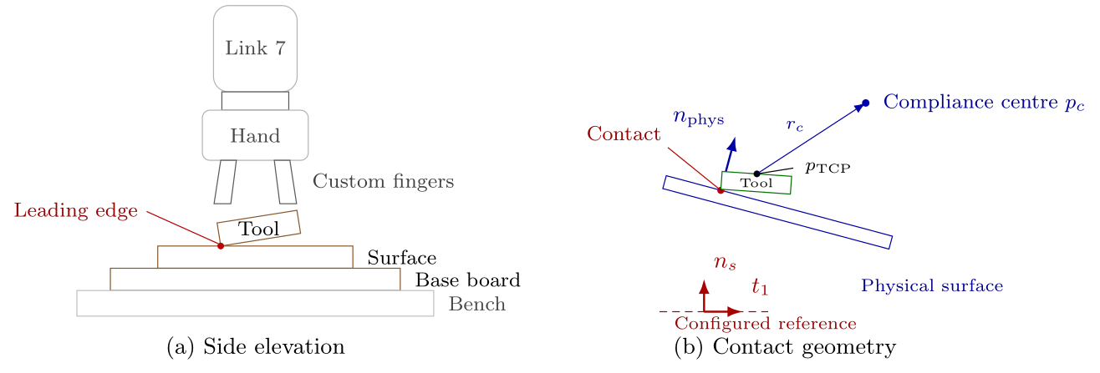
Motivation
Angular mismatch at contact entry can create edge-first contact and high local loads
Problem
• Surface placement, tool mounting and pose tolerances produce a small angular mismatch before contact.
• A rigid pose controller resists the corrective rotation generated at the leading edge or corner.
Desired behaviour
• Maintain the commanded normal press.
• Allow contact interaction to rotate the tool passively towards the surface.
7 DOF
1 kHz
69
Franka Emika Panda
torque-control loop
reported trials
Design and Implementation of a Real-Time Impedance Controller for a 7-DOF Collaborative Robot
1
Master Thesis · Heykel Khadhraoui

Slide 3
Research objective and contribution
What the controller should achieve and what the experiments measure
Main question
Contributions
How do directional stiffness and the position of the virtual centre of compliance influence passive tool alignment during Contact Establishment?
• Real-time Cartesian impedance controller with surface-relative stiffness and damping.
• Shiftable virtual centre of compliance that couples translation and rotation.
• Experimental comparison of rotational stiffness, translational stiffness and CoC position.
• Separate evaluation of projected null-space damping and singular-value conditioning.
Primary measured response
γₜ₁ — signed end-effector rotation about the first surface tangent during Contact Establishment
Design and Implementation of a Real-Time Impedance Controller for a 7-DOF Collaborative Robot
2
Master Thesis · Heykel Khadhraoui

Slide 4
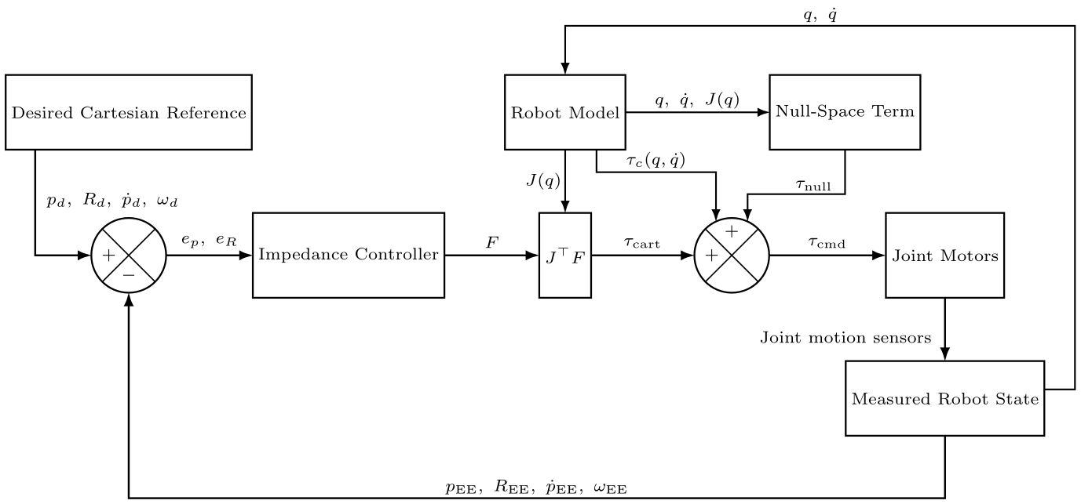


Controller concept
Cartesian impedance in the surface frame and torque-level implementation
Cartesian impedance
Joint-torque command
• The desired orientation is held during Contact Establishment.
• Finite rotational compliance lets the measured contact moment generate the observed rotation.
The controller does not prescribe an additional alignment trajectory.
Design and Implementation of a Real-Time Impedance Controller for a 7-DOF Collaborative Robot
3
Master Thesis · Heykel Khadhraoui

Slide 5
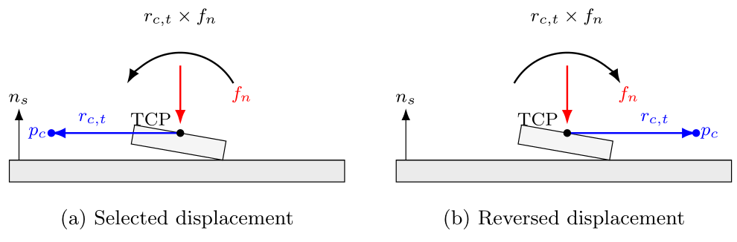




Virtual centre of compliance
A tangential CoC displacement turns the normal press into a direction-selective moment
Small-angle direction used for the general selection rule
• u gives the first-order direction of the combined small rotations about t₁ and t₂.
• r₍c,t₎ is selected perpendicular to u in the surface tangent plane.
• With Fₙ < 0 during pressing, the resulting contribution acts opposite to u and supports reduction of the offset.
Design and Implementation of a Real-Time Impedance Controller for a 7-DOF Collaborative Robot
4
Master Thesis · Heykel Khadhraoui

Slide 6
Experimental setup and procedure
The contact experiment isolates one parameter at a time while retaining the same geometry and state sequence
1
→
2
→
3
→
4
Tool Orientation
Surface Approach
Contact Establishment
Pre-Grinding Hold
Common Contact Establishment settings
• Normal pressing trajectory along −nₛ.
• Orientation reference held at the measured entry orientation.
• Low rotational stiffness about t₁ and t₂; higher stiffness about nₛ.
• Three repetitions per parameter setting.
Main cases
A: TCP baseline · B: Kᴿ,ₜ₁ · C: Kᵖ,ₜ₂ · D: rᶜ,ₜ₂
Design and Implementation of a Real-Time Impedance Controller for a 7-DOF Collaborative Robot
5
Master Thesis · Heykel Khadhraoui

Slide 7
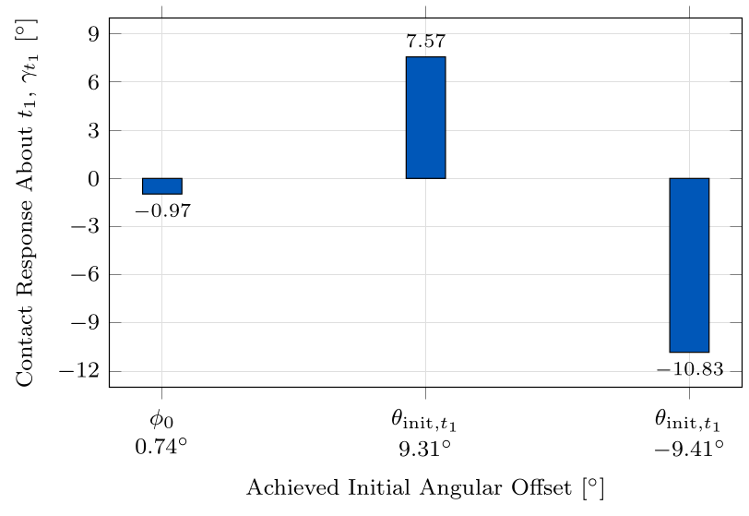
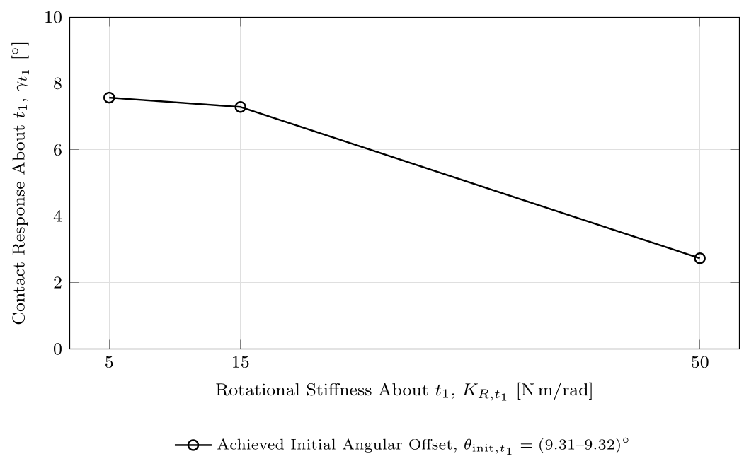
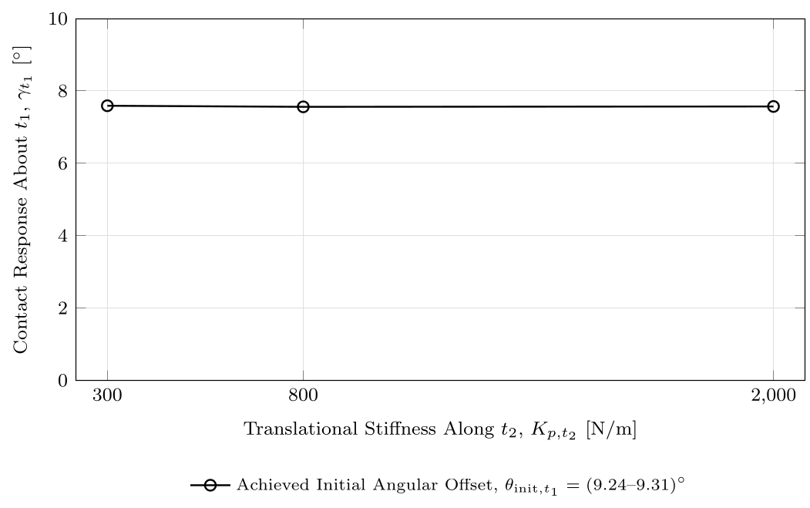
Results I — baseline and stiffness effects
Cases A–C show which controller parameters most strongly change the contact response
Case A
Case B
Case C
TCP-centred baseline
63.9% lower response from 5 to 50 N m/rad
Only 0.4% response span across the tested Kᵖ,ₜ₂ range
Takeaway: the alignment response is much more sensitive to rotational stiffness than to the tested tangential translational stiffness.
Design and Implementation of a Real-Time Impedance Controller for a 7-DOF Collaborative Robot
6
Master Thesis · Heykel Khadhraoui

Slide 8
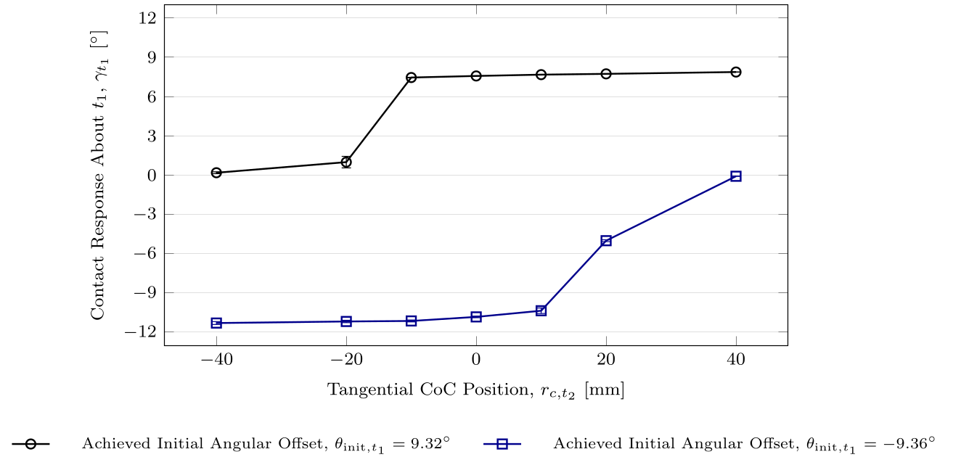
Results II — tangential CoC position
Case D is the main compliance-centre result
What changes with rᶜ,ₜ₂?
• For the positive initial offset, increasing rᶜ,ₜ₂ increases the measured alignment response.
• For the negative initial offset, the same displacement direction progressively suppresses the response.
• A suitably selected displacement increased the final response by about 4%.
• The opposite displacement direction reduced the response by approximately 98–99%.
Main interpretation
The displaced CoC acts mainly as a selector of the preferred rotational direction.
Design and Implementation of a Real-Time Impedance Controller for a 7-DOF Collaborative Robot
7
Master Thesis · Heykel Khadhraoui

Slide 9
Why the CoC position changes the response
The normal press is converted into an additional TCP moment through the virtual lever arm
Physical interpretation
• At the TCP, rᶜ = 0 and the CoC-induced moment vanishes.
• A tangential displacement creates a lever arm relative to the normal pressing force.
• Reversing the displacement reverses the sign of the additional moment.
• Therefore the same normal press can support one rotational direction and oppose the other.
This explains the strong sign dependence measured in Case D.
Design and Implementation of a Real-Time Impedance Controller for a 7-DOF Collaborative Robot
8
Master Thesis · Heykel Khadhraoui

Slide 10
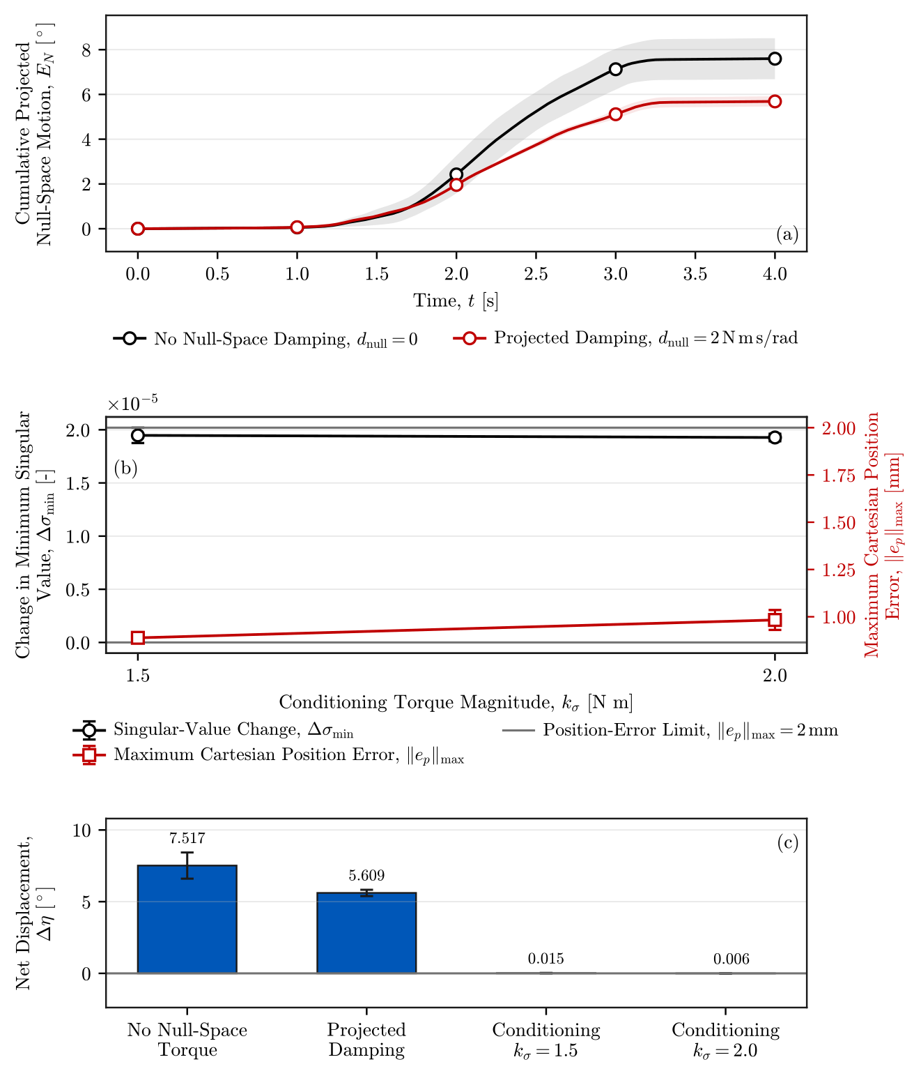
Secondary study — null-space pose hold
Projected damping and singular-value conditioning were evaluated separately
Projected damping
Cumulative projected null-space motion reduced by about 25%.
Singular-value conditioning
Net displacement reduced by about 99.8–99.9% for the tested disturbance direction.
Trade-off
The larger conditioning torque produced more back-and-forth motion although the final net displacement remained near zero.
Design and Implementation of a Real-Time Impedance Controller for a 7-DOF Collaborative Robot
9
Master Thesis · Heykel Khadhraoui

Slide 11
Main conclusions
What the experimental results establish
1
A real-time Cartesian impedance controller produced passive contact-induced rotation towards the configured surface.
2
Rotational stiffness strongly affected the response; the tested tangential translational stiffness had only a minor effect.
3
The virtual CoC mainly selected the preferred rotational direction by changing the additional TCP moment generated during pressing.
4
The TCP-centred CoC is direction-independent and is therefore a suitable final configuration after alignment.
5
The results motivate an adaptive strategy: detect the initial tilt direction, temporarily select the tangential CoC displacement, then return the CoC to the TCP.
Design and Implementation of a Real-Time Impedance Controller for a 7-DOF Collaborative Robot
10
Master Thesis · Heykel Khadhraoui

Slide 12
Limitations and future work
Scope of the present results and the next development steps
Limitations
Future work
• One robot configuration, one rectangular tool and one planar surface.
• Physical tool–surface angle was not measured directly during contact.
• Tool-mount compliance can make the physical tool-face rotation differ from the measured end-effector rotation.
• The null-space study used one disturbance direction.
• Measure the physical tool–surface angle and interaction wrench more directly.
• Implement online selection of the tangential CoC direction from the measured initial angular mismatch.
• Return the CoC to the TCP after alignment to remove the directional bias.
• Extend the evaluation to additional surfaces, tool geometries and real grinding trajectories.
Design and Implementation of a Real-Time Impedance Controller for a 7-DOF Collaborative Robot
11
Master Thesis · Heykel Khadhraoui

Slide 13
Conclusion
The virtual centre of compliance is a direction-selective design parameter for passive alignment
The key result
A displaced CoC does not simply “increase compliance”. It creates a preferred rotational direction through the moment rᶜ × f.
Thank you
Questions and discussion
For unknown initial misalignment, the direction should therefore be selected from the measured angular-offset direction rather than using one fixed non-zero tangential displacement.
Design and Implementation of a Real-Time Impedance Controller for a 7-DOF Collaborative Robot
12
Master Thesis · Heykel Khadhraoui

